Slide 1


To Understand the effect of Covid-19 on Physical Health and associated complication of general population in India
Organization :– BYJU’S
Presented By :- Vaibhav Walia
Faculty Member :- Dr. Vinay Tripathi

Slide 2
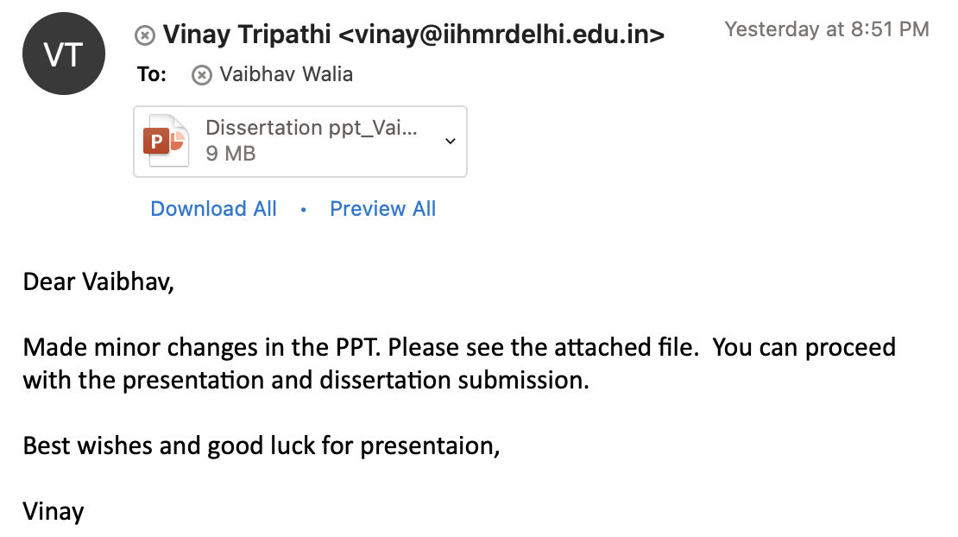
Screenshot of Approval

Slide 3

Introduction
Need of the Study:
During Covid-19 Pandemic, restrictions happened and most of the people lost their jobs and others were working from home. Businesses were also shut down completely. Population faced restriction due to which people of all the ages had substantially decrease their level of physical activity during Covid-19. The decrease in physical activity has impacted health of the people and also started to form some associated complications.

Slide 4
Objective
  1. To understand the effects of COVID-19 restrictions on physical health among general population in India.
  2. To understand the probable complications on physical health associated with Covid-19 restrictions among General population of India.

Slide 5

Methodology
Study Design
  A Descriptive Cross-Sectional study to understand the effect of Covid-19 on physical health of general population in India.
Study Setting
  The study was conducted on the general population of India in the month of April 2020 to June 2020
Study Population
  The population of interest in our study are the general population in India.

Slide 6
Methodology
Sample Size
  Sample size is 385.
Sampling Method
  Convenience sampling technique was used to take out sample.
Study Tool
  A structured questionnaire is taken for the general population to understand the effect of Covid-19 on physical health in India. The questionnaire was close ended for the target population.
Data Collection
  Self administered survey – Social Media ( LinkedIn, Instagram, WhatsApp)

Slide 7
Data Analysis
Data was analyzed through excel and then visualization was done to portray the result.
Data was divided into 4 Categories that are Physical Activity level, Diet pattern, Sleep pattern and associated complications.
Further, we have formed parameters under each of the 4 categories to understand their effect on the general population.
In addition, in the demographic data we have collected their height and weight to calculate their BMI through Excel.

Slide 8
Result
Demographic Status
Age Group
 | 18-30 |  | 30-39 |  | 40-49 |  | 50+
 | 140 |  | 50 |  | 14 |  | 8
 | 66% |  | 23% |  | 6.6% |  | 3.7%
Gender
 | Male |  |  |  | Female
 | 91 |  |  |  | 121
 | 42.9 |  |  |  | 57.1%
Marital status
 | Unmarried |  |  |  | Married
 | 132 |  |  |  | 80
 | 62.2% |  |  |  | 37.7%
BMI
 | 0-18 | 19-25 |  | 26-30 |  | 31-39 |  | 40+
 | 13 | 141 |  | 33 |  | 23 |  | 2
 | 6.1% | 66.5% |  | 15.5% |  | 10.8% |  | 0.9%

Slide 9
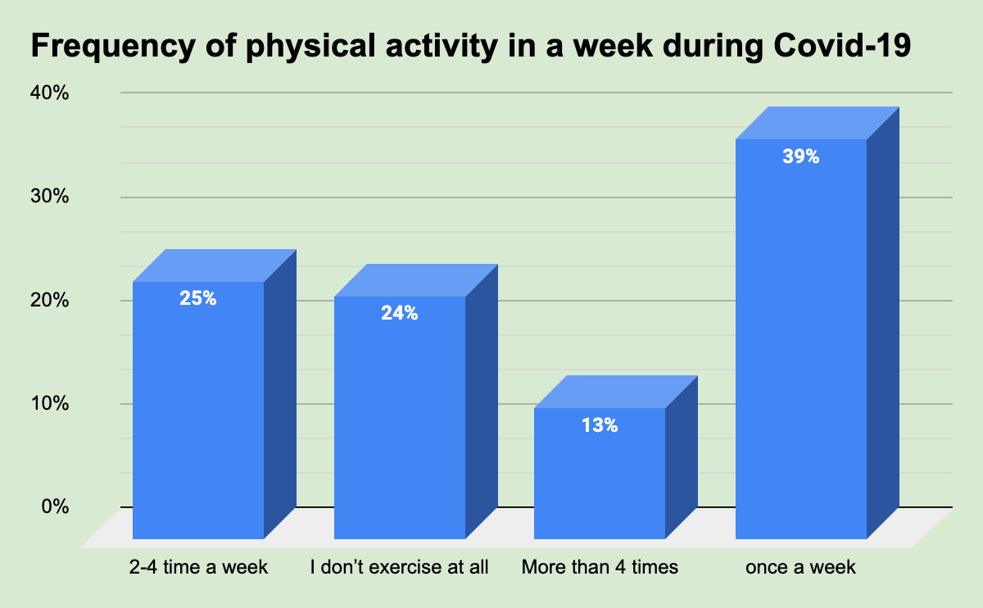
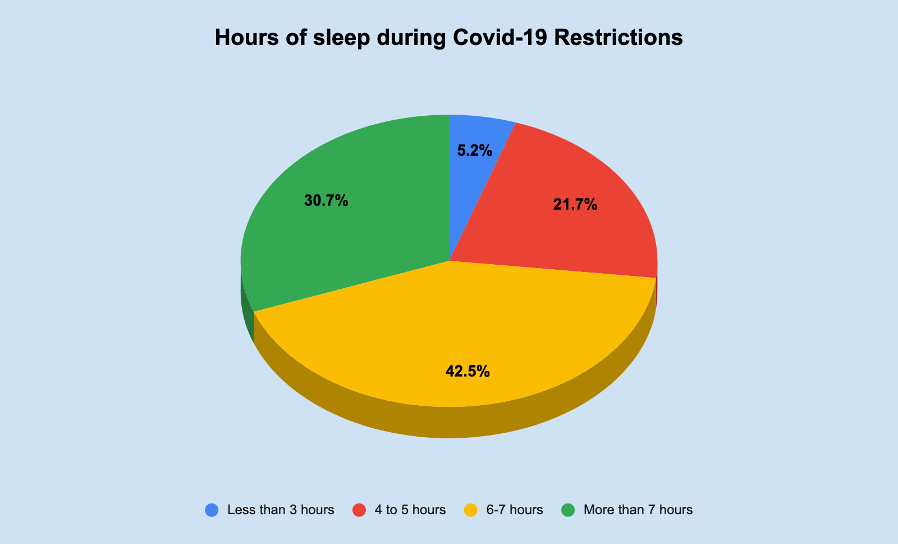
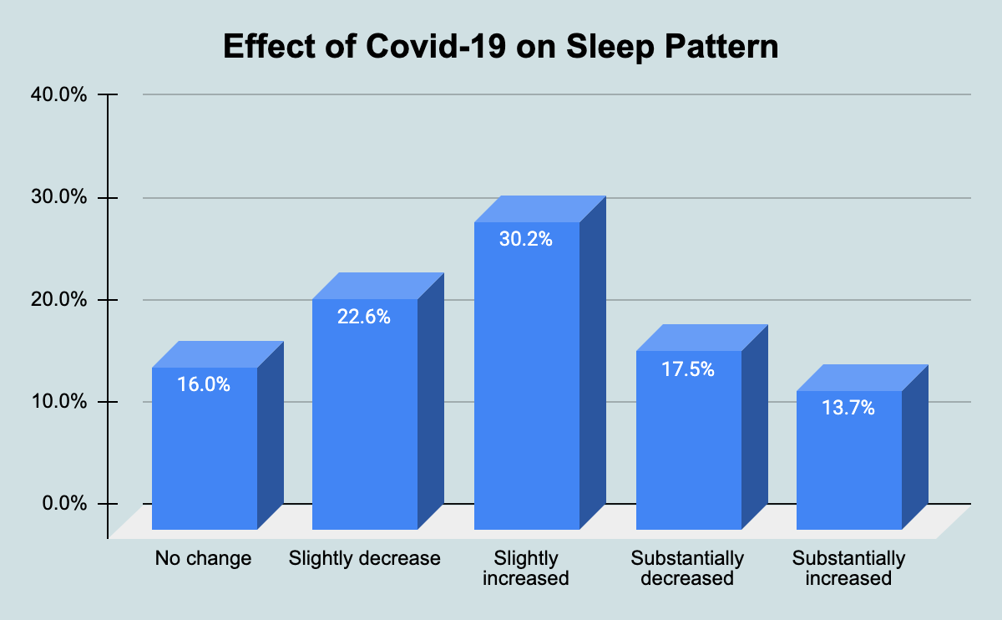
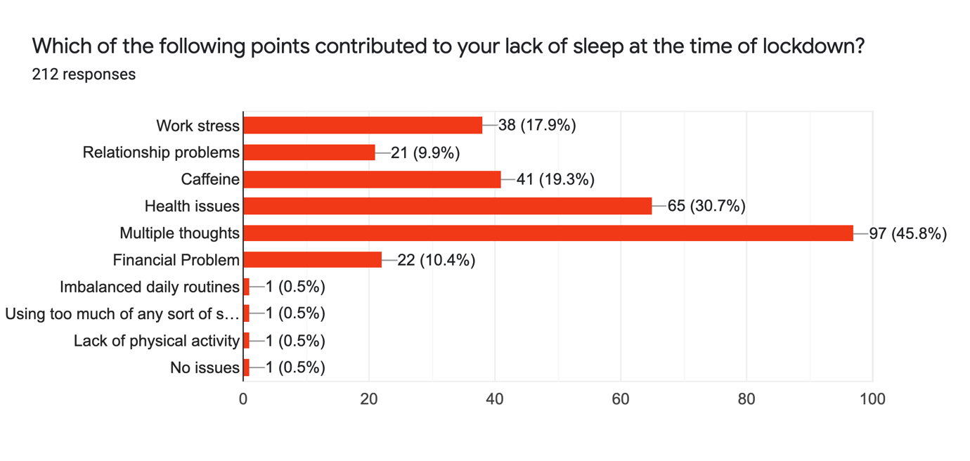
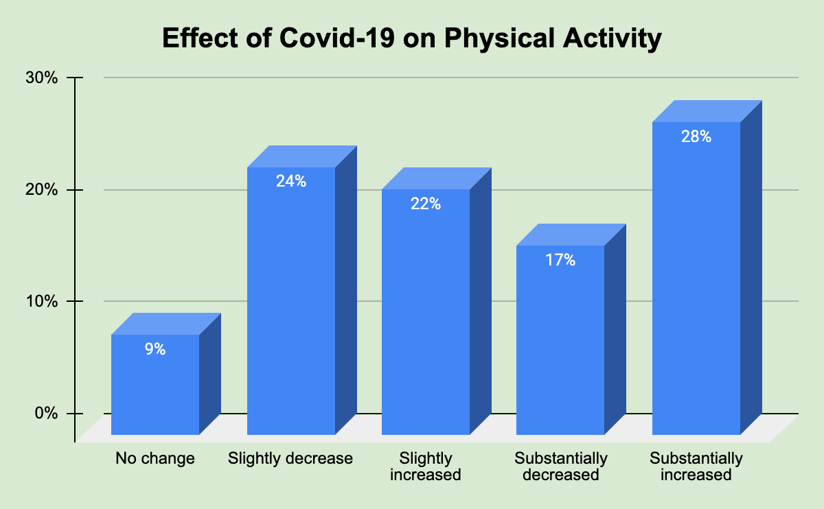
Section A- Physical Activity Levels
Section B- Sleep Pattern
Figure-1 Frequency of Physical activity
Figure-3 Hours of sleep during Covid-19 restrictions
Figure-4 Effect on Sleep Pattern
Figure-2 Effect of Covid-19 on Physical Activity
Figure-5 Causes of disturbed sleep

Slide 10
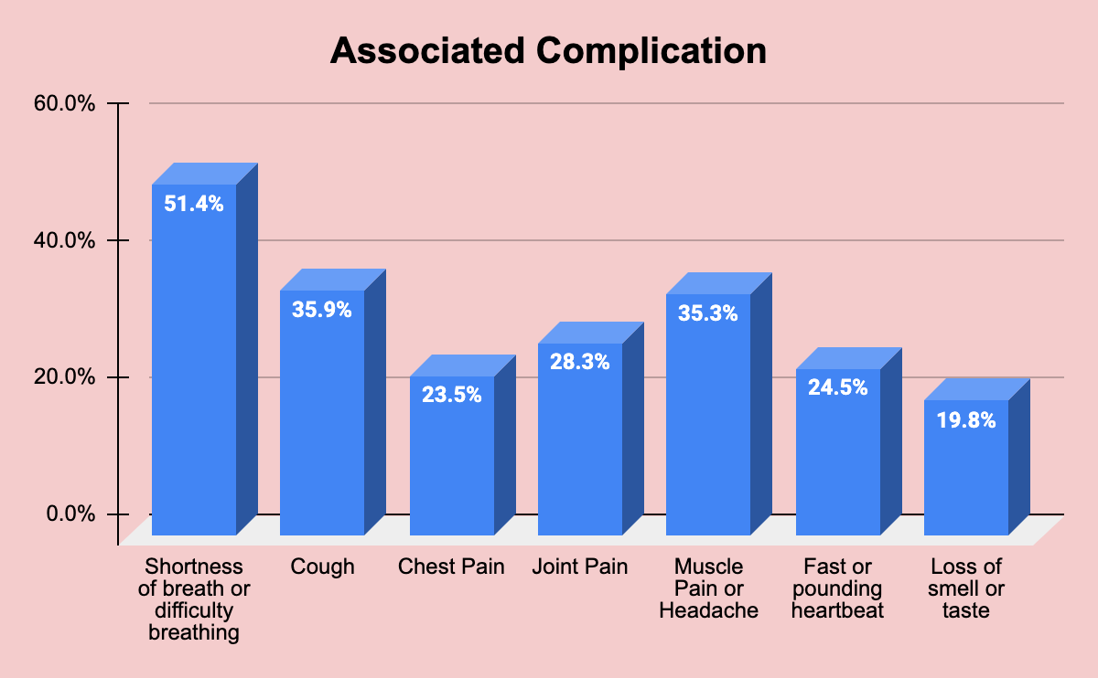
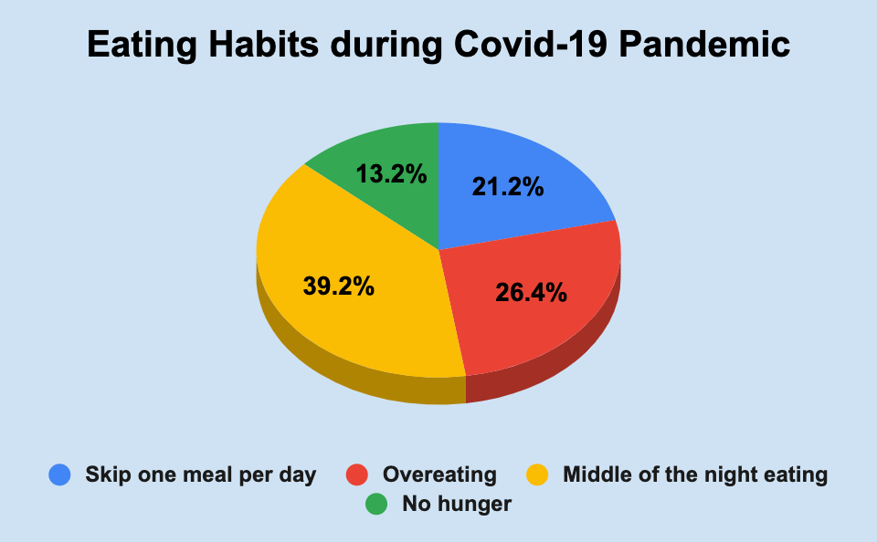
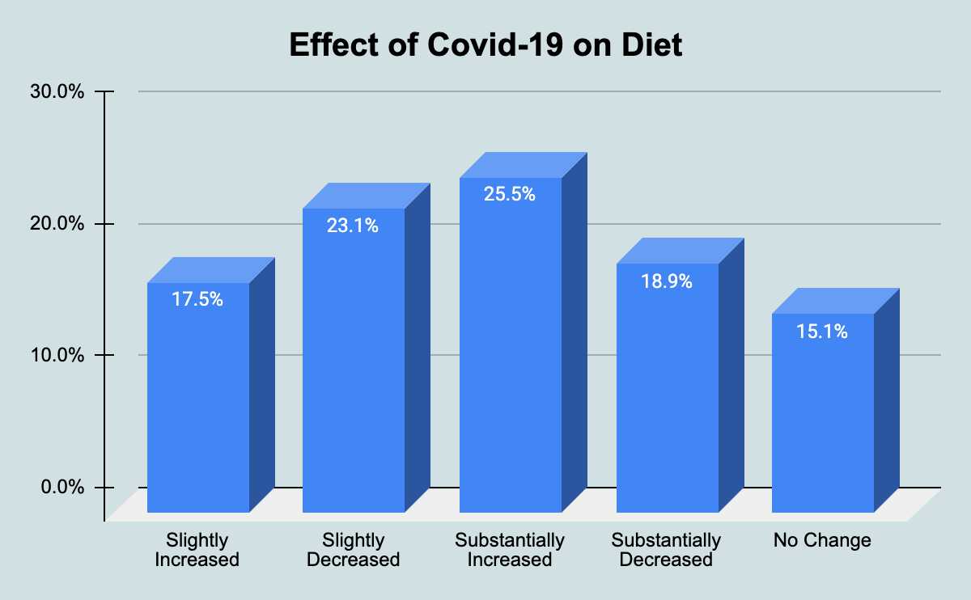
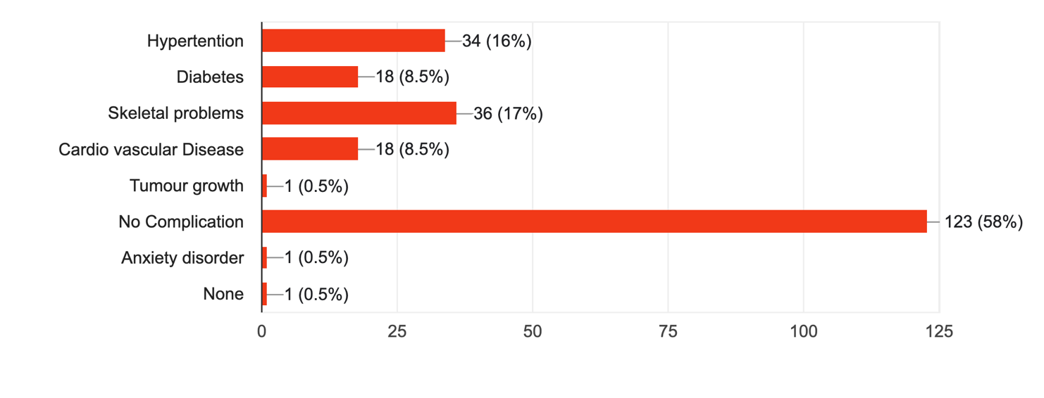
Section C- Diet Pattern
Section D- Associated Complications
Figure-6 Eating Habits during Covid-19 Pandemic
Figure-8 Associated Complication during Covid-19 Pandemic
Figure-7 Effect of Covid-19 on Diet
Figure-9 Post Covid diagnosed, Complication

Slide 11



Discussion
​Majority of the participants (28%) have substantially decreased in their physical activity and only 9% of the respondent were not impacted by Covid-19 Pandemic restriction.
The frequency of the participants in our study depicts that 39% of the participants exercises once a week and only 13% of the participants exercises more than 4 times.
A change has been noticed in sleep time and wake time after lockdown. Covid-19 restriction also impacted sleep pattern. This study depicted that 42.5% of the participants had poor sleep during Covid-19 pandemic.

Slide 12
Limitation Of the Study
The proposed sample size could not be completed due to limited span of time and chosen particular inclusion criteria for the population.

Slide 13
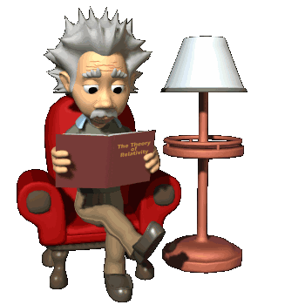
Conclusion
Overall, this research has showed that Covid-19 restriction was associated with physical health, poor sleep quality, disturbed sleep cycle, disturbed diet and also complication on some of the respondent. Results have shown negative effect on the respondent due to covid-19 pandemic restrictions.

Slide 14

REFERENCES
Theis N, Campbell N, De Leeuw J, Owen M, Schenke KC. The effects of COVID-19 restrictions on physical activity and mental health of children and young adults with physical and/or intellectual disabilities. Disabil Health J. 2021 [cited 2022 Jun 21];14(3):101064.
Giuntella O, Hyde K, Saccardo S, Sadoff S. Lifestyle and mental health disruptions during COVID-19. Proc Natl Acad Sci U S A. 2021;118(9):e2016632118.
Tison GH, Avram R, Kuhar P, Abreau S, Marcus GM, Pletcher MJ, et al. Worldwide effect of COVID-19 on physical activity: A descriptive study. Ann Intern Med. 2020;173(9):767–70.
Sidor A, Rzymski P. Dietary Choices and Habits during COVID-19 Lockdown: Experience from Poland. Nutrients. 2020 [cited 2022 Jun 21];12(6):1657.
Eime R, Harvey J, Charity M, Elliott S, Drummond M, Pankowiak A, et al. The impact of COVID-19 restrictions on perceived health and wellbeing of adult Australian sport and physical activity participants. BMC Public Health. 2022;22(1):848.

Slide 15


Slide 16
Suggestions to the Organization where the Study was Conducted
BYJU’S provides a good level of support in conducting the study. I would suggest them to Create a Reward and Accountability Program.

Slide 17
Dissertation Experiences
What did you learn (skill/ topic)?
Overall self comments on Dissertation
Learned all the parameters that are used in the report. Also learned about how to conduct a primary research.
This project taught me about data analysis through excel especially Pivot table and how to add slicer in that.

Slide 18
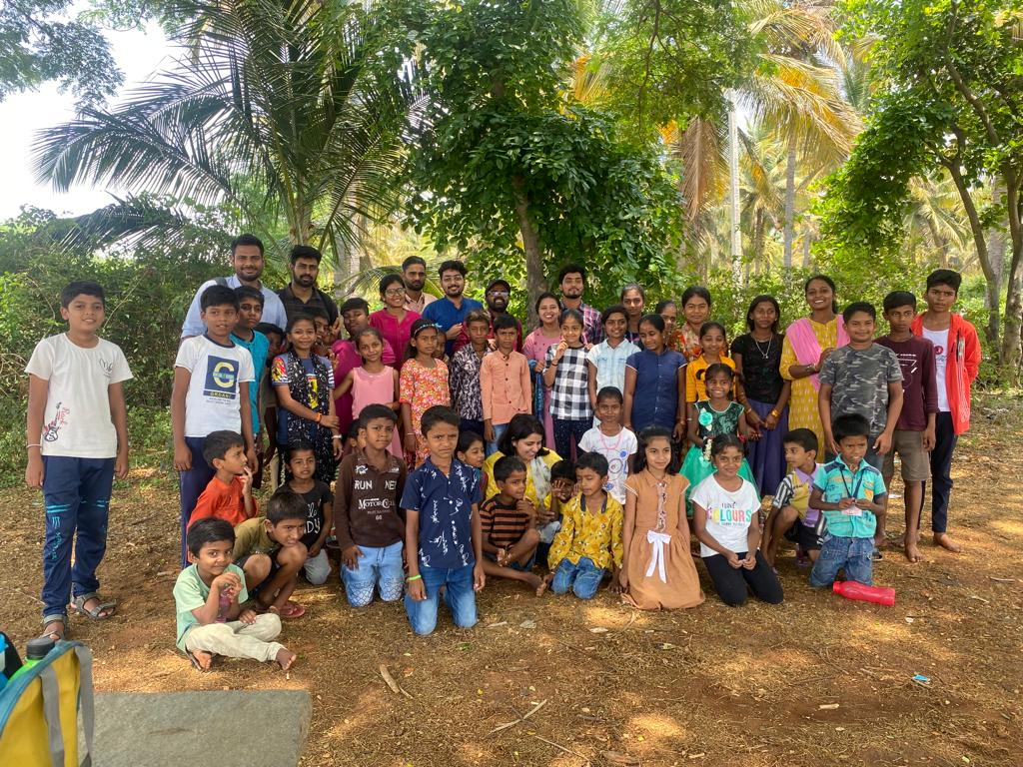
Pictorial Journey (1/2)

Slide 19
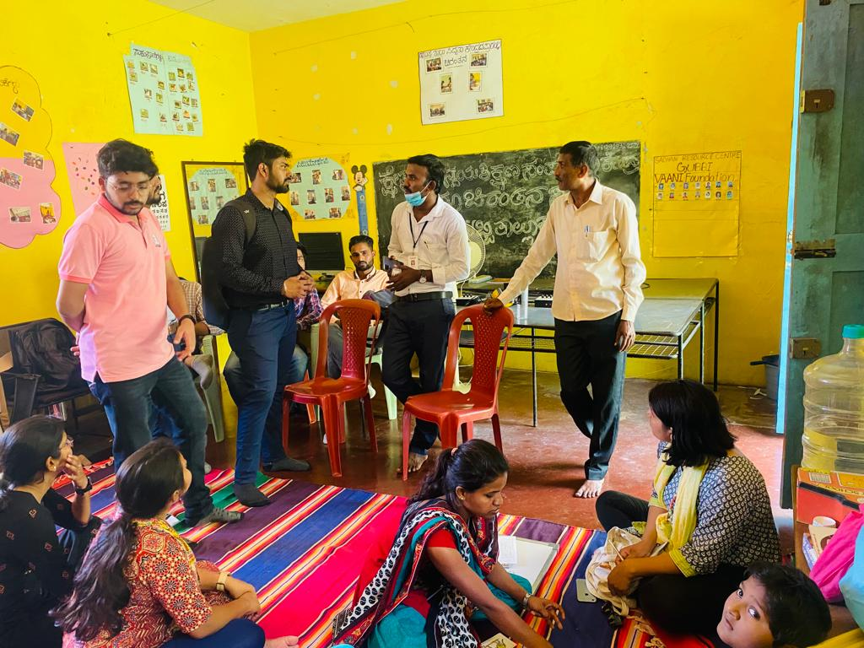
Pictorial Journey (2/2)

