Slide 1

Patient and caregiver experience in the EHR enabled hospitals in urban India – a narrative review
Presented by- Dr. Aditi Nasa(PT) Faculty Mentor – Dr. Archana Thakur IIHMR Delhi

Slide 2
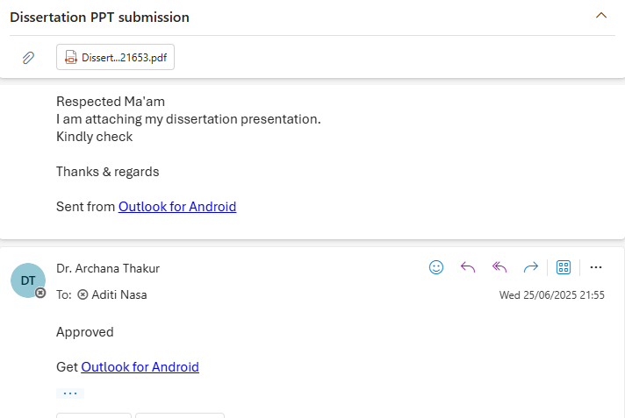

Slide 3
Introduction
In urban India, more people are using electronic health records (EHRs) instead of paper files, which has changed how patients and caregivers feel about their care.
EHRs are digital versions of medical records that can be shared across hospitals, labs,
pharmacies, and doctors.
Under programs like the Ayushman Bharat Digital Mission (ABDM), India is building a national, standards-based EHR system with unique Health IDs for every person.
People believe EHRs can save time, reduce errors, and make care smoother.
This narrative review looks closely at studies from cities and towns in India to find out how EHRs affect patient and caregiver experience—like ease of use, trust, and communication.

Slide 4
Rationale
This study compiles all the primary studies focused on patient and caregiver experience in urban India from 2020 - 2025.
Through this study we will know how patients and caregivers are directly affected by the use of EHRs - can it improve or worsen their experience.
The findings can help improve EHR systems to make them more patient-friendly, and guide hospitals and policymakers in making better digital healthcare decisions.

Slide 5
Review Of Literature
In Kerala (2020), a qualitative study on hybrid patient-held records in urban Primary Health Centres (PHCs) focused on non-communicable disease (NCD) patients and their caregivers. Patients reported that having access to both digital and paper records helped them keep better track of medications and test results, making them feel more in control of their health. Caregivers, on the other hand, shared how they brought the records to appointments or during emergencies, which helped them stay more engaged and confident in managing care. However, low literacy levels still posed a challenge for consistent usage.

Slide 6
Review Of Literature
A study conducted in Chandigarh (2022) explored the uptake of Digital Health IDs among 419 adult participants through a mixed-methods approach. The findings showed that 78% had enrolled, and their willingness to engage with digital records was closely tied to their awareness, trust in data security, and the perceived usefulness of the platform. An interesting aspect was that younger family members often helped elderly patients in using the digital tools, showing that family involvement plays a key role in digital health adoption.

Slide 7
Review Of Literature
A Karnataka-based study (2020) reviewed the CPHM app used for Maternal and Child Health (MCH) data through a mixed-methods design. Although it focused more on data accuracy, the study revealed inconsistencies in data entry and emphasized the need for stronger digital infrastructure, which affects patient trust and caregiver confidence.
In Telangana (2021), a study of 75 urban PHCs found that while 83% had digitized immunization records, most facilities were not using EMRs for prescriptions or broader patient management. This meant that caregivers still had to carry paper records for medications and referrals. Patients did appreciate faster access to immunization records, but there was no significant improvement in care coordination, especially from the caregiver’s perspective.

Slide 8
Review Of Literature
Theme
Key Studies
Evidence Found
Perception towards EHR & Digital Health IDs, Chandigarh (2022– 2021)
78% uptake among adult participants • Uptake strongly linked with EHR awareness, trust in data security, and perceived utility • Elderly were supported technically by younger relatives
1. Adoption & Awareness of Digital Health IDs
2. Empowerment via Hybrid Patient-Held Records
Kerala qualitative exploratory (2020)
Patients tracking meds/lab results felt easy • Caregivers coordinated care using records, especially in emergencies
Highlighted literacy and confusion across hybrid formats
3. Process Efficiency vs Data Accuracy
CPHM app consistency in Karnataka (2020)
Only 3/12 MCH indicators showed ≥80% agreement between paper and app data • Frontline staff reported connectivity issues and dual data entry load
4. Benefits & Limitations of Partial PHC EMR Barriers in Telangana
Digitization (2019 survey/2018–19)
83% digitized immunization records—leading to quicker retrieval for patient visits • No EMR for prescriptions or referrals—caregivers remained paper-dependent
Public hospitals showed improved history access and faster services • Patients benefited from clearer documentation and less lost data • Caregivers & HWs reported smoother information sharing, though they stressed need for training
5. Urban PHC EMR Uptake &
Efficiency
Urban PHC EMR adoption
(Bhubneshwar 2020)

Slide 9
OBJECTIVES
To summarize patient and caregiver experience in the EHR enabled hospitals in urban India.

Slide 10
METHODOLOGY
Study Type
A secondary desk review using a systematic literature search focused on published studies from 2020–2025 in urban India.
Search Strategy
Develop an appropriate search strategy using key words like(Patient OR caregiver) AND (experience OR satisfaction) AND (electronic health records OR EHR) AND India through an iterative process. Database used for search of articles is pubmed.

Slide 11
METHODOLOGY
Inclusion & Exclusion
Inclusion: The review will focus on studies conducted in last five years (2020-2025)— observational and experimental — which have evaluated patient and caregiver experience in primary, secondary and tertiary care hospitals located in urban part of India.
Exclusion: Case studies, case series, editorials, viewpoint, commentaries, non-English language, reviews, studies with abstract only will be excluded.

Slide 12
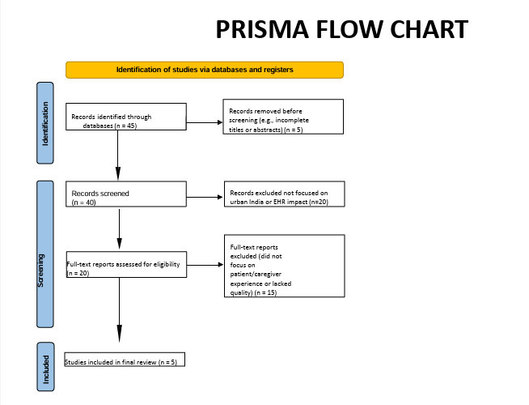
RESULTS
Secondary studies were excluded.
Studies not in English language were also excluded (n=15)

Slide 13
RESULTS
Study Title (Year)
Setting & Design
Participants
Patient Experience
Highlights
Caregiver Experience
Highlights
Key Insights
Perception towards Mixed-methods: 419
electronic health records & participants surveyed at
Family members guided elders in the use of EHRs D• Uptake tied to awareness, security trust, usefulness and family support
It heled them a lot because the exact type and stage of the disease and the medications are recorded
Highlights that trust, awareness are crucial
uptake of Digital Health IDs Chandigarh CHC + screening 419 adults ≥18 yrs
(2022, Chandigarh) (ijmr.org.in)
camps; followed by in-depth interviews.
_{Patient-held hybrid records} Qualitative interviews (Feb–
Patients used hybrid records to monitor meds and lab results• Felt more in control of their care
Carers carried records for
Hybrid records facilitated
in urban PHCs (2020,
Kerala)
Nov 2020) with patients, caregivers, and staff across urban PHCs in Kerala
20 NCD patients, 15
caregivers, 17 HCPs
appointments and emergency _{shared coordination but}
visits• Increased caregiver
engagement and confidence
literacy was a challenge
Sequential mixed-methods at
CPHM App consistency for Gumballi PHC: compared PHC MCH records; ~10–15
MCH data (2020, Karnataka) digital vs paper MCH records workers
Found discrepancies in data entry; implementation needs better infrastructure
— (focus on data accuracy)
—
and interviewed frontline staff

Slide 14
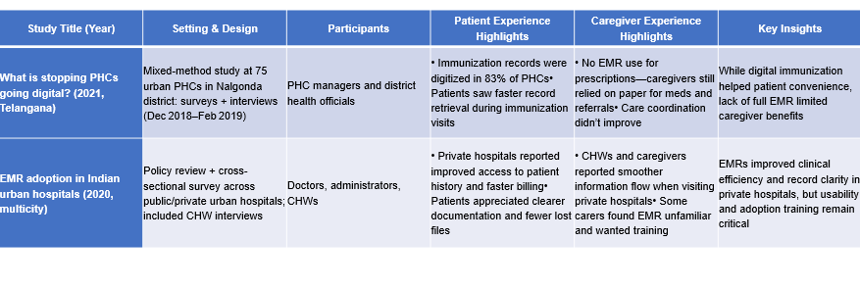
RESULTS

Slide 15
Categorization of patients’/caregivers’ experience
Categories | Explanation
Trust & privacy | Privacy top concern: Shared reviews highlight consistent fears of data misuse, caregiver access without consent, and insecure storage . Security worries among professionals: Indian clinicians expressed worry about system crashes, viruses, and data breaches in EMRs

Slide 16
Categorization of patients’/caregivers’ experience
Categories | Explanation
User-friendliness & workload | Mixed reviews on ease of use: In hospitals, doctors felt EMR saved time, but many reported system complexity and slow interfaces. Prior experience helps: Clinicians familiar with EMRs adapted more easily and found them more usable, while some reported navigation struggles, lost data, and power issues.

Slide 17
Categorization of patients’/caregivers’ experience
Access & equity | Literacy & demographics matter: Elderly patients (>65 years), low-income, less educated, and computer-unfamiliar individuals are less likely to use EHRs. Socioeconomic divides: Urban India still faces inequality—gender, language, income, and digital literacy affect EHR access .

Slide 18
Discussion
This study explores how Electronic Health Records (EHRs) are affecting patient and
caregiver experiences in urban India. Most patients found EHRs helpful, especially
because they did not have to repeat their medical history at every visit. Doctors could access past reports quickly, which saved time and improved decision-making.
Caregivers appreciated faster registration and follow-ups in some hospitals. However,
system delays and low internet connectivity sometimes caused frustration. Patients
trusted digital records for being more accurate, but many were concerned about privacy and data misuse.
A major challenge was that older adults and people with limited education found it hard to
understand or use EHR-related apps. Also, doctors mentioned spending more time on computers, which reduced personal interaction with patients.
Private hospitals had better systems in place, while government hospitals often faced issues due to lack of training and poor infrastructure.

Slide 19
Limitations
Variation in EHR Implementation: Different hospitals use different types of EHR
systems. This variation makes it hard to compare experiences clearly across
hospitals.
Possible Bias in Published Literature: Most available studies may focus more
on successful EHR outcomes. Negative experiences or challenges might be
underreported.
Single database used for the study selection.

Slide 20
Conclusion
EHRs are improving patient care, but there are gaps that need attention are :-
More training, stronger data security, and better digital support are needed. Making EHRs
more user-friendly will ensure that patients and caregivers from all backgrounds can benefit equally from this digital shift in healthcare.

Slide 21
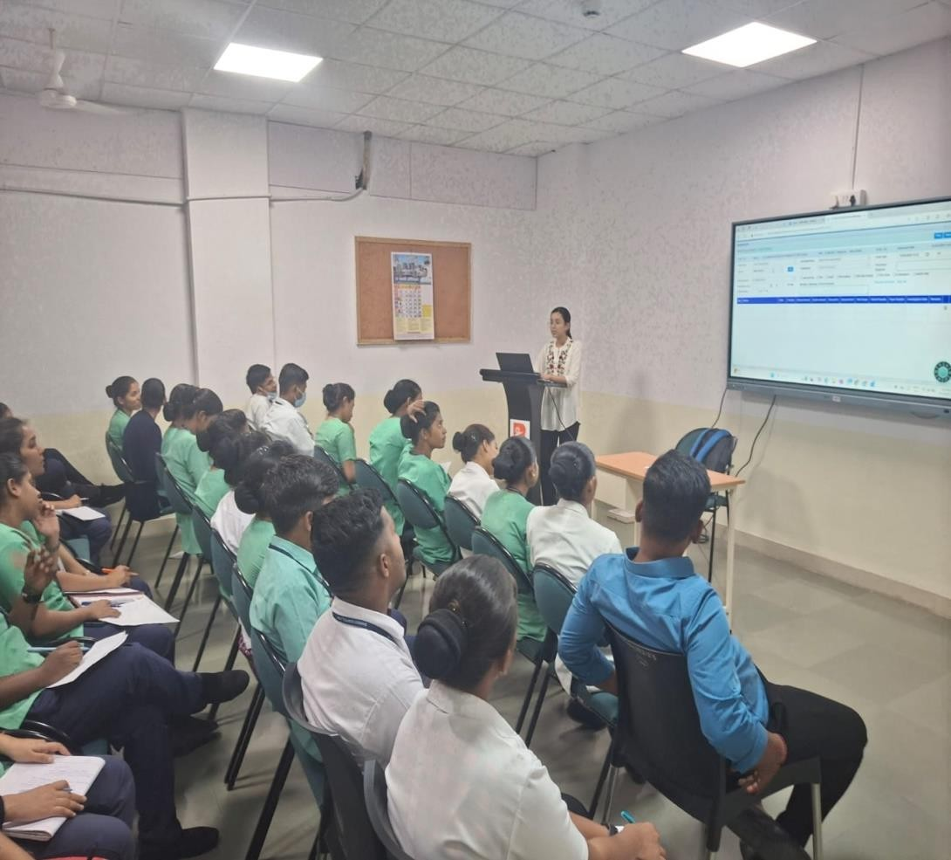
Community Outreach Program- BHRC Pune
The hospital serves economically weaker sections with low-cost healthcare.
Infrastructure includes OPD, IPD, ER, pharmacy, labs and basic diagnostic facilities.
Human resources comprise doctors, nursing staff,technicians, and support staff.
The hospital manages an average daily patient
attendance of 150–200.
The visit highlighted the hospital's commitment to accessible and compassionate care

Slide 22
Key learnings from COP
Gained practical exposure to healthcare delivery in a charitable hospital setting.
Understood the importance of empathy and patient-centered care in underserved communities.
Observed how limited infrastructure is managed effectively to serve large patient volumes.
Learned about the role of teamwork among healthcare providers for smooth functioning.
Noted the importance of health education and awareness in improving patient outcomes.
Identified challenges like staff shortages and lack of advanced equipment.
Recognized the value of community trust in sustaining healthcare services.

Slide 23
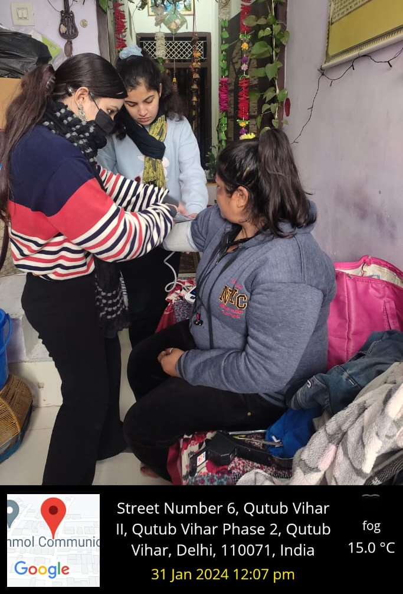
Community Outreach Program- BHRC Pune
Practical Understanding of Public Health Work
  Gained hands-on experience of working at the ground level in a real community setting.
  Understood how public health activities are implemented at a micro-scale.
Community Interaction and Communication Skills
  Learned how to effectively communicate with local residents about their health problems.
  Developed confidence in approaching people and gathering health-related information.
Basics of Primary Research in Public Health
  Understood the importance of data collection through field surveys and questionnaires.
  Learned how to design, fill, and analyze questionnaires to assess disease burden.

Slide 24
References
Gandhi AP, Soundappan K. Perception towards electronic health records & uptake of Digital Health IDs among the urban residents in northern India: a mixed‐methods study. Indian J Med Res. 2024;159(1):51‑60
Joseph G, Kissinger P, Johnston R, et al. Patients’, carers’ and healthcare providers’ views of patient‑held hybrid records in urban primary health centres in Kerala, India: a qualitative exploratory study. BMJ Open. 2022;12(11):e064189.
Shilpa R, Binu A, Mahmood N, et al. Assessing the implementation of a mobile app‑based electronic health record: a mixed‑method study from South India. J Educ Health Promot. 2020;9:102.
Barigela R, Kodali PB, Hense S. What is stopping primary health centers to go digital? Findings of a mixed‑method study at a district‑level health system in Southern India. Indian J Community Med. 2021 Jan–Mar;46(1):97–101
Saleh H, Stålsby Lundborg C. Perceived benefits and barriers of medical doctors regarding electronic medical record systems in an Indian private‑sector healthcare facility. Ann Glob Health. 2025;? (epub ahead of print).

Slide 25


