Slide 1

A Study on the Impact of Health and Nutrition Initiatives in Addressing Child Malnutrition in Delhi
Presented by Jai Singh (Roll No: PG\23\040) under the supervision of Dr. Sumant Swain

Slide 2
Mentor Approval

Slide 3
Introduction
Prevalence
NFHS-5 reports stunting at 30.3%, wasting at 17.1%, and underweight at 27.2% among children under five in Delhi, highlighting a persistent health challenge.
Urban Challenges
Poverty, lack of proper sanitation, limited healthcare access, and inadequate feeding knowledge contribute to malnutrition amidst Delhi’s dense urban landscape.
Interventions
Initiatives like Mid-Day Meal, Poshan Abhiyaan, ICDS, and supplementation programs play a vital role, supported by frontline workers including ANMs and ASHAs.
Systemic Issues
However, gaps in monitoring, inter-departmental coordination, and training hinder full program effectiveness.

Slide 4
Objectives of Your Study
General Objective:
To assess the effectiveness and impact of health and nutrition initiatives in reducing and managing child malnutrition in Delhi.
Specific Objectives:
To identify the key health and nutrition programs implemented in Delhi targeting child malnutrition.
To evaluate the coverage and reach of these initiatives among the target child population (0–5 years).
To examine the perceptions of caregivers and healthcare providers regarding the effectiveness of these programs.
To identify challenges and barriers in the implementation and uptake of health and nutrition initiatives.

Slide 5
Methodology
Study design
This is a cross-sectional, community-based observational study conducted in Delhi from March to June 2025.
Target Population: Children aged 6–59 months and their primary caregivers in low-income urban communities.
Sample Size: 400 households
Sampling Method: Purposive (non-probability) sampling.
Inclusion Criteria:
Children aged 6–59 months
Caregivers willing to give informed consent
Exclusion Criteria:
Children below 6 months or above 59 months
Children with chronic illnesses or birth defects (to avoid confounding nutritional outcomes)

Slide 6
Results

Slide 7
Results

Slide 8
Results

Slide 9
Discussion
Awareness–Access Gap: Notable disparity between awareness and service uptake, especially in PMMVY (35% vs 75%) and JSY (25% vs 70%).f
Strong Performance: ICDS (92.5%) and POSHAN Abhiyaan (87.5%) show high service coverage, supported by frontline workers like AWWs and ASHAs.
Low Awareness, High Access: Many beneficiaries receive services without understanding scheme names or benefits, indicating passive participation.
Services like immunization (90%), IFA distribution (82.5%), and growth monitoring (80%) are being widely accessed—suggesting frontline health workers are reaching beneficiaries effectively, even without full awareness.
Limited Awareness: Nearly half of respondents (47.25%) are unaware of UHND sessions, indicating a need for stronger community outreach and visibility.
Need for IEC: Urgent need to strengthen Information, Education, and Communication (IEC) to increase scheme visibility and informed use.

Slide 10
Discussion
Low Nutrition Counselling Uptake (30.75%): A significant gap in nutrition education, despite its importance in improving maternal and child health outcomes.
Strong Performance in Nutrition Delivery: 87.5% receiving supplementary nutrition and THR reflects the success of key ICDS objectives focused on early childhood nutrition.
Education and Awareness Components Active: High provision of nutrition & health education (85%) highlights the effort to integrate knowledge along with services.
Moderate Community Participation in Group Meetings (52.75%): Nearly half of the respondents are not participating in ASHA/ANM-led group sessions, signaling a gap in community engagement and peer learning.

Slide 11
Conclusion
The findings indicate a strong performance in service delivery under government initiatives like ICDS and POSHAN Abhiyaan, with high coverage in supplementary nutrition (87.5%), immunization, and health checkups. However, a significant awareness–utilization gap exists, especially in PMMVY (35% awareness vs. 75% uptake) and JSY (25% vs. 70%), reflecting passive participation without full understanding of schemes. The low uptake of nutrition counselling (30.75%) signals a missed opportunity in addressing malnutrition through behavior change.
Despite 85% receiving health education, nearly 47.25% are unaware of UHND sessions and community participation in ASHA/ANM meetings is only 52.75%, highlighting the need for stronger community engagement. These findings emphasize the urgent need to enhance IEC (Information, Education, and Communication) strategies to bridge knowledge gaps and promote informed, meaningful participation in health and nutrition services.

Slide 12
References
Pahwaet al. (2010). The impact of health &amp; nutrition education focused on the community. DOI: 10.3329/jhpn.v28i6.6603
Chhabra et al. (2021). Impact of supplementary feeding & maternal consciousness. DOI: 10.4103/ijcm.IJCM_1046_20
Bhandari et al. (2004). A long-term study on additional nutrition. DOI: 10.1093/jn/134.9.2342
Toteja et al. (2006). Prevalence of anemia & nutrition programs. DOI: 10.1177/156482650602700405
Kapuret et al. (2003). Impacts of dietary education &amp;amp; iron supplementationmentation. DOI: 10.1007/s13312-018-1352-y
Verma et al. (2020). Nutritional guidance during prenatal care and practices concerning feeding. DOI: 10.1016/j.clnu.2019.03.008
Bassiet al. (2022). Maternal hygiene and sanitation practices. DOI: 10.1097/FCH.0000000000000347
Mehra et al. (2021). Contribution of Anganwadi Workers in the delivery of food services. DOI: 10.1111/mcn.13245
Singh and colleagues (2022). Challenges in the implementation of Poshan Abhiyaan. DOI: 10.4103/ijcm.IJCM_187_21
Jain et al. (2023). Integrated interventionsStrategies for alleviating malnutrition. DOI: 10.1016/j.foodpol.2022.102340

Slide 13
INVOLVEMENT IN COMMUNITY OUTREACH PROGRAMME (COP) ACTIVITIES
Total no. of visits done by the Student: 10
Activities done by the student:
Mapping and listing of the area.
Interaction with the community and frontline healthcare workers.
Conducted IDI with the ASHA on High risk pregnant women (Group project).

Slide 14
KEY LEARNING FROM COP ACTIVITIES
1. Mapping and Listing of the Area
Understanding Community Layout: Developed a detailed understanding of the geographical distribution of households, health facilities, and key resources.
2. Interaction with Community & FLHWs
Observed field-level challenges (resource gaps, cultural barriers).
Gained clarity on roles of ASHA, ANM, and AWW.
Learned community engagement and trust-building skills.
3. IDI with ASHA on High-Risk Pregnancies
Understood criteria for identifying high-risk pregnancies.
Learned about referral and coordination systems.
Noted ASHA's challenges and coping mechanisms.

Slide 15
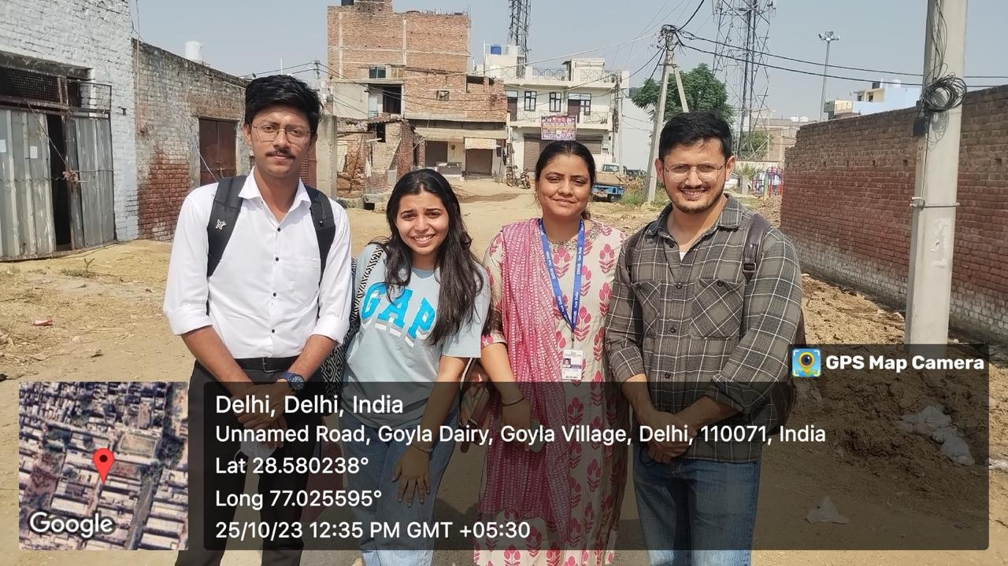
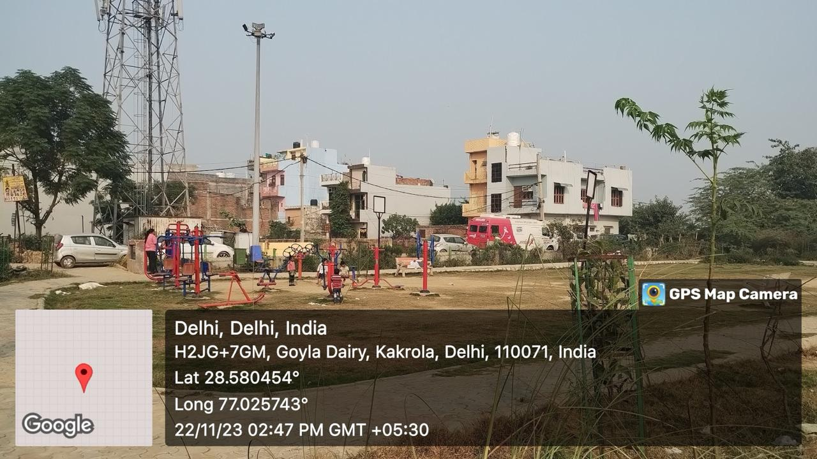
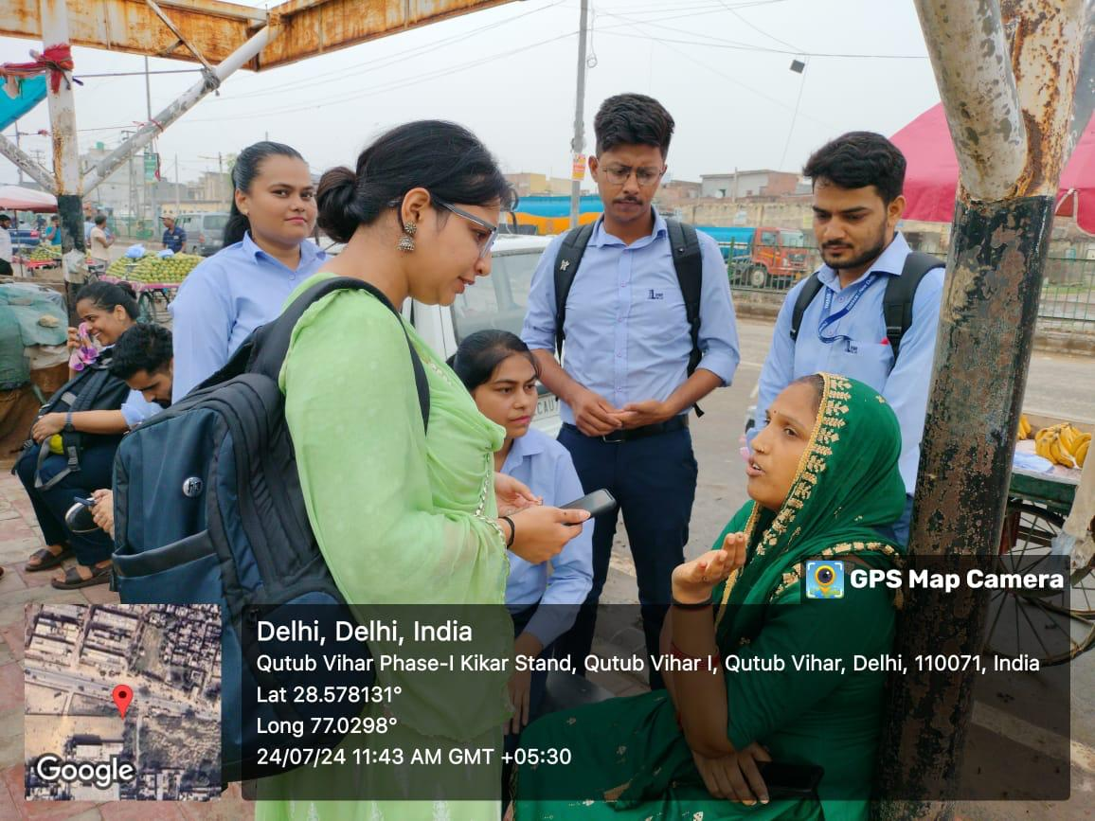
COP FIELD ACTIVITIES PHOTOGRAPHS

Slide 16
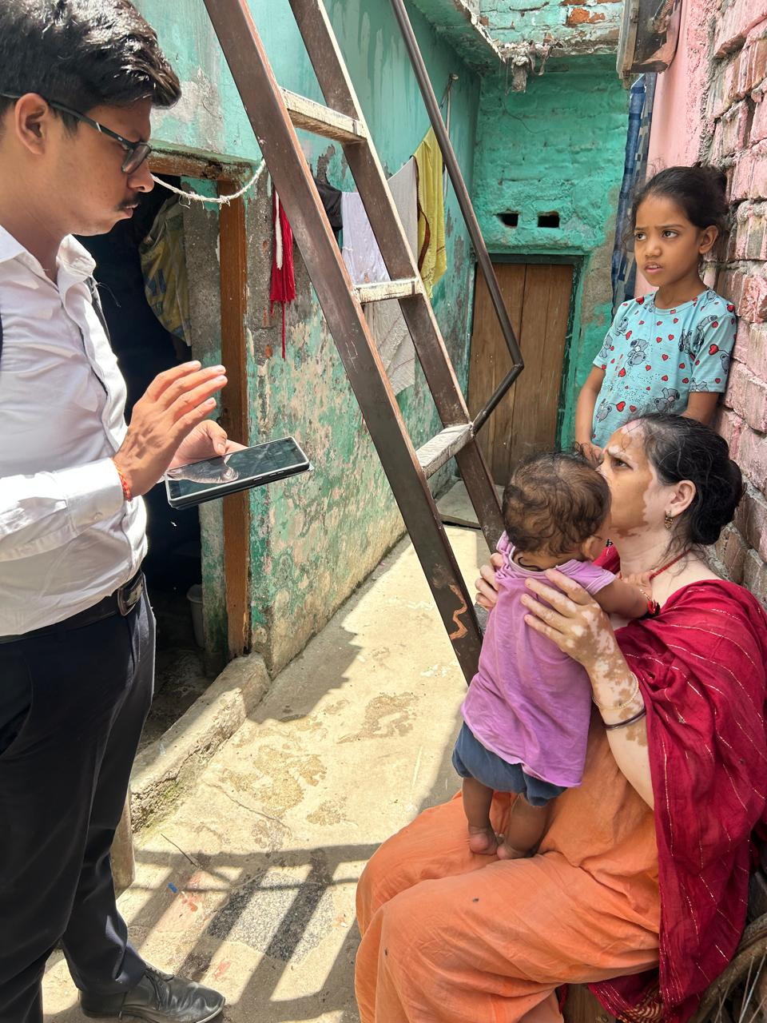
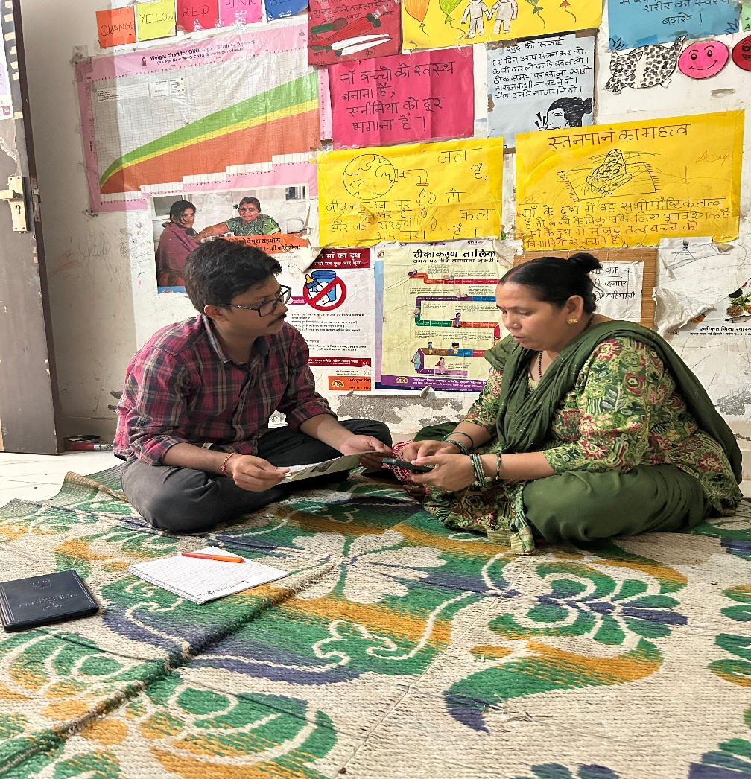
Pictorial Journey

Slide 17


