Slide 1


Social Media
Benefits to Healthcare Industry
By
Dr. Aditi chauhan

Slide 2

Organization Profile
Indian Health Consultants (IHC) - working in the domain of Health Management
Provide customized and cost effective solutions to the health care providers and patients
Services offered:
Sales and Marketing
Operations, Quality & Accreditations
HR & Project Management
Website Designing & Maintenance
Medical Tourism

Slide 3
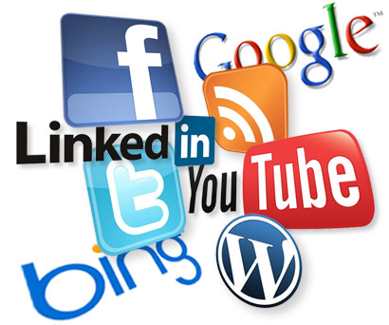
Introduction
What is social media?
Communication channel
Conversation that happens online
Driven by advances in internet capabilities
And by evolution in internet user behaviour
Enabled by diverse array of online tools

Slide 4

Why it matters?
Speed of adoption
Facebook launched in 2004 and in 2012 counted more than 845 million users worldwide
Twitter launched in 2006 and in 2011 counted more than 200 million users
In India internet users growing by 1.8 million per year
60 million monthly active users which makes it no 3 in ranking

Slide 5
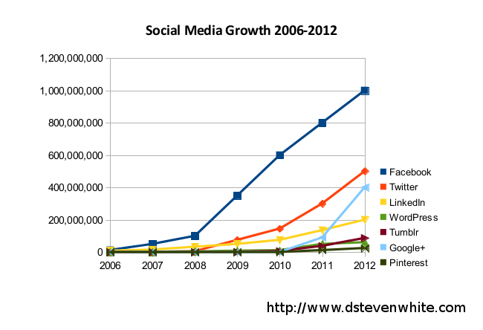

Slide 6

Social Media in Healthcare
Most intriguing developments in healthcare during the 21st century
Once confined to areas of entertainment and life management, blossomed to become an integral part of healthcare.
Increasing number of people now use the web to communicate and are more likely to use social media websites and portals to procure healthcare-related information.
Healthcare has been slower on the adoption curve than other business

Slide 7

Rationale of study
Very few studies have been conducted on role of social media in healthcare as it is a new concept as far as healthcare industry is concerned. My study aims to explain how social media is emerging as a helpful tool in integrating consumers and healthcare providers, what is the consumer perception about the social media, and how healthcare providers are using it now to market their services to a larger customer base and what better can be done to use the social media platform more effectively.

Slide 8
Conceptual Framework
Healthcare Providers
Customer relationship
Strategic use
Patient empowerment
Risk management
Business benefits
User’s Perception
Social demographics
Awareness
Acceptability
Benefits
Usage
Harm
Social media presence of health care provider (good practice for early adopters)
User evaluation

Slide 9

Objectives
General objective
-To assess, the usefulness of social media in, maintaining relationship between healthcare providers and consumers
Specific objective
- To determine the consumer perception about the use of social media in healthcare.
-To find out how the healthcare providers are using social media for their organization.
-To identify the factors associated with utilization of social media in healthcare.
-To recommend appropriate measures for better utilization of social media

Slide 10
Major Findings

Slide 11
Major Findings

Slide 12
Major Findings

Slide 13
Major Findings

Slide 14
Major Findings

Slide 15
Major Findings

Slide 16
Major Findings

Slide 17
Major Findings

Slide 18
Major Findings

Slide 19
Major Findings

Slide 20

Recommendations
Developing an strategy
Not enough resources-Get it outsourced
Social Media policy for Staff
Staff training to ensure that policy is being followed
Social Disclaimer for site
Recruit social media managers internally
Distribute responsibilities among staff who are Internet-savvy
Keep social media content accurate and current.
Monitoring

