Slide 1

A STUDY ON FEEDING HABITS AND EATING BEHAVIORS AMONG CHILDREN OF PARENTS BELONGING TO ALPHA GENERATION IN NEW DELHI, INDIA.
By: Dr Manvi Verma
Faculty Mentor: Dr. Vinay Tripathi
IIHMR Delhi

Slide 2
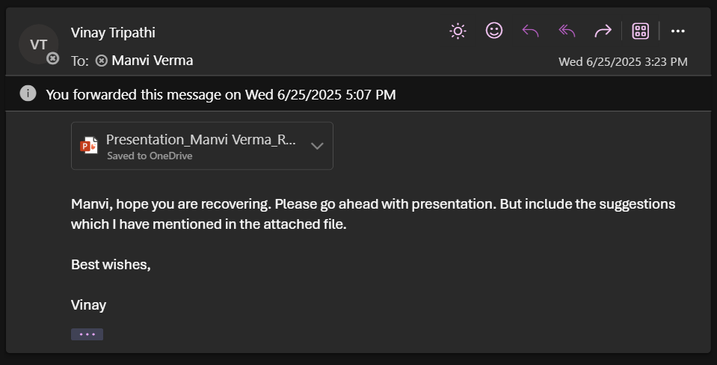
Mentor Approval

Slide 3
Introduction (1/2)
Parents are uniquely positioned to influence and shape their children's eating patterns and overall diet, both directly and indirectly.
Mothers, in particular, often bear the primary responsibility for feeding young children.
This parental influence manifests through various feeding behaviours and parenting styles, which collectively establish the emotional context of eating.
Parents' feeding decisions are driven by various motivations, including promoting good health, building positive relationships, addressing practicalities and constraints, and emotional factors.
Practical and emotional motivations disproportionately impact low-income parents.

Slide 4
Introduction (2/2)
The Alpha Generation, comprising children born from approximately 2010 onwards, represents the first cohort to grow up entirely in the digital age.
In the context of this digital-native generation, it becomes crucial to understand the patterns of food intake, parental influence, and behavioral responses related to eating.

Slide 5
Objectives of Your Study
1. To explore the feeding habits and eating behaviours of a new generation of children of 2 - 5 years of parents in New Delhi.
2. To examine the eating behaviours, traits, and tendencies of children aged 2-5 years.
3. To assess the parental beliefs, attitudes, and practices around feeding of children of 2-5 years in new generation parents.
4. To examine the influence of different demographics such as different types of families( nuclear/ joint), and employment of parents etc.

Slide 6
Methodology (1/2)
• Study Design: Cross-sectional
• Sample Size: 384
• Population: Caregivers of children of age 2 years-6years.
• Tools: Pre-formed questionnaire
• Sampling technique: Purposive Selection of Urban Slum Areas
• Variables: Age, income of parents, occupation of parents, Family type and education of parents also recorded

Slide 7
Methodology (2/2)
Data Analysis
Data were entered in Microsoft Excel and analyzed using SPSS (Statistical Package for the Social Sciences).
Descriptive statistics (frequency, percentage, mean, standard deviation) were used to summarize variables.
Chi-square tests were used to assess the association between socio-demographic variables and ANC utilization.
P-values < 0.05 were considered statistically significant

Slide 8
Results (1/4)
Parental feeding practices such as restriction, applying pressure to eat, and monitoring were found to be common among parents in New Delhi.
Mothers were the predominant primary caregivers.
Parental concern about child weight was present and appeared associated with increased monitoring practices.
The perception of parental responsibility in child feeding was strongly linked to the use of restrictive feeding practices.
While demographic factors like family size and parental employment varied, the analysis did not reveal strong, clear patterns of influence on specific feeding behaviors or parental practices. Restrictive feeding and monitoring were prevalent regardless of parental employment status.

Slide 9
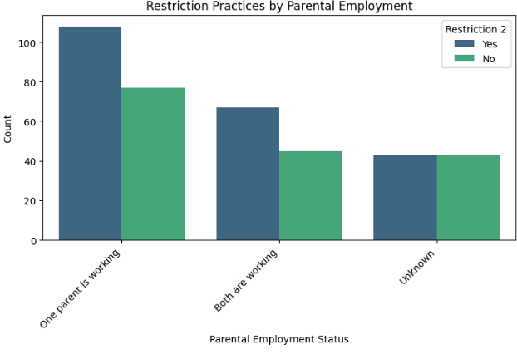
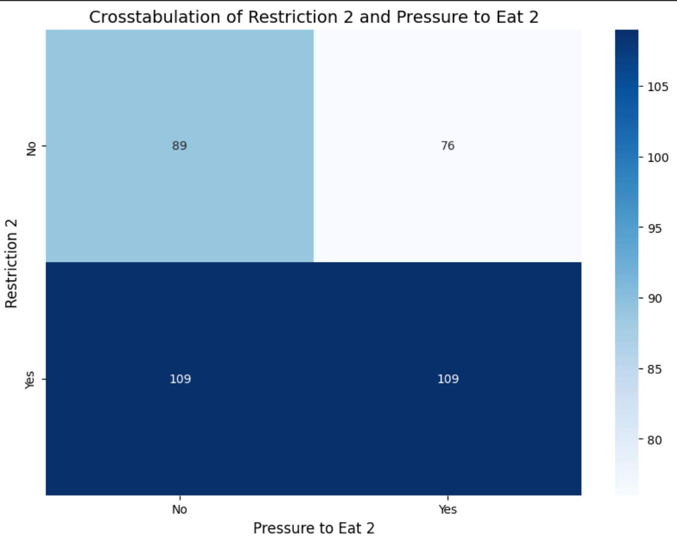
Results (2/4)

Slide 10
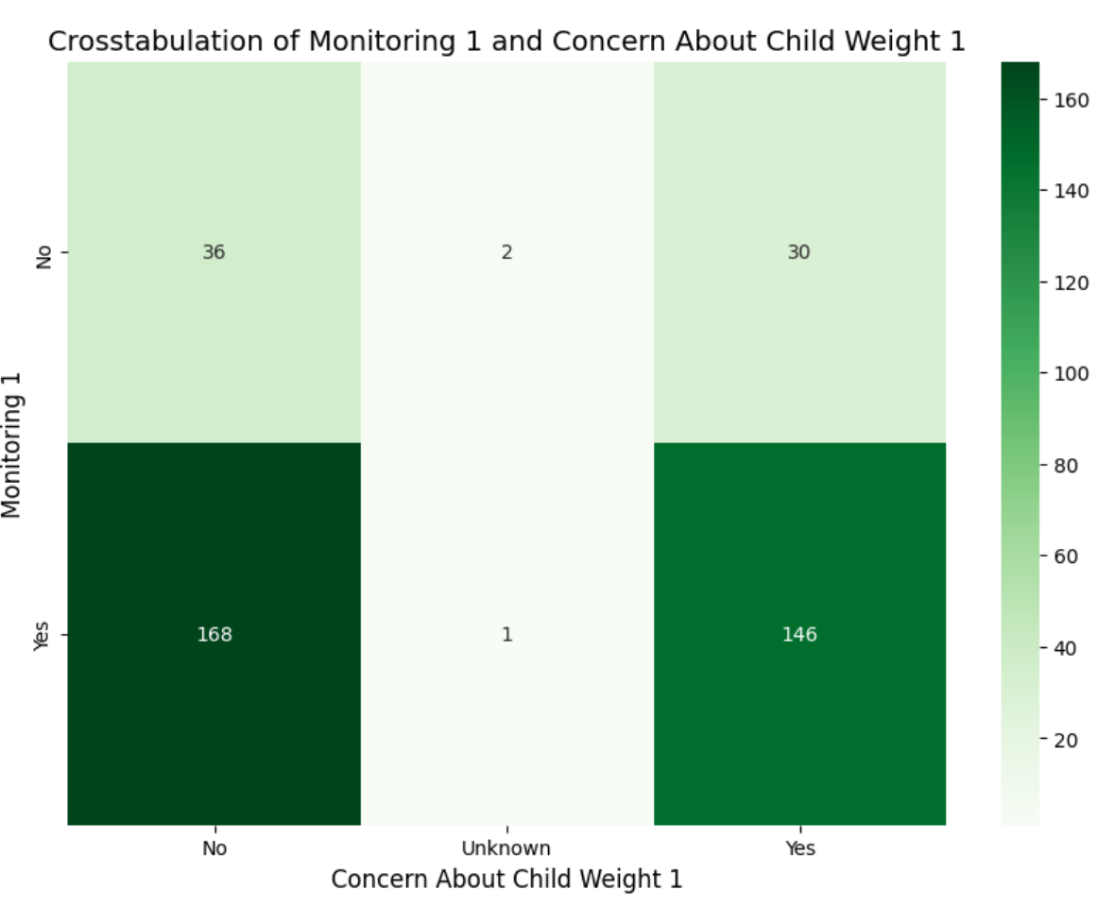
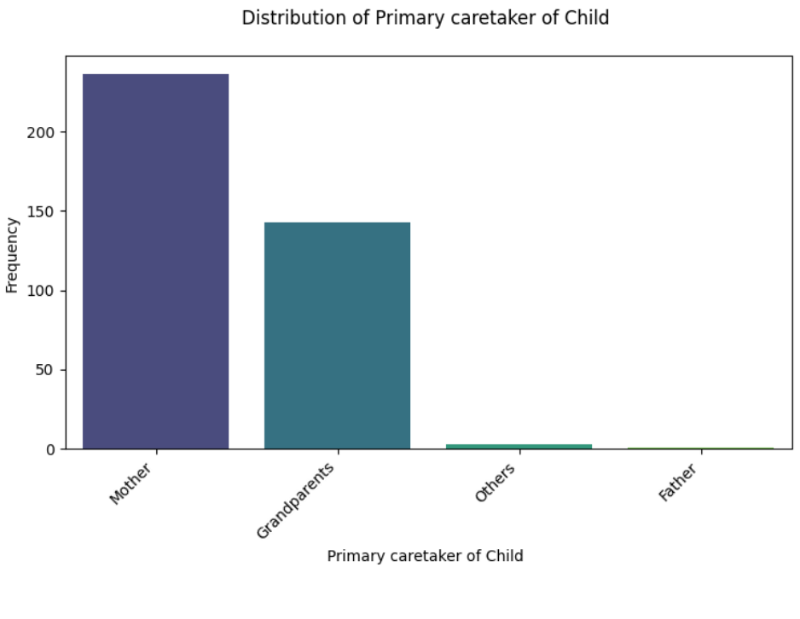
Results (3/4)

Slide 11
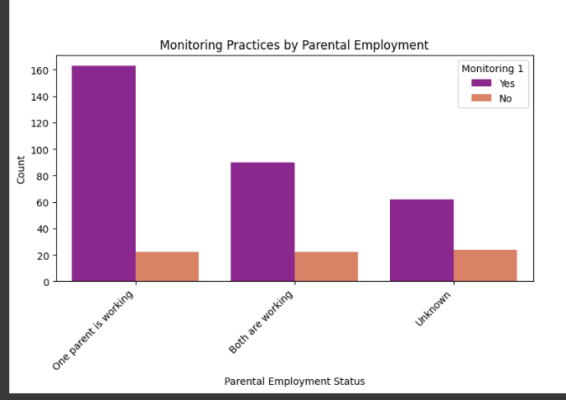
Results (4/4)

Slide 12
Discussion (1/2)
Regarding children's eating behaviors, a significant proportion of children in the study were identified as fussy eaters and were reported as not trying new foods. This highlights that challenges related to pickiness and limited dietary variety are prevalent in this age group within the study population. While many children exhibited generally positive eating traits in other aspects (like regular meal structures), the common occurrence of fussy eating and reluctance to try new foods suggests these are key areas for attention for parents and potentially public health initiatives.
The assessment of parental beliefs, attitudes, and practices revealed a high level of parental engagement in child feeding. Mothers were the primary caregivers, and parental monitoring of children's eating was found to be a very widespread practice. This indicates that parents are actively involved in overseeing what and how much their children eat.

Slide 13
Discussion (2/2)
When examining demographic influences, the analysis used family size as a proxy for family type and also looked at parental employment status. While these demographic factors showed varying distributions within the dataset, the analysis did not reveal very strong, clear patterns of influence on specific feeding behaviors or parental practices. Fussy eating and not trying new foods were observed across different family sizes, and restrictive feeding and monitoring practices were prevalent regardless of parental employment status.

Slide 14
Conclusion
Based on the analysis, the study provides valuable insights into the feeding landscape for young children in New Delhi.
It confirms the prevalence of challenging eating behaviors like fussiness and not trying new foods.
It also highlights the active role parents play, particularly mothers, and the common use of practices like monitoring, restriction, and pressure to eat, which are influenced by parental beliefs and concerns.

Slide 15
References
Rylatt L, Cartwright T. Parental feeding behaviour and motivations regarding pre-school age children: A thematic synthesis of qualitative studies. Appetite. 2016 Apr;99:285–97.
Bowne M. A Comparative Study of Parental Behaviors and Children’s Eating Habits. ICAN: Infant, Child, & Adolescent Nutrition. 2009 Feb;1(1):11–4.
Birch LL, Fisher JO, Grimm-Thomas K, Markey CN, Sawyer R, Johnson SL. Confirmatory factor analysis of the Child Feeding Questionnaire: a measure of parental attitudes, beliefs and practices about child feeding and obesity proneness. Appetite. 2001 Jun;36(3):201–10.
Shloim N, Edelson LR, Martin N, Hetherington MM. Parenting Styles, Feeding Styles, Feeding Practices, and Weight Status in 4–12 Year-Old Children: A Systematic Review of the Literature. Frontiers in Psychology. 2015 Dec 14;6(6).

Slide 16
INVOLVEMENT IN COMMUNITY OUTREACH PROGRAMME (COP) ACTIVITIES
Total no. of visits done by the Student: 15
Activities done by the student:
Mapping & listing
Health intervention delivery
Health Education & Awareness Campaigns
Door to door surveys
Conducting in-depth interviews and focused group discussion

Slide 17
KEY LEARNING FROM COP ACTIVITIES
Identification of vulnerable communities
understanding community needs
Public awareness approaches
Building trust and relationships
Promoting civic engagement
Fostering a sense of collective responsibility

Slide 18
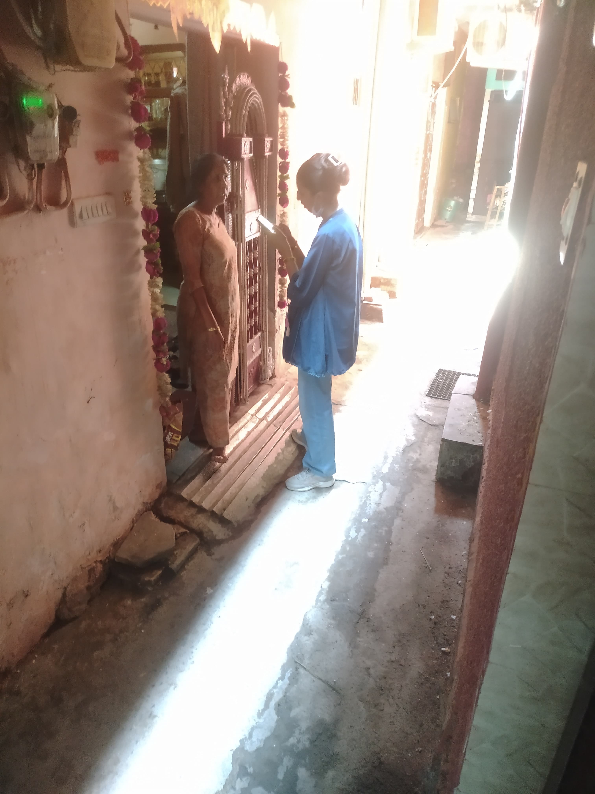

COP FIELD ACTIVITIES PHOTOGRAPHS

Slide 19
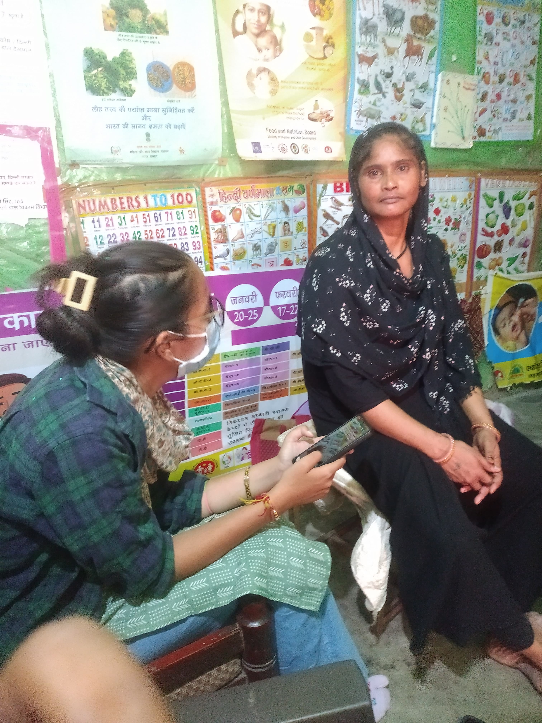
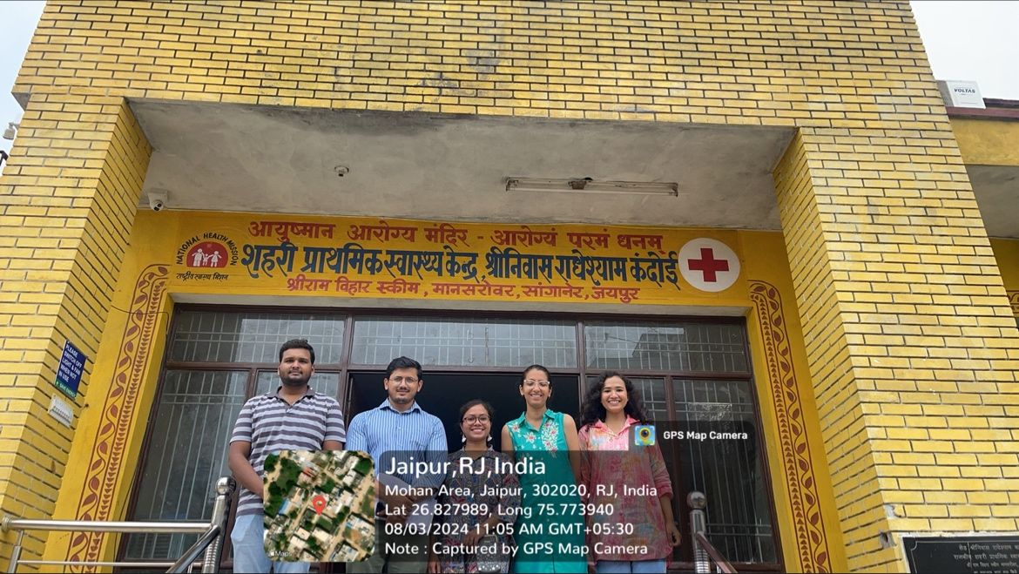
Pictorial Journey (1/2)

Slide 20
Thank You
Any Questions

