Slide 1

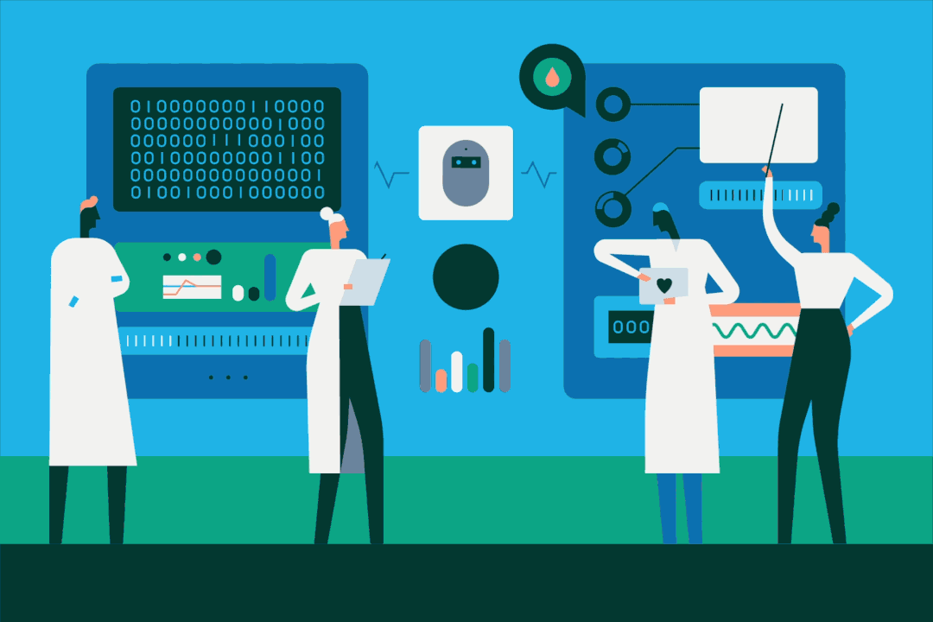
AI FOR DISEASE SURVEILLANCE & FORECASTING
Transforming Population Health
Dr. Simran Kaur Antal
Roll no: PG/23/117
Organization: CARPL.ai
Faculty Mentor: Dr. Altaf Yousuf Mir
IIHMR Delhi

Slide 2
MENTOR APPROVAL

Slide 3
INTRODUCTION
The 21st century has seen explosive AI growth, transforming how we address global health threats like pandemics, antimicrobial resistance, and climate-driven outbreaks.
Traditional surveillance is slow and reactive. AI via ML, NLP, and big data enables real-time monitoring, prediction, and response.
AI tools can analyze diverse data from EHRs, social media, mobility trends, climate data, offering insights at population scale. Systems like BlueDot & HealthMap identified COVID-19 risks before official reports.
Yet, challenges related to data bias, algorithm transparency, ethical use remain.
This study explores how AI reshapes public health, focusing on disease surveillance, forecasting, and implementation challenges.

Slide 4

RESEARCH QUESTION
What are the key thematic trends and challenges in the use of Artificial Intelligence for disease surveillance and forecasting in population health?

Slide 5
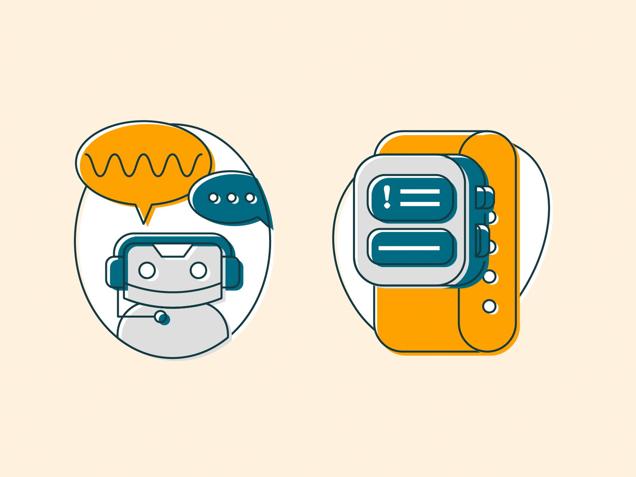
OBJECTIVES
To explore current trends and developments in the use of AI for disease surveillance, prediction, and control.
To classify the types of AI models (e.g., ML, DL, NLP) used in epidemiological applications.
To identify common challenges, limitations, and ethical considerations in applying AI in public health.

Slide 6


METHODOLOGY
Study design - Secondary Thematic Review
Literature search strategy - A comprehensive search was conducted using PRISMA guidelines.
Database searched – PubMed, Scopus, Google Scholar, ScienceDirect
Keywords used - Artificial Intelligence, AI, Disease Surveillance, Epidemiology, Public Health, Population Health, Predictive Modeling, Forecasting.
These terms were used in combination with Boolean operators (AND, OR) to refine the search and ensure comprehensive coverage of the relevant literature.

Slide 7

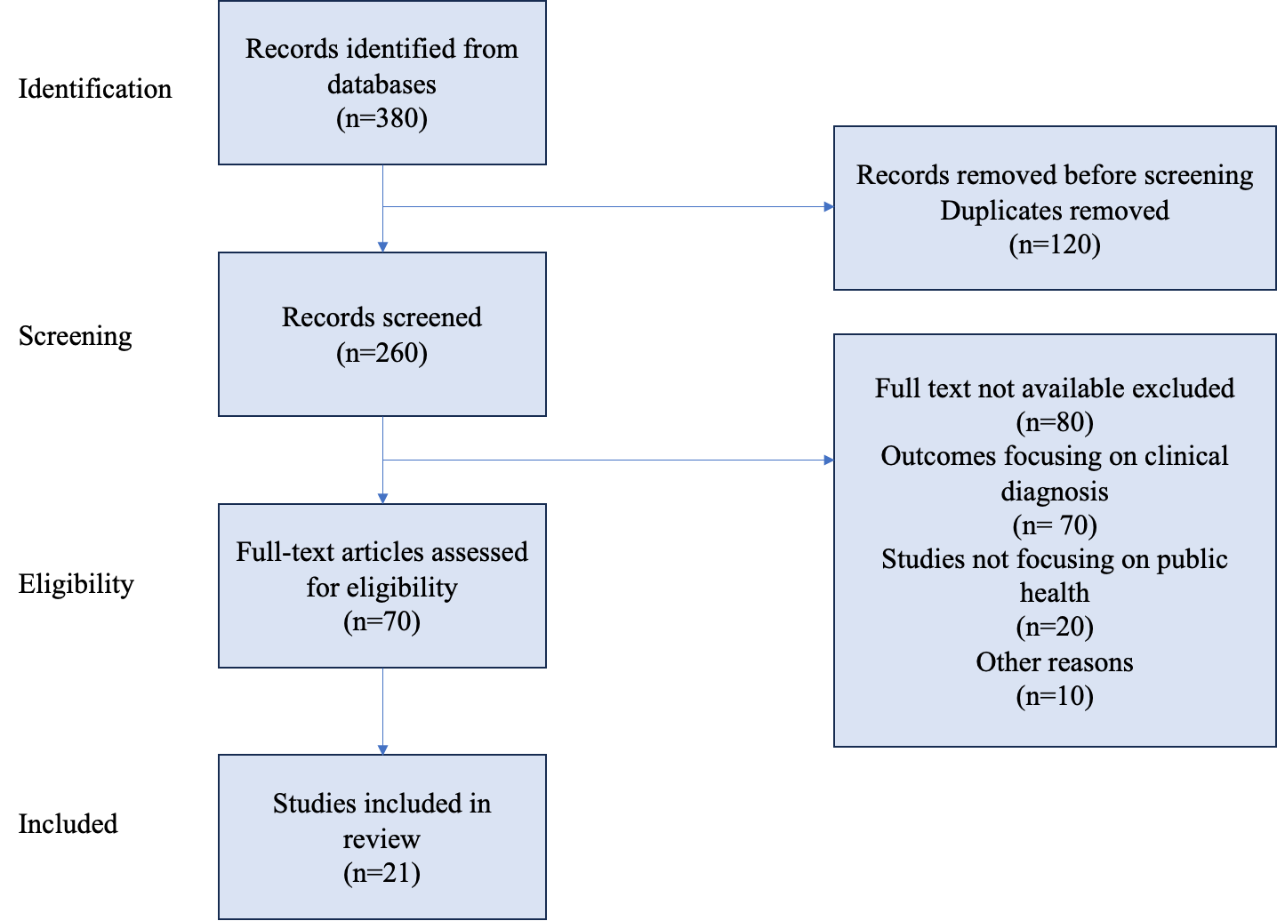
METHODOLOGY
A total of 21 articles were selected after title/abstract screening and full-text eligibility checks.
Inclusion Criteria
Peer-reviewed journal articles (2018–2025)
Articles discussing AI in the context of disease surveillance and/or prediction
Studies in English
Research focused on public/population health
Exclusion Criteria
Articles not available in full text
Conference abstracts, posters, and editorials
Studies unrelated to public health or AI
Articles focusing solely on AI for clinical/individual diagnosis

Slide 8


THEMATIC ANALYSIS APPROACH
1. Familiarization with the Data
2. Generating Initial Codes
3. Searching for Themes
4. Reviewing Themes
5. Defining and Naming Themes
6. Producing the Report
Braun and Clarke’s six-phase thematic analysis framework was employed to systematically analyze the selected secondary literature.

Slide 9
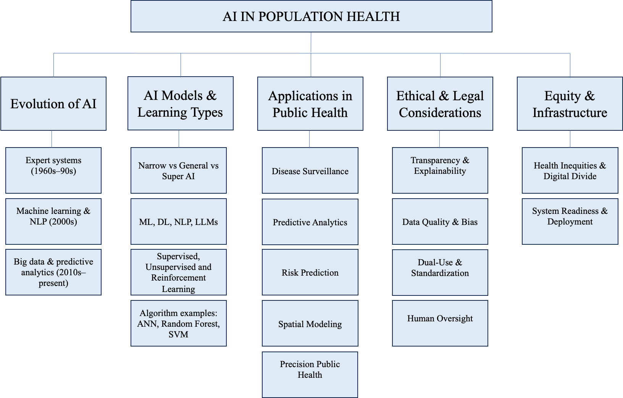

THEMATIC CODE TREE

Slide 10
The following key themes were identified
RESULTS
THEME 1
Evolution from Manual Systems to AI-Driven Prediction
01
THEME 2
Typology and Function of AI Models in Epidemiology
02
THEME 3
Expanding Applications in Public Health Practice
03
THEME 4
Ethical Tensions and Trust Deficits
04
THEME 5 Infrastructure and Inequity - Double-Edged Potential
05

Slide 11
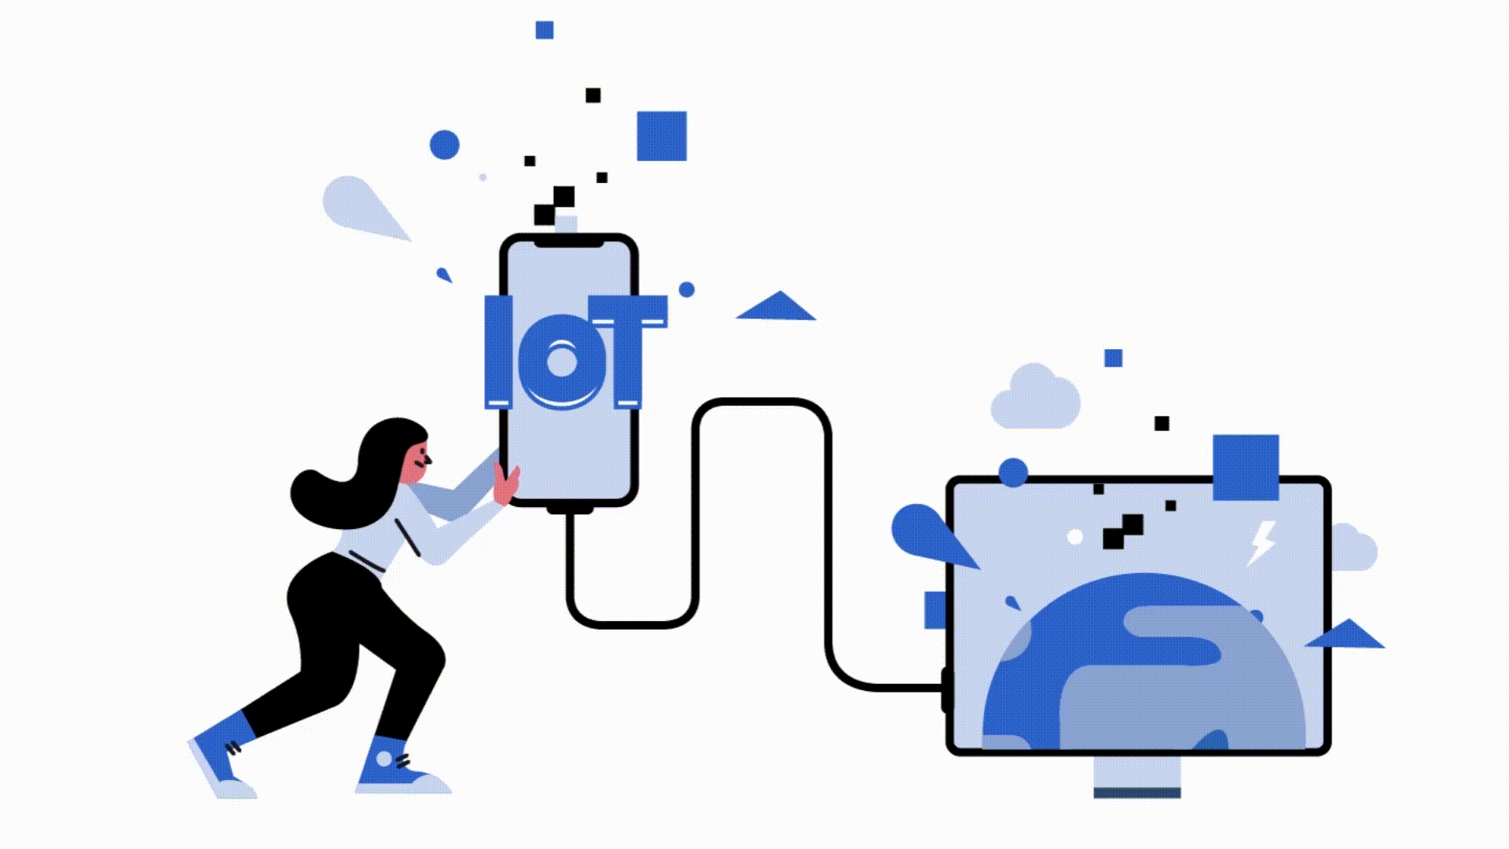

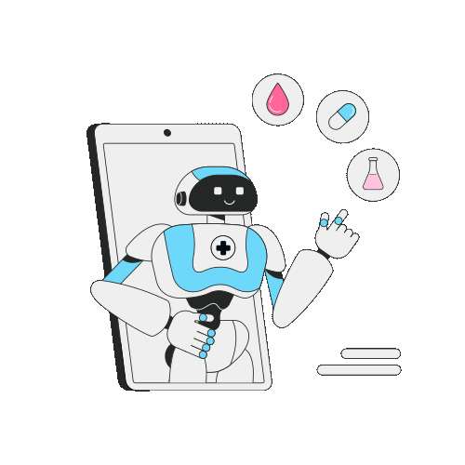

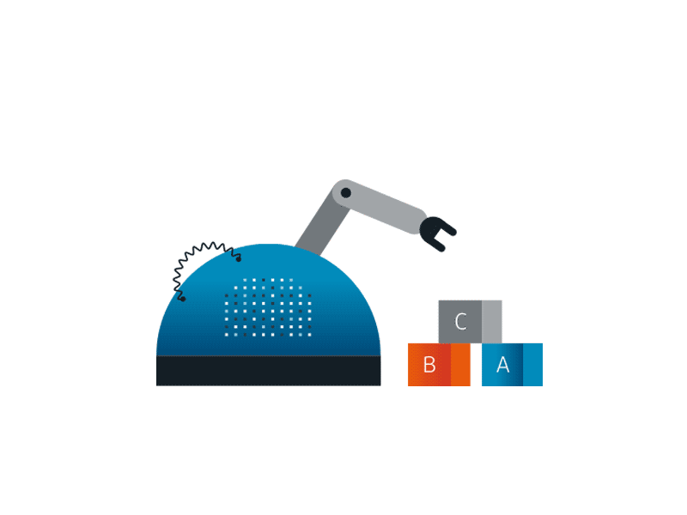
THEME 1
Evolution from Manual systems to AI driven prediction
Surveillance was based on manual reporting and rule based expert systems, which restricted prompt action and early detection of public health threats.
Machine learning and artificial intelligence entered healthcare, and surveillance systems were able to identify intricate patterns in health data.
Modern systems now use predictive analytics and cloud infrastructure to forecast disease trends and improve resource planning.
1960
2010
1960
Advent of EHR and automated data capture technologies, optimized data accuracy, sped up reporting, and set the stage for more advanced analysis capabilities.
2000
Big data from EHRs, wearables, and social media allowed real-time surveillance and early outbreak detection.

Slide 12

THEME 2
Typology and Function of AI Models in Epidemiology
Artificial Narrow Intelligence (ANI)
Artificial General Intelligence (AGI)
Artificial Superintelligence (ASI)
🧮 Machine Learning (ML) → Learns from data patterns
🧠 Deep Learning (DL) → Multi-layered neural networks for images, signals
🗣️ Natural Language Processing (NLP) → Understands human language
📚 Large Language Models (LLMs) → Text generation & summarization
🔧 LEARNING TYPE | 📊 DESCRIPTION | 🏥 HEALTHCARE USE
Supervised | Labeled data | Diagnosis from scans
Unsupervised | Unlabelled data(clustering, anomaly detection) | Patient segmentation
Reinforcement | Learns via rewards | Sepsis alert systems

Slide 13

THEME 2
Typology and Function of AI Models in Epidemiology
Model Type | Description | Prediction Accuracy | Processing Speed | Data Requirements | Implementation Cost
Neural Networks | Learn from unstructured health data to detect complex disease patterns and enable early outbreak warnings. | 92% | High | Extensive | High
Random Forest | Ensemble algorithms that handle noisy, multi-source data to accurately predict population-level disease risk. | 88% | Medium | Moderate | Medium
Support Vector Machines | High-precision classifiers that separate disease states in complex datasets for early detection and diagnosis. | 85% | Medium | Moderate | Medium
Regression Models | Analyze temporal patterns in health data to forecast trends and seasonal disease behavior and and population-level health outcomes. | 78% | Low | Low | Low

Slide 14

THEME 3
Expanding Applications in Public Health Practice
Disease Surveillance
AI detects abnormal patterns early using data from EHRs, travel, and social media.
Explainable AI (XAI) builds trust via transparent decision-making.
Enables personalized prevention (e.g., IBM Watson’s 90% heart attack risk prediction).
Predictive Analytics
ML models predict disease spread with 85–92% accuracy.
Combines social, genetic, and environmental data for high-precision forecasts.
Tools like ANNs, SVMs, Random Forests drive early warnings and resource planning.
AI assesses disease risk using genomics, imaging, and wearables.
Risk Prediction
AI also tracks non-communicable diseases (e.g., CVD, diabetes) via real-time monitoring.
BlueDot predicted COVID-19 before traditional systems.

Slide 15
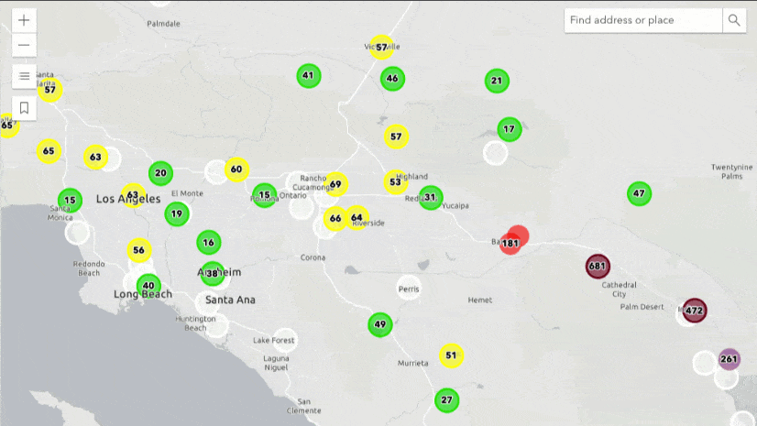
THEME 3
Expanding Applications in Public Health Practice
Spatial Modeling
AI + GIS improve geographic disease prediction (e.g., dengue, respiratory diseases).
Precision Public Health
Moves beyond "one-size-fits-all" to individualized care based on genetics, lifestyle and environment.
Analyzes satellite data, mobility patterns, and local risks for hotspot targeting.
Supports real-time tracking and spatially-targeted interventions.
AI tools support targeted, equitable interventions and reduce health disparities.
Enhances efficiency in resource allocation and population health outcomes.

Slide 16
THEME 4
Ethical Tensions and Trust Deficits
Explainability & Trust
Many AI models are “black boxes” difficult to interpret, lowering clinical trust.
Explainable AI (XAI) offers clearer reasoning behind outputs.
Data Bias & Informed Consent
Incomplete or non-representative data risks privacy violations and biased decisions.
Ethical AI must be based on diverse datasets and transparent consent.
Dual-Use Risks
AI intended for public benefit (e.g., outbreak alerts) can be co-opted for surveillance or profit.
Need strict governance to prevent misuse.
Human Oversight
Fully autonomous AI in healthcare is risky.
Experts recommend “human-in-the-loop” systems for accountability and safety.

Slide 17

THEME 5
Infrastructure and Inequity - Double-Edged Potential
Opportunities
Telehealth & Remote care
AI for diagnosis and Access
Barriers
Telehealth Disparity
Dataset Bias
Digital Divide
Offer diagnostics in resource-limited areas, improving timely care.
Infrastructure Readiness
Lack of connectivity, digital skills, and devices prevents equitable AI use.
Virtual assistants and AI-powered chatbots support underserved populations
Underrepresentation of marginalized groups leads to discriminatory predictions.
Real-time AI (e.g., contact tracing during COVID-19) showed promise, but exposed infrastructure gaps in low-resource settings.
Only effective where digital literacy and tools are in place.

Slide 18
DISCUSSION
1. From Reactive to Predictive: A Readiness Gap
Shift from retrospective reports → real-time prediction (e.g., BlueDot).
Institutional preparedness lags behind AI capabilities.
Prediction ≠ action without policy agility & interdisciplinary coordination.
2. Narrow AI: Effective but Fragile
ANI models dominate: precise, task-specific (e.g., outbreak detection).
Limited resilience to novel or uncertain data (e.g., misinformation).
Underuse of unsupervised/reinforcement learning = missed adaptability.
3. Systemic Innovation & Digital Inequity
AI drives shift toward integrated, personalized health systems.
Success skewed to high-income, data-rich environments.
Risk of "algorithmic advantage" without equitable infrastructure.

Slide 19
DISCUSSION
4. Ethical Disruption
Opacity, bias, and dual-use threats are central—not peripheral.
Black-box models erode trust; XAI adoption still limited.
Datasets underrepresent vulnerable populations → diagnostic bias.
5. Equity: Between Empowerment & Exclusion
AI extends access (telehealth, mobile diagnostics) but...
Barriers persist: digital illiteracy, bias, lack of local adaptation.
Calls for a capability-oriented approach: who benefits, at what cost?

Slide 20

CONCLUSION
AI in Public Health: Promise with Responsibility……..
Health Systems: Build infrastructure + AI-readiness plans
Key Implications
AI is transforming disease surveillance from reactive to predictive, but success is uneven limited by bias, data gaps, ethical concerns, and infrastructure shortfalls.
AI is not neutral its impact depends on equity, transparency, and human oversight.
Developers: Prioritize explainability, reduce bias, co-design with users
Policymakers: Enforce AI laws on privacy, consent, accountability

Slide 21
REFERENCES
Bajwa J, Munir U, Nori A, Williams B. Artificial intelligence in healthcare: transforming the practice of medicine. Future Healthc J. 2021;8(2):e188–e194. https://doi.org/10.7861/fhj.2021-0095
Chadwick F. AI for Disease Surveillance in the Modern Era: Early Detection and Rapid Response. 2025;1:1–6. https://www.researchgate.net/publication/389912671_AI_for_Disease_Surveillance_in_the_Modern_Era_Early_Detection_and_Rapid_Response
Sultana R, Aktar MN. Artificial Intelligence and Big Data for Enhancing Public Health Surveillance and Disease Prevention: A Systematic Review. JMDEDS. 2024;1(1):129–146. https://doi.org/10.70008/jmldeds.v1i01.50
Shah B. Artificial Intelligence (AI) in Public Health and Healthcare Systems Management. Open Access Public Health Health Adm Rev. 2024;3(1). https://doi.org/10.59644/oaphhar.3(1).132
Kraemer M, Yang CH, Gutierrez B, Wu CH, Klein B, Pigott D, et al. The effect of human mobility and control measures on the COVID-19 epidemic in China. Science. 2020;368:eabb4218. https://doi.org/10.1126/science.abb4218
Whitelaw S, Mamas M, Topol E, Van Spall H. Applications of digital technology in COVID-19 pandemic planning and response. Lancet Digit Health. 2020;2. https://doi.org/10.1016/S2589-7500(20)30142-4
Olawade DB, Wada OJ, David-Olawade AC, Kunonga E, Abaire OJ, Ling J. Using artificial intelligence to improve public health: a narrative review. Front Public Health. 2023. https://doi.org/10.3389/fpubh.2023.1196397
Ezeh CJ, Anioke SC, Oyewole S, David M. The role of predictive analytics in enhancing public health surveillance: Proactive and data-driven interventions. World J Adv Res Rev. 2024;24(3):3059–3077. https://doi.org/10.30574/wjarr.2024.24.3.3909
Mitchell TM. Machine Learning. New York: McGraw-Hill; 1997.
Goodfellow I, Bengio Y, Courville A. Deep Learning. Cambridge, MA: MIT Press; 2016.
Jurafsky D, Martin JH. Speech and Language Processing. 3rd ed. Hoboken, NJ: Pearson; 2023.

Slide 22
Continued….
Bommasani R, Hudson DA, Adeli E, Altman R, Arora S, von Arx S, et al. On the Opportunities and Risks of Foundation Models. arXiv. 2021. Available from: https://arxiv.org/abs/2108.07258
McKee M, Rosenbacke R, Stuckler D. The power of artificial intelligence for managing pandemics: A primer for public health professionals. Int J Health Plann Manage. 2024. https://doi.org/10.1002/hpm.3864
Guijarro Reinoso GP, Paredes Haro HD, Alonso Madero JL, Orozco Escaleras LG, Angulo Quinquiguano MI, Masapanta Pilatasig WJ, et al. Epidemiological Surveillance Innovative Applications for Community and Public Health: A Systematic Review. J Med Sci Clin Res. 2024. https://doi.org/10.47191/ijmscrs/v4-i03-32
Okoro Y, Ayo-Farai O, Maduka C, Okongwu C, Sodamade O. Emerging technologies in public health campaigns: Artificial intelligence and big data. Acta Inform Malays. 2023;8:5–10. https://doi.org/10.26480/aim.01.2024.05.10
Data H. Pro/con workshop: Whether AI will decrease health inequalities or deepen them? Eur J Public Health. 2023;33. https://doi.org/10.1093/eurpub/ckad160.111
Kapoor N, Sanjana SN, Davalagi S, Balu PS, Sethia S. AI Horizons in Indian Healthcare: A Vision for Transformation and Equity. Indian J Community Med. 2024;49(Suppl 2):S210–S216. https://doi.org/10.4103/ijcm.ijcm_806_24
Olorunsogo TO, Anyanwu A, Abrahams TO, Olorunsogo T, Ehimuan B, Reis O. Emerging technologies in public health campaigns: Artificial intelligence and big data. Int J Sci Res Arch. 2024;11(1). https://doi.org/10.30574/ijsra.2024.11.1.0060
Giri P, Gupta M. Transforming Disease Surveillance through Artificial Intelligence. Indian J Community Med. 2024;49(5):663–664. https://doi.org/10.4103/ijcm.ijcm_459_24
Borda A, Molnar A, Neesham C, Kostkova P. Ethical Issues in AI-enabled Disease Surveillance: Perspectives from Global Health. Appl Sci. 2022. https://doi.org/10.20944/preprints202202.0233.v1
Jillahi KB, Iorliam A. A scoping literature review of artificial intelligence in epidemiology: Uses, applications, challenges and future trends. 2024. https://doi.org/10.62411/jcta.10350

Slide 23
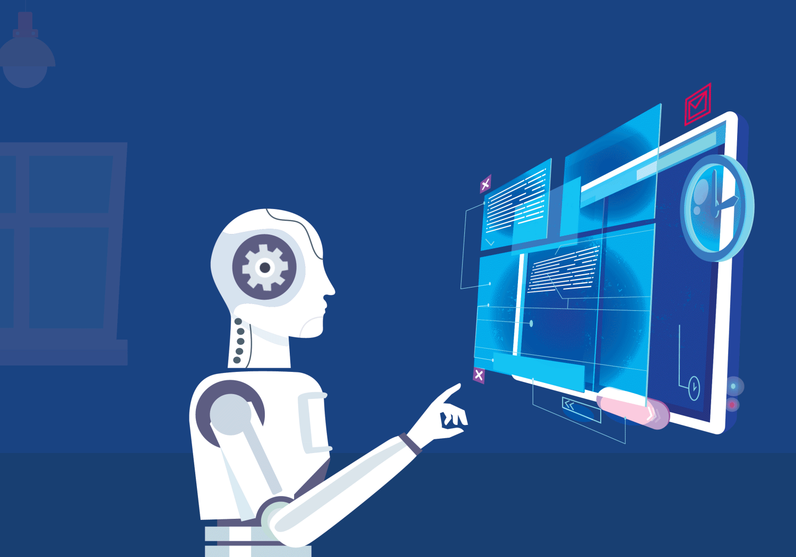
THANK YOU
Any Questions

