Slide 1

Patient satisfaction in ECHS polyclinics using SERVQUAL
Mentor : Dr. Punit Yadav
Presented by: Dr. Chahat
IIHMR DELHI

Slide 2
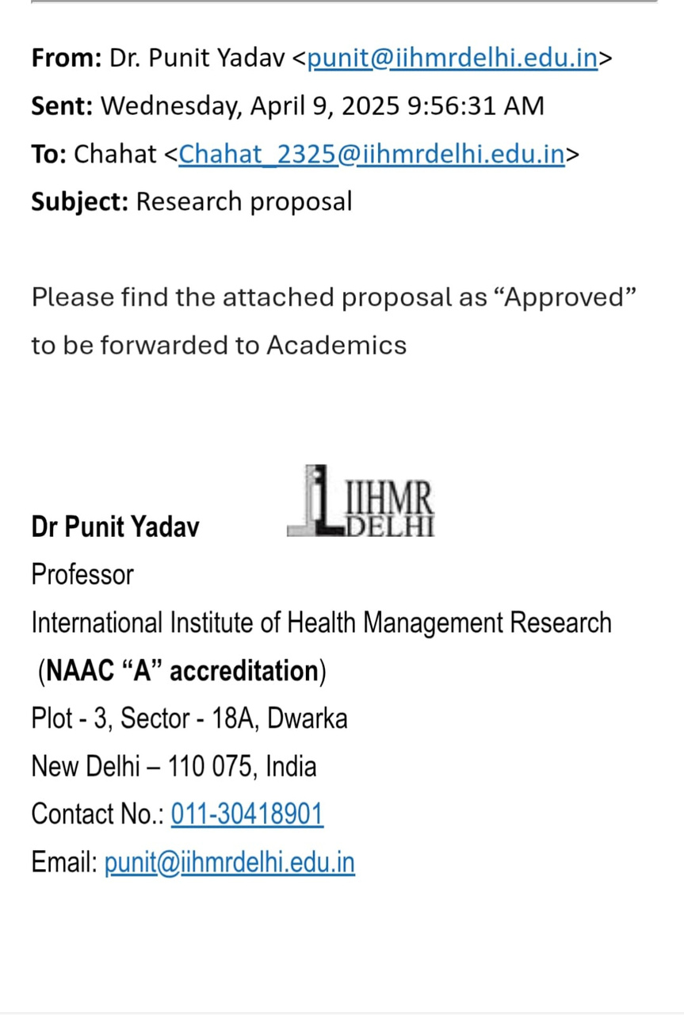
Mentor Approval

Slide 3
BACKGROUND
  Patient satisfaction is essential in modern, patient-centered healthcare.
  The SERVQUAL model assesses gaps between patient expectations and actual experiences.
  This satisfaction is not only linked to clinical outcomes and
treatment success but also influences patient loyalty, adherence to medical advice, and the overall perception of healthcare providers
  ECHS provides healthcare to ex-servicemen but lacks comprehensive service quality evaluation.

Slide 4
Rationale
  Multiple individual studies exist, but no meta-analysis using SERVQUAL has been done for ECHS.
  Helps identify specific areas of improvement in service delivery to veterans.
  Provides data-driven insights for better management of government-funded healthcare services.

Slide 5
REVIEW OF LITERATURE
Liu et al. (2019)
• Cross-sectional study in China
• Found communication, trust, and staff responsiveness as key satisfaction drivers in outpatient care
AlAbri & Al-Balushi (2014)
•⁠ ⁠Oman-based study
•⁠ ⁠Identified staff behavior, waiting times, and cleanliness as major factors influencing patient satisfaction
Siddiqui & Khandaker (2007)
• Compared private and public hospitals in Pakistan
• Found higher satisfaction in private hospitals due to better interpersonal relationships and responsiveness

Slide 6
OBJECTIVES
  To analyze patient satisfaction in ECHS polyclinics using the SERVQUAL modeL ( RATER Model)
STUDY VARIABLES
  Reliability
  Assurance
  Tangibles
  Empathy
  Responsiveness

Slide 7
METHODOLOGY
  Study Design: Individual Participant Data Meta-analysis (IPD-MA)
  Study Area: ECHS Polyclinics in Delhi
  Study Population: Patients attending ECHS Polyclinics
  Databases: PubMed and Web of Science
  Inclusion Criteria:
English language publications
Studies from 2013 onward
Conducted in Indian ECHS settings

Slide 8
DATA EXTRACTION AND ANALYSIS
  Data will be extracted using a structured Excel sheet
  Survey questions from included studies to be classified under SERVQUAL dimensions
  Two-expert review to validate the classification
  Narrative summary and visual charts will show the satisfaction levels by dimension
  Follows PRISMA-ScR guidelines for reporting

Slide 9
ETHICAL CONSIDERATIONS
No primary data collection: This study uses only published and publicly available data - so there is no direct patient involvement.
So no ethical approval is required.

Slide 10
EXPECTED OUTCOMES:
  Identification of Key Gaps:
Pinpoint which SERVQUAL dimensions (e.g., empathy or responsiveness) are lacking in ECHS polyclinics.
  Evidence-Based Recommendations:
Provide specific suggestions for improving service delivery in underperforming areas.
  Support for Policy Improvement:
Findings can help guide decision-makers in the Ministry of Defence and ECHS authorities to enhance patient-centered care.

Slide 11

References
1. Liu et al. (2019): Liu, Y., Kong, Q., Yuan, S., & van de Klundert, J. (2019). Factors
associated with patient satisfaction in outpatient healthcare: A cross-sectional study in China. Frontiers in Public Health, 7, 183.
https://www.frontiersin.org/articles/10.3389/fpubh.2019.00183/full
2 .AlAbri, R., & Al-Balushi, A. (2014). Patient satisfaction survey as a tool towards
quality improvement. Oman Medical Journal, 29(1), 3–7.
https://doi.org/10.5001/omj.2014.02
3. Siddiqui, N., & Khandaker, S. Comparison of service quality between privateand public hospitals: Empirical evidence from Pakistan. Journal of Quality andTechnology Management, 3(1), 1–22.

Slide 12
4. Parasuraman, A., Zeithaml, V. A., & Berry, L. L. A conceptual model of service quality and its implications for future research. Journal of Marketing, 49(4), 41–50. https://doi.org/10.1177/002224298504900403
5. Ministry of Defence. (2023). Ex-Servicemen Contributory Health Scheme (ECHS). Department of Ex-Servicemen Welfare. Retrieved from https://www.desw.gov.in/ex-servicemen-contributory-health-scheme
6. Parasuraman, A., Zeithaml, V. A., & Berry, L. L. SERVQUAL: A multiple item scale for measuring consumer perceptions of service quality. Journal of Retailing, 64(1), 12–40.

Slide 13
Thank You

