Slide 1
ASSESSMENT OF DIGITAL HEALTH ECOSYSTEM OF ARMENIA WITH FOCUS ON HEALTH FINANCING
By
Dr Ramanjeet Singh
PG/22/087
Mentor: Dr Altaf Yousuf Mir
Date: 06-06-2024

Slide 2
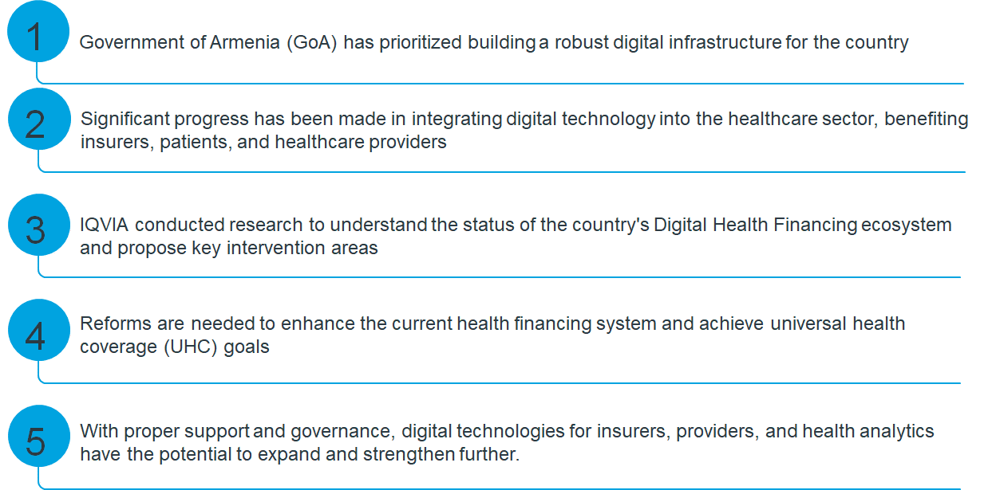
Background

Slide 3
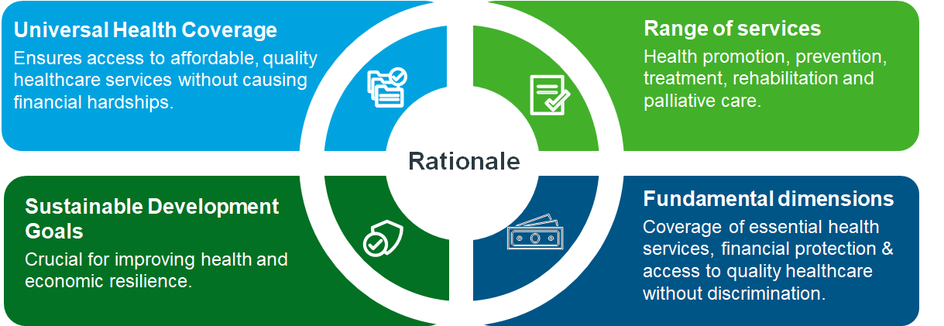
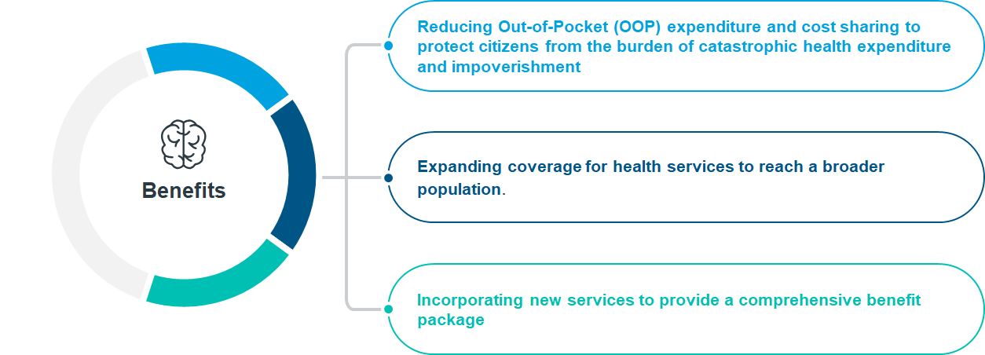
Rationale
To achieve UHC, SDGS, coverage of essential health services, financial protection against health expenses, and access to quality healthcare without discrimination in Armenia healthcare system.

Slide 4
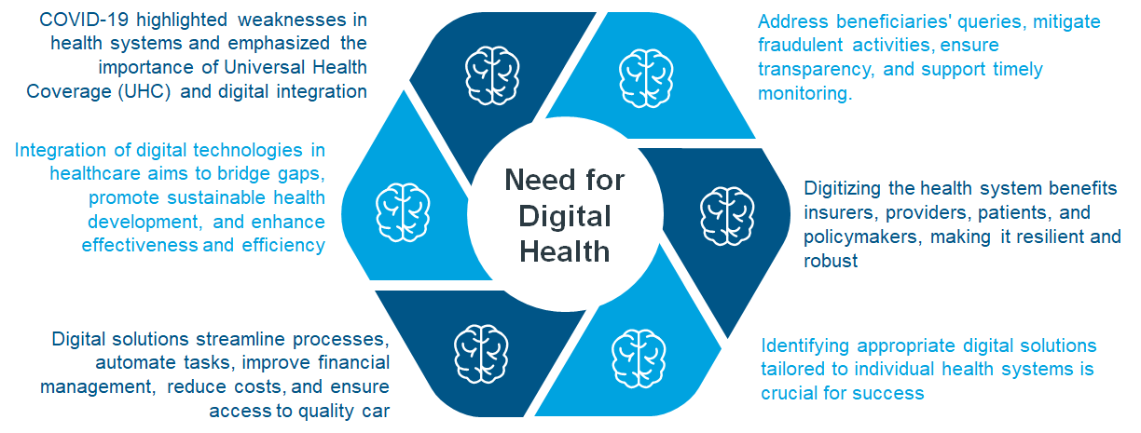
Need for digital health in Armenia
Assess the Armenian digital health ecosystem focusing on infrastructure, governance, services for insurers, providers, citizens, and health analytics. Identify gaps and propose interventions to enhance efficiency, efficacy, and transparency of the digital health financing system

Slide 5
Review of Literature
Progress and challenges in the Armenian digital health financing over the years.
Establishment of ARMED Platform (2017)
Aimed at collecting and synchronizing clinical, administrative, and financial information, facilitating patient engagement
Connectivity Challenges at Primary Healthcare (PHC) Facilities
Distribution of computers to PHC doctors lacked inclusion of specialists, hindering access to the ARMED system
Responsibilities and Data Management
Healthcare facilities manage their data, while the National e-health Operator (NEO) handles data management once entered into ARMED
Limited accessibility to ARMED due to connectivity issues.
Data Exchange and Implementation Challenges
ARMED permits limited data exchange among users and secure data exchange with healthcare facilities.
Role of National Institute of Health (NIH) and Digital Health Strategy
Armenian eHealth Strategy and Action Plan for 2021–23
Supported by ADB and endorsed by MoH, highlights room for improvement in regulatory framework and strategic vision.
Full-scale implementation of the EHIS is pending with MoHTI
NIH coordinates digital health activities within the Ministry of Health (MoH)

Slide 6
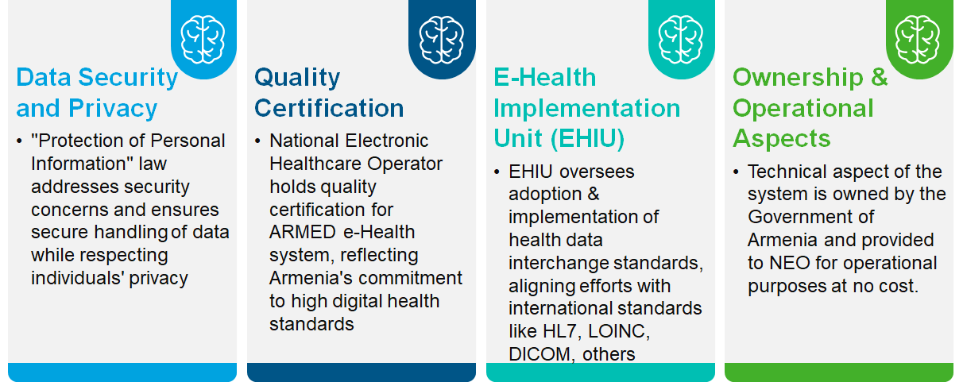
Governing bodies in the Armenian health system.

Slide 7
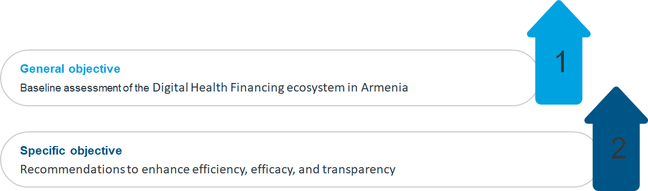
OBJECTIVES

Slide 8
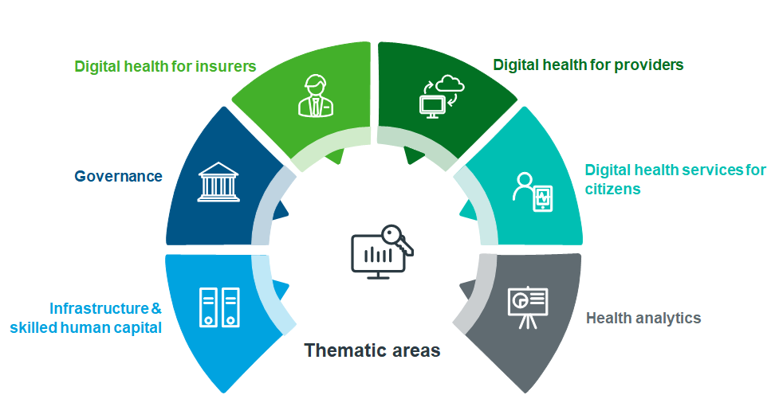
Methodology
Secondary Research - The six thematic areas have been subdivided into various parameters that are essential aspects for fulfilling the thematic areas, with an aim to undertake as-is analysis via secondary research and recommend intervention areas. To further refine and standardize the evaluation process, a scoring scale have been devised to capture the as-is status of Armenia, from basic to advanced stages across all thematic areas.

Slide 9
Description of the assessment methodology
The six thematic areas have been sub-divided into various parameters, with an aim to undertake situational analysis via secondary research and recommend key interventional areas.
The evaluation matrix was developed which facilitated extensive secondary research to capture as-is status of DMCs, from its basics to advanced stages across all thematic areas.
To further refine and standardize the evaluation process, a scoring scale has been devised.
Additionally, to ensure that the evaluation matrix is user-friendly and easy to comprehend, a color-coding system has been introduced
Scoring scale across all parameters
0: Non-existent
1: First initial steps taken
2: Existing and in working order
3: Fully developed / advanced

Slide 10
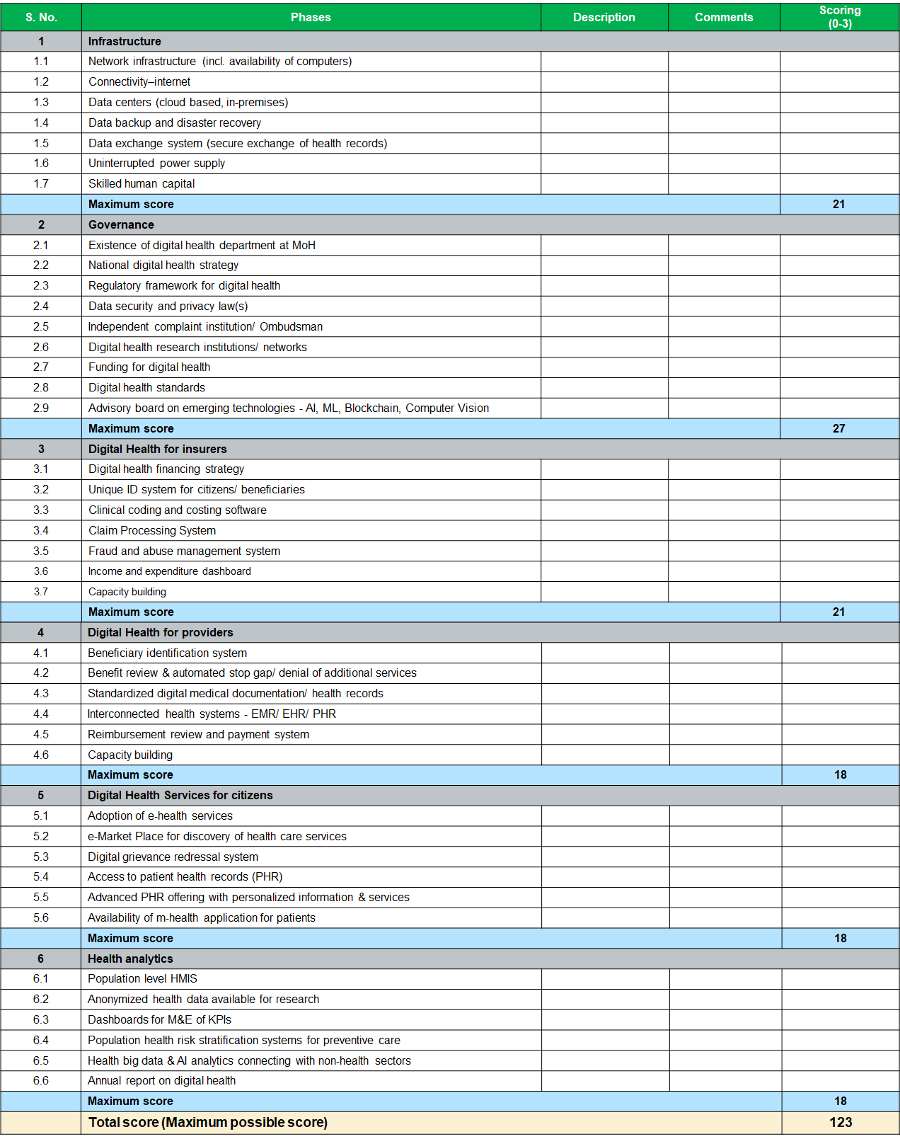
Evaluation matrix:

Slide 11
Infrastructure and skilled human capital:
Health facilities manage their own data until it enters the ARMED system.
Once in ARMED, the National e-health Operator (NEO) assumes responsibility for data management.
The technical system components belong to the Government of Armenia (GoA) and are provided to NEO for operational purposes at no cost.
ARMED permits limited data exchange among users but ensures secure exchanges with healthcare facilities per Ministry of High-Tech Industry (MoHTI) guidelines.
Full-scale implementation of Electronic Health Information system (EHIS) remains incomplete.
MoHTI mandates functional, internal and external data security, and technical standards for EHIS.
Capacity building for skilled human capital is ongoing to support evolving automation needs.
Armenia's digital infrastructure currently scores 7 out of 21 (33%), indicating a need for further scaling in providing computers, internet connectivity, etc., to health facilities.

Slide 12
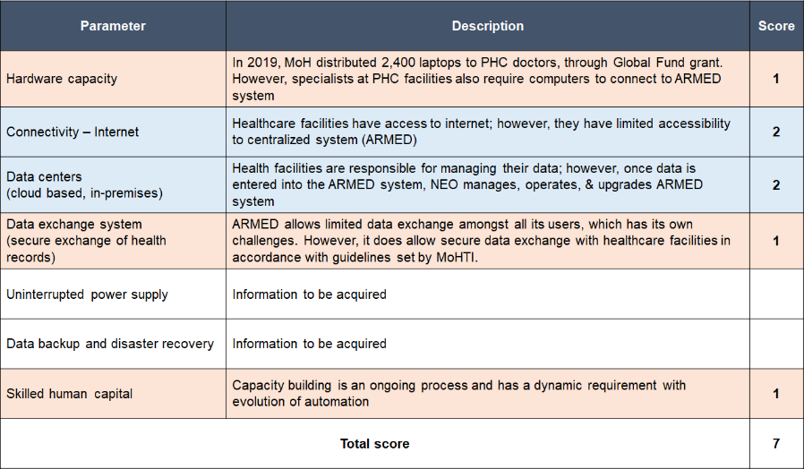
Scorecard based on the situational analysis :

Slide 13
Governance:
Protection of Personal Information Law: Addresses data security and privacy concerns, ensuring secure handling of personal data and respecting individuals' privacy.
Quality Certification of National Electronic Healthcare Operator (CJSC): Demonstrates Armenia's commitment to maintaining high standards in digital health through certification of the ARMED e-Health system.
E-Health Implementation Unit (EHIU): Operated within NIH, oversees adoption and implementation of health data interchange standards.
Alignment with International Standards: Efforts ongoing to align with international standards such as HL7, LOINC, DICOM, etc., enhancing Armenia's digital health ecosystem.
Maturity Score: Armenia's digital health infrastructure scores 10 out of 27 (37%), indicating a need for active interventions in governance. Areas include strengthening the national strategy and regulatory framework

Slide 14
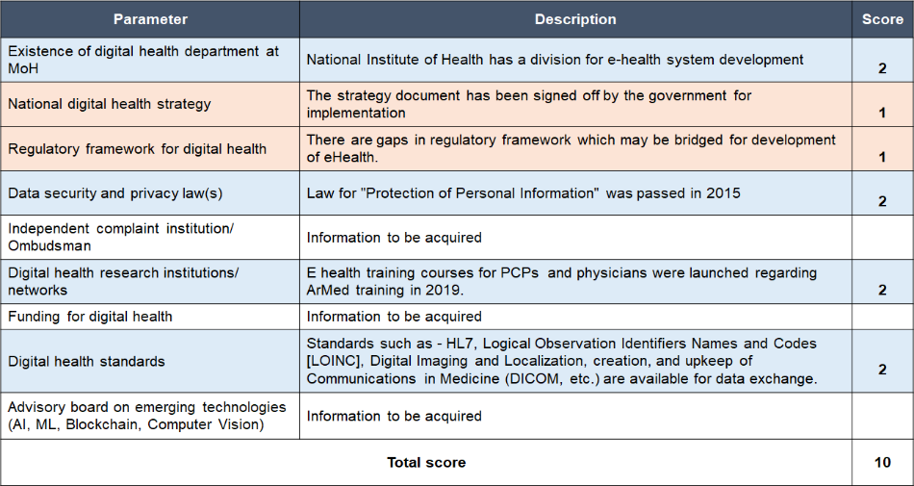
Scorecard based on the situational analysis :

Slide 15
Digital Health for Insurers:
Digital Health Financing Strategy: Armenia currently lacks a formalized digital health financing strategy, but a draft is under development, pending government approval.
Unique ID (UID) System: Implemented for approximately 2.9 million citizens, providing personal Electronic Health Records (EHRs).
Access to ARMED: Citizens can access their EHRs through ARMED using their ID card and PIN, facilitating retrieval of medical histories, diagnosis details, services received, diagnostics, and upcoming appointments.
Standardization of Medical Data: Ministry of Health (MoH) is responsible for standardizing medical and health data, including terminologies (e.g., ICD-10) and healthcare services classification
Claim Processing System: Integral to ARMED for delivering Basic Benefit Packages (BBP) services, handling functions like pre-authorization, claims submission, and reimbursement.
Enhanced Transparency: Proposed improvement includes displaying the history of actions taken on each claim, enhancing transparency in the process.
Fraud Detection: Currently, the State Health Agency (SHA), Ministry of Health (MoH) employs a sampling method to detect fraud during claims processing.

Slide 16
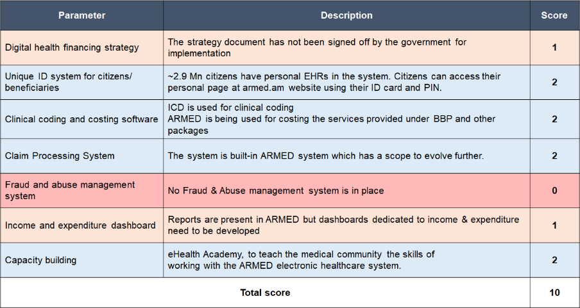
Need for Robust Fraud & Abuse Management: There is a recognized need to implement a robust fraud and abuse management system to improve efficiency in claims management.
Maturity Score: The current maturity score of 10 out of 21 (48%) suggests functional but improvable operations. Focus areas include digital health financing strategy and strengthening anti-fraud mechanisms
Scorecard based on the situational analysis :
Figure 7: Evaluation of Armenia's digital health for insurers

Slide 17
Digital Health for providers:
Beneficiary Identification: ARMED lacks a centralized social register for beneficiary identification. Instead, Armenia utilizes a combination of databases to assess social status and potential eligibility.
Integration with MoLSA: ARMED is integrated with the Ministry of Labor & Social Affairs (MoLSA) to automate beneficiary identification, particularly for verifying disability status before hospital admission.
Challenges in Integration: The process needs streamlining due to discrepancies and inconsistencies, such as incomplete or unreliable connections between ARMED and MoLSA. Automatic checking of Basic Benefit Package (BBP) eligibility criteria remains a challenge.
Role of EKENG: Information from various ministries is consolidated at EKENG and provided to ARMED for benefit assessments. Non-BBP services require out-of-pocket payments.
Interconnected Health Systems: ARMED incorporates interconnected health systems, including Electronic Medical Records (EMR), Electronic Health Records (EHR), and Personal Health Records (PHR)
E-Referral Registry: Fully implemented in ARMED to improve patient care by facilitating referrals between healthcare providers.
E-Prescription Registry: Partially implemented to issue and monitor prescriptions electronically.

Slide 18
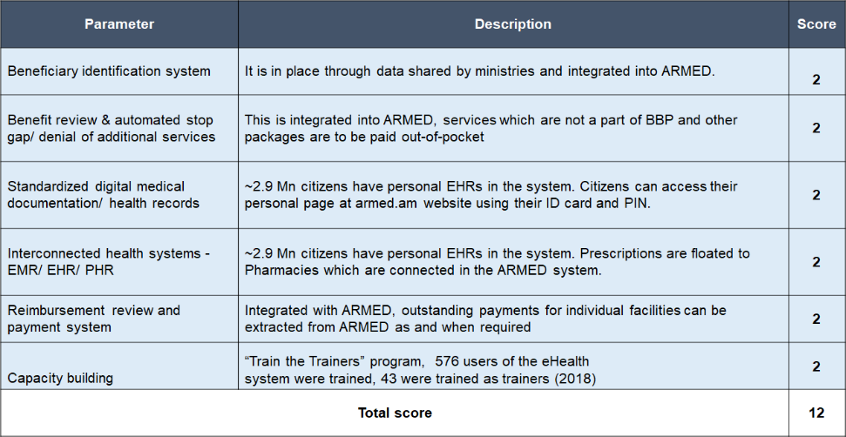
Challenges: Despite functionalities, challenges include lack of real-time data updating, user-friendly interface issues, compliance issues, double data entry, and varying levels of digital literacy among users.
Reimbursement System: Integrated within ARMED for reviewing and processing reimbursements, including extraction of outstanding payments as needed.
Future Collaboration: Plans to establish a distinct reimbursement information system in collaboration between SHA, MoH, and NEO, separate from EMR and eHealth services used for patient care.
Maturity Score: Armenia's digital health system for providers scores 12 out of 18 (67%), indicating good overall functionality despite some identified gaps and challenges

Slide 19
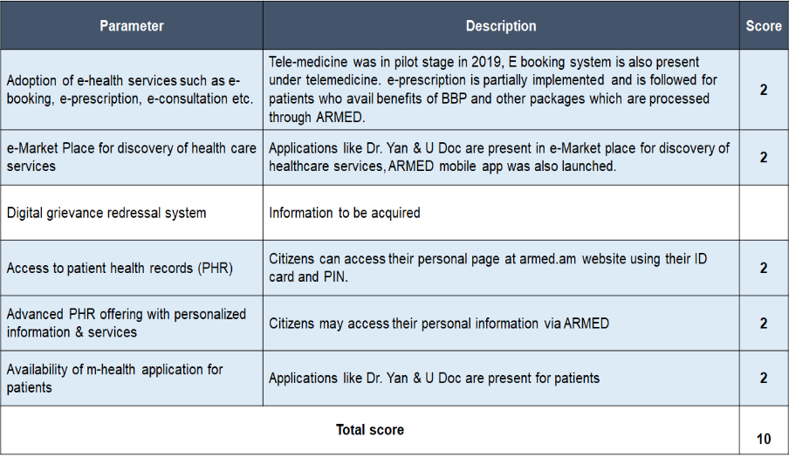
Digital Health services for citizens :
E-Marketplaces and M-Health Applications: Designed to enhance patient convenience by offering platforms like Dr. Yan and U Doc.
Functionality: These applications facilitate discovery and scheduling of appointments online, improving access and convenience for patients.
Maturity Score: Armenia's digital health system scores 10 out of 18 (56%), indicating functional implementation and acceptance by citizens
Scorecard based on the situational analysis :

Slide 20
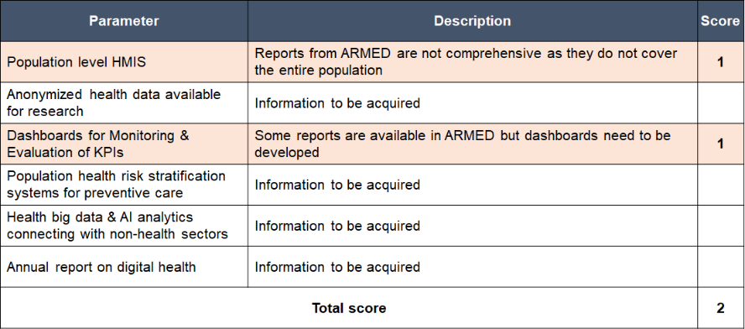
Health analytics :
Population-Level Health Management Information Systems: Armenia lacks a comprehensive system within ARMED to provide a complete overview of the health status of the entire population.
Impact on Monitoring and Evaluation: This gap hampers effective monitoring and evaluation of Key Performance Indicators (KPIs) crucial for policymakers.
Real-Time Patient Information Dashboard: Developed during COVID-19, but requires further development and refinement to support robust and timely data-driven decision-making.
Weak Health Analytics: Based on secondary research, Armenia's health analytics capability is lacking, with a maturity score of 2 out of 18 (11%)
Scorecard based on the situational analysis:

Slide 21
Identified gaps:
Claim Processing System: ARMED allows manual claim submission without required documents, increasing risk of errors and fraud.Lack of automated segregation by priority and absence of claim history complicate the process.
Beneficiary Verification System: Poor integration between ARMED and MoLSA hinders automated disability status retrieval.Providers resort to time-consuming manual checks due to these integration issues.
Anti-Fraud System: ARMED lacks efficient anti-fraud mechanisms like automatic detection of suspicious pre-authorizations.Current methods rely on sampling, lacking uniform assessment of filed claims for errors.
E-Prescription System: Pilot e-prescription system initiated by MoH with mandatory pharmacy connection to ARMED.Inadequate integration increases risk of medication errors, especially with hospital pharmacies linked.
E-Referral System: Referral module in ARMED suffers from incomplete or outdated information entry.Lack of feedback mechanism impacts continuity of care, affecting patient perspective on completed referrals.
Monitoring and Evaluation System: ARMED provides data entry and reporting interfaces but faces challenges with data inconsistency. Absence of consistent financial monitoring at facility level hampers informed decision-making

Slide 22
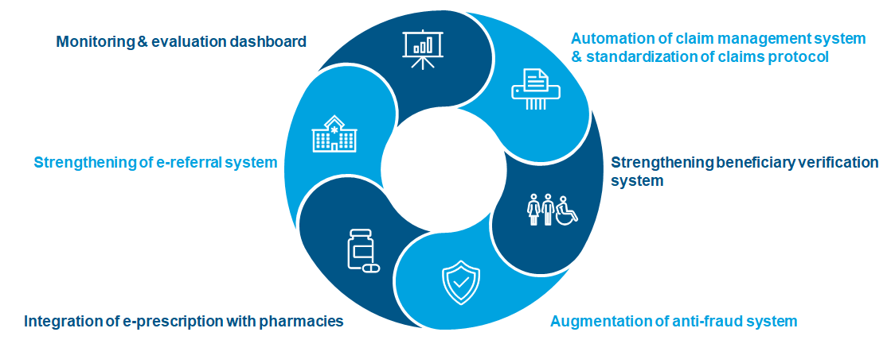
Proposed interventions:
Armenia is actively working to strengthen its digital health financing ecosystem, to make it efficient & resilient, stakeholders may focus on scaling up digital technologies for insurers (score: 10 (out of 21)), providers (score: 10 (out of 18)), and health analytics (score: 2 (out of 18)). Following are the six key intervention areas; one of these may be shortlisted by SHA, MoH.

Slide 23
Way forward:
Basis this gap analysis, it is proposed that SHA, MoH may shortlist on one of the recommended mature digital technologies for implementation.
IQVIA shall set-up a discussion between SHA, MoH to facilitate shortlisting of mature digital technology.
Once the technology has been shortlisted IQVIA shall furnish Terms of Reference pertaining to implementation of technology, along with a detailed action plan.
Based on the final workplan agreed by ADB, and SHA, MoH; IQVIA will involve its project team of international and national experts for execution.

Slide 24
References:
https://www.who.int/europe/publications/i/item/9789289053402
IQVIA’s estimate.
https://www.gov.am/en/news/item/9307/
https://publications.iom.int/system/files/pdf/pub2023-076-r-migration-management-digital-maturity-armenia.pdf
https://www.primeminister.am/en/press-release/item/2020/07/20/Nikol-Pashinyan-meeting-Digitization/
https://www.oecd.org/eurasia/Covid19_%20Advancing%20digital%20business%20transformation%20in%20the%20EaP%20countries.pdf
https://www.isfteh.org/files/media/A_Century_of_Telemedicine_-_Part_IV.pdf
MOH Order_456-L_eHealth Action Plan_eng
IQVIA’s estimate.
https://openknowledge.worldbank.org/server/api/core/bitstreams/f3a12463-2225-54e6-a838-4c756c65a2ae/content
Armenian eHealth Strategy and Action Plan for 2021-2023
https://www.adb.org/sites/default/files/project-documents/51129/51129-002-pcr-en.pdf

Slide 25
^{IQVIA estimate.}
https://armdigihealth.org/digital-health-in-armenia/
https://www.oecd.org/eurasia/Covid19_%20Advancing%20digital%20business%20transformation%20in%20the%20EaP%20countries.pdf
“National Electronic Healthcare Operator” CJSC operating ARMED, e-Health system in Armenia, has been certified by the globally recognized ISO/IEC 27001 Standard
https://eufordigital.eu/wp-content/uploads/2021/02/Analysis-of-the-current-state-of-eHealth-in-the-Eastern-partner-countries.pdf
IQVIA’s estimate.
https://corporate.armed.am/en/about-system
https://corporate.armed.am/en/about-system
IQVIA’s estimate.
https://documents1.worldbank.org/curated/en/174831600184459793/pdf/Strategic-Purchasing-for-Better-Health-in-Armenia.pdf
IQVIA’s estimate.
IQVIA estimate.

