Slide 1
Food Security and Vulnerability Assessment of Drought Affected Districts of Faryab and Jawzjan
Presented by:
Upendra Kumar
PGDHHM
IIHMR, New Delhi

Slide 2
Solidarity for Afghan Families
A nongovernmental, non-political and not for profit organization
with an independent legal identity
works with an aim to serve the disastrous and needy people
irrespective of their thoughts, religion, race and language.

Slide 3
Vision
A developed and welfare society for Afghan families
Mission
Empowering and enabling Afghan families to combat against diseases, poverty, social injustice and illiteracy

Slide 4
Background
Afghanistan - one of the world’s most disaster prone countries, facing frequent natural disasters every year.
Different types of disasters like earthquake, floods, cyclones, drought and landslides have hit Afghanistan over the years.
14 worst drought affected provinces-
Balkh, Samangan, Takhar, Saripul, Herat, Badghis, Faryab, Jowzjan, Baghlan, Kunduz, Badakshan, Bamiyan, Daikundi and Ghor. (source: Md. Asif Rahimi, Agriculture Minister, Afghanistan. 6oct 2011 )

Slide 5
2.6 million drought affected people are living in a state of severe food insecurity. (Source: WFP 10 Nov 2011)
Drought and harsh winter conditions regularly intensify the underlying food insecurity in the country, which sees nearly 50% chronic malnutrition rates. ( Source :Humanitarian Action Plan for Afghanistan 2010)
At present more than 2.5 million people require either immediate solution to water supply or long-term drought and flood mitigation measures and food security. (UNEP Afghanistan, Dec 2011)

Slide 6
Rationale
Lack of evidence on the current effects of
drought on the population.
Lack of data to formulate specific policies and
strategies by the policy makers and humanitarian
agencies for the affected population.
This study will try to fill the gap of evidence
based studies in the two most affected provinces
of Afghanistan i.e. Faryab and Jawzjan.

Slide 7
Study Objectives
To assess the impact of drought on the community in the affected districts of Faryab and Jawzjan.
To know the common water, sanitation and hygiene (WASH) practices in the drought affected community
To assess the prevalence of acute diseases in last 15 days of the survey among children and adults in the community.
To assess the food security situation among the affected population of the targeted districts.

Slide 8
Research Methodology

Slide 9
Type of Study
Cross Sectional Descriptive Study (Household Survey).
Study Area
Faryab Province- Dawlatabad and Shirin Tagab Districts.
Jawzjan Province- Khaniqa and Mingajik Districts.
Study Population
Households in the selected districts.
Expected duration of the study
3 months.

Slide 10
Sampling Technique and Sample Size
Two stage Cluster Sampling
Standardized CDC (Center for Disease Control)
sampling technique.
Also used in the Expended program of
Immunization (EPI) by World Health Organization
Best sampling method to conduct rapid
need assessment in the disaster affected areas.

Slide 11
First stage
20 villages selected randomly from the list of
the villages of the 4 districts.
Second stage
First household from each selected village
Selected randomly.
After that subsequent 14 households surveyed.
In total -15 households from each village.

Slide 12
Sample Size
20 clusters ( villages)
Sample households from each village=15
Sample Size =20*15= 300.

Slide 13
Data Collection and Analysis
Data Collection Tools
The standard survey tool (Structured Questionnaire).
Contents of questionnaire
Questions related to demography, literacy level, socio economic
status, common water, sanitation and hygiene practices,
prevalence of diseases, food security and adverse effects of
disasters in the community and their coping mechanism.
Data Analysis
Collected data has been entered first in the SPSS software
package and after that data has been analyzed with the help of it.

Slide 14
Work Schedule
Activities | January |  |  |  | February |  |  |  | March |  |  |  | April
Literature review
Preparation of research protocol, data collection tools, consent form
IRB Approval
Training to investigators
Data collection
Data entry, data validation, data edition
Data analysis
Report writing
Dissemination of report and presentation

Slide 15
Ethical Consideration
Study protocol submitted to MOPH- IRB for the approval.
After getting approval from the MOPH-IRB , the assessment had been
commenced in the study areas.
Informed Consent has been taken from each Respondent.
The data collected has been used only for the research purpose.
Survey forms have been treated with utmost confidentiality.

Slide 16
Result and Analysis

Slide 17
1. Impact of drought on the community

Slide 18
Main difficulties faced by the people in last 2 years

Slide 19
Problems faced during last disaster

Slide 20
Access of the household to the general facilities

Slide 21
Community level systems in place

Slide 22
Governmental/ nongovernmental programs running in village in relation to effect of disaster.

Slide 23
2. Common water, sanitation and hygiene (WASH) practices in the community.

Slide 24
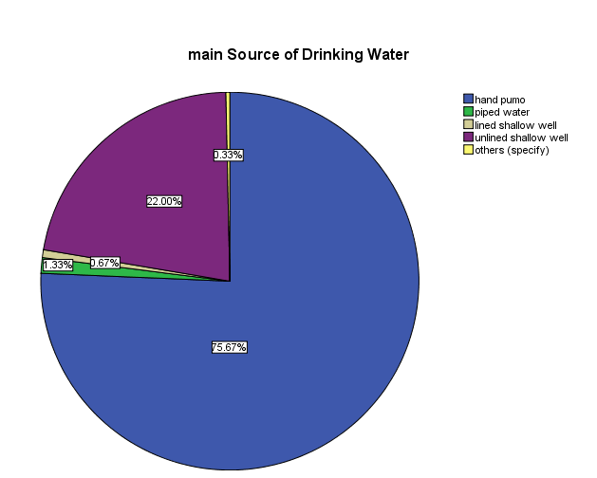
Source of drinking water

Slide 25
Contamination of water source
Notes:
32%

Slide 26
Water treated before drinking
Notes:
30%

Slide 27
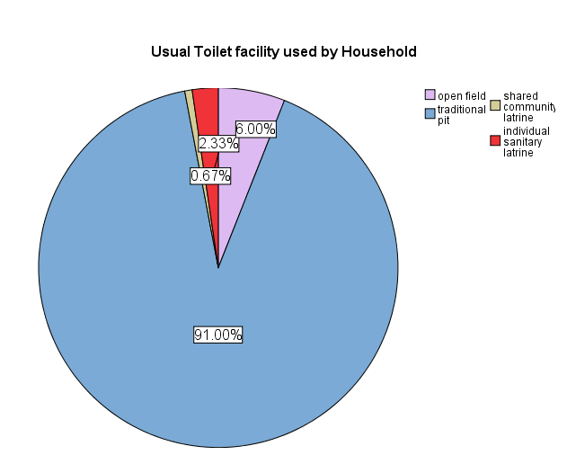
Type of toilet facility

Slide 28
Hands washing after Defecation

Slide 29
3. Prevalence of water, sanitation and hygiene related diseases among community in the affected regions

Slide 30
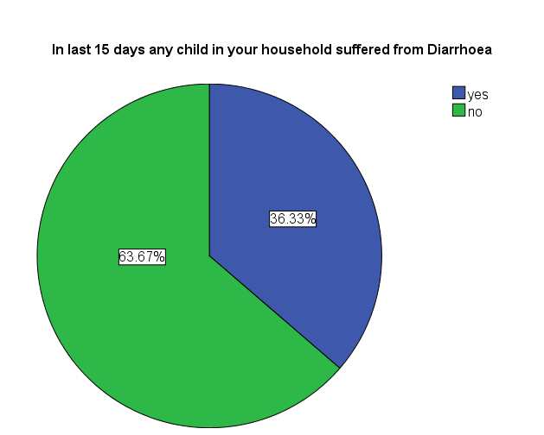
Prevalence of diarrhea among children in the community

Slide 31
Treatment of diarrhea case

Slide 32
Prevalence of diseases other than diarrhea in children below than 5 years of age.
Notes:
122

Slide 33
Symptoms

Slide 34
Prevalence of different diseases in person above 5 years of age.
Notes:
177

Slide 35
Symptoms

Slide 36
4. Food Security situation in Drought affected districts of Faryab and Jawzjan

Slide 37
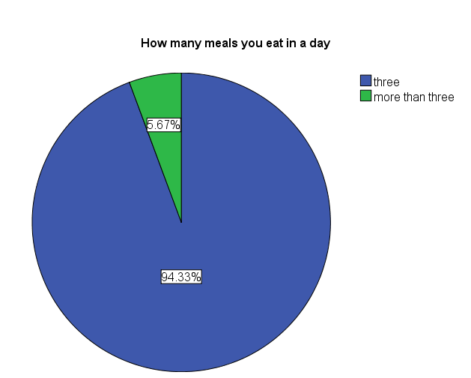
Number of meals eaten in a day by the households.

Slide 38
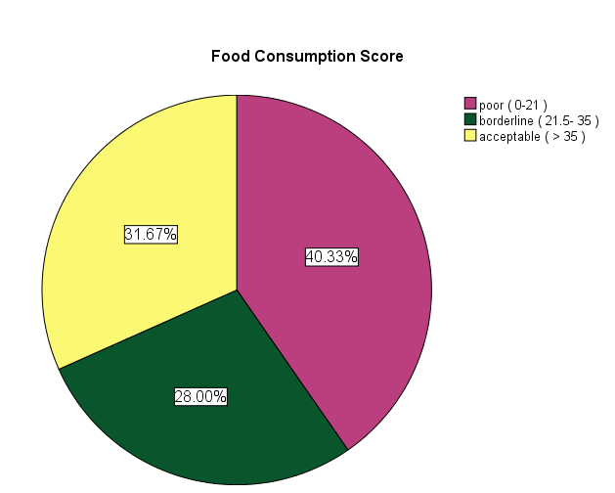
Food consumption score

Slide 40
Coping mechanism

Slide 41
Discussion
Food insecurity is a very big problem in drought affected areas all over the world especially in developing countries. In Afghanistan almost 2.5 million people, or 10 percent of the population, are at risk and many of them will need assistance for at least the next 12 months. We have seen that in Afghanistan that because of drought there is loss of crops and high food prices, because of that there is high food insecurity among population. Agriculture is one of that field where we felt immediate effect of drought. As the intensity and duration of drought increases, food production decreases and further in related fields food insecurity increases. Not only the food insecurity but increased prevalence of diseases, displaced population, violence and high food prices are some other effects of drought. Drought also affect national economy.

Slide 42
To reduce the condition of food insecurity in population there is the need of poor empowerment and proper distribution of the food. In most of the cases there is enough supply of the food but that does not reach to the needy population. So there should be a proper food supply management. As drought and Food insecurity are a major problems threw out the world, so government of the countries have to make proper plan and policies to reduce the effects of the drought and to fight with the after effects of the drought.

Slide 43
Conclusion
There are many problems faced by the community in last two years due to disasters.
Drought, cold temperature, high food prices and high fuel prices has affected most of the population
Not enough access to all general facilities
Lack of governmental and non-governmental programmes to fight with after effects of disasters
programmes related to agriculture, irrigation, transportation are very minimal.
Drinking water used by the people is contaminated at many places.
There is huge lack of awareness among community about the health.
Prevalence of diarrhea, sore throat/ cough/ running nose, fever, pneumonia etc is high.

Slide 44
Recommendations
Government of Afghanistan should focus on pre disaster plan and policies to reduce the effect of drought on population. Government should apply an effective and efficient disaster management plan.
Need to focus more on transport, health problems, and other general facilities like roads, irrigation etc by the government and other NGOs.
Government of the Afghanistan should work on the poor empowerment and to uplift the economy level of the population. For that government has to work on the availability of employment of the population.

Slide 45
Government should provide employment to the affected population in emergency situation.
Government and other NGOs should organize health awareness camps in the community.
Government has to provide facility of individual sanitary latrine to the households.
Government should focus more on proper supply of drinking water and food to the community in disaster affected areas. For that government should establish emergency disaster management teams.

Slide 46
References
M Hall, Civil Military Fusion Centre. January 2012
M K Awasthi, S Singh; System Analysis of Food Security Situation in India.
Journal of Food SecurityVolume 1 , No. 1 ISSN 0975—2994 ,January– June, 2010.
Poverty and food security in Afghanistan, the world bank, economic policy and poverty sector, south asia region, february 2012
P V. Rigterink; A Plan for Improving Food Security in Afghanistan, 9208 Orchard Brook Dr. Potomac, MD 20854.
Rapid Needs Assessment for Water, Sanitation and Hygiene, WHO, December 2004
Surveillance and rapid needs assessment, Centers for Disease Control and Prevention.
The Coping Strategies Index, Field Methods Manual, Second Edition,USAID, January 2008.
The State of Food Insecurity in the World, Food and Agriculture Organization of the United Nations, Rome, Italy, 2005
T Reardon, P Matlon, C Delgado, Coping with Household-level Food Insecurity in Drought-affected Areas of Burkina Faso. World Development, Vol. 16, No. 9, pp. 1061-1074, 1988.
United Nations Assistance Mission Afghanistan
United Nations Environment Programme in Afghanistan, January 2009
Y Gebremedhin, Preliminary Assessment of Informal Settlements in Kabul City, USAID, March 2005
World Bank. Afghanistan Nutrition.

Slide 47
THANK YOU
Have a
nice day

