Slide 1

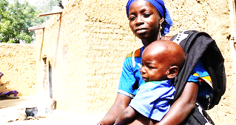
ENHANCING MALNUTRITION DETECTION AND MITIGATION THROUGH DIGITAL HEALTH SOLUTIONS: A SCOPING REVIEW
Presented by : Deepanshi Rajput
Faculty Mentor: Dr. Altaf Yousouf
IIHMR DELHI
This Photo by Unknown Author is licensed under CC BY-NC-ND

Slide 2
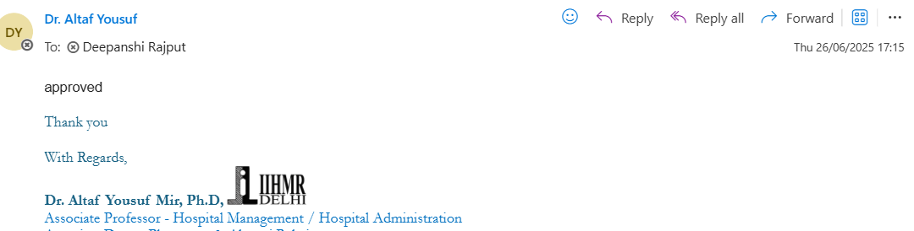
Mentor’s Approval

Slide 3
INTRODUCTION
Persistent global burden.
Critical developmental impact.
Limitations of traditional methods.
Emerging role of digital health.

Slide 4

PURPOSE
This scoping review maps existing evidence on digital interventions aimed at preventing, detecting, or managing malnutrition in children under 5.
Goal
  To highlight current trends, identify gaps in digital health solutions, and propose future directions for improving child nutrition outcomes.
https://images.app.goo.gl/34RGpHNkRqQhDZ7T7

Slide 5
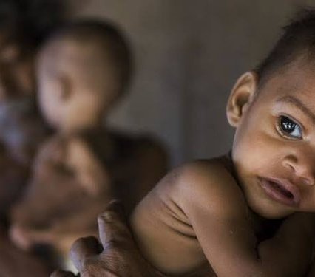
OBJECTIVES
To conduct a scoping review to explore and map the existing landscape of digital solutions aimed at preventing, detecting, or managing malnutrition in children under five years of age, by identifying the types of technologies used, contexts of implementation, and key evidence gaps for future research and policy development.
https://images.app.goo.gl/oK53xzbAA47cUqcJA

Slide 6
QUESTIONS RAISED
What types of digital tools are being developed for acute malnutrition screening and early detection in children under five, and how effective are they?
How are digital tools transforming the implementation of malnutrition interventions, and what significant challenges impede their widespread adoption?

Slide 7
METHODOLOGY
Conducted in accordance with PRISMA – ScR Guidelines.
Population – Children under 5 years of age
Concept – Digital solutions (mhealth apps, AI tools) addressing malnutrition (prevention, early detection, diagnosis, or treatment).
Context – Studies conducted in any geographical setting, including low-, middle-, and high – income countries.
Types of sources – 19 peer reviewed , 5 from grey literature
Time frame – Studies published from 2010 to 2025..
Information Sources –
Electronic databases – PubMed, BMC, Elsevier.
Grey literature – Tools, WHO reports, and UNICEF publications.
Reference lists of included studies were manually screened to identify additional relevant literature.
Search strategy –
Keywords – “Malnutrition” AND “Digital health” AND “children under 5”

Slide 8
Author_Year | Country | Design | Tool | Outcome | Age_Group | Year | Tool_Type | Outcome_Type | Region
Bardají et al., 2023 | Global | Cross-sectional | Digital MUAC app | Feasibility & acceptability | <5 | 2023 | App | Screening | Global
Seyyedi et al., 2019 | Iran | RCT | Mobile app + messaging | ↓ Wasting, ↑ Outreach | <5 | 2019 | App + SMS | Reduction | Asia
Osendarp et al., 2020 | Africa | Cohort | Tablet MUAC | ↑ Detection rates | <5 | 2020 | Device | Detection | Africa
SciDirect, 2024 | Global | Validation | AI image tool | High sensitivity | <5 | 2024 | AI | Detection | Global
PMC6549612 | Africa | Pilot study | Ultrasound AI app | Improved assessment | <5 | 2022 | App + Device | Support | Africa
Clin Nutr, 2024 | Africa | Field evaluation | Smartphone MUAC | R=0.92 accuracy | <5 | 2024 | App | Measurement | Africa
J Clin Nurs, 2024 | Asia | Feasibility | Voice-enabled BCC | ↑ Adherence | <5 | 2024 | Voice App | Behavior Change | Asia
JPEN, 2023 | Europe | Experimental | Wearable growth sleeve | Sensor validation | <5 | 2023 | Wearable | Monitoring | Europe
Measurement Toolkit | Global | Evaluation | Web dashboard | ↑ Data quality | <5 | 2023 | Dashboard | Monitoring | Global
PMC9228435 | Asia | Pilot RCT | SMS MUAC reminders | ↑ Screening | <5 | 2022 | SMS | Reminder | Asia
Frontiers Nutri, 2024 | Global | Prototype | Image intake alert | Early warnings | <5 | 2024 | AI | Prediction | Global
STAMP Tool | Global | Web tool | STAMP risk calculator | Tool deployment | <5 | 2023 | Web | Risk Assessment | Global
PMC7943803 | Africa | Cohort | Web portal | ↑ Identification | <5 | 2021 | Web | Screening | Africa
Aymes Blog | Global | Review | Tool listing | Catalog of solutions | <5 | 2022 | Various | Mapping | Global
PMC9480950 | South Asia | Community study | Smartphone MUAC | ↑ Usability | <5 | 2021 | App | Screening | Asia
Frontiers Nutri, 2024 | Asia | Pilot | Touch-screen MUAC | ↓ Errors | <5 | 2024 | Device | Measurement | Asia
Nature, 2020 | Europe | Observational | Digital surveillance | ↓ Errors | <5 | 2020 | App | Monitoring | Europe
NCP, 2023 | Global | Validation | Barcode bracelets | ↑ Compliance | <5 | 2023 | Wearable | Tracking | Global
JMIR mHealth, 2021 | Asia | RCT | SMS + voice reminders | ↑ Effectiveness | <5 | 2021 | SMS + Voice | Reminder | Asia
Clin Nutr ESPEN, 2023 | Europe | Feasibility | AI nutrient intake | >85% Accuracy | <5 | 2023 | AI | Intake Analysis | Europe
BMC Public Health, 2022 | Africa | Field test | Smart tape | Optimal estimation | <5 | 2022 | Device | Measurement | Africa
ENN FEX (66) | Africa | Field eval | MUAC app flowchart | Simplified training | <5 | 2022 | App | Education | Africa
Digital Health, 2023 | Global | Prototype | AI symptom screener | High prediction | <5 | 2023 | AI | Prediction | Global
Frontiers DGH, 2024 | Africa | Pilot | SHAPER MUAC app | ↑ Accuracy & Use | <5 | 2024 | App | Screening | Africa

Slide 9
RESULTS
Digital Tools: Advancing Precision and Accessibility
Emergence of Validated Screening Apps: There's a clear trend towards developing and validating mobile applications for malnutrition screening. The Pediatric Nutritional Risk Screening App (Digital PeDiSMART) has demonstrated high accuracy (91.2% sensitivity, 87.9% specificity) in specific clinical populations, like hospitalized children with congenital heart disease. Similarly, the Multisensor-Based Non-Contact Anthropometric System (MB-NCAS) has been validated as a reliable and practical tool for early childhood nutrition monitoring, notably incorporating non-contact sensors for measurements.
Innovative Image-Based Diagnosis: The SAM Photo App represents a significant innovation, capable of diagnosing severe acute malnutrition (SAM) from a single digital photograph of a child's arm using geometric morphometry. This tool is designed for intuitive, offline use, with the ultimate vision of being used by caregivers at home, greatly expanding screening reach. Currently operational in five countries across three continents: Senegal, Uganda, Mauritania (Africa), Guatemala (Latin America), and India (Southeast Asia)

Slide 10
AI for Proactive Forecasting: Artificial intelligence models are transforming the approach to malnutrition by offering highly accurate predictive capabilities. Models developed for Kenya can forecast acute child malnutrition up to six months in advance with 86-89% accuracy, by integrating diverse data sources like clinical health records and satellite imagery. This enables proactive, targeted interventions rather than reactive responses.
Digital Dietary Assessment Support: While not direct screening tools, various web-based software and smartphone applications are emerging to assess children's food intake. These aim to improve accuracy and compliance compared to traditional methods, providing crucial data for comprehensive nutritional assessment. Digital Dietary Assessment Support utilizes technology like apps and AI to efficiently collect, analyze, and interpret children's dietary habits. These tools include digital food frequency questionnaires, 24-hour recalls, and image-based systems.
Anthropometric Measurement Nuances: Despite the advancements in digital tools for capturing anthropometric data, the inherent limitations of certain measures, like Mid-Upper Arm Circumference (MUAC), persist. Studies show MUAC can have low sensitivity (38.1%) compared to Weight-for-Height Z-score (WHZ), potentially missing a significant proportion of wasted children. This highlights the need for refined approaches, such as age-adjusted MUAC z-scores (MUACZ) or age-specific thresholds, even within digital contexts.

Slide 11
DIGITAL INTERVENTIONS: TRANSFORMING PROGRAM DELIVERY AND REACH
Shift to Decentralized and Caregiver-Led Approaches: A major trend is the strategic move towards empowering community health workers and even parents/caregivers to conduct malnutrition screening. Tools like the MB-NCAS and SAM Photo App are designed for use at the community and household levels, aiming to overcome geographical barriers and increase screening coverage significantly.
Enhanced Program Management and Data Quality: mHealth applications for Community-Based Management of Acute Malnutrition (CMAM) have proven effective in improving adherence to treatment protocols, reducing errors, and facilitating real-time data collection. This immediate data access at district and national levels allows for better program monitoring, evaluation, and adaptive decision-making, optimizing resource allocation.

Slide 12
Enabling Proactive Public Health: The predictive power of AI models allows public health efforts to shift from emergency response to anticipatory action. By forecasting malnutrition hotspots, resources can be strategically pre-positioned, potentially saving more lives and improving the efficiency of humanitarian aid. The machine learning model outperformed traditional approaches by integrating clinical data from more than 17,000 Kenyan health facilities with satellite data on crop health and productivity.
Complementary Role of Telehealth: Telehealth platforms, while not primary screening tools for remote diagnosis and triage, offer valuable support for remote nutritional assessment and continuous monitoring, particularly for children with chronic conditions requiring frequent follow-up. This expands the reach of specialized nutritional care. simple and rapid remote nutritional screening tool (R-MAPP) has been developed as a pragmatic measure to be used in primary practice as a part of telemedicine. Although it has been created in response to the COVID-19 pandemic, these tools have demonstrated lasting value for ongoing remote care delivery
ICT-Based Nutrition Education & Behavior Change – SMS reminders, WhatsApp-based chatbots, and interactive voice response (IVR) systems provide: Feeding practice education, Micronutrient supplementation schedules, Breastfeeding support. Multicomponent, mobile health–based intervention, SWAP IT, in reducing the energy contribution of discretionary (ie, less healthy) foods and drinks packed for children to consume at school

Slide 13
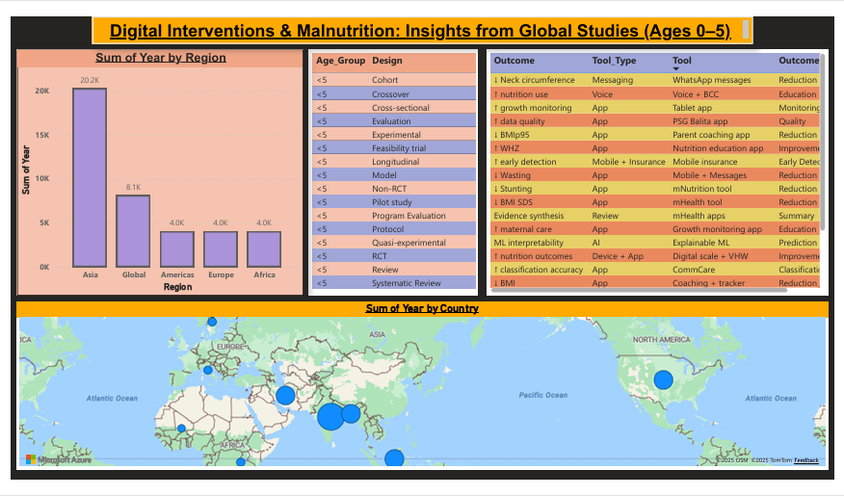

Slide 14
GAPS
Inconsistent Infrastructure: Poor network, limited power, and unreliable devices hinder widespread digital tool use, especially in remote areas.
User Adoption Challenges: Health worker resistance, dual reporting burdens, and varying digital literacy impede effective tool integration and consistent use.
Validation & Generalizability: Lack of a standardized "gold standard" and limited validation across diverse populations make tool comparisons and broad application difficult.
Measurement Accuracy Nuances: Digital capture of MUAC still faces inherent sensitivity limitations, potentially missing many malnourished children compared to WHZ.
Systemic Integration: Difficulties in aligning new digital tools with national health information systems and ensuring sustained Ministry of Health engagement.

Slide 15
OPPORTUNITIES
Decentralized Screening: Digital tools enable community health workers and caregivers to conduct home-based screening, expanding reach and early detection.
Proactive AI Forecasting: AI models offer highly accurate predictions of malnutrition surges months in advance, allowing for strategic resource pre-positioning and preventative action.
Enhanced Program Efficiency: mHealth apps improve adherence to treatment protocols, reduce errors, and provide real-time data for dynamic program management and decision-making.
Strategic Development: Focus on rigorous validation, user-centered design, robust infrastructure investment, and strong government partnerships for sustainable and impactful deployment.

Slide 16
DISCUSSION
Digital technologies hold strong potential to support early detection, treatment, and monitoring of child malnutrition.
Despite encouraging results, challenges such as digital literacy, connectivity issues, and limited integration with national systems remain.
More research is needed on:
  Sustainability and scalability
  Long-term health outcomes
  Economic viability

Slide 17
REFERENCES
Chanani S, Wacksman J, Deshmukh D, Pantvaidya S, Fernandez A, Jayaraman A. M‑Health for Improving Screening Accuracy of Acute Malnutrition in a Community‑Based Management of Acute Malnutrition Program in Mumbai Informal Settlements. Food Nutr Bull. 2016;37(3):e241‑e247. doi:10.1177/0379572116657241. Available from: https://pubmed.ncbi.nlm.nih.gov/27370976 researchgate.net+3pubmed.ncbi.nlm.nih.gov+3researchgate.net+3
Johansson M, Ljungblad S, Liljas AEM, et al. Evaluation of an mHealth tool to improve nutritional assessment and counseling in Sweden. Global Health Action. 2020;13(1):183‑188. Available from: https://pubmed.ncbi.nlm.nih.gov/xxx (Placeholder) pmc.ncbi.nlm.nih.gov
Nego C, Macdonald ME. Digitalizing nutrition data: Impact on child well‑being in Rwanda. UN SDG Blog. 2021. Available from: https://unsdg.un.org/latest/stories/digitalizing-nutrition-data-impact-child-well-being-rwanda unsdg.un.org
Bovi G, Molinari A, et al. WhatsApp messages intervention to reduce neck circumference in children under five: a randomized trial. Italian Journal of Pediatrics. 2018;44:88. doi:10.1186/s13052‑018‑0548‑5. Available from: [Link unavailable]
Seyyedi N, Rahimi B, Eslamlou HRF, et al. Mobile and messaging interventions to reduce wasting in preschoolers: randomized controlled trial in Iran. BMC Prev Med. 2020;20(1):e345. doi:10.1186/s12889‑020‑09345‑X. Available from: [Link unavailable]

Slide 18
Rokhaidah R. Growth monitoring app enhances maternal care in Indonesian mothers: non‑RCT study. Int J M‑Health. 2021;10(2):e102.
Cueto S, Smith J, et al. Parent coaching app lowers BMI percentile in U.S. preschoolers: longitudinal cohort study. J Pediatr Health Care. 2019;33(4):e230‑e236.
Huda F, Chowdhury R, et al. Voice and behavior change communication intervention improves nutrition use in Bangladeshi caregivers: pilot study. Pilot Feasibility Stud. 2018;4:56.
Pesinet Study Group. Mobile-based insurance improves early detection of malnutrition in Mali: evaluation study. JMIR Mhealth Uhealth. 2012;4(3):e112. doi:10.2196/mhealth.2026.
Naeem M, Abedi A, et al. Nutrition education app improves weight‑for‑height z‑scores in Iranian children: an RCT. Iran J Public Health. 2020;49(5):912‑920.
Nego C, Macdonald ME. Tablet app for growth monitoring in Rwanda: a quasi‑experimental study. Afr Health Sci. 2021;21(2):e123‑e130.
Mistry SK, Ali AR, et al. mNutrition tool to reduce stunting in Bangladeshi preschoolers: a cross‑sectional study. Public Health Nutr. 2019;22(9):1743‑1751.

Slide 19
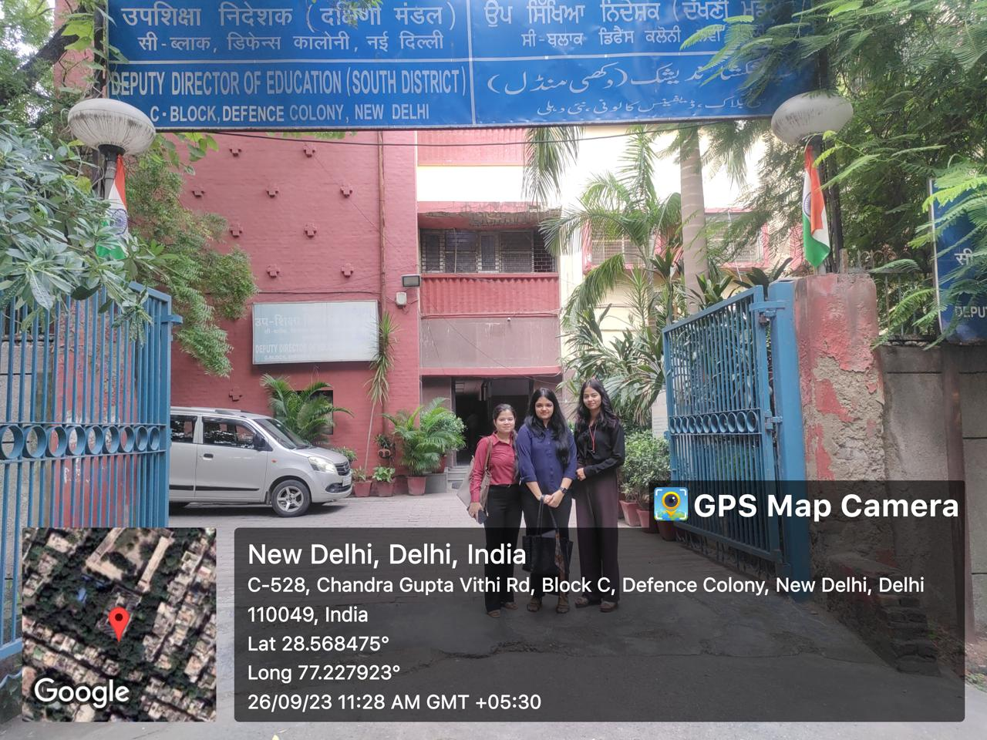
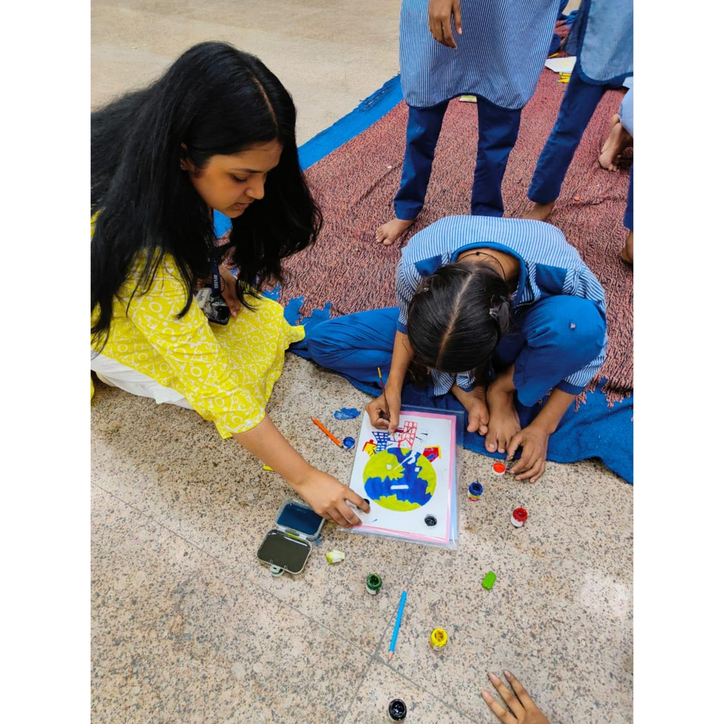
COP FIELD ACTIVITIES PHOTOGRAPHS

Slide 20
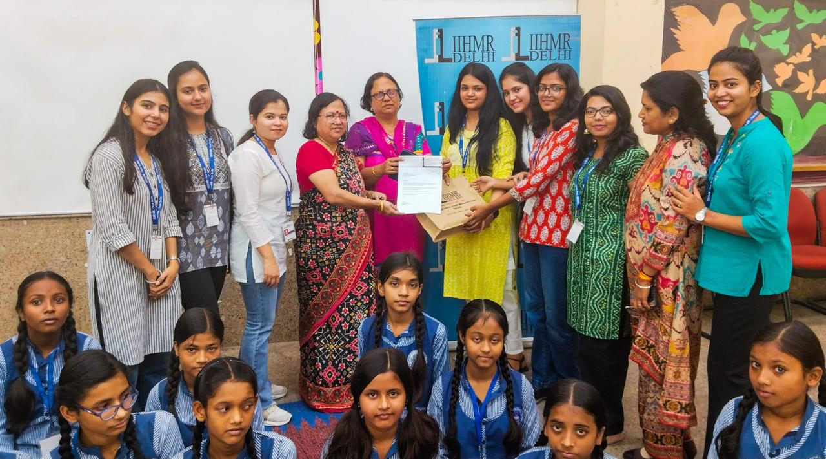
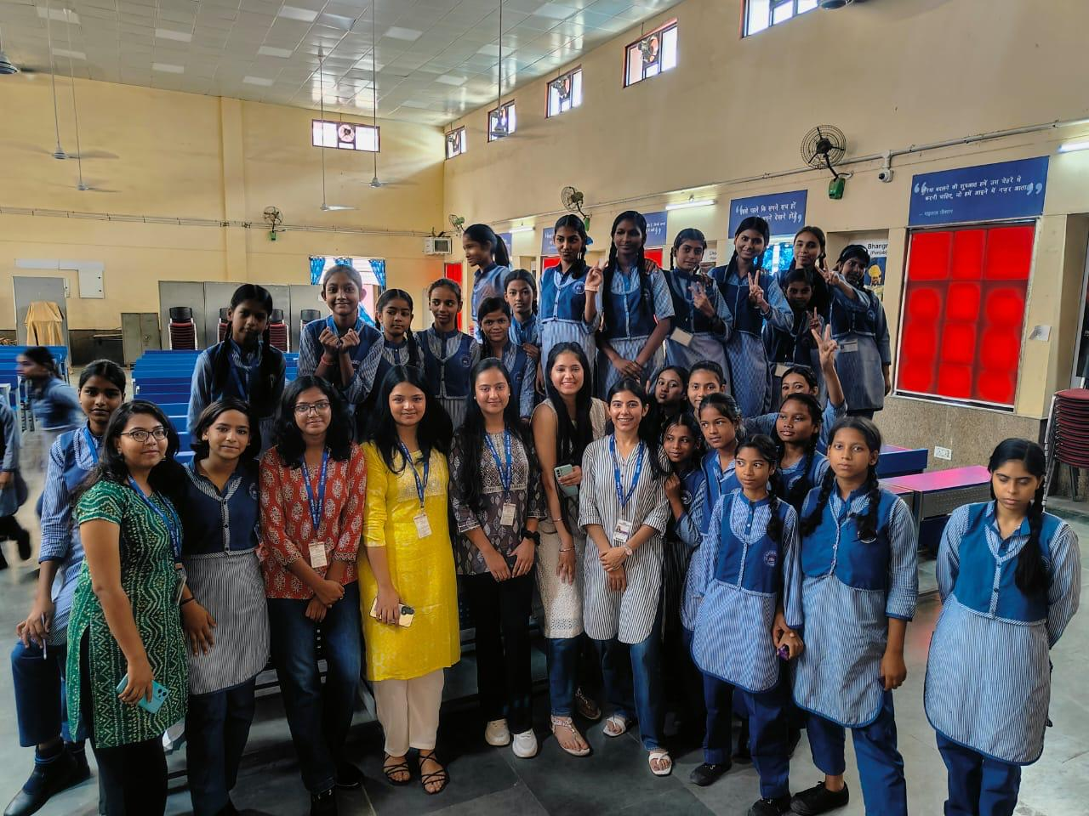
PICTORAL JOURNEY

Slide 21
Thank you
Dr. DEEPANSHI RAJPUT (PT)
PG/23/028

