Slide 1

Assessing the use of the internet by health care professionals (HCP’s) and its effects on their own clinical practice.
Organisation: SPAG
Dr. Tanvi Tiwari
Dr. Pankaj Talreja
IIHMR Delhi

Slide 2
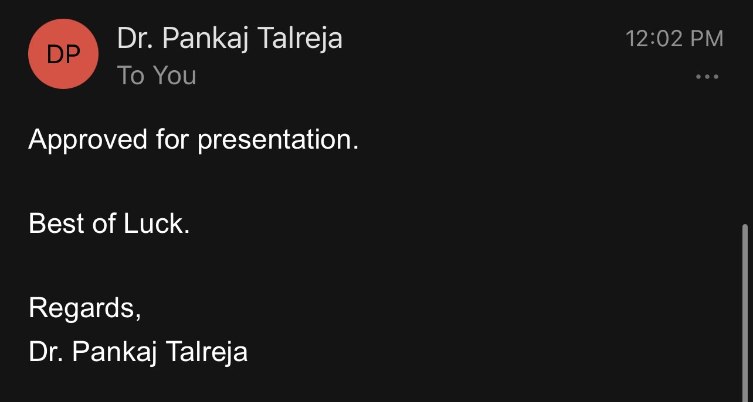
Screenshot of Approval

Slide 3
Introduction
The Internet is the most extensive network of information and communication services in the world. The internet's availability has allowed for instant access to the most up-to-date and reliable clinical research outcomes in everyday medical practise.
Patients are more informed about their medical conditions as a result of the worldwide exponential growth of the internet, which has led to an increase in demand for improved clinical services based on the information available on the internet.
As a result, doctors are being put under more pressure to stay current on medical breakthroughs. Many platforms are available such as WHO, Medindia, health blogs, microblogs, Wikipedia, National health portal and many more are providing health information for all to access.

Slide 4
Introduction
About Various Internet Platforms
National Health Portal (NHP)
The National Health Portal intends to provide citizens, students, healthcare professionals, and researchers with a single point of access to authorised health information. Users can obtain thorough information on health-related topics.
Medindia
Medindia is a leading online health information, application, and service provider for consumers, doctors, and healthcare professionals around the world.
World Health Organization (WHO)
The World Health Organization is the global organisation in charge of public health. Many facets of health policy and planning are influenced by it.

Slide 5
Objectives
To understand the views of the health care professionals regarding the health information provided on the Internet.
To identify the effects caused by the information on the internet in the clinical practice of health care professionals.

Slide 6

Methodology
Study Design- The study uses quantitative designs to gain insight of healthcare professional’s acceptance and views regarding health information available on the internet. The literature was searched through Google Scholar and PubMed to obtain relevant studies.
Study period - The study was conducted from April - June 2022.
Study area- The data was collected from healthcare professionals from Delhi- NCR area.
Sample Size- Sample for the study were the healthcare professionals. The inclusion criteria for the study were healthcare professionals who are currently in practice in Delhi- NCR area, who have access to internet and are using it, who were willing to participate in the study and had no language issue. The exclusion criteria included healthcare professionals who are no longer practicing in Delhi-NCR area, those who do not use internet and those who didn’t give consent to participate in the study. For the study, 74 healthcare professionals responded on the basis of their availability.

Slide 7
Methodology
Sampling Technique- Purposive sampling technique was carried out for the study in order to collect information from the healthcare professionals.
Research Instrument - In order to understand the views of healthcare professionals and their acceptance towards health information available on the internet a questionnaire was circulated which consisted of mostly close ended questions. Where the participants were sent the questionnaire as a Google Form through WhatsApp/Email. Research ethics principles with regard to inform consent, confidentiality of data and individual’s privacy were followed. The participants were informed about the study and their consent was confirmed before answering of the questionnaire.

Slide 8
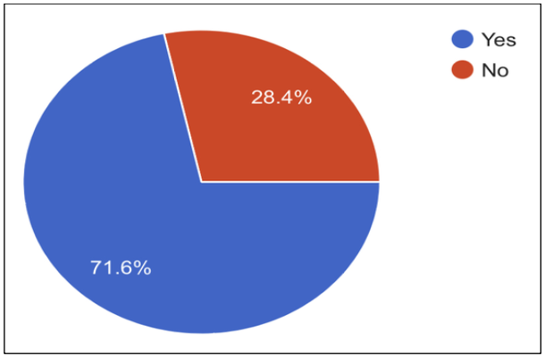
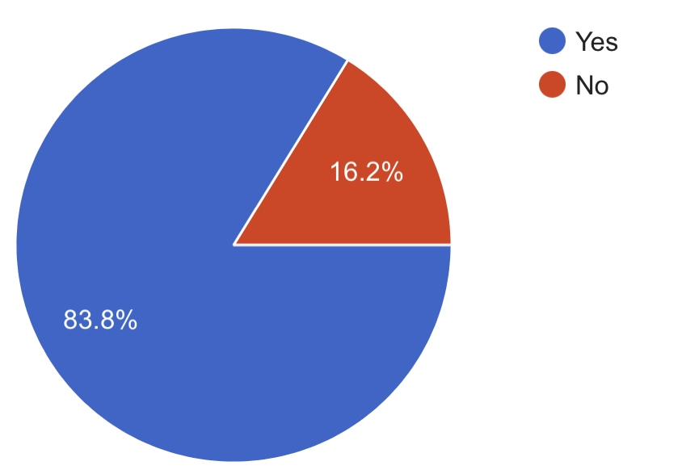
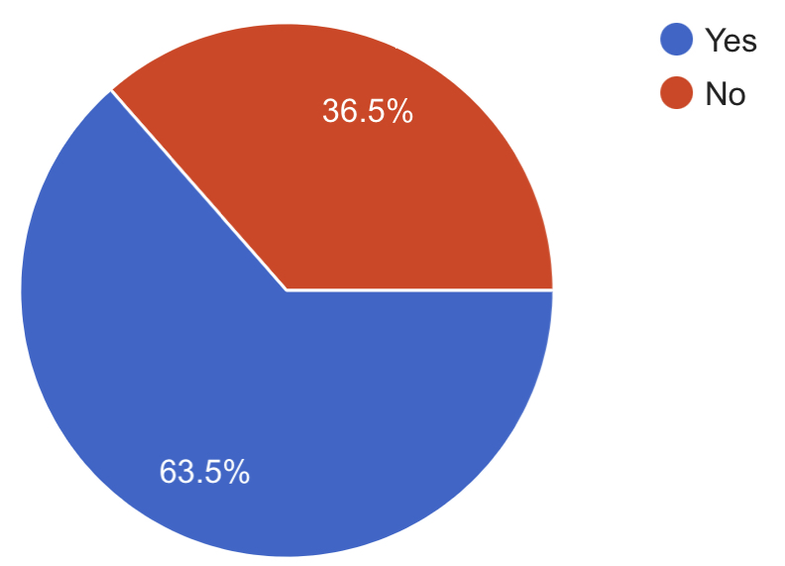
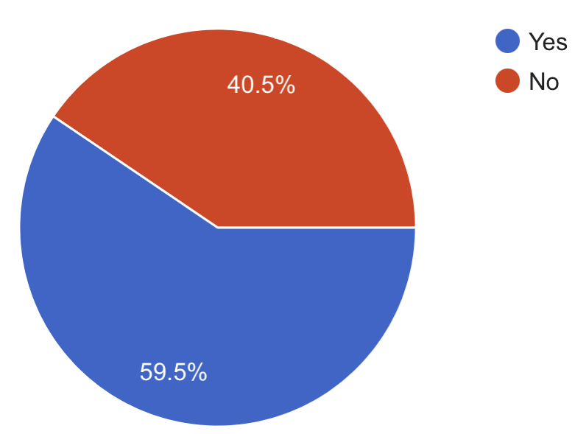
Results
Objective 1: To understand the views of the health care professionals regarding the health information provided on the Internet.
1. Use of internet regularly for medical/professional updating
71.6% of the healthcare professionals use the internet regularly for medical/ professional updating while 28.4% healthcare professionals do not use the internet regularly for medical/ professional updating.
2. Taking web-based certified CME courses through an online website
83.8% healthcare professionals are willing to take web-based certified CME courses through a website while 16.2% healthcare professionals are not willing to take certified web-based CME courses through a website.
3. Allow patients to access medical information through via an online web site
63.5% healthcare professionals will allow patients to access medical information through a web site while 36.5% healthcare professionals will not allow patients to access medical information through a web site.
4. Considered second opinions for patients through the internet on specific conditions as a valuable resource
59.5% of the healthcare professionals considered second opinions for patients through the internet on specific conditions as a valuable resource while 40.5% healthcare professionals would not consider second opinions for patients via the internet.

Slide 9
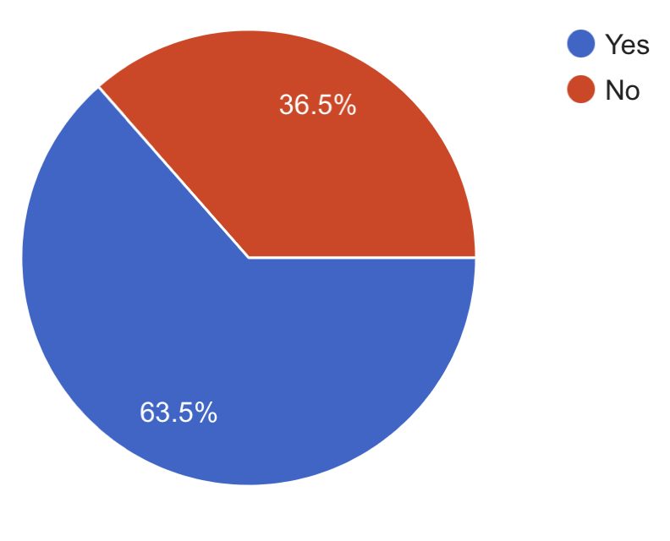
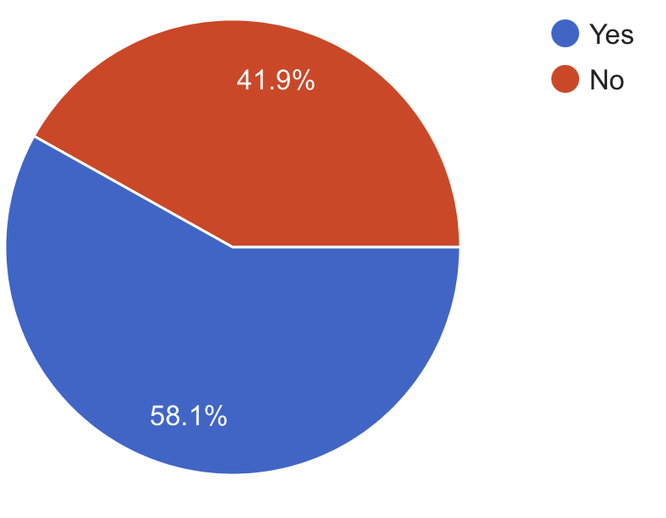
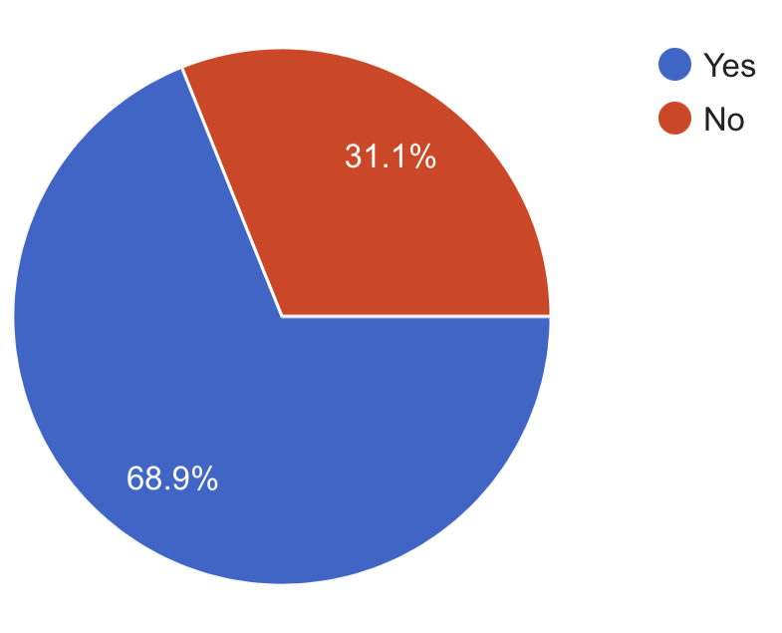
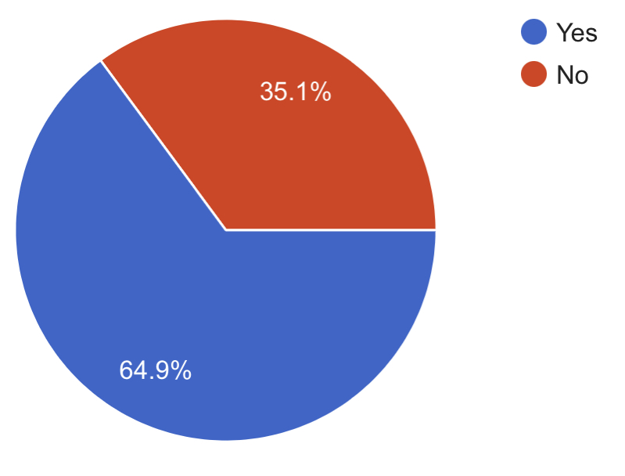
Results
Objective 2: To identify the effects caused by the information on the internet in the clinical practice of health care professionals.
5.Experienced patients bringing web-based information printed with them about their condition
63.5% healthcare professionals have experienced patients bringing web-based information printed with them about their condition while 36.5% healthcare professionals have not experienced patients bringing web-based printed information with them.
6. Whether healthcare decisions have any influence from the information from web sites
58.1% healthcare professionals agree that information from web sites influence healthcare decisions while 41.9% healthcare professionals feel information from web sites does not influence healthcare decisions.
7. Beneficial or not for the patients and practice to have a website and communication through it
68.9% healthcare professionals feel owning a website and communication through it would be beneficial to patients and practice while 31.1% healthcare professionals feel owning a website and communication through it would not be beneficial to patients and practice.
8. Asked by a patient to refer a web site for more information for their condition
64.9% healthcare professionals were asked by a patient for the name of a web site for more information on their condition while 35.1% healthcare professionals were not asked by a patient for the name of a web site for more information on their condition.

Slide 10
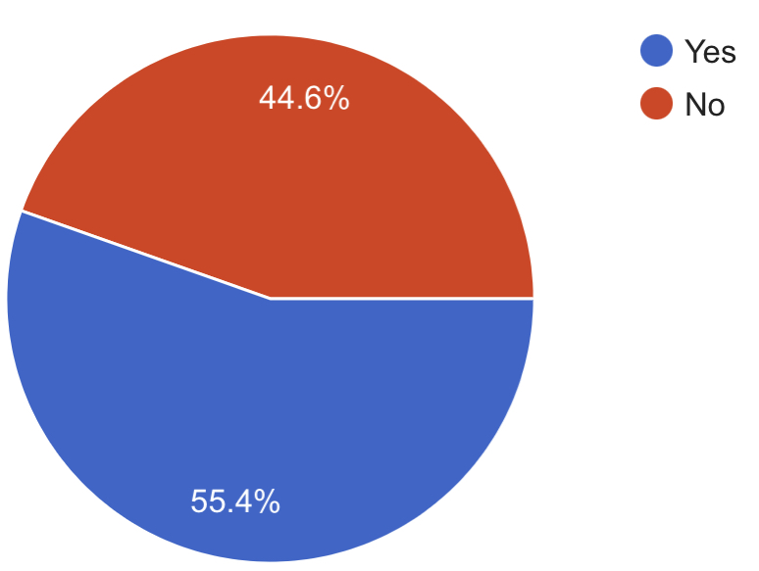
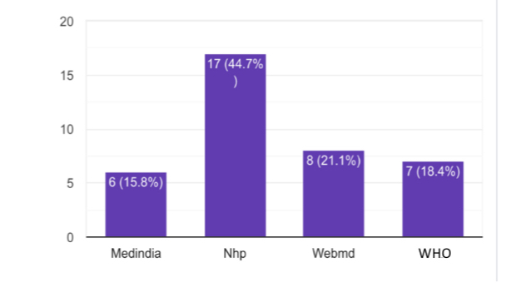
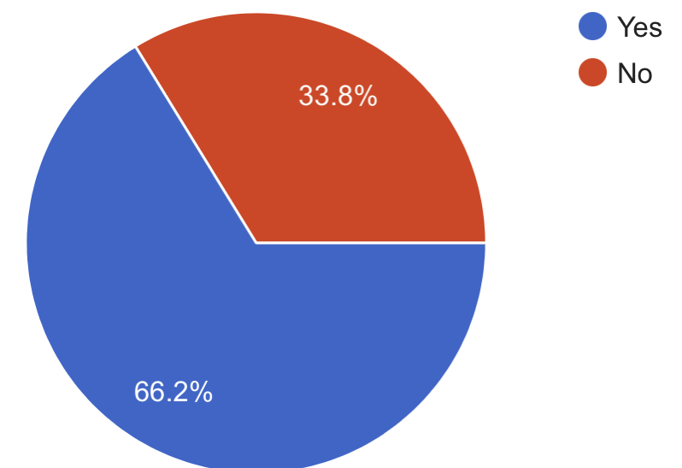
Results
Objective 2: To identify the effects caused by the information on the internet in the clinical practice of health care professionals.
9. Advised a web site to a patient
55.4% healthcare professionals have advised websites to their patients while 44.6% healthcare professionals have not advised any websites to their patients.
10.Website recommended
Website recommended by healthcare professionals to their patients are National Health Portal (NHP), Webmd, World Health Organistion website (WHO) and Medindia.
11. The quality of medical information on web sites
66.2% healthcare professionals trust the quality of medical information on web sites while 33.8% healthcare professionals do not trust the quality of medical information on web sites.

Slide 11

Discussion
Over the last decade, the widespread availability of medical information on the internet and its impact on health care has expanded tremendously. However, there is little information on how healthcare workers use the internet.
More healthcare professionals are starting to have trust in the general quality of information on medical websites available online and believe that information from websites tend to influences healthcare decisions.
Perhaps healthcare professionals are increasingly turning to the internet for medical knowledge, and this information is having a substantial impact on their practise. If health information on the internet is used with caution and after verifying its accuracy then it can help healthcare professionals provide better and faster solutions of health problems to their patients.

Slide 12

Limitations of the Study
The sample size for the study was small
The study was focused on the particular area of Delhi – NCR
The study period is only about two months
The survey may not be fully accurate as people may not like to give their honest opinion.
Limited literature was available

Slide 13

Conclusion
Internet has proved to be quite useful in all sectors of life. It has made a significant impact on the health sector as well.
This study shows that internet use and web based medical information is widely popular among healthcare professionals and patients
Internet helps in making the practice of evidence-based medicine, a reality by providing up-to-date information to healthcare professional
This study adds to the literature by describing the healthcare professional’s perspective on the evolving internet environment and experience with patients who have sought internet health information.

Slide 14
References
Koller M, Grütter R, Peltenburg M, Fischer JE, Steurer J. Use of the Internet by medical doctors in Switzerland. Swiss Medical Weekly. 2001 May 5;131(17-18):251–4.
Murray E, Lo B, Pollack L, Donelan K, Catania J, Lee K, et al. The Impact of Health Information on the Internet on Health Care and the Physician-Patient Relationship: National U.S. Survey among 1.050 U.S. Physicians. Journal of Medical Internet Research. 2003 Aug 29;5(3):e17.
Podichetty VK. Assessment of internet use and effects among healthcare professionals: a cross sectional survey. Postgraduate Medical Journal. 2006 Apr 1;82(966):274–9.
Ajuwon GA, Popoola SO. Influence of Internet Accessibility and Demographic factors on utilization of Web-based Health Information Resources by Resident Doctors in Nigeria. African Journal of Medicine and Medical Sciences. 2014,43( Suppl 1):61–71.
Bhatia S, Patnaik L, Pattanaik S, Sahu T. Internet use for patient care and health research: A cross-sectional study among physicians in a teaching hospital of Eastern India. Journal of Family Medicine and Primary Care. 2018 Sep 1;7(5):993–7.
Jadoon NA, Zahid MF, Mansoorulhaq H, Ullah S, Jadoon BA, Raza A, et al. Evaluation of internet access and utilization by medical students in Lahore, Pakistan. BMC Medical Informatics and Decision Making. 2011 May 30;11(1).
Zhou H, Zhang J, Su J. Internet access, usage and trust among medical professionals in China: A web-based survey. International Journal of Nursing Sciences. 2020 Sep;7:S38–45.

Slide 15

Thank You
Dr. Tanvi Tiwari

Slide 16
Dissertation Experiences
The starting was a bit tough as public relations was not a familiar field but with time and support of my team got to learn and get in flow with the public relations in healthcare.
It is still a long road ahead as have a lot of things to learn with respect to public relations in healthcare

Slide 17

Pictorial Journey at SPAG

Slide 18

Pictorial Journey at SPAG

