Slide 1


PATIENT SATISFACTION AT ECHS POLYCLINIC, BASE HOSPITAL, DELHI CANTT
Col Jitender Mann
Roll No- PG/043/21-23
Mentor
Dr Vinay Tripathi

Slide 2
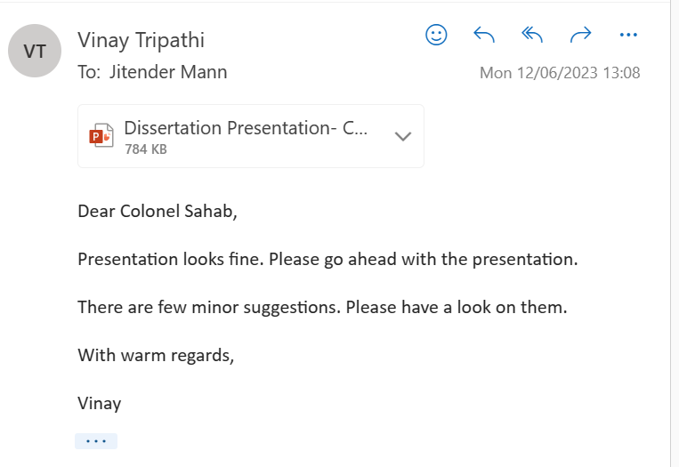
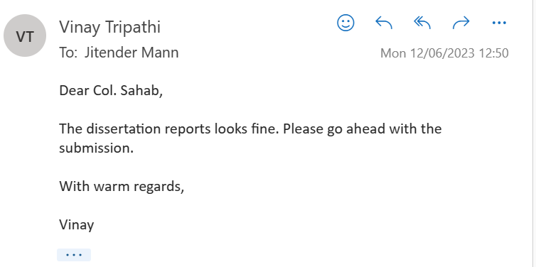
APPROVAL

Slide 3
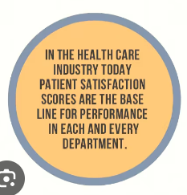
INTRODUCTION
Assessing Patient Satisfaction .
  To improve the services provided by the health care industry.
  To identify the areas which have gaps & need of specific improvements
  Leading to better health outcomes for the patients, professional developments for the health care providers & an overall improvement in health status.
This study attempted to evaluate the working of the ECHS Polyclinic at Base Hospital, Delhi Cantt.
The study was carried out at the facility through online structured questionnaire & personal interaction with the beneficiaries of the scheme.

Slide 4
FACILITIES AVAILABLE AT THE POLYCLINIC
Consultation Rooms. Cubicles for privacy. Trained personnel for operating ECG, BP etc. Treatment Room.
Pharmacy. Adequately stocked, HVAC provision, color coding of medicines, LAN for paperless working & seating arrangements.
Dental Services. Fully equipped to cater for dental care & treatment. On an average 120 - 150 patients is attended by the dental officers & the dental hygienist on daily basis.
Diagnostic/ Laboratory Services. X-Ray, ECG & other lab tests facilities of the Base Hospital are utilized.
Ambulance Service. Not available
Referral Issue Counter. Counter for issuing referral for empaneled health facility.
Smart Card Issue/Renewal. Counter for processing Smart card application.
Additional Amenities. Waiting rooms for veterans with entertainment facilities, hot/cold water dispenser & water coolers, electronic digital counter display system & display boards at prominent places with relevant information & contact numbers.

Slide 5
LIT REVIEW
S. No. | Study | By | Published | Location | Methodology
(a) | Inclusive management of ESM in India: Satisfaction of AF veterans from resettlement facilities with special reference to TN. | Kari Mahajan R Krishnaveni | IIMB Management Review, 2017 | Tamil Nadu | Descriptive, conclusive, cross-sectional data with longitudinal study covering veterans superannuating in past 30 yrs.
(b) | Study on Patient Satisfaction in the Govt. Allopathic Health Facilities of Lucknow Distt. | Ranjeeta Kumari MZ Idris Vidya Bhushan Anish Khanna Monika Agarwal SK Singh | India Journal of Community Medicine 2009 | Lucknow, UP | Cross-sectional study Period of study: May to August 2006 Study population: Patients attending the OPD of Govt. Health facilities of Lucknow.
(c) | Client satisfaction in ECHS Polyclinic: An Experience from India | Naveen Phuyal Ashok Jindal Sandip Mukerji | MJSBH Vol. 14 Issue 2 July-Dec 2015 | ECHS polyclinic | Observational & Analytical Cross sectional Duration: 2 years Sample size: 400 Stratified sample Structured Questionnaire
(d) | Healthcare Delivery & Stakeholder’s satisfaction under social health insurance schemes in India: An evaluation of CGHS & ECHS | Sukumar Vellakkal Shikha Juyal Ali Medhi | India Council for Research on International Economic Relation Dec 2010 | 12 Indian Cities | Primary Survey of 1204 CGHS 7 640 ECHS primary beneficiaries in 100 empanelled health care providers & 100 scheme officials.

Slide 6
AIM & OBJECTIVES
Aim. To assess satisfaction level of the patients visiting the ECHS Polyclinic.
Objectives of the Study.
  To examine the satisfaction with respect to the services received & availed at the polyclinic.
  To suggest measures for improvement of satisfaction level.

Slide 7
METHODOLOGY
Research Design. Cross-sectional.
Study Setting. ECHS, Base Hospital, Delhi Cantt.
Study Population. ESM & their dependents visiting the ECHS Polyclinic, Base Hospital, Delhi Cantt.
Study Tools. Online Questionnaire & physical informal interviews at ECHS Polyclinic
Sample Size. 150
Sampling Method. Convenient Sampling.
Selection Criteria.
(a) Inclusion Criterion. All patients dependent on the ECHS Polyclinic.
(b) Exclusion Criterion. All respondents who are unwilling were excluded from the study.

Slide 8
RESULTS

Slide 9
GENERAL
Count of Gender. Out of the total sample size of the study, 84% (126) were male & 16% (24) were female patients/dependants.
Gender | Count of Gender
Female | 24
Male | 126
Grand Total | 150
Count of Number of Dependants. 52% of the respondents have less than 2 dependants, 47% have 3 to 5 dependants & balance have more than 5 dependants.
Row Labels | Number of Dependants
3 to 5 | 70
Less than 2 | 78
More than 5 | 2
Grand Total | 150

Slide 10
GENERAL
Purpose of Visit to the ECHS. 49% of the respondents visited the ECHS facility for referral, 42% for consultation & 9% for medicine collection.
Row Labels | Purpose of Visit
Consultation | 63
Medicine Collection | 13
Referral | 74
Grand Total | 150
Data on Current Employment. More than half the current beneficiaries are currently not employed anywhere at present. Moreover, all 39% who are currently employed, are not covered by any other health scheme.
Row Labels | Are you currently employed with in any organization as on date?
No | 82
Prefer not to say | 10
Yes | 58
Grand Total | 150

Slide 11
STAFF
Professionalism of the Staff. 63% of respondents were very happy with the professional competence of the staff rated the, 33% were fairly happy & balance were unhappy.
Row Labels | How would you rate the professionalism of the staff?
Excellent | 8
Fair | 49
Good | 87
No Comments | 1
Poor | 5
Grand Total | 150
Courteousness of the Staff. 66% of respondents were very happy with the behaviour of the staff, 31% were satisfied & only 3% were unhappy.
Row Labels | Count of How courteous was the staff?
Excellent | 16
Fair | 47
Good | 83
Poor | 4
Grand Total | 150

Slide 12
CONSULTATION PROCESS
Waiting Time. 107 respondents out of 150 (71%) were attended to by the staff in a reasonable timeframe. A total of 43 respondents were not happy with the long waiting time.
Row Labels | Count of Waiting time?
Prompt | 2
Reasonable | 105
Long | 38
Very Long | 5
Grand Total | 150
Time Spent with the Consultant. 94% respondents were given adequate time by the consultant. Balance 6 % were not satisfied with the time utilized during consultation by the attending physician.
Row Labels | Did the doctor give you adequate time during consultation?
Adequate | 53
Inadequate | 7
No comments | 1
Reasonable | 89
Grand Total | 150

Slide 13
CONSULTATION PROCESS
Professionalism of the Consultant. 61% were highly satisfied with the consultant, 37% were satisfied & balance 2 % were not satisfied with the attending physician.
Row Labels | Was the doctor clear & compassionate during consultation?
Excellent | 21
Fair | 56
Good | 71
No Comments | 1
Poor | 1
Grand Total | 150
Privacy during Consultation. 93% respondents said that privacy was maintained during consultation & the balance said that no privacy was maintained or did not comment.
Row Labels | Was privacy maintained during consultation?
No | 6
No Comments | 4
Yes | 140
Grand Total | 150

Slide 14
CONSULTATION PROCESS
Overall Experience with the Consulting Physician. 58% respondents said that they were highly satisfied with the consulting physician, 41% were fairly satisfied & the balance respondents were unsatisfied.
Row Labels | Count of Overall experience with the consulting physician?
Excellent | 19
Fair | 62
Good | 67
No comments | 1
Poor | 1
Grand Total | 150

Slide 15
ALLIED SERVICES
Cleanliness & Hygiene in the Waiting Area. 82% of the respondents in the sample population were very happy with the cleanliness & hygiene maintained in the facility, 15% were fairly happy & 35% were unhappy about the aspect.
Row Labels | Count of How was the cleanliness & hygiene at the waiting area?
Excellent | 21
Fair | 23
Good | 102
Poor | 4
Grand Total | 150
Availability of Emergency Services. 21% of the respondents in the sample population were happy with emergency services in the facility, 37% were fairly happy & 42% were unhappy about the aspect. This aspect needs to be improved.
Row Labels | Are Emergency Services available at ECHS?
Excellent | 12
Fair | 55
Good | 20
No comments | 1
Poor | 62
Grand Total | 150

Slide 16
ALLIED SERVICES
Availability of Diagnostic Services at the Base Hospital, Delhi Cantt. 83% of the respondents in the sample population were satisfied with the diagnostic services at the Base Hospital, 8% were fairly satisfied & 9% were unsatisfied about the aspect.
Row Labels | How are the Diagnostic services at Base Hospital?
Excellent | 60
Fair | 12
Good | 64
No comments | 1
Poor | 13
Grand Total | 150
Availability of Health-Related Information. 64% of the respondents felt that adequate Health Related Information was available whereas, only 8% felt that more information should be made available.
Row Labels | Availability of Health-Related Information in ECHS?
Excellent | 13
Fair | 46
Good | 82
No Comments | 2
Poor | 7
Grand Total | 150

Slide 17
PHARMACY
Availability of Adequate Medicines in the Pharmacy. 66% people in the study were satisfied, 27% were fairly satisfied & 7% were unsatisfied or did not comment on the medicines available in the pharmacy.
Row Labels | Are adequate medicines available in the pharmacy?
Excellent | 21
Fair | 40
Good | 80
No comments | 3
Poor | 6
Grand Total | 150
Availability of Critical Medicines in the Pharmacy. Merely 19% people in the study were happy, 26% were fairly happy & 63% were unsatisfied or did not comment on the medicines available in the pharmacy. The aspect needs to be improved.
Row Labels | Are critical medicines available in the pharmacy?
Excellent | 11
Fair | 26
Good | 18
No comments | 6
Poor | 89
Grand Total | 150

Slide 18
PHARMACY
Home Delivery of Medicines. 99% respondents in the study stated that medicines are not home delivered.
Row Labels | Count of Are the medicines home delivered?
No | 149
Yes | 1
Grand Total | 150

Slide 19
REFERRAL PROCEDURE
Ease of Getting a Referral. 69% of the sample in the study were satisfied, 27% were fairly satisfied & balance were unsatisfied or did not comment on the ease of referral by the ECHS facility.
Row Labels | How easy was it to get referral?
Excellent | 13
Fair | 40
Good | 90
No comments | 3
Poor | 4
Grand Total | 150
Ease of Getting an Online Referral. Only 21% of the subjects in the study were satisfied, 48% were unsatisfied & balance were fairly satisfied on the ease of online referral by the ECHS facility.
Row Labels | Count of How easy was it to get online referral?
Excellent | 3
Fair | 47
Good | 28
No comments | 6
Poor | 66
Grand Total | 150

Slide 20
REFERRAL PROCEDURE
Level of Satisfaction with Services of the Empanelled Hospitals. 69% of the sample subjects were satisfied, 25% were fairly satisfied & balance 6% were unsatisfied on the services of the empanelled hospitals.
Row Labels | Are you satisfied with services at empanelled hospitals?
Excellent | 10
Fair | 38
Good | 93
No comments | 3
Poor | 6
Grand Total | 150
Preference of Hospitals for Referral. 51% of the respondents preferred to be referred to Service Hospitals & rest 49% preferred private hospitals.

Slide 21
REFERRAL PROCEDURE
Approximate Time Spent in the ECHS Polyclinic during a Visit. 11% samples stated that they spent more than 2 hours, 55% spent 1-2 hours, 29% spent between 30 minutes to an hour & 5% spent less than 30 minutes during a single visit to the facility.
Row Labels | Count of Approximate time taken in the polyclinic during one visit?
01 to 02 hours | 82
30 minutes to 01 hour | 44
Less than 30 minutes | 8
More than 02 hours | 16
Grand Total | 150

Slide 22
OOPE
Out of Pocket Expenditure. 3% subjects spent more than Rs 10,000/-, 64% spent Rs 1,000/- to Rs 10,000/- & balance 33% spent less than Rs1,000/- out of their pockets on health issues. Almost all the respondents use this money for medical related issues.
Row Labels | Count of How much is your monthly OOPE on healthcare?
Less than Rs 1000/- | 49
More than Rs 10,000/- | 5
Rs 1000/- to Rs 10,000/- | 96
Grand Total | 150

Slide 23
RECOMMENDATION TO OTHERS
Would you Recommend this Polyclinic to Others? Only 3% sample responded in negative to the question & 25% were undecided.
Row Labels | Will you recommend this polyclinic to others?
Maybe | 37
No | 5
Yes | 108
Grand Total | 150

Slide 24
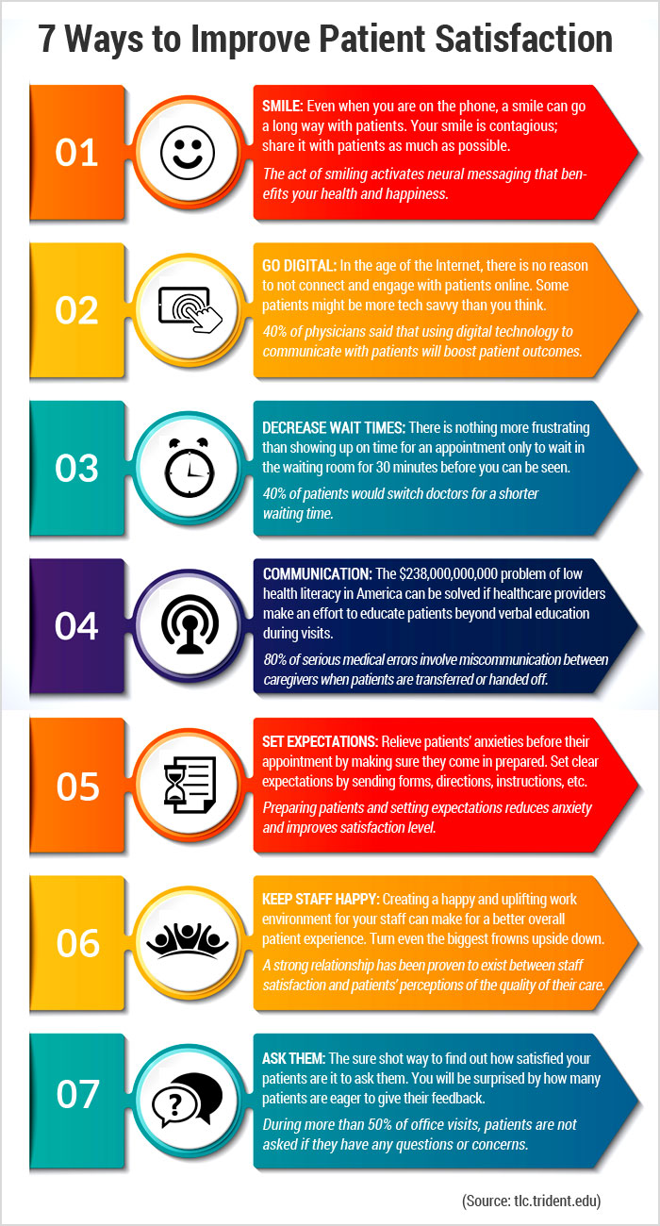
RECOMMENDATIONS
(a) Diagnostic Services. Basic diagnostic services at the polyclinic. Also, beneficiary has to visit the facility again for consultation, once the diagnostic results are available.
(b) Pharmacy. Adequately stocked including with critical. Home delivery of medicines.
(c) Referrals. The referral procedures need to be streamlined, especially the online referrals through education of beneficiaries as well as smoothening the process.

Slide 25
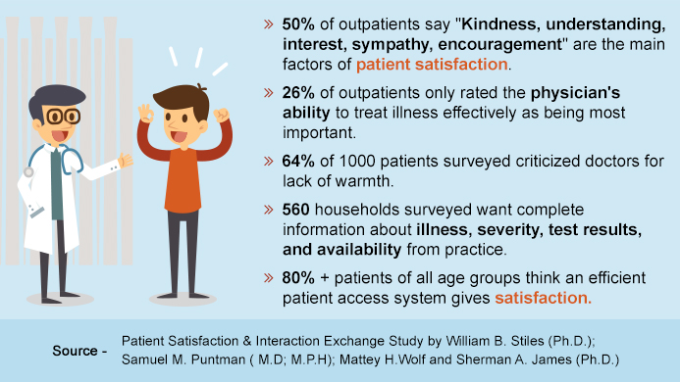
RECOMMENDATIONS
(d) Waiting Time. To be reduced. Polyclinic is over-subscribed many times over than its handling capability due to the concentration of ESMs in the area. Increase the number of polyclinics in the Delhi NCR region.
(e) Payment to Empaneled Hospitals. Adequate funds should be made available in time & the payments must be done in shortest possible time frame to avoid embarrassment to the beneficiaries.

Slide 26
REFERENCES
COECHS. (2021, April). https://echs.gov.in/. Retrieved from Official ECHS Web Portal, maintained & managed by COECHS : https://echs.gov.in/
Department of Ex-servicemen Welfare, MoD, GoI. (2020, APR). http://desw.gov.in/. Retrieved from Department of Ex-servicemen Welfare: http://desw.gov.in/ 3. http://qi.nhsrcindia.org/cms-detail/national-quality-assurance-standards/MTAx
https://www.continence.org.au/sites/default/files/2020-05/Academic_Report_Short_Assessment_of_Patient_Satisfaction_SPAS.pdf
https://www.ncbi.nlm.nih.gov/pmc/articles/PMC2763650/
5. https://webgate.ec.europa.eu/chafea_pdb/assets/files/pdb/20091104/20091104_d08-00_en_ps.pdf

Slide 27
REFERENCES
Kumari R, Idris M, Bhushan V, Khanna A, Agarwal M, Singh S. Study on patient satisfaction in the government allopathic health facilities of Lucknow district, India. Indian J Community Med. 2009 Jan;34(1):35-42. doi: 10.4103/0970-0218.45372. PMID: 19876453; PMCID: PMC2763650.
Sukumar Vellakkal, Shikha Juyal, Ali Mehdi S. J. (2010). Healthcare Delivery & Stakeholder's Satisfaction under Social Health Insurance Scheme in India: An Evaluation of Central Government Health Scheme(CGHS) & Ex- servicemen Contributory Health Scheme(ECHS). Indian Council for Research on International Economic Relations(ICRIER).
PanelKari Maharajan ª, R. Krishnaveni Inclusive management of ex-servicemen in India: Satisfaction of air force veterans from resettlement facilities with special reference to Tamil Nadu, Centre for Research, Anna University, Chennai, India, PSG Institute of Management, Coimbatore, India, 22 November 2016
9. Naveen Phuyal, A.K. Jindal, Sandip Mukherji Client Satisfaction in 'Ex - servicemen Contributory Health Scheme (ECHS) Polyclinic': An Experience from India, May 2016Medical Journal of Shree Birendra Hospital 14(2): 5DOI: 10.3126/mjsbh.v14i2.14910

Slide 28
THANK YOU

