Slide 1


Role of funding received through National Health Mission (NHM)under Swachh Swasth Sarvatra (SSS) Programme on Community Health Centres (CHCs) for achieving the Kayakalp Award
NHSRC
Presented by - Dr. Aman Sharma (PG/20/117)
Under the guidance of - Ms. Divya Aggarwal
IIHMR Delhi

Slide 2
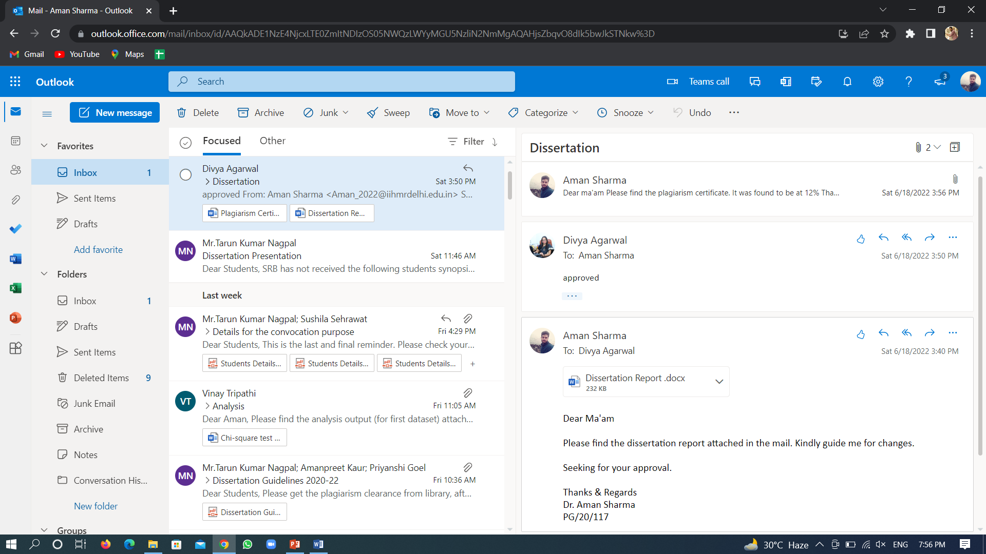
Screenshot of Approval

Slide 3
Introduction
Key initiatives taken by the Government of India:
Objectives of the SSS –
      Enabling Gram Panchayats to become Open Defecation Free(ODF).
      Strengthening CHCs in ODF blocks to achieve Kayakalp Award through a support of Rs. 10 Lakhs under NHM.
      Capacity building through training in WASH.
2015
2007
Indian Public Health Standards
2013
National Quality Framework (National Quality Assurance Standards)
Kayakalp
2016
Swachh Swasth Sarvatra
2014
Swachh Bharat Mission

Slide 4
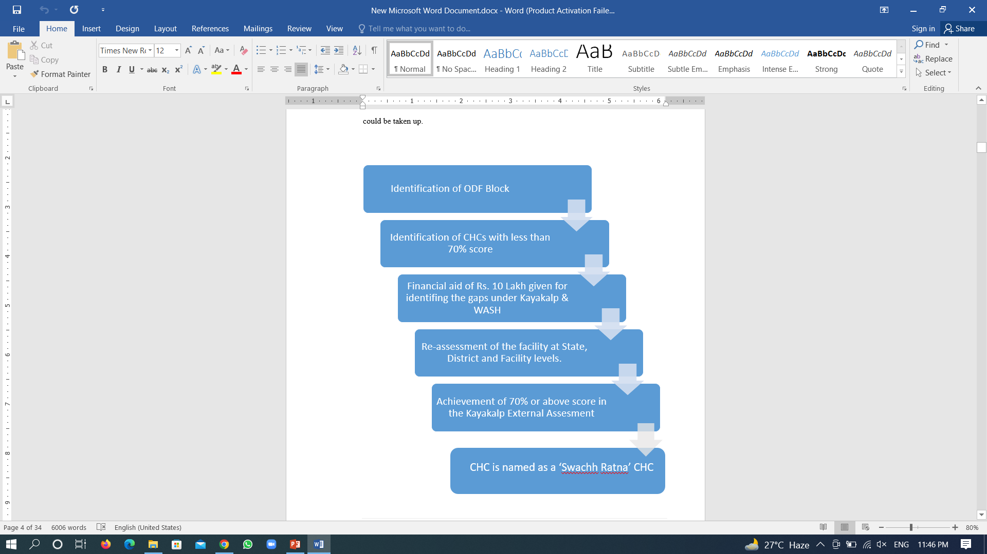
Introduction
Key activities for fund utilization –
  Drinking water
  Hand washing
  Toilets & Infrastructure
  Waste Management
  Staffing and Training
Limitations to fund utilization are hiring or paying salary, major purchases or constructions or for clearing pending payments of contractual agencies etc.

Slide 5
Objectives of the Study
Primary Objective - To determine the total number of CHCs traversing the gaps and achieving Kayakalp Awards after attaining the grant of Rs. 10 Lakhs under SSS programme through NHM in 9 States/UTs of India till March 2021.
Secondary Objectives -
To compare the percentages of CHCs receiving funds under the SSS programme and achieving the Kayakalp Awards with the CHCs not receiving funds under the SSS programme but still achieving the Kayakalp Awards.
To find out the average number of years, it takes for the CHCs funded under the SSS programme to traverse the gaps and achieve the Kayakalp Awards.

Slide 6
Methodology
Study Design: An Observational secondary data analysis study.
The study covered 10291 CHCs of 9 States/UTs of India funded during FY 2017-18 to FY 2020-21.
Sample size: Data of 10291 CHCs from 9 states of India was collated and analysed.
Sample design: Non probability purposive sampling and further selection of states based on the completeness of the data fetched from the states.
Inclusion Criteria: The States/UTs with complete data; namely Assam, Bihar, Jammu & Kashmir, Jharkhand, Maharashtra, Meghalaya, Odisha, Tamil Nadu and Uttar Pradesh.
Exclusion Criteria: States/UTs with incomplete information were excluded.
CHCs which were already Awarded before launch of SSS programme or before funding.
CHCs which have been Awarded more than once are counted one time only.
Ethical Issues: Required permissions and approvals were taken from the NHSRC team for the study of the data provided by the states.
Conflict of Interest: No conflict of interest during the study.
Tools Used:
        Google Spreadsheet
        MS Excel
        MS Power-point
Name of the State | No. of Functional CHCs | Names of the CHCs recieved funds | Are they Kayakalp Awardee | If Yes, in which FY

Slide 7
Methodology
Step 1
Selection of the Topic.
Sought permissions and approvals for the study.
Step 2
Collection and collation of data fetched from states.
Bifurcation of the CHCs among funded and non-funded under SSS programme.
Step 3
Collation of data according to the Objectives.
Step 6
Reviewing the Kayakalp Award status of these facilities.
CHCs which were already Awarded before launch of SSS programme or before funding were removed.
Step 4
CHCs which have been Awarded more than once are counted one time only.
Step 5
Data Analysis and Interpretation.
Step 7
Result formation

Slide 8
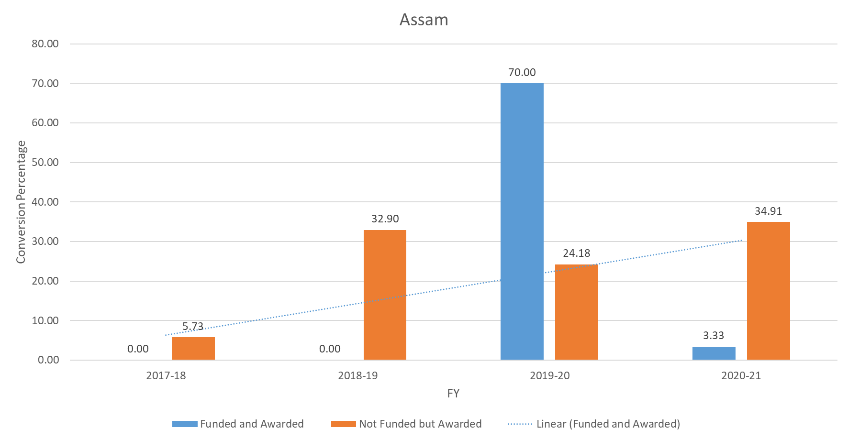
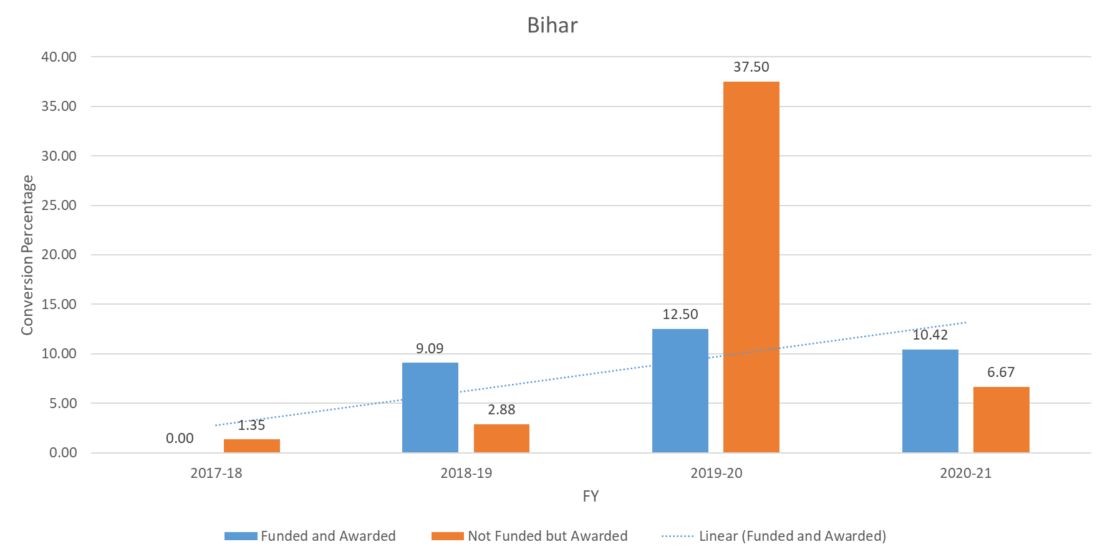
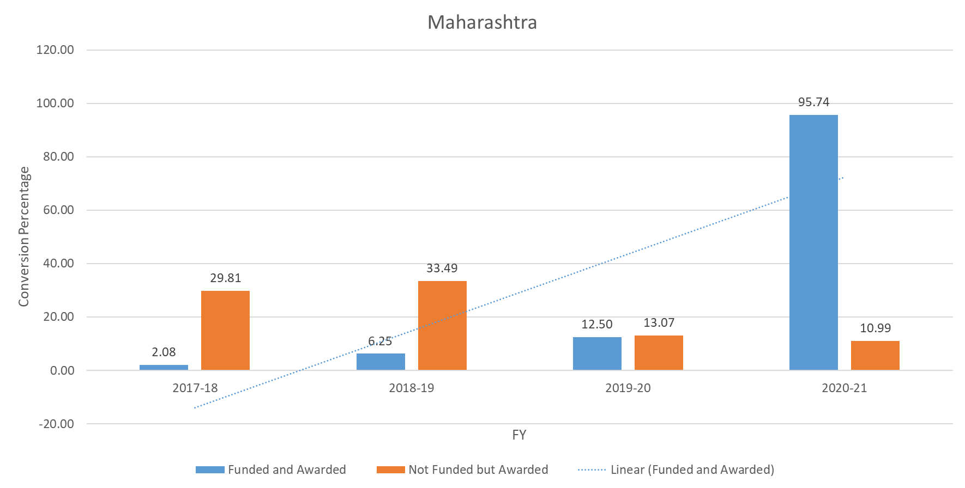
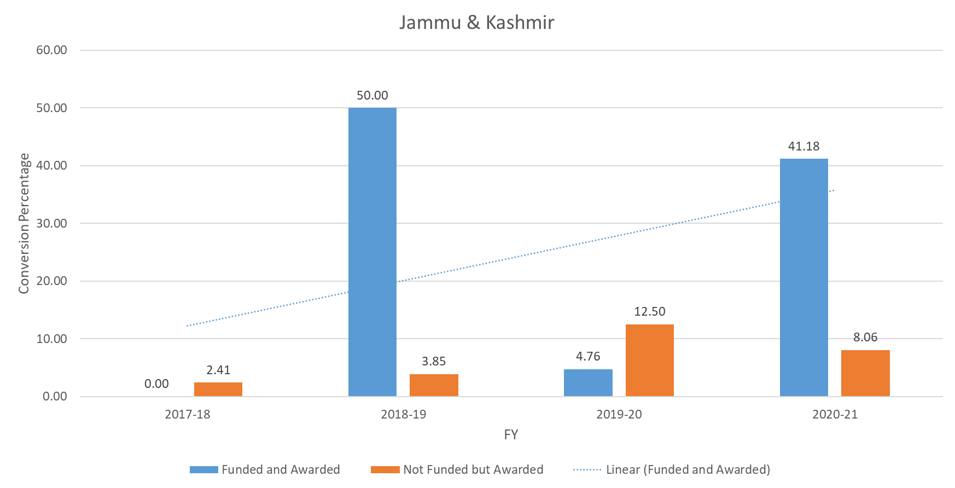
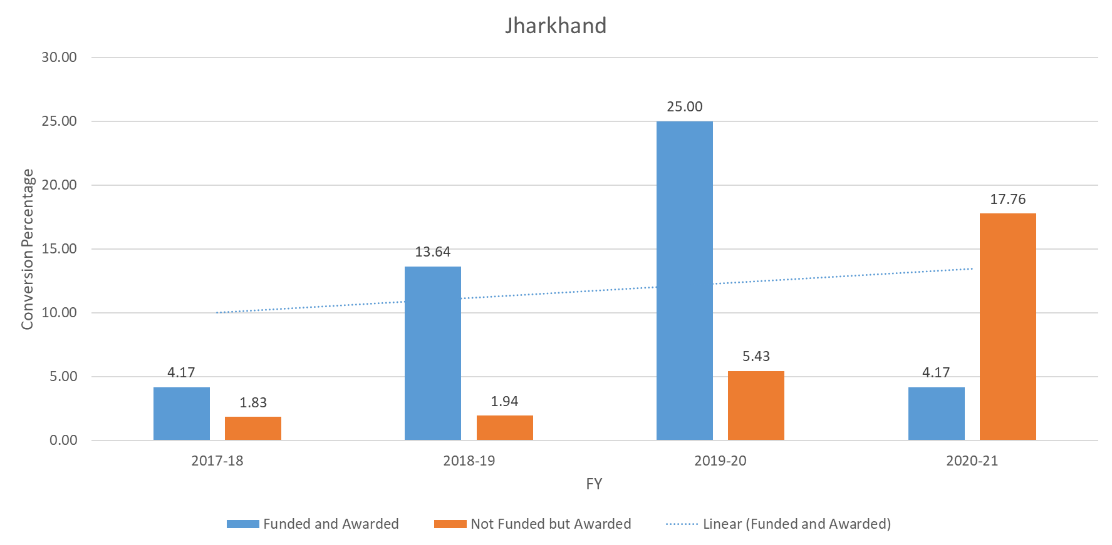
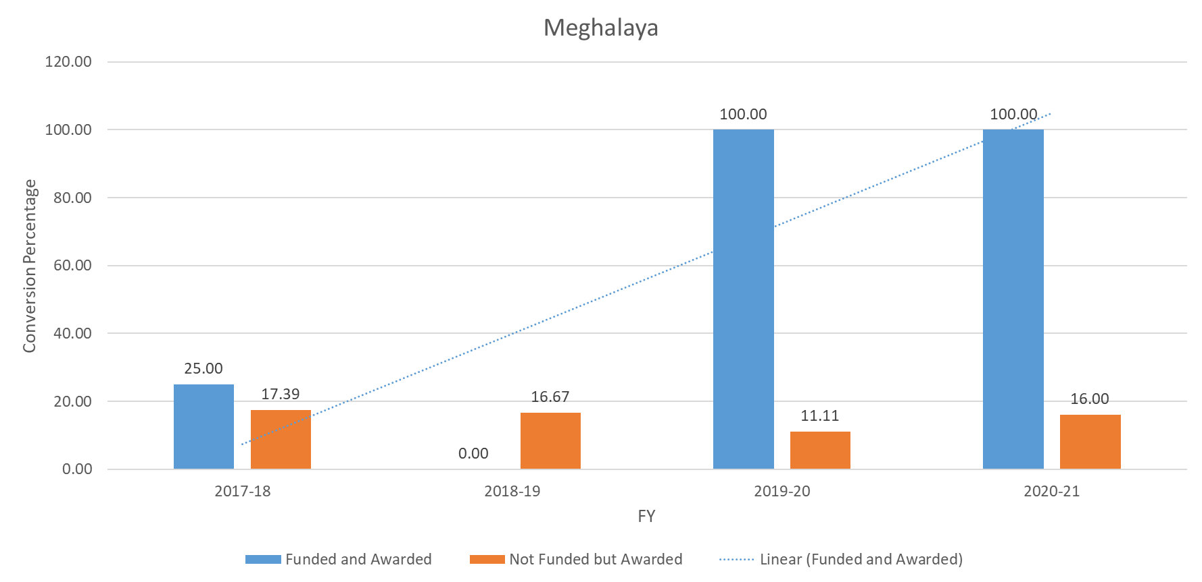
Results
Comparative analysis of the Funded CHCs with the Non funded CHCs and winning the Kayakalp Awards

Slide 9
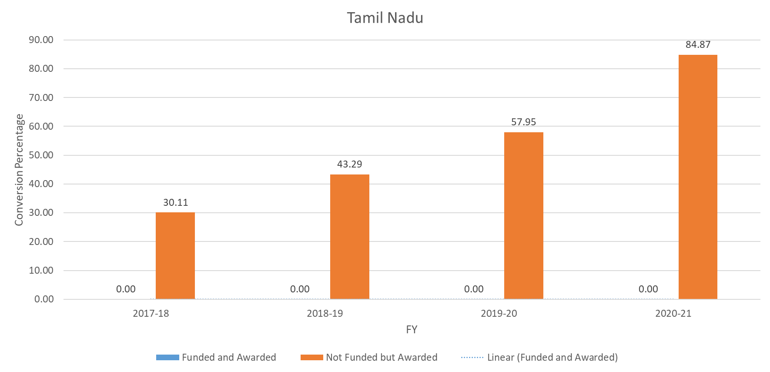
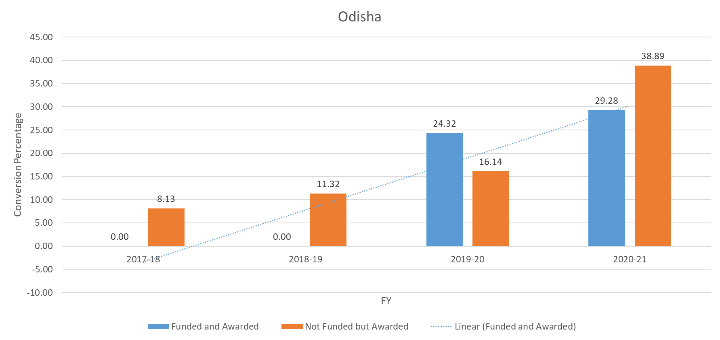
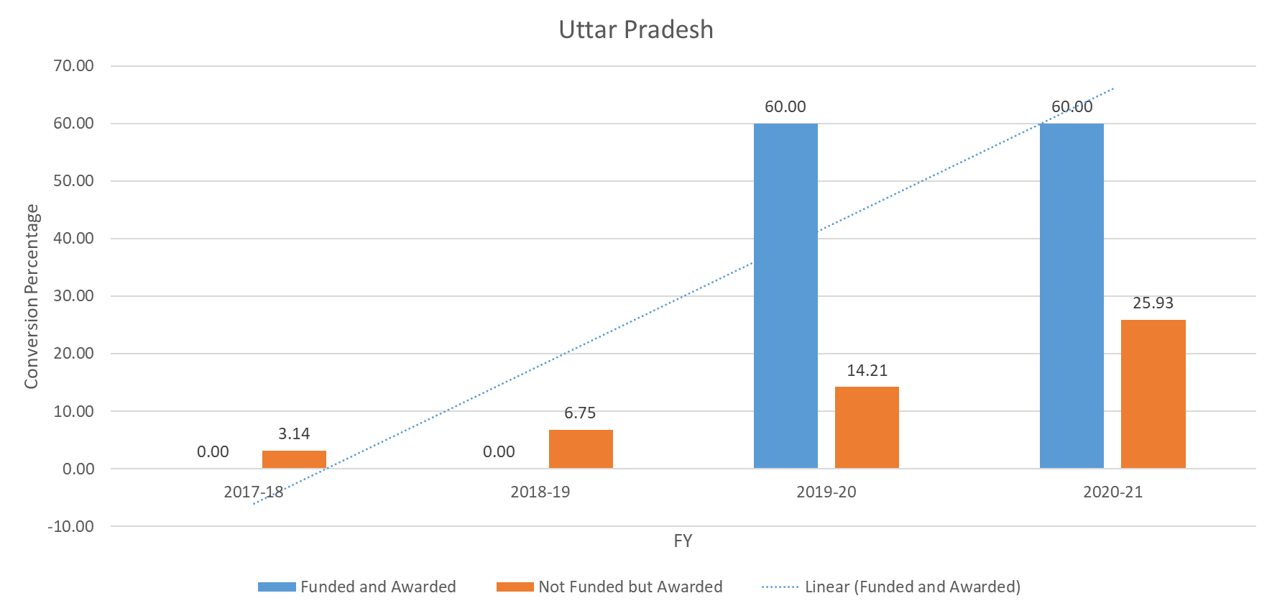
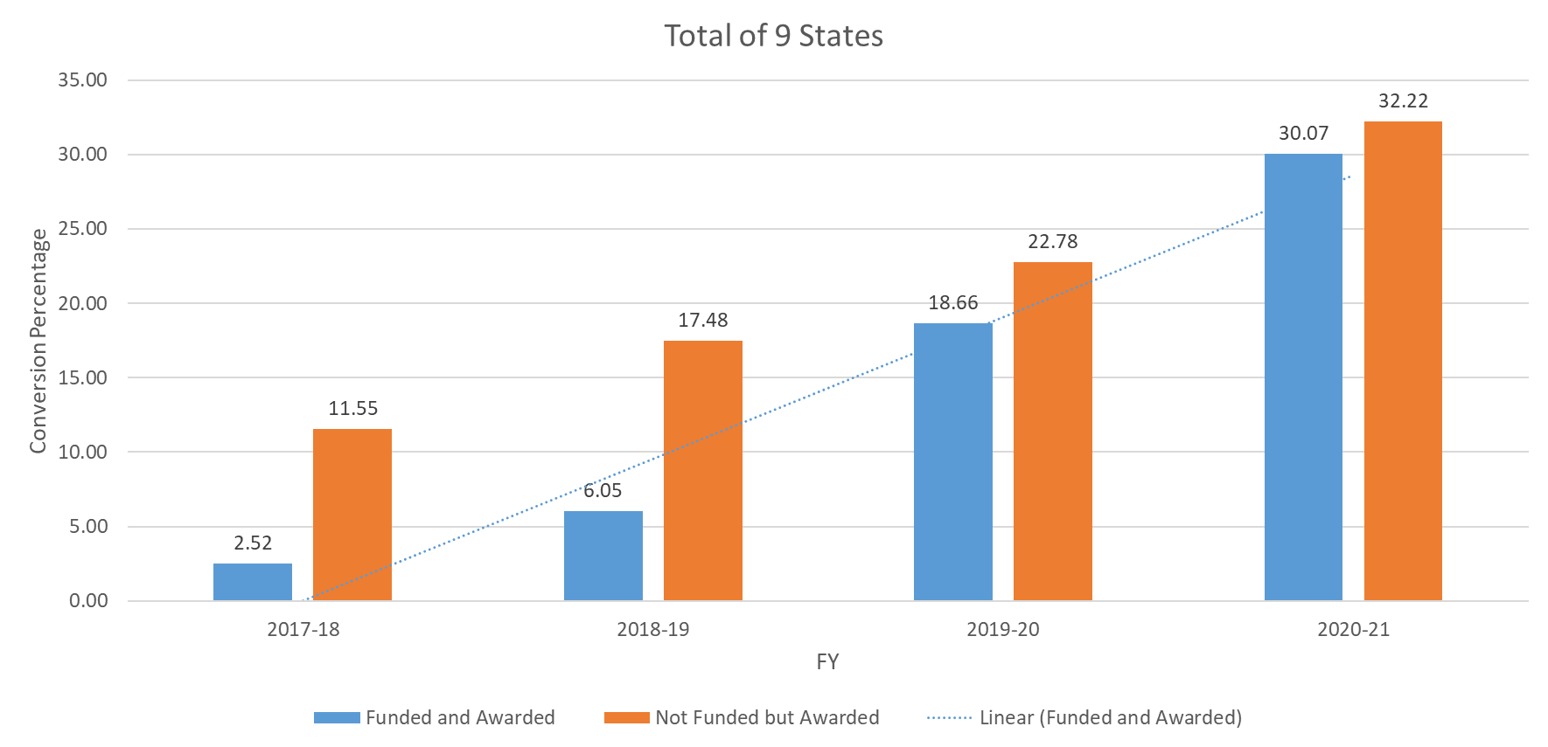
Results (Cont..)
Comparative analysis of the Funded CHCs with the Non funded CHCs and winning the Kayakalp Awards

Slide 10
Chi sq test for scientific significance testing
2017-18
2018-19
2019-20
2020-21
observed values | Funded | Not Funded | total
Awarded | 3 | 280 | 283
Not Awarded | 116 | 2145 | 2261
total | 119 | 2425 | 2544
Expected values | Funded | Not Funded | total
Awarded | 13.23781 | 269.76219 | 283
Not Awarded | 105.7622 | 2155.2378 | 2261
total | 119 | 2425 | 2544
 | p value | 0.01
observed values | Funded | Not Funded | total
Awarded | 19 | 381 | 400
Not Awarded | 295 | 1799 | 2094
total | 314 | 2180 | 2494
Expected values | Funded | Not Funded | total
Awarded | 50.36086608 | 349.63913 | 400
Not Awarded | 263.6391339 | 1830.3609 | 2094
total | 314 | 2180 | 2494
 | p value | 0.00
observed values | Funded | Not Funded | total
Awarded | 50 | 500 | 550
Not Awarded | 218 | 1695 | 1913
total | 268 | 2195 | 2463
Expected values | Funded | Not Funded | total
Awarded | 59.84572 | 490.15428 | 550
Not Awarded | 208.1543 | 1704.8457 | 1913
total | 268 | 2195 | 2463
 | p value | 0.31
observed values | Funded | Not Funded | total
Awarded | 138 | 751 | 889
Not Awarded | 321 | 1580 | 1901
total | 459 | 2331 | 2790
Expected values | Funded | Not Funded | total
Awarded | 146.2548 | 742.7452 | 889
Not Awarded | 312.7452 | 1588.255 | 1901
total | 459 | 2331 | 2790
 | p value | 0.66

Slide 11
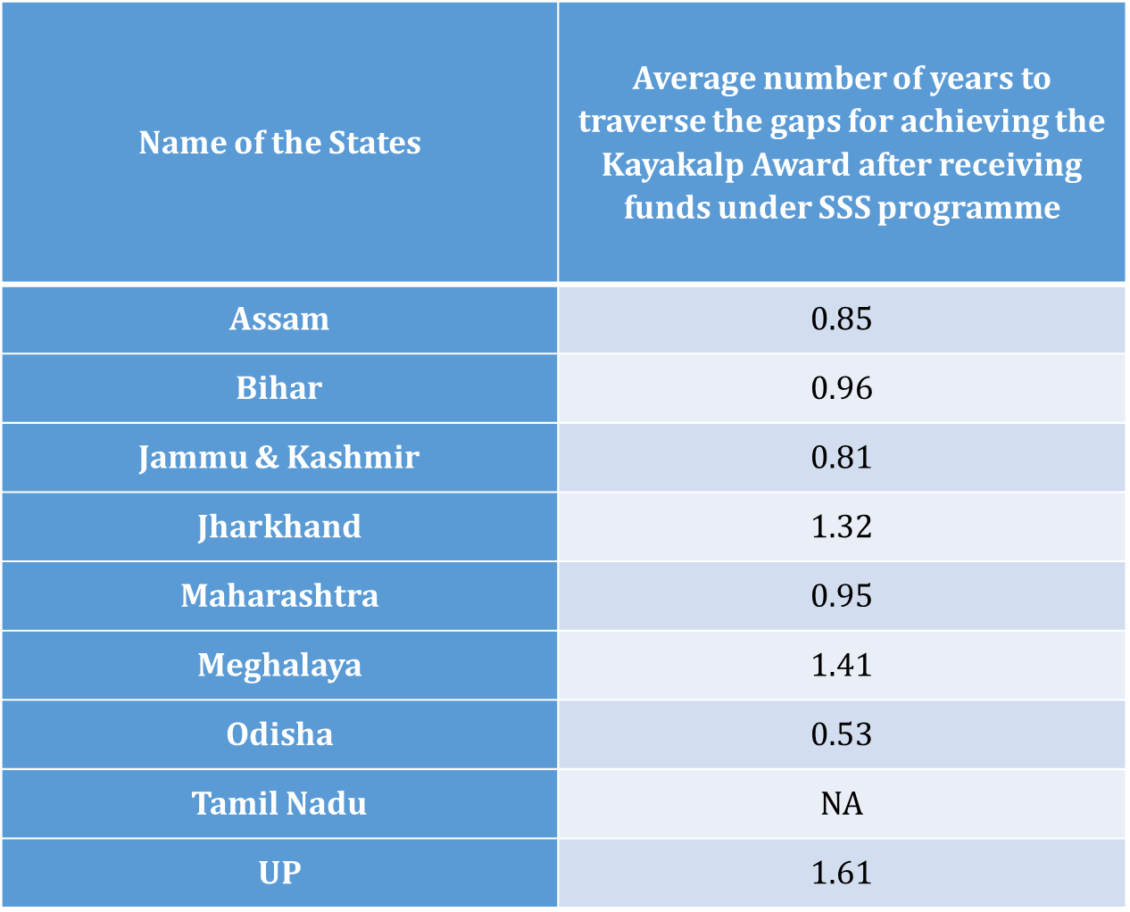
Results (Cont…)

Slide 12
Discussion
With the collated and analysed data it is difficult to generalise the role of funding received through National Health Mission (NHM)under Swachh Swasth Sarvatra (SSS) Programme on Community Health Centres (CHCs) for achieving the Kayakalp Award across India.
None of the state is showing 100% conversion in all the FYs.
In some states, there are improvements in the initial years and then decline in the subsequent years while in other states, it is vice versa.
However, when we look at the combined data of these states, it can be inferred that there is a consistent improvement in the number of facilities receiving the funds for traversing the gaps to achieve the “Swachh Ratna CHC” status.

Slide 13
Discussion
But at the same time, there is an increase in the conversion percentage of the CHCs which were not funded but still achieving the Kayakalp Awards and hence awarded “Swachh Ratna CHCs” status.
The CHCs in the state of Odisha, after getting funded took the minimum average time to traverse the gaps to achieve the Kayakalp Award while Uttar Pradesh took the longest time to traverse the gaps.
However, in the state of Tamil Nadu, none of the funded facility achieved the Kayakalp award in any of the year.

Slide 14
Limitations of the Study
The pre and post intervention internal/peer assessment scores of the facilities were not available within the organization.
Due to great variation in the number of CHCs in different states, the result cannot be generalized to the whole country.
There are very few literatures published on this topic.
Way Forward-
An impact assessment study can be done to check the real progress and impact of the SSS programme.
Issues and challenges to this study, could be taken up for further studies to check and re-assess the impact of this programme again.

Slide 15
Conclusion
With the increased burden of water-borne diseases, need for cleanliness, sanitation and hygiene has become all the more important. (9)
The Swachh Bharat Mission, Kayakalp Award scheme and the Swachh Swasth Sarvatra are trying to do the same in terms of improving cleanliness and promoting sanitation & hygiene and infection control practices.
With the collated and analysed data, it is evident that there has been an increase conversion of facilities funded under the SSS programme and achieving the Kayakalp award over the period of time. However, individual State/UTs have their respective percentage changes over the period of all 4 years.
The funding through the SSS programme has had a positive association in the first two years but has not been consistent in the last two years.
This inconsistency of the conversion rate can be due to administrative issues in releasing the funds, delays in the release of funds, due to differences in the amount asked in the PIPs by states/UTs or may be due to the physical access to the location.
However, it should be noted that there has been an increase in the conversion of facilities not funded under the SSS programme but achieving the Kayakalp award.
The average number of years taken by the CHCs to traverse the gaps ranged from around half a year to more than one and a half years.

Slide 16
References
India. National Health Mission. Swachh Swasth Sarvatra: Operational Guidelines. MoHFW & MDWS; 2018.
Ministry of Health & Family Welfare. Award to Public Health Facilities – Kayakalp. New Delhi: Ministry of Health & Family Welfare; 2021.
Apurva T, Ankita T. Kayakalp: Impact of Swachh Bharat Abhiyan on cleanliness, infection control & hygiene promotion practices in District Hospitals of Chhattisgarh, India. ISOR J of Env Sci [Internet]. 2016 [cited May 2022]. 10(9):55-58. Available from ISOR: https://www.iosrjournals.org/iosr-jestft/papers/vol10-issue9/Version-1/I1009015558.pdf
Agrawal A, Srivastava JN, Priyadarshi M. Impact of implementation of “Kayakalp” initiative on quality certification of district hospitals to National quality assurance standards. Indian J Community Med[Internet]. 2019 [cited May 2022]. 44(3):228-32. Available from- https://tinyurl.com/ycx46vmf
Suresh S, Bindiya K, Ritwika M. Qualitative assessment of Kayakalp programme for Public Health Care Facilities. Population Res Centre [Internet]. 2020 Feb [Cited 2022 May]; Available from: https://tinyurl.com/2p84xsps
Saravanakumar V, Ravichandran S. Assessing the reasons for poor performance of Public Health Facilities in Tamil Nadu, in Kayakalp Award. Population Res Centre [Internet]. 2020 Feb [Cited 2022 May]; Available from: https://tinyurl.com/52dczx6t

Slide 17
Suggestions to the Organization where the Study was conducted
More field visits at the Intern/fellow level.
Increased inter departmental integration.
Increased automation into the system.
Inclusion of thoughts, suggestions and comments of all the employees at all levels.
Best practices of the Organisation

Slide 18
Dissertation Experiences
What did you learn (skill/ topic)?
Overall self comments on Dissertation
Field visits and evaluation of the health care facilities.
Facility assessments.
National level event organisation
TOT
Policies, guidelines and protocol formation
New tool/programme formation
Communication and dissemination of information to the states at national level.
It was indeed an amazing and over-whelming experience with the organisation.
Great learning experience.

Slide 19
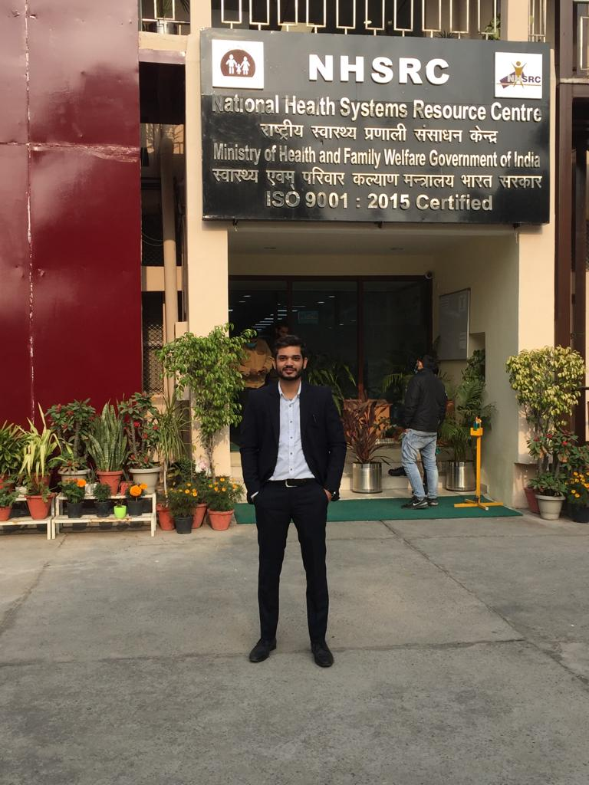
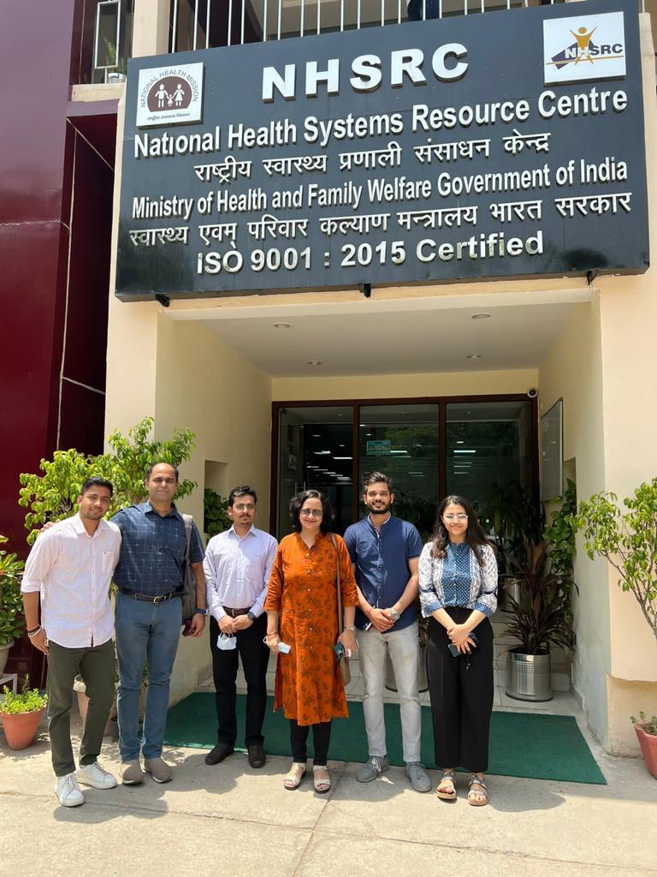
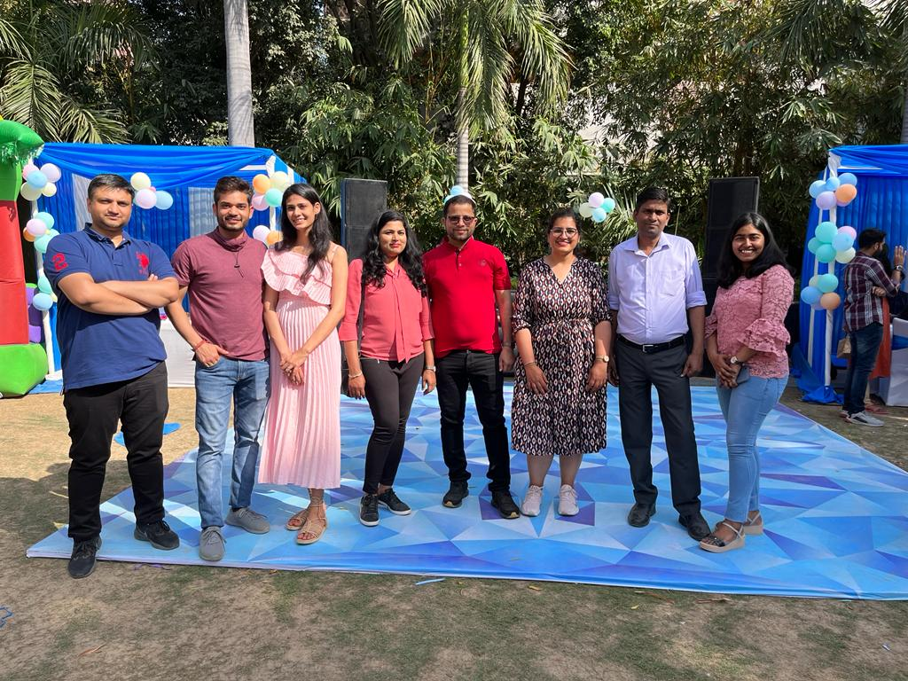
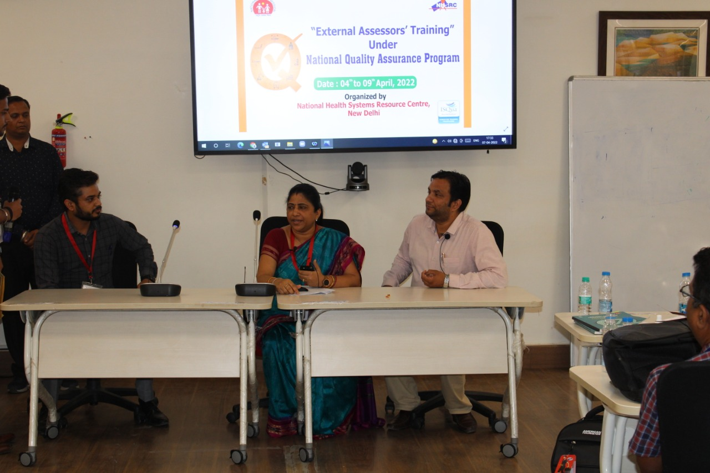
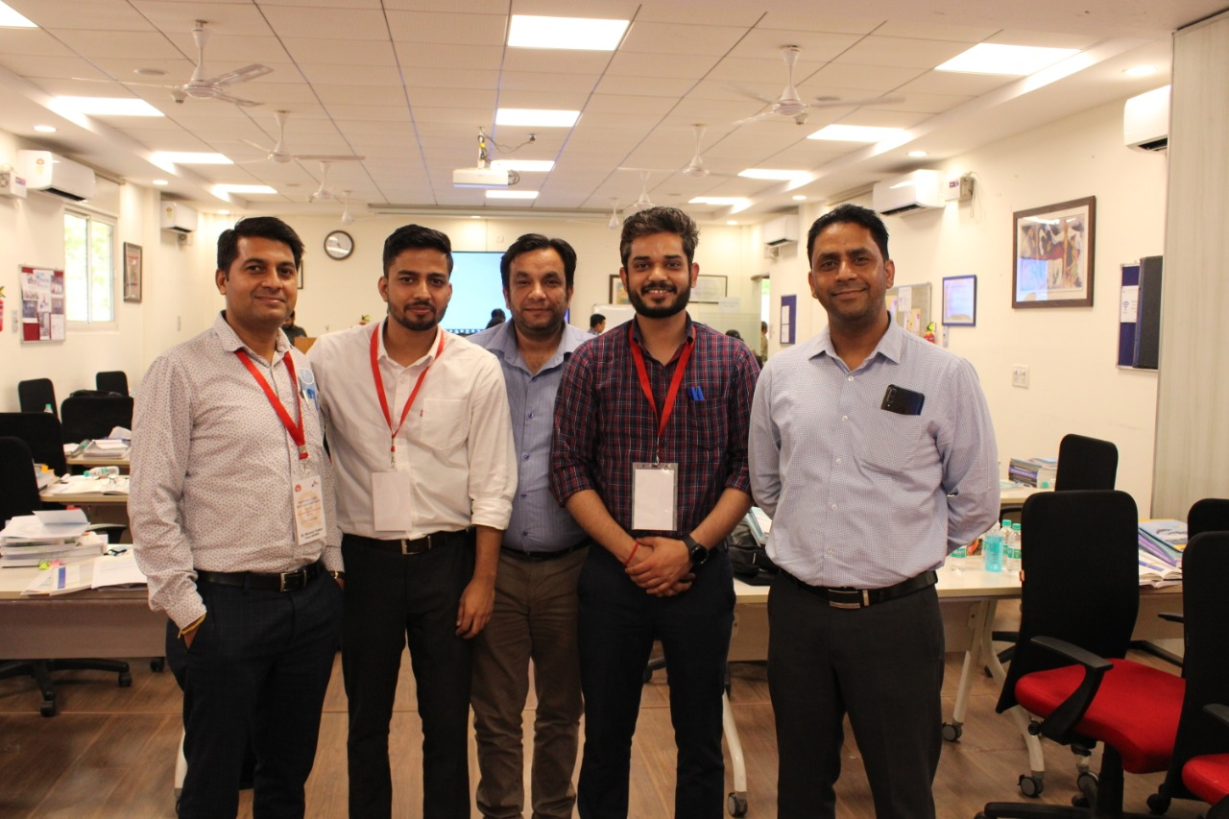
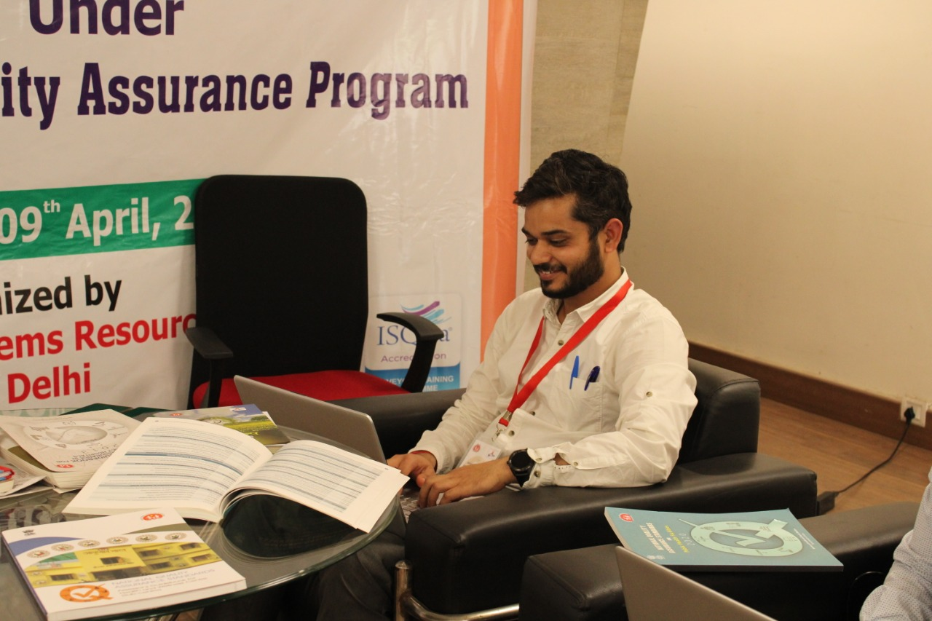
Pictorial Journey

Slide 20
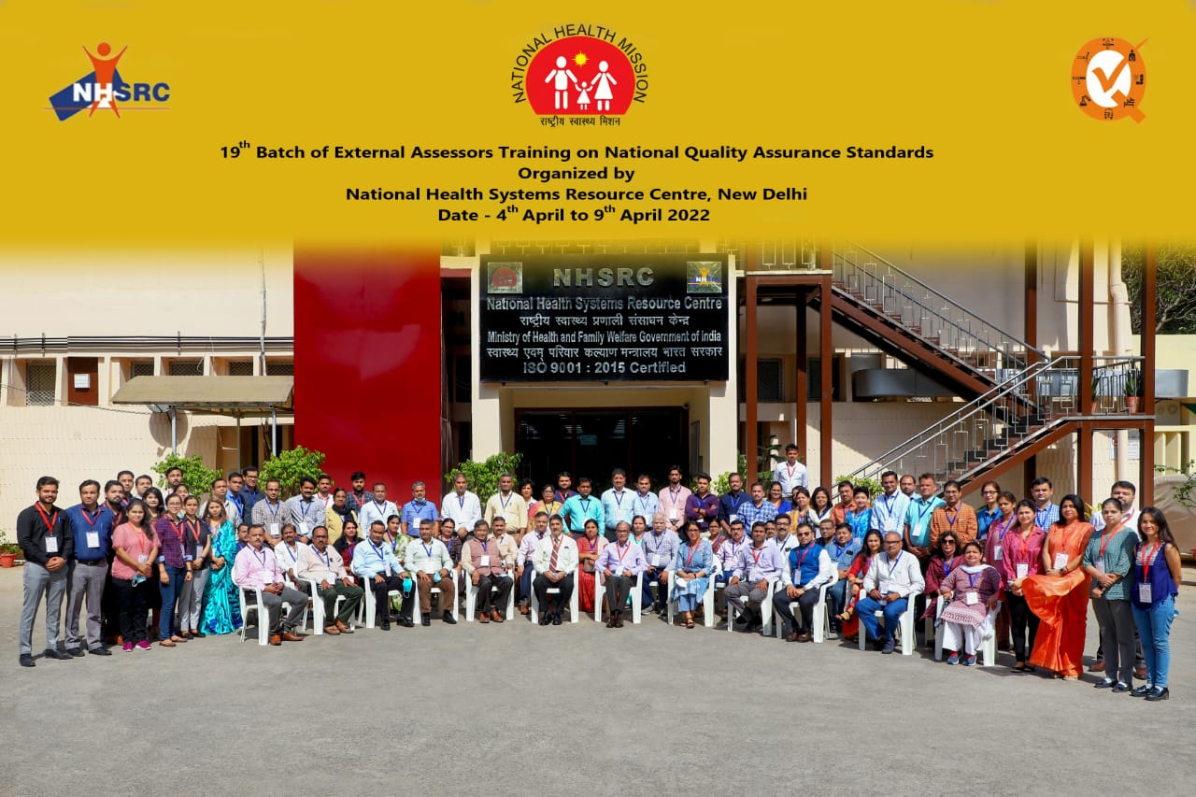
Thank You

