Slide 1

Quality in Rural Healthcare: A Scoping Review of NQAS Implementation in Bihar
UNICEF BIHAR
KAUSIK HALDER
UNDER GUIDANCE- DR.NIDHI YADAV
IIHMR DELHI

Slide 2
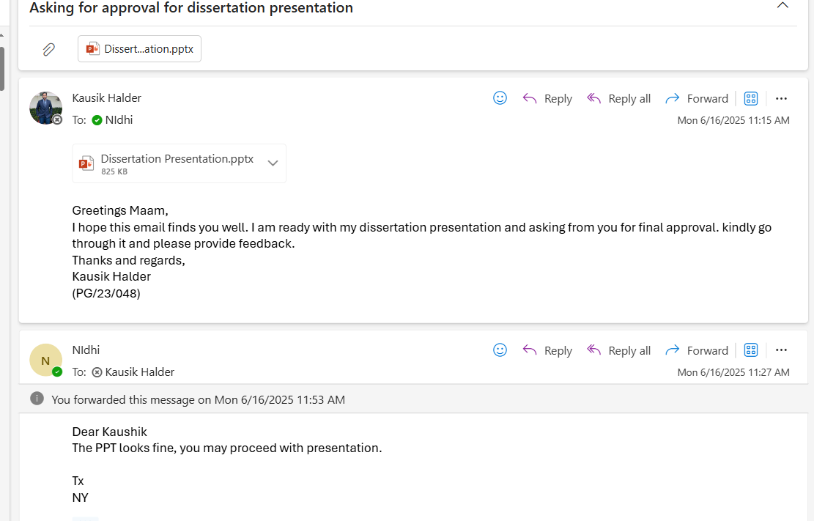
Mentor Approval

Slide 3
Introduction
Quality healthcare includes infrastructure, patient needs, clinical care, and provider performance.
IPHS introduced to standardize infrastructure; other certifications (NABH, ISO) used earlier (2008–2012).
NQAS launched in 2013 by MoHFW to improve quality in PHCs, CHCs, and DHs.
NQAS covers 8 key areas: service delivery, patient rights, HR, support services, clinical care, infection control, quality management, and outcomes.
Facilities must score ≥70% in assessments to be NQAS certified.
Bihar faces high MMR (208) and NMR (27), below SDG targets; 34% of population lives below poverty line.

Slide 4
Introduction
Primary Health Care is vital—Bhore Committee (1946) & Alma Ata Declaration (1978) laid the foundation.
Bihar’s challenges: 88% rural population, low per capita income, low female literacy (63.82%), inadequate PHC staff/tools.
NHM efforts in Bihar include capacity-building and health system strengthening.
National strategies like RMNCH+A (2013) and LaQshya (2017) target maternal and newborn care.
State-led efforts like Manav Vikas Mission support ambitious healthcare goals.

Slide 5
OBJECTIVES OF THE STUDY
To evaluate the implementation of NQAS program execution in Public Health Centers and Health Wellness Centers in Bihar.
To evaluate the effect of NQAS on service quality and patient satisfaction in Bihar.
To identify the gaps and challenges in achieving NQAS certification.
To identify the success stories regarding the implementation of NQAS in Bihar.

Slide 6
METHODOLOGY
STUDY DESIGN-
This study follows secondary research
INCLUSION CRITERIA-
Studies or reports on NQAS implementation in Bihar.
Articles published between 2014-2025.
Focus on public healthcare facilities(PHC,HWC,CHC).
EXCLUSION CRITERIA-
Studies from other states.
Articles not related to quality assurance in healthcare.
Articles solely addressing private healthcare facilities.

Slide 7
DATA COLLECTION & ANALYSIS
IDENTIFY DATA SOURCES-
Searched scientific databases: Pubmed, Google scholar, Scopus.
Included grey literature- NHM Bihar reports, MoHFW documents, conference papers.
DEVELOP SEARCH STRATEGIES-
Used keywords like “NQAS”, “Bihar”, “Rural health”, “Quality assurance”
Applied Boolean operators (“NQAS” AND “Bihar” AND “Rural”).
SCREEN AND SELECT STUDIES-
Screened titles and abstracts using inclusion and exclusion criteria.
Conducted full text review for final selection.

Slide 8
DATA COLLECTION & ANALYSIS
CREATE A DATA EXTRACTION FORM-
Used Excel/Google sheets to chart key fields like Author name, District, Facility type, NQAS components, Findings.
EXTRACT AND CHART DATA-
Systemically collected and organized data from included sources.
DOCUMENT THE PROCESS-
Used PRISMA flowchart to show inclusion/exclusion and also recorded the number of studies at each stage and reasons for exclusion.

Slide 9
RESULTS
Study Selection Process
35 records initially identified from PubMed, Google Scholar, and grey literature.
5 duplicates removed.
30 studies screened by title & abstract.
20 full-text studies assessed.
8 excluded due to non-NQAS focus or lack of Bihar-specific data.
12 studies included in the scoping review.

Slide 10
Results
Thematic Findings
NQAS Component | Coverage | Percentage
Infrastructure & Facility readiness | 11/12 | 92%
Infection prevention & control | 10/12 | 83%
Human Resources & Staffing | 9/12 | 75%
Clinical care & Service delivery | 9/12 | 75%
Documentation & Record | 7/12 | 58%

Slide 11
RESULTS
Key reasons for excluded studies
Not focused on NQAS framework.
Not Bihar-specific (studies from Kerala, Gujarat, Tamil Nadu).
Covered clinical outcomes, not facility-based quality assurance.
Evaluated economic access/utilization, not service quality standards.
Focused on tertiary hospitals or non-public sector settings.

Slide 12
RESULTS
Barriers to NQAS implementation
Shortage of skilled staff (doctors, nurses, lab technicians).
Inadequate infrastructure (power, water, sanitation, equipment).
Poor documentation (partographs, referral records, registers).
Weak referral systems and emergency transport delays.
Low awareness of NQAS among frontline workers and supervisors.

Slide 13
RESULTS
Enablers of Quality Improvement
Simulation-based mentoring (e.g., AMANAT model) improves clinical readiness.
SOPs and checklists promote consistent protocol adherence.
Engaged leadership leads to better audits and accountability.
State-led programs (Kayakalp, LaQshya) reinforce NQAS compliance.

Slide 14
DISCUSSION
Infrastructure and Infection Control were the most frequently assessed NQAS domains across the 12 studies.
Many PHCs and DHs lacked functional 24x7 services and essential utilities like power, water, and sanitation (Kaur et al., Madhav).
Labour room improvements through targeted quality assurance programs were found effective but not yet sustainable (Sharma et al.).
Human resource shortages—especially doctors and nurses—continue to be a major barrier in most districts (Kumar & Birendri).
Training programs like simulation-based mentoring significantly improved provider skills in maternal and emergency care (Ghosh, Morgan).
SOPs, mentorship, and leadership engagement contributed to improved documentation, IPC practices, and staff motivation (Creanga, Neogi).

Slide 15
DISCUSSION
Patient rights, provider beliefs, and community engagement were underrepresented in the reviewed studies (Karvande).
No studies assessed adolescent health or mental health services—highlighting a critical quality care gap.
Cultural mismatch between national quality frameworks and on-ground provider attitudes was observed.
Facilities recognized under the Kayakalp initiative showed better cleanliness and IPC standards (Agarwal A.).
Hygiene improvements alone did not guarantee clinical quality—lack of HR and supervision remained limiting factors.
Sustainable NQAS success depends on HR continuity, integrated training, strong leadership, and inclusive quality domains.

Slide 16
CONCLUSION
Based on 12 studies, the review highlighted progress and persisting gaps in NQAS implementation in rural Bihar.
Key domains addressed: infrastructure, infection control, human resources, and clinical service delivery.
Interventions like simulation mentoring, SOPs, and quality audits showed measurable improvements.
Barriers remain: HR shortages, weak referral systems, poor supervision, and lack of patient-centered models.
Literature gaps included underreporting on adolescent health, mental health, patient perspectives, and long-term outcomes.
Future reforms must focus on capacity building, district-level leadership, real-time monitoring, and systemic integration of NQAS.

Slide 17
REFERENCES
1.Agrawal A, Srivastava J, Priyadarshi M. Impact of implementation of “Kayakalp” initiative on quality certification of district hospitals to National quality assurance standards. Indian J Community Med. 2019;44(3):228.
2.Operational-Guidelines-for-Improving_Quality_Public_Health_Facilities_2021.
3.National Quality Assurance Standards 2020.
4.Kaur J, Franzen SRP, Newton-Lewis T, Murphy G. Readiness of public health facilities to provide quality maternal and newborn care across the state of Bihar, India: a cross-sectional study of district hospitals and primary health centres. BMJ Open. 2019 Jul;9(7):e028370.
5.ResearchGate [Internet]. [cited 2025 May 25]. (PDF) Primary Health Care in Rural Bihar : Gaps in Infrastructure and Service Delivery. Available from: https://www.researchgate.net/publication/314153705_Primary_Health_Care_in_Rural_Bihar_Gaps_in_Infrastructure_and_Service_Delivery
6.Kumar IB, Birendri D. Challenges And Innovations In The Primary Healthcare System Of Bihar: A Comprehensive Review.
7.Creanga AA, Srikantiah S, Mahapatra T, Das A, Sonthalia S, Moharana PR, et al. Statewide implementation of a quality improvement initiative for reproductive, maternal, newborn and child health and nutritionin Bihar, India. J Glob Health. 2020 Dec;10(2):021008.

Slide 18
REFERENCES
8.Ghosh R, Cohen S, Spindler H, Vincent D, Sterling M, Das A, et al. Simulation and nurse-mentoring in a statewide nurse mentoring program in Bihar, India: diagnosis of postpartum hemorrhage and intrapartum asphyxia. Gates Open Res. 2022 Jun 13;6:70.
9.Sharma J, Neogi S, Negandhi P, Chauhan M, Reddy S, Sethy G. Rollout of quality assurance interventions in labor room in two districts of Bihar, India. Indian J Public Health. 2016;60(4):323.
10.Karvande S, Sonawane D, Chavan S, Mistry N. What does quality of care mean for maternal health providers from two vulnerable states of India? Case study of Bihar and Jharkhand. Journal of Health, Population and Nutrition. 2016 Feb 20;35(1):6.
11.Agarwal N, Singh C, Naik BN, Mishra A, Ahmad S, Lohani P, et al. Capacity building among frontline health workers (FHWs) in screening for cardiovascular diseases (CVDs): Findings of an implementation study from Bihar, India. AIMSPH. 2023;10(1):219–34.
12.Morgan MC, Dyer J, Abril A, Christmas A, Mahapatra T, Das A, et al. Barriers and facilitators to the provision of optimal obstetric and neonatal emergency care and to the implementation of simulation-enhanced mentorship in primary care facilities in Bihar, India: a qualitative study. BMC Pregnancy Childbirth. 2018 Dec;18(1):420.
13.Neogi SB, Shetty G, Ray S, Sadhukhan P, Reddy SS. Setting up a Quality Assurance model for newborn care to strengthen health system in Bihar, India. Indian Pediatr. 2014 Feb;51(2):136–8.

Slide 19
INVOLVEMENT IN COMMUNITY OUTREACH PROGRAMME ACTIVITIES
Total no. of visits done by the Student: 10
Activities done by the student:
Coordinated with ASHAs to mobilize community members.
Conducted door-to-door visits and made public announcements about the outreach activities.
Delivered interactive sessions on maternal and child health, non-communicable diseases, sanitation, and immunization.
Collected community feedback and suggestions for improving health services.

Slide 20
KEY LEARNING FROM COP ACTIVITIES
Participated in Household surveys.
Communicated with local people and understands their health concerns.
Worked with ASHA and observe their communication with the people to address their health issues .
Spread awareness among the people on different childhood diseases like diarrhea and ARI and prevention from those.
.

Slide 21
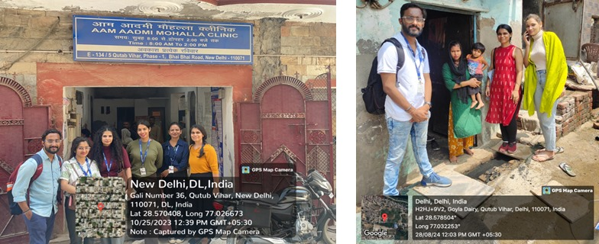
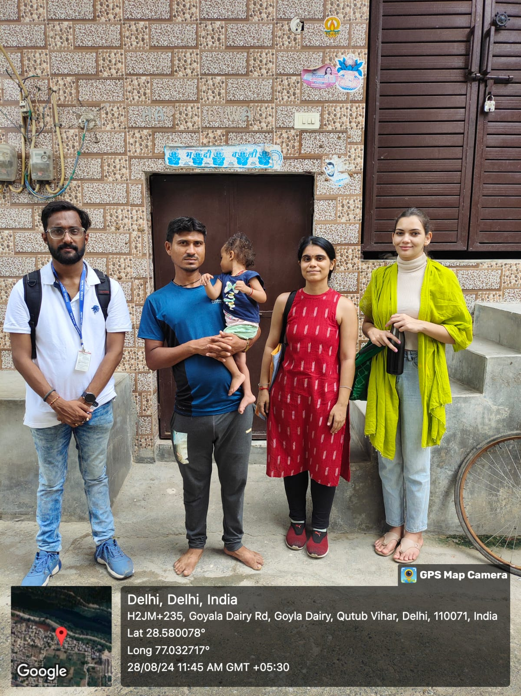
CO FIELD ACTIVITIES PHOTOGRAPH

Slide 22
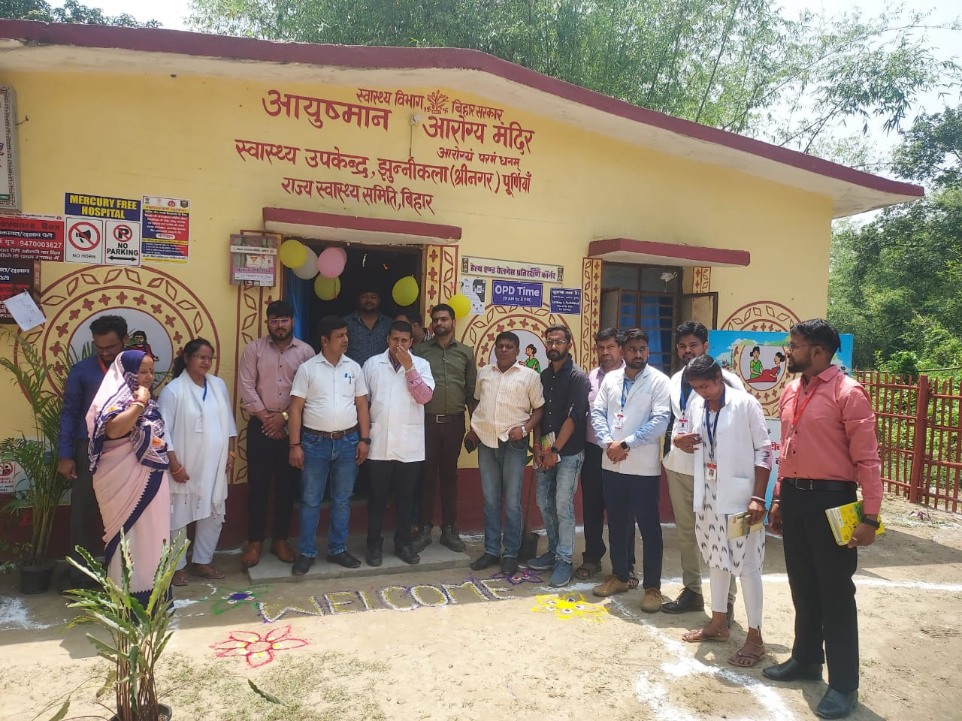
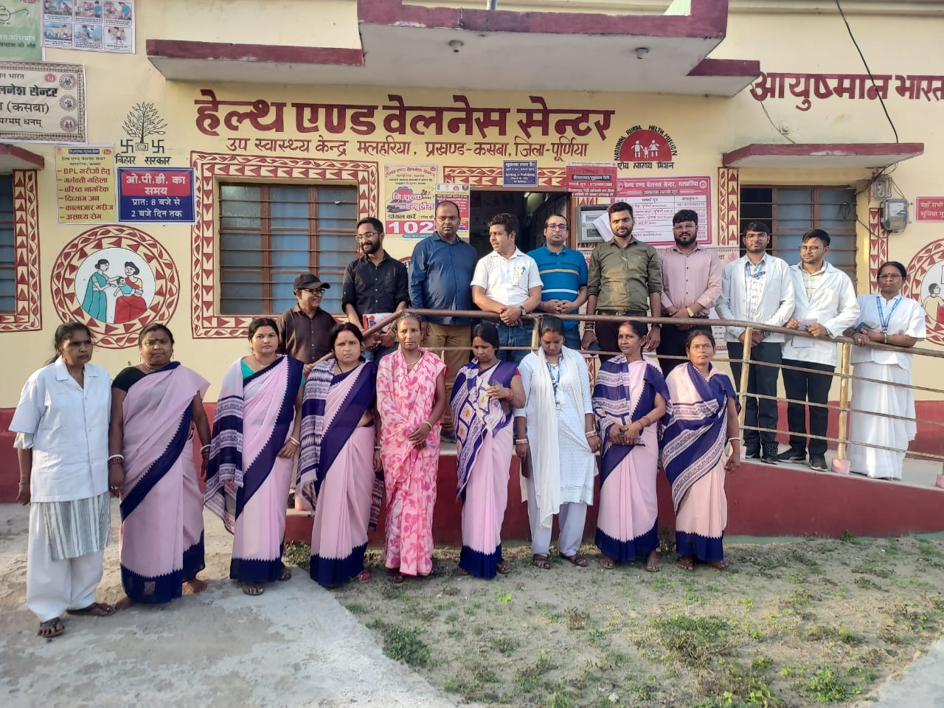
PICTORIAL JOURNEY

Slide 23
THANK YOU

