Slide 1

Camp Automation through RPA: A comparative Study on Improving Turnaround Time and Operational Efficiency
Dissertation at
U4RAD XRAI DIGITAL
BY
NAME: Anisha Goyal
FACULTY MENTOR: Dr. Divya Aggarwal
IIHMR, Delhi
Notes:
💰 Cost-Effectiveness
RPA can reduce costs by 25% to 50%. Once the bots are set up, they work 24/7 without breaks, salaries, or leaves.
👉 Example: In our health camps, earlier we needed 5 volunteers just to register patients and type reports. With RPA, we now need only 3 staff — the bot handles form-filling, report saving, and data syncing. Huge savings on manpower!
⚡ Improved Productivity
Bots finish tasks faster than humans, which helps us handle more patients in less time.
👉 Example: In optometry, instead of writing vision scores manually, the bot automatically enters data in the system. This gives the technician more time to check the next patient — resulting in faster patient flow and higher camp throughput.
✅ Higher Accuracy
Bots follow the same steps every time — no spelling mistakes, no missing patient details, and no wrong entries.
👉 Example: In doctor consultations, earlier some patient records had missing vitals or incorrect IDs. After RPA, IDs are auto-generated and vitals are logged correctly, avoiding confusion and ensuring complete records.
🧪 Enhanced Quality
Tasks that were often done in a rush or with errors are now done perfectly by bots.
👉 Example: In dental camps, referrals or treatment advice were sometimes wrongly recorded or misplaced. Now, the bot auto-generates the dental advice form and saves it instantly. This reduces rework and improves documentation quality.
😊 Better Customer (Patient) Satisfaction
Since RPA takes over the boring tasks, staff can spend more time with patients and explain reports properly.
👉 Example: Instead of spending 5 minutes filling forms, our team now uses that time to guide patients on how to follow up. Patients also receive their reports faster and correctly, which improves their trust and satisfaction.
📈 Increased Return on Investment (ROI)
Even though RPA setup has some cost, the savings and speed we get in return are visible in just a few weeks.
👉 Example: We saw reduced admin cost and time savings from the very first camp. Faster processing = more patients served = more impact — all without increasing staff or working hours.

Slide 2
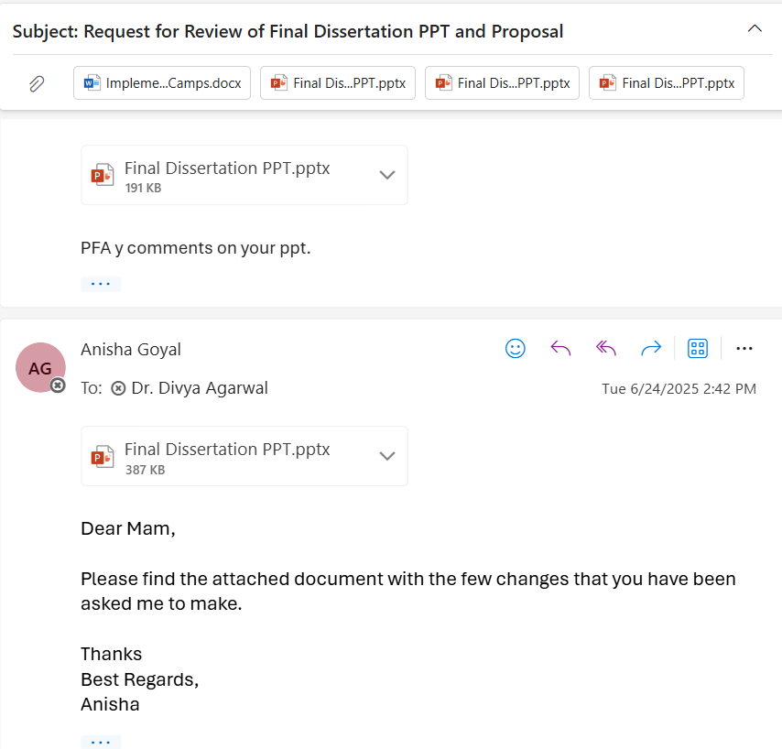
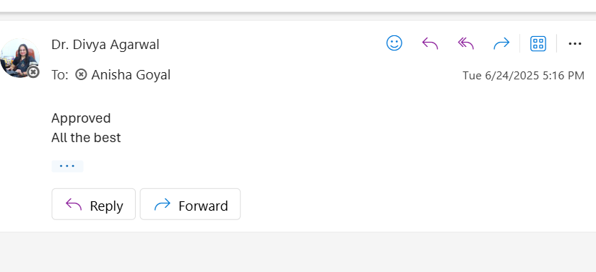
Mentor Approval

Slide 3
What is RPA?
Robotic Process Automation (RPA) is a software technology that uses bots to perform repetitive tasks like data entry, report generation, and form filling.
In health camps, RPA was used to automate patient registration, assign IDs, and generate consultation reports instantly.

Slide 4
For example, earlier in doctor consultations, staff manually entered vitals and filled out forms, which took 7–10 minutes per patient.
With RPA, the bot now auto-fills Patient Details and copies patient details into the doctor's form — saving time and reducing errors.
In optometry, bots generate vision reports immediately after testing, so the technician can attend to the next patient without delay.
In dental consultations, RPA fills diagnosis and treatment fields based on selected symptoms, removing the need to type everything manually.

Slide 5
This automation reduced overall turnaround time (TAT) by 4 to 5 hours across departments.
Staff workload was lowered, allowing them to focus on counselling and clinical decisions instead of paperwork.
Patients received reports faster and felt more satisfied with the smooth process.
Overall, RPA acted like a digital assistant, making the health camp more efficient, accurate, and scalable.

Slide 6
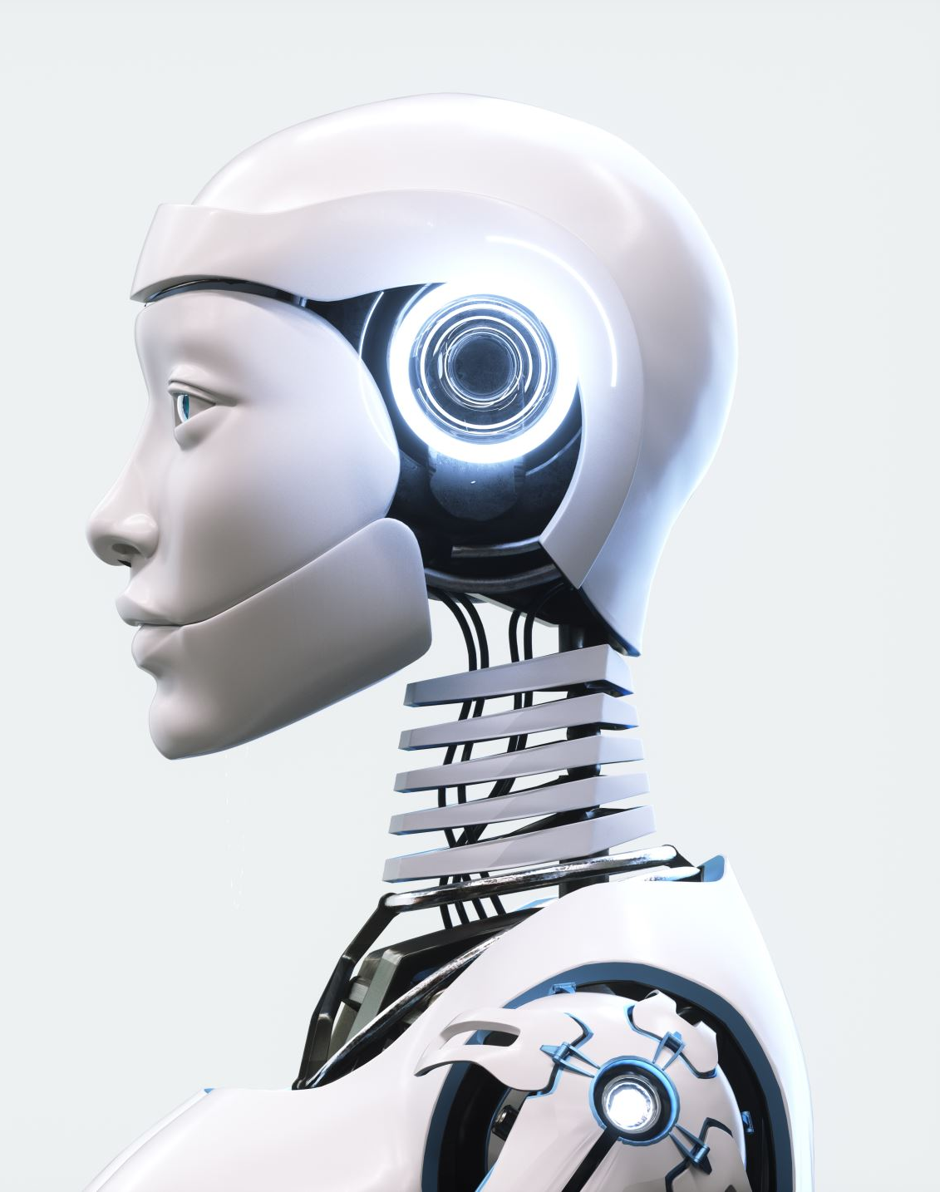
Introduction
Health camps are organized to provide essential medical services to underserved and remote populations. These camps often face challenges such as high patient volume, manual registration, delayed data processing, and limited manpower. Robotic Process Automation (RPA), a technology that uses bots to perform repetitive tasks, can significantly improve the operational efficiency of health camps. By automating routine tasks like patient registration, report generation, and data entry, RPA can reduce human error, save time, and enhance the overall patient experience. Integrating RPA in health camps is a novel approach that holds potential for scalability and replication in similar healthcare delivery models.

Slide 7
Objective
To measure the post-implementation TAT and compare it with pre-implementation data to assess efficiency gains.

Slide 8
Methodology
Study Location: U4RAD Technologies PVT LTD
Study Design: Comparative operational study conducted over a 4 month period , Retrospective & prospective studies respectively.
Study Population: Patients attending health camps.
Sampling Method: Convenience sampling of health camps.
Sample Size: 400 patients
Source of Data Collection: U4RAD reporting bot
Data Tool: Microsoft Excel used for data compilation and management
Notes:
💰 Cost-Effectiveness
RPA can reduce costs by 25% to 50%. Once the bots are set up, they work 24/7 without breaks, salaries, or leaves.
👉 Example: In our health camps, earlier we needed 5 volunteers just to register patients and type reports. With RPA, we now need only 3 staff — the bot handles form-filling, report saving, and data syncing. Huge savings on manpower!
⚡ Improved Productivity
Bots finish tasks faster than humans, which helps us handle more patients in less time.
👉 Example: In optometry, instead of writing vision scores manually, the bot automatically enters data in the system. This gives the technician more time to check the next patient — resulting in faster patient flow and higher camp throughput.
✅ Higher Accuracy
Bots follow the same steps every time — no spelling mistakes, no missing patient details, and no wrong entries.
👉 Example: In doctor consultations, earlier some patient records had missing vitals or incorrect IDs. After RPA, IDs are auto-generated and vitals are logged correctly, avoiding confusion and ensuring complete records.
🧪 Enhanced Quality
Tasks that were often done in a rush or with errors are now done perfectly by bots.
👉 Example: In dental camps, referrals or treatment advice were sometimes wrongly recorded or misplaced. Now, the bot auto-generates the dental advice form and saves it instantly. This reduces rework and improves documentation quality.
😊 Better Customer (Patient) Satisfaction
Since RPA takes over the boring tasks, staff can spend more time with patients and explain reports properly.
👉 Example: Instead of spending 5 minutes filling forms, our team now uses that time to guide patients on how to follow up. Patients also receive their reports faster and correctly, which improves their trust and satisfaction.
📈 Increased Return on Investment (ROI)
Even though RPA setup has some cost, the savings and speed we get in return are visible in just a few weeks.
👉 Example: We saw reduced admin cost and time savings from the very first camp. Faster processing = more patients served = more impact — all without increasing staff or working hours.

Slide 9
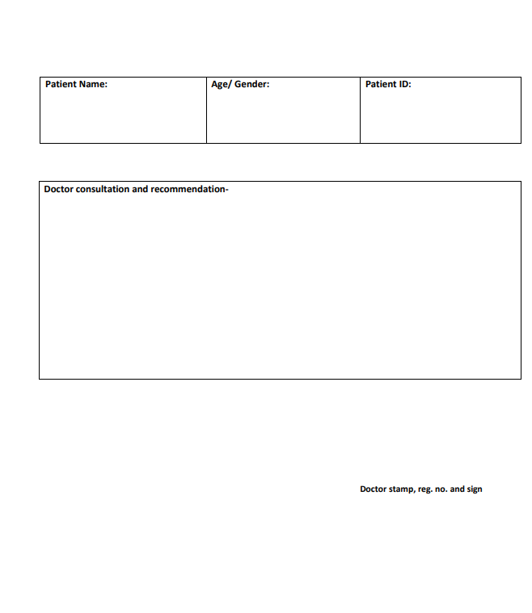
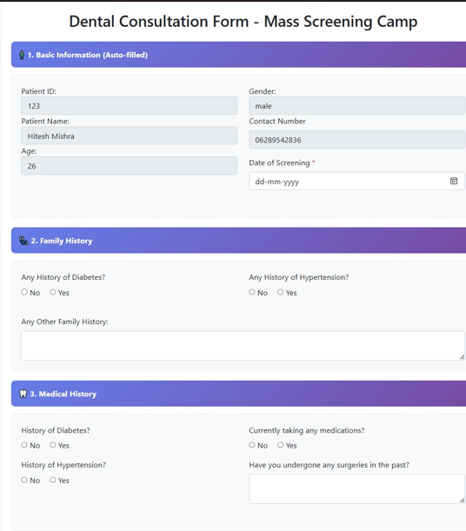
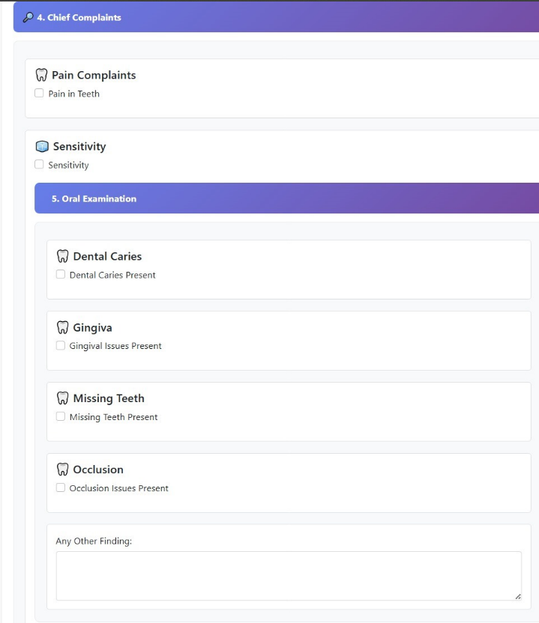
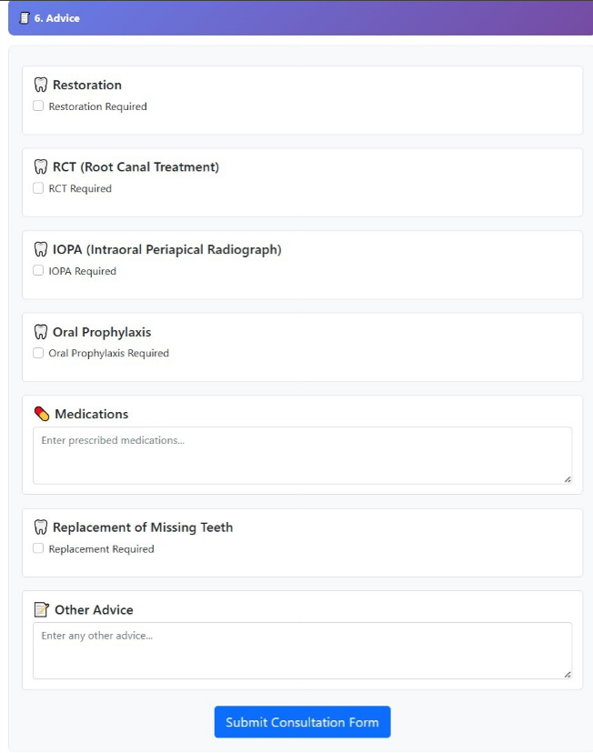
Results
Dentals consultation before RPA
Dentals consultation After RPA

Slide 10
Results (1/3)

Slide 11
Results (2/3)

Slide 12
Results (3/3)

Slide 13
Discussion (1/2)
Reduced patient waiting time and faster report turnaround.
Lower administrative burden on camp staff.
Improved patient satisfaction.
Substantial TAT reduction across all departments confirms that RPA optimizes workflow efficiency.
Doctors Consultation achieved the highest time gain, possibly due to automation of registration, vitals entry, and auto-report dispatch.
Manual bottlenecks like form filling, data transfer, and result communication were significantly minimized.
Notes:
Reduced Patient Waiting Time & Faster Reports
Bots work faster than humans, which means patients don’t have to wait long and get their reports sooner.
👉 Example: In Optometry, earlier patients waited hours to get their vision check reports printed. Now, the bot creates and saves the report instantly — patients receive it before even leaving the camp.
🧑‍💼 Lower Workload on Camp Staff
RPA takes over the repetitive admin tasks, reducing stress and workload on staff.
👉 Example: In Dental Consultation, staff no longer have to type the diagnosis or treatment plan — the bot fills the form based on dropdowns selected. This saves staff energy, especially in high-footfall camps.
😊 Happier Patients
Faster service and fewer mistakes make patients feel more cared for and respected.
👉 Example: In Doctor Consultation, patients now get their prescription and advice sheet in under 10 minutes — this improves their trust and satisfaction with the camp service.
📉 Big Drop in Turnaround Time (TAT)
The time taken from registration to report delivery dropped in all departments.
👉 Example: In Dental, Doctor, and Optometry, reports used to take a day or more to complete and deliver. With RPA, it now happens within a few hours — same-day service even with hundreds of patients.
🥇 Doctors Consultation Saved the Most Time
Because most steps (registration, vitals entry, report dispatch) were automated, doctors could see more patients in less time.
👉 Example: Earlier, doctors could consult 25–30 patients per day. With RPA handling the backend, they now consult 40–50 patients — with no burnout.
🛑 Manual Delays Are Gone
Tasks like copying form details, sending reports by hand, or searching for patient data are now automated.
👉 Example: In the past, if one field was missed in registration, the whole form was delayed. Now, the bot ensures no field is left blank and files are named and stored correctly — no confusion or rework needed.

Slide 14
Discussion (2/2)
Interpretation
RPA bots standardized processes and eliminated redundant steps.
Automation ensures consistency in data capture, faster input, and real-time updates to doctors.
Even a few hours saved per day translates to massive gains at scale (multi-day or multi-location camps).

Slide 15
Conclusion
RPA significantly reduced Turnaround Time (TAT) across all departments (Dental Consultation, Optometry, Doctors Consultation).
Helped in automating repetitive tasks like registration, form filling, and report dispatch.
Improved staff efficiency and reduced dependency on manual processes.
Enabled faster patient flow, minimizing waiting time and delays.
Enhanced patient satisfaction through quicker services and digital communication.
Supported real-time monitoring and data accuracy in health camp operations.
Demonstrated scalability and cost-effectiveness, making it suitable for replication in other health camps.

Slide 16
References
World Health Organization India. Health Camp Toolkit – Quality Assurance and Service Delivery. WHO India; 2015. Available from: https://www.who.int/india/docs/default-source/default-document-library/health-camp-quality-toolkit.pdf.
Patil VN, Pandey B, Joshi M. Organising a health camp and its management. J Emerging Technol Innov Res (JETIR). 2021 Aug;8(8):e584–e590. Available from: https://www.jetir.org/papers/JETIR2108558.pdf.
Agarwal AK, Dash S, Biswal S, et al. Organizing health camp: opportunities for building public health skills. Indian J Community Med. 2024;49(1):228–230. doi:10.4103/ijcm.ijcm_52_23. Available from: https://journals.lww.com/ijcm/fulltext/2024/49010/organizing_health_camp__opportunities_for_building.39.aspx.

Slide 17
Thank You
Any Questions

Slide 18
Pictorial Journey
Total no. of visits done by the student: 7 (Goyala Dairy)
Activities done by student:
Mapping and listing of the area
Interaction with community FLWHs

Slide 19
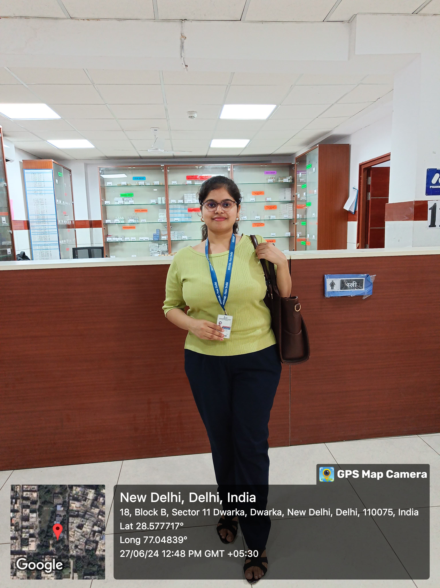
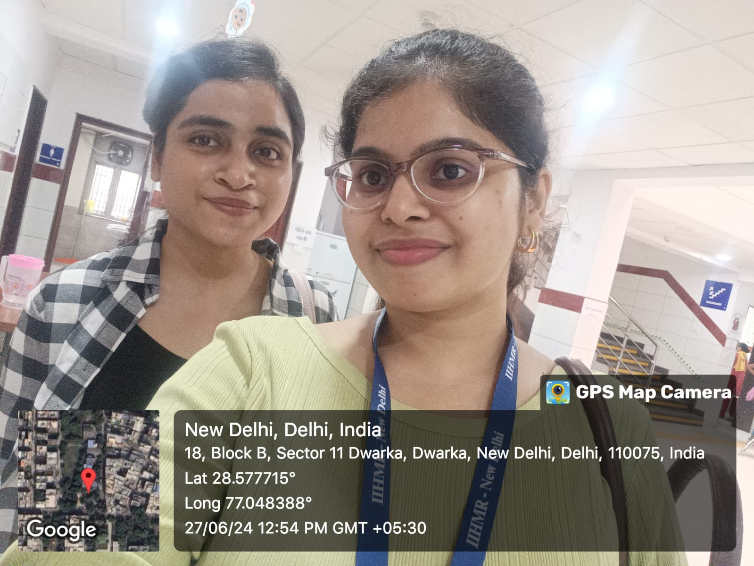
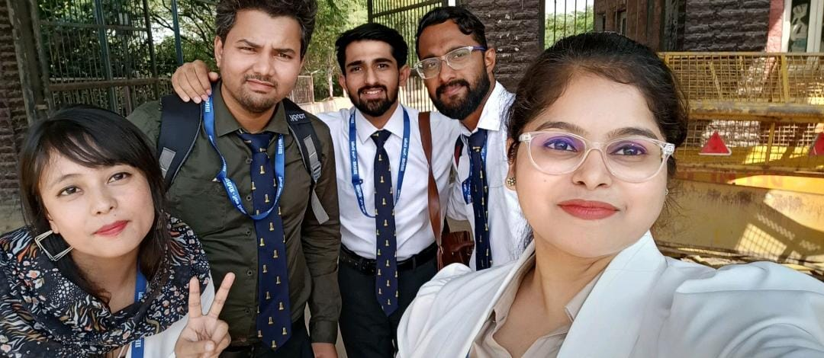
Pictorial Journey (2/2)
Goyala Dairy

