Slide 1

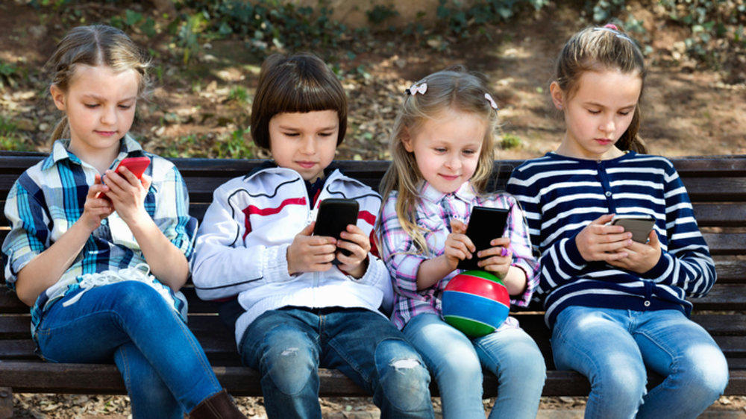
“Nomophobia and Behavioural Changes in Children during the Pandemic”
NHM Kozhikode, Kerala
Dr. Anamika K
Guided by Dr. Sumant Swain
IIHMR Delhi

Slide 2
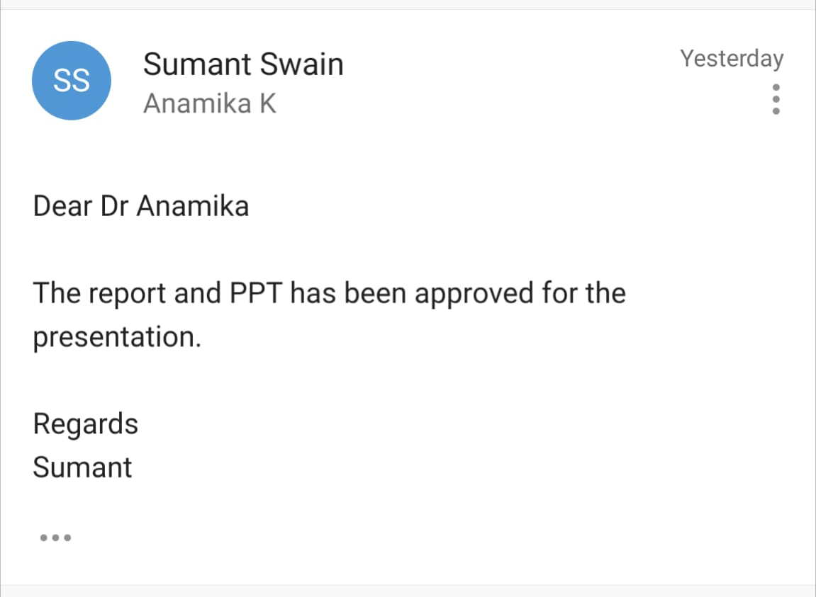
Screenshot of Approval

Slide 3
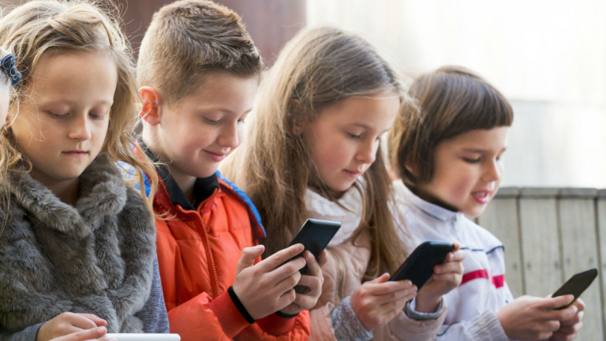
INTRODUCTION
Today, the lives of many children and adolescents are increasingly influenced by new technological devices and means of communication (smartphones, tablets, social networks).
Children and adolescents had lower incidence and mortality rates of COVID-19 than adults. However, they had adverse psychological and behavioural effects, especially among school-age ones, due to home confinement and other infection control measures.
This led children and adults to spend more time at home with effective use of technological devices.

Slide 4
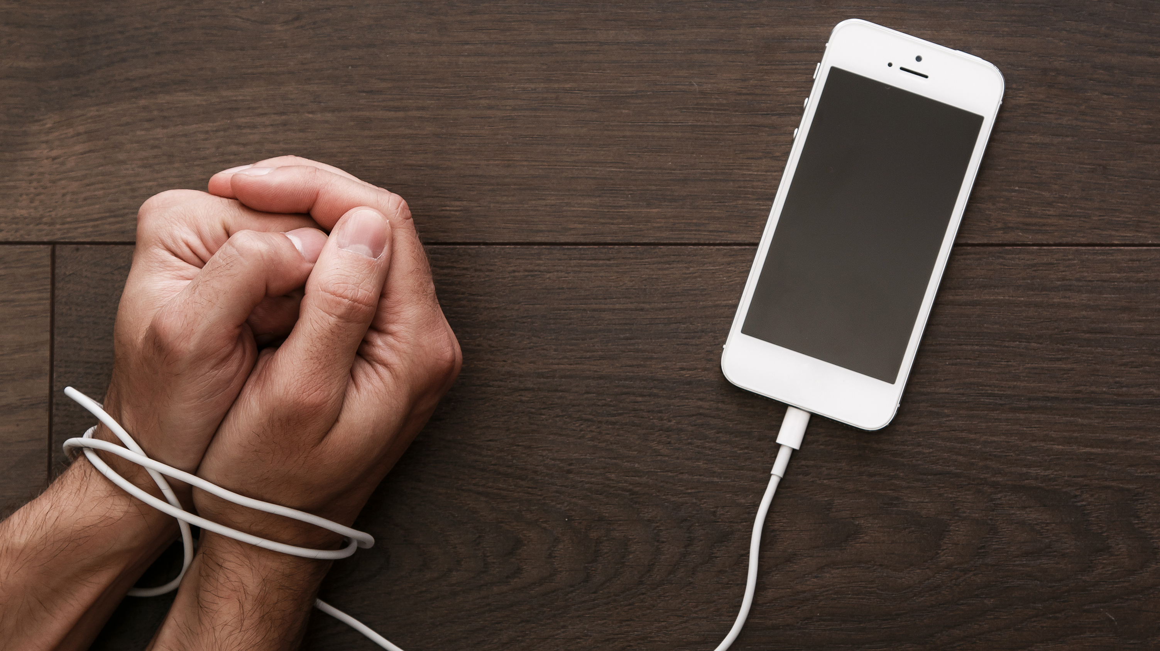
INTRODUCTION
NOMOPHOBIA = NO MObile PHone PhoBIA
a psychological condition when people have a fear of being detached from mobile phone connectivity.
Signs and symptoms,
anxiety,
Respiratory alterations
agitation,
disorientation
tachycardia

Slide 5
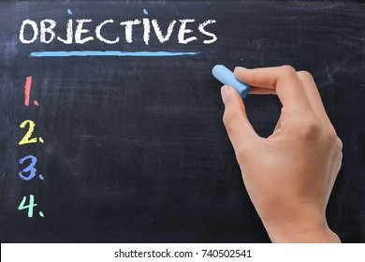
General Objective
To Identify the impact of digital gadgets among children.
Specific Objectives
To understand the Level of Nomophobia among children.
To assess the Symptoms of Nomophobia.

Slide 6

Methodology
Study Design: cross-sectional e-survey.
Study Period: April 4th 2022 –June 14th
Study area: The data was collected from the parents in Kozhikode district in Kerala.
Sampling Technique: Random sampling techniques, Data collection techniques were carried out by questionnaire and telephonic interview.
Sample Size: a total of 200 participants were surveyed and the contact numbers were collected with the support of RBSK nurses.
Research instrument: A personalised e-questionnaire was designed in Google Form in the native language of Kerala and circulated among the parents using social media(What’s App).

Slide 7
Results (1/3)
Nomophobia questionnaire
Statement | Never | Rarely | More often | Always
When they play games on a mobile phone they don't care about other people and even forget themselves, for example, eating, bathing
2) The amount of time spent playing continues to grow until they forget to study
3) Games from mobile phones keep them entertained because they are dizzy with schoolwork.
4) They prefer playing on mobile phones rather than doing work
5) Their tasks are too late if they spend time playing on mobile phones
6) They are happy when they win a game on a mobile phone
7) They feel happy when levelling up or discovering new games from a mobile phone
8) They refuse and argue when told by my parents to help when playing so that makes parents angry
9) We parents make ends meet (obey) them so they don't get angry
10) When they play games from a mobile phone, they always increase the game level
11) they always add time to play games from a mobile phone
12) They feel uneasy when they don't play games on the mobile phone a day
13) They fill my free time by playing with a mobile phone
14) They play a game from a mobile phone so they don't miss another friend
15) they prefer to play mobile phone instead of playing outdoor with friends

Slide 8
Results (2/3)
Nomophobia questionnaire Responses
 | Never | Rarely | More often | Always
Total Score | 1019 | 806 | 791 | 384
Average(Children) | 67.9 | 53.8 | 52.7 | 25.6
Percentage | 33.9% | 26.9% | 26.4% | 12.8%
Around 121 children or 60.8%,(Added responses, Never + Rarely) did not experience the habit or frequency of using mobile phones.
Around 25 children or 12.8% of the total 200 children have shown high intensity or always using mobile phones for games.
Around 52 children or 26.4% of 200 children with intensity more often used mobile phones.

Slide 9
Results (3/3)
Nomophobia symptom’s responses
Nomophobia Symptoms | Never | Rarely | More often | Always
Anxiety | 72 | 57 | 59 | 12
Agitation | 75 | 57 | 58 | 10
Disorientation | 80 | 60 | 46 | 14
Respiratory Alteration | 110 | 47 | 33 | 10
Total score | 337 | 221 | 196 | 46
Average (Children) | 84.25 | 55.25 | 49 | 11.5
Percentage | 42.1% | 27.6% | 24.5% | 5.8%
Around 139 children or 69.7%(Added responses Never + Rarely), did not show the symptoms or behavioural changes as an impact of using mobile phones.
Children who indicated nomophobia symptoms were around 11 children or 5.8% of the total 200 children due to high intensity or always showing the behavioural changes
49 children or 24.5% of 200 children with intensity more often showed the symptoms.

Slide 10

The result of this survey will be a stepping stone for the realisation and a reminder for the parents, teachers and the authority that it’s high time to find a solution for mobile addictions in children.
12.8% of the children had high intensity or always using mobile phones and 26.4% of children used mobile phones with an intensity of more often.
5.8% of the children have shown the symptoms of nomophobia always and 24.5% of the children have shown the symptoms more often.
Although it does not reach 50%, this condition must be observed and anticipated so that no more serious negative impacts occur.

Slide 11
Factors to be focused on,
There is no limit to mobile phone use in India.
A single person can use multiple phones.
Telecom Regulatory Authority of India (TRAI) can play an active role by making a policy/law.
There should be a minimum upper age limit for using mobile.
The schools/colleges should strictly enforce the mobile phone restriction in their institution.

Slide 12

Limitations of the Study
The survey was conducted based on the respective online network.
The study is limited to those who have smartphones and understand the Google form survey.
Many samples were not collected as it was expected.
Despite these limitations, these findings will likely provide valuable information for the upcoming actions.

Slide 13

It can be concluded that from the results of this study,
some children indicate dependency on using mobile phones as a means of entertainment when there is an opportunity and free time,
they prefer to play using a mobile phone rather than playing with their friends.
Moreover, around 30% of the children started showing the consequences of gadget addiction.

Slide 14
References
Kumar, Ravi, Supriya Kumari, Puja Bharti, and Divyam Sharma. “Nomophobia: A Rising Concern among Indian Students.” Industrial Psychiatry Journal 30, no. 2 (2021): 230. https://doi.org/10.4103/ipj.ipj_134_21.
Pratiwi, Ika, Zuhdan Prasetyo, Samsuri Samsuri, Much Fardani, and Tutik Khotimah. “Identification of Nomophobia in Primary School Age Children and Its Consequences for Friendly Character Behavior.” In Proceedings of the Proceeding of the 2nd International Conference Education Culture and Technology, ICONECT 2019, 20-21 August 2019, Kudus, Indonesia. Kudus, Indonesia: EAI, 2019. https://doi.org/10.4108/eai.20-8-2019.2288143.
Anboucarassy B, Begum M. Effect of use of mobile phone on the mental health of higher secondary school students. I-manager's J Educ Psychol. 2014;8:15–9.
B. ANBOUCARASSY, and MUMTAZ BEGUM *. “Effect of Use of Mobile Phone on Mental Health of Higher Secondary School Students.” Journal. India, 2014.

Slide 15
Thank You

Slide 16
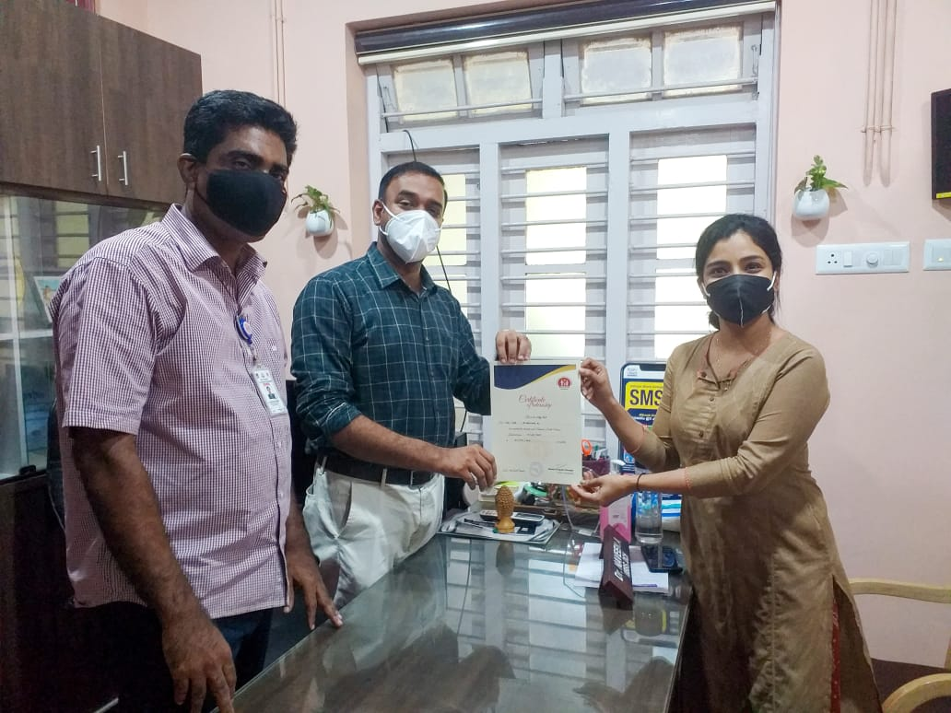
Pictorial Journey
NHM Kozhikode

