Slide 1

Household expenditure on diabetes care among patients with voluntary funded health insurance coverage in India- a Systematic Review.
IIHMR,DELHI
DR. ARCHANA THAKUR
(Associate Professor)
IIHMR Delhi

Slide 2

Mentor Approval

Slide 3
Introduction
Diabetes mellitus is a global public health concern.
Globally, 537 million adults suffer from diabetes and is expected to rise to 783 million by year 2045. In India, estimated 74 million people suffer from Diabetes.
Out-of-pocket expenditure due to diabetes care ranges from INR 5000 to INR 30,000 per month highlighting the inaccessibility to affordable healthcare services for the population.
The voluntary health insurance policies cover people with diabetes only after waiting period of 2-3 years. These policies offer a variety of additional benefits, such as coverage for AYUSH treatments (Ayurveda, Unani, Siddha, and Homeopathy), no-claim bonuses, tax breaks under Section 80D, portability options, restoration benefits, ambulance services, advanced diagnostic tests, domiciliary treatment, and regular health check-ups.
However, clear evidence supporting the hypothesis is lacking.

Slide 4
Review of Literature
Author; Year | Study Design | Study Objective | No. of Studies included | Findings
Bansode B et al;2019 | Systematic Review | To determine the economic burden of diabetic patients in India. | 18 | Total annual expenditure on diabetes on an average was INR 10000 in Urban areas and INR 6260 in Rural areas
Tripathy J et al;2018 | Secondary analysis of Nationally representative data | To estimate household OOPE for hospitalization in DM. | 3935 episodes of hospitalization | OOPE for DM hospitalization –USD 151
Einarson T et al;2018 | Systematic Review | To review published articles describing costs of CVD in Type 2 DM | 24 | $9750 for treatment of CVD and Type 2 DM , cost of treatment of Type 2 DM alone was $3418

Slide 5
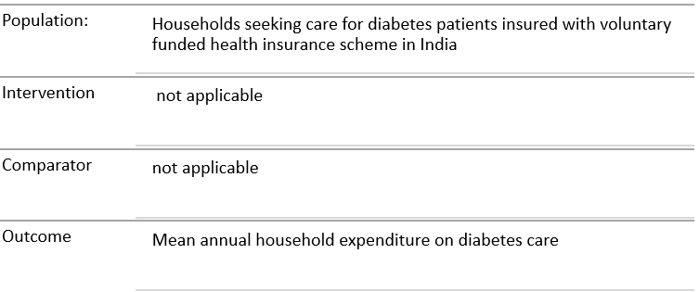
Research Question
What is the average out of pocket expenditure by patients with diabetes possessing voluntary funded health insurance coverage in India?

Slide 6
Objectives of Your Study
We planned a systematic review to gather evidence on annual expenditure on diabetes care among households with voluntary health insurance policies.
Household expenses will include direct medical and non-medical as well as indirect costs due to loss of income from productivity losses.
This study will provide estimates of household expenditure to understand economic burden among insured person and highlight the need of further innovations in health insurance policies both by innovators and at policy levels.

Slide 7
Methodology (1/2)
Search Strategy and Selection Criteria
The research papers were searched from the following three databases- PubMed(511), Cochrane, Central Register of Controlled Trials (CENTRAL), Cochrane Register of Studies Online(387) and ProQuest (168).Studies published between 2018 and 2025 were included.
Inclusion Criteria-
  We focussed on studies estimating household expenditure/out-of-pocket expenditure/loss of wages due to illness or care-seeking for diabetes, with voluntary health insurance coverages in India.
  All observational studies or RCTs from community or hospital-based sources ,
  Only Type 2 DM studies ,included.
Exclusion Criteria- Non-English language studies, Case reports, case series, editorials, letter to editor, conference presentations, reviews, viewpoint, other forms of diabetes – type 1, GDM, or other conditions leading to hyperglycaemia not included.

Slide 8
Methodology (2/2)
Screening and Data Extraction
  We performed screening in Microsoft excel.
  Title and Abstract screening of studies obtained from search results in the databases was conducted . PubMed-52, Cochrane-3, ProQuest-33.
  Number of Relevant studies after Full Text Review-20
  Selection of relevant studies based on title and abstract followed by full text review. Final selection of the studies was included in the review done by considering the inclusion and exclusion criteria.
  Data was extracted using Microsoft excel tool.
  Quality Appraisal
We will use “consensus-based checklist for the critical appraisal of cost-of-illness (COI) studies”
for Quality Appraisal.
Reporting
We will use PRISMA 2020 for reporting.

Slide 9
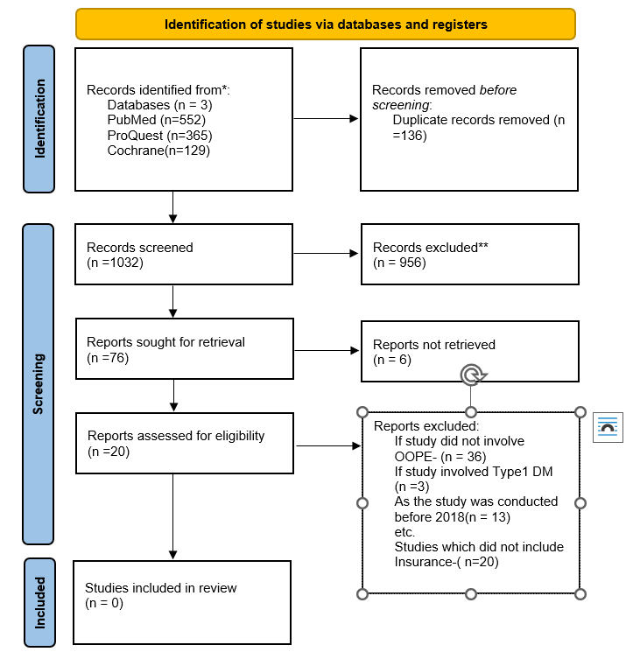
Results (1/2)

Slide 10
Results (2/2)
Findings related to Insurance
AUTHOR, YEAR,PLACE | Insurance status | Type of Insurance | OOPE among insured | Proportion of household expenditure spent on diabetes care
Basu S et al;2020;DELHI | 29 PATIENTS INSURED | Unspecified but with complete medication coverage | UNSPECIFIED | UNSPECIFIED
Seshadri H et al;Chennai;2024 | Insured:67.5% | state government insurance programme. | UNSPECIFIED | UNSPECIFIED
Sharma A et al;2021;Punjab | 20% insured | 17% with personal HI and 3% with employer provided insurance | UNSPECIFIED | UNSPECIFIED
Mathew G et al;2019;Bengaluru | insured;6.5% | unspecified | UNSPECIFIED | UNSPECIFIED

Slide 11
Discussion
We did not find any eligible study to support our research question.
Future studies should be conducted in this area to find evidence regarding the economic burden on Indian households due to Diabetes Care among patients having Voluntary funded health insurance schemes or provide sub group analysis by insurance status(different types of insurance).

Slide 12
Limitation of the study
We did not find any relevant studies which could be eligible to be included in this review.

Slide 13
Conclusion
The study revealed that there is no evidence of economic burden on Indian households with voluntary funded health insurance due to Type 2 Diabetes care.
There is a definite need to design and conduct studies to evaluate the effectiveness of the Voluntary funded health insurance in reducing the financial burden on the Indian population and ensure financial risk protection.

Slide 14
References
[1] IDF Diabetes Atlas, Diabetes around the world in 2021 https://diabetesatlas.org/
[2] https://idf.org/our-network/regions-and-members/south-east-asia/members/india/International Diabetes Federation. (n.d.). India. Retrieved April 2, 2025, from https://idf.org/our-network/regions-and-members/south-east-asia/members/india/
[3] https://cadiresearch.org/ CADI Research Foundation. Home. [Internet]. [cited 2025 Apr 2]. Available from: https://cadiresearch.org/
[4] https://www.who.int/india/diabetes World Health Organization. (n.d.). Diabetes. Retrieved April 2, 2025, from https://www.who.int/india/diabetes
[5] An economic evaluation of diabetes mellitus in India: A systematic review
https://www.sciencedirect.com/ ScienceDirect. Home. [Internet]. [cited 2025 Apr 2]. Available from: https://www.sciencedirect.com/
[6]https://www.expresshealthcare.in/ Express Healthcare. Home. [Internet]. [cited 2025 Apr 2]. Available from: https://www.expresshealthcare.in/

Slide 15
INVOLVEMENT IN COMMUNITY OUTREACH PROGRAMME (COP) ACTIVITIES
Total no. of visits done by the Student: 4
Day-wise activities done by the student: Collecting data on type of household, no. of family members, family size, nutrition status, education status , type of toilet used, sanitation levels.

Slide 16

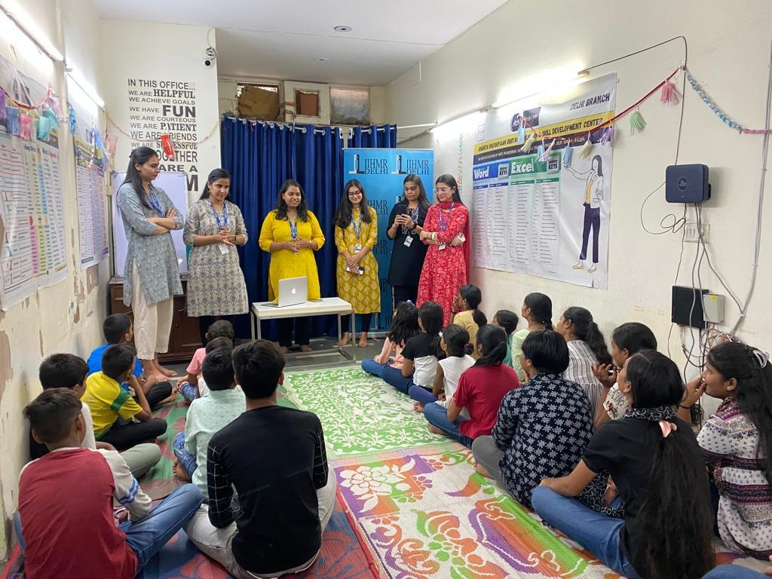
COP FIELD ACTIVITIES PHOTOGRAPHS

Slide 17
Thank You
Any Questions

