Slide 1
DISSERTATION
PRESENTATION
PRESENTED BY: swati kumari
PG/12/099
Batch-E (HEALTH)

Slide 2
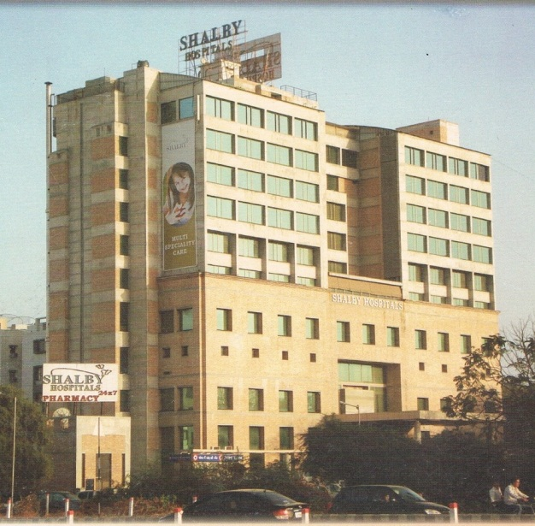

PROFILE OF ORGANIZATION

Slide 3
organization name :- Shalby Hospital , Ahmadabad
Shalby is the leading multi-speciality tertiary care healthcare institutions in Western India.
Shalby began its journey as a Joint Replacement Centre in 1994 by Dr.VikramShah.
Till date, over 40,000 joint replacement surgeries of different types have been done.
The quality of our healthcare services has been certified by by accreditations bodies like the NABH, NABL and ISO 9001:2008 and recognised by most prestigious awards like the Rajiv Gandhi National Quality Award, the FICCI award and many more.
It is 200 bedded hospital .
The OPD is average 250 to 270 patients/day.

Slide 4
The specialties include
Arthroscopy Bariatric surgery Bronchoscope Cardio thoracic surgery Cosmetic surgery Critical care Dermatology Dialectology Internal medicine Joint replacement Physiotherapist | Dentistry Kidney transplant Ear ,nose and throat surgery G.I. surgery Gastroenterology Nutrition and diet Onco surgery Oncology Ophthalmology Endoscopy laparoscopy | Plastic surgery Pulmonology spine surgery Trauma surgery Urology Vascular surgery urology Surgery Neurology General surgery Gynecology obstetrics. Infectious disease .

Slide 5
KEY LEARNING
NABH standard monitoring for awareness and implementation .
Learning as to what are the basic issues in providing quality healthcare services at the Hospital.

Slide 6
DISSERTATION TOPIC
Awareness and implementation of international patient safety goal

Slide 7
WHY PATIENT SAFTEY GOAL
To promote specific improvements in patient safety.
To highlight problematic areas in health care and describe evidence and expert –based consensus solution to these problems.

Slide 8
List of goals
Identify patient correctly.
Improve effective communication.
Improve the safety of high alert medication.
Ensure correct site, correct procedure, and correct patient surgery.
Reduce the risk of health care associated infection.
Reduce the risk of patient harm resulting from falls.

Slide 9
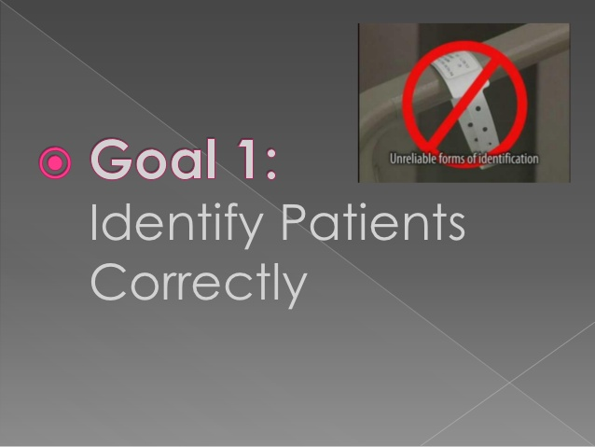
Wrong patient error occurs in virtually all aspects of diagnosis and treatment. patients may disoriented , not fully alert ,may change bed, room or location that may lead to error in identification .
So patient room no and location cannot be used for identified the patient .
Identified only by :-
1. name
2.IP no.
3.Bed no.

Slide 10
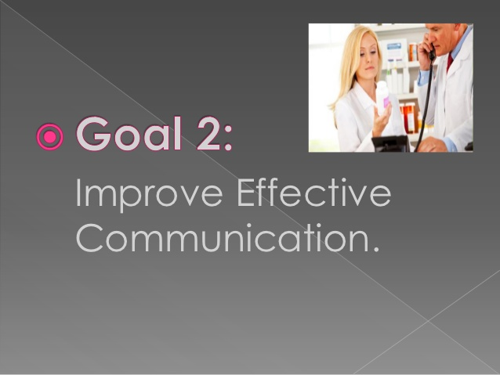
Developed accuracy of verbal and telephonic communication .
The most error in communication are patient care order given verbally .
To complete verbal and telephonic order written down- read back by the receiver
And confirmed by individual who gave the order .

Slide 11
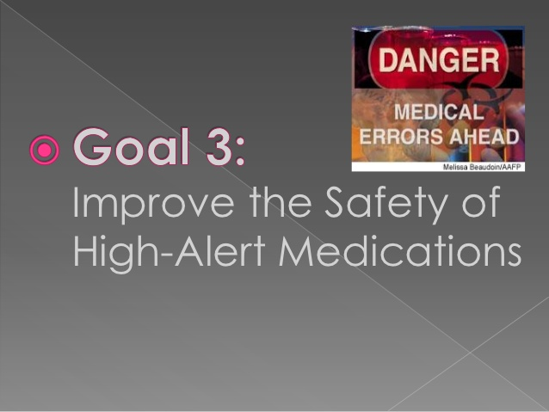
High alert medication are those medication involve in the high percentage of error and sentinel events .
Medication that carry high risk for adverse outcomes well as look alike and sound alike medication .
The organization should be identify the organization list of high risk medication based on their own data .
The location ,storage and labeling should be proper of high risk medication .

Slide 12
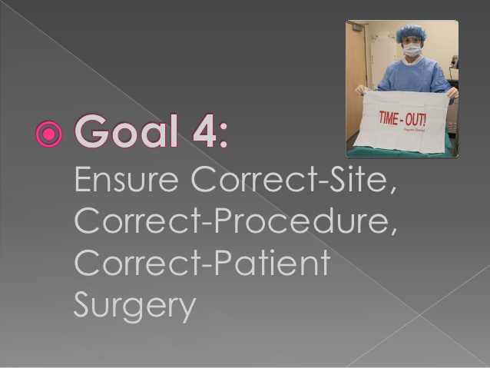
Wrong –site ,wrong procedure ,wrong patient surgery is an alarmingly common Occurrence in health care organization .
The surgical site marking should be done with instantly recognizable .
Be visible after the patient is prepared and draped.
The essential processes found in the Universal Protocol are :-
marking the surgical site.
A preoperative verification process.
A time-out that is held immediately before the start of a procedure .

Slide 13
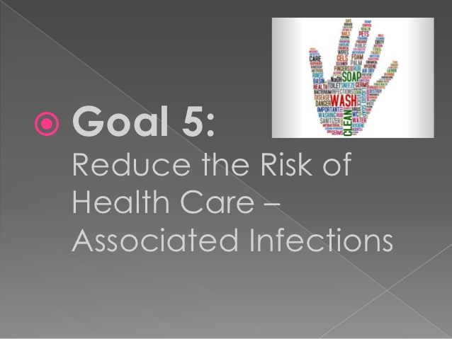
Infection prevention and control are challenging in most health care settings
Infections common to many health care settings include catheter-associated urinary tract infections, bloodstream infections..ETC
Central to the elimination of these and other infections is proper hand hygiene.

Slide 14
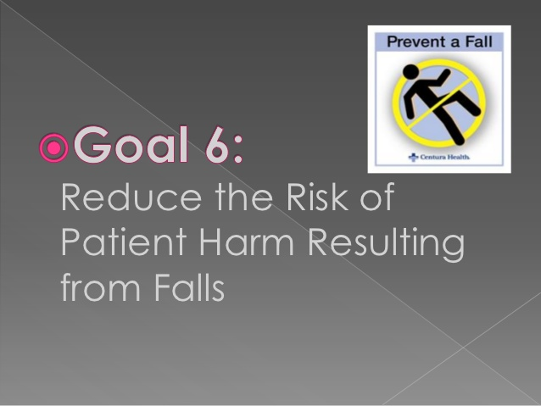
Falls account for a significant portion of injuries in hospitalized patients.
The organization should be evaluated its patients’ risk for falls and take action to reduce the risk of falling.
The organization establishes a fall-risk reduction program based on appropriate policies.

Slide 15
Review of literature
Rachel E. Davis et al. Patient involvement in patient safety: Health Expectations 10, pp. 259-267, 2007
Vikki A. Entwistle et al. Speaking up about safety concerns: multi-setting qualitative study of patient‟s views and experiences, Quality and Safety in Health Care 19, pp. 1-7 ,2010
Sander Gaal et al. What do primary physicians and researchers consider the most important patient safety improvement strategies? BMC Health Services Research 11(102), pp. 1-6,2010
Jill Hall et al. ,Effectiveness of interventions designed to promote patient involvement to enhance safety: a systematic review Quality and Safety in Health Care 19, pp. 1-7 ,2010

Slide 16
PROBLEM STATEMENT AND RATIONALE
In India, Heath System currently operates within an environment of rapid social, economical and technical changes. Such changes raise the concern for the quality of health care.
Problems faced: Staffs are busy with their schedule so most of the time we have to wait for their response.
SOLUTION WOULD BE
Monitoring of NABH standards

Slide 17
objectives
GENERAL OBJECTIVE
To make aware and implement international patient safety goal.
SPECIFIC OBJECTIVE
The specific objectives of the study are as follows-
To assess the awareness of healthcare provider about the NABH standard regarding patient safety goal.
To determine the basic status of patient safety goal in shalby hospital.

Slide 18
METHODOLOGY
STUDY AREA
The study was conducted in the Shalby Hospital, Ahmadabad
STUDY DESIGN:-Cross sectional and descriptive study
STUDY POPULATION:IPD patients
Sample size:- 100
Type of sampling:-Randomly convenient sampling
TOOLS:- Questionnaire, check list
TECHNIQUES:- Observation, interview
DATA COLLECTION METHOD
Primary data:- Observation, interview
CONTAINENT VALIDITY
The tool was given to some of the expert to contain validity based on their suggestion and recommendation tool was modified

Slide 19
FINDINGS
INTERNATIONAL PATIENT SAFTEY GOAL SURVEY
Question | YES | NO | PARTIAL
1. Patient ID band is checked. | 90% | 10% | 0
2. Patient Id no. and name on patient bed is cheeked. | 80% | 18% | 2%
3. Verbal communication to the patient for his/her name. | 95% | 4% | 1%
4. Hand over written in over book . | 100% | ………… | ………….
5. Care plan written in nursing notes. | 47% | 16% | 37%
6. Verbal information transfer on patient ‘s treatment plan . | 93% | 7% | ………..

Slide 20
QUESTION | YES | NO | PARTIAL
7. Awareness about high alert medication including sound alike and look alike medication. | 35% | 53% | 12%
8. Double cheek high alert medication for date ,name, dose, route ,frequency etc | 51% | 445 | 5%
9. Segregation of sound alike and look alike medication | 88% | 12% | ……….
10. WHO surgical safety checks list filled and available in medical records.
11. Goal 1 is adequately is followed | 100% | ………… | ………..
12. Site marking for surgery on patient’s body | 100% | ………… | …………
13. Awareness about correct hand hygiene practices and other infection control protocols. | 55% | 25% | 20%
14. Correct hand hygiene technique used for hand hygiene. | 31% | 48% | 21%
15.PPE used prior to patient care | 87% | 13% | …….
16.Nursing initial assessment is done including fall risk assessment. | 93% | 7% | ……
17.Patient vulnerability is identified. | 100% | ……… | ………
18.Safety measures are available to patient | 100% | ……… | ……..

Slide 21
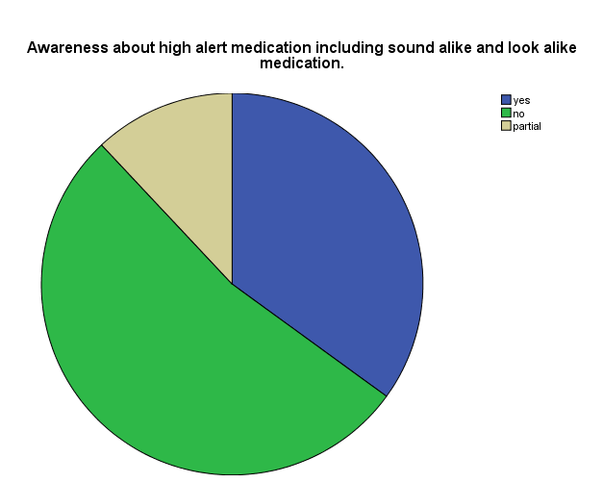
MAJOR PROBLEMS FINDINNG
Awareness of healthcare providers about high alert medication including sound alike and look alike medication is 35% and 53 % are not aware and 12% are partially aware.
12%
35%
53%

Slide 22
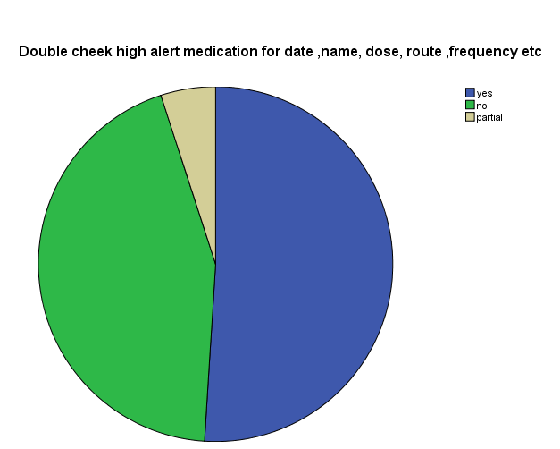
Double checking of high alert medication is followed by 51% staff and 44% not followed and 5% partially followed by healthcare providers
5%
51%
44%

Slide 23
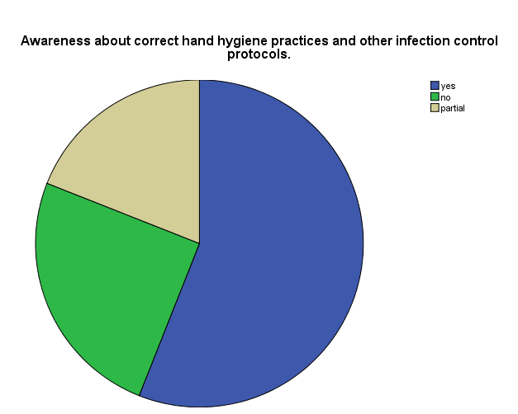
55% of staff are aware about hand hygiene process and 25 % staff are not aware and 20% are partially aware
20%
55%
25%

Slide 24
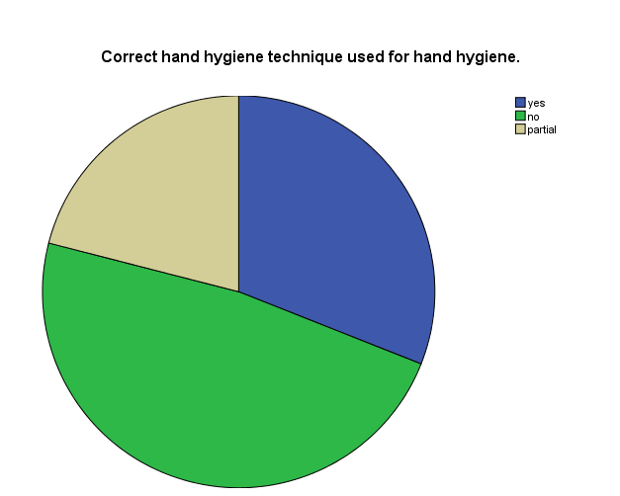
30% are used correct hand hygiene techniques and 50% are not followed correct hand hygiene techniques 20% are partially followed hand hygiene techniques.
20%
30%
50%

Slide 25
Recommendations and Suggestions
Comprehensive Plane of care should be filled in all files.
Frequently training facility /workshops for all healthcare providers.
Frequently monitoring for hand washing technique.
Use technology for decrease work load.
By followed strict rule and regulation..
By proper monitoring, survey.

Slide 26
References
www.shalby.com .
shalby hospital
www.jci.com.
Susan Kirk et al. Patient safety culture in primary care: developing a theoretical frame-work for practical use .Quality and Safety in Health Care 16, pp. 313-320 ,2007.

Slide 27


