Slide 1
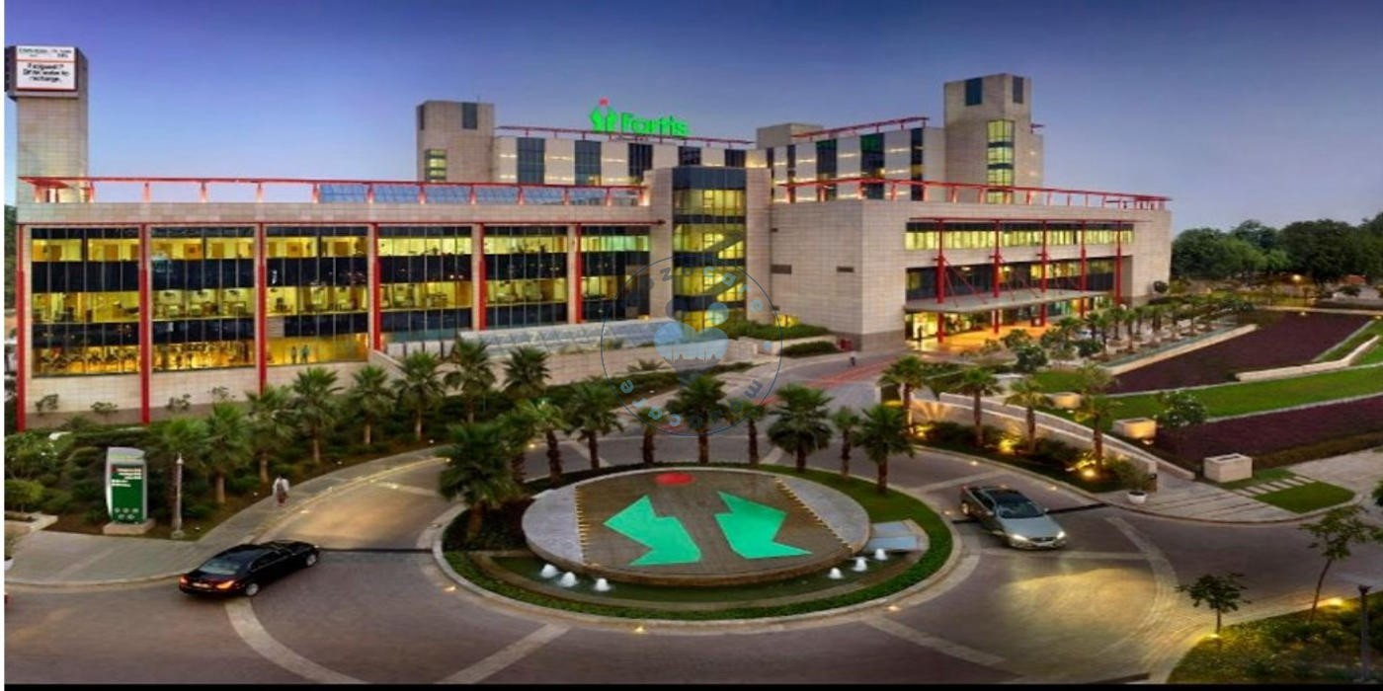

Process Improvement of Master Health Check-Up at Fortis memorial research institute, Gurugram
Mentor – Dr. Nikita Sabherwal
Submitted by ;- Aashish Garg
Enrollment no. – PG/21/003
Batch – 2021 -23

Slide 2

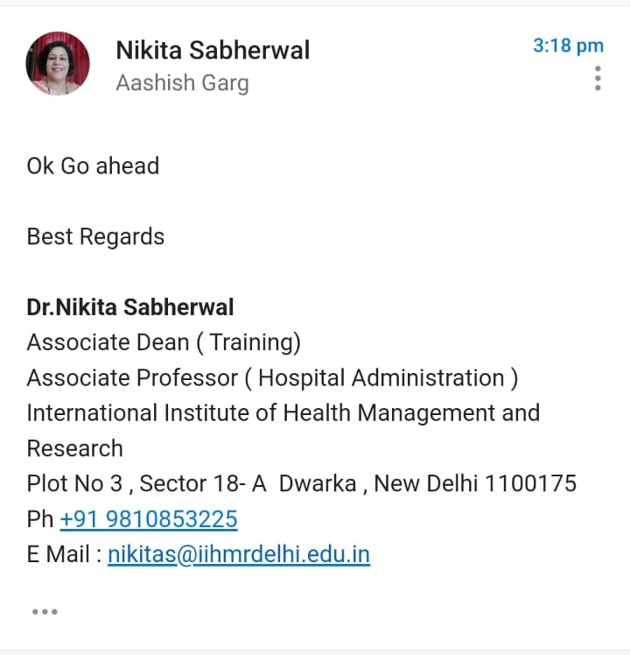
Screenshot of approval
Date of Approval: 23rd June

Slide 3
Fortis Memorial Research Institute (FMRI)
Is a multi-super strength, quaternary consideration clinic with a lucky global workforce, rumored clinicians, including super-subtrained professionals and specialty medical caretakers, upheld by state of the art innovation.
FMRI is a high level focus of greatness in Robotic Surgery, Neurosciences, Oncology, Renal Sciences, BMT, Organ Transplants, Orthopedics, Cardiac Sciences and Obstetrics and Gynecology.
The clinic houses some exceptional top notch offices for the orderlies of the patients as well, which incorporate Tummy Luck, R&R Lounge, Meditorium, Holistic Health, Mamma Mia, Retail Therapy, Crèche, Health 4 U, Pevonia and Fortiplex.

Slide 4
H4U DEPARTMENT
Health4u at Fortis Memorial Research Institute is a one-stop destination for all Lab and Diagnostic tests, Consultation with the Specialist, and further treatment if necessary. It is designed to offer lifestyle interventions and tailor made health screenings for your health. The programme is run and supported by specialists and super-specialists from all medical disciplines with an aim to deliver the highest standard of Preventive Medicine for your healthier life.
Two Types of patients:
Corporate patients – 76%
Individual patients – 24%
Packages for Individual patients –
Basic
Essential
Lifestyle
Premium
Golden Age (above 60 years)

Slide 5
AIM :
To find the turnaround time and provide feasible solution to reduce the waiting time of the health check up process at Fortis Memorial Research Institute, Gurugram.
Primary objectives :
Map the entire process flow from patient entry till the patient leaves from H4U department.
Secondary objectives ;
Identify areas of delay.
Identify causes of delay.
Provide feasible recommendation.
Problem Statement :
The increased turnaround time of heath check-up which lead to more patient complaints and poor feedback.

Slide 6
METHODOLOGY
All the samples have been tracked from the point of entry to exit from the master health check-up department.
MODE OF DATA COLLECTION:
Data Collection was done through the checklist method. Interviewing the staff, checking the patient’s record file.
The data is collected from both primary as well as secondary sources
Primary source:-
Personal observation
Secondary sources:-
Hospital information system (HIS)

Slide 7
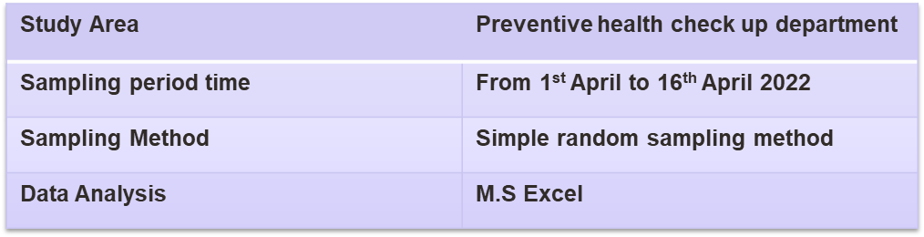
From 1st May to 30th May 2022
Convenience sampling
Selection Criteria-
This study included all those patients who were presented for their annual health checkup and excluded those patients who came from OPD.

Slide 8
Results
Waiting time Analysis
Results

Slide 9
ANALYSIS
The average time for the completion of health check up for 50 patients is 6 Hours 9 minutes out of which 2 hours and 24 minutes are spend on the services and 3 hours 45 min is waste time (waiting time).
The standard turn around time set by the hospital is between 4 hours – 5 hours.
Arrival time for 82% of the patient observed was between 8am to 9am. 7% of them arrived before 8 am and rest of the patient’s after 9am.

Slide 10
DISCUSSION
Gynaecology Consultations
  Gynaecologist is available usually after 1 pm or 2pm. Altering the time would be beneficial.
  Consultation mostly takes place in ECG room therefore delaying the ECG, TMT/Echo. A separate space can be allocated to the doctor.
Patient coordination
  Patient is clueless about the process and where to go next.
  Executives not present at times to guide and handover the files for next investigation.
  Poor team work leading to confusion and more waste time.

Slide 11
ULTRASOUND
  6-7 patients simultaneously waiting for USG.
  Patient not able to control bladder pressure for longer duration because of waiting period.
  Delayed USG leads to delayed PP blood sample time increasing the idle time of patient.
INTERNAL MEDICINE CONSULTATION
  Pre consultation time : 2-3 mins
  Post consultation time: 5-10 mins
  Appointment is not given for post consultation, patient is asked to collect the file after 24 hours and consult the doctor resulting in more patients for post consultation at a time on some days. More post consultation appointments delays the pre-consultation after ECG further delaying the TMT/ECHO.
  No queue is formed for consultation
  Staff is not available for queue management leading to confusion and decrease patient satisfaction.

Slide 12
Limitations of study
Difficulty in tracking patient.
Extended waiting time.
Transfer of patients to different departments

Slide 13
Conclusion
The time spent on various activities in the Health4U department of a hospital was documented to see if proper guidelines were being followed at the department.
A positive result was found after the study was done.
In the department, the staff was well-trained, and doctors were present. While performing a wide range of activities in the department, the average time also was found satisfying.

Slide 14
References
Hawkins RC. Laboratory turnaround time. Clin Biochem Rev. 2007 Nov;28(4):179–94.
Fang DZ, Sran G, Gessner D, Loftus PD, Folkins A, Christopher JY, et al. Cost and turn-around time display decreases inpatient ordering of reference laboratory tests: a time series. BMJ Qual Saf. 2014 Dec;23(12):994–1000.
A B, Natarajan P. REDUCTION OF TURNAROUND TIME OF IN-PATIENTS IN A PRIVATE HOSPITAL, CHENNAI A SIX SIGMA APPROACH. IJEMR. 2011 Nov 1;2249–8672.
Cole, F.L., Mackey, T.A., & Lindenberg, J. (2001). Wait time and Satisfaction with Care and
Service at a Nurse Practitioner Managed Clinic. Journal of the American Academy of Nurse Practitioners, 13, 467-472.
Dansky, K.H., & Miles, J. (1997). Patient Satisfaction with Ambulatory Healthcare Services:
Waiting Time and Filling Time. Hospital & Health Services Administration, 42, (2) 165-177.
Student Dissertation [Internet]. [cited 2022 Jun 22]. Available from: https://iihmr.edu.in/research/student-dissertation/2015-2017/study-on-turnaround-time-of-patient-in-emergency-department

Slide 15
Internship experiences
Skills learnt
Patient handling
Patient coordination
Grievance handling
Department coordination

Slide 16
Recommendations
The H4U department follows SOP’s as set by the hospital and operates smoothly. Doctors and nurses obediently follow all the rules and regulations, and the patients are pleased as well.
The thing that can be improved is making appointments for the post-test consultations so as to reduce the waiting time and provide optimum care to the patients.
Patients should be informed for the post consultation during their assessment at the department.
Sometimes coordination is missing, due to less no. of coordinators, which should be increased for the efficient patient handling and smooth work flow of the department.

Slide 17
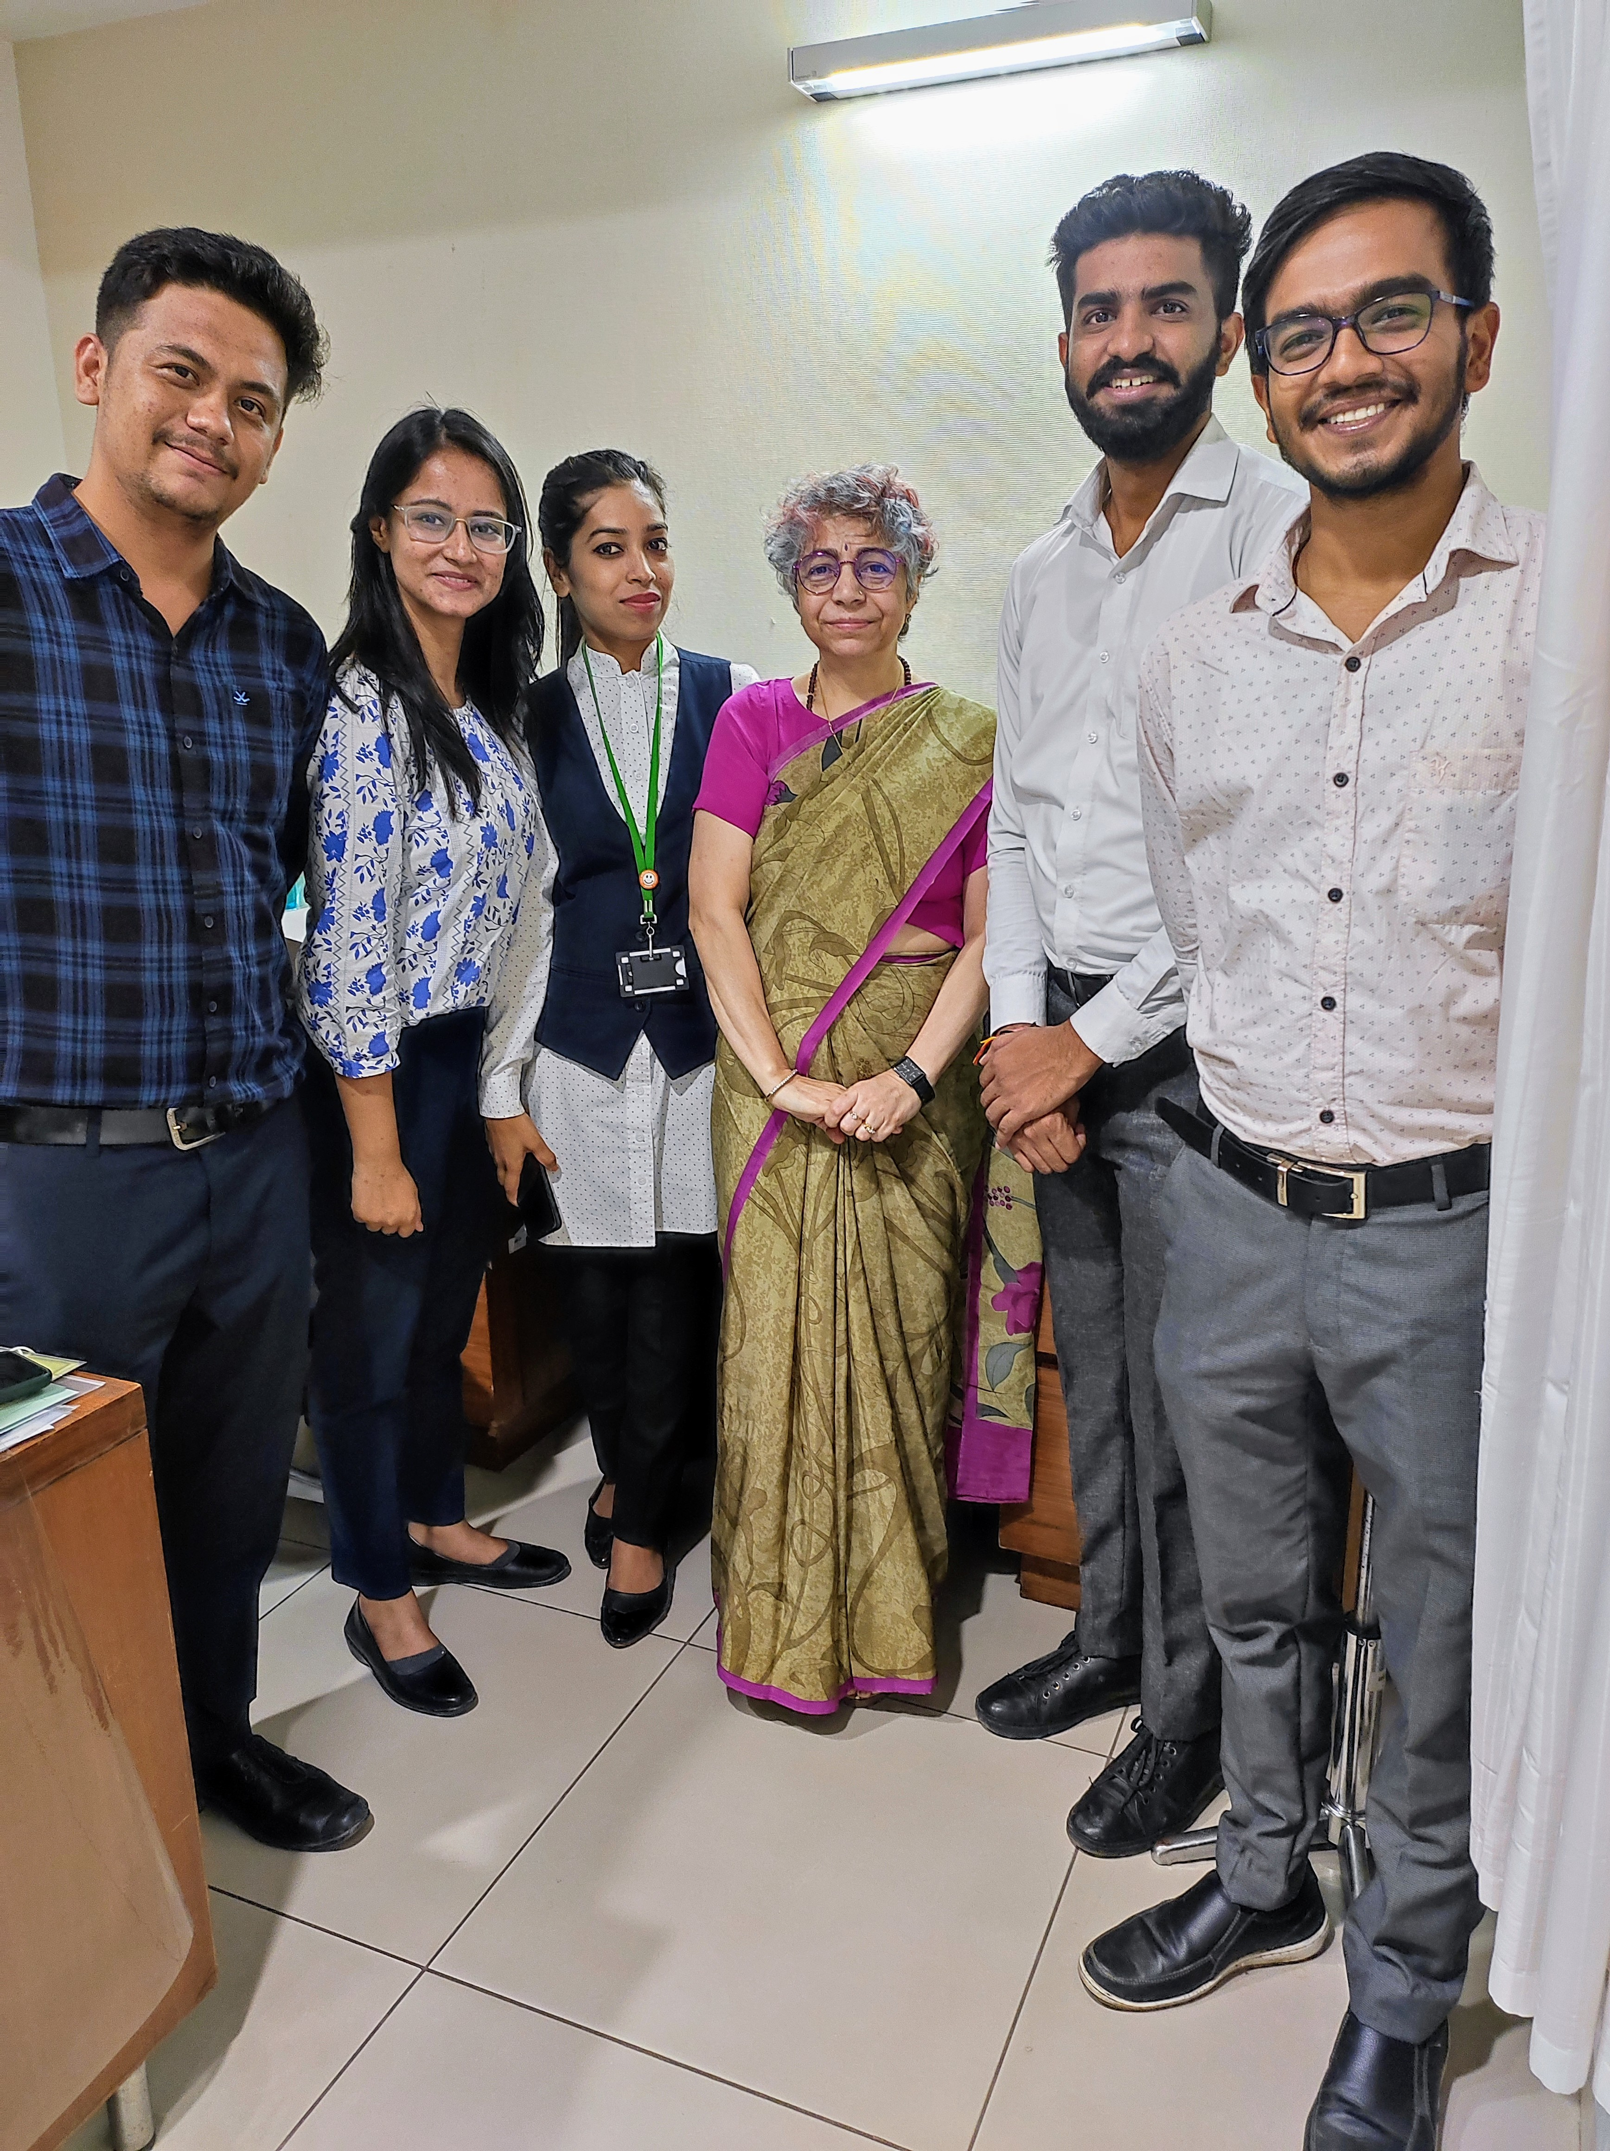
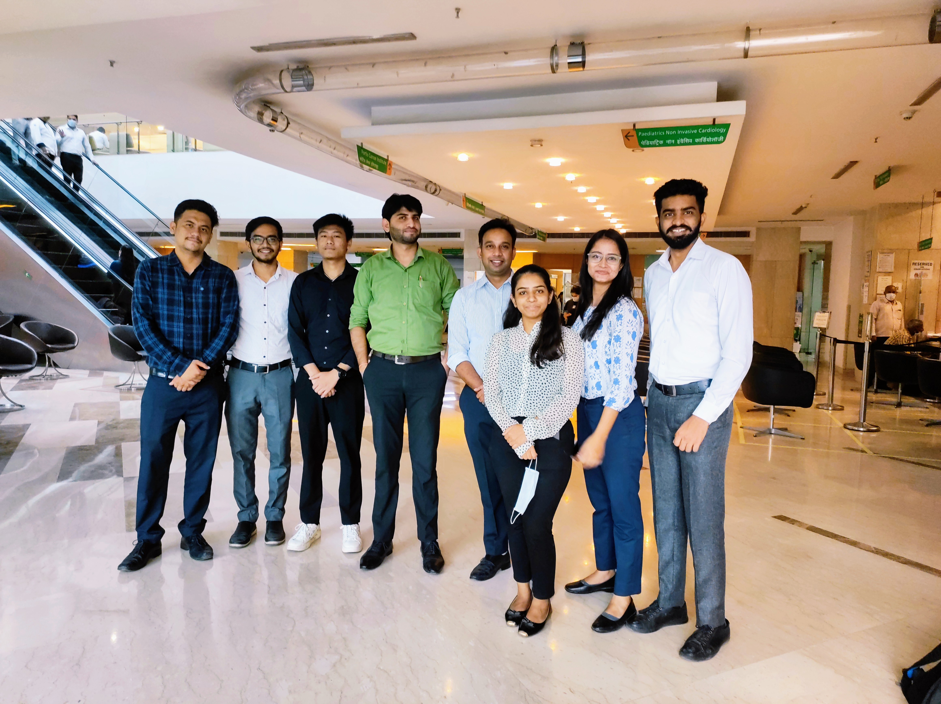

Slide 18
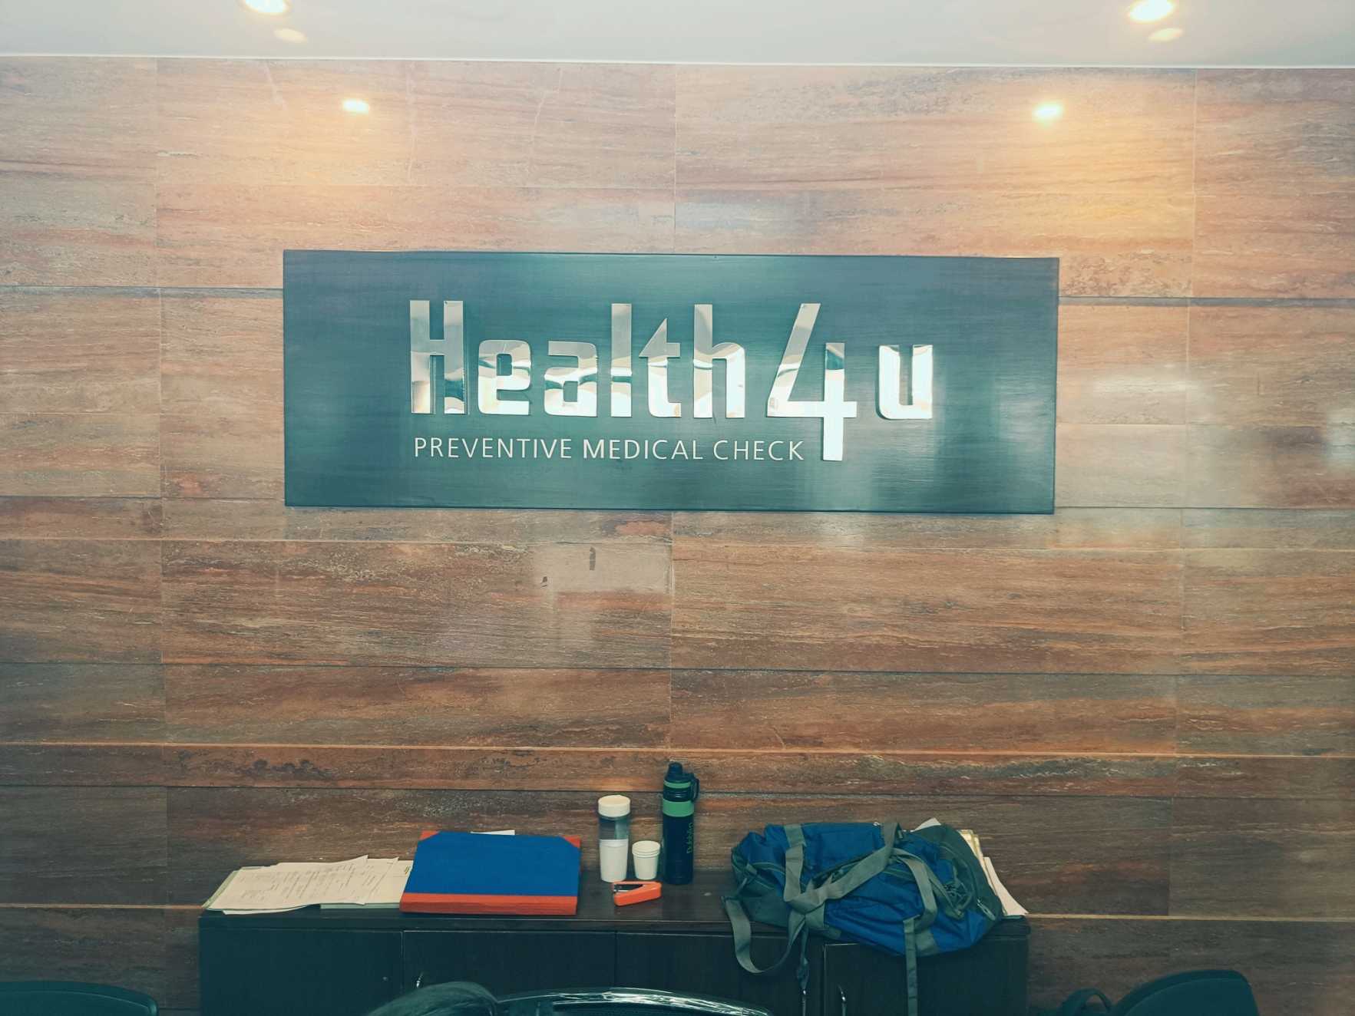
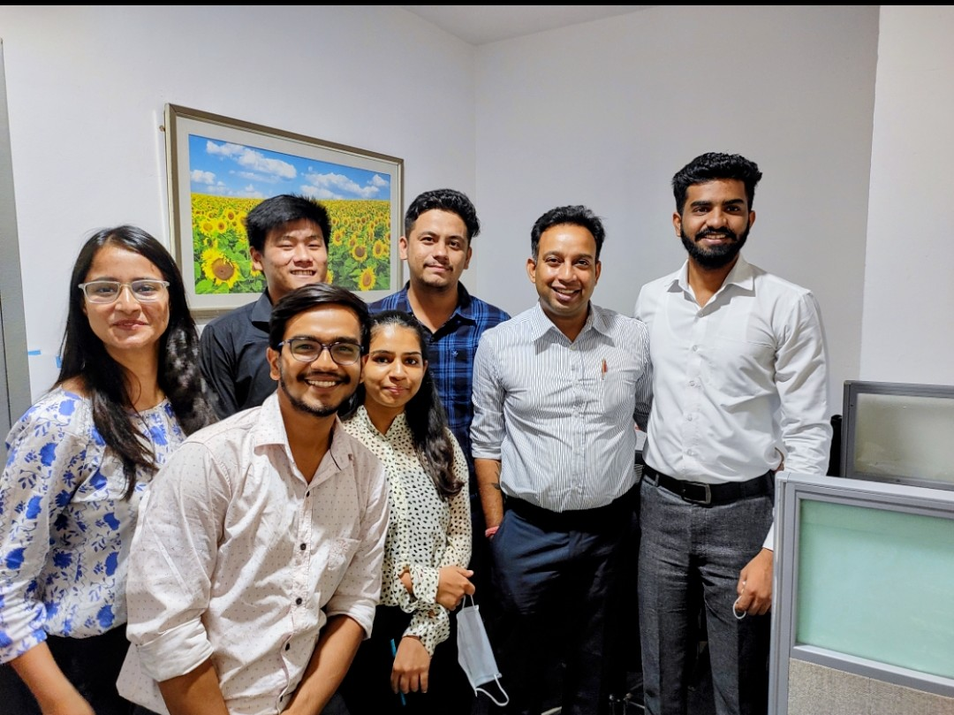
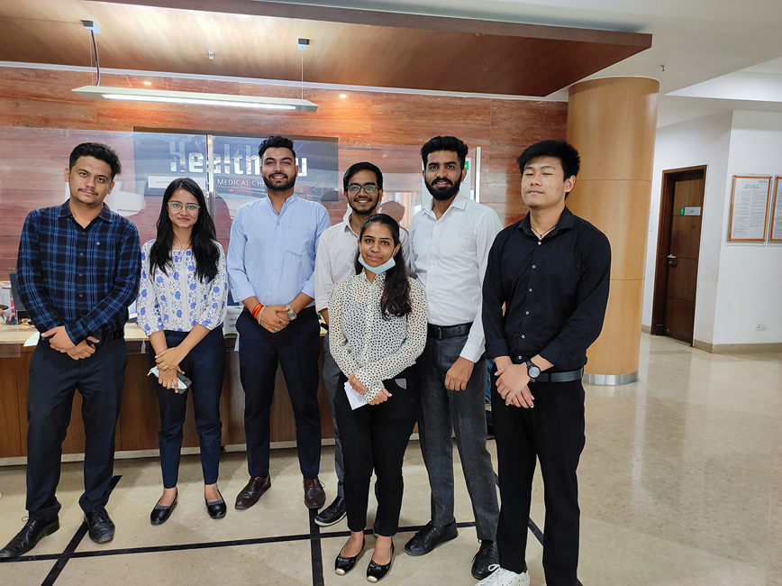

Slide 19
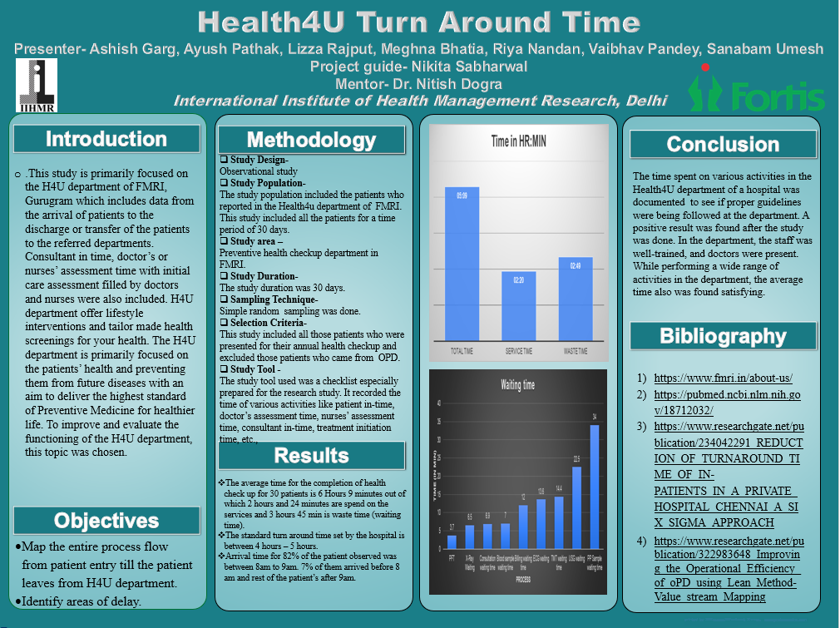

Slide 20
THANK YOU

