Slide 1
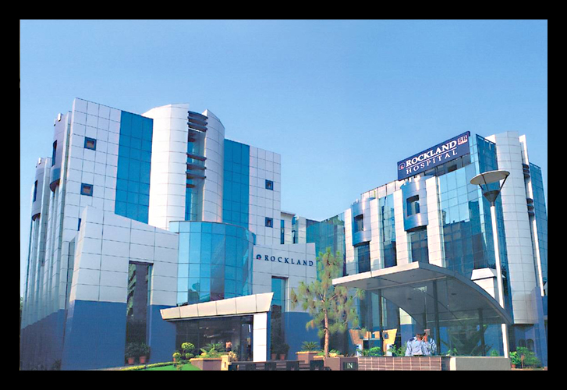
By: MEGHA DHINGRA

Slide 2
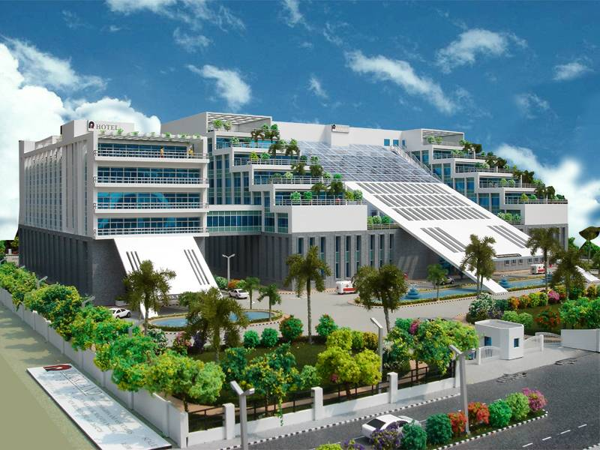
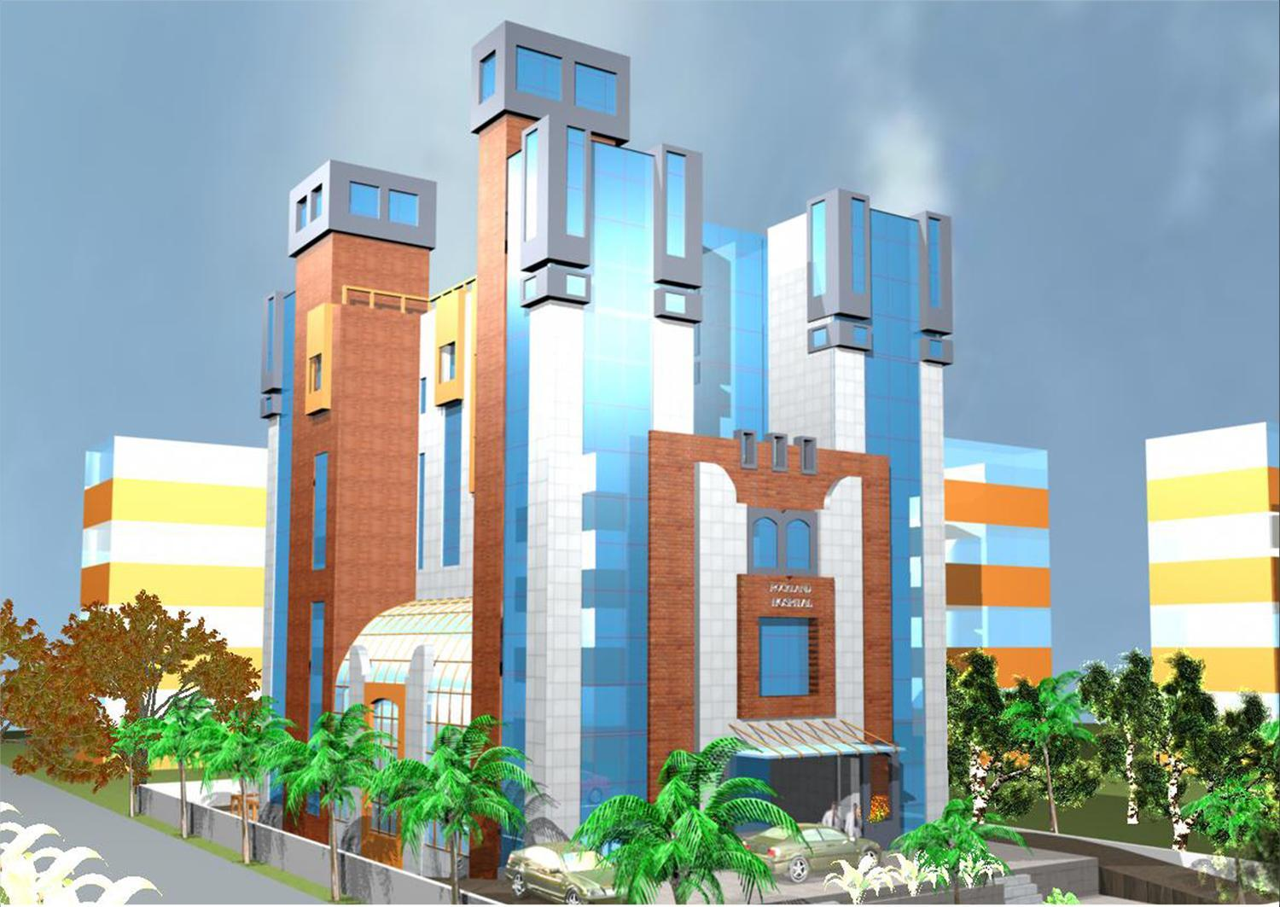
NEW ESTABLISHMENTS
MANESAR
DWARKA

Slide 3
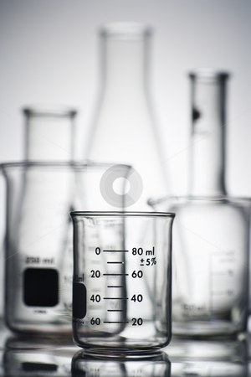
“Streamlining the Laboratory Workflow
Through Identification of Problem Areas”

Slide 4
In simple words, TAT is “time taken between submission of a program/process/task for execution (order time) and return of complete output to the customer/user”
Laboratory Turnaround time (TAT) is commonly defined as the time from “when a test is ordered
until the result is reported”
Clinicians consider TAT from the time the test is ordered to results reporting, whereas laboratory professionals usually use specimen receipt to reporting of results as the TAT

Slide 5
Need for study
Patients at Rockland Dwarka complained of
getting Late reports
The Turnaround time has been identified as
an quality indicator for laboratory services by
the quality assurance experts
Clinicians depend on fast TATs to achieve
early diagnosis and treatment of their
patients

Slide 6
Objective
To study the TAT for laboratory
tests for Outpatients of
Rockland Hospital, Dwarka
To study the causes that had an
impact on TAT.

Slide 7
Methodology
Sample Size:
MARCH APRIL
TOTAL
303
219
MOST COMMON TESTS
TOTAL
81
71
MOST COMMON TESTS

Slide 8
Sampling Technique: Random
Data Collection Plan:
Technique: through LIS
2. Inclusion and Exclusion Criteria
Inclusion Criteria:
Patients who came to lab for specimen and collected and tests reported to their physicians

Slide 9

Patients who came from other institutes,
outpatient clinic, nursing homes, referrals
Exclusion Criteria:
Specimen of the patient who got registered
with Emergency before ordering of tests
Specimen of Inpatients.
Specimen collected for Hospital staff

Slide 10
Variables of Study
Order Time/Requisition Time
Reporting Time (of Values in the LIS)

Slide 11
Analysis:
Definition of TAT
“the time at which the order is placed for the test by the patient at billing counter or requisition made in the LIS to the Reporting of the values of the tests in the LIS by the laboratory personnel”.

Slide 12
2. Formula
Time taken to complete the TEST =
Time of order of test (starting point) – Time of reporting of values in LIS (end point)
TAT = Sum of Time taken
No. of Tests done in particular month

Slide 13
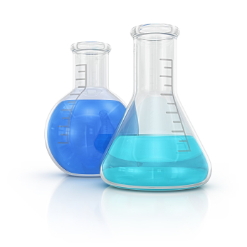
Results were evaluated using MS Excel
2007
Duration of Study:
15th March 2012 – 11th April 2012

Slide 14
Results and Findings
The laboratory investigations are divided majorly into categories of:
Biochemistry
Clinical pathology
Hematology
Microbiology
Serology

Slide 29
Discussion
For month of March: observed that TAT for almost all of the tests was more than one day (> 24 hours) ranging between 1-2 days
While culture tests, serology tests were on much higher side of spectrum ranging between 4-5 days

Slide 30
Next month analysis, April: remarkable reduction in TAT … since sample analysis started here in Dwarka.
Hospital did not have set standard time for any
of the investigations documented.
Rockland Qutub laboratory was contacted for the same.
Delivery of sample and getting reports back got waived

Slide 31
They stated that:
Routine tests like CBC, RFT, LFT, Lipid Profile, Blood Sugar fasting & PP should be done within 3-5 hours (ordering to reporting)
Culture tests take about 1week
Serology tests takes about 1-2 days. (if the sample is given before 12.00 pm, reports is given in evening BUT if sample is given after 12.00, then report is given next day)

Slide 32
Study of TAT from order to reporting of
hemoglobin was found to be 12 hours in
the month of April
1998 CAP Q-Probe study HB results should take 55 or less minutes

Slide 33
Blood Sugar test took about 6 hours in
month of April….. still higher than what is
defined by Rockland Qutub.

Slide 34
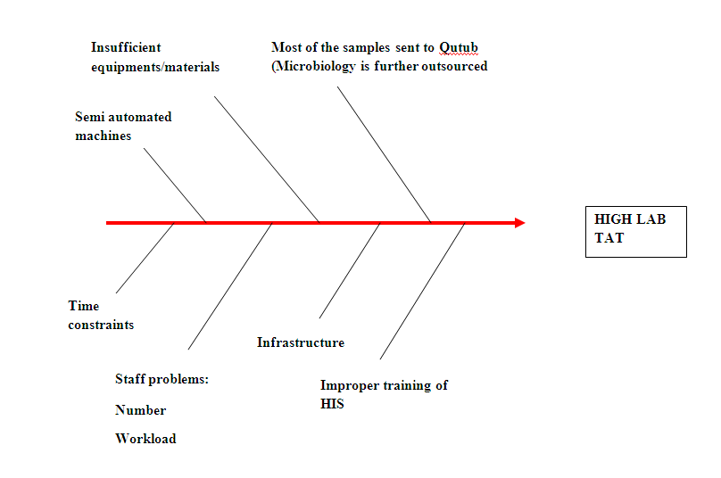
Root Cause Analysis

Slide 35
Limitation of Study
The hospital did not have their own set
benchmark/standard for respective investigations so
outliers cannot be defined
Data was collected from the LIS software in the Lab.
Sometimes, the values of the tests were entered later
than the actual result time. So it brought shift in the TAT.
The time calculated could not be categorized into pre
analytical time, analytical time and post-analytical time
due to insufficient maintenance of records.

Slide 36
Recommendations
Alert POP up
Appropriate and Efficient Staff
Consider total laboratory automation
Reporting through Computerization:
Mails/Fax

Slide 37
Weekly training of the Laboratory Staff in
using LIS
Maintenance of Records properly especially
for missing reports

Slide 38


