Slide 1


AUDIT OF ECHS POLYCLINIC
Col DEEPAK VARSHNEY
PG/19/024
Health Management
Mentor
Dr Nishikant BELE

Slide 2

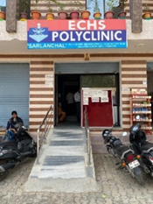
INTRODUCTION
ECHS, Social Health Insurance Launched in 2003.
Service Delivery- 426 Polyclinic and empanelled health facilities
Aligarh Polyclinic estb in 2006.
Type D Polyclinic, Non- Military Station
Load – 10000 ESM & dependents of district of Aligarh.

Slide 3
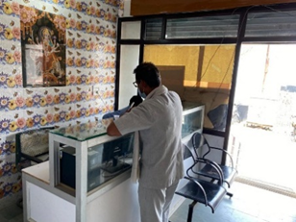
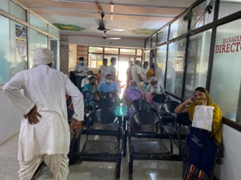
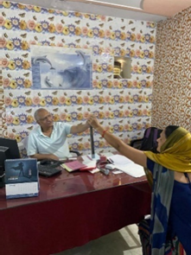
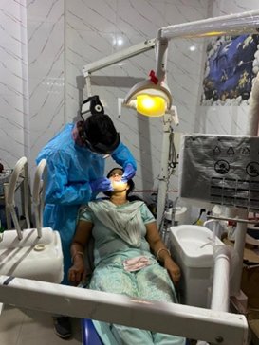
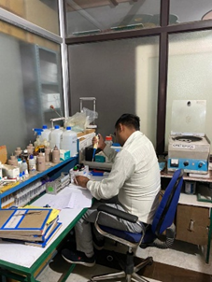
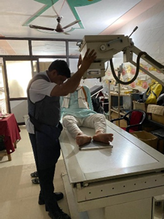
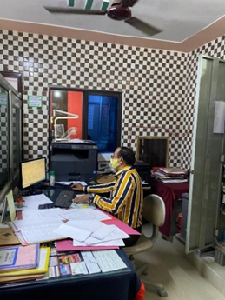
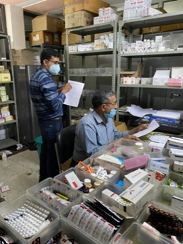
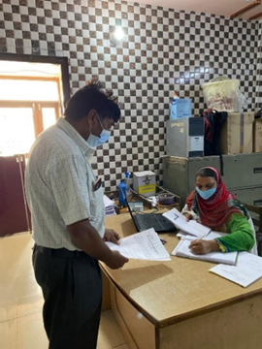
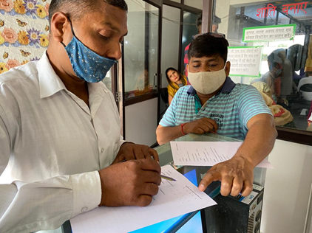
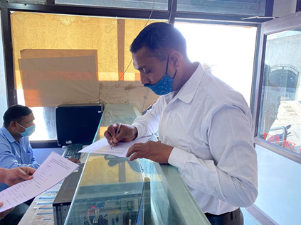
Reception
Waiting Area
Consultation
Dental Procedure
Laboratory
Polyclinic Entrance
ECHS Polyclinic, Aligarh
X-Ray in Progress
Smart Card Desk
PSS in progress
Pharmacy
Referral Issue

Slide 4
RATIONALE
Quality of Care.
Measuring quality at a health care facility.
Customer Satisfaction.
Enhance Quality of Care and Satisfaction Level
Onus on provider.
ECHS evolving as a Health Care System.
Standards - Pillars of Quality Management System.

Slide 5
REVIEW OF LITERATURE
An in-depth review of literary articles from Google Scholar, published and unpublished reports and official websites of Indian government (ECHS, NHSRC), was conducted to come up with the following themes
Need of Quality audit
Available Quality tools for Public Health System
NQAS
PATIENT SATISFACTION
KAYAKALP
ECHS
CGHS

Slide 6
OBJECTIVES
General Objective is to study the ECHS Polyclinic as a health care facility and suggest a system of Quality Audit for continual quality improvement.
Specific objectives are to conduct Quality Audit of ECHS polyclinic, Aligarh.
:.
Obj 1
Obj 2
Obj 3
Obj 4
Kayakalp Checklist
Patient Satisfaction Survey of the Polyclinic
Identify ‘Gaps’ and suggest a ‘Way Ahead’ for Quality Assessment of ECHS Polyclinic to enhance Client Satisfaction level and improve quality..
National Quality Assurance Standards( NQAS) checklist

Slide 7
METHODOLOGY
Study Design | Observational and Analytical study involving ECHS polyclinic, Aligarh.
Study population for Patient Satisfaction Survey (PSS) | For PSS, the participants were drawn from the beneficiaries visiting the polyclinic who were Master card holders, Consenting Had used the services on more than three occasions
Sampling Method and Size | Non probability, purposive sampling with a initial sample size of 100( Later restricted to 70)
Tools used | OPD sheet of NQAS PHC Toolkit_19March20 and ( http://qi.nhsrcindia.org/cms-category/nqas-tools ) PHC Kayakalp Checklist without beds-JUNE 2019 ( http://qi.nhsrcindia.org/cms-category/tools-kayakalp ) For PSS A Questionnaire was administered.
Data Collection and Assessment method | Means of Review – As per guidelines of checklist. Assesment method – OB, SI, RR, PI Scoring System: 2 mks full compliance, 1 for partial and 0 for non compliance.
Data Analysis | NQAS and Kayakalp checklist and Inbuilt analysis was used. Data collected for PSS was analyzed in SPSS software.

Slide 8
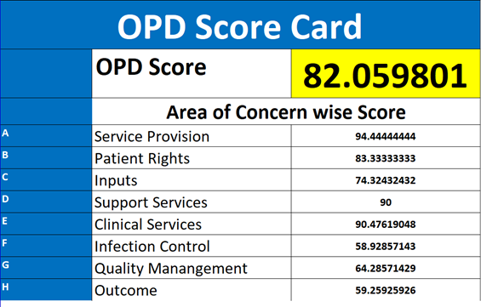
FINDINGS (NQAS)
C. Inputs Unidirectional flow of services. Fire safety measures.
D. Support Services Drug expiry data management.
E. Clinical Services Follow up of patients discharged from higher facilities. Triage system in case of mass casualty. MLC (Medico Legal Cases) .
F. Infection Control Non display of hand hygiene at point of use. Decontamination drills to be well defined.
G. Quality Management Comprehensive Patient satisfaction survey not carried out. No internal assessment mechanism exists.
H. Outcome The facility lacks Service Quality Indicators measures. No system to assess whether State/ National benchmarks are being achieved.
GAPS
A. Service Provision Facility does not provide AYUSH services as mandated.
B. Patient Rights Formulary needs to be displayed. IEC corner . Privacy aspect .

Slide 9
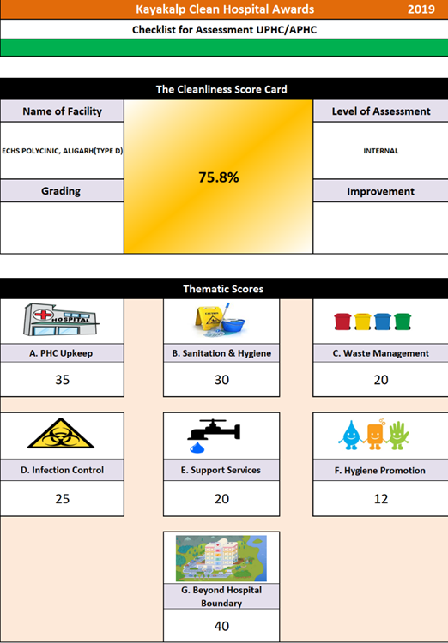
FINDINGS (KAYAKALP)
A. Polyclinic Upkeep
  No earmarked store for condemned stores.
  Rain water harvesting mechanism needs to be installed.
B. Sanitations and Hygiene
  3 bucket system for cleaning.
C. Waste Management
  Innovations in general waste management be encouraged.
D. Infection Control
  IEC of hand hygiene at some point of use is lacking.
  Spill management protocol not displayed.
  Reporting of notifiable diseases & events needs to be streamlined.
E. Support services
  No observation noticed.
F. Hygiene Promotion
  Training & capacity building and standardisation to required level is lacking.
G. Beyond Hospital Boundaries
  Not applicable to subject Polyclinic

Slide 10
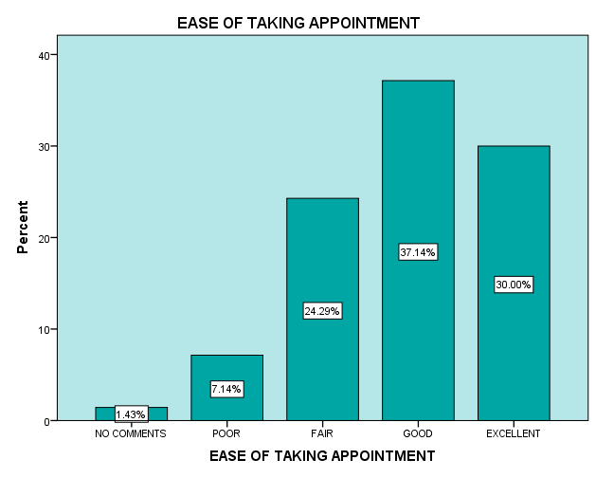
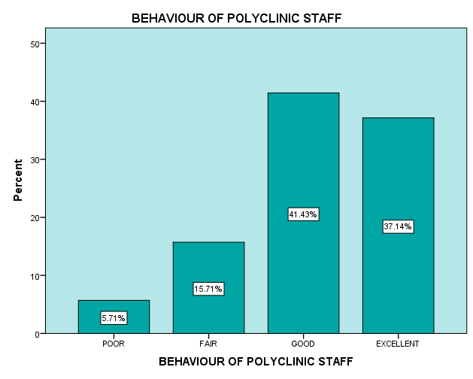
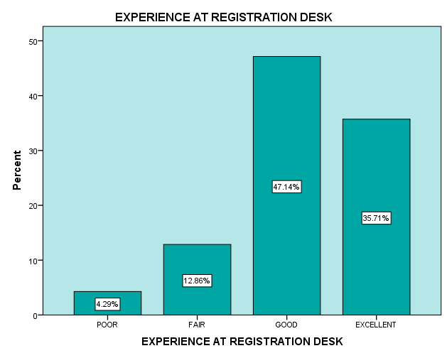
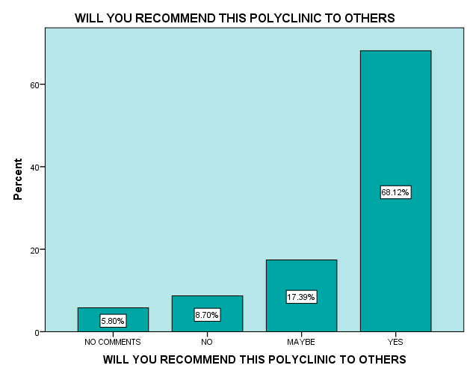
FINDINGS PATIENT SATISFACTION SURVEY(PSS), REGISTRATION
85 % were males and 15% females .
ESM have 2 dependents on an average.
32% of the respondents are employed.
67% are satisfied with the comfort levels of taking appointment .
82% are satisfied with Registration experience
Behaviour of the staff has been rated exemplary.

Slide 11
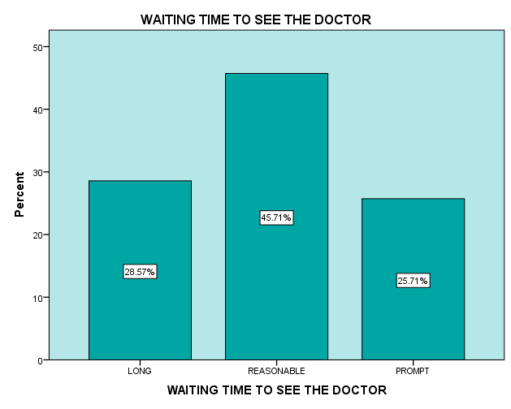
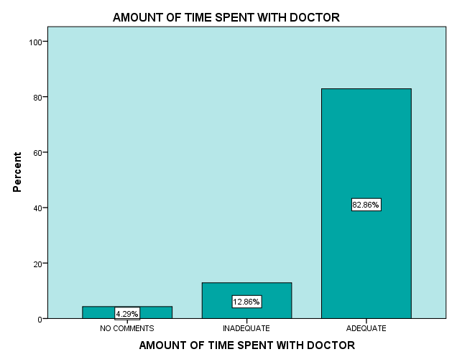
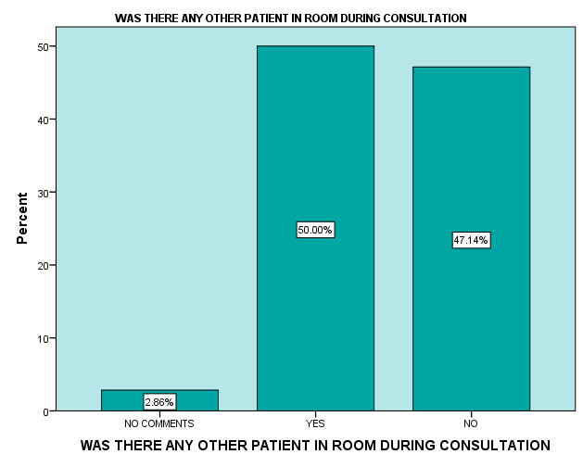
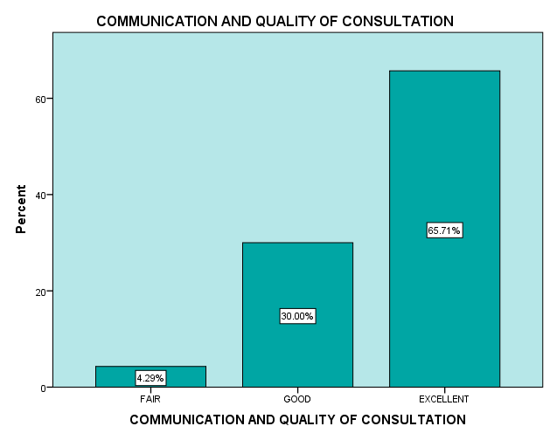
FINDINGS PSS, CONSULTATION)
29% respondent, rate wait time long
Respondents are happy with the amount of time spent with the MO.
Half of the beneficiaries have confirmed presence of other patients during consultation.
Quality of consultation have been rated high.

Slide 12
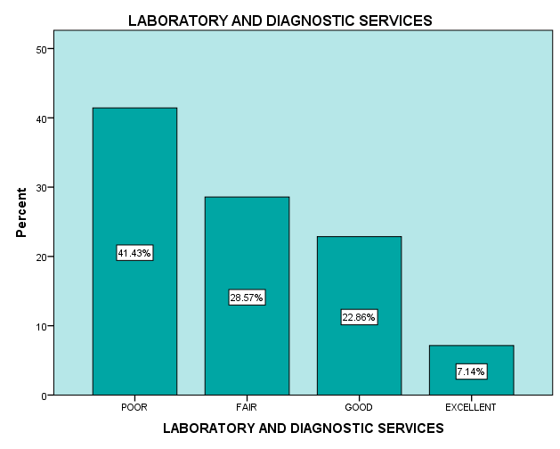
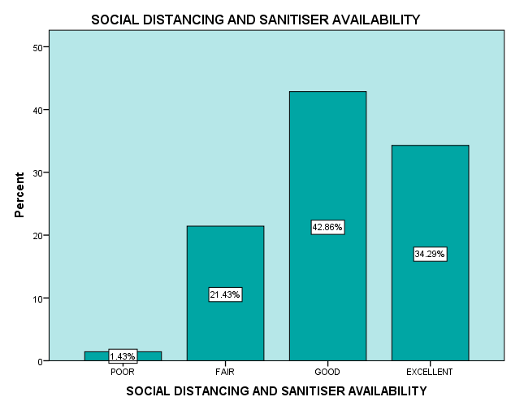
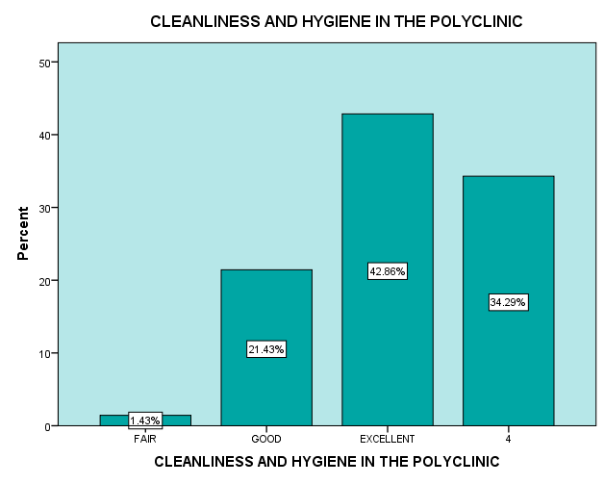
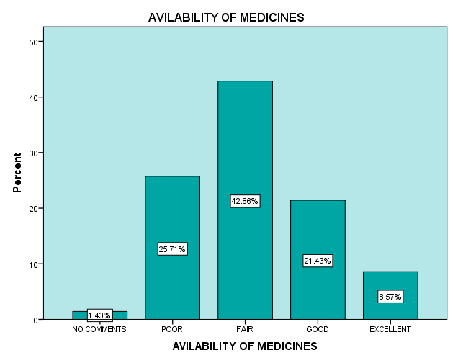
FINDINGS, PSS SERVICES
Hygiene and Pandemic protocol have been rated good.
70% of respondents are not happy with Lab/ Diagnostic services.
42% rate medicine availability as fair and 26% poor.

Slide 13
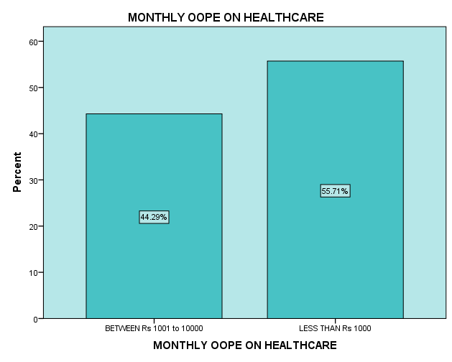
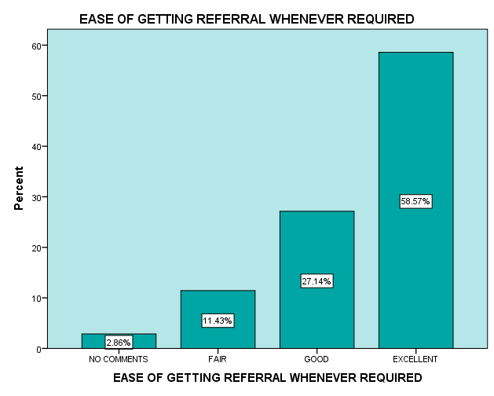
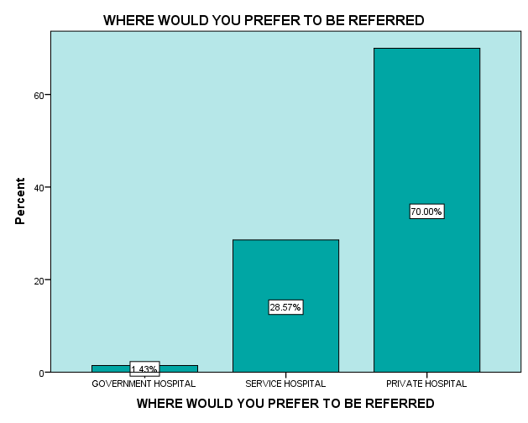
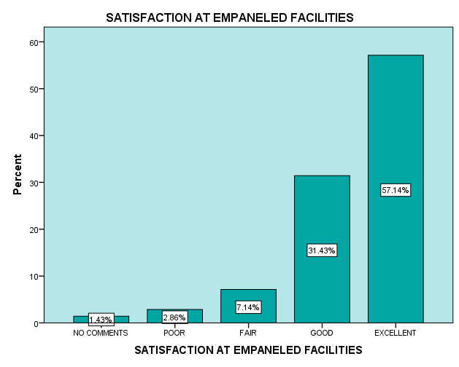
FINDINGS, PSS REFERRAL
OOPE on medical care of 44% beneficiaries is high
Referral system has been rated high. 70% would like to get referred to Private Facility and about 28% to service hospitals and has very few takers for Government facilities.
The survey revealed that a considerable number (88%) are satisfied with the referral being made to the empanelled hospitals

Slide 14
OTHER IMPORTANT FINDINGS BASED ON SUGGESTIONS OF BENEFICIARIES
S.No | SERVICE CATEGORY | Suggestions
1. | No of Doctors | No of doctors be increased and the specialists should be made available in Polyclinic
2. | Lab/Diagnostics tests | All lab test facilities should be available, Report to be made available same day
3. | Medicines | Costly medicines not available. In lieu medicines issued. Medicines of all strengths not available.
4. | Others | Location of Polyclinic should be on the main Highway, commuting is an issue. Very few empanelled health facilities in the City, beneficiaries have to move to Noida, Agra, Mathura

Slide 15
CONCLUSION
NQAS score card for OPD is 82, which is reasonably high. It should be read in conjunction with the limitations.
Kayakalp score is 75.8, which is well above the pass criteria, but this result has to be read in conjunction with the limitations.
Patient Satisfaction Survey
Registration | Registration experience of the beneficiaries has been rated high.
Consultation | Consultation wait time needs to be brought down and privacy protocol during consultation require attention. Although overall Consultation experience has been rated high by respondent.
Services | Laboratory services are far from satisfactory.
Med & OOPE | Availability of medicines needs improvement, and OOPE of beneficiaries needs to be brought down
Referrals | The beneficiaries are satisfied with ease of referral and services of empanelled private partners. For referral Private hospitals are most preferred followed by Service hospitals very few takers for Government hospitals.

Slide 16
RECOMMENDATION
Holistic Quality Audit system for ECHS Polyclinic.
Professional NQAS and Kayakalp Audit in all types of Polyclinics .
Constitute an internal audit team.
Formulary revision in order to reduced OOPE .
Reduction in wait time .
Improvement in Laboratory services.
Location of Polyclinic.

Slide 17
GAPS AND WAY AHEAD
The study has suggested a way ahead in the form of adopting the existing toolkit with services/Type specific modification to start with
To include other stake holders ( Employees and Service Partners )
Institutionalised robust the Patient feedback to get the pulse of the aspiration of its clientele.
Holistic Quality Management System Lacking in ECHS
Gaps
Way Ahead

Slide 18
LIMITATION
Toolkits are not tailormade.
Quality of Interaction and sample size of PSS was compromised due to pandemic.
Time and resource constraint.
Prevailing social conditions.

Slide 19
RATING : HOW PGDHM COURSE ADDRESSES THE PROGRAM OUTCOMES
S.No | Category | Score
1. | Internalize the concepts of management such as healthcare delivery system, strategic planning, HR, marketing, finance and operations. | 3
2. | Apply knowledge of research and management techniques and functions in an integrated manner in healthcare set up | 3
3. | Use appropriate skills to support healthcare organizations to take informed decision in planning, building and managing healthcare organizations | 3
4. | Utilize learning acquired from trainings and practical exposures in real time situations. | 2
Score- 1: Slight (Low) 2: Moderate (Medium) 3: Substantial (High)

Slide 20




Thank you for your attention!!

Slide 21
References
COECHS. (2020, April). https://echs.gov.in/. Retrieved from Official ECHS Web Portal, maintained & managed by COECHS : https://echs.gov.in/
Department of Ex-servicemen Welfare, MoD, GoI. (2020, APR). http://desw.gov.in/. Retrieved from Department of Ex-servicemen Welfare: http://desw.gov.in/
Dudeja, P. A. (2013). Health promotion initiatives: An experience of a Well Women’s Clinic. Medical Journal Armed Forces India .
(2008). ECHS Handbook. New Delhi: Directorate of Personnel, Air Headquarters .
Gerard La Forgia, S. N. (2012). Government- Sponsored Health Insurance in India, Are you Covered ? Washington, D.C.: The World Bank.
Grover, M. (2014, october 11). Time to reform the central government health scheme. Economic & Political Weekly, pp. 24-25.
Kari Maharajan, R. K. (2017). Inclusive management of ex-servicemen in India: Satisfaction of Air Force veterans from resettlement facilities with special reference to Tamil Nadu. IIMB management revie, 5-17.
Naveen Phuyal, A. k. (2015). Client Satisfaction Ex-Servicemen Contributory Health Scheme(ECHS) Polyclinic: An Experience from India. MJSBH, 5-14.
NHM, M. G. (2021). http://qi.nhsrcindia.org/national-quality-assurance-standards. Retrieved from NHSRC.
NHSRC, M. o. (2021, Apr). http://qi.nhsrcindia.org/. Retrieved from National Health System resource centre, Technical support institute for NHM.
Sarwal, R. (2015). Reforming Central Government Health Scheme into a 'Universal Health Coverage' model. The National Medical Journal of India, e1-e9.
Sethi, S. (2015). National Veterans Commission. New Delhi: CLAWS.
Sukumar Vellakkal, S. J. (2010). Healthcare Delivery and Stakeholder's Satisfaction under Social Health Insurance Scheme in India: An Evaluation of Central Government Health Scheme(CGHS) and Ex- servicemen Contributory Health Scheme(ECHS). Indian Council for Research on International Economic Relations(ICRIER).

Slide 22
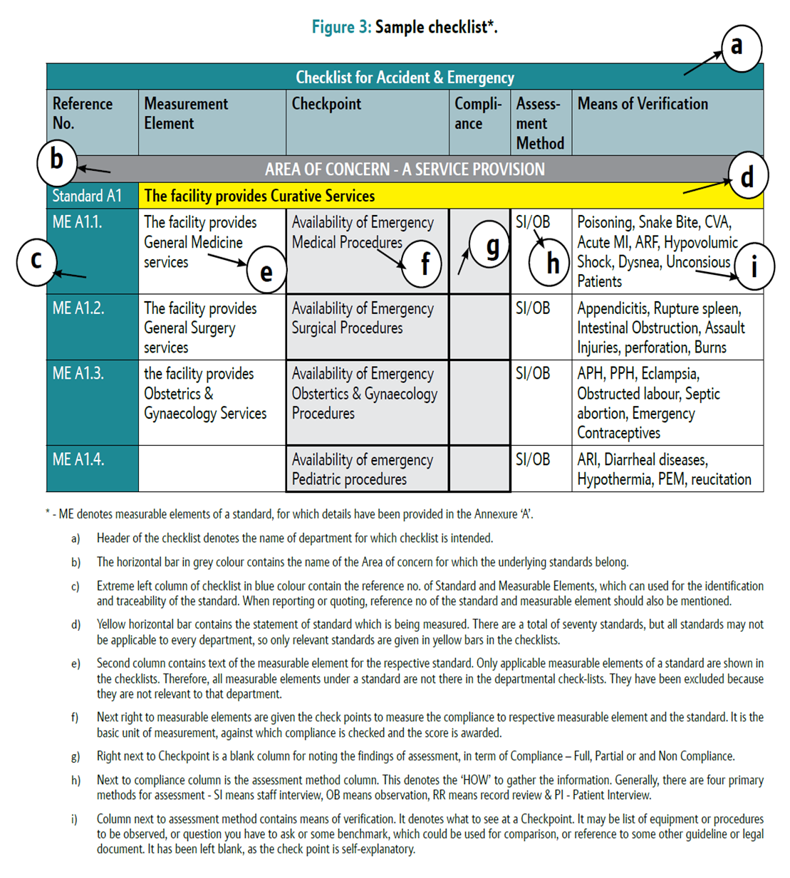

Slide 23

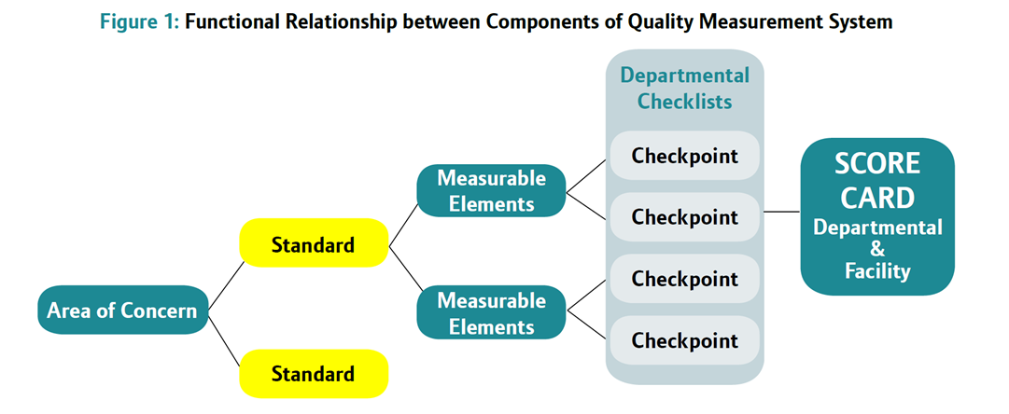

Slide 24
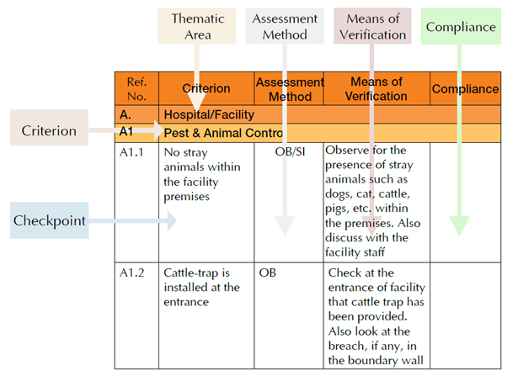

Slide 25


Slide 26
LITERATURE REVIEW
S.No | Study | By | Published | Location | Methodology
1. | Client satisfaction in ECHS Polyclinic : An Experience from India | Naveen Phuyal Ashok Jindal,YSM Sandip Mukerji | MJSBH Vol 14 Issue 2 Jul- Dec 2015 | ECHS polyclinic | Observational and Analytical Cross sectional Duration -2y Sample size -400 ( obtained by estimation of proportion) Stratified Sample Criteria of selection of sample Staff beneficiary excl Every third OPD patient ( Systematic Random Sampling) Patients who had at least 3 vis, > 18y, willing Vetted Structured Questionnaire was used
2. | Healthcare Delivery and Stakeholder’s satisfaction under social health insurance schemes in India : An evaluation of CGHS and ECHS | Sukumar Vellakkal Shikha Juyal Ali Mehdi | Indian Council for Research on International Economic Relation (ICRIER) Dec 2010 | 12 Indian Cities | Primary Survey of 1204CGHS ,640 ECHS primary beneficiaries, 100 empanelled health care providers and 100 scheme officials

Slide 27
3. | An Audit of Prescribing practices of CGHS dispensaries of Kolkata, India | A Chattopadhyay Tanushree Mondal Tushar Kanti Saha Badal Kumar Sahu Jashodip Bhattacharya | IOSR Journal June 2013 | 5 out of 18 CGHS Dispensaries in Kolkata | Systematic random sampling of 5 Dispensaries and 412 patients . Informed consent
4. | Reforming CGHS into a ‘Universal Health Coverage ‘ model | Rakesh Sarwal | The National Medical Journal of India, Vol 28, No 1,2015 | India | Interview of CGHS beneficiaries, MO and administrators. Published articles and documents of CGHS UHC
5. | Inclusive management of Ex-Servicemen in India: Satisfaction of Air force veterans from resettlement facilities with special reference to Tamil Nadu | Kari Mahajan R Krishnaveni | IIMB Management Review,2017 | Tamil Nadu | Descriptive, conclusive, cross sectional data with longitudinal study covering veterans superannuating in past 30 y. Subjects AF veterans other rank

Slide 28
S No | Contractual Post | Type of ECHS Polyclinic |  |  |  |  | Total | Held* | Remarks*
 |  | A | B | C | D | E
1 | Medical Officer | 6 | 3 | 2 | 2 | 1 | 953 | 2
2 | Medical Specialist | 2 | 2 | 1 | 0 | 0 | 200 | 0
3 | Dental Officer | 2 | 2 | 1 | 1 | 0 | 470 | 1
4 | Gynaecologist | 1 | 1 | 0 | 0 | 0 | 61 | 0
5 | Radiologist | 1 | 1 | 0 | 0 | 0 | 61 | 0
6 | Officer-in-Charge | 1 | 1 | 1 | 1 | 0 | 409 | 1
7 | Radiographer | 1 | 1 | 0 | 0 | 0 | 61 | 1 | Surplus
8 | Lab Technician | 1 | 1 | 1 | 1 | 0 | 409 | 1
9 | Lab Assistant | 1 | 1 | 1 | 1 | 0 | 409 | 0 | Defi
10 | Physiotherapist | 1 | 1 | 1 | 0 | 0 | 139 | 0
11 | Pharmacist | 1 | 1 | 1 | 1 | 0 | 409 | 1
12 | Nursing Assistant | 3 | 3 | 2 | 1 | 1 | 626 | 1
13 | Dental Assistant/ Technician/ Hygienist | 2 | 2 | 1 | 1 | 0 | 470 | 1
14 | Driver | 2 | 2 | 1 | 1 | 1 | 487 | 1
15 | Chowkidar | 1 | 1 | 1 | 1 | 0 | 409 | 1
16 | Female Attendant | 1 | 1 | 1 | 1 | 0 | 409 | 1
17 | Peons | 1 | 1 | 1 | 1 | 0 | 409 | 1 | Clk posted inLieu
18 | Safaiwala | 1 | 1 | 1 | 1 | 0 | 409 | 1
 | Total | 29 | 26 | 17 | 14 | 3 | 6800 | 14

Slide 29
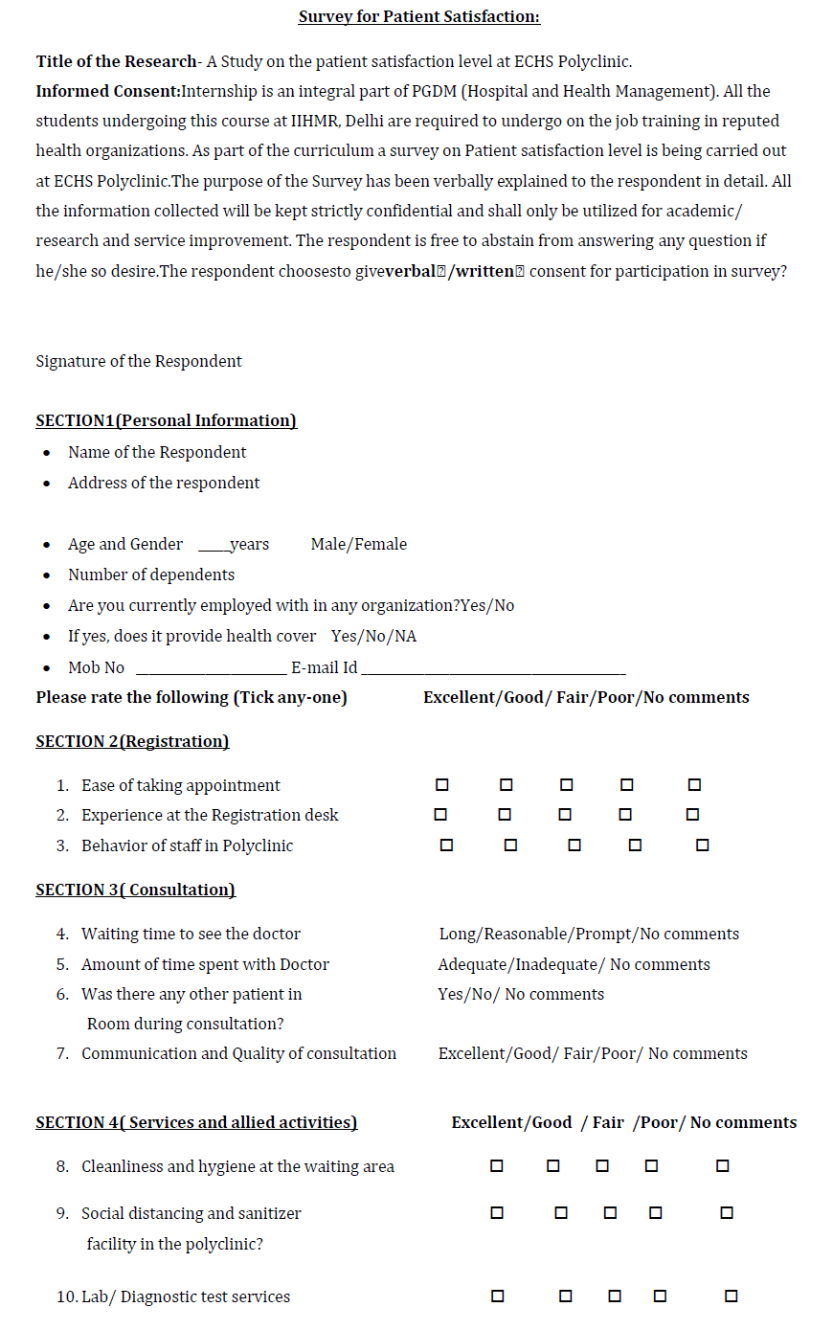
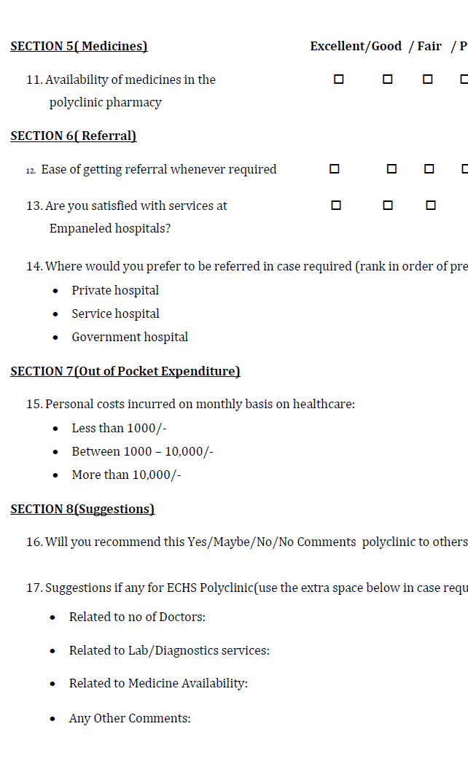
PSS Questionnaire

