Slide 1




TRADITIONAL METHOD OF CONTRACEPTION USERS' PATTERNS AND PREDICTORS
-AN EXPLORATORY SYNTHESIS OF A MIXED METHOD RESEARCH IN BIHAR
CARE India Solutions for Sustainable Development (CISSD), Bihar
PRESENTED BY:
Dr. Tulika Rajan
PG/21/122
Mentor: Dr Sidharth Sekhar Mishra
IIHMR Delhi

Slide 2

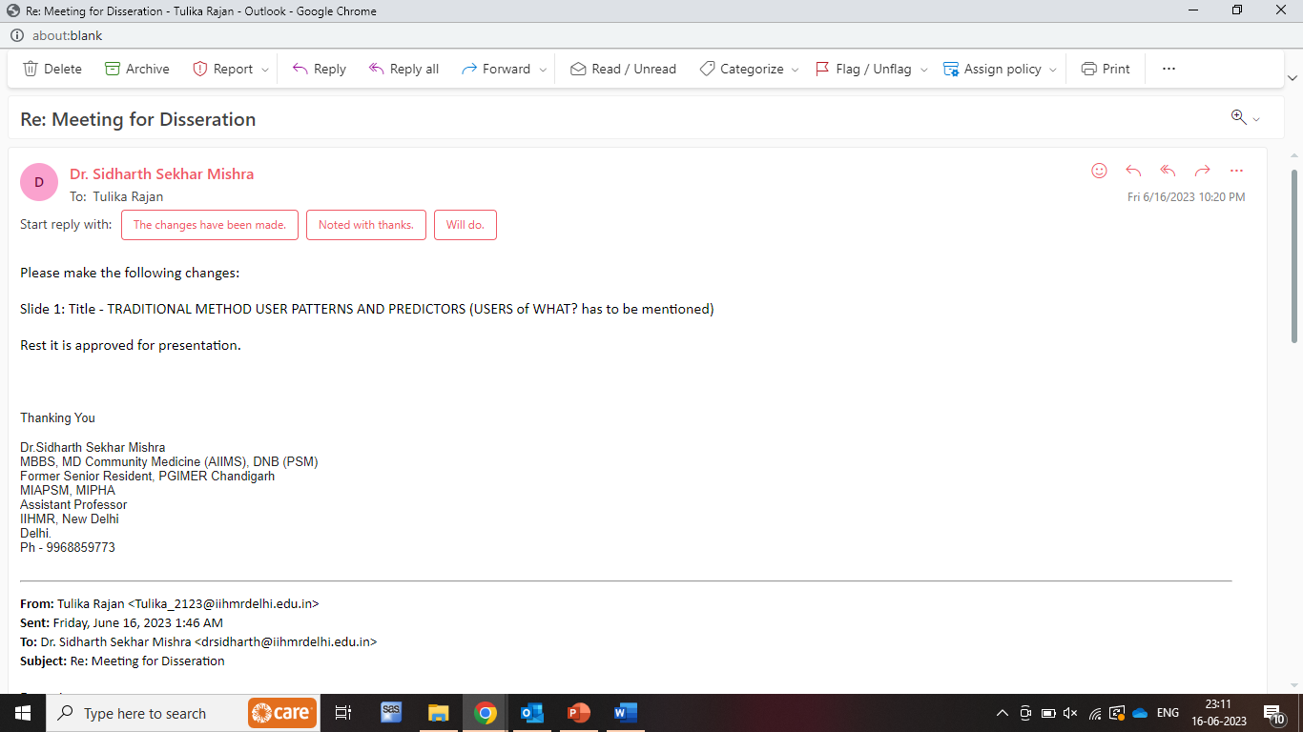
Mentor Approval

Slide 3
Contents
Introduction
Objectives
Methodology
Result
Discussion
Pictorial Journey
Annexure

Slide 4
Introduction
India became the first nation in the world to implement a national family planning programme in 1952.
According to the findings National Family Health Survey (NFHS-5), India's total fertility rate (TFR) decreased from 2.2 in 2015–16 to 2.0 in 2019–21, demonstrating the substantial gains population control measures have made (NFHS-5).
Contraceptive use has increased between 2015 and 2019 (from 53.5% in 2015 to 66.7% in 2019)
Despite six decades of official family planning programmes, India has a low rate of modern contraceptive technique use.
Contraceptive Prevalence Rate (CPR)
67% in 2019 (NFHS-5)
54% in 2015 (NFHS-4)
Modern Contraceptive Prevalence Rate (MCPR)
57% in 2019
48% in 2015
Bihar (2.98),
Meghalaya (2.91)
Uttar Pradesh (2.35)
Jharkhand (2.26)
Manipur (2.17)
5 Indian states with highest TFR
Data Source: NFHS-5
4

Slide 5
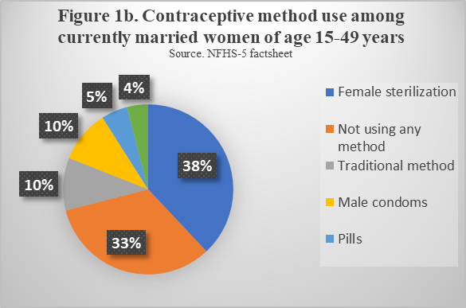
Reasons for not using modern method of contraception
Need for more children
Side effects of modern methods
Myth/Fear of Infecundity
Familial/societal pressure,
Spouses opposition
Gender-based obstacles to obtaining services
Lack of interspousal communication
Limited access to services
Limited choice of methods
Key facts
Bihar is the 3rd largest state by population in India (Census 2011).
The population of Bihar forms 8.60 percent of India in 2011.
Trends of Contraceptive Use
CPR
24.1% in 2015
55.8% in 2019
MCPR
23.3% in 2015
44.4% in 2019
Led to decreased use and increased discontinuation rate of modern methods of contraception with
Injectables (66%)
Condoms (61%)
Pills (55%)
Data Source: NFHS-5

Slide 6
Rationale
In response to chronically poor contraceptive use and high rates of early and fast recurrent birth among young married women, there is a rising push to address the causes of low contraceptive use and enhance access to contraception for young married couples.
It is important to address the issue and challenges faced by users who are switching from modern methods of contraception to traditional methods.
This study is conducted with an intent to observe the changes and patterns in the use of traditional method. To understand the increase in usage of traditional method and its increase among women of reproductive age in Bihar.
Objective of the study
To understand the drivers of traditional methods use among women of reproductive age in Bihar.
6

Slide 7
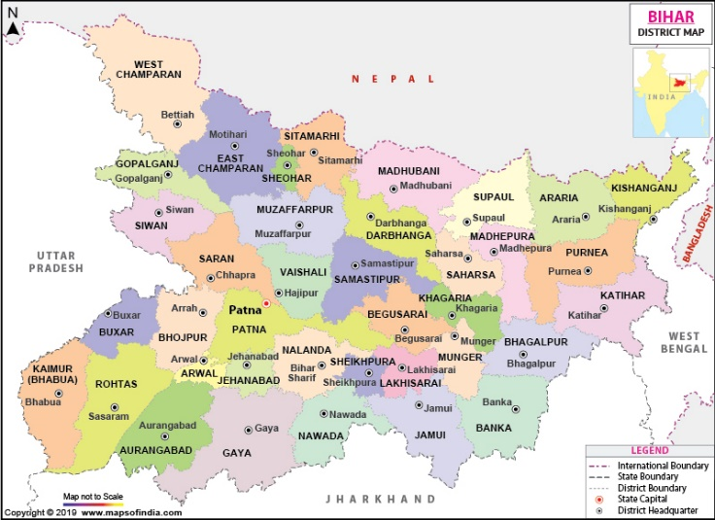
Methodology
The study being a work of secondary research, used the data collected for Cross-sectional study :-
Bihar Integrated family planning survey (BIFS) conducted in 3 rounds 2016, 2018 and 2021 for quantitative analysis conducted in all 38 districts of Bihar.
Zero to Low Parity Couples (ZLPP) pilot study (Qualitative) done in 5 districts of Bihar namely Saran, Lakhisarai, Jehanabad, Bhopur, Patna.
Study design and area
Sampling
A multi-stage probability sampling procedure was used in each district.
PSU was block, SSU was AWC in rural areas/ward in urban area
From each structure only a single respondent was selected.
Total sample size= 22800 (600*38) (600 per district)
From each PSU and SSU 5 structures were selected
Inclusion criteria for respondents
Married women of reproductive age group (15-49 years)
Had been living in the selected household for at least 3 months (i.e. if a married daughter had been staying at her paternal house for >= 3 month then she was also eligible to be selected)
Exclusion criteria for respondents
Widow and divorcee /separated.
Visitors/guests
Working women living in a hostel like structure
7

Slide 8
Methodology
Data collection
The outcome measures were:
social, gender and family level constructs
Interviews were conducted using a pre-tested structured digital questionnaire in local (Hindi) language.
Current contraceptive usage (including contemporary and traditional)
unmet need for spacing, unmet need for restricting techniques
unexpected pregnancy
intention for future use among individuals who had stopped using contraception for any reason
interspousal balance of power
self-efficacy of women in family planning related discussion
Supported by a training manual, rigorous training of the data collectors was conducted by an experienced MLE team member.
Data Analysis
The quantitative data analysis was done using SAS 9.4. Data cleaning, coding/re-coding and data processing were done.
The qualitative data analysis adhered to following the grounded theory approach to extract major themes through the coding of text data. The coding was initially done by interviewers, then a separate batch of experts read and reread all transcripts for improving the coding and recoding was done, as per the requirement. The codes were further refined, combined, and categorized for analysis. A multi-stage deductive interpretative thematic process was adopted to identify recurring themes and ideas from the transcripts.
8

Slide 9
Results
Data source: BIFS 2016, 2018 and 2021
Quantitative analysis
Age and Parity wise
Socio-demographic profile
Programmatic exposure
Gender measures
Based on the data obtained, it was found that the respondents who had more than 8 years of education used traditional methods more in each round of the survey with 11.4%, 11.8% and 11.2 in 2016, 2018 and 2021 respectively
More Likely
OBC caste
Have at least 1 living child
Belong to higher economic strata
Wives with greater agency on FP-related decision-making *
Couples where the husband is salaried / doing business
Had at least one interaction with FLW regarding FP during last one year
Formally educated
Have history of child loss
In zero to low parity (ZLP) couples (15-24 age group and 0 or 1 parity) there was gradual increase in traditional method users 6.7%, 6.6% and 8.2 in 2016, 2018 and 2018 respectively. Zero parity couples are not considered as target group by FLWs for any FP methods
9

Slide 10
Results
The respondents who interacted with FLWs (frontline workers) regarding contraception use used traditional method more than who did not.
Interspousal communication regarding family planning and its method, usage and husband’s involvement was found to be good (~20%) in the 2021.
Myths and misperception about contraceptive method:
  Among 22668 respondents, any myth about those who were aware of the female sterilization, male sterilization, injectables, IUCD, pills and condoms were found to be 8.8%, 9.5%, 7.2%, 9.2%, 10% and 9.7% respectively.
Overall knowledge regarding usage of FP methods was found to be good (13.2%), overall knowledge about HTSP was found to be average (8.5%) and overall knowledge regarding FP was good (9.2%).
Data source: BIFS 2016, 2018 and 2021
Husband Involvement
Improve Knowledge
Correct and basket of choice.
Advantage of small family
Health benefit (women and child)
Improve Knowledge
Correct and basket of choice.
Advantage of small family
Health benefit (women and child)
Communication with wife
Use of Contraception
Use of Contraception

Slide 11
Results
Themes and sub-themes from Qualitative data
Women’s Age, age of first childbearing
Socio-demographic Profile and Migration
Women’s autonomy
Reproductive History
Knowledge of Family Planning Methods
Reason for delay and spacing between children
Preference of FP method used
Reason for adopting any FP method in future
Transition of FP methods
Current Practises-Preferred method, reason, time of use and difficulty encountered
मेरा आन्टी थी मेरा आन्टी थी आंगनबाड़ी में वहीं में जैसे फाइल उइल बनता है न तो हमलोग बनाते थे”
(MWRA_LAK_HAL_HAL)
“कॉपर-टी के बारे में सुने हैं हम को मम्मी खुदे आशा हैं”
MWRA_JEH_MAK_KAF_TU
दो बच्चा हम तो एक ही सोंचे हैं लेकिन घर भर में दो बच्चा” MWRA_Saran_Tar_har_Tra
Verbatims
अच्छा मम्मी बतायी है अच्छा मम्मी आशा हैं ,मतलब वो तो हमलोग मतलब दूसरा कोई आते हैं तो उस को बताते हैं समझाते हैं की ऐसे कीजियेगा परहेज” MWRA_JEH_MAK_KAF_TU,

Slide 12
Results
Mostly educated (upto 10th or above) and husband involved in skilled work
Mostly married at teenage having limited conversation with husband, early first child and son preference dominate
FLWs avoid educated women and explain limited basket of choice – Could not explain and encounter questions properly
Any delay or spacing was by chance due to personal problems /Gauna/ migrants husbands, But majority desired for spacing for childcare
Traditional users have about 2/5th cases of abortion or miscarriage so avoid any medicines all together out of fear
Gender preference hardly matters in case of non-users
General Findings common for all Category
Male have comparatively more information on FP than female due to easy of movement, interaction and autonomy limits female awareness level and information due
  But, husband lack correct and complete information
  Majority have knowledge of more than one method atleast have heard of TL and condom
  Limited spousal communication on the topic except those adopted spacing

Slide 13
Discussion
The cases of contraception switching, and discontinuance shows no significant pattern but has been found to be associated with the myths and side effects of different methods and family size completion. People tend to prioritize their health over their reproductive profile as found in this study.
Among zero to low parity couples, who are not considered as target group by FLWs for any FP methods. Pressure for early first child from in-laws and subsequent social stigma and self-desire.
The community people are aware about the different family planning methods which shows that the interventions done by government by increasing the basket of choice has shown improvement.
Autonomy of women have improved over the years. This study shows improved mobility, economic independence, decision making power of women showing a gradual progress towards women empowerment.

Slide 14
Discussion
Way Forward
Hard to tackle MIL state or mind can work on current beneficiaries and prepare her for future
Providing contraceptives with regular updates as women generally lack financial independence
Promote couples communication on topic FLWs must try to involve husband will explaining and need focus on impact on women and child health particularly
Training to FLWs to handle on questions generally encounter during explaining especially to literate women
Adopting FP methods for childcare and upbringing but mothers healthcare was missing expect said by few traditional users, so propagation of impact of child bearing on women health especially in quick succession

Slide 15
Limitations
Some of the domains were done only in Round-3 (2021) like gender measures and some part of programmatic exposure.
Not enough study available on traditional methods in Bihar.

Slide 16
References:
1. Muttreja P, Singh SJTIjomr. Family planning in India: The way forward. Indian Journal of Medical Research 2018;148(Suppl 1):S1.
2. Mohfw. Family planning Annual Report INDIA 2015-16. In: Mohfw, editor. New Delhi2015-2016.
3. Contraceptive Use by Method- Department of economic and social affairs
[Internet]. 2019. Available from: https://www.un.org/development/desa/pd/content/contraceptive-use-method-2019.
4. World Population Prospects- India Fertility rate 1950-2023 [Internet]. 2022. Available from: https://population.un.org/wpp/.
5. MoHFW. National Family Health Survey-5 Factsheet- INDIA In: MoHFW, editor. New Delhi2019.
6. Government of India MoHaFW. National Family Health Survey (NFHS - 5)- INDIA REPORT. Deonar, Mumbai: International Institute for Population Sciences; 2022.
7. Bradley SE, Schwandt H, Khan SJDas. Levels, trends, and reasons for contraceptive discontinuation. 2009;20.
8. Goldberg HI, Toros AJSifp. The use of traditional methods of contraception among Turkish couples. 1994:122-8.
11. MoHFW. National Family Health Survey-5 -BIHAR-FACTSHEET. In: MoHFW, editor. New Delhi2019.
12. Steele F, Diamond IJSiFP. Contraceptive switching in Bangladesh. 1999;30(4):315-28.
13. New JR, Cahill N, Stover J, Gupta YP, Alkema LJTLGH. Levels and trends in contraceptive prevalence, unmet need, and demand for family planning for 29 states and union territories in India: a modelling study using the Family Planning Estimation Tool. 2017;5(3):e350-e8.
14. Narzary PK, Madhusudana B, Sathiya Susuman AJJoA, Studies A. Unfolding the mystery of reliance on traditional methods of birth control in Assam, India. 2017;52(6):780-93.
15. Shah NM, Shah MA, Al-Rahmani E, Behbehani J, Radovanovic Z, Menon IJMP, et al. Trends, patterns and correlates of contraceptive use among Kuwaitis, 1984–1999. 2001;10(1):34-40.
16. Pathak KB, Feeney G, Luther NY. Alternative contraceptive methods and fertility decline in India. 1998.

Slide 17
THANKYOU

Slide 18
Annexure
Table 1 Age & Parity-wise Traditional Method Use (STRATIFIED):
Variable | Category | Traditional method (Overall)
 |  | Round-1 (2016) |  | Round-2 (2018) |  | Round-3 (2021)
 |  | Frequency | Percentage (95% CI) | Frequency | Percentage (95% CI) | Frequency | Percentage (95% CI)
Age of respondent | 15-19 y | 87 | 5.7 (4.5-6.9) | 101 | 5.4 (4.4-6.5) | 87 | 7.5 (6-9)
 | 20-24 y | 417 | 8.4 (7.6-9.1) | 416 | 8 (7.2-8.7) | 391 | 8.9 (8.1-9.7)
 | 25-29 y | 419 | 8.5 (7.7-9.2) | 446 | 8.8 (8-9.5) | 447 | 9 (8.2-9.7)
 | 30-34 y | 324 | 7.6 (6.8-8.4) | 282 | 6.9 (6.1-7.7) | 317 | 7.5 (6.7-8.3)
 | 35-39 y | 296 | 8.4 (7.5-9.3) | 190 | 5.6 (4.8-6.4) | 273 | 7.2 (6.3-8)
 | 40-44 y | 175 | 7.5 (6.4-8.5) | 102 | 4.9 (4-5.8) | 127 | 5.1 (4.3-6)
 | 45-49 y | 73 | 5.4 (4.2-6.6) | 30 | 2.4 (1.5-3.3) | 64 | 3.7 (2.8-4.6)
Parity | 0 | 38 | 2 (1.4-2.7) | 49 | 2.6 (1.9-3.3) | 55 | 3.7 (2.7-4.7)
 | 1 | 264 | 9.1 (8-10.1) | 287 | 9.2 (8.1-10.2) | 319 | 10.3 (9.3-11.4)
 | 2 | 468 | 9.7 (8.8-10.5) | 489 | 9.4 (8.6-10.2) | 525 | 9.5 (8.7-10.2)
 | 3 or more | 1021 | 7.6 (7.2-8.1) | 742 | 5.8 (5.4-6.2) | 807 | 6.3 (5.9-6.8)
ZLP (15-24 age group and 0 or 1 parity) |  | 223 | 6.7 (5.8-7.5) | 242 | 6.6 (5.8-7.4) | 248 | 8.2 (7.2-9.2)
Rest |  | 1568 | 8 (7.6-8.4) | 1325 | 6.9 (6.5-7.2) | 1458 | 7.4 (7-7.7)

Slide 19
Table 2 Socio-demographic profile (STRATIFIED):
Domain | Variable | Category | Traditional method (Overall)
 |  |  | Round-1 (2016) |  | Round-2 (2018) |  | 2021
 |  |  | Frequency | Percentage (95% CI) | Frequency | Percentage (95% CI) | Frequency | Percentage (95% CI)
SD | Religion | Others | 303 | 8.4 ( 7.5- 9.4) | 245 | 7.2 ( 6.3- 8.1) | 270 | 9.78 ( 8.6-10.8)
 |  | Hindu | 1488 | 7.7 ( 7.3- 8.1) | 1322 | 6.8 ( 6.4- 7.1) | 1436 | 7.21 ( 6.8- 7.5)
 | Caste | SC/ST | 460 | 7.4 ( 6.7- 8.0) | 351 | 5.9 ( 5.3- 6.5) | 283 | 6.26 ( 5.5- 6.9)
 |  | OBC | 1038 | 7.6 ( 7.1- 8.0) | 976 | 6.8 ( 6.4- 7.3) | 1109 | 7.68 ( 7.2- 8.1)
 |  | Others | 293 | 9.7 ( 8.6-10.8) | 240 | 8.8 ( 7.7- 9.8) | 314 | 8.46 ( 7.5- 9.3)
 | Respondent education | NO education | 887 | 6.4 ( 6.0- 6.8) | 550 | 4.4 ( 4.0- 4.7) | 599 | 5.37 ( 4.9- 5.7)
 |  | UPTO 8 YEARS | 378 | 8.5 ( 7.6- 9.3) | 346 | 7.4 ( 6.6- 8.1) | 361 | 7.59 ( 6.8- 8.3)
 |  | >8 YEARS | 526 | 11.4 (10.5-12.3) | 671 | 11.8 (11.0-12.7) | 746 | 11.2 (10.2-11.7)
 | Wealth index | Low | 499 | 6.5 ( 5.98- 7.0) | 360 | 4.4 (4.2- 5.2) | 465 | 6.15 ( 5.6- 6.6)
 |  | Middle | 596 | 7.8 ( 7.2- 8.4) | 476 | 6.2 ( 5.7- 6.8) | 510 | 6.75 ( 6.1- 7.3)
 |  | High | 696 | 9.1 ( 8.5- 9.8) | 731 | 9.6 ( 8.9-10.2) | 731 | 9.67 ( 9-10.3)
 | Respondent occupation | Not working |  |  |  |  | 1429 | 7.7 ( 7.32- 8.08)
 |  | Skilled labour |  |  |  |  | 19 | 6.14 ( 3.46- 8.82)
 |  | Unskilled labour |  |  |  |  | 165 | 5.82 ( 4.96- 6.68)
 |  | Salaried/Bussiness |  |  |  |  | 93 | 9.53 ( 7.69-11.37)
 | Husband occupation | Not working | 38 | 7.8 ( 5.4-10.2) | 31 | 5.5 ( 3.6- 7.3) | 59 | 8.21 ( 6.2-10.2)
 |  | Skilled labour | 279 | 7.2 ( 6.4- 8.0) | 234 | 6.1 ( 5.4- 6.9) | 262 | 6.57 ( 5.8- 7.3)
 |  | Unskilled labour | 880 | 7.7 ( 7.2- 8.2) | 625 | 6.1 ( 5.6- 6.6) | 668 | 6.7 ( 6.2- 7.2)
 |  | Salaried/Bussiness | 594 | 8.3 ( 7.7- 9.0) | 677 | 8.2 ( 7.67- 8.86) | 717 | 8.97 ( 8.3- 9.6)

Slide 20
Annexure
Table 3 Programmatic exposure (STRATIFIED)
Prgrammatic | SHG | No | 1513 | 7.9 ( 7.52- 8.28) | 1120 | 7.3 ( 6.95- 7.78) | 1157 | 8.27 ( 7.81- 8.72)
 |  | Yes | 278 | 7.6 ( 6.76- 8.49) | 447 | 5.8 ( 5.35- 6.41) | 549 | 6.32 ( 5.81- 6.83)
 | JTSP and SHG | Non SHG member from non-JTSP blocks | 1256 | 7.9 (7.51-8.35) | 845 | 7.3 (6.82-7.77) | 879 | 8.31 (7.78-8.84)
 |  | SHG member from non-JTSP blocks | 200 | 7.5 (6.56-8.57) | 492 | 6.5 (5.94-7.05) | 656 | 7 (6.48-7.52)
 |  | Non SHG member from JTSP blocks | 257 | 7.7 (6.83-8.65) | 127 | 6.7 (5.63-7.9) | 79 | 5.92 (4.65-7.18)
 |  | SHG member from JTSP Block | 78 | 7.7 (6.12-9.44) | 103 | 5.8 (4.73-6.92) | 92 | 6.6 (5.3-7.9)
 | FLW Interaction | No | 635 | 8.4 ( 7.81- 9.06) | 223 | 5.8 ( 5.06- 6.54) | 1535 | 7.18 ( 6.83- 7.52)
 |  | Yes | 305 | 12.8 (11.53-14.23) | 185 | 10.5 ( 9.11-11.99 | 171 | 13.2 9(11.44-15.15
 | Any discussion on FP took place during VHSND session | Yes | 201 | 12.5 (10.92-14.17) | 168 | 9.4 (8.04-10.75) | 144 | 11.5 1(9.74-13.28)
 |  | No | 347 | 9.2 (8.34-10.2) | 353 | 6.8 (6.15-7.53) | 335 | 7.68 (6.89-8.47)
 | FLW advice during current pregnancy/last pregnancy (last trimester) (Q339) - Unprompted | No | NA | NA | NA | NA NA | 1456 | 7.39 ( 7.02- 7.75)
 |  | Yes | NA | NA | NA | NA | 204 | 9.89 ( 8.60-11.17)
 | PNC Advice during last delivery (Q340) - Unprompted | No | NA | NA | NA | NA | 1064 | 8.63 ( 8.14- 9.13)
 |  | Yes | NA | NA | NA | NA | 182 | 10.7 7( 9.30-12.25
 | Participated in Saas-Bahu Sammelan in last 12 month | No | NA | NA | NA | NA | 1686 | 7.52 ( 7.17- 7.86)
 |  | Yes | NA | NA | NA | NA | 20 | 7.84 ( 4.54-11.14)
 | Exposure of SARATHI VAN (Met with FP counselor or received contraceptive during Sarathi Van campaign (Q617e_1 or Q617e_2) | No | NA | NA | NA | NA | 1474 | 7.52 (7.15-7.88)
 |  | Yes | NA | NA | NA | NA | 232 | 7.57 (6.63-8.51)

Slide 21
Table 4 Gender Measures (Stratified)
Traditional method (Overall)
 |  |  | Round-1 (2016) |  | Round-2 (2018) |  | Round-3 2021
 |  |  | Frequency | Percentage (95% CI) | Frequency | Percentage (95% CI) | Frequency | Percentage (95% CI)
Women's Empowerment | Mobility (At least 2 components out of 4) | No | 694 | 6.7 ( 6.2- 7.2) | 829 | 7.7 (7.22- 8.23) | 751 | 7.7 ( 7.23- 8.30)
 |  | Yes | 1097 | 8.7 ( 8.2- 9.2) | 738 | 6.1 (5.69- 6.54) | 955 | 7.3 ( 6.89- 7.79)
 | Economic independence (At least 2 components out of 3) | No | 1060 | 7.0 ( 6.6- 7.4) | 607 | 6.8 (6.30- 7.35) | 473 | 6.4 ( 5.90- 7.03)
 |  | Yes | 731 | 9.3 ( 8.7- 9.9) | 960 | 6.9 (6.48- 7.33) | 1233 | 8.0 ( 7.60- 8.46)
 | Decision making (At least 2 components out of 4) | No | 371 | 6.4 ( 5.7- 7.0) | 170 | 5.9 (5.12- 6.86) | 268 | 7.1 ( 6.34- 7.99)
 |  | Yes | 1414 | 8.3 ( 7.9- 8.8) | 1397 | 7 (6.65- 7.36) | 1438 | 7.6 ( 7.22- 7.98)
 | Women's Empowerment (mobility, economic independence and household decision-making) - At least 5 components out of 11 | No | 451 | 6.1 ( 5.5- 6.6) | 256 | 6.6 (5.89- 7.48) | 276 | 6.6 ( 5.90- 7.42)
 |  | Yes | 1340 | 8.6 ( 8.2- 9.1) | 1311 | 6.9 (6.55- 7.27) | 1430 | 7.7 ( 7.33- 8.10)
 | Type of area | Rural | 1595 | 7.7 ( 7.3- 8.1) | 1435 | 6.6 (6.35- 7.02) | 1444 | 7.0 ( 6.73- 7.44)
 |  | Urban | 196 | 8.9 ( 7.7-10.1) | 132 | 9.92 (8.32-11.53) | 262 | 11. (10.07-12.66)
Interspousal communication | Interspousal communication - (Ever 731a, 732 & Q736) | Poor |  |  |  |  | 372 | 8.8 ( 8.01- 9.73)
 |  | Average |  |  |  |  | 419 | 11.3 (10.35-12.40)
 |  | Good |  |  |  |  | 882 | 17.9 (16.88-19.03)
 |  | None |  |  |  |  | 372 | 8.8 ( 8.01- 9.73)
 |  | Any |  |  |  |  | 104 | 9.8 ( 8.02-11.61)
 |  | More than 1 |  |  |  |  | 1197 | 15.8 (15.06-16.71)
 | Interspousal communication - recent (in last 12 months 733, 734 & Q736) | Poor |  |  |  |  | 687 | 9.7 ( 9.08-10.47)
 |  | Average |  |  |  |  | 477 | 14.4 (13.27-15.67)
 |  | Good |  |  |  |  | 509 | 20. (19.06-22.25)
 |  | None |  |  |  |  | 687 | 9.7 ( 9.08-10.47)
 |  | Any |  |  |  |  | 477 | 14.4 (13.27-15.67)
 |  | More than 1 |  |  |  |  | 509 | 20.6 (19.06-22.25)
 | Interspousal communication - overall (731a, 732, 733, 734, 736 | Poor |  |  |  |  | 371 | 8.8 ( 7.99- 9.71)
 |  | Average |  |  |  |  | 368 | 11 ( 9.94-12.06)
 |  | Good |  |  |  |  | 934 | 17.7 (16.75-18.82)
 |  | None |  |  |  |  | 371 | 8.8 ( 7.99- 9.71)
 |  | Any |  |  |  |  | 97 | 9.7 ( 7.90-11.58)
 |  | More than 1 |  |  |  |  | 1205 | 15.8 (15.03-16.67)
Self efficacy | Overall Self efficacy | Low |  |  |  |  | 312 | 5.5 ( 4.98- 6.18)
 |  | Medium |  |  |  |  | 680 | 8.0 ( 7.49- 8.65)
 |  | High |  |  |  |  | 714 | 8.2 ( 7.67- 8.82)
Myths and misperception about contraceptive method | Any myth about female sterilization among those who were aware of the method | No |  |  |  |  | 405 | 5.3 ( 4.85- 5.87)
 |  | Yes |  |  |  |  | 1241 | 8.8 ( 8.38- 9.32)
 | Any myth about male sterilization among those who were aware of the method | No |  |  |  |  | 124 | 8.5 ( 7.12-10.00)
 |  | Yes |  |  |  |  | 1001 | 9.5 ( 8.94-10.06)
 | Any myth about injectables among those who were aware of the method | No |  |  |  |  | 209 | 10.8 ( 9.42-12.18)
 |  | Yes |  |  |  |  | 1497 | 7.2 ( 6.86- 7.57)
 | Any myth about IUCD among those who were aware of the method | No |  |  |  |  | 116 | 10 ( 8.32-11.80)
 |  | Yes |  |  |  |  | 1151 | 9.2 ( 8.75- 9.76)
 | Any myth about MALA N pills among those who were aware of the method | No |  |  |  |  | 192 | 10.5 ( 9.18-12.01)
 |  | Yes |  |  |  |  | 954 | 10 ( 9.44-10.65)
 | Any myth about Chhaya pills among those who were aware of the method | No |  |  |  |  | 65 | 12 ( 9.33-14.85)
 |  | Yes |  |  |  |  | 300 | 10.7 ( 9.57-11.87)
 | Any myth about Emergency Contraceptive Pills among those who were aware of the method | No |  |  |  |  | 46 | 14.1 (10.39-17.99)
 |  | Yes |  |  |  |  | 165 | 11.6 ( 9.96-13.30)
 | Any myth about Condoms among those who were aware of the method | No |  |  |  |  | 431 | 13.1 (11.95-14.26)
 |  | Yes |  |  |  |  | 810 | 9.7 ( 9.11-10.39)
Knowledge | Overall knowledge regarding correct usage of FP methods | Poor |  |  |  |  | 580 | 6.3 ( 5.86- 6.86)
 |  | Average |  |  |  |  | 576 | 10.7 ( 9.93-11.59)
 |  | Good |  |  |  |  | 385 | 13.2 (12.04-14.51)
 | Overall knowledge regarding HTSP | Poor |  |  |  |  | 516 | 6.0 ( 5.54- 6.55)
 |  | Average |  |  |  |  | 608 | 8.5 ( 7.91- 9.21)
 |  | Good |  |  |  |  | 582 | 8.2 ( 7.62- 8.91)
 | Overall knowledge regarding FP | Poor |  |  |  |  | 361 | 4.9 ( 4.46- 5.46)
 |  | Average |  |  |  |  | 528 | 8.0 ( 7.43- 8.76)
 |  | Good |  |  |  |  | 817 | 9.2 ( 8.60- 9.80)
Health system responsiveness during provider-client interaction | Balancing power index (couple communication) | good>=4 |  |  |  |  | 122 | 10.2 ( 8.51-11.95)
 |  | Average >=3 & <4 |  |  |  |  | 116 | 8.9 ( 7.40-10.51)
 |  | Poor<3 |  |  |  |  | 160 | 8.2 ( 7.06- 9.52)
 | Overall injuctive norms | Poor<3 |  |  |  |  | 117 | 9.9 ( 8.21-11.63)
 |  | Average >=3 & <4 |  |  |  |  | 152 | 10.6 ( 9.07-12.27)
 |  | Good>=4 |  |  |  |  | 109 | 6.7 ( 5.55- 8.01)

Slide 22
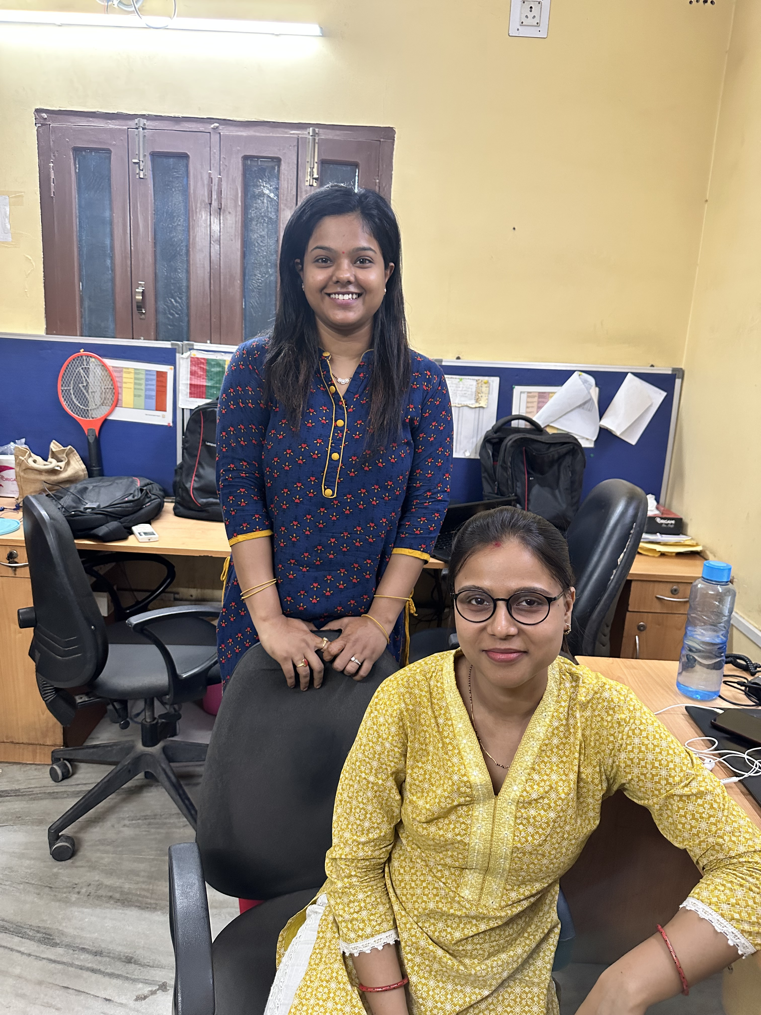
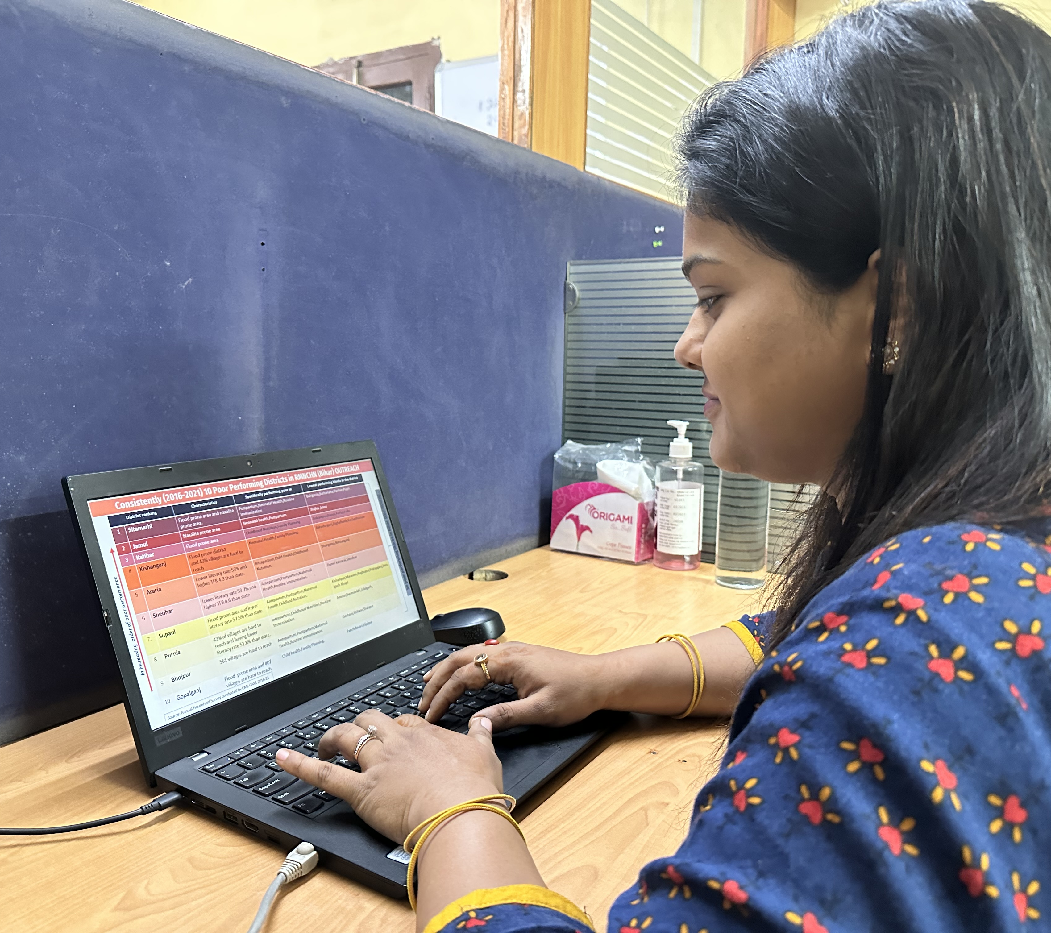
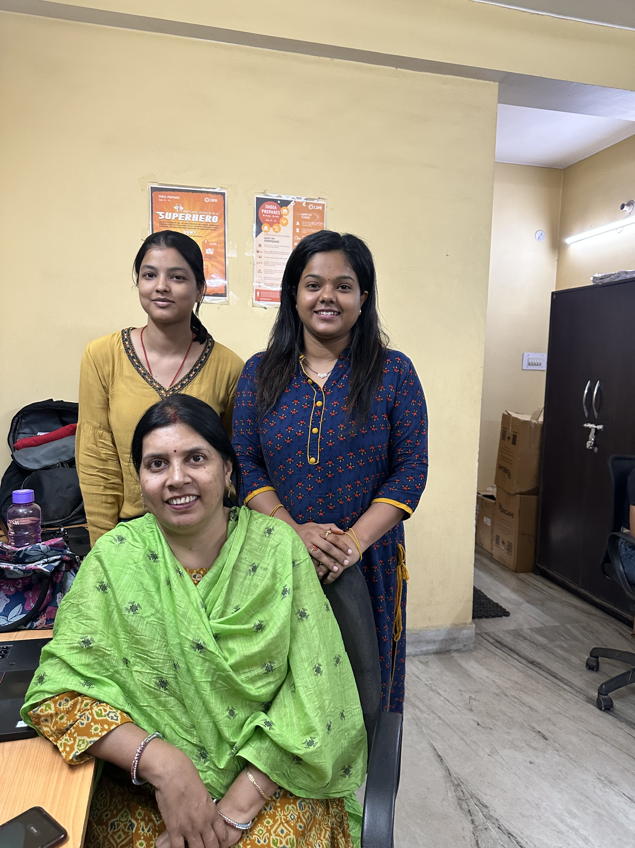
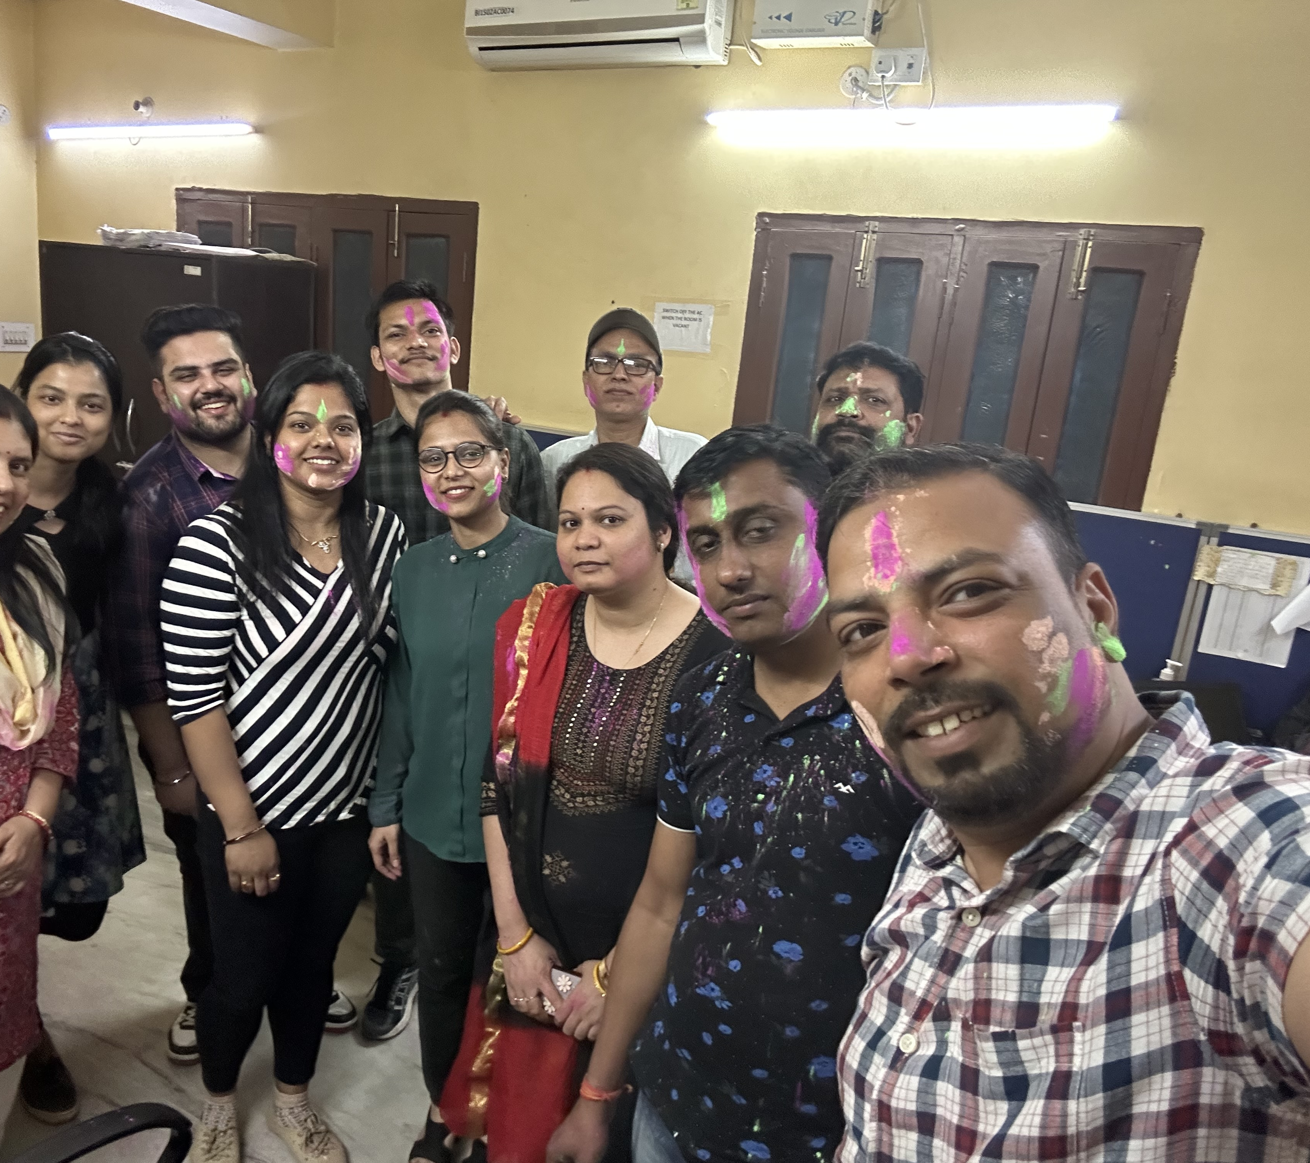
Pictorial Journey

