Slide 1

Knowledge and Practices of Health care providers regarding Management of High-Risk Pregnancies in the selected Public Healthcare facilities in Karauli, Rajasthan.

Slide 2
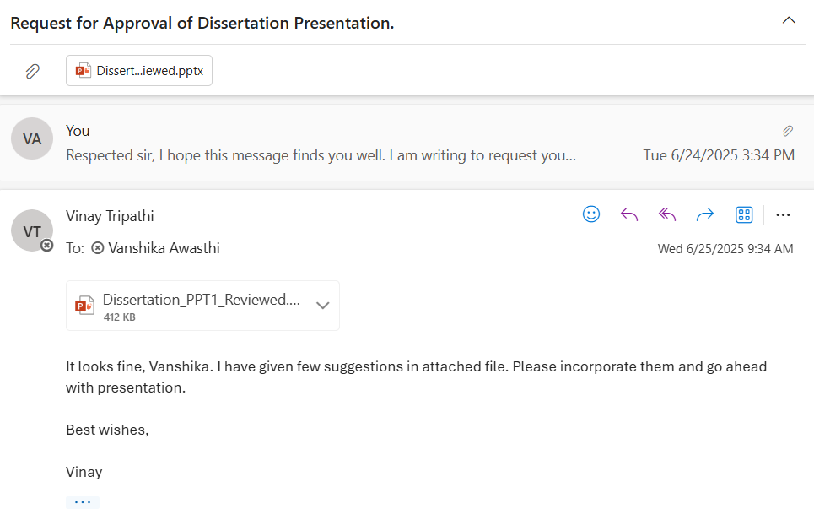
Mentor approval

Slide 3
Background of the Study
Maternal health is a critical indicator of a nation’s overall health system performance. High-risk pregnancies (HRPs) represent a significant problem in maternal health and lead to high rates of complications and mortality in India.
Pre-eclampsia, eclampsia, gestational diabetes, severe anemia, and multiple pregnancies are examples of medical or obstetric diseases that fall under the category of HRPs. If left untreated, these illnesses can have life-threatening consequences for both the mother and the fetus.
Nursing staff, particularly those assigned to District Hospitals and Community Health Centers, frequently serve as the initial responders to these situations. Their function is essential in identifying warning signs and handling pregnancies that are considered high risk in an effective manner.
Despite the existence of national programs and guidelines, noticeable gaps remain between nurses' knowledge and their practical application.

Slide 4
BACKGROUND OF THE STUDY
Rajasthan, specifically, still encounters difficulties such as a high rate of anemia, inadequate antenatal care services, and restricted availability of consistent training opportunities. These factors can influence the capacity of staff nurses to handle HRPs with expertise and skill
This study aims to assess their current knowledge and practices, identify existing gaps, and suggest areas for improvement.
The findings will help inform future training programs and contribute to better maternal care at the facility level—ultimately supporting efforts to reduce preventable maternal and neonatal complications.

Slide 5
Objectives of THE Study
To assess the level of knowledge among staff nurses about high-risk pregnancy conditions.
To evaluate the actual practices of staff nurses in the identification and management of high-risk pregnancies.
To identify gaps between knowledge and practice in managing high-risk pregnancies.

Slide 6
Methodology
Study Design: A descriptive cross-sectional study.
Study Setting: Selected District Hospitals (DHs) and Community Health Centers (CHCs) in Karauli Rajasthan.
Study Population: Staff nurses working in antenatal clinics, maternity wards, and labor rooms.
Sample Size: A total of 38 staff nurses was selected through convenience sampling.
Data Collection Tool:
A structured, self-administered questionnaire divided into three sections:
Section A: Demographic profile
Section B: Knowledge of high-risk pregnancy conditions
Section C: Practical application and routine management of HRPs

Slide 7
Methodology
Ethical Considerations
Informed consent was obtained from all participants prior to data collection.
Confidentiality and anonymity of the respondents was strictly maintained.
Limitations of Study
The study is limited to selected public health facilities in Karauli, Rajasthan and may not reflect practices in private or urban tertiary hospitals.
The responses related to clinical practice are self-reported and may be influenced by the participant’s recall.
The study uses a cross-sectional design, which assesses knowledge and practices at a single point in time.

Slide 8
Result
A total of 38 staff nurses participated in the study, all currently working in selected public health facilities of Karauli district, Rajasthan.
Among them, the majority were female (81.6%) and 18.4% were male.
Regarding educational qualification, 50% were General Nursing and Midwifery (GNM) trained, 32.5% were Auxiliary Nurse Midwives (ANMs), and 15% held a BSc Nursing degree.
A large proportion (70%) were posted at Community Health Centres (CHCs), while 30% were working in District Hospitals.
Only 23.7% of the participants had received formal training on high-risk pregnancy (HRP) management in the past year.

Slide 9
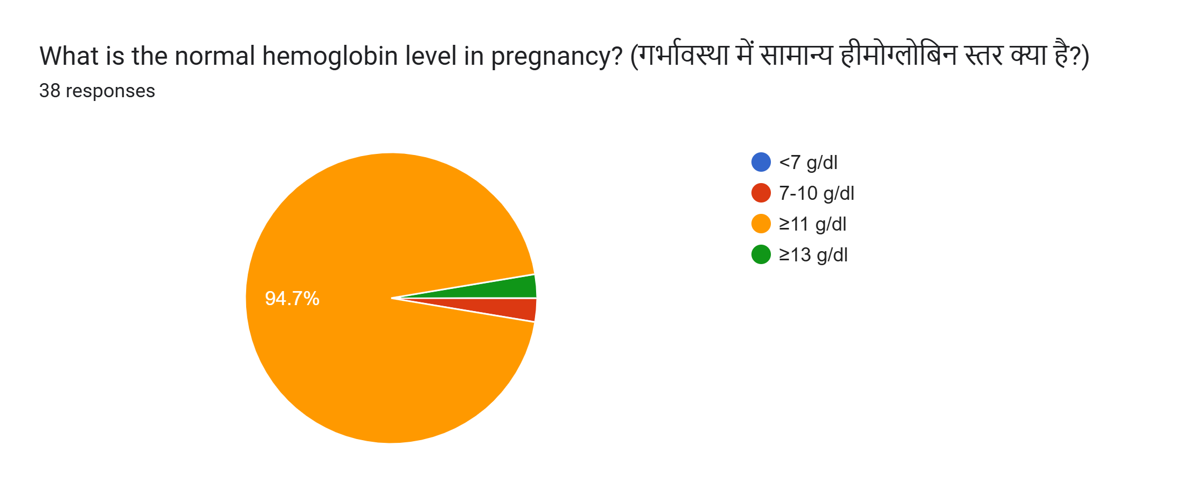
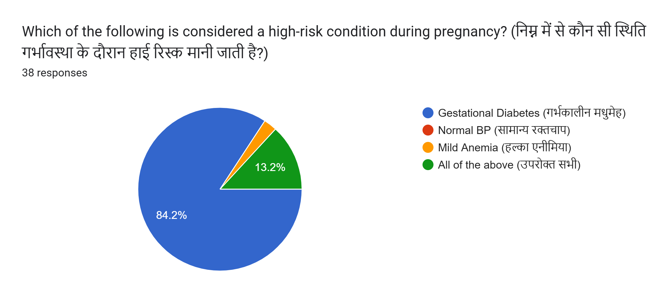
RESULT
In terms of knowledge:
84.2% correctly identified gestational 94.7% knew that the normal hemoglobin
diabetes as high-risk conditions. level during pregnancy should be above 11 gm/dl.

Slide 10
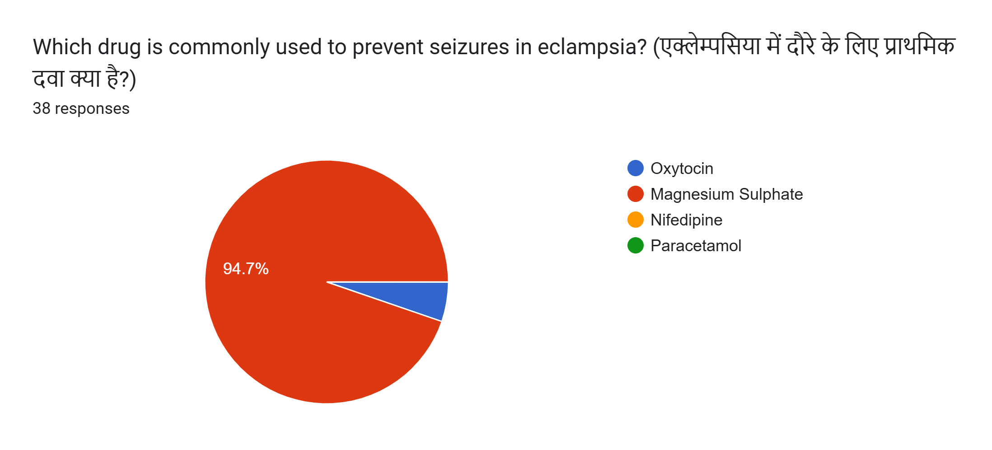
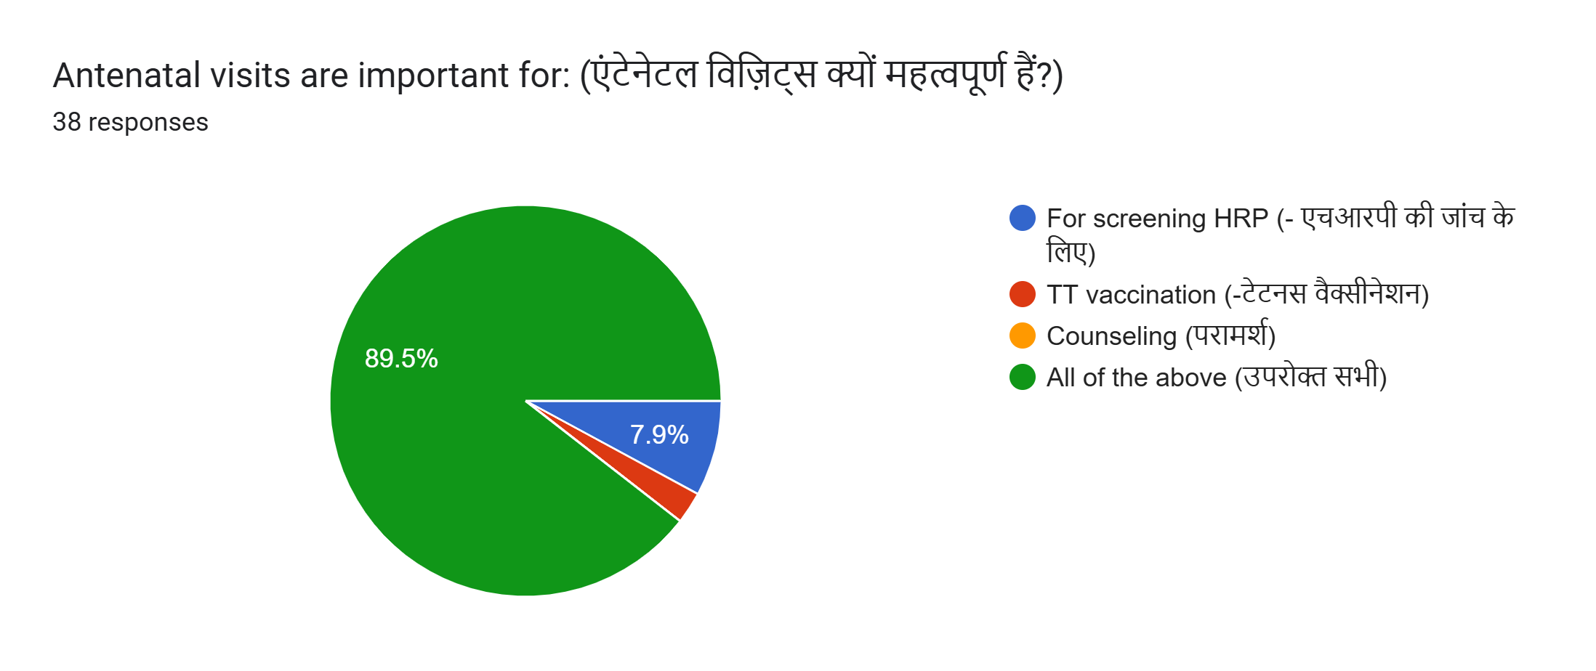
RESULT
94.7% were aware that Magnesium Sulphate 89.5% recognized the importance of antenatal visits for timely (MgSO₄) is recommended drug for preventing identification of HRP. and managing eclampsia

Slide 11
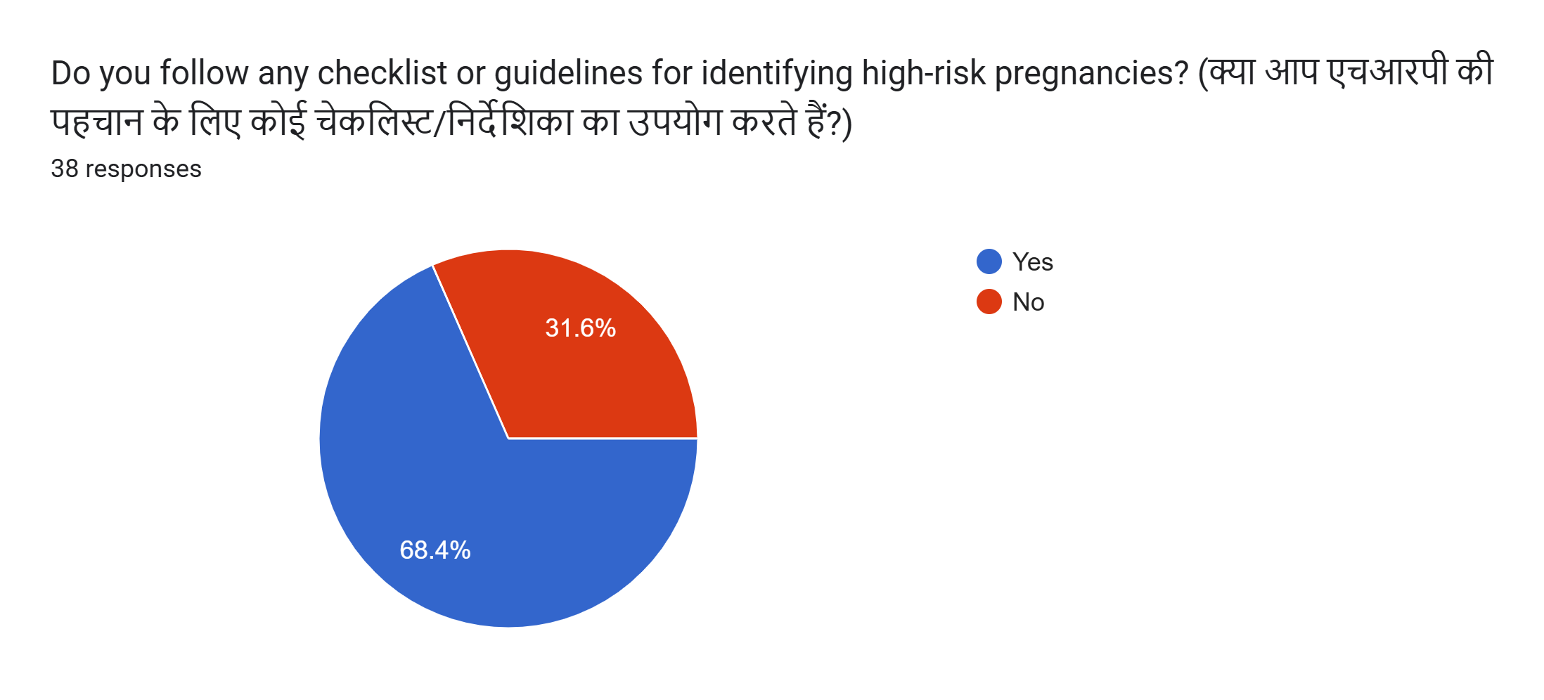
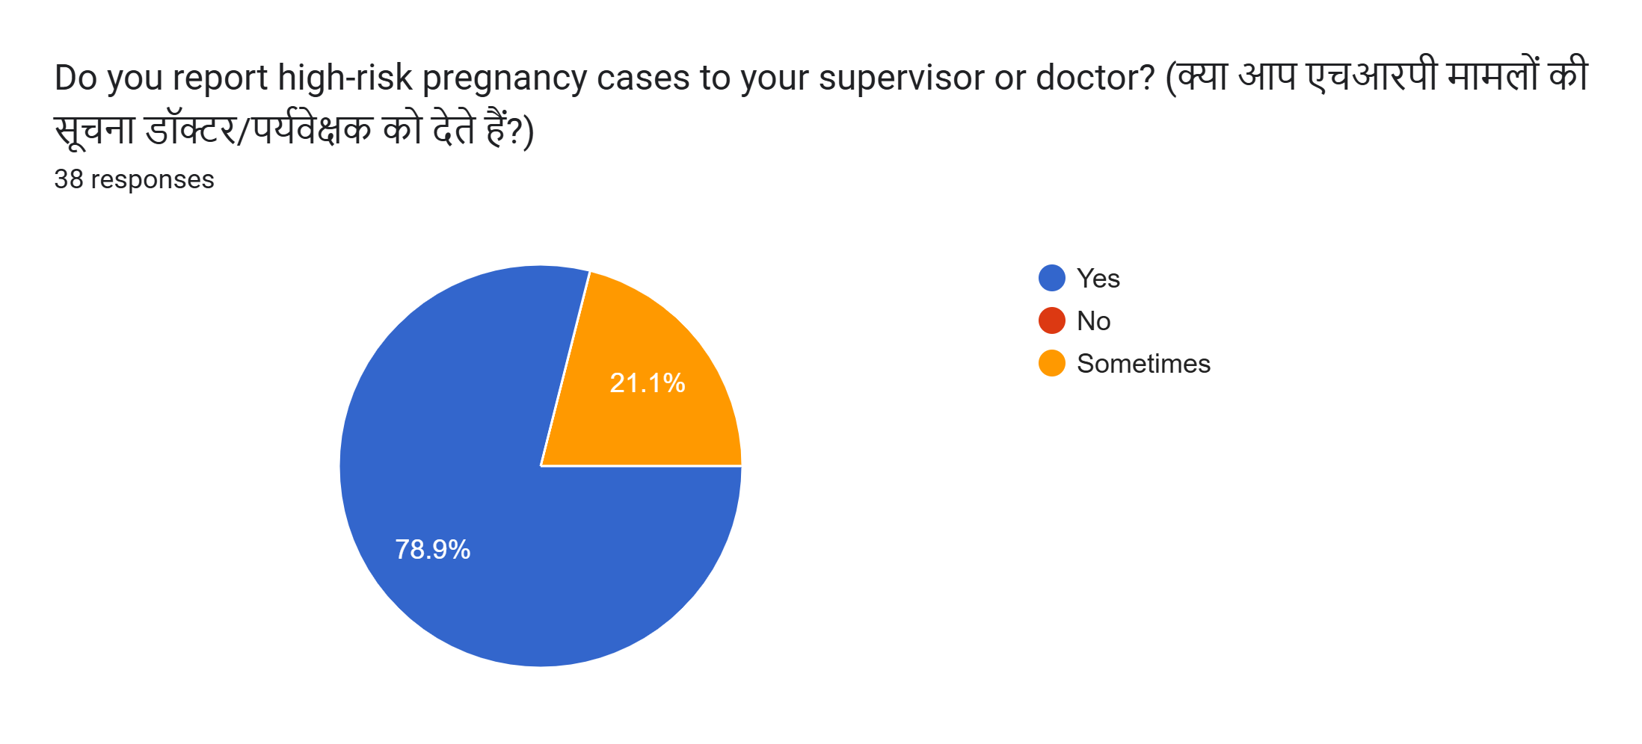
RESULT
Regarding practical application:
68.4% agreed that using a checklist helps 78.9% stated that reporting HRP cases to doctors in the routine management of HRP cases. is a standard part of their protocol.

Slide 12
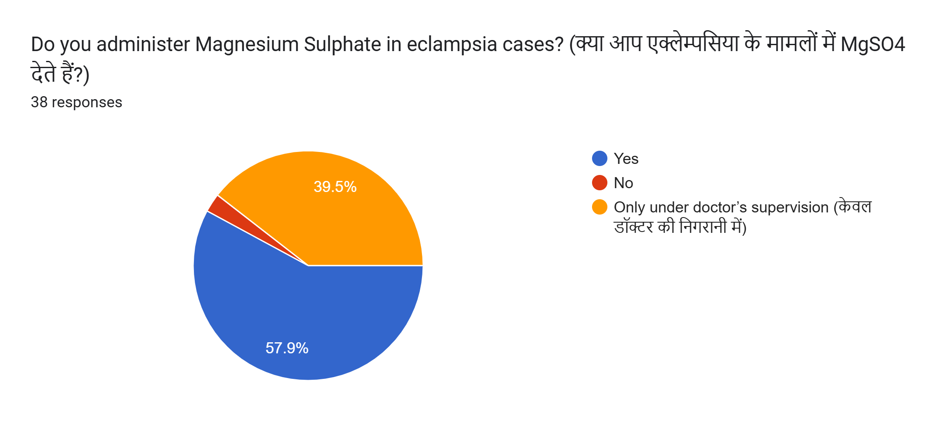
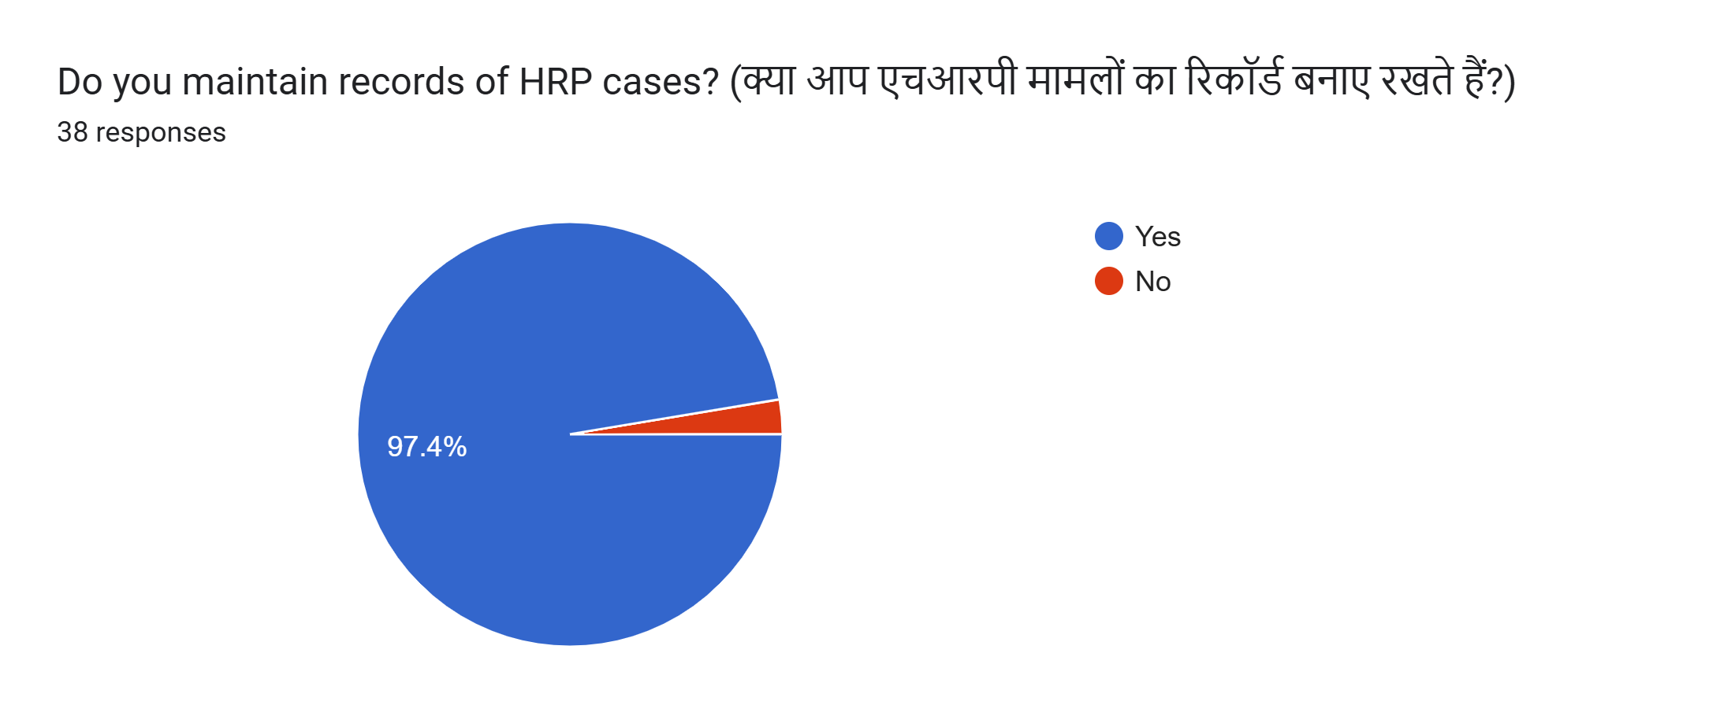
RESULT
57.9% of nurses reported that they independently administered MgSO₄ for eclampsia management, while 37.5% did so only under a doctor’s supervision.
97.4% maintained records of HRP cases consistently.

Slide 13
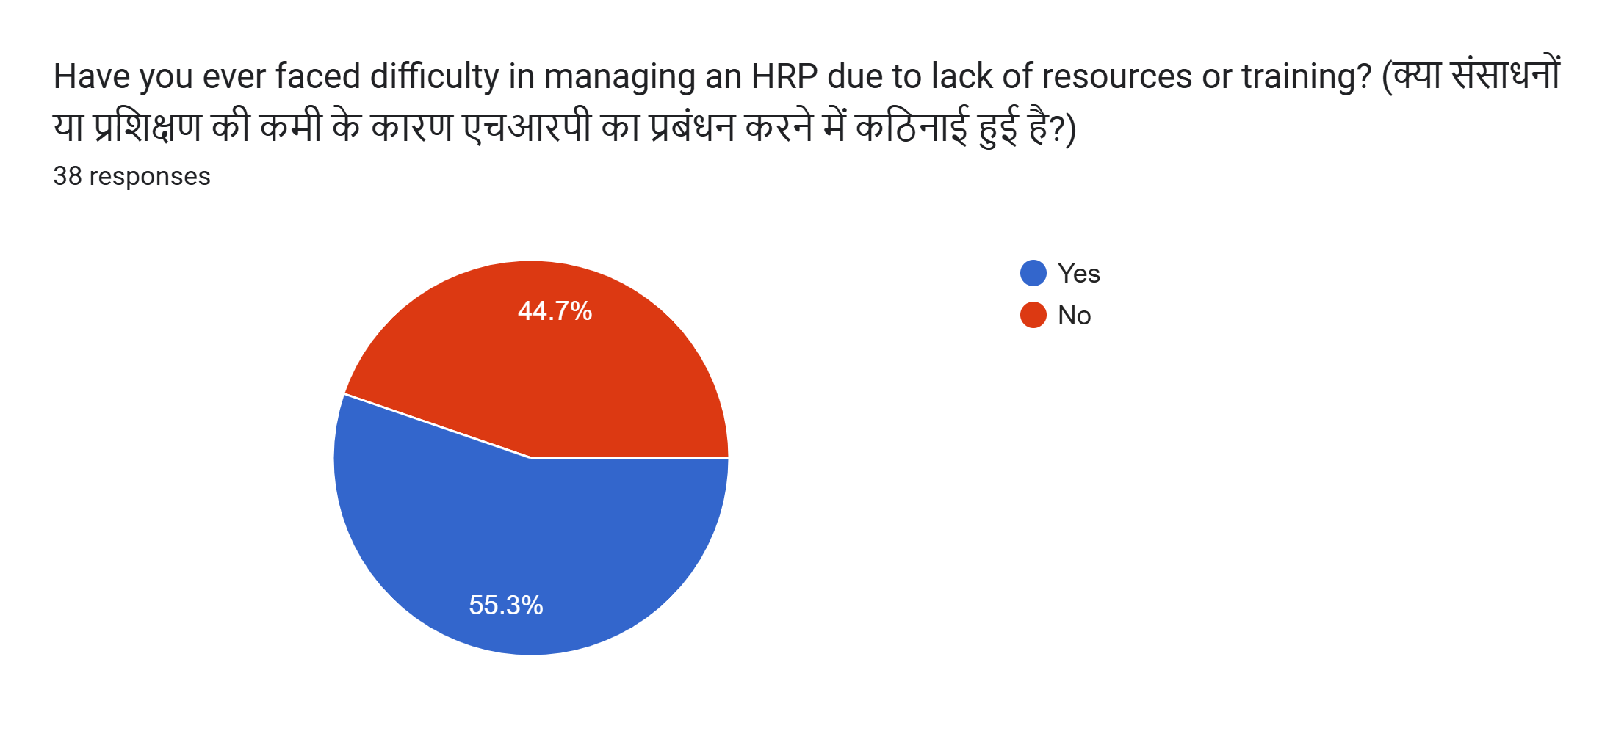
RESULT
52.5% of respondents reported facing difficulties in managing HRPs, which they attributed to limited resources, insufficient training, and high patient loads.

Slide 14
Discussion
The present study was undertaken to assess the knowledge and practices of staff nurses in managing high-risk pregnancies and to examine the extent of alignment between their theoretical understanding and actual clinical practice.
Most participants demonstrated awareness of common high-risk conditions, including pre-eclampsia and gestational diabetes. However, it was noted that only a small proportion (23.7%) had undergone formal training on the subject within the past year. This observation is in line with previous findings by Dalal et al. (2022), who highlighted similar challenges faced by frontline health workers , particularly due to infrequent training and unclear referral mechanisms.

Slide 15
Discussion
In terms of practice, while more than half of the nurses reported being confident in administering Magnesium Sulphate in cases of eclampsia, a substantial number indicated that they did so only under direct supervision. This pattern suggests the presence of clinical hesitation or dependence on physician guidance, even when the intervention is within nursing scope.
A comparable trend was reported by Ramadurg et al. (2016) in Karnataka, where community health workers expressed uncertainty in handling hypertensive complications due to limited hands-on exposure.
Over half of the respondents in the current study also reported difficulties in managing HRP cases, which they attributed to constraints such as inadequate resources, lack of updated knowledge, and increased workload. This finding reflects systemic issues that may hinder the practical application of knowledge. Supporting this, research from Bihar (2019) demonstrated that structured, simulation-based training considerably improved nurses’ competence in managing high-risk obstetric scenarios.

Slide 16
Conclusion
The study concludes that while nurses working in public health facilities are generally aware of high-risk pregnancy conditions, their clinical practices are affected by limited training, lack of confidence in decision-making, and workplace challenges.
To bridge the gap between knowledge and practice, regular hands-on training, clear clinical protocols, and supportive supervision are essential. Strengthening these aspects will not only enhance nurse performance but also improve the early identification and management of high-risk pregnancies, contributing to better maternal health outcomes.

Slide 17
References
World Health Organization. (2023). Maternal mortality. Retrieved from https://www.who.int/news-room/fact-sheets/detail/maternal-mortality
International Institute for Population Sciences (IIPS) & ICF. (2021). National Family Health Survey (NFHS-5), 2019–21: India and Rajasthan Fact Sheets. Retrieved from https://rchiips.org/nfhs/NFHS-5_FCTS/Rajasthan.pdf
Archana, T. (2021). Effectiveness of planned teaching programme on knowledge regarding effects of anemia on mother and fetus among the pregnant women in selected rural hospitals. Bioscience Biotechnology Research Communications, 14(9), 11–14. https://doi.org/10.21786/bbrc/14.9.3
Mohammed, A. R., & Ghafel, H. H. (2022). Evaluation of nurses’ practices about management of main danger signs during pregnancy. International Journal of Health Sciences, 6(S2), 8090–8100. https://sciencescholar.us/journal/index.php/ijhs/article/view/7021
Dalal S, Nagar R, Hegde R, Vaishnav S, Abdullah H, Kasper J.Referral care for high-risk pregnant women in rural Rajasthan, India: a qualitative analysis of barriers and facilitators. BMC Pregnancy Childbirth. 2022;22:310. Available from: https://bmcpregnancychildbirth.biomedcentral.com/articles/10.1186/s12884-022-04601-6

Slide 18
6. Ramadurg UY, Vidler M, Charantimath U, Katageri G, Ramana P, Kavi A, et al.Community health worker knowledge and management of pre-eclampsia in rural Karnataka State, India.Reprod Health. 2016;13(Suppl 2):113. Available from https://reproductive-health-journal.biomedcentral.com/articles/10.1186/s12978-016-0219-8
7. Varghese B, Copas A, Tharyan P, Chinnakali P, Chatterjee P, Yadav B, et al.Simulation-enhanced nurse mentoring to improve preeclampsia and eclampsia care in Bihar, India.BMC Pregnancy Childbirth. 2019;19:41.
Available from: https://bmcpregnancychildbirth.biomedcentral.com/articles/10.1186/s12884-019-2186-x

Slide 19
THANK YOU

