Slide 1

The Role of Wearable Devices in Healthcare:
A Systematic Review
PRESENTED BY –
SUHANI SAXENA
[PG/22/144]
International Institute of Health Management Research
Mentor : DR. EKTA SAROHA

Slide 2

INTRODUCTION
With the advancements in mobile medicine and development of technologies like smart sensing and personalization of health concepts, the field of wearable devices has developed in recent years.
Wearables are the Internet of Things (IoT) solutions which combines hardware, software and app development.
IoT are the interconnected system of physical objects along with the embedded technology for data transmission and sensors to interact both with internal and external objects and environment.
In healthcare, wearable devices can be referred as the devices that can be worn or mated with human skin for constant and close monitoring of individual’s activities.
In the healthcare domain, wearables consisting of the portable and health electronic devices that can be worn directly on the body, to perceive, record, analyze, regulate for the maintenance of the health and to prevent illnesses.

Slide 3

INTRODUCTION (Contd.)
According to Deloitte Insights, compared to 275 million units in 2021, the global market for wearable devices in healthcare sector would rise upto 440 million units in 2024.
International Data Corporation states that, wearable device market in India in 2023 achieved a 34% growth to a record of 134.2 million units.
Wearable healthcare devices collect physiological and environmental data using sensors, which is processed to extract meaningful information for deriving health metrics. Processed data is then transmitted via or cellular connections to devices or cloud platforms for analysis, storage, and integration into electronic health records. Users receive feedback through visual displays, haptic alerts, and mobile notifications, with data security measures such as encryption and regulatory compliance protecting personal health information.
Alongside the usage and advantages of wearable devices, there are certain challenges such as data quality and health equity, privacy and security that require potential solutions.

Slide 4

RESEARCH QUESTION
How can wearable devices be utilized in healthcare practices; considering the current market trends, growth projections and existing technological shortcomings?

Slide 5
OBJECTIVES
To understand the concept of wearable devices in healthcare sector, highlighting its application and integration into daily life and healthcare practices.
To analyze its growth projections in health domain.
To emphasize existing limitations and propose recommendations for advancement in the technology.

Slide 6
RESEARCH METHODOLOGY
Research Design: A systematic review design will be used to analyze the existing evidence and future predictions based on evidence found.
Search Strategy: The search for this report is centered around secondary research methods. Data will be acquired through analysis of research papers available on sites such as PubMed & Research Gate limiting to texts published between 2019 and 2024 and various organization’s websites dealing with the market research and other concepts
Keywords: Wearable technology, Wearable devices, Healthcare
Inclusion Criteria: Recent studies focusing on wearable technology in the healthcare sector.
Exclusion Criteria:
• Studies lacking relevance to the research question and objectives outlined in the systematic review.
• Studies containing outdated information to the healthcare wearables.

Slide 7
Prisma Methodology
Identification of studies via databases
Identification of studies via other methods
Identification
Records Identified (n=394)
Records Identified from Websites
(n= 76)
Records Screened (n=67 )
Screening
Reports Excluded:
Reason-
1).Full text not available
2).Content not in English Language
Reports Excluded:
Reason-
1). Outdated Information
2). Accessibility Issues
Reports assessed for eligibility (n= 25)
Reports assessed for eligibility (n=54)
Included
Studies Included in review (n= 9)
Studies Included in review (n= 8)

Slide 8
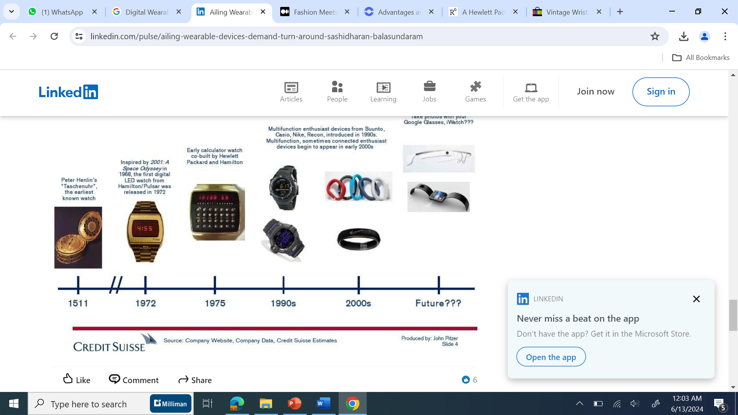
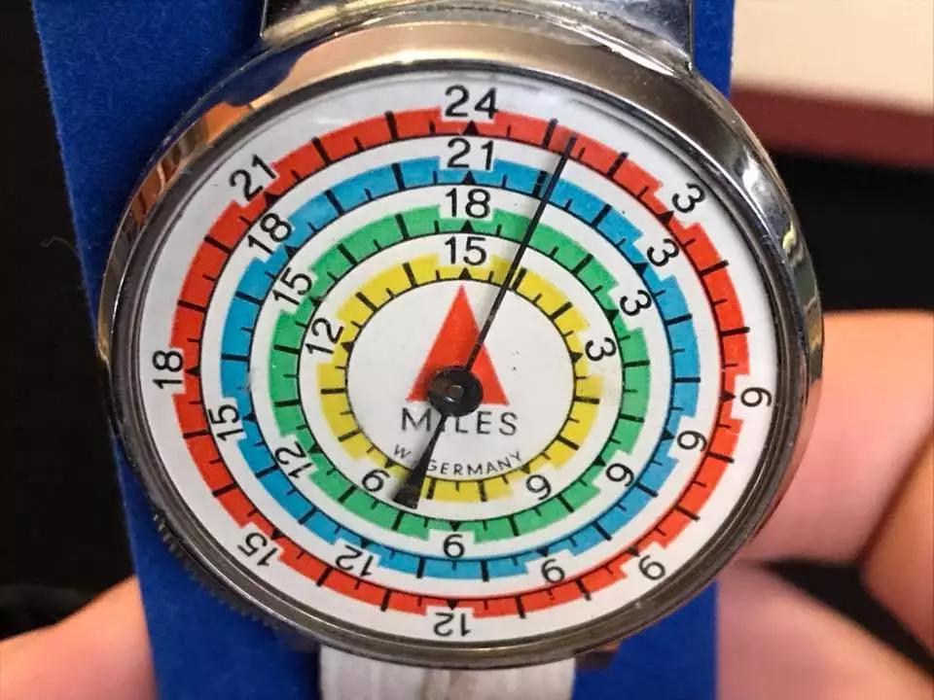
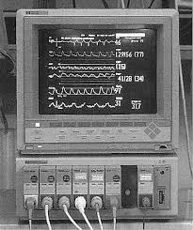
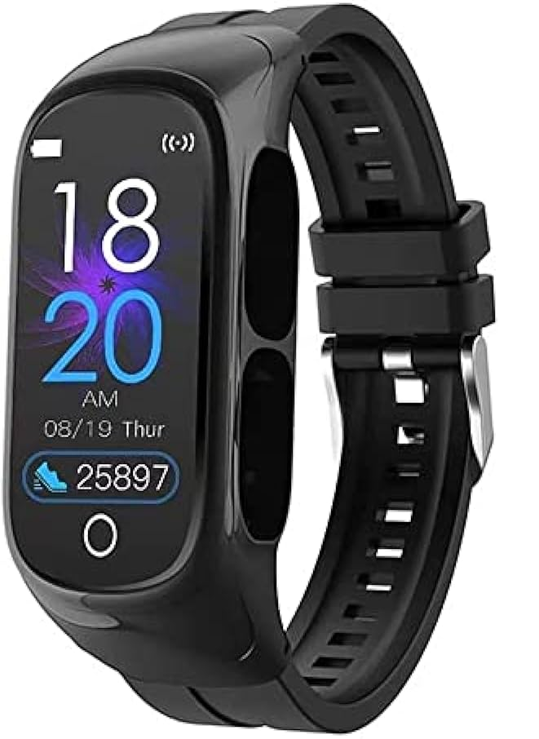
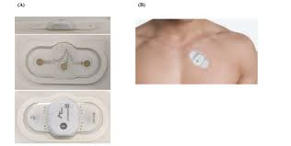
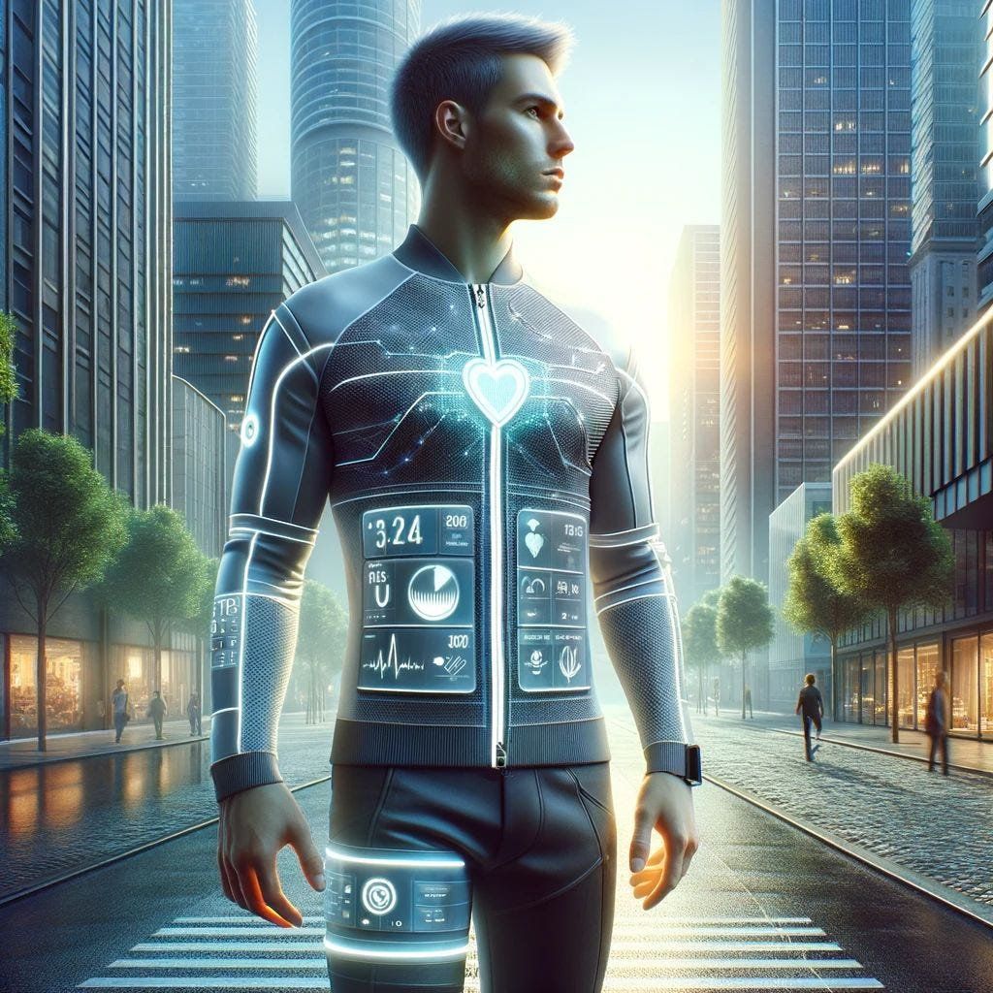
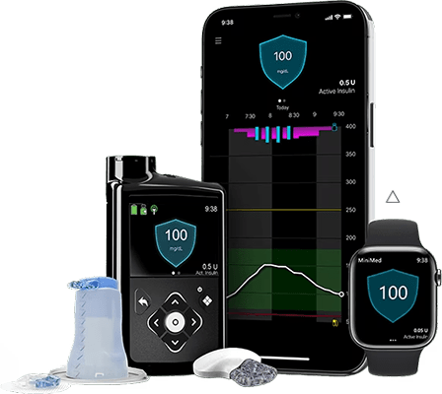
Historical Context of Wearable Devices
RESULT
Pedometers (1960s-1970s)
Heart Rate Monitors (1980s)
Early Digital Wearables (1990s)
Fitness Trackers & Smartwatches (2000s-2010s)
Smart Clothing (2020s)
Wearable ECG Monitors (2010s-Present)
Continuous Glucose Monitors (CGMs) (2010s)

Slide 9
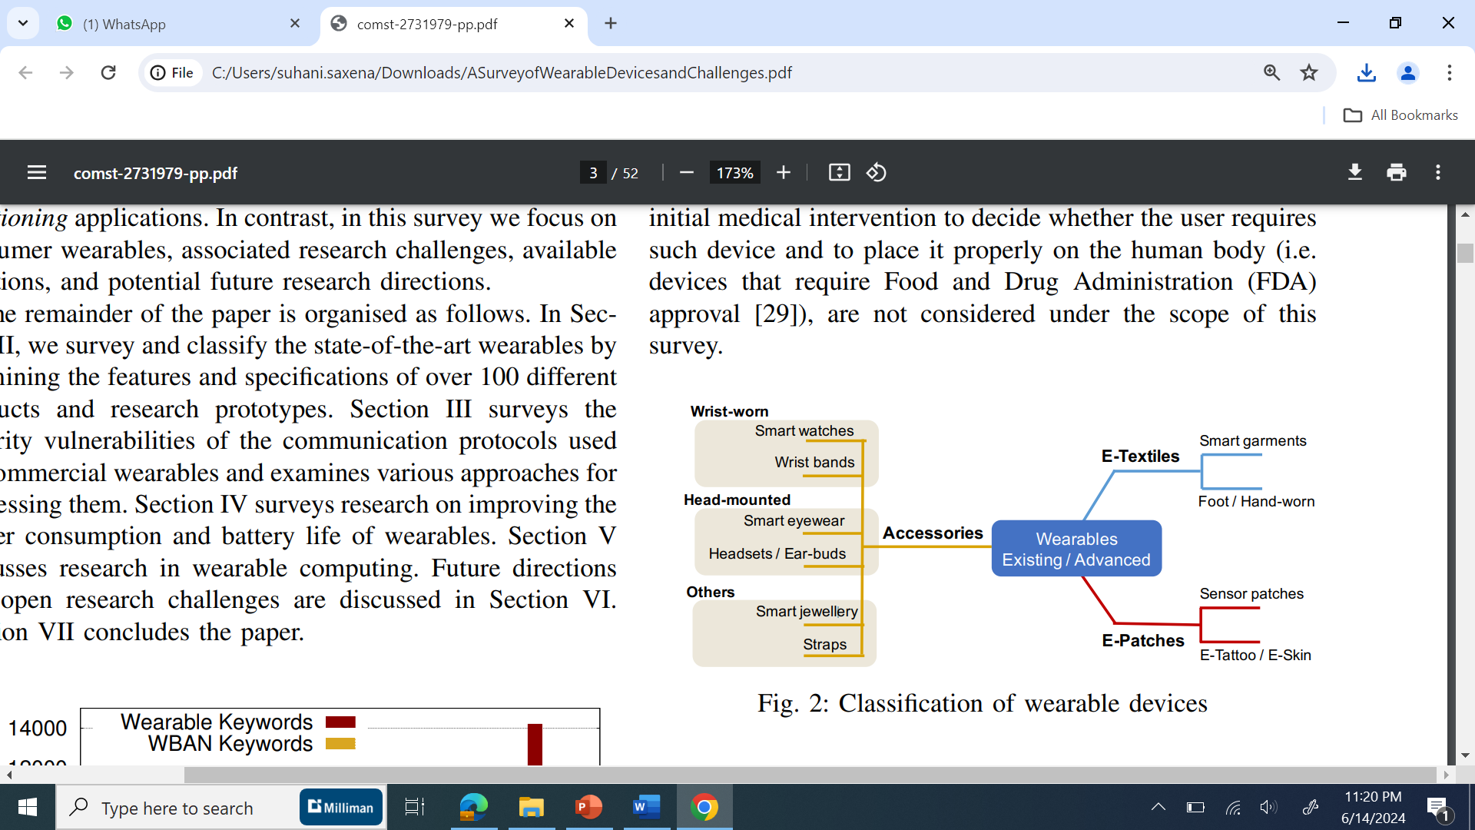
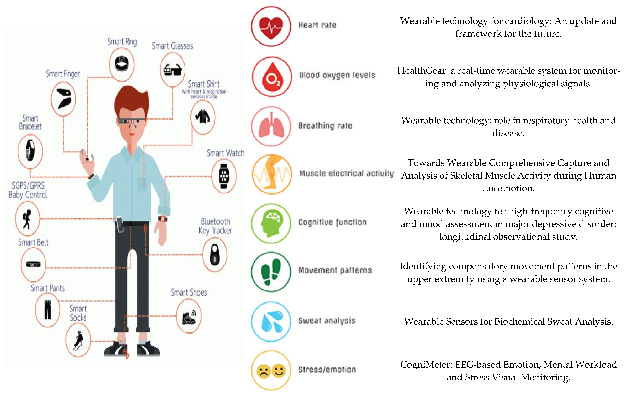
Classification of Wearable Devices

Slide 10
Categorization of Devices
Category | Wearable Device | Applications in Healthcare
Activity Tracking | Smartwatches | Provides real-time health data to individual and to healthcare providers for remote-patient monitoring.
 | Fitness Trackers | Monitors physical activity levels for patients.
Vital Signs Monitoring | Continuous Glucose Monitors (CGMs) | Continuous monitoring of glucose levels in diabetic patients.
 | ECG Monitors | Monitoring heart health in patients with heart conditions.
 | Blood Pressure Monitors | Monitoring blood pressure trends in hypertensive patients, aiding in medication management and lifestyle modifications.
 | Respiratory Monitors | Monitoring respiratory rate and patterns in patients with chronic respiratory conditions.
Emergency Response and Safety | Medical Alert Devices | Providing immediate assistance to individuals, especially in elder age, ensuring timely medical intervention.
Fashion and Lifestyle Wearables | Smart Clothing | Garments embedded with sensors to monitor various health conditions like heart rate, respiratory rate and activity levels.
 | Smart Glasses | Interaction and transmission of data by healthcare professionals and enable hands-free to patient data.
Health and Wellness | Sleep Trackers | Assesses sleep quality and identifying sleep disorders, aiding in the diagnosis and management of sleep disorders.

Slide 11
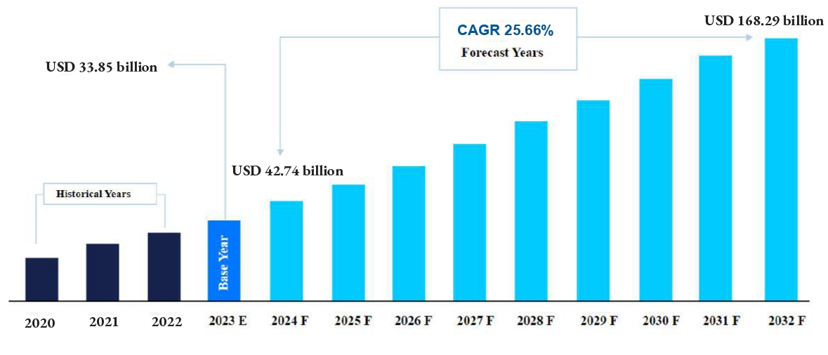
MARKET RESEARCH
Market size value in 2024 | USD 42.74 billion
Revenue forecast in 2030 | USD 168.29 billion
Growth rate | CAGR of 25.66% from 2024 to 2030
Base year for estimation | 2023
Historical data | 2020 - 2022
Forecast period | 2024 - 2030
Taking into account the influence of technological advancements, the global market for wearable devices is experiencing significant expansion.
The estimated value of the global market for wearable medical devices stood at USD 33.85 billion in 2023, with a projected compound annual growth rate (CAGR) of 25.66% from 2024 to 2030.
The market holds significant opportunities driven by technological advancements, merger and acquisition activities, increasing clinical trials, and intensified awareness of personal health monitoring.
The market holds significant opportunities driven by technological advancements, merger and acquisition activities, increasing clinical trials, and intensified awareness of personal health monitoring.

Slide 12
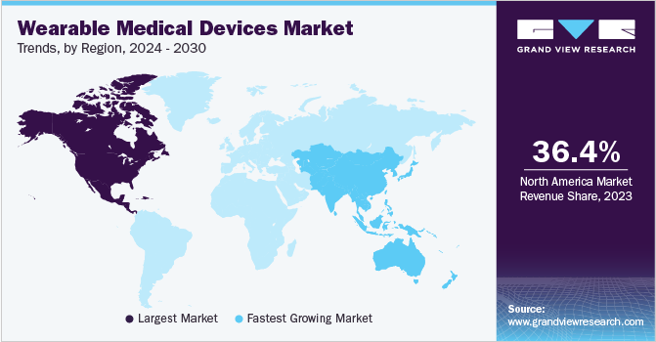
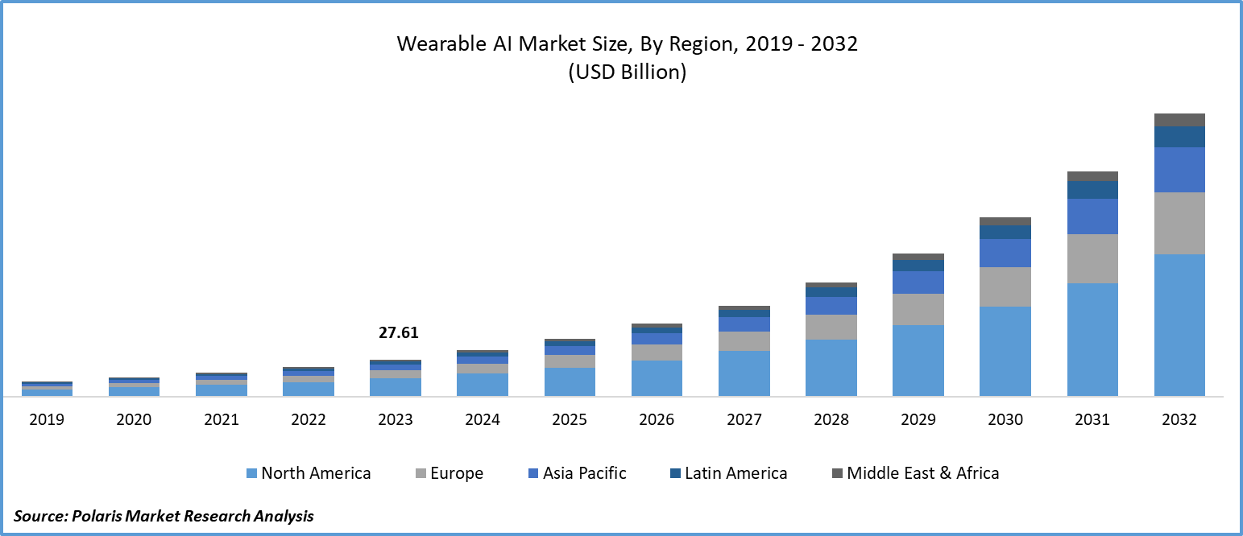
Regional Insights
North America is the most significant global wearable healthcare devices market shareholder and is estimated to grow at a CAGR of 8.8% over the forecast period.
Europe is anticipated to exhibit a CAGR of 9.0% over the forecast period.
The Asia-Pacific market is expected to grow at the fastest CAGR due to the increasing focus of governments NGOs on reducing patient hospital stays. Japan had the largest market share in Asia Pacific for remote patient monitoring devices.
Latin America, the Middle East and Africa account for a lower market share because they are large and untapped markets.
The domestic wearable healthcare market in India is rapidly strengthening. As per a Research and Markets report, it is predicted to reach a value of $1.26 billion by 2025, up from $310.4 million in 2020.

Slide 13
Segmental Analysis
The market is further segmented by device type into Diagnostic Devices, Therapeutic Devices, Multiparameter Trackers, heart rate Monitors, Blood Pressure Monitors, Pulse Oximeters, Wrist Actigraphy, Polysomnography Devices, and Traditional Diagnostic Tests.
Based on product type, the market is fragmented into Activity Monitors/Trackers, Smartwatches, Smart Clothing, Hearables, Trackers, and Paths. Smartwatches generate the highest revenue share.
The market can be bifurcated by application into Sports and Fitness, Remote Patient Monitoring, Home Healthcare
The market is sub-segmented into Consumer and clinical Grades based on grade type.
The market is classified by Distribution Channel into Pharmacies, e-Commerce, and Hypermarkets.

Slide 14
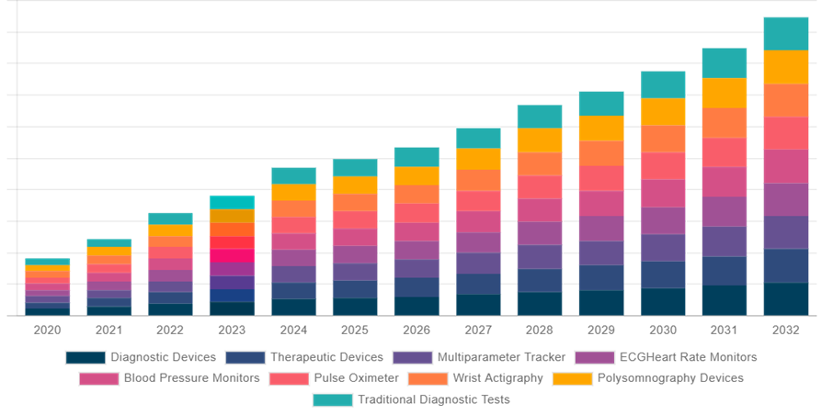
Global Wearable Medical Device Market Share by Device Type

Slide 15
CHALLENGES AND RECOMMENDATIONS
Parameter | Description | Challenges | Recommendations
Battery Life | Smartwatches and fitness trackers, require frequent charging. Enhancing battery life can significantly improve user experience and device reliability. | Limited battery life leading to frequent recharges, causing user inconvenience. | Develop energy-efficient hardware and optimize software to reduce power consumption
Data Accuracy | Accurate data is critical for health monitoring devices to provide reliable insights. | Inaccurate readings due to sensor limitations, placement issues, or interference. | Use advanced sensors and improve algorithms for better accuracy. Regularly update software and calibrate devices to ensure precision.
User Compliance | Non-compliance can result in missing critical health data and reduce the effectiveness of the device. | Difficulty in maintaining regular use due to discomfort or complexity. | Design comfortable, user-friendly, and aesthetically pleasing devices. Provide clear instructions and support for users.
Data Privacy | Breaches can lead to sensitive information being exposed, causing significant privacy issues and potentially legal consequences for companies. | Concerns over the security and privacy of personal health data. | Implement robust encryption methods and comply with healthcare regulations (e.g., HIPAA, GDPR).
Interoperability | Interoperability ensures that wearable devices can seamlessly integrate with other medical equipment and electronic health records. | Challenges in integrating with other healthcare systems and devices, limiting their effectiveness. | Develop open standards and protocols to facilitate compatibility. Collaborate with other technology providers and healthcare systems.
Cost | The cost of wearable devices can limit accessibility, especially for those in lower-income brackets | High costs can be a barrier to widespread adoption. | Optimize production and supply chain processes to reduce costs. Explore subsidies or insurance coverage for essential health devices.
Regulatory Approval | Regulatory approval ensures that devices are safe and effective for medical use. | Lengthy and complex approval processes. | Maintain clear documentation and rigorous testing to meet standards.

Slide 16
LIMITATIONS OF THE STUDY
Scope Limitation: The time duration mentioned may limit the breadth of available literature and potentially exclude relevant studies published before 2019.
Potential Bias: Relying solely on secondary research may introduce bias, as the selection and interpretation of existing literature may be influenced by the researcher's perspectives and the availability of data.
Generalization Challenges: The proposal aims to analyze existing evidence and future predictions based on the selected literature. However, making predictions about future trends may be challenging without primary data.

Slide 17
DISCUSSION
The growing field of wearable devices in healthcare represents a significant intersection of technology and medicine, poised to revolutionize patient care and health management.
The integration of wearables with IoT platforms enhances data collection and analysis. For example - the ability to transmit data to cloud platforms and integrate it into electronic health records (EHRs) ensures that healthcare providers can access comprehensive patient data, leading to more informed clinical decisions.
Despite the promising outlook, several challenges need to be addressed to maximize the potential of wearable devices in healthcare.
Collaborative efforts between technology developers, healthcare providers, and regulatory bodies can drive the creation of standards and protocols that support seamless integration and interoperability.
Continued innovation, coupled with strategic collaborations, will pave the way for a future where wearable technology is an integral part of healthcare, enhancing patient care and health outcomes globally.

Slide 18
CONCLUSION
The exploration of wearable devices in healthcare has seen a transformative shift in medical practices and personal health management.
Wearable devices offer a wide array of applications, from tracking physical activity and monitoring vital signs to providing emergency response and safety.
Issues such as data accuracy, battery life, user compliance, data privacy, and interoperability pose significant challenges. Addressing these challenges through technological advancements and regulatory compliance is crucial to realizing the full potential of wearable devices in healthcare.
The continued growth and integration of these devices into healthcare practices hold the promise of enhancing patient outcomes, promoting proactive health management, and ultimately transforming the healthcare industry.

Slide 19
REFERENCES
Khan Y, Ostfeld AE, Lochner CM, Pierre A, Arias AC. Monitoring of vital signs with flexible and wearable medical devices. Advanced materials. 2016 Jun;28(22):4373-95.
https://www2.deloitte.com/us/en/insights/industry/technology/technology-media-and-telecom-predictions/2022/wearable-technology-healthcare.html
Haghi M, Thurow K, Stoll R. Wearable devices in medical internet of things: scientific research and commercially available devices. Healthcare informatics research. 2017 Jan;23(1):4.
https://www.researchgate.net/publication/351184717_Understanding_the_Wearable_Technologyhttps://www.idc.com/getdoc.jsp?containerId=prAP51880624
Canali S, Schiaffonati V, Aliverti A. Challenges and recommendations for wearable devices in digital health: Data quality, interoperability, health equity, fairness. PLOS Digital Health. 2022 Oct 13;1(10):e0000104.
Kang HS, Exworthy M. Wearing the future—Wearables to empower users to take greater responsibility for their health and care: Scoping review. JMIR mHealth and uHealth. 2022 Jul 13;10(7):e35684.

Slide 20
REFERENCES (Contd.)
https://www.researchgate.net/publication/224563132_From_Backpacks_to_Smartphones_Past_Present_and_Future_of_Wearable_Computers
Seneviratne S, Hu Y, Nguyen T, Lan G, Khalifa S, Thilakarathna K, Hassan M, Seneviratne A. A survey of wearable devices and challenges. IEEE Communications Surveys & Tutorials. 2017 Jul 26;19(4):2573-620.
https://straitsresearch.com/report/wearable-healthcare-devices-market#:~:text=Market%20Overview,period%20(2024%2D2032).
https://www.polarismarketresearch.com/industry-analysis/wearable-ai-market
https://www.grandviewresearch.com/industry-analysis/wearable-medical-devices-market
Canali S, Schiaffonati V, Aliverti A. Challenges and recommendations for wearable devices in digital health: Data quality, interoperability, health equity, fairness. PLOS Digital Health. 2022 Oct 13;1(10):e0000104.

Slide 21


