Slide 1

Burnout Among Healthcare Workers Post-COVID-19: A Narrative Review
By: Rupam Sharma
Mentor:Dr. Preetha G.S.
IIHMR Delhi

Slide 2
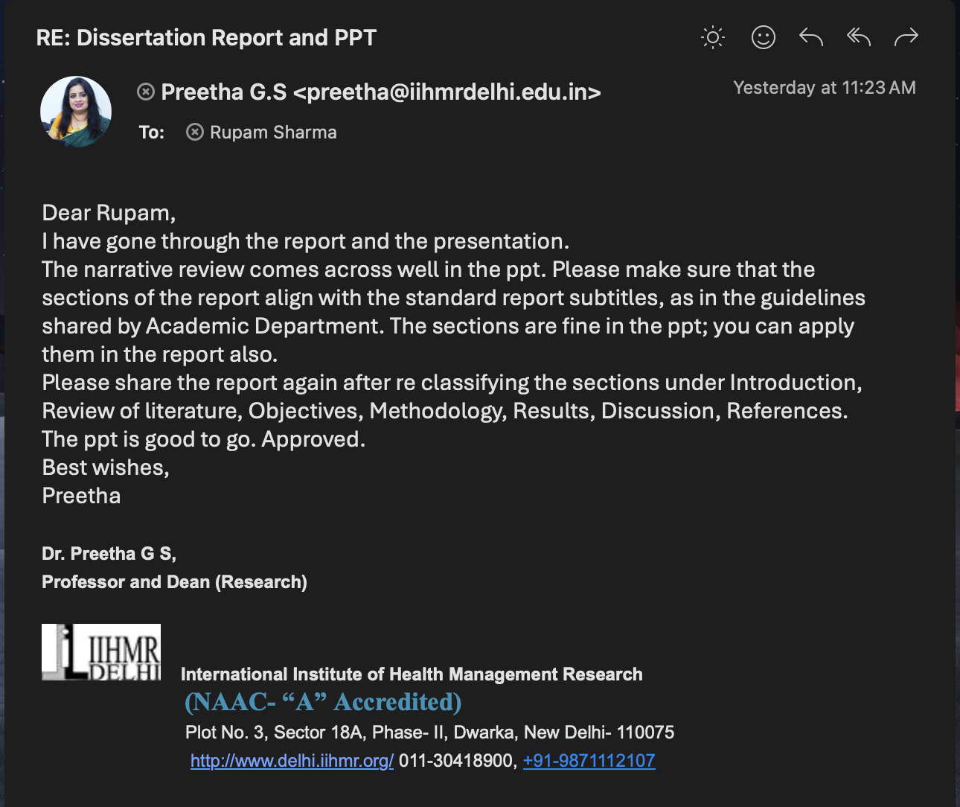
Mentor Approval

Slide 3
Introduction
The COVID-19 pandemic placed unprecedented strain on global healthcare systems, positioning healthcare workers (HCWs) at the epicenter of a prolonged crisis.
While the acute phase of the pandemic has subsided, a more insidious and enduring psychological aftermath has taken root: a pervasive wave of burnout that has been profoundly exacerbated by the pandemic's toll.
Burnout—a syndrome of emotional exhaustion, depersonalization, and reduced personal accomplishment—is now a critical threat to individual well-being, patient safety, and the stability of the healthcare workforce.
This review synthesizes the current literature to analyze the prevalence, causes, and consequences of post-pandemic burnout, evaluating interventions in both global and Indian contexts to identify a path forward.

Slide 4
Distinguishing Key Psychological Constructs in Healthcare Workers
Construct | Core Definition | Primary Locus | Key Symptoms/Features | Causal Relationship to Burnout
Burnout | An occupational syndrome of emotional exhaustion, depersonalization, and reduced personal accomplishment from unmanaged chronic workplace stress.⁵ | Work-related | Disengagement, cynicism, helplessness, feeling of ineffectiveness.⁴ | The outcome of chronic, unmanaged stressors.
Stress | A state of over-engagement characterized by hyperactivity, urgency, and loss of energy.⁴ | General | Over-engagement, emotional hyperactivity, anxiety disorders.⁴ | A precursor to burnout; chronic stress can lead to burnout.
Depression | A global mood disorder affecting all areas of life, not just work.⁷ | General Life | Pervasive low mood, anhedonia, lack of energy in all life domains.⁴ | A distinct but overlapping condition; burnout can be a predictor for developing depression, and vice-versa.⁷
Moral Injury | Psychological distress from actions (or inactions) that transgress one's deeply held moral beliefs, often due to systemic constraints.²¹ | Work-related (ethical context) | Shame, guilt, anger, disgust, sense of betrayal, shattered sense of self.²¹ | A key cause of burnout, particularly the depersonalization and cynicism dimensions.²¹
Compassion Fatigue | A state of emotional and physical exhaustion resulting from chronic exposure to the suffering and trauma of others.¹⁵ | Work-related (empathic context) | Secondary traumatic stress, reduced capacity to empathize.¹⁵ | A component of and contributor to the emotional exhaustion dimension of burnout.

Slide 5
Objectives of Your Study
Primary Objective:
To explore the causes and consequences of burnout among healthcare workers in the post-COVID- 19 period.
Secondary Objectives:
To identify the key contributing factors (e.g., workload, emotional stress, institutional support) related to post-pandemic burnout
To review existing coping mechanisms and policy interventions.

Slide 6
Methodology
Study Design: Narrative Review
Search Strategy:
This narrative review was conducted through a comprehensive literature search of electronic databases, including PubMed, Scopus, and Google Scholar. The search was restricted to articles and reports published in English from January 2020 to the present to ensure a focus on the COVID-19 and post-pandemic periods.
The review prioritized peer-reviewed journal articles, systematic reviews, meta-analyses, and official reports from major health organizations.
Keywords Used:
Key search terms included “burnout,” “healthcare workers,” “physicians,” “nurses,” “post-COVID-19,” “mental health,” “moral injury,” “emotional exhaustion,” “depersonalization,” “patient safety,” “workforce turnover,” “India,” and “interventions.” Boolean operators (AND, OR) were utilized to combine and refine search queries.
Boolean operators (AND, OR) were utilized to refine searches.

Slide 7
Comparative Prevalence of HCW Burnout and Mental Health Outcomes (Global vs. India)
Study (Author, Year) | Country/Region | Sample (N, HCW type) | Burnout Instrument Used | Key Prevalence Findings
De Kock et al. (2021) ³³ | 60 Countries (Global) | 2,707 HCPs | Single-item measure (emotional exhaustion) | 51% reported burnout.
Sahebi et al. (2021) ³¹ | Global (Meta-analysis) | 81,277 HCWs (47 studies) | Various | Pooled prevalence: Anxiety 37%, Depression 36%, Insomnia 32%.
Pappa et al. (2020) ³² | Global (Meta-analysis) | N/A (13 studies) | Various | Pooled prevalence: Anxiety 23.2%, Depression 22.8%, Insomnia 38.9%.
Shaukat et al. (2020) ⁴⁷ | Global (Meta-analysis) | N/A | Various | High levels of depressive, post-traumatic stress, and anxiety symptoms reported.
Sidiq et al. (2024) ³⁸ | India (Jaipur) | 578 HCWs | Copenhagen Burnout Inventory (CBI) | Overall burnout: 68.1%; Work-related burnout: 67.5%; Personal burnout: 56.4%.
Kulkarni et al. (2020) ⁴⁰ | India | 2,026 HCWs | Copenhagen Burnout Inventory (CBI) | Pandemic-related burnout: 52.8%; Personal burnout: 44.6%; Work-related burnout: 26.9%.
Mathias et al. (2024) ⁴¹ | India (Meta-analysis) | N/A (31 studies) | Various | Pooled prevalence: Depression 32.96%, Anxiety 29.49%, Stress 33.47%.
Gupta et al. (2021) ⁴³ | India | 1,615 HCWs | Mini-Z burnout item | Burnout prevalence lower than reports from developed nations; higher in second-line vs. frontline.

Slide 8
Results (1/4)
Defining the Crisis - Burnout Prevalence & Evolution
Definition: Burnout is an occupational syndrome defined by three dimensions: Emotional Exhaustion, Depersonalization (or cynicism), and a sense of Reduced Personal Accomplishment. It results from chronic, unmanaged workplace stress.
Post-Pandemic Surge: Burnout rates among U.S. health workers, stable around 30-31% before 2020, surged during the pandemic, peaking at 39.8% in 2022.
A New, Elevated Baseline: Following the end of the public health emergency, the rate declined to 34.4% in 2023. While an improvement, this remains significantly higher than pre-pandemic levels, indicating a lasting psychological toll on the workforce.

Slide 9
Results (2/4)
A Tale of Two Contexts - Global vs. Indian Prevalence
Global Phenomenon: Multinational studies report high rates of psychological distress among HCWs globally, with one major survey finding 51% experienced burnout. Meta-analyses confirm high pooled prevalence for anxiety (37%) and depression (36%).
The Indian Context: Studies from India report alarmingly high burnout rates, with one 2022 study finding an overall prevalence of 68.1%. Another large survey found 52.8% of Indian HCWs experienced pandemic-related burnout.
Systemic Stressors in India: The crisis in India is magnified by pre-existing systemic challenges, including chronic underfunding, weaker infrastructure, resource scarcity, and a severely overburdened workforce.

Slide 10
Results (3/4)
The Multifactorial Causes of Post-Pandemic Burnout
Systemic & Organizational Failures: The root of the crisis lies in organizational dysfunction.
  Primary Drivers: Excessive workloads due to chronic understaffing, immense administrative burdens (EHRs), and a lack of autonomy and control.
  Leadership & Culture: A lack of supportive leadership and a culture that fails to prioritize well-being are critical factors. Trust in management among HCWs declined post-pandemic.
The Psychological Toll:
  Moral Injury: A key driver of cynicism, moral injury is the distress from actions that transgress one's moral beliefs due to systemic constraints (e.g., rationing care).
  Enduring Trauma: High and persistent rates of PTSD, depression, and anxiety continue to affect the workforce long after the acute phase of the pandemic.
A Hostile Work Environment:
  Workplace Harassment: Reports of harassment of HCWs by patients/families more than doubled from 6% in 2018 to 13% in 2022.
  Erosion of Trust: The public narrative of "heroes" has often been replaced by distrust and aggression, fueled by misinformation.

Slide 11
Results (4/4)
The Cascading Consequences of Burnout
Impact on Patient Safety:
  Physician burnout is associated with a twofold increase in the odds of patient safety incidents, including major medical errors.
  This is driven by cognitive impairment from exhaustion and the erosion of empathy from depersonalization.
The Human Cost to Professionals:
  Burnout is a primary driver of the mass exodus from healthcare. Approximately 100,000 RNs left the workforce in the two years post-pandemic, with 610,000 more reporting an "intent to leave" by 2027.
  It is linked to severe mental health outcomes, including depression, anxiety, and an increased risk of suicidal ideation.
The Economic Burden:
  The annual cost of physician burnout in the U.S. is conservatively estimated at $4.6 billion.
  This cost is driven by high turnover rates (replacing a single physician can cost $500k to over $1M) and reduced clinical hours.

Slide 12
Discussion (1/2)
Interpreting the Crisis - A System in a Vicious Cycle
A Systemic, Not Individual, Failure: The evidence overwhelmingly indicates that burnout is a predictable outcome of a dysfunctional work system, not a lack of individual resilience. The pandemic exposed and amplified pre-existing systemic flaws.
The Importance of Moral Injury: The concept of moral injury provides a crucial explanatory lens, accounting for the profound cynicism and emotional withdrawal that simple "stress" or "fatigue" cannot fully explain. It is an ethical wound to the conscience of the caregiver.
The Vicious Feedback Loop: The crisis is self-perpetuating. High workloads and burnout lead to staff turnover, which worsens understaffing. This, in turn, increases the workload and stress on the remaining clinicians, driving even more burnout and threatening the long-term stability of the workforce.

Slide 13
Discussion (2/2)
Pathways to Recovery - A Call for Systemic Solutions
A Paradigm Shift in Responsibility: The most effective and ethical approach requires a shift in focus from "fixing the worker" to "fixing the workplace." The primary responsibility for well-being lies with the organizations and systems that create the work environment.
Top-Down Interventions are Paramount: Policy changes (e.g., Dr. Lorna Breen Act), regulatory reform to reduce administrative burdens, and organizational strategies to optimize workload, staffing, and workflow are the most impactful solutions.
The Role of Individual Strategies: Individual coping mechanisms like self-care and mindfulness training are valuable complements, but they are insufficient alone. When offered in the absence of systemic reform, they can be perceived as shifting the burden of a broken system onto the individual.

Slide 14
Conclusion
Conclusion & Future Research Agenda
Conclusion: HCW burnout is a persistent, systemic crisis in the post-COVID era, driven by organizational failures and compounded by moral injury. It has severe consequences for patient safety, workforce stability, and healthcare economics. Meaningful recovery requires a fundamental commitment to systemic and organizational reform.
Future Research Agenda - From Problem to Solution: Future research must pivot from simply documenting the crisis to engineering and evaluating solutions. Key priorities include:
  Methodology: Adopting standardized measurement tools and prioritizing longitudinal studies to track burnout and intervention effectiveness over time.
  Interventions: Rigorously evaluating the cost-effectiveness of specific systemic interventions to identify what works best, for whom, and in what context.
  Thematic Gaps: Focusing on underrepresented HCWs, the long-term impact of moral injury, and strategies to rebuild the fractured social contract between HCWs and the public.

Slide 15
References (1/2)
Helfrich CD, Blevins D, Simonetti JA, Rose D, Woolever D, Sylling P, et al. Burnout and Professional Stress Among Health Care Workers After the COVID-19 Pandemic. JAMA Netw Open. 2024 Jun 3;7(6):e2415777.
De Hert S. Burnout in Healthcare Workers: Prevalence, Impact and Preventative Strategies. Local Reg Anesth. 2020;13:171-83.
Gnanadurai A, Harold Robinson E, Kaliyaperumal D, Kumar S. Burnout Syndrome. In: StatPearls [Internet]. Treasure Island (FL): StatPearls Publishing; 2024 [cited 2025 Apr 15]. Available from: https://www.ncbi.nlm.nih.gov/books/NBK538330/
Restauri N, Sheridan AD. Burnout and Posttraumatic Stress Disorder in the Coronavirus Disease 2019 (COVID-19) Pandemic: Intersection, Impact, and Interventions. J Am Coll Radiol. 2020 Jul;17(7):921–6.
de Kock JH, Latham HA, Leslie SJ, Grindle M, Munoz SA, Ellis L, et al. A rapid review of the impact of COVID-19 on the mental health of healthcare workers: implications for supporting psychological well-being. BMC Public Health. 2021 Jan 9;21(1):104.
Sahebi A, Nejati-Zarnaqi B, Moayedi S, Yousefi K, Torres M, Golitaleb M. The prevalence of anxiety and depression among healthcare workers during the COVID-19 pandemic: An umbrella review of meta-analyses. Front Psychiatry. 2021;12:797545.
Sidiq M, Khan A, Singh A, Sharma R, Wani A, Wani Z, et al. Burnout experience among healthcare workers post third COVID-19 wave in India; findings of a cross-sectional study. PeerJ. 2024;12:e18039.
Kulkarni S, Ganesan V, Sharma P, Gorthi SP, Hiremath S, Kumar S, et al. Burnout in healthcare workers during COVID-19 pandemic in India: a cross-sectional study. Indian J Crit Care Med. 2020;24(11):1059-64.

Slide 16
References (2/2)
Grover S, Sahoo S, Mehra A, Avasthi A, Tripathi A, Subramanyan A, et al. Prevalence and factors associated with burnout among healthcare professionals in India: A systematic review and meta-analysis. Indian J Psychol Med. 2020;42(2):109-19.
Rao KD, Ramani S, Hazarika I, George S, Jhalani M, Seshadri S. The first 15 years of the National Health Mission (NHM) in India: progress and challenges. BMJ Glob Health. 2021;6(Suppl 5):e006782.
The Commonwealth Fund. India [Internet]. 2020 [cited 2025 Apr 15]. Available from: https://www.commonwealthfund.org/international-health-policy-center/countries/india
Kisely S, Warren N, McMahon L, Dalais C, Henry I, Siskind D. Occurrence, prevention, and management of the psychological effects of emerging virus outbreaks on healthcare workers: rapid review and meta-analysis. BMJ. 2020 May 5;369:m1642.
Onyegbule CJ, Muoghalu CG, Ofoegbu CC, Ezeorah F. The Impact of Poor Sleep Quality on Cardiovascular Risk Factors and Quality of Life. Cureus. 2025 Jan 13;17(1):e77397.
U.S. Department of Health & Human Services. Addressing Health Worker Burnout: The U.S. Surgeon General’s Advisory on Building a Thriving Health Workforce [Internet]. 2022 May 23 [cited 2025 Apr 15]. Available from: https://www.hhs.gov/surgeongeneral/reports-and-publications/health-worker-burnout/index.html
National Council of State Boards of Nursing. NCSBN Research Projects Significant Nursing Workforce Shortages and Crisis [Internet]. 2023 Apr 13 [cited 2025 Apr 15]. Available from: https://www.ncsbn.org/news/ncsbn-research-projects-significant-nursing-workforce-shortages-and-crisis
Centers for Disease Control and Prevention. Health Worker Mental Health [Internet]. 2023 Oct 24 [cited 2025 Apr 15]. Available from: https://www.cdc.gov/vitalsigns/health-worker-mental-health/index.html

Slide 17
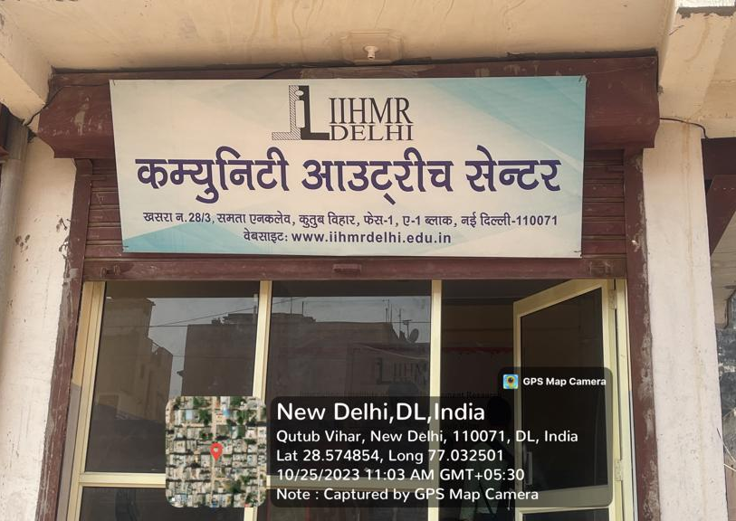
INVOLVEMENT IN COMMUNITY OUTREACH PROGRAMME ACTIVITIES
INVOLVEMENT IN COMMUNITY OUTREACH PROGRAMME (COP) ACTIVITIES
Total no. of visits done: 9
Day-wise activities done
Mapping and listing of the area.
Interaction with the community and frontline healthcare workers.
Observed field-level challenges
Total no. of visits done by the Student:
Day-wise activities done by the student:

Slide 18
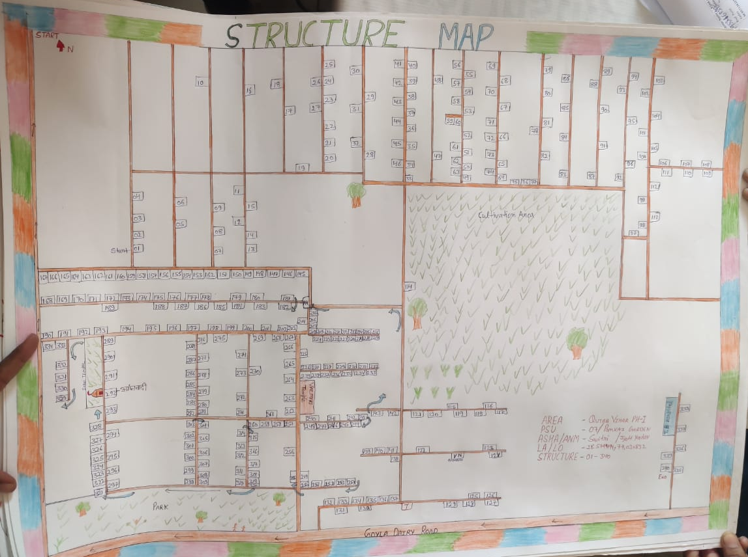
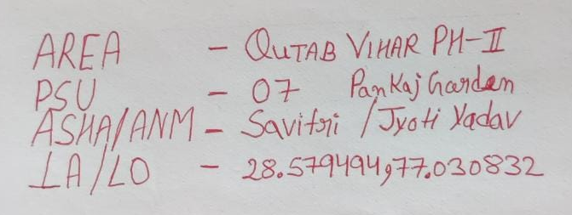
KEY LEARNING FROM COP ACTIVITIES
KEY LEARNING FROM COP ACTIVITIES
Community Insights: Understood local health beliefs, social structures, and demographic patterns.
Health Challenges Identified: Poor sanitation, waste disposal and water quality.
Field Skills Developed: Conducted household visits and health screenings(BP checks, BMI measurements).
IEC/BCC Exposure: Delivered health education using posters, group talks, and interactive sessions.
System Understanding: Observed role of frontline workers and referral linkages.
Professional Growth: Improved communication, empathy, and on-ground problem-solving.

Slide 19
Thank You
Any Questions

