Slide 1



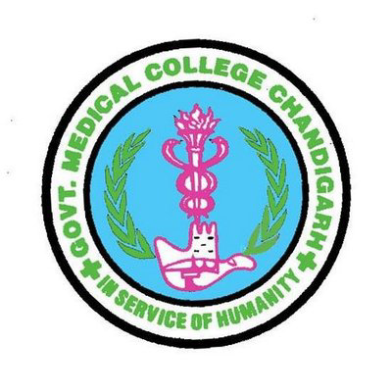
Study On
Post-Pandemic Health System Of Delhi For Better Healthcare Delivery.
Internship :IQVIA
Team :Noida
Supervisor: Mrs. Vaishali Talani

Slide 2

Mentor: Dr. Sumant Swain
Name: Dr. Vaibhav Sethi
(BATCH 2023-25)
ROLL NO : 125

Slide 3
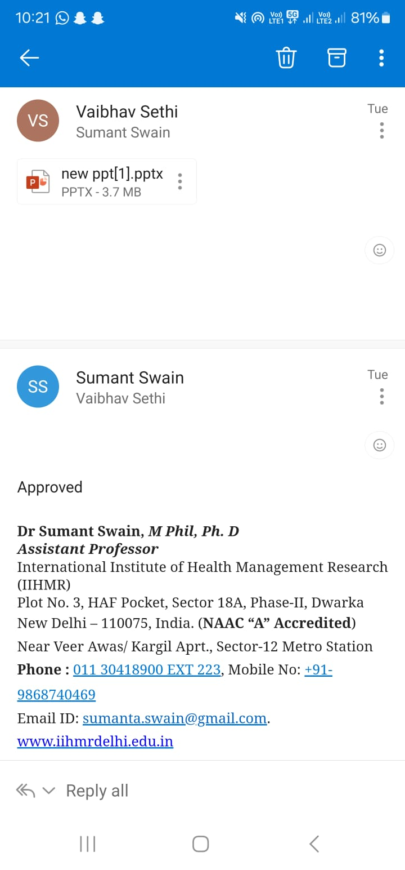

Slide 4
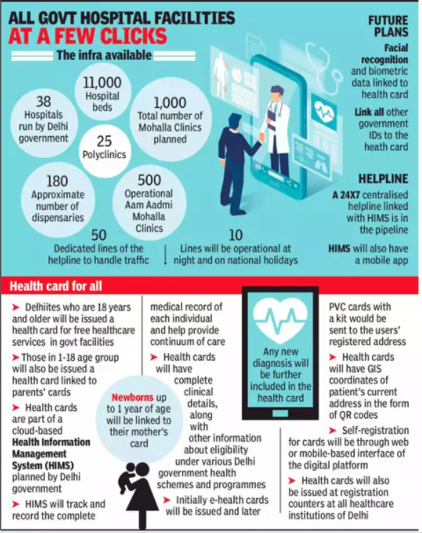
Introduction
Health as a basic, indisputable human right - a right that is obligatory for the state to provide to all citizens regardless of income, social groups, localities or social class
The population of Delhi in 2021 was 31,181,000, a 2.94% increase from 2020 despite of covid-19 deaths.
The tremendous increase in population of delhi was due to migration for better healthcare facility as capital is known for its best healthcare institutes such as AIIMS ,Safdarjung Hospital etc. This tremendous increase exposed existing poor health infrastructure and opened way for new amendments
The healthcare landscape is rapidly evolving, necessitating continuous improvements in infrastructure, services, and standards.
The COVID-19 pandemic has brought unprecedented challenges to governments worldwide, with profound impacts on governance, public health measures, and economic resilience. Understanding these impacts is crucial for informing future policies and strengthening health systems

Slide 5
Delhi Healthcare Delivery System (re-organized in July, 2015)
Super Specialty Hospitals (Earlier Called Tertiary Level Hospitals)
Multi Specialty Hospitals (Earlier Called Secondary Level Hospitals)
Multi Specialty Clinics (Polyclinics)
Mohalla Clinics (Aam Aadmi Mohalla Clinics)

Slide 6
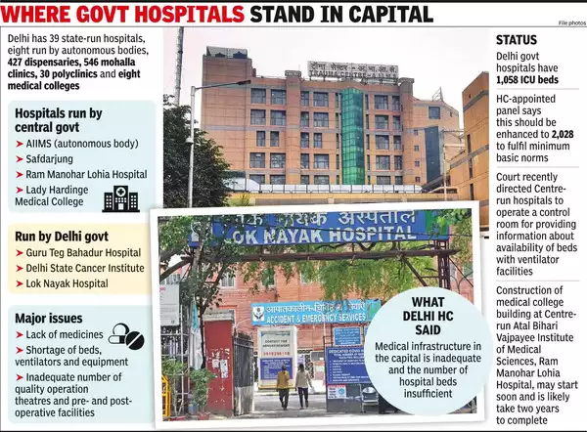
Objectives
To assess the existing infrastructure, facilities, and services of Delhi.
To Identify key areas of improvement
Suggest Recommendations

Slide 7
Delhi, the capital territory of India, faced unique challenges during the pandemic due to its dense population, significant economic activity, and complex governance structures.
The impact of the pandemic on governance, public health measures, and economic resilience in Delhi offers valuable insights into the broader context of crisis response and health system transformation.
This study is conducted with the intent to find wether the lessons learned from the pandemic have catalysed transformations in Delhi's health system.
These include investments in healthcare infrastructure, expansion of testing and vaccination capacity, improvements in data collection and analysis, and reforms to enhance healthcare accessibility and affordability, particularly for marginalized communities.
RATIONALE

Slide 8
The COVID-19 pandemic exposed vulnerabilities in healthcare systems worldwide, and Delhi was no exception. The city faced immense pressure on its hospitals, testing facilities, and medical personnel. A post-pandemic analysis of Delhi's health infrastructure is crucial for several reasons:
Identifying Strengths and Weaknesses
Prioritizing Investments
Building Resilience for Future Threats
Improving Public Health Outcomes.
Informing Policy Decisions
Need for Analysis of Post-Pandemic Restructuring of Delhi's Health Infrastructure

Slide 9
DURATION OF STUDY
Two month
Methodology
This research employed a secondary data analysis approach.
Searched academic databases like Google Scholar and ScienceDirect for peer-reviewed journal articles published within the last five years that addressed Post-Pandemic Restructuring of Delhi's Health Infrastructure.
Keywords:
Mohalla Clinics ,Health Infrastructure, Nurse :Patient Ratio, Doctor: Patient Ratio, Ambulance Response time ,Ambulance Services, Bed Capacity
Documents reviewed:
Delhi Health Department: https://health.delhi.gov.in/ This website contain reports, press releases, or data dashboards related to the pandemic response and healthcare infrastructure development.
Delhi State Health Mission: https://dshm.delhi.gov.in/ This website had information on healthcare initiatives undertaken during and after the pandemic.
National Health Mission (India): https://www.nhm.gov.in/ Since Delhi falls under the National Health Mission's ambit, found relevant data on national health policies and their impact on Delhi.

Slide 10

Areas studied and discussed are:
HEALTH INFRASTRUCTURE FACILITIES IN DELHI
PER CAPITA EXPENDITURE ON HEALTH BY GNCTD
EXPENDITURE ON HEALTH WITH REFERENCE TO GSDP
SCHEME/ PROGRAMME/PROJECT EXPENDITURE UNDER HEALTH AND FAMILY WELFARE BY DELHI GOVT.
AMBULANCE SERVICES
DOCTOR AVAILABILITY
NURSE AVAILABILITY

Slide 11
Results

Slide 12
Results

Slide 13
Results

Slide 14
Discussion
The COVID-19 pandemic exposed the reality of Delhi's health infrastructure, highlighting the need for a strengthning it . In response, the Delhi government has adapted restructuring initiative that includes expanding hospital bed capacity, improving access to critical care services, and improving the primary care system.
While long-term effectiveness of the reforms is yet to be determined, but they hold the capability to enhance healthcare quality for all Delhi residents. The success of this restructuring effort is associated with several factors. First and foremost, the Delhi government's commitment is important. Regular monitoring and evaluation are crucial to ensure the reforms achieve their targeted goals. It's important to remember that this restructuring is an ongoing process. By continuously identifying and addressing the challenges that confront Delhi's health system, a more robust and resilient healthcare infrastructure can be established.
This was made possible as shown by above results .Also by following recommendations it can lead to tremendous success in making Delhi No.1 state in terms of health infrastructure and healthcare service providing.

Slide 15

CONCLUSION
The COVID-19 pandemic has put immense pressure on the healthcare infrastructure of Delhi, exposing its strengths and weaknesses.
This report provides a comprehensive evaluation of the Delhi healthcare infrastructure before and after the pandemic, highlighting the challenges faced, responses undertaken, and lessons learned.
The COVID-19 pandemic has brought about unprecedented challenges to the healthcare system in Delhi, forcing facilities to adapt and evolve to meet the surge in demand.
This report presents a comparative analysis of doctor hospitals, ambulance services, and nurse availability in Delhi along with infrastructure development and basic needs fulfilment in terms of healthcare before and after the COVID-19 pandemic trying to ensure health is supreme wealth in this changing times.
The COVID-19 pandemic has brought about significant challenges to the healthcare system in Delhi, but it has also accelerated the growth and development of healthcare facilities.
While there have been notable improvements in doctor hospitals, ambulance services, and nurse availability, there are still challenges that need to be addressed. By continuing to invest in healthcare infrastructure and addressing the challenges faced by healthcare professionals, Delhi can emerge stronger and more resilient in the face of future healthcare crises.

Slide 16
Recommendations:
Sustain Infrastructure Expansion: The government should sustain the expanded healthcare infrastructure to ensure a robust response to future emergencies.
Enhance Emergency Preparedness: The government should enhance emergency preparedness, including developing contingency plans and conducting regular drills.
Invest in Healthcare Technology: The government should invest in healthcare technology, including telemedicine and digital health platforms, to enhance the city's healthcare capabilities.
Strengthen Public-Private Partnerships: The government should strengthen public-private partnerships to leverage the expertise and resources of private healthcare providers.
The Delhi government should continue to invest in healthcare infrastructure development, focusing on critical care facilities and specialized services.
Ambulance services should be further augmented to ensure 100% availability and reduced response times.
Nurse training programs and staff welfare initiatives should be implemented to reduce burnout and improve job satisfaction.

Slide 17
Bibliography
Economic Survey of Delhi 2022-23. Planning Department. Government of NCT of Delhi. March 2023. Available from:
https://delhiplanning.delhi.gov.in/planning/economic-survey-delhi-2022-23. [Last accessed on 2024 June 24].
Singh K, Kondal D, Mohan S, Jaganathan S, Deepa M, Venkateshmurthy NS, Jarhyan P, Anjana RM, Narayan KV, Mohan V, Tandon N. Health, psychosocial, and economic impacts of the COVID-19 pandemic on people with chronic conditions in India: a mixed methods study. BMC public health. 2021 Dec;21:1-5 Available from:
https://bmcpublichealth.biomedcentral./articles/10.1186/s12889-021-10708-w . [Last accessed on 2024 June 22].
Dutta C, Kumar K. Socio-Economic Disparities Among Youth in Delhi: Issues and Challenges. Marginalization in Globalizing Delhi: Issues of Land, Livelihoods and Health. 2017:369-85. Available from:
https://link.springer.com/chapter/10.1007/978-81-322-3583-5_20 .
[Last accessed on 2024 June 22].
Bailwal N, Kaushik R, Sah T. Importance of Primary Healthcare in Delhi in the Times of COVID-19. Indian Journal of Human Development. 2020 Dec;14(3):527-35. Available from:
https://journals.sagepub.com/doi/full/10.1177/0973703020978846 .
[Last accessed on 2024 June 22].

Slide 18
Study Of Post-pandemic Health System Of Delhi For Better Healthcare Delivery
Dr.Vaibhav Sethi
under the guidance of : dr.sumant swain
INTRODUCTION
Health as a basic, indisputable human right - a right that is obligatory for the state to provide to all citizens regardless of income, social groups, localities or social class. The health system in the largely urban city- state of Delhi is beset with many pressing challenges. Firstly, the state government is responsible for planning and implementing the delivery of health services within the National Capital Territory, its clientele, comprising the entire national capital region (NCR) and its contagious districts in the neighboring states, actually surpasses manifold the domiciled population. Secondly, the existing laws and regulations often lead to overlapping actions by multiple agencies regarding public health aspects viz. the State Government, Urban Local Bodies and Central Government.
METHODOLOGY
"This research employed a secondary data analysis approach. We searched academic databases like Google Scholar and ScienceDirect for peer-reviewed journal articles published within the last five years that addressed Post-Pandemic Restructuring of Delhi's Health Infrastructure. When evaluating sources, we considered author expertise, publication reputation, and the research methodology used to collect the data."
CONCLUSION
The COVID-19 pandemic has put immense pressure on the healthcare infrastructure of Delhi, exposing its strengths and weaknesses. This report provides a comprehensive evaluation of the Delhi healthcare infrastructure before and after the pandemic, highlighting the challenges faced, responses undertaken, and lessons learned.
The COVID-19 pandemic has brought about unprecedented challenges to the healthcare system in Delhi, forcing facilities to adapt and evolve to meet the surge in demand.
RESULTS
1. Infrastructure: The Delhi government rapidly expanded its healthcare infrastructure, setting up temporary hospitals, COVID-19 care centers, and quarantine facilities. The total bed capacity increased by 50%.
2. Workforce: The government recruited additional healthcare professionals, including doctors, nurses, and paramedics, to cope with the surge in demand.
3. Equipment and Technology: The government invested in modern medical equipment, including ventilators, ICU beds, and diagnostic facilities, to enhance the city's healthcare capabilities.
4. Emergency Services: The emergency services were strengthened, with the introduction of a dedicated COVID-19 helpline and an increase in the number of ambulances
Recommendations:
Sustain Infrastructure Expansion
Enhance Emergency Preparedness
Invest in Healthcare Technology
Strengthen Public-Private Partnerships.
References
Economic Survey of Delhi 2022-23. Planning Department. Government of NCT of Delhi. March 2023. Available from: https://delhiplanning.delhi.gov.in/planning/economic-survey-delhi-2022-23. [Last accessed on 2024 June 24].

Slide 19
Internship Experience
Work and conduct :
General
1.Gain the understanding of the health services and daily activities, functioning of Iqvia.
2. Providing office support to seniors and for the smooth-running of projects
3. Understanding some common responsibilities of a coorperate employee.
4. Daily Project deadlines met.`
5. Learning Time management with assigned work
6. Learning the importance of management and confidentiality of data privacy.
Academic :
1 .Finalizing reports
2. Understanding way of writing report.
3. Discussions and suggestions on various data collection with supervisor
RESEARCH WORK AND PROJECT
1.SNCU Resource Mapping And Biomedical Equipement Survey Across Uttar Pradesh, Bihar, Jharkhand And Maharashtra.
2. Presentation Finalization For Various Other Projects
3. Report Finalization For Mizoram

Slide 20
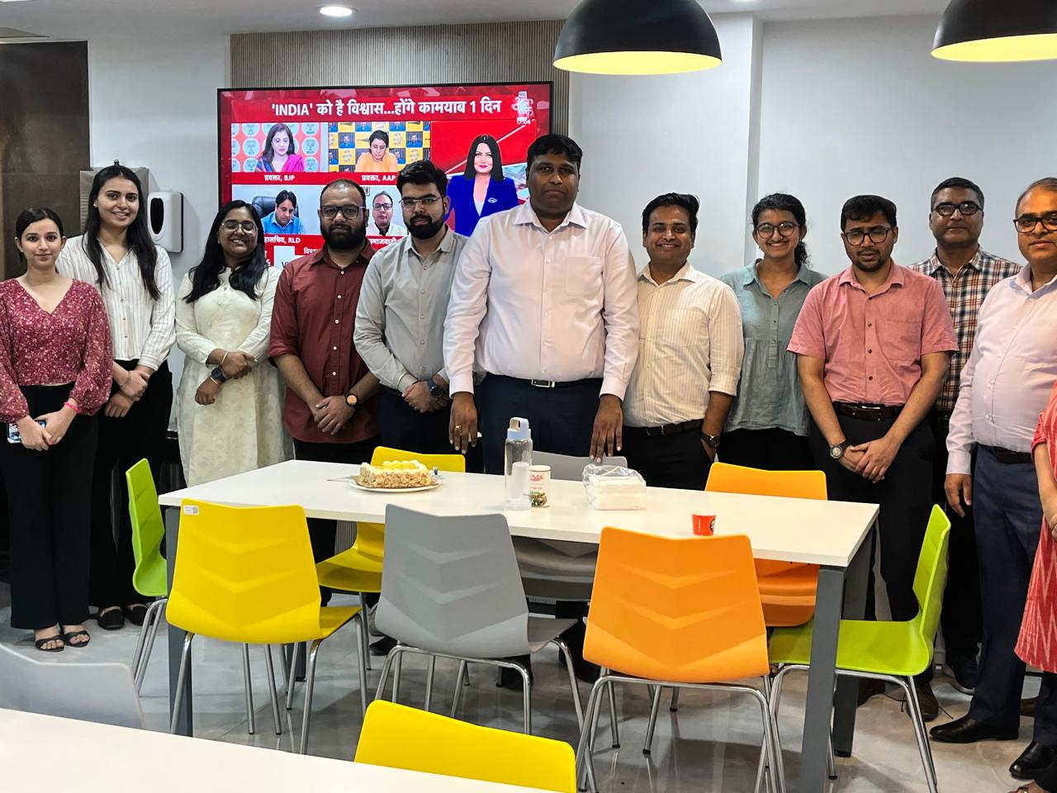
Pictoral Journey

Slide 21
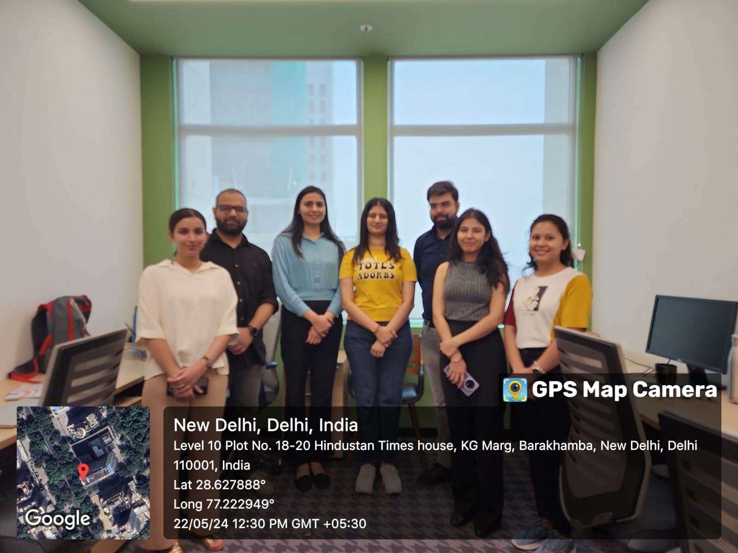

Pictoral Journey

Slide 22
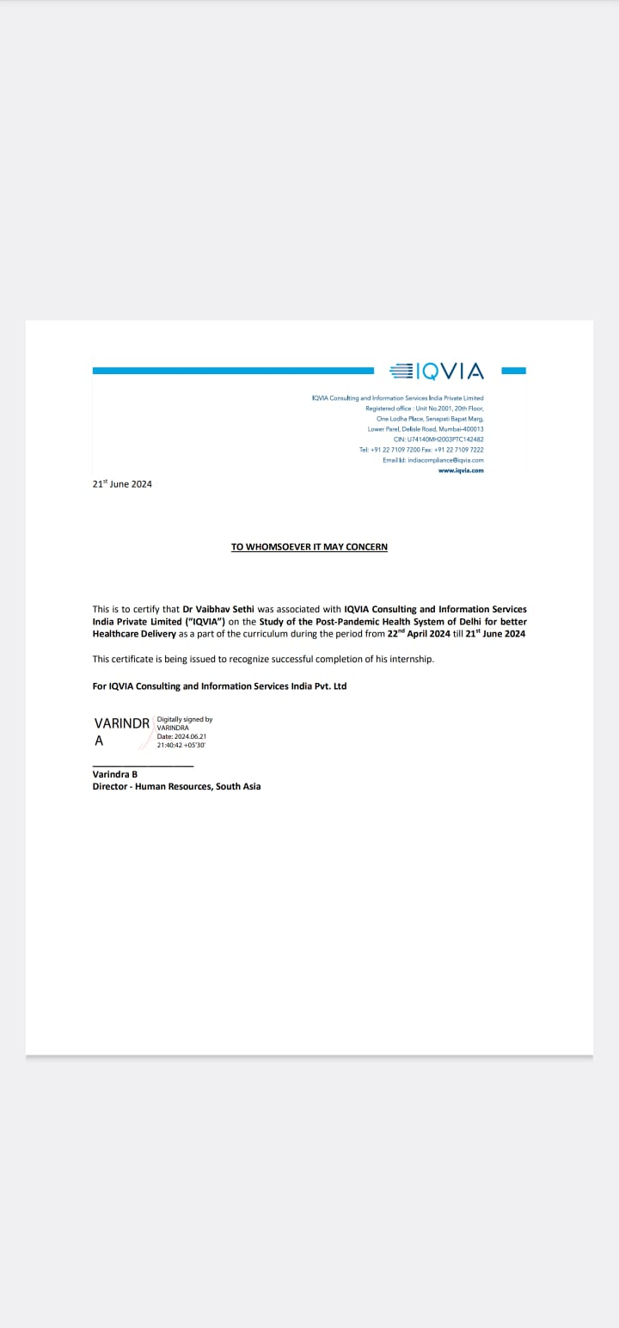

Slide 23
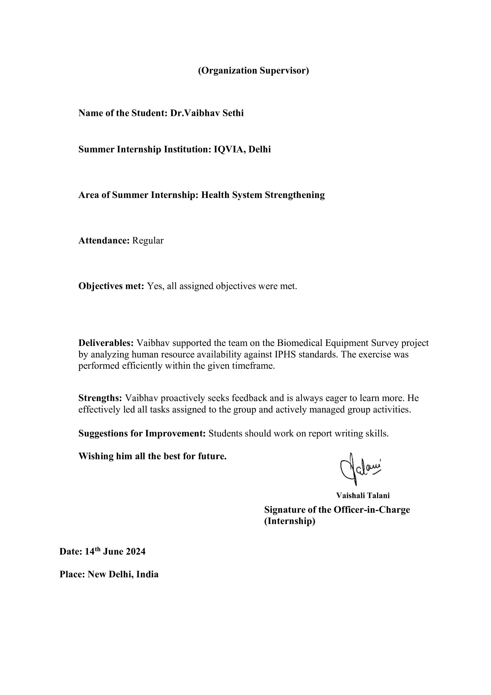

Slide 24
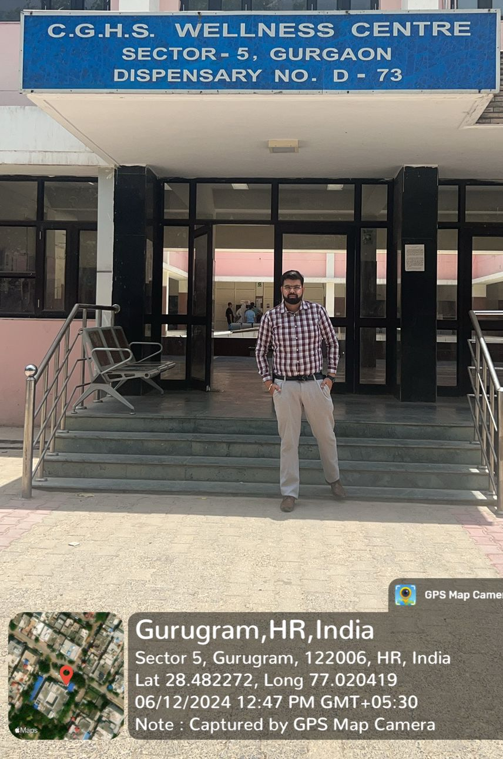
Visit to the C.G.H.S. Health & Wellness Centre
Sector 5, Gurgaon
Dispensary No. D-73
Presented by:-
Dr.Vaibhav Sethi
PG/23/125

Slide 25
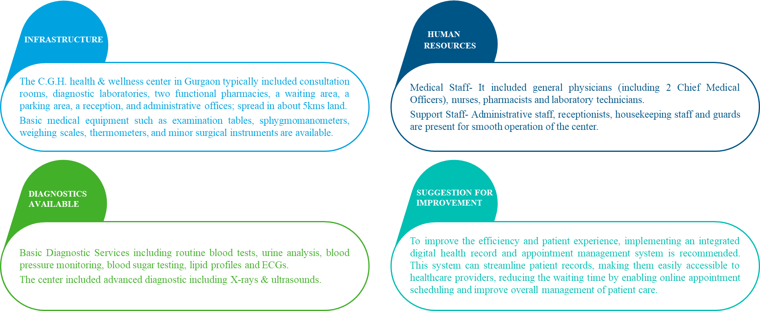
About the C.G.H.S. Health & Wellness Centre.

Slide 26
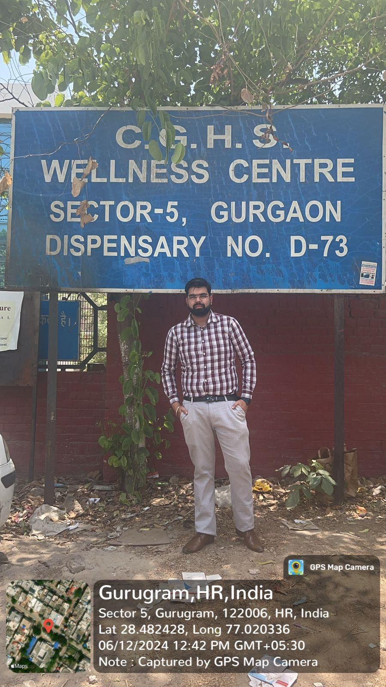
THANK YOU!

Slide 27
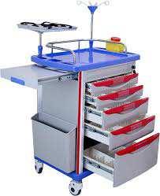
Thank You!
ANY QUESTIONS?

