Slide 1

Association between Polycystic Ovary Syndrome (PCOS) and Cognitive Dysfunction:
A Narrative Review
Presented by : Dr. Dhriti Bhagat
Faculty Mentor : Dr. Divya Aggarwal
IIHMR Delhi

Slide 2

Mentor Approval

Slide 3
Introduction
PCOS affects an estimated 6–20% of women of reproductive age worldwide, making it one of the most common endocrine disorders in women.
While traditionally known for symptoms such as irregular menstruation, acne, weight gain and infertility, there is a growing body of evidence that suggests PCOS may also impact brain function.
Up to 60% of women with PCOS report cognitive symptoms such as:
Difficulty concentrating
Forgetfulness
Mental fatigue or “brain fog”

Slide 4
Introduction
Research using functional MRI and cognitive testing has shown:
Altered activity in brain regions like the prefrontal cortex
Reduced performance in memory, attention and executive function
These cognitive challenges are believed to be linked to underlying physiological features of PCOS, including:
Hyperandrogenism (elevated male hormones)
Insulin resistance
Chronic low-grade inflammation
Despite growing recognition, the cognitive effects of PCOS remain underdiagnosed and under-addressed in clinical settings.

Slide 5
Objectives of Your Study
PRIMARY OBJECTIVE
To explore the association between Polycystic Ovary Syndrome (PCOS) and cognitive dysfunction based on a comprehensive review of scientific literature
SECONDARY OBJECTIVES
To examine the underlying physiological mechanisms including hyperandrogenism, insulin resistance and inflammation that may contribute to cognitive deficits in PCOS.
To critically analyse and synthesize the available evidence using a narrative review approach.
To highlight gaps in the current literature and propose future research directions that could lead to more targeted diagnosis and intervention strategies.

Slide 6
Methodology (1/2)
Study Design: Narrative Review
Databases Used:
PubMed
Google Scholar
Keywords Used:
“Polycystic Ovary Syndrome AND cognition”
“PCOS AND memory/ Brain fog”
“Hyperandrogenism AND cognitive function”
“Insulin resistance AND cognitive impairment”
“PCOS AND neuropsychology”
Boolean Operators Used:
AND, OR to refine and broaden the search scope

Slide 7
Methodology (1/2)
Filters Applied:
Publication years: From 2000 to 2024
Language: English
Population: Human studies (adult women of reproductive age)
Article Types:
  Observational studies
  fMRI and EEG-based studies
  Randomized controlled trials (RCTs)
  Narrative and systematic reviews
  Cross-sectional and cohort studies

Slide 8
Methodology (2/2)
Article Selection Process:
Initial Yield: ~950 articles identified using keyword search across four databases
Screening Steps:
  Title Screening: ~180 articles shortlisted
  Abstract Screening: ~65 articles selected for full-text review
  Final Inclusion: 30 core studies selected for synthesis and evidence tabulation
Inclusion Criteria: Studies assessing cognitive function in women with PCOS
  Studies exploring hormonal/metabolic links to brain health
  Peer-reviewed, full-text articles in English
  Focus on cognitive domains: memory, attention, executive function
Exclusion Criteria: Animal studies
  Articles unrelated to cognition or neurofunction
  Non-peer-reviewed sources (blogs, news)
  Conference abstracts without full access

Slide 9
Methodology (2/2)
Final Evidence Table:
A detailed table was constructed including:
  Author, year, study design
  Target population
  Cognitive domains assessed
  Key findings, limitations and recommendations
A total of 30 high-quality, peer-reviewed articles were analyzed in-depth.

Slide 10
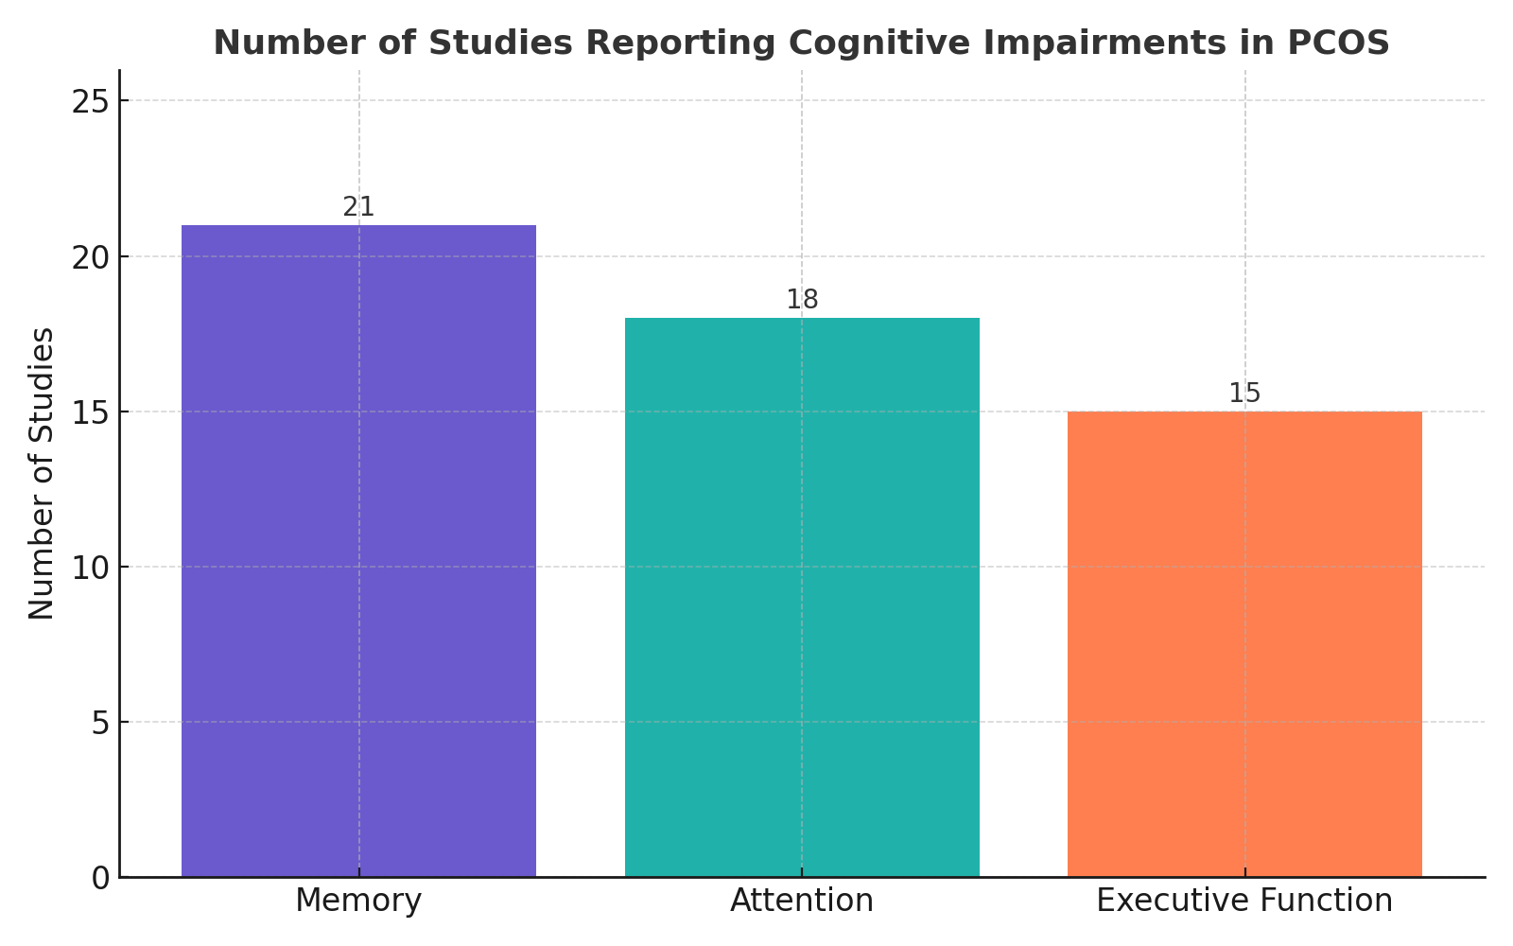
Results (1/3)

Slide 11
Results (2/3)
Chart Interpretation: The bar chart illustrates the number of reviewed studies (out of 30) that reported impairments in specific cognitive domains among women with PCOS.
Memory was the most frequently affected domain, with 21 studies reporting deficits, especially in verbal recall and short-term retention.
Attention difficulties, including reduced focus and mental fatigue, were identified in 18 studies.
Executive Function, involving planning, decision-making and cognitive flexibility was reported impaired in 15 studies.
These findings support the emerging understanding that PCOS is not only a metabolic or reproductive disorder but also one that may impact brain function and quality of life.

Slide 12
Results (3/3)
Out of the 30 studies:
14 were observational (cross-sectional or cohort)
7 were narrative or systematic reviews
5 used neuroimaging techniques (fMRI, DTI)
4 used EEG/ERP to capture brainwave-based cognitive responses
Across the included studies, these tools frequently appeared:
Montreal Cognitive Assessment (MoCA) – to screen for mild cognitive dysfunction
P300 latency (ERP) – a neural marker for attention and processing speed
Neuropsychological test batteries – including tasks for memory, executive function, attention span, etc.

Slide 13
Discussion (1/2)
Interpreting the Findings
The review highlights consistent impairments in memory, attention and executive function among women with PCOS.
These cognitive difficulties are not isolated symptoms but may be driven by biological mechanisms intrinsic to PCOS, including:
Hyperandrogenism, which may disrupt neural processing and affect verbal memory.
Insulin resistance, linked to poor glucose metabolism in brain cells.
Chronic inflammation, possibly contributing to long-term neural damage.
Neuroimaging & Neurophysiological Insights
fMRI and DTI studies show altered brain activity and reduced white matter integrity, especially in prefrontal and hippocampal regions.
ERP studies (P300 latency) confirm slowed brain processing speed and reduced cognitive efficiency.

Slide 14
Discussion (2/2)
Subjective vs Objective Disparity:
Many women report symptoms like “brain fog,” but cognitive complaints are often dismissed or underexplored in clinical settings.
Objective tools (MoCA, neuropsychological batteries, ERP) support these subjective reports, validating the lived experience of PCOS patients.
Research Gaps Identified:
Most existing studies are cross-sectional, limiting causal conclusions.
Variability in assessment tools and outcome measures makes cross-study comparison difficult.
There is a lack of interventional studies that examine whether treatment improves cognition.

Slide 15
Conclusion
This review highlights that PCOS is associated with cognitive dysfunction, particularly affecting memory, attention and executive functioning.
These deficits are likely linked to hyperandrogenism, insulin resistance and chronic inflammation, which may disrupt brain function and structure.
Evidence from neuropsychological tests, neuroimaging (fMRI/DTI), and EEG (P300 latency) supports both subjective brain fog and objective impairments.
However, cognitive symptoms in PCOS remain underdiagnosed and clinically underprioritized.
The findings underscore the need for a more holistic clinical approach that integrates cognitive and psychological well-being.
Future research should focus on longitudinal studies and assess whether treating hormonal/metabolic abnormalities can improve cognition.

Slide 16
References
Barnard L, Balen AH, Ferriday D, Tiplady B, Dye L. Cognitive functioning in polycystic ovary syndrome. Psychoneuroendocrinology. 2007;32(8–10):906–914.
Schattmann L, Sherwin BB. Effects of elevated androgen levels on cognitive functioning in women with PCOS. Horm Behav. 2007;51(4):579–584.
Li L, Yu Q, Li Y, Zhang S, Zhang Q. Altered brain activity in women with polycystic ovary syndrome using resting-state functional MRI. Front Endocrinol (Lausanne). 2020;11:603279.
Jarrett BP, Hurd YL, Foster DW. Cognitive function and glucose metabolism in PCOS. J Endocr Soc. 2019;3(6):1070–1079.
Pinto J, Cera N, Pignatelli D. Psychological symptoms and brain activity alterations in women with PCOS and their relation to quality of life: a narrative review. J Endocr Invest. 2024.
Showkath MA, Shah H, et al. Cognitive dysfunction in PCOS: An ERP and MoCA-based study. Sleep Breath. 2022;26:1123–1131.
Nye J. PCOS tied to worse cognitive scores and white matter integrity in midlife. Neurology Advisor. 2024.
Chen X, Liu J, Zhao Y. Cognitive impairment in PCOS: a systematic review and meta-analysis. EClinicalMedicine. 2023;61:101234.
González F, Rote NS, Minium J, Kirwan JP. Inflammation in PCOS: Role in cognition. Reprod Health. 2021;18(1):203.
Singh R, Taneja R, et al. Event-related potentials in PCOS and cognitive processing. Clin Neurophysiol. 2024;145(3):456–464.

Slide 17

Community Outreach Program
Visits : 2
The Health and Wellness Centre (HWC) in Danapur provides a comprehensive range of services designed to address the health needs of the local population, which stands at 10,206.
Observed field level challenges
Interaction with ASHAs and Frontline health workers.

Slide 18




PICTORIAL JOURNEY

Slide 19




Slide 20
Thank You

