Slide 1
Medical Cost Management in U.S Health Insurance
Presented By:
Dr. Swati Srivastava
PG/16/066
Guided By:
Dr. Manish Priyadarshi

Slide 2
Contents:
NTT Data Overview
Introduction
Claim Submission process flow
Paper Claim Process Flow
Electronic Claim Process Flow
Review of Literature
Objectives
Methodology
Results & Findings
Recommendations
Conclusions
Case studies

Slide 3
NTT DATA Overview
Headquartered in Tokyo, Since 1967
Aim – long term commitment and combine Global reach and local intimacy to provide premier professional services through consulting, system Development to business IT outsourcing.
NTT DATA in Healthcare
NTT DATA partners with some of the world’s leading healthcare organizations to help them proactively manage their business through the use of information, data, and technology
Its technology-enabled services support over thousands of organizations within the sector, enabling them to rapidly and cost-effectively adjust to dynamic market and regulatory demands

Slide 4
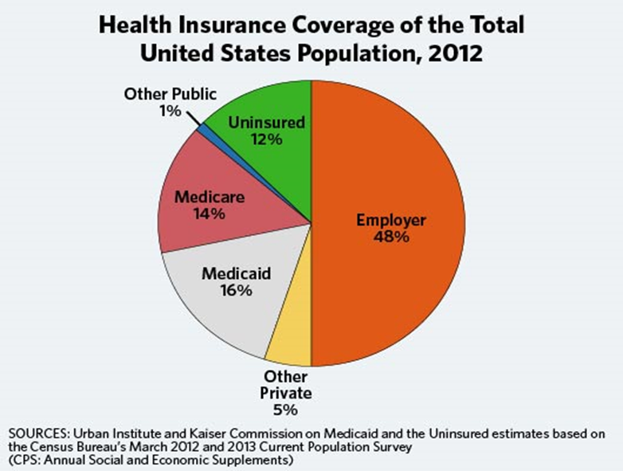
Introduction
Reasons for rising Healthcare Cost in US
Increase prevalence of chronic disease
Shift in cost from uninsured to the insured
A pre-dominant third party payer system
Un-necessary patient care
More Corrective treatment in place of preventive
Inefficient coordination among Provider, Payer, Patient
High Administrative costs
Americans receive more medical intensive care than people do in other countries

Slide 5
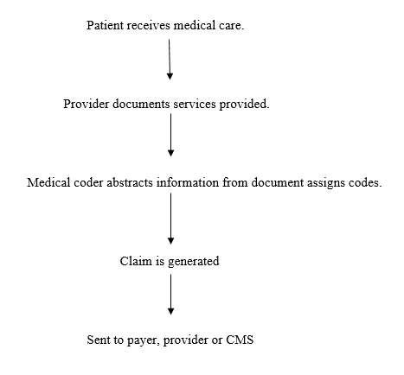
Claim Submission process flow

Slide 6
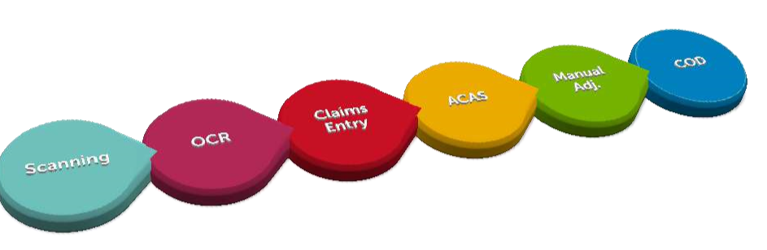
Paper Claim Process Flow

Slide 7
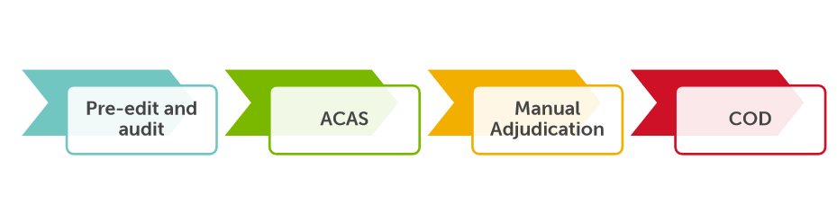
Electronic Claim Process Flow

Slide 8
Review of Literature
(David. M. Cutler, Richard J in Anatomy of Insurance )Health insurance is a mixed blessing due to adverse selection – as the tendency of sick and old will be to buy a policy which covers more
When sick and healthy enroll in different plans, plans disproportionately composed of poor risks have to charge more than they would if they insured an average mix of people.
(Hideki Funatsu, Export Credit Insurance, the Journal of Risk and Insurance Vol. 53, No. 4 )Importance of educating Providers in use of proper claim submission and use of proper coding to avoid administrative costs.

Slide 9
Objectives
General Objective
To study Medical cost management by payer in United States Health insurance.
Specific Objective
To Determine the reimbursement optimization opportunities for the payer
To Analyze and calculate the financial impact in different Reimbursement Optimization Opportunities for the payer

Slide 10
Methodology
Study Design: Prospective (quantitative) study
Data collection period: February 2018 to April 2018
Method: Convenience Sampling (Available NTT Data Project Data )
Sample Size: 4565 claims
Exclusion Criteria: Data with unspecified fields or incomplete data.
Data Collection Tools and technique:
A working Excel sheet, containing all the fields present in Claim Data was designed and analysis was carried on that data through SQL tool and MS excel 2013

Slide 11
Results & Findings
Optimization Category | Scenario Count | Claim Count | Issue Counts | Total Impact Amount | Total Charge Amount | Total Allowed Amount | Total Paid Amount
Configuration Issue | 2 | 21 | 21 | $ 6,137 | $ 5,810 | $ 3,353 | $ 8,158
Contract Optimization Opportunity | 14 | 3,461 | 2,398 | $ 766,073 | $ 11,116,717 | $ 4,274,571 | $ 3,953,117
Requires Medical Documentation Audit | 3 | 58 | 58 | $ 157,163 | $ 5,353,448 | $ 1,887,853 | $ 1,703,291
Scrubber Optimization Opportunity | 7 | 659 | 662 | $ 72,013 | $ 2,246,763 | $ 843,489 | $ 726,712
System Issue | 4 | 366 | 465 | $ 23,166 | $ 846,307 | $ 127,256 | $ 122,258
 |  | 4,565 | 3,604 | $ 1,024,553 | $ 19,569,045 | $ 7,136,522 | $ 6,513,537

Slide 12
Areas Of Optimization

Slide 13
Impacted amount in various optimization categories

Slide 14
Total and Affected Number of Claims

Slide 15
Total Allowed amount and Total Paid amount

Slide 16
Case studies

Slide 17
Wasted portion of single use injection vial is paid at a higher rate than actual usage
Institutional Outpatient claim – ID xxxxxxxxxxxxxxx
Drug (J9035 - Injection, bevacizumab, 10 mg) was given to patient where
Used part charged @ $ 97.09 /unit
Discarded unit charged @ $106.49 /unit
Inference – Extra charged @$9.40 /unit
HCPCS | Description | Modifier | Unit | Line Charge Amount | Allowed Amount | Paid Amount | JW (Per Unit)
J9035 | Injection, bevacizumab, 10 mg | JW | 8 | $1,936.19 | $851.92 | $851.92 | $106.49 | Wasted Drug
 |  |  | 82 | $18,093.32 | $7,961.06 | $7,961.06 | $97.09 | Used Drug
Take away : System Issue
Notes:
EMMA PENDLETON BRADLEY HOSPITAL and few other hospitals of Lifespan group are exempted from this rule
Rhode Island Hospital for Encounter for antineoplastic chemotherapy and taken services from 4/1 to 4/5 with claim id E024546333.
The same subscriber admitted to Rhode Island Hospital for Encounter for antineoplastic chemotherapy on 4/5 with claim id E024780965

Slide 18
Surgery Claim split by provider
.
Claim ID : xxxxxxxxxx , yyyyyyyyyyyy
A 21 Year old female patient gone through surgery 19271 (EXCISION OF CHEST WALL TUMOR INVOLVING RIBS, WITH PLASTIC RECONSTRUCTION; WITHOUT MEDIASTINAL LYMPHADENECTOMY ) which was performed by primary surgeon along with an assistant surgeon. Split claims have been billed which leads to non Flat rate payment for each claim.
Claim ID | Billing NPI | Billing NPI Name | Service Start Date | Service End Date | HCPC_CPT | Modifier | Billed Amount | Allowed Amount | Paid Amount
xxxxxxxxxxxx | 1891893343 | BAPTIST HEALTH MEDICAL GROUP PHYSICIANS, | 10/2/2017 | 10/2/2017 | 19271 |  | $ 6938 | $ 2180.62 | $ 2180.62
yyyyyyyyyyyyy | 1891893343 | BAPTIST HEALTH MEDICAL GROUP PHYSICIANS, | 10/2/2017 | 10/2/2017 | 19271 | AS | $ 6938 | $ 188.72 | $ 188.97
Takeaway : Contract Optimization Opportunity
Related surgeries performed on same day should be billed in a single claim
.

Slide 19
Conclusions
Pressure of increasing cost can be managed by
By optimizing the contracts between network providers
High Patient responsibilities for Out of network provider.
Prior Authorization with clinical documents should be encouraged rather than retro authorization to avoid dispute between provider and payer and thus cost management.
Providing incentives or rewards related to health prevention ,for cost containment in future.
Placing limits on Dependents benefit sharing .

Slide 20
Recommendations
Apart from the pre-defined optimization categories to control cost several other untapped areas are present in the claim management process which can reduce revenue loss of the Payer, These areas could be
To underwrite a group or Individual effectively
Increased examination on Patient’s Responsibility
Reshaping the advantage configuration to address the present issues
Revisiting the capitation fee and contracts and keep upgrading them as per the market.

Slide 21
Thank You!

