Slide 1

Understanding Awareness of Bio-Medical Waste Management in Hospital Setting
Faculty Mentor- Dr. Divya Aggarwal
IIHMR Delhi
By- Simran Anand

Slide 2
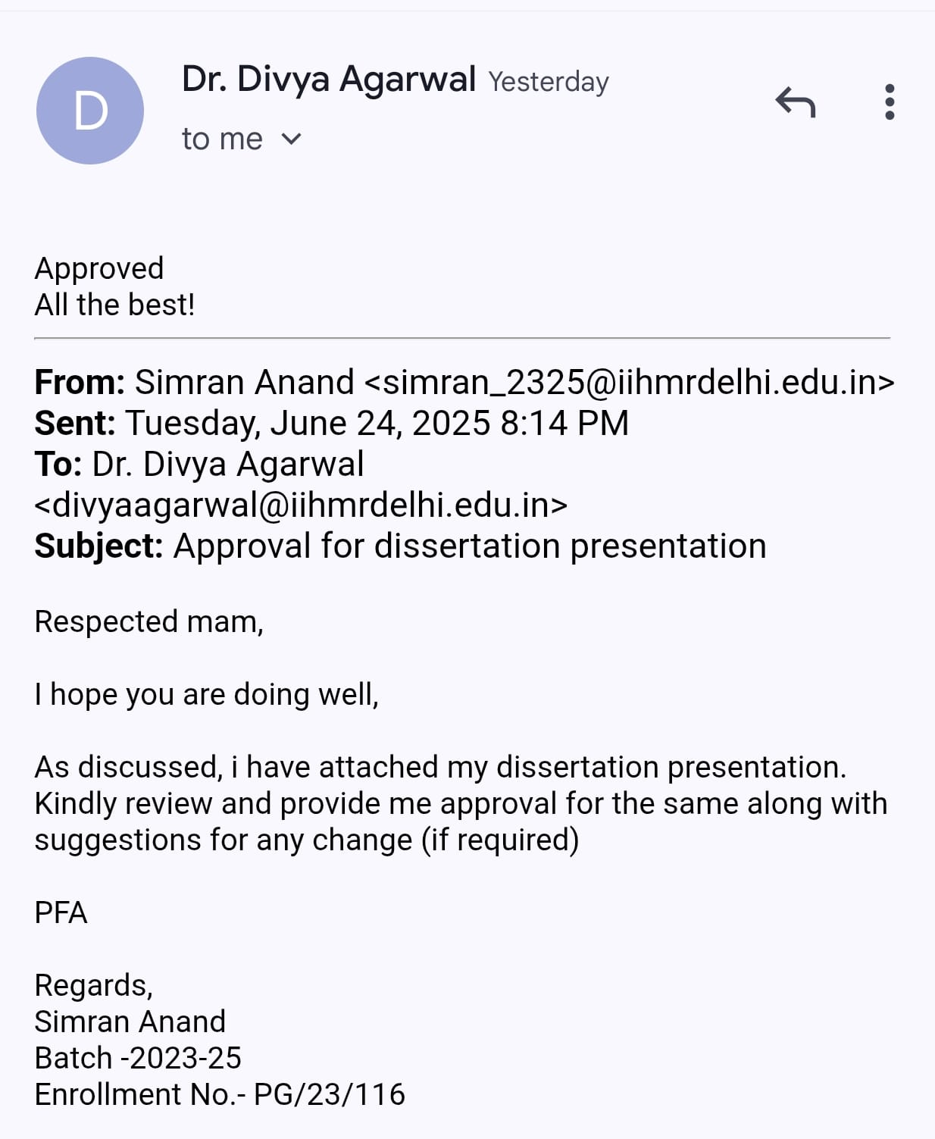
Mentor Approval

Slide 3
Introduction (1/2)
Biomedical waste (BMW) refers to any waste generated during the diagnosis, treatment, or immunization of humans or animals, or in related research activities. Proper management of BMW is critical to prevent hospital-acquired infections, environmental contamination, and occupational hazards among healthcare workers.
This study uses a KAP (Knowledge, Attitude, and Practice) framework to assess how well hospital staff understand and follow biomedical waste management protocols. By evaluating the staff’s knowledge level, mindset, and day-to-day practices, the study aims to identify gaps and areas for improvement in BMW management within the hospital setting.

Slide 4
Rationale
Effective biomedical waste management is crucial for ensuring patient safety, occupational health, and environmental protection. Despite existing guidelines under the Biomedical Waste Management Rules, 2016, non-compliance remains a widespread issue in many Indian healthcare facilities. Poor knowledge, negative attitudes, and unsafe practices among hospital staff are key contributors to improper waste handling, increasing the risk of infections and regulatory violations. This study aims to assess the knowledge, attitude, and practices (KAP) of hospital staff toward BMW management to identify gaps and support targeted interventions for improving compliance and safety within the hospital setting.

Slide 5
Objectives of Your Study
To assess the level of knowledge among hospital staff regarding BMW segregation, risks, and disposal methods.
To evaluate attitudes toward BMW management, including perceptions of its importance and barriers to compliance.
To analyze current practices related to BMW handling, including adherence to hospital guidelines and regulations.
To identify gaps between knowledge, attitude, and practice and propose interventions for improvement.

Slide 6
Methodology (1/4)
Study Design: Quantitative study including cross-sectional KAP (knowledge, attitude and practices) based survey of hospital staff.
Study Area: 266 bedded Multi-Super-Speciality hospital, Delhi.
Study Population: Hospital staff (doctors, nurses, housekeeping, technicians, admin).
Sampling: Stratified Random Sampling to include different hospital staff.

Slide 7
Methodology (2/4)
Sample Size: 280 (calculated using Cochran formula)
Study Variables:
Independent Variables- demographic ( age, designation, years of experience, training)
Dependent Variables- Knowledge, Attitude and Practice scores.
Data Collection Tool: Structured Google Form questionnaire.

Slide 8
Methodology (3/4)
Data Analysis Plan:
Knowledge scores categorized Good, Moderate, or Poor after analyzing the responses, by categorizing Knowledge levels as >75%, 50-75% or <50% respectively. (score=1 for each correct answer)
Attitude assessment by using Likert scale responses (Strongly Agree to Strongly Disagree). Scoring given out of 5 and categorization is done as Positive, Neutral or Negative attitudes according to >3.75, 2.5-2.75, <2.5 respectively.
Practice assessment by calculating % of staff following proper disposal protocols by calculating practice scores as Good, Moderate and Poor according to >75%, 50-75% or <50% respectively.
Correlation analysis to examine links between independent and dependent variables.

Slide 9
Methodology (4/4)
Timeline : 3 months
Ethical Consideration:
Informed consent before proceeding with survey.
Completely Anonymous as it doesn’t require any personal detail.
Volunteer participation with right to refuse anytime during survey.
Limitations:
Variability in training policies.
No response bias.
Time constraints.

Slide 10
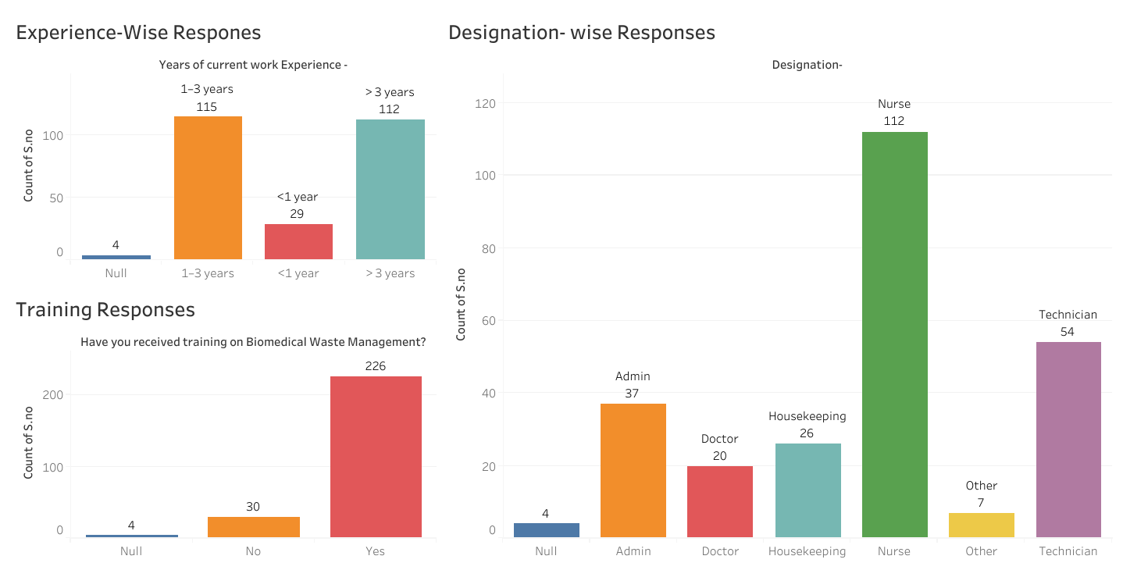
Results (1/5)

Slide 11
Results (2/5)

Slide 12
Results (3/5)

Slide 13
Results (4/5)

Slide 14
Results (5/5)
Relationship | Correlation (r) | p-value | Interpretation
Training ↔ Practice | 0.223 | .000 | Weak but statistically significant positive correlation
Training ↔ Attitude | 0.327 | .000 | Moderate positive correlation, statistically significant
Training ↔ Knowledge | 0.008 | .899 | No correlation, not statistically significant

Slide 15
Discussion (1/2)
Inferences from Correlation Analysis
Training Received vs Knowledge Score
  Implication: Training has no clear effect on knowledge scores, suggesting the training might not be effectively improving theoretical understanding — or that knowledge may already be high across participants.
Training Received vs Attitude Score
  Implication: Training appears to have a noticeable impact on improving employee attitude toward biomedical waste management.
Training Received vs Practice Score
  Implication: Employees who received biomedical waste training tend to follow better practices, but the relationship is not very strong.

Slide 16
Discussion (2/2)
Gaps-
Limited effectiveness of training indicates gaps in training content, delivery, or follow-up.
Inconsistent Practice Compliance shows gaps in daily routine monitoring and supervision.
Gaps Among Non-Clinical Staff like housekeeping, security, and administrative staff.
Weak links between Knowledge and Practice indicates a gap between theoretical understanding and practical implementation of BMW rules.

Slide 17
Discussion (2/2)
Recommendations-
Strengthen Training Programs by conducting mandatory trainings for all hospital staff, including non-clinical staff.
Periodic Check-ins for staff, if in case of skipped training sessions, to ensure their proper trainings.
Use infographics/posters in wards and waste zones to reinforce daily reminders.
Modification in trainings structures which may include practical demonstrations, visual aids, and real-life case scenarios to improve retention.
Conduct awareness drives highlighting the risks of improper BMW handling.

Slide 18
Conclusion
This study highlights significant insights into the knowledge, attitude, and practices of hospital staff regarding BMW management. While the majority of staff showed positive attitudes and had received training, noticeable gaps still persists. The correlation analysis further revealed that attitude plays a more significant role in influencing proper waste handling than knowledge alone.
These findings underscore the need for more effective, hands-on training, regular monitoring, and behavioral reinforcement strategies. Bridging these gaps is essential not only for compliance with BMW Management Rules, 2016, but also for ensuring patient safety, infection control, and environmental sustainability within healthcare settings.

Slide 19
References
Abas Khan DA, Gupta M, Udhampur J, Gupta M. A cross-sectional study of Knowledge, Attitude and Practices regarding Biomedical waste management among the healthcare workers at a tertiary care teaching hospital in Northern India. https://ijlbpr.com/uploadfiles/70vol14issue3pp395-400.20250314071826.pdf
Mehta A. A study of knowledge, attitude, and practices regarding biomedical waste management among the health care workers at a tertiary care teaching hospital of western uttar pradesh. International Journal of Medical and Biomedical Studies. 2019;3:12.
https://doi.org/10.32553/ijmbs.v3i12.786
Lipika Singhal, Arpandeep Kaur Tuli, Vikas Gautam,
Biomedical Waste Management Guidelines 2016: What’s done and what needs to be done,
Indian Journal of Medical Microbiology,
Volume 35, Issue 2,
2017 https://doi.org/10.4103/ijmm.IJMM_17_105
Kharat, Dr. D.S.. (2016). Biomedical Waste Management Rules, 2016: A review. International of advanced Research and Development. 1. 48-51. https://www.researchgate.net/publication/317305231_Biomedical_Waste_Management_Rules_2016_A_review
Parida A, Capoor MR, Bhowmik KT. Knowledge, attitude, and practices of Bio-medical Waste Management rules, 2016; Bio-medical Waste Management (amendment) rules, 2018; and Solid Waste Rules, 2016, among health-care workers in a tertiary care setup. Journal of laboratory physicians. 2019 Oct;11(04):292-6. https://www.thieme-connect.com/products/ejournals/abstract/10.4103/JLP.JLP_88_19?device=mobile&innerWidth=416&offsetWidth=417
https://dhr.gov.in/sites/default/files/Bio-medical_Waste_Management_Rules_2016.pdf
Bio-medical_Waste_Management_Rules_2016.pdf https://share.google/IyXUNRl4PSChudDwf

Slide 20
INVOLVEMENT IN COMMUNITY OUTREACH PROGRAMME (COP) ACTIVITIES
Total no. of visits done by the Student:
Day-wise activities done by the student:

Slide 21
KEY LEARNING FROM COP ACTIVITIES
Goyla Diary Visit and Indira Gandhi Hospital Visit-
Community engagement to understand ground level challenges.
Teamwork and coordination to engage community.
Challenges in govt. medical hospital and healthcare systems.

Slide 22
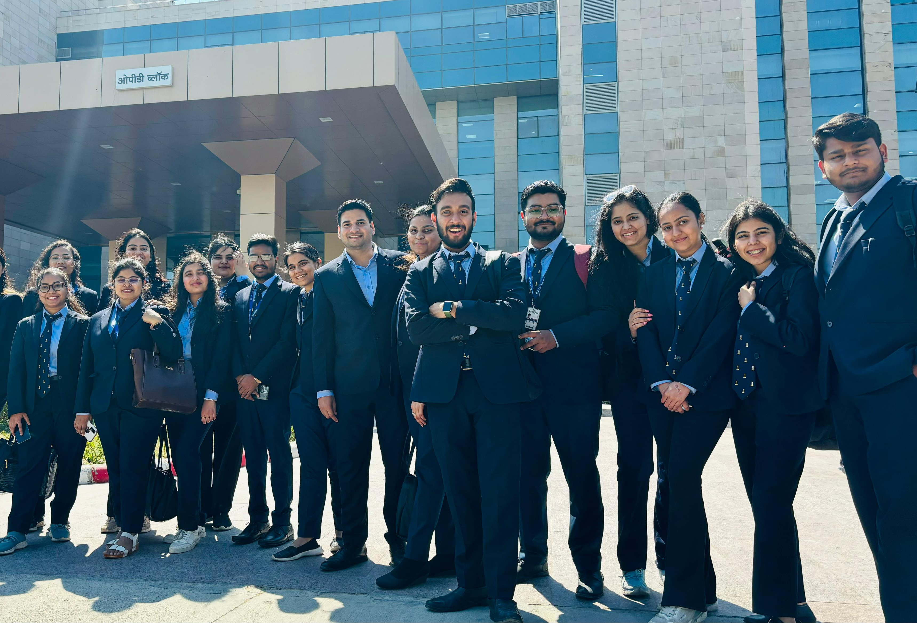
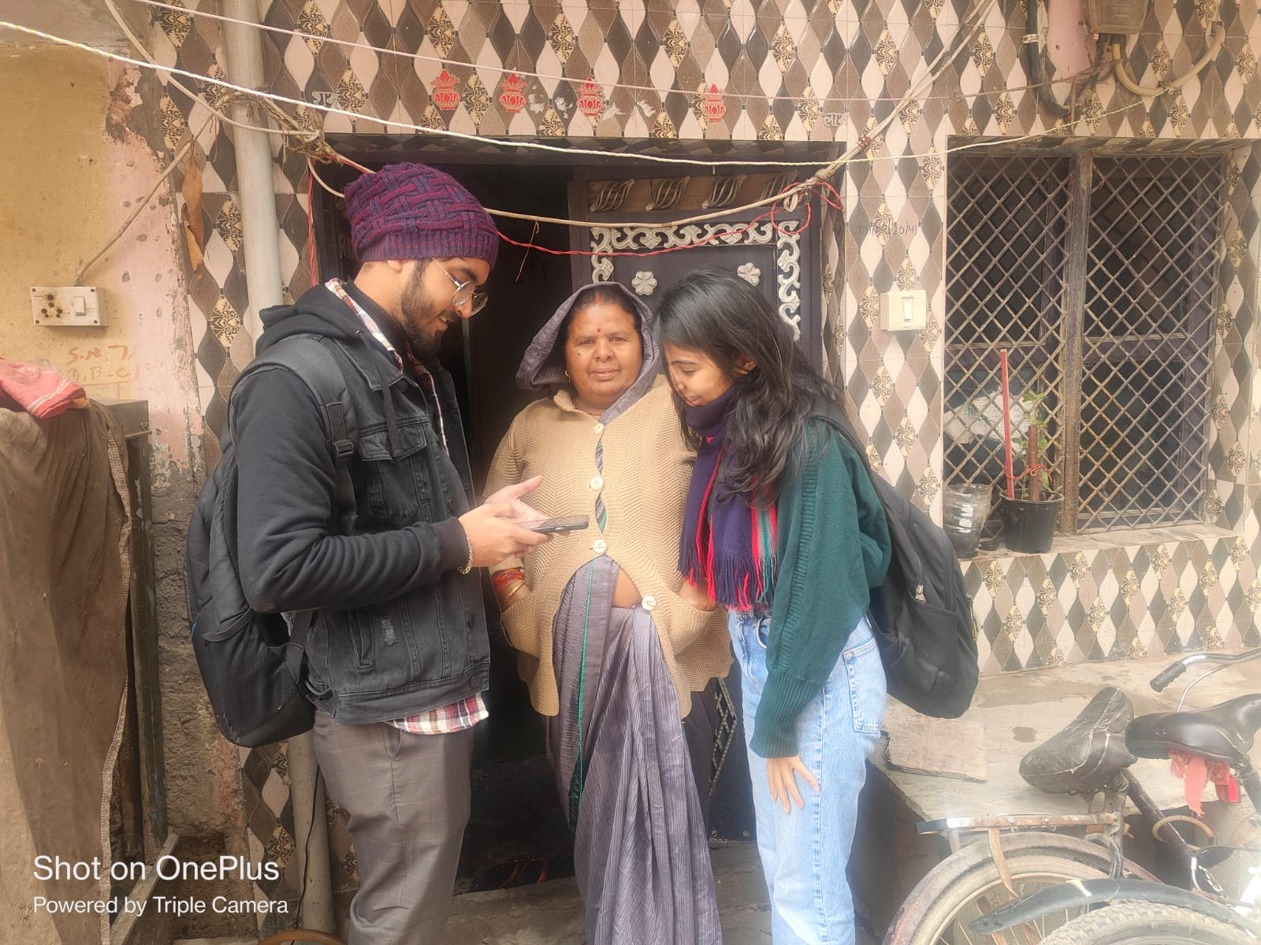
COP FIELD ACTIVITIES PHOTOGRAPHS

Slide 23
Thank You
Any Questions

