Slide 1

Impact of VHSND Strengthening on Immunization Coverage in Rural Bihar
UNICEF BIHAR
Nisha Sharma
UNDER GUIDANCE- DR. Divya Aggarwal
IIHMR DELHI

Slide 2
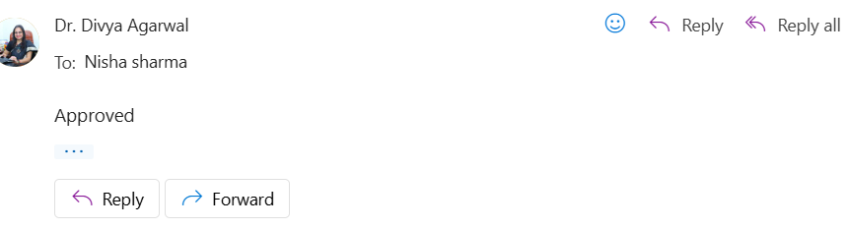
Mentor Approval

Slide 3
Introduction
Immunization is one of the most cost-effective and powerful public health strategies to reduce illness, disability, and death—especially among children under five. It forms the foundation of child survival efforts in countries like India.
Over the past decade, India has launched several national initiatives—such as Universal Immunization Programme (UIP) and Mission Indradhanush—to increase vaccination coverage. Yet, rural states like Bihar continue to face persistent challenges in achieving full immunization for all children.
To strengthen outreach and last-mile service delivery, the Government of India institutionalized the Village Health, Sanitation, and Nutrition Day (VHSND). This monthly event aims to provide integrated maternal, child health, and nutrition services at the village level, with active participation of ANMs, ASHAs, and AWWs.

Slide 4
Introduction
VHSND is a well-designed initiative, its actual impact depends on how effectively it is carried out at the village level.
In many rural areas of Bihar, several issues reduce its success:
Sessions are often irregular or not properly organized
Vaccines, medicines, and basic supplies are frequently unavailable
Health workers are overworked and lack proper coordination
Villagers are not always informed or encouraged to attend the sessions
Poor documentation makes it difficult to track services and follow-up care

Slide 5
Objectives of the Study
Review existing literature on the role and functioning of VHSND in improving immunization services in rural Bihar.
Assess the relationship between VHSND strengthening activities (like planning, monitoring, and community participation) and changes in immunization coverage.
Identify major gaps and challenges in the current implementation of VHSND sessions at the grassroots level.
Suggest actionable recommendations to improve the effectiveness of VHSND in increasing full immunization coverage among children.

Slide 6
Methodology
STUDY DESIGN-
This study follows secondary research
INCLUSION CRITERIA-
VHSND sessions that took place in villages of Gaya district.
Sessions where field visit reports or supervision data were available.
Sessions that included services like vaccination, ANC/PNC, or nutrition advice.
Reports collected during May and June 2025.
EXCLUSION CRITERIA-
Studies from outside Bihar.
Articles not focused on VHSND or immunization
studies focusing only on nutrition or sanitation.

Slide 7
Data collection & Analysis
IDENTIFY DATA SOURCES-
Search scientific databases: Pubmed, Google scholar, Scopus.
Include grey literature- NHM Bihar reports, MoHFW documents, conference papers.
VHSND guidelines and supervision formats.
DEVELOP SEARCH STRATEGIES-
Use keywords like “VHSND”, “Immunization”, “Bihar”, “Rural health”, “Community health workers”, “ANM”, “ASHA”, “Coverage improvement”
SCREEN AND SELECT STUDIES-
Screen titles and abstracts using inclusion and exclusion criteria.
Conduct full text review for final selection.

Slide 8
Data Collection & Analysis
CREATE A DATA EXTRACTION FORM-
Use Excel/Google sheets to chart key fields like Author name, District, Facility type, VHSND components, Findings.
EXTRACT AND CHART DATA-
Systemically collect and organize data from included sources.
Due list and MCP card analysis.
DOCUMENT THE PROCESS-
Use PRISMA flowchart to show inclusion/exclusion and also record the number of studies at each stage and reasons for exclusion.

Slide 9
Results
Study Selection Process
42 records initially identified through PubMed, Google Scholar, ResearchGate, and grey literature
6 duplicates removed
36 studies/reports screened by title and abstract
24 full-text studies/reports assessed for eligibility
10 excluded due to:
  Lack of focus on VHSND
  No mention of immunization
  Data not specific to Bihar
14 studies/reports included in the final review and analysis

Slide 10
Results
Thematic Findings
Key Component | Coverage | Percentage
Monthly VHSND Session Conducted | 20/23 sessions | 87%
Availability of Vaccines | 19/23 sessions | 83%
Presence of Frontline Workers | 22/23 sessions | 96%
Accurate Documentation and Records | 15/23 sessions | 65%
Supportive Supervision Visits Conducted | 16/23 sessions | 70%

Slide 11
Results
Key reasons for excluded studies
Not focused on VHSND framework.
Data not specific to Bihar (studies from other states like Uttar Pradesh, Maharashtra, Tamil Nadu).
Studies addressing only maternal or neonatal outcomes, excluding immunization.
Evaluated general healthcare access/utilization rather than immunization-specific interventions.
Focused on urban or tertiary hospital settings, excluding rural and VHSND-based contexts.

Slide 12
Results
Barriers to VHSND Strengthening
Irregular Stakeholder Participation - Inconsistent presence of frontline workers.
Poor Infrastructure - Lack of essential equipment like weighing scales and cold storage.
Documentation Issues -Incomplete immunization and follow-up records.
Vaccine Shortages -Frequent unavailability of key vaccines.
Community Hesitation - Fear and reluctance towards vaccination.
Limited Training -Inadequate guidance for frontline workers.

Slide 13
Results
Enablers of VHSND Strengthening
Regular Supportive Supervision ensures quality service delivery and proper documentation.
Standardized Guidelines like micro-plans and checklists maintain consistency in implementation.
Community Engagement driven by ASHAs and local leaders increases session participation.
Capacity-Building Workshops improve the skills and readiness of frontline workers.
Government Initiatives such as Mission Indradhanush strengthen immunization efforts in rural areas.

Slide 14
Discussion
Service Delivery and Community Outreach
VHSND sessions with proper planning and FLW participation (ANM, ASHA, AWW) were more effective in delivering routine immunization and maternal-child health services. Regular follow-up through due lists improved coverage post-Penta-3 (field report).
Documentation and Data Management Gaps
Across several sites, U-WIN portal entries were incomplete, and registers often lacked reasons for non-vaccination, delivery dates, or follow-up details. Incomplete MCP cards and poor HBNC documentation limited tracking of child health status (Field data – Gaya).

Slide 15
Discussion
Supply Chain and Logistics Issues
Frequent shortages of essential items like Vitamin A, MUAC tapes, and urine test strips were observed in most VHSND sites. Rotavirus vaccine was unavailable in 75% of centers during supervision visits (Rajpur report, 2025).
FLW Training and Supportive Supervision
Short on-site sessions helped FLWs understand the importance of accurate register maintenance, EDD calculation, and using digital tools. Supportive supervision was found to improve session quality, especially in Aliganj and Raudamath .
Community Participation and Vaccine Hesitancy
Low awareness, fear of side effects, and misinformation led to refusal in some households. ASHA-led counselling during home visits played a critical role in increasing trust and vaccine uptake (Rajpur case – child vaccinated after refusal).

Slide 16
Conclusion
Based on field observations and review of supervision reports, this study highlights significant progress and persistent gaps in the implementation of VHSND sessions in rural Bihar.
Key components addressed:
Immunization delivery, FLW coordination, microplanning, and community mobilization
Supportive supervision improved session quality, on-the-spot mentoring, and recordkeeping
ASHA-led counselling reduced hesitancy and improved child follow-up after Penta-3
Persistent barriers: Incomplete or delayed U-WIN and MCP documentation

Slide 17
References
Singh, R., & Kumar, A. (2021). Effectiveness of Village Health Sanitation and Nutrition Day (VHSND) in Delivering Immunization Services in Rural India: A Review. Indian Journal of Public Health, 65(3), 205–210.
Pandey, A., & Rai, R. K. (2022). Barriers to Full Immunization Coverage in Bihar: A Systematic Review. BMC Public Health, 22(1), 1187.
Gupta, S., & Bhatia, P. (2020). Role of Frontline Health Workers in Strengthening VHSND Services in India: A Literature Review. Journal of Community Medicine, 47(2), 113–118.
UNICEF India. (2021). Evaluation of VHSND Platforms in Low-Coverage Rural Areas of Bihar and Uttar Pradesh. Retrieved from: www.unicef.org/india
International Institute for Population Sciences (IIPS). (2021). National Family Health Survey-5: State Factsheet for Bihar. Mumbai: IIPS.
Bhandari, R., & Sharma, N. (2022). Strengthening Immunization Coverage Through Community-Based Interventions in India: A Review of Evidence. The Lancet Regional Health – Southeast Asia, 2, 100017.

Slide 18
References
Kumar, P., & Das, A. (2023). Monitoring and Evaluation of Immunization Programs in Bihar: Gaps and Opportunities. Indian Journal of Health Management, 38(1), 45–52
Mohanty, S., & Prasad, R. (2020). Evaluation of Immunization Services During VHSNDs in Rural Bihar: A Secondary Data Analysis. Journal of Epidemiology and Global Health, 10(4), 305–312.
Berman, P., & Ahuja, R. (2021). Improving the Reach of Routine Immunization through Strengthened Outreach Platforms: Evidence from Bihar. Harvard School of Public Health Working Paper Series.
Kar, A., & Meena, R. (2023). Community Engagement and Frontline Worker Performance in VHSNDs: Findings from a Block-Level Assessment in Bihar. Indian Journal of Health and Development, 29(2), 108–115.
Desai, D., & Verma, P. (2022). Impact of Training and Supervision on VHSND Functioning in Low-Performing States. Health Policy and Planning, 37(9), 1124–113

Slide 19
Involvement in VHSND Activities
Date | Location | Activities Conducted
16th May 2025 | Dobhi Block, Gaya | Reviewed immunization records, assessed vaccine stock, and identified gaps in planning and equipment.
21st May 2025 | Anganwadi Centre, Sakerbigha (Belaganj Block) | Observed vaccine availability, equipment functionality, and community awareness activities.
21st May 2025 | Jola Bhiga Health Sub-Centre | Assessed immunization services, biomedical waste management, and gaps in infrastructure and records.
6th June 2025 | Aliganj & Raudamath Villages (Guraru Block) | Monitored documentation practices, addressed vaccine resistance, and evaluated session planning.
14th May 2025 | Rajpur Paswan Tola (Paraiya Block) | Reviewed immunization gaps, conducted household surveys, and engaged with families on vaccine safety.

Slide 20
KEY LEARNING FROM Field Involvement and Learning Experience
Participated in supportive supervision of VHSND sessions in rural blocks of Gaya district (Aliganj, Raudamath, Rajpur Paswan Tola).
Observed service delivery and documentation practices of FLWs (ANMs, ASHAs, AWWs).
Reviewed and guided filling of U-WIN portal entries, due list registers, and MCP cards.
Assisted in counselling vaccine-hesitant families and supported community mobilization activities.
Learnt about microplanning, checklist-based supervision, and session quality indicators.
Gained hands-on experience in identifying service delivery gaps and providing on-the-spot feedback to health workers.

Slide 21
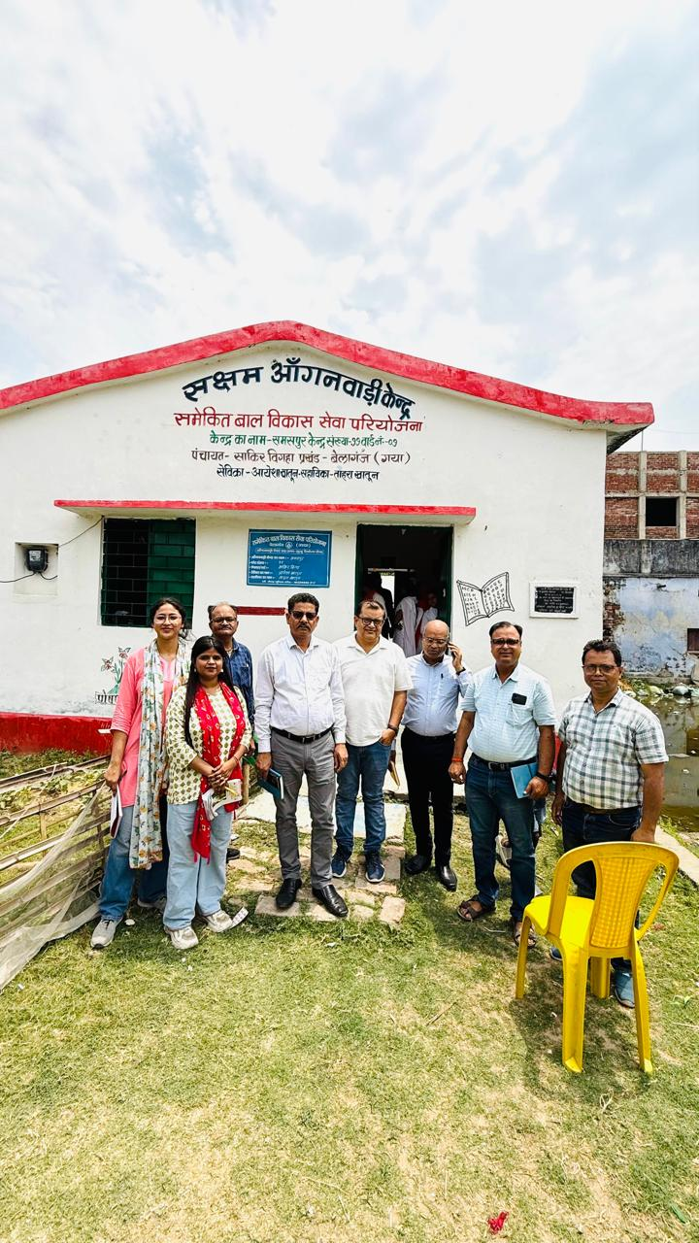
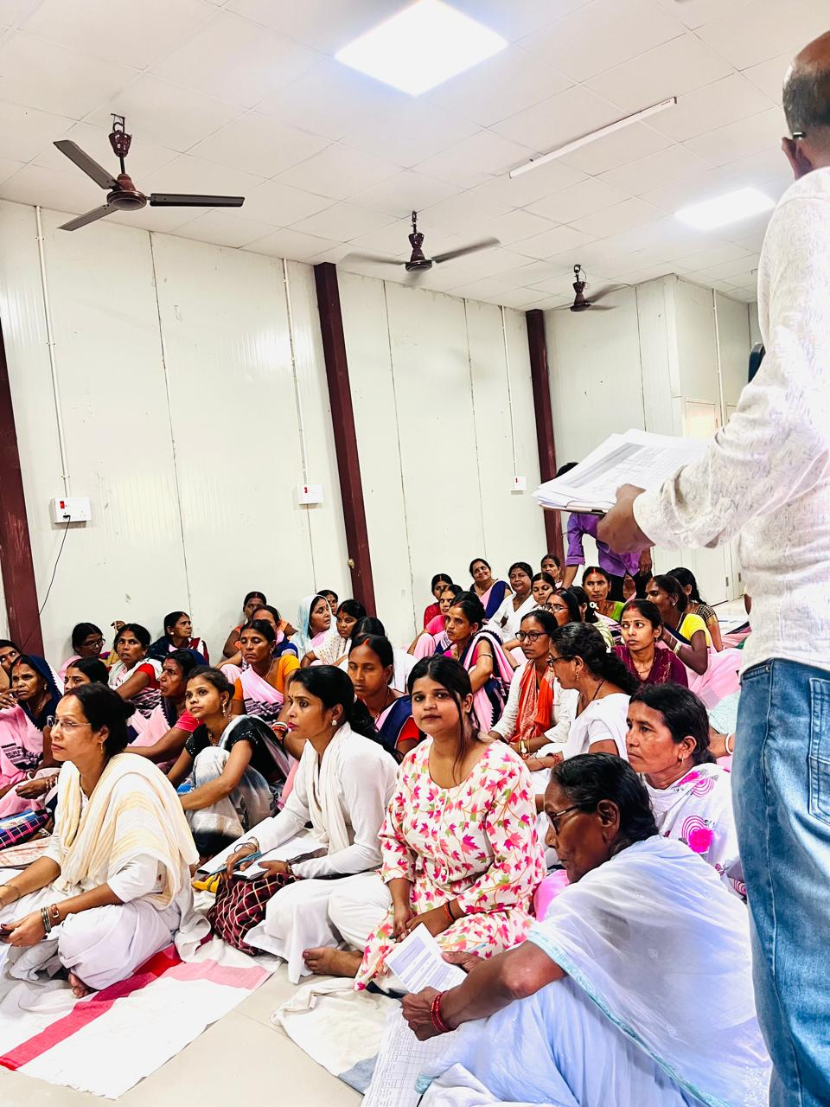
CO FIELD ACTIVITIES PHOTOGRAPH

Slide 22
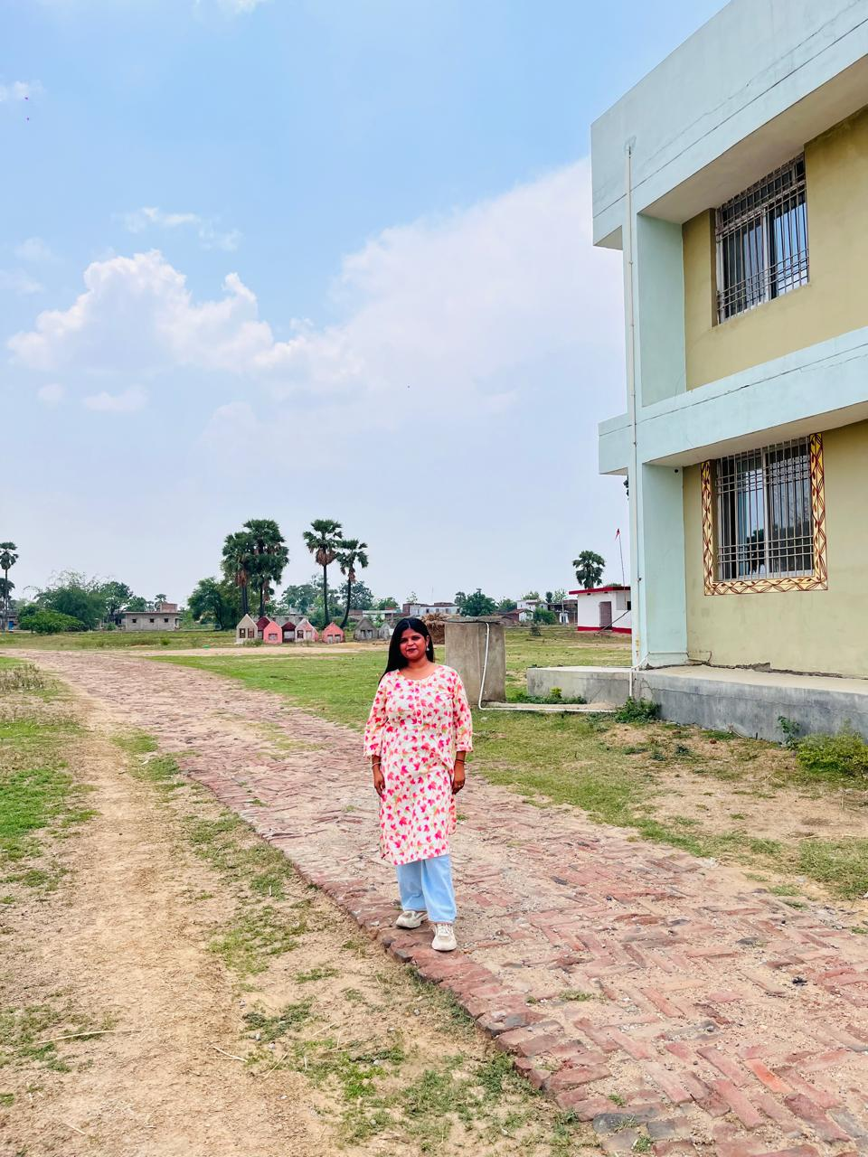
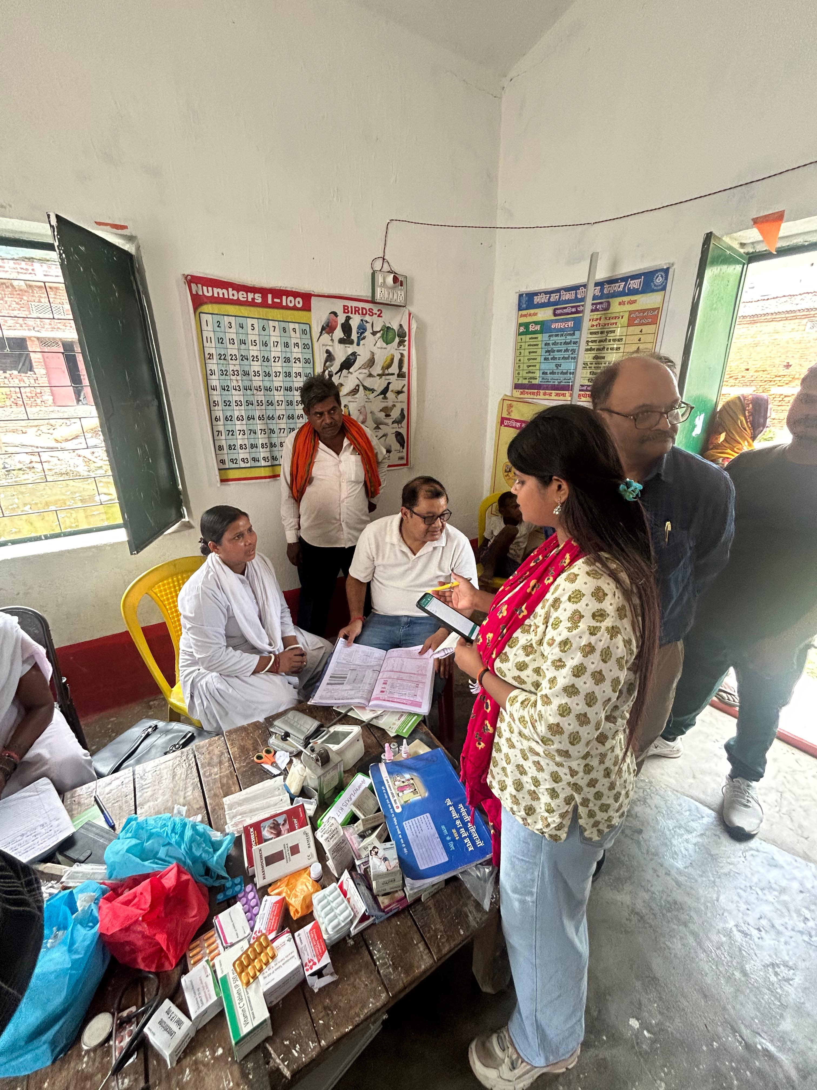
PICTORIAL JOURNEY

Slide 23
THANK YOU

