Slide 1


Assessing the Factors Affecting Customers' Choice for buying Health Insurance Policies
: A Secondary Research :
At
HDFC ERGO
By
Dr. Maitri Mishra
PG/21/054
Under the guidance of:
Dr. Himanshu Tolani
Assistant Professor, IIHMR

Slide 2
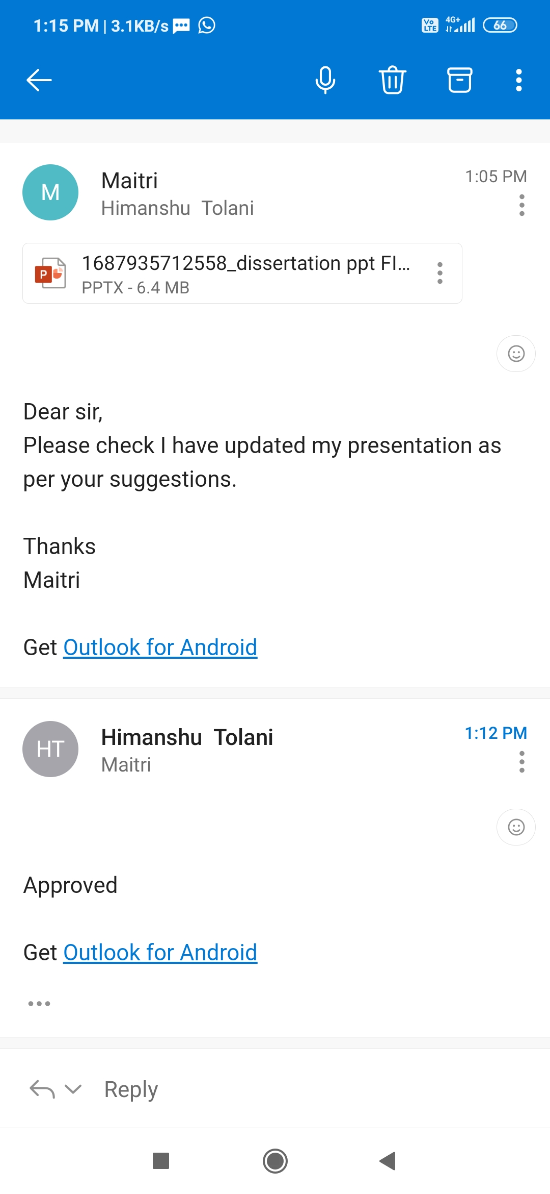
MENTOR APPROVAL

Slide 3
Introduction
Health insurance policies provide individuals with a financial safety net in case of medical emergencies. The Indian health insurance industry has been witnessing significant growth in recent years, with a variety of policies being offered by different insurers. However, customers face a multitude of options while choosing a policy, which can be a daunting task.
Therefore, it is important to understand the factors that influence customers' choices of health insurance policies based on the benefits offered.

Slide 4
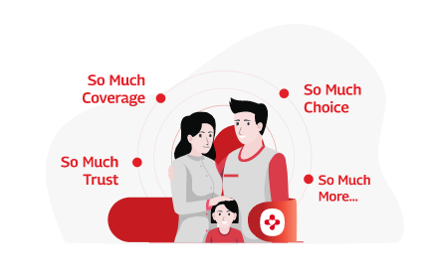
Health insurance policies offer a range of benefits such as hospitalization expenses, outpatient department (OPD) coverage, pre-existing illness coverage, and critical illness coverage, among others.
Health insurance policies are an essential component of financial planning, especially in the wake of rising medical expenses. With the growing number of health insurance providers in the market, customers have access to a wide range of policies, making it challenging for them to choose the right policy.

Slide 5
Objectives
The objective of this study is to identify and analyze the studies related to the factors affecting customers' choice of health insurance policies based on the benefits offered.

Slide 6
Methodology
Study design- This study will adopt a systematic review approach to gather and analyze the secondary data.
Study Period- 10th February to 15th May 2023
Method of data collection- search of electronic databases, including PubMed, Research Gate, and Google Scholar etc.
The review will be conducted using relevant keywords such as "health insurance", "policy benefits", "customer choice", "factors influencing choice", and "India". The data will be analyzed, with a focus on identifying the key factors affecting customers' choices of health insurance policies based on the benefits offered.

Slide 7
P: Population
Studies concerning customers or individuals seeking to purchase health insurance policies (electronic databases, including PubMed, Research Gate and Google Scholar etc. )
I: Intervention
Factors affecting customers' choices for buying health insurance policies
C: Comparison
Comparison of different factors influencing customers' decisions, such as disease covered, coverage options, awareness, reputation of insurance providers, claim settlement ratio, and marketing strategies.
O: Outcome
Understanding & identifying the most influential factors, and their relative importance in customers' choice for buying health insurance policies.

Slide 8
Eligibility Criteria:
Inclusion Criteria:
The inclusion criteria will be studies that examine health insurance policies including the most important factors affecting customers' choice of health insurance policies
Studies conducted in India
Full text available
Age above 18 years
Exclusion Criteria:
The exclusion criteria will be studies that examine health insurance policies that does not focuses on factors affecting customers' choice of health insurance policies.
Studies not conducted in India
Full text not available
Age below 18 years
Methodology
This study will focus on the secondary data available in the form of published academic research papers, industry reports, and online resources.

Slide 9
Identification of studies via databases
INDENTIFICATION
RECORS IDENTIFIED FROM DATABASES : (n =12370)
PUBMED: N=4103
RESEARCH GATE: N=4652
GOOGLE SCHOLAR: N=3615
Records removed before screening
Duplicates (n=938)
SCREENING
Reports removed after Title and Abstract screening
Study title not meeting inclusion (n=8383)
Records not relevant (n= 2157)
Wrong Population (n=870)
Reports sought for title and Abstract screening (n=11432)
Reports assessed for eligibility (22 )
ELIGIBLITY
Reports excluded because of no full text* (n=2)
INCLUDED
Reports of final included studies (n=20 )
PRISMA flowchart

Slide 10
RESULTS
STUDY | STUDY FOCUS | OUTCOME
R Mathivanan (2013), | Awareness, Transparency | At stage of interview schedule framing 10 criterions were considered as the bench marks for selection of health insurance service providers by a rational customers. Results of the data analysis indicated that customers‟ Awareness, Transparency, is ranked in the first place, with a highest mean score of 7.06.
Rahul Tripathi (2013), | Disease coverage Claim settlement ratio | It is seen the disease coverage is considered as the major constraint by the respondents with the highest mean value of 58.44 occupying the first place. Mode of claim settlement ratio with mean score of 55.84 is ranked as the second next.
Sasi kala devi D (2014), | Awareness Claim settlement ratio | Out of 200 respondents surveyed that 48% of them are aware of risk covered by medi-claim policies and 97%of the sample populations’ are aware of claim settlement ratio
Nair(2019), | Claim settlement ratio | He found that claim settlement ratio of insurance companies in public sector is better than those insurance companies in private sector.
Jothi and Sitaram (2014), | Awareness | customer purchase intention is influenced by the marketing mix ie. product, price, place and Promotion.

Slide 11
RESULTS
STUDY | STUDY FOCUS | OUTCOME
Srimannarayana Gajula and P.Dhanavanthan (2020), | Claim settlement ratio | Smooth claim application process, smooth claim settlement and Claim settlement in a short tenure were the most significant factors in logging of health insurance policy as its weighted average scores are 6.95, 6.84 and 6.74 respectively.
Dr. D. Y Patil , Dr. Kamini Khanna , Veena Kotle (2022), | Compatibility, Awareness, Transparency, Availability of Information, Claim settlement ratio | The factors influencing the customer perception towards health insurance were Compatibility, Awareness, Transparency, Tax Benefit, Accuracy clarity and Availability of Information, claim settlement ratio and number of network hospital. Through the study it was found that, awareness of health insurance products was observed in majority of the respondents. Compatibility of premium with the services 0.755 Awareness 0.758 Claim settlement ratio 0.765 Number of network hospitals
Siddhartha and Sumanth(2017), | Risk coverage, Image of the company | It was observed in the study that most of the investors in Insurance policies had invested with the main objective of tax saving and earning return rather than the actual objective of insurance that is risk coverage. During the study it was also seen that the major factors which influence the choice of an insurance company are image of the company and customer relationship.
Sareen, S. et al. (2020), | Awareness, Reputation, Ease of claiming | It was found that the most important factors affecting customers' choice of health insurance policies were the policy coverage and benefits offered by the insurer. Customers also considered the insurer's reputation, customer service, and ease of claiming as important factors.

Slide 12
RESULTS
STUDY | STUDY FOCUS | OUTCOME
Thakur, S. et al. (2020), | Premiums, Disease coverage | Choice of health insurance policies was influenced by the insurer's reputation, disease coverage , premiums, and network of hospitals. Customers were also influenced by the insurer's digital presence and ease of buying policies online.
Sharma, P. et al. (2019), | Availability of Information, Claim settlement ratio | Found that customers' choice of health insurance policies was influenced by the insurer's brand image, policy features, premiums, and customer service. Customers also considered the insurer's claim settlement ratio and network of hospitals as important factors.
Choudhary, P. et al. (2019), | Risk coverage, Image of the company | Customers' choice of health insurance policies was influenced by the insurer's reputation, policy features, premiums, and ease of buying policies online. Customers also considered the insurer's customer service and network of hospitals as important factors.
Sareen, S. et al. (2020), | Insurer's reputation | It was found that the most important factors affecting customers' choice of health insurance policies were the policy coverage and benefits offered by the insurer. Customers also considered the insurer's reputation, customer service, and ease of claiming as important factors.
Verma, N. et al. (2018), | Claim settlement ratio. Customers , Insurer's reputation | Insurer's reputation, policy features, premiums, and claim settlement ratio. Customers were also influenced by the insurer's network of hospitals and customer service.

Slide 13
RESULT
Composition of Articles
Total of 12370 papers were reviewed and out of which 20 papers were included which talked about predominant factors affecting customers' choice while choosing health insurance policies . All studies reviewed were primary studies
PRE-DOMINANT FACTORS | NO. OF ARTICLES INCLUDED
AWARENESS | 14
DISEASE COVERAGE | 9
IMAGE/REPUTATION | 6
PREMIUM | 7
CLAIM SETTLEMENT RATIO | 13

Slide 14



DISCUSSION:
AWARENESS
Higher levels of awareness about health insurance options lead to increased demand and a greater willingness to invest in suitable policies.
DISEASE COVERAGE
Disease coverage is a crucial consideration .
CLAIM SETTLEMENT RAIO
Consumers prioritize insurance providers that have a reputation for efficiently settling claims, as this assures them that their medical expenses will be covered when needed.
Findings highlight the importance of educational campaigns and marketing.
When individuals are aware of the benefits of health insurance and the financial protection it provides in the event of medical emergencies, they are more likely to prioritize obtaining coverage.
Individuals want comprehensive coverage that includes a wide range of medical services, including hospitalization, surgeries, consultations, diagnostic tests, and medications. Policies that offer robust coverage for specific diseases or critical illnesses are particularly attractive to consumers.

Slide 15


DISCUSSION:
REPUTATION OF INSURANCE COMPANY
PREMIUM
The premium cost of health insurance policies also plays a crucial role in decision-making.
The reputation of the insurance company emerges as another influential factor.
Consumers consider the track record and credibility of insurance providers before making their decision.
Companies with a strong reputation for customer service, prompt claims processing, and reliable coverage are more likely to gain trust and attract customers.
Consumers evaluate the affordability of premiums and weigh them against the benefits provided by the policy. While individuals recognize the importance of adequate coverage, they also seek policies that fit within their budgetary constraints.
Insurance providers must strike a balance between offering competitive premiums and providing sufficient coverage to cater to the diverse economic backgrounds of consumers.

Slide 16
Conclusion
Based on these factors, it can be concluded that individuals tend to consider the awareness of a health insurance company ,its claim settlement ratio, and its reputation & low premiums when selecting a health insurance policy.
These considerations indicate a desire for a reliable and reputable insurance provider that offers competitive rates and demonstrates a strong track record of settling claims. The findings of this study can contribute to the development of policies that cater to customers' needs and preferences, ultimately improving customer satisfaction.

Slide 17


PICTORIAL JOURNEY

Slide 18
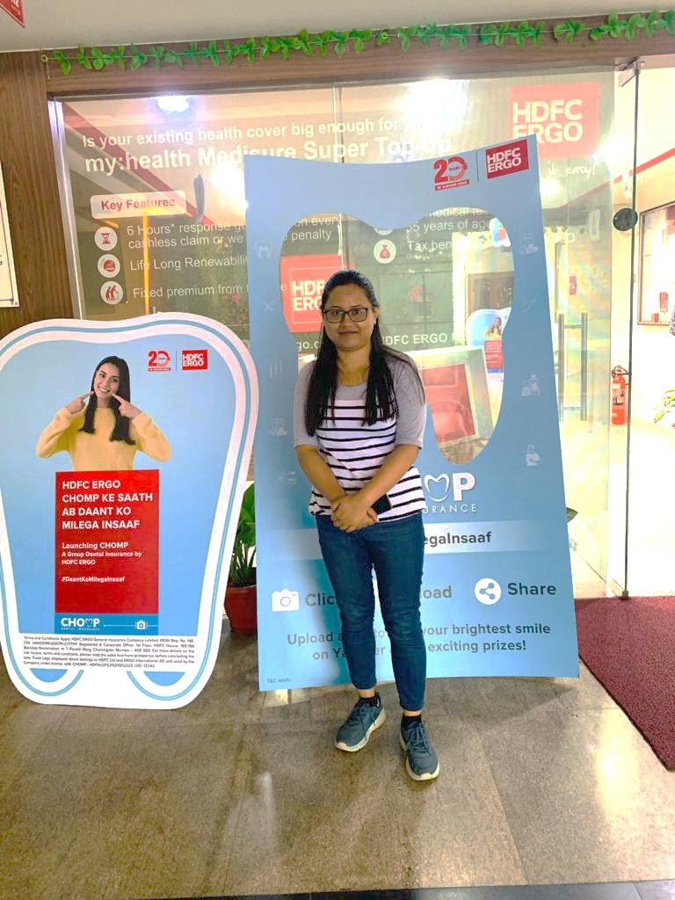
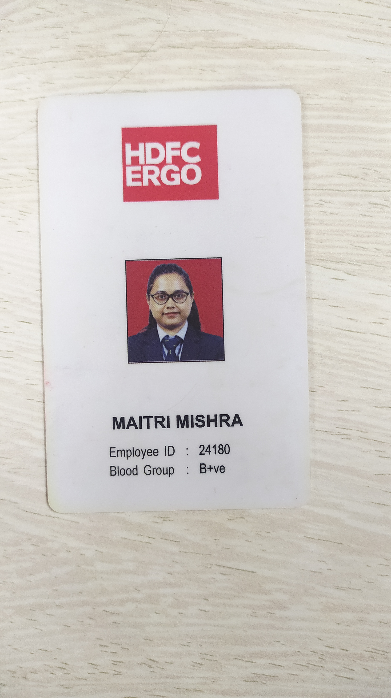
PICTORIAL JOURNEY

Slide 19
References
Mehrdad Asghari and Dr. S. Harish Babu (2017), Understanding of Customer Expectations and Perceptions of Indian Health Insurance Companies, International Journal of Engineering Trends and Technology (IJETT) – Volume-43 Number-3, pp. 138-146.
Srimannarayana Gajula and ,P.Dhanavanthan (2020). Consumer’s Perception and Factors influencing Selection of Health Insurance Policy in Hyderabad Region Volume-9 Issue-1S5, December, 2019
Nilay Panchal (2013), Customer’s Perception towards Health Insurance: An Empirical Study in Bardoli & Mandvi Region, Indian Journal of Applied Research, Vol. 3, Issue.4, pp. 62-64.
Tanuj Mathur, Ujjwal Kanti Paul, Himanshu Narayan Prasad and Subodh Chandra Das (2015), Understanding perception and factors influencing private voluntary health insurance policy subscription in the Lucknow region, Int J Health Policy Manag 2015, 4(2), pp. 75–83
Anjali Jacob (2018), A study on customer perception towards health insurance in Ranny Thaluk, International Journal of Advance Research and Development, Volume 3, Issue 12, pp. 41-48.

Slide 20
Sareen, S., Gupta, N., & Gupta, N. (2020). An exploratory study on the factors influencing the choice of health insurance policy among Indian consumers. Journal of Health Management, 22(4), 495-509.
Thakur, S., Sachdeva, S., & Singh, J. (2020). Factors influencing consumers' choice of health insurance policies in India: An empirical study. International Journal of Healthcare Management, 13(3), 265-276.
Sharma, P., Saini, G. K., & Goyal, P. (2019). Consumers' preferences for health insurance policies in India: An empirical study. International Journal of Healthcare Management, 12(2), 130-141.
Choudhary, P., Nishant, R., & Nagendra, A. (2019). Understanding factors affecting the choice of health insurance policies: An empirical study in India. International Journal of Healthcare Management, 12(4), 318-328.
Verma, N., Ahuja, S., & Prakash, A. (2018). Factors influencing health insurance purchase decisions in India: An empirical study. International Journal of Healthcare Management, 11(3), 173-181.
References

Slide 21
Thank You

