Slide 1
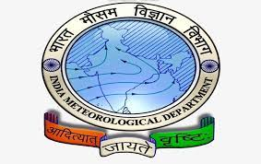
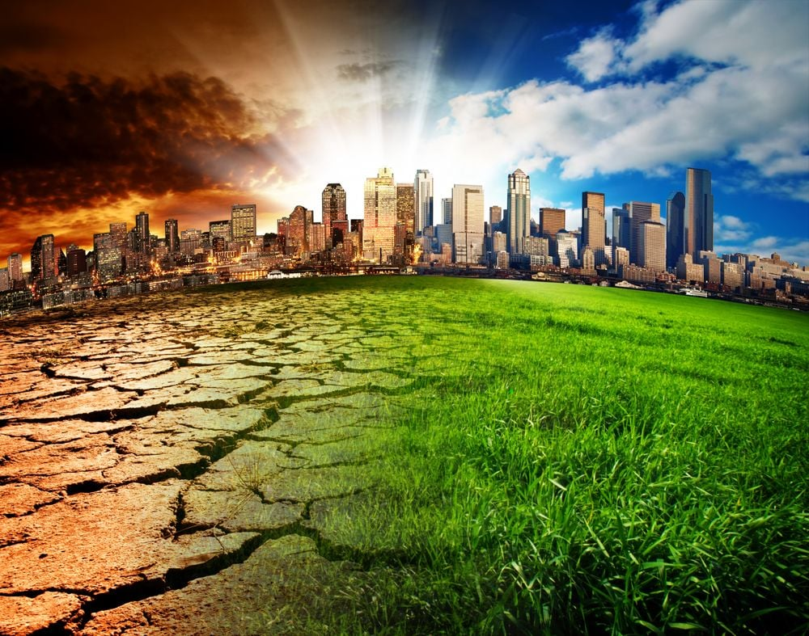

“Changing Trends in Heat Wave Events over the Last 15 Years in India: Insights from IMD Data”
Mr. Rinku Yadav
PG/21/084
Mentor – Dr. Ratika Samtani

Slide 2

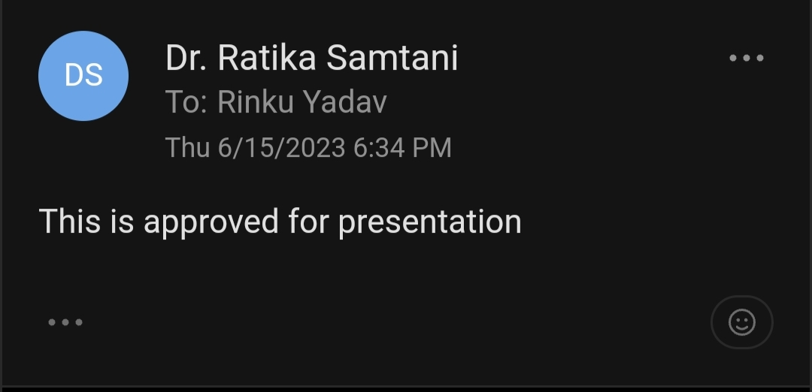
CERTIFICATE OF APPROVAL

Slide 3
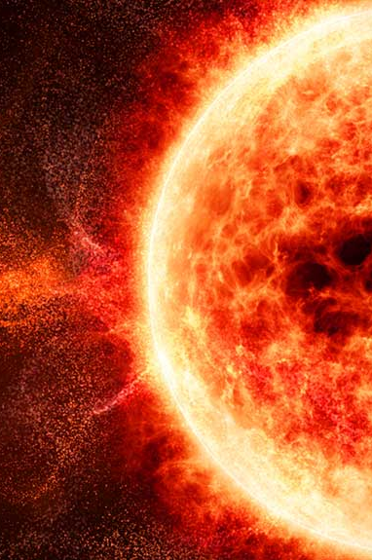

INTRODUCTION
The alteration of weather and atmospheric conditions over an extended period of time is known as climate change.
Heat waves are prolonged periods of excessively high temperature.
Heat waves have adverse impacts on human health, agriculture, and infrastructure.
India experiences significant heat waves between the months of March and June.
=<40’C
>40’C
+5-6’C
+7’C
+4-5’C
+6’C
Heat Wave
Severe Heat Wave
Heat Wave
Severe Heat Wave
This Photo by Unknown author is licensed under CC BY-NC-ND.

Slide 4



OBJECTIVES
To identify the Trends of Heat Waves in India over the Last 15 Years.
Primary objective
To identify the Hotspot Districts in India facing Heat Waves.
Secondary objective

Slide 5
METHODOLOGY
Research Design
Secondary Research
Data Collection IMD
(Last 15 Years)
Data Analysis
Excel, SPSS, QGIS
Limitation
Data Accuracy,
Data completeness

Slide 6
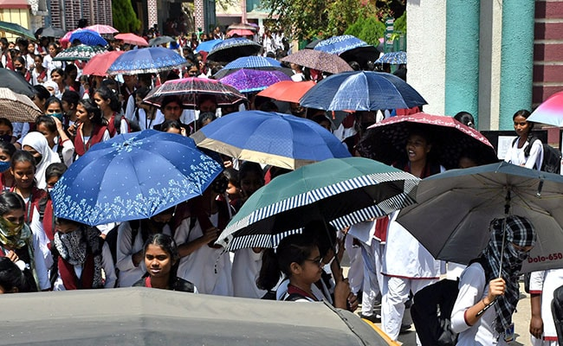
Trends of Heat Wave Events (1990-2019)

Slide 7
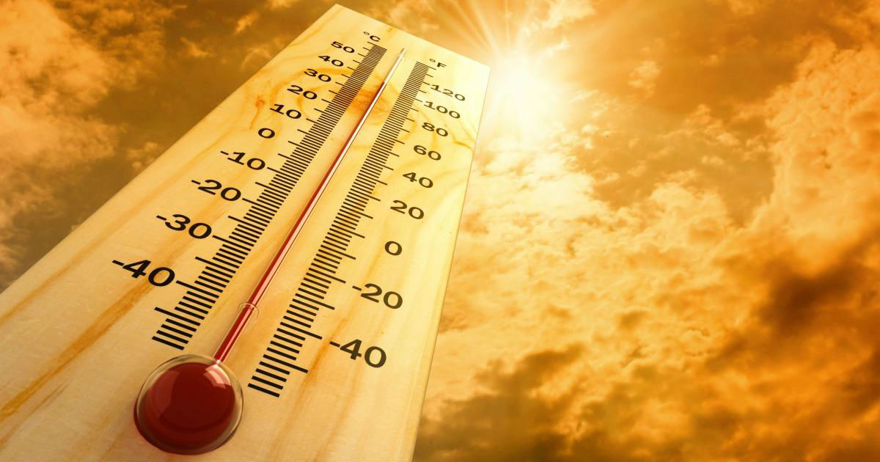
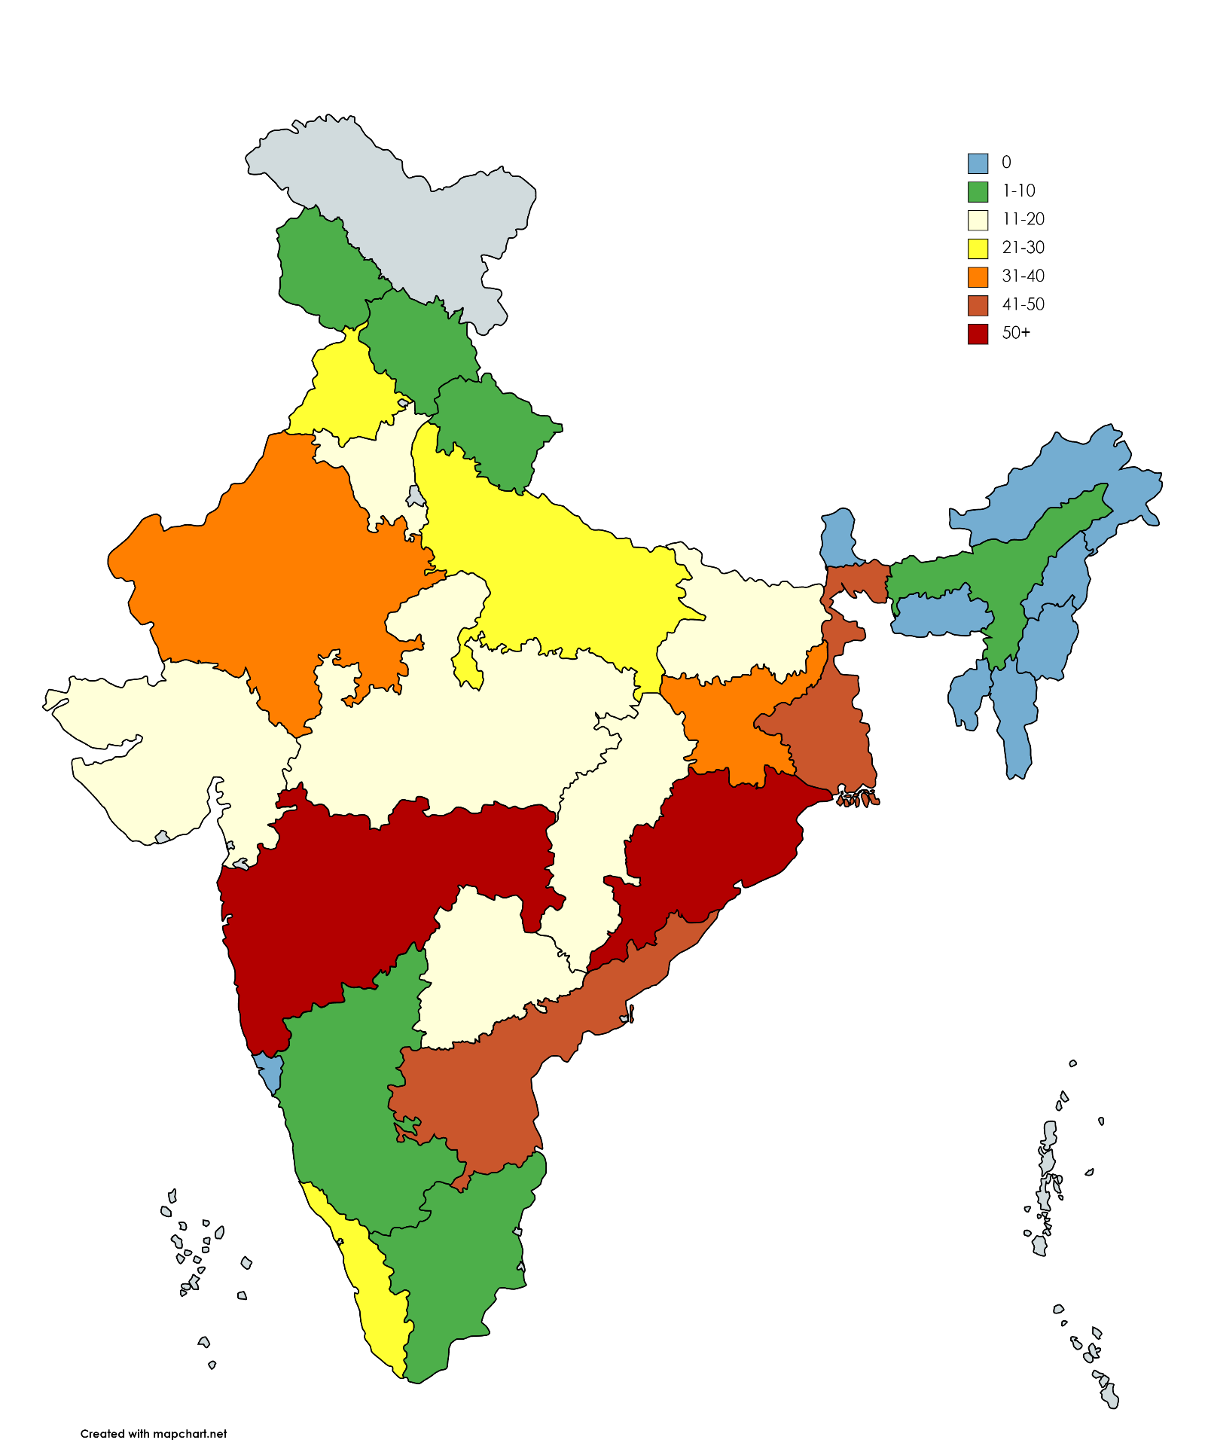
OBJECTIVES
No. of HWEs occurred state-wise (2005-2019)

Slide 8
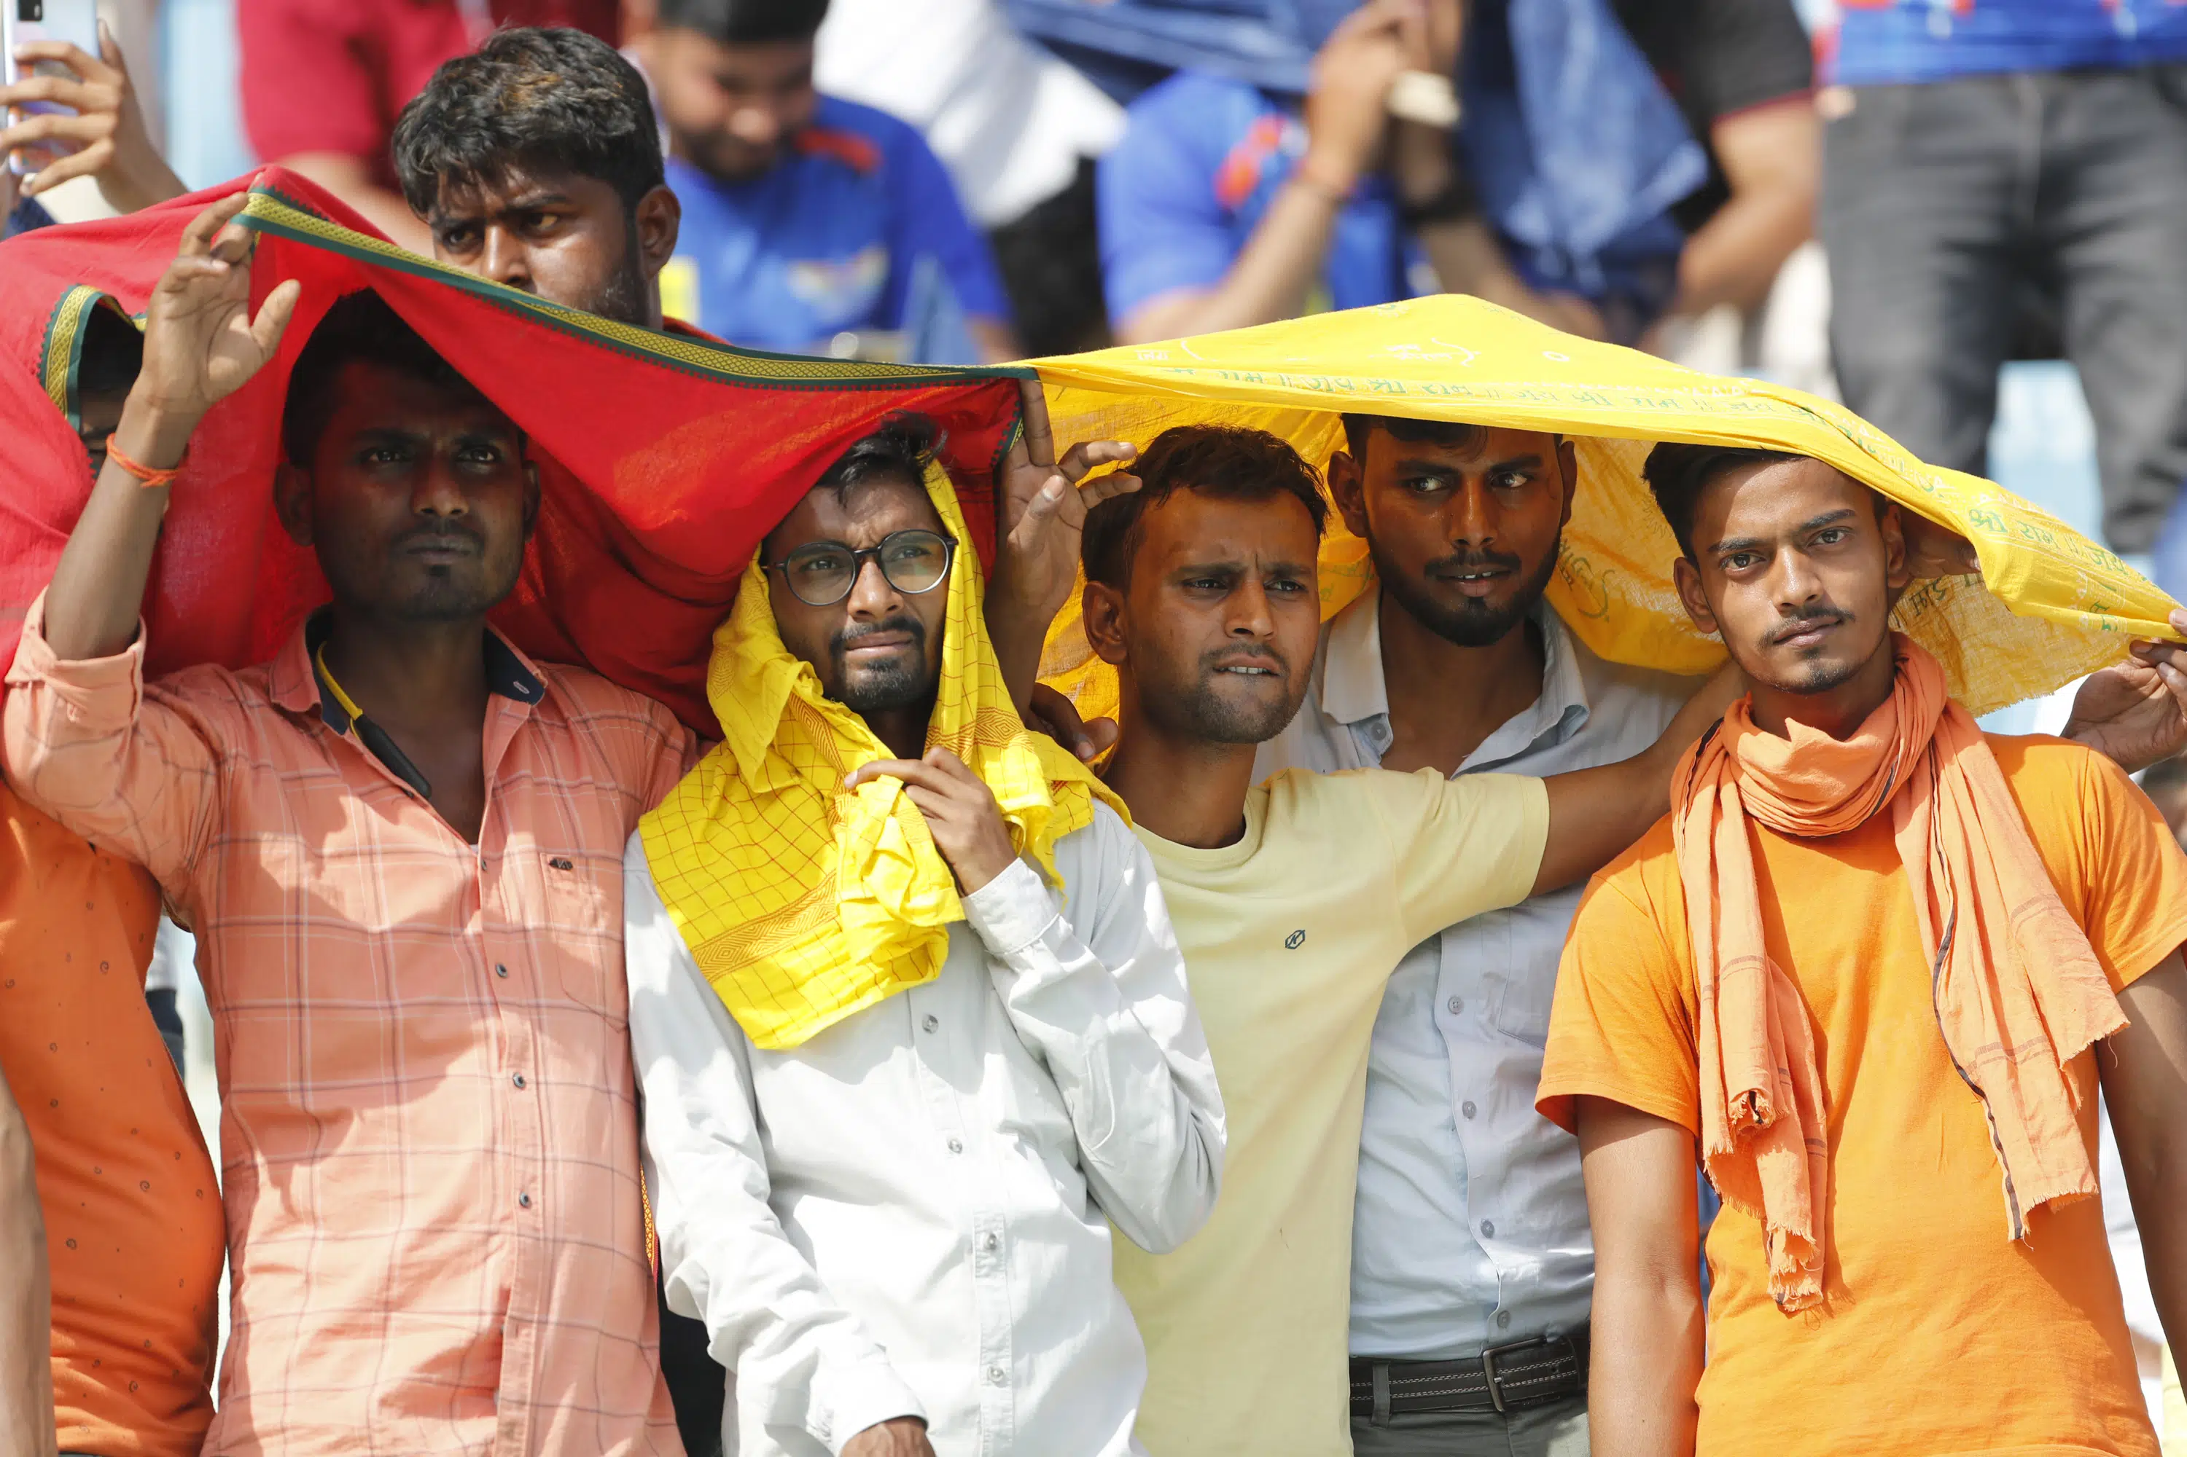
Most affected states (2005-2019)

Slide 9
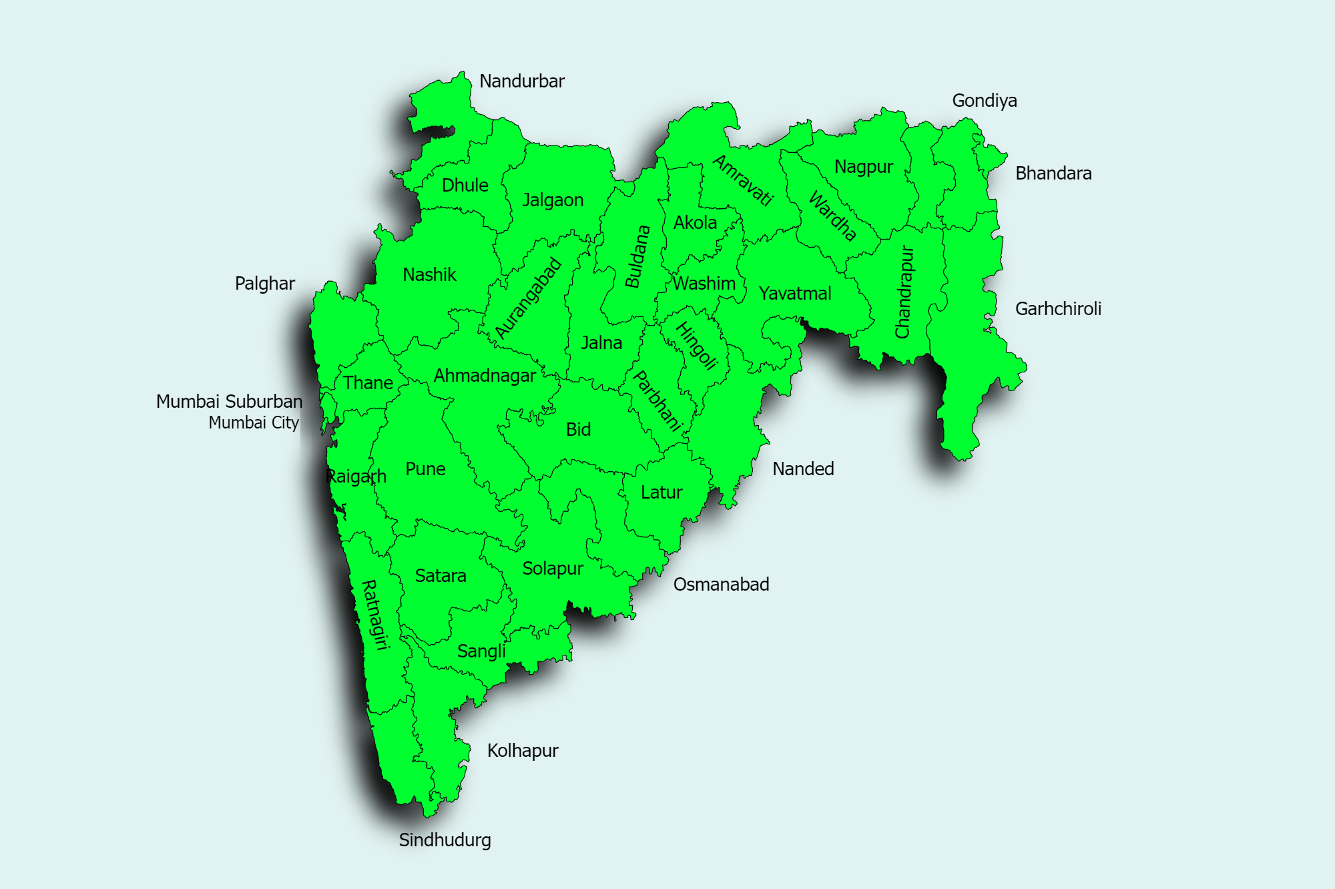
HWEs in Maharashtra
2005-2019

Slide 10
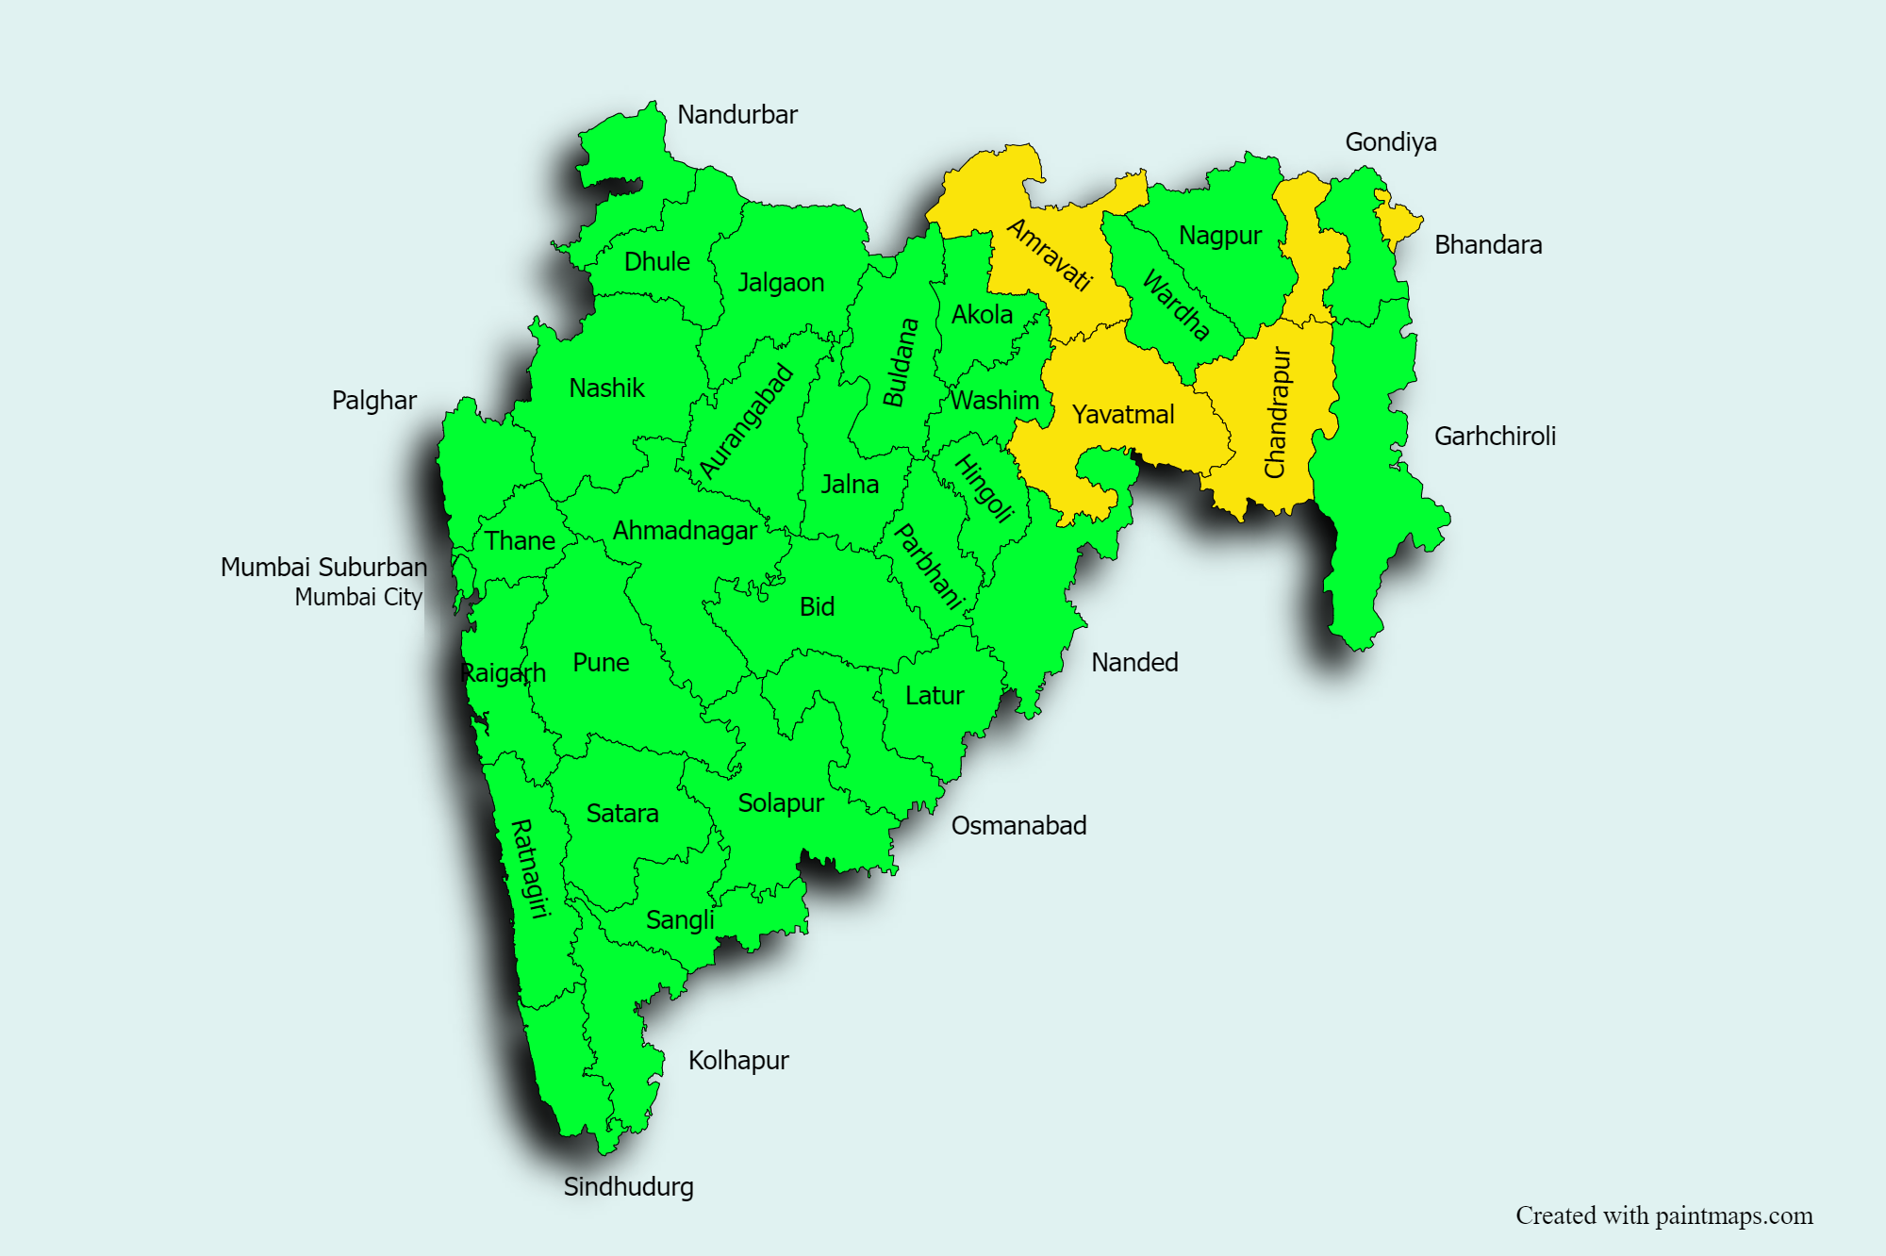
Hotspot districts
District Name | Years HWEs occurred
Amravati | 8
Bhandara | 8
Chandrapur | 9
Yavatmal | 8
Chi-square trend for analysis used to calculate hotspot districts.

Slide 11
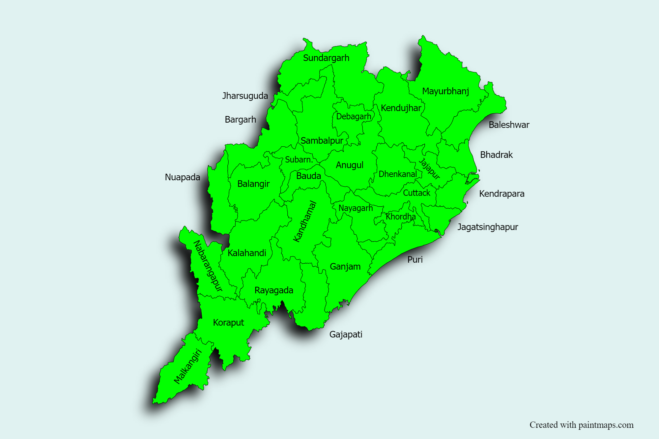
HWEs in Odisha
2005-2019

Slide 12
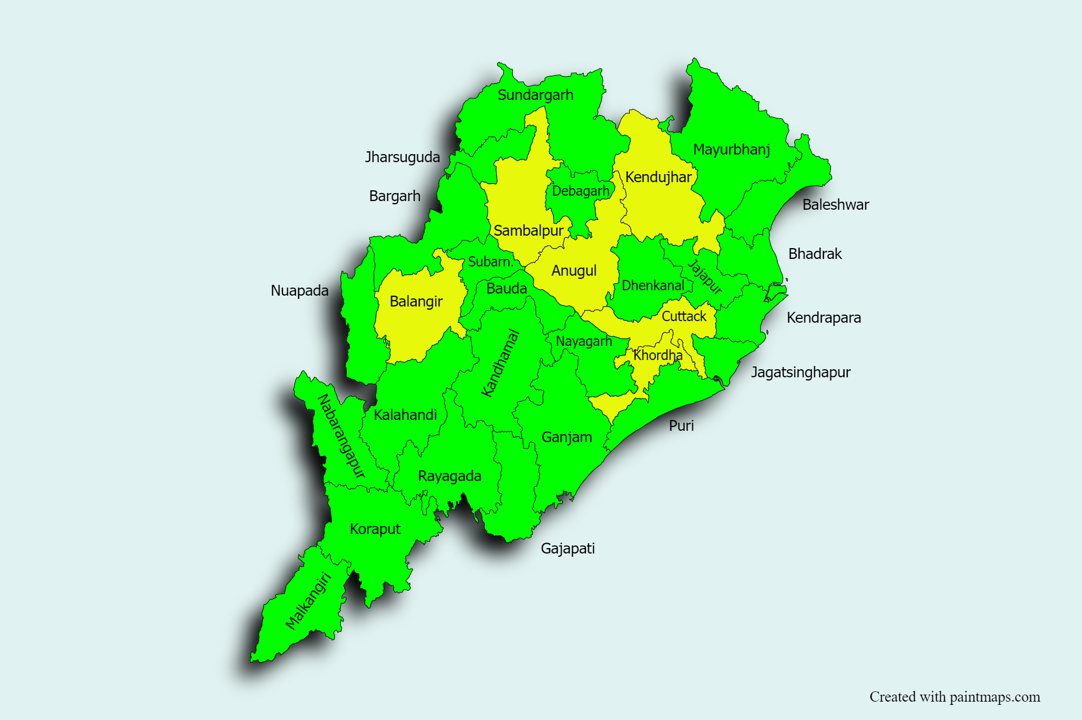
Hotspot districts
District Name | Years HWEs occurred
Anugul | 11
Balangir | 10
Cuttack | 9
Kendujhar | 8
Khordha | 8
Sambalpur | 9
Chi-square trend for analysis used to calculate hotspot districts.

Slide 13
The analysis of the graph representing the total number of HWEs from 1990 to 2019 reveals a significant increase in the occurrence of HWEs over time. The cyclical pattern observed in the trendline indicates fluctuating HWEs.
The map of India further contributes to understanding HWEs distribution across states. Several states, such as Sikkim, Arunachal Pradesh, and Nagaland, did not experience any HWEs.
Maharashtra and Andhra Pradesh emerged as the states with the highest number of HWEs.
Maharashtra and Odisha as the most affected, accounting for 35% of the total HWEs .
There is evidence of HWEs encroaching into new districts over time. Examples such as Nashik, previously considered a relatively HWE-free (Fan-free) district, are now being affected.
HWEs in India have significant implications for public health, agriculture, and infrastructure.
Discussion

Slide 14
This study sheds light on India's increasing trends and distribution of heat wave events (HWEs) over the past 15 years. The analysis reveals a significant rise in the occurrence of HWEs, with a cyclical pattern indicating a consistent annual increase. Maharashtra and Andhra Pradesh emerged as the states most affected by HWEs, emphasizing the need for targeted interventions in these regions. The district-level analysis highlights the dynamic nature of HWE distribution, with certain districts consistently experiencing higher frequencies and new districts being affected over time. The study underscores the urgent need for effective strategies and adaptive measures to mitigate the adverse impacts on public health, agriculture, and infrastructure. While the research provides valuable insights, future studies should consider incorporating climate models and assessing socio-economic impacts to enhance our understanding of this pressing issue.
Conclusion

Slide 15
1. Why is climate important? [Internet]. NCAS. [cited 2023 Jun 4]. Available from: https://ncas.ac.uk/learn/why-is-climate-important/
2. What is climate change? [Internet]. NCAS. [cited 2023 Jun 4]. Available from: https://ncas.ac.uk/learn/what-is-climate-change/
3. Klingelhöfer D, Müller R, Braun M, Brüggmann D, Groneberg DA. Climate change: Does international research fulfill global demands and necessities? Environ Sci Eur. 2020 Oct 15;32(1):137.
4. Marx W, Haunschild R, Bornmann L. Heat waves: a hot topic in climate change research. Theor Appl Climatol. 2021 Oct 1;146(1):781–800.
5. Heat Wave Warning Services.pdf [Internet]. [cited 2023 Feb 15]. Available from: https://mausam.imd.gov.in/imd_latest/contents/pdf/pubbrochures/Heat%20Wave%20Warning%20Services.pdf
6. Disastrous Weather Events 2015.pdf [Internet]. [cited 2023 Feb 22]. Available from: https://www.imdpune.gov.in/library/public/Disastrous%20Weather%20Events%202015.pdf
7. FAQ_heat_wave.pdf [Internet]. [cited 2023 Feb 15]. Available from: https://internal.imd.gov.in/section/nhac/dynamic/FAQ_heat_wave.pdf
8. Ratnam JV, Behera S, B Ratna S, Rajeevan M, Yamagata T. Anatomy of Indian heatwaves. Sci Rep. 2016 Apr 15;6:24395.
Reference

Slide 16


