Slide 1

Perception of HMIS Users on the Performance of system in a Tertiary Care Hospital
Komal
Faculty Mentor- Prof. Divya Aggarwal
IIHMR Delhi
KareXpert Technologies Pvt Ltd.
1

Slide 2

Screenshot of Approval
<number>

Slide 3
Introduction
HMIS functionalities means- HMIS features
HMIS Functionalities refers to the hospital management information system's appropriateness and efficacy in data gathering, processing, and data quality in order to ensure the smooth flow and efficiency of hospital operations.
The functionality of a HMIS should guarantee that the right information is available to the right people at the right time.
It support high quality, efficient and patient centered care.
<number>

Slide 4
Introduction
It decreases the cost of quality care and the accessibility time to patient records.
HMIS functions are an integrated and comprehensive information system designed to manage the clinical, financial, and administrative elements of a hospital.
HMIS functionality standardises management reporting in support of patient care and administrative applications, decreasing the work and time spent by health-care professionals such as nurses, pharmacists, and doctors.
<number>

Slide 5
Objectives of the Study
1- To determine the HMIS functionalities at the hospital.
2- To determine the effect of HMIS functionalities on the performance of a hospital.
RESEARCH QUESTIONS
The study aims to answer the following questions:
1- What are the HMIS functionalities at the hospital?
2- What are the effects of HMIS functionalities on the performance of a hospital?
<number>

Slide 6
Methodology
This study was based on primary data.
It was conducted using an online survey questionnaire of Karexpert User.
The sampling unit of this study was the population who have experience in hospital and using HMIS.
This study focuses on the effect of HMIS functionalities on the performance of a hospital. A total of 92 respondents participated in this survey.
<number>

Slide 7
Methodology
The survey was designed with multiple questions.
In this survey, there are many statements given to the respondents. They were asked to indicate their responses whether they are agree, strongly agree, disagree or strongly disagree with the statement.
<number>

Slide 8
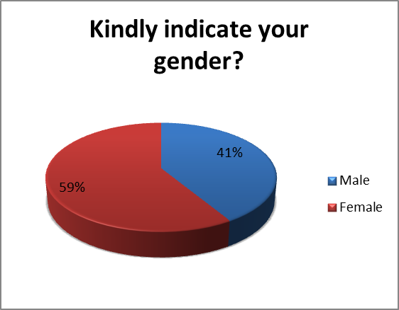
Results
<number>

Slide 9
Results
<number>

Slide 10
Results
<number>

Slide 11
Discussion
Hospital management information system was connected to greater work coordination and cooperation, considerable gains in labour cost distribution, quality control, employee productivity, and more effective and efficient service delivery.
It also offered a structure for organising diverse data related to management, financial, and medical processes.
HMIS functions increased work collaboration and teamwork
You are not allowed to add slides to this presentation
<number>

Slide 12
Discussion
HMIS also provided benefits such as simplified operations, greater management and administration, higher patient care, cost control, and increased profitability.
MIS improved the Hospital's customer experience, patient happiness, and service delivery efficiency, resulting in a rise in the number of patients treated and, eventually, revenue growth.
HMIS functions resulted in enhanced patient and employee safety, greater income due to paperless operations, and efficient billing and official document creation processes
You are not allowed to add slides to this presentation
<number>

Slide 13
Conclusion
According to the findings of the study, the Hospital has improved its performance over time as a result of the services/procedures provided at the institution.
Patient satisfaction with the services provided had increased, as had work collaboration and teamwork. There had also been improvements in the efficiency of health-care delivery, the elimination of medical errors, and the efficient conveyance of information to patients.
The study also found that HMIS functions resulted in faster patient turnaround times. As a result of HMIS functions, work collaboration, teamwork, health care cost reduction, revenue growth, and patient happiness have all increased.
You are not allowed to add slides to this presentation
<number>

Slide 14
References
Najem FM. the impact of hospital information system quality on the health care quality: a case study on european gaza hospital.
Kumar V. Impact of health information systems on organizational health communication and behavior. Internet Journal of Allied Health Sciences and Practice. 2021;9(2):8.
Ross DS, Venkatesh R. Role of hospital information systems in improving healthcare quality in hospitals. Indian journal of science and technology. 2020 Jul;9(26):1-5.
Aghazadeh S, Aliyev A, Pirnejad H. Study the effect of hospital information systems (HIS) on communication improvement and service quality among nursing staff. Life Science Journal. 2021;10(10):307-10.
Sinha R. Impact of health information technology in public health. Sri Lanka Journal of Bio-Medical Informatics. 2019 Dec 6;1(4).
You are not allowed to add slides to this presentation
<number>

Slide 15
Thank You
Any Questions
You are not allowed to add slides to this presentation
<number>

Slide 16
Dissertation Experiences
What did you learn (skill/ topic)?
Overall self comments on Dissertation
Learn different workflows of the hospital.
Work on core concept of implementation of HMIS.
Handling the live situations and clients.
End to end testing of the HMIS software.
Know about the different HMIS functionalities
Got to know how the HMIS functionality effects the performance.
You are not allowed to add slides to this presentation
<number>

