Slide 1

HIPAA Knowledge & Awareness in an EMR Support Project
Presented By:
Shivang Sharma

Slide 2
What is HIPAA?
Health insurance portability and accountability act of 1996 is United States legislation that provides data privacy and security provisions for safeguarding medical information.
HIPAA
Privacy Rule
Requirements on how entities can use or disclose health information
Security Rule
Requirements on how entities must secure and protect health information

Slide 3
Components of HIPAA
HIPAA
Health Insurance Portability and Accountability Act of 1996
Title I
Title II
Title III
Title IV
Title V
Health Care Access, Portability, and Renewability
Preventing Health Care Fraud and Abuse
Medical Library Reform
Administrative Simplification
Tax Related Provision
Group Health Plans Requirements
Revenue Offsets
Electronic Data Interchange`
Privacy
Security
Administrative Safeguards
Physical Safeguards
Technical Safeguards
Organizational Requirements
Policy & Procedures and documentation Requirement
Transactions
Identifiers
Code Sets

Slide 4
HIPAA Security Rule Components
Administrative Safeguards
Physical Safeguards
Technical Safeguards
Security Management Process
Assigned Security Responsibilities
Work Force Security
Information Access Management
Security and Awareness Training
Contingency Plan Evaluation
Business Associate Contract
Facility Access Control
Workstation Use
Workstation Security
Device And media Control
Access Control
Audit Control
Integrity
Personal or Entity Authentication
Transmission Security

Slide 5
Scope of the Study
The study aims to assess the knowledge about HIPAA as a concept amongst the support employees. The study also intends to measure the awareness of the support employees about the existing measures being taken by the organization in order to abide by HIPAA rule.
The study does not intend to measure/audit HIPAA rule compliance within the organization. It only intends to measure the knowledge and awareness of the support employees on HIPAA.

Slide 6
Study Objectives
Objective
To assess the HIPPA knowledge and awareness within support projects based on the study findings.
Assessment
HIPAA Knowledge
HIPAA Compliance Awareness

Slide 7
Study Methodology
Study Group
Support Employees
Tools Applied
Two questionnaire - 1 for HIPAA knowledge assessment and 1 for compliance awareness assessment
10 questions for HIPAA knowledge assessment and 10 for compliance awareness assessment
Data Collection
Paper and Electronic distribution of questionnaire
Sample size
112
Inclusion Criteria- Availability, Participation

Slide 8
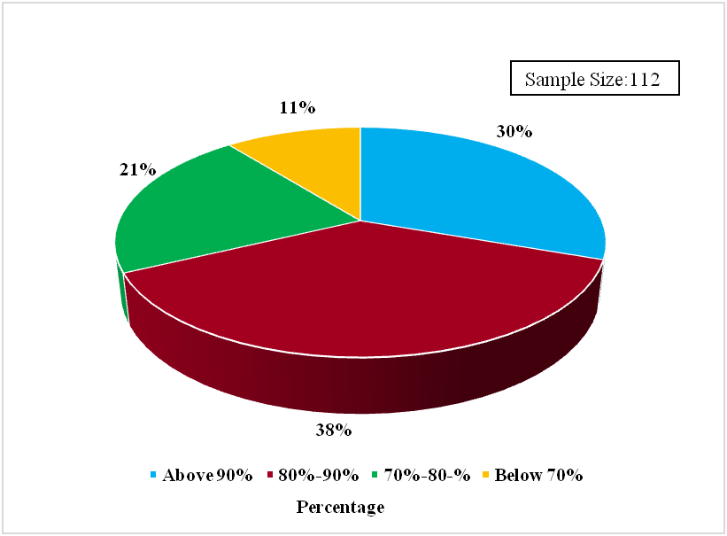
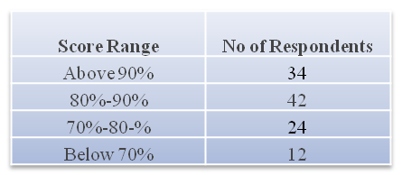
Study Findings
HIPAA Knowledge Assessment Result for Support Employees
Note: The result of the study group was grouped into four sections based upon respondents score

Slide 9
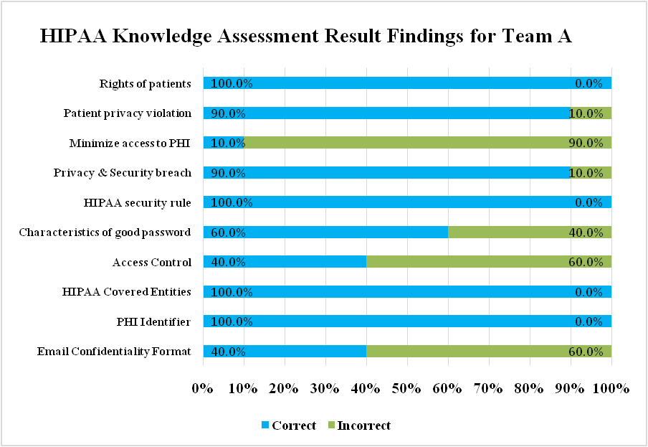
HIPAA Knowledge Assessment Result for Support Employees

Slide 10
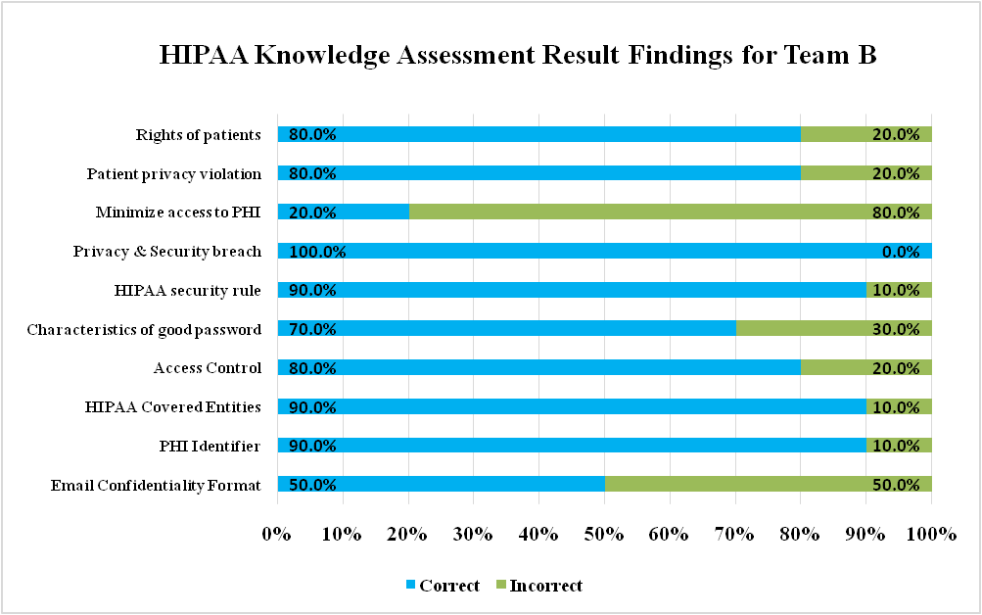
HIPAA Knowledge Assessment Result for Support Employees

Slide 11
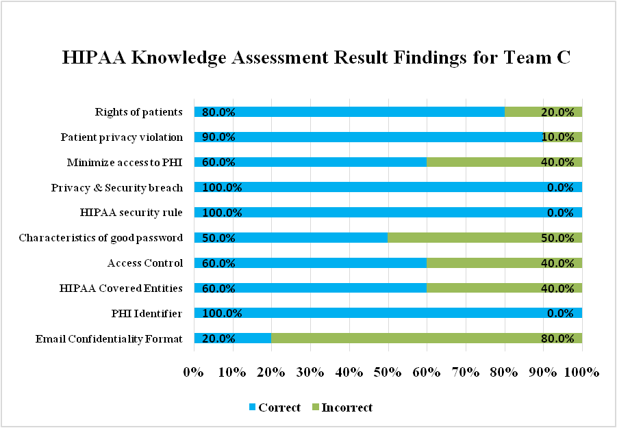
HIPAA Knowledge Assessment Result for Support Employees

Slide 12
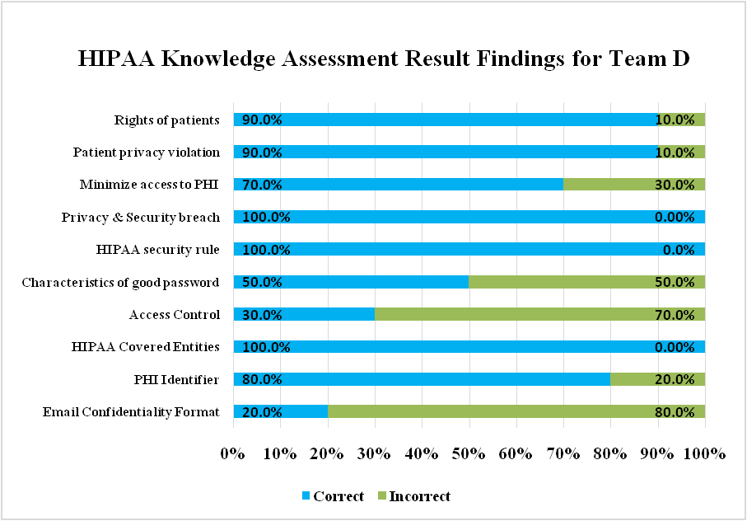
HIPAA Knowledge Assessment Result for Support Employees

Slide 13
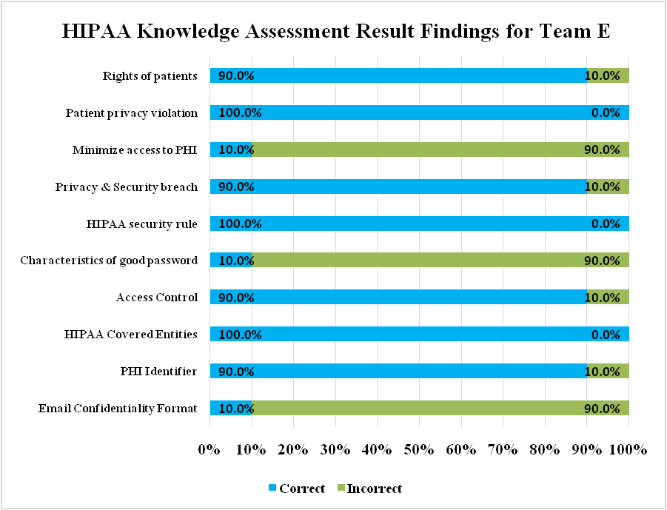
HIPAA Knowledge Assessment Result for Support Employees

Slide 14
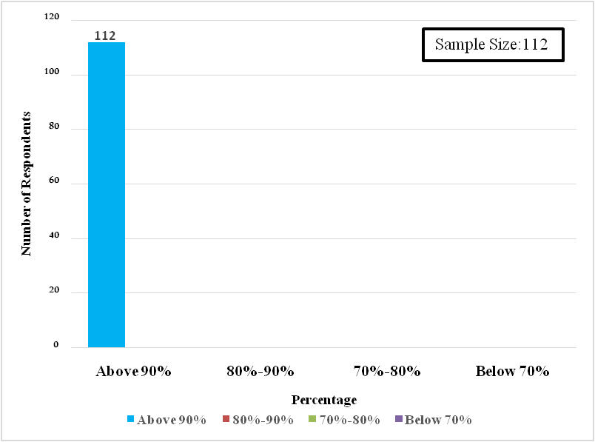
HIPAA Compliance Awareness Assessment Result for Support Employees
Score Range | No of Respondents
Above 90% | 112
80%-90% | 0
70%-80-% | 0
Below 70% | 0
Note: The result of the study group was grouped into four sections based upon respondents score

Slide 15
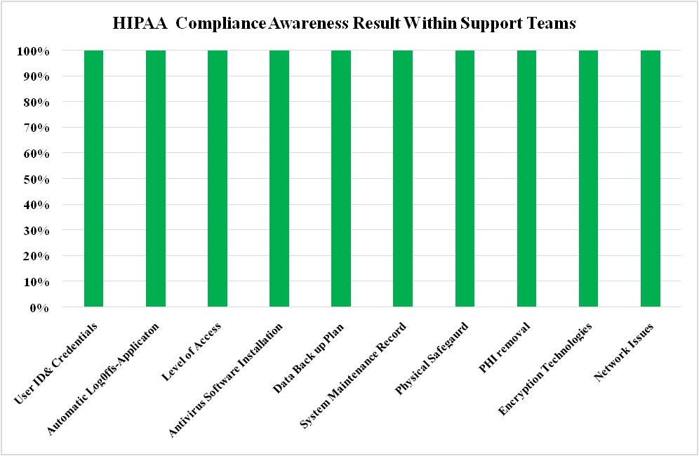
HIPAA Compliance Awareness Assessment Result for Support Employees

Slide 16
Current Organizational Security Measures
Clear Desk And Clear Screen Policy
  No PHI information should be left lying in the work areas or left displayed on the screen when not in use
Designated HIPAA Compliance officer in the organization
No support staff is allowed access to production systems without successful completion of the HIPAA course. In addition this course has to be taken every year to maintain access to production systems.
Audit Trails for network/application access
Security cameras at every entrance/exit
User id and password dependent VPN and application authorization
Access management- no tail gaiting; only RFID authorized entry’s in work areas
Security X ray scanners at organization entrance to identify any unauthorized movement of systems, LAN’s, storage devices etc.

Slide 17
Conclusion
Every Healthcare organization must address HIPAA compliance requirements in terms of their unique business goals and technical environment.
The organization offers the highest security standards to meet the stringent demands of all types of healthcare data interfaces and data transmissions.
Every project resource should go for Induction programme on awareness of HIPAA and periodically knowledge check on same.
Every organization must conduct annual HIPAA compliance audit and if any gaps are found, remedial measures should be taken to ensure that these gaps are not repeated. This may also involve periodic process changes across the entire organization.
Audit should also be conducted for the various business associates of the organization to ensure compliance.

Slide 18
Thank You

