Slide 1



Dissertation Presentation
"Digitalization of Health Records in India: Needs, Current Scenario, and Challenges – A Narrative Review”
Presented by: Vivek Chaudhary
Enroll No.: PG/23/127
Mentored by: Dr Archana Thakur

Slide 2

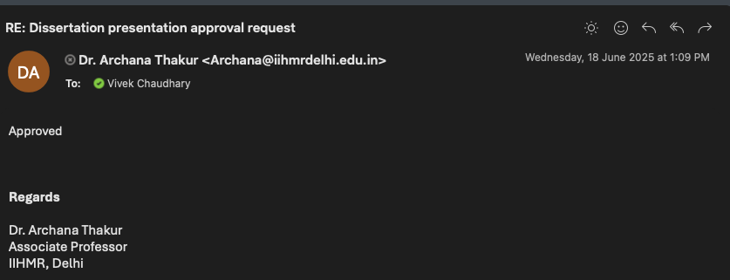
Mentor Approval

Slide 3
Introduction
India's healthcare system has historically relied on paper-based records, which are often fragmented, poorly maintained, and lack continuity of care. Recognizing the need for an integrated digital health ecosystem, the Indian government launched flagship initiatives like the Ayushman Bharat Digital Mission (ABDM) and the National Digital Health Blueprint (NDHB). The digitization of health records is central to these initiatives and aims to create longitudinal Electronic Health Records (EHRs) that are accessible, secure, and interoperable across providers

Slide 4
Review of Literature
Global History of EHRs
Year/Period | Development | Key Highlights
1960s | Early Concepts | First medical record systems appeared in U.S. academic hospitals (e.g., Problem-Oriented Medical Record by Dr. Lawrence Weed). Systems were large, costly, and institution-specific.
1970s–1980s | Development in Western Nations | VistA (U.S. VA Health System) and systems in the UK and Europe developed. Focus was on inpatient care, billing, and administration. Mostly siloed systems.
1990s | Start of Commercial EHR Market | Vendors like Cerner, Epic, and McKesson emerged. HL7 standards were introduced for interoperability. Adoption started in private hospitals and clinics.
2000s | Government Pushes for Adoption | U.S. launched Health Information Technology for Economic and Clinical Health (HITECH) Act (2009), offering incentives. UK launched NPfIT (later dismantled). Countries like Australia and Canada created national EHR platforms.
2010s | Global Expansion and Integration | EHRs became widespread in developed countries. Focus shifted to patient portals, telehealth integration, data analytics, and interoperability (e.g., FHIR standards).
2020s | AI & Cloud-Based EHRs | Post-COVID, EHRs are being integrated with AI tools, remote monitoring, blockchain, and cloud platforms. Emphasis on patient-centered care, privacy, and real-time accessibility. LMICs began adopting EHRs through open-source platforms (e.g., OpenMRS, Bahmni).

Slide 5
Review of Literature
Evolution of EHRs in India
Period | Development in India | Key Highlights
Pre-2000s | Paper-based Systems | Hospitals and clinics relied entirely on manual records. No standard digital infrastructure.
Early 2000s | Isolated Digital Systems | Private hospitals like Apollo, Fortis started using basic hospital management systems (HMS). No nationwide strategy.
2013 | First EHR Standards Published | Ministry of Health and Family Welfare (MoHFW) released EHR Standards for India (v1.0) based on HL7 and SNOMED CT to promote interoperability.

Slide 6
Methodology
Study Design: Narrative review of peer-reviewed articles (PubMed, PMC) and government sources.
Inclusion: Post‑2016 India-specific studies and official NDHM/ABDM documentation.
Exclusion: Pre‑2016 or non-governmental/non-peer-reviewed sources.
Search Strategy: Boolean searches (“EHR” OR “digital health”) AND “India” in PubMed/PMC; inclusion of PMC’s government data portals like ABDM FAQs and certification pages.

Slide 7

Objectives
To assess the need for digital health records in India's healthcare ecosystem.
01
To examine the current initiatives and implementation status of digital health records.
02
To identify the key challenges and gaps in the adoption and scalability of EHR systems.
03
To recommend solutions for wider adoption, data security, and user engagement.
04

Slide 8
Results
Objective 1: Assess the Need for Digital Health Records
Study Author, Year | Design | Setting | Population | Sample Size | Key Findings | Reference
Srivastava et al., 2024 | Cross-sectional survey | Primary care clinics, India | Physicians | 200 consultations | 45% visits lacked patient history; EHRs improved prescribing accuracy by ~27% | Journal of Public Health Informatics
Verma et al., 2024 | Hospital registry audit | 18 district hospitals | Chronic care patients | ~3,500 records | 35% missed follow-ups due to inaccessible records | BMC Health Services Research
Chatterjee et al., 2020 | Policy & ethical review | National policy review, India | Legal frameworks | N/A | Highlighted inadequate consent procedures and privacy protections | Indian Journal of Medical Ethics

Slide 9
Results
Objective 2: Examine Current Initiatives & Implementation Status
Study / Source, Year | Design / Type | Setting | Population / Facilities | Sample Size / Scope | Key Findings | Reference
ABDM Dashboard (MoHFW), 2024 | National implementation report | India-wide | National population & facilities | 67 crore ABHA IDs; 1.3 lakh facilities; 42+ crore records | Significant digital footprint via ABDM (drishtiias.com, swachhindia.ndtv.com, in.investing.com, reddit.com, reddit.com) | MoHFW Press Release
MoHFW NDHB, 2020 | Policy framework document | National | System architecture | N/A | Defined 5 foundational blocks: IDs, registries, consent, etc. | NDHB Blueprint 2020
Singh et al., 2022 | National hospital survey | 90 hospitals across India | Hospital administrators | 90 hospitals | Only 39% had fully functional EHR systems | Health Informatics Journal
eSanjeevani statistics, 2023 | Service uptake data | National telemedicine program | Teleconsult users | 14 crore+ consultations | Indicates growing digital health readiness | eSanjeevani Portal

Slide 10
Results
Objective 3: Identify Challenges & Gaps in Adoption & Scalability
Study / Source, Year | Design / Type | Setting | Population / Facilities | Sample Size / Scope | Key Findings | Reference
ABDM Dashboard (MoHFW), 2024 | National implementation report | India-wide | National population & facilities | 67 crore ABHA IDs; 1.3 lakh facilities; 42+ crore records | Significant digital footprint via ABDM (drishtiias.com, swachhindia.ndtv.com, in.investing.com, reddit.com, reddit.com) | MoHFW Press Release
MoHFW NDHB, 2020 | Policy framework document | National | System architecture | N/A | Defined 5 foundational blocks: IDs, registries, consent, etc. | NDHB Blueprint 2020
Singh et al., 2022 | National hospital survey | 90 hospitals across India | Hospital administrators | 90 hospitals | Only 39% had fully functional EHR systems | Health Informatics Journal
eSanjeevani statistics, 2023 | Service uptake data | National telemedicine program | Teleconsult users | 14 crore+ consultations | Indicates growing digital health readiness | eSanjeevani Portal

Slide 11
Results
Objective 4: Recommend Solutions for Adoption, Security & Engagement
Author / Source, Year | Design / Type | Focus Area | Target Audience | Evidence / Scope | Key Recommendations | Reference
ABDM Policy Guidelines, 2023 | National policy | Health system architecture | Government & implementers | N/A | Federated model, consent-based sharing, open APIs | ABDM Guidelines
Dutta & Bain, 2025 | Quantitative platform review | Open-source EHR alignment | EHR platforms | 10 systems analyzed | OpenEMR covers ~73.8% of national EHRMDS | arXiv (reddit.com, arxiv.org)
World Bank, 2022 | Advisory report | User engagement | LMIC health systems | N/A | Promote open APIs, training, multilingual patient tools | Digital-in-Health Report
Gupta et al., 2023 | Programmatic strategies | Patient engagement | Clinicians & patients | N/A | Suggest gamified patient portals, dashboards, reminders | Health Tech Policy Journal
NITI Aayog Health Data Policy, 2020 | Framework document | Security & privacy | Policy makers | N/A | Recommend encryption, audit logs, role-based access | NITI Framework

Slide 12
Discussion
The need for digitalization of health records in India arises from significant systemic challenges such as fragmented care, lack of continuity in treatment, and frequent duplication of diagnostic tests, all of which compromise patient outcomes and increase healthcare costs.
Electronic Health Records (EHRs) offer a unified platform to store, retrieve, and share patient information seamlessly across various levels of care, enhancing coordination and clinical decision-making.
However, the implementation of EHRs remains uneven—while urban and corporate hospitals have made notable progress due to better infrastructure and investment, public healthcare systems continue to lag behind, primarily because of limited funding, inadequate IT infrastructure, and insufficient training of healthcare professionals.
Bridging this digital divide is crucial to ensure equitable and efficient healthcare delivery across the country.

Slide 13
Challenges
Infrastructure: Limited internet connectivity and power in remote areas
Workforce Training: Digital literacy among healthcare workers is low
Data Privacy & Security: Regulatory gaps and patient consent management are concerns
Interoperability: Disparate vendor systems hinder data sharing

Slide 14
References
Ministry of Health and Family Welfare. Electronic Health Record (EHR) Standards for India [Internet]. New Delhi: Government of India; 2016 [cited 2025 Jun 18]. Available from: https://main.mohfw.gov.in
National Health Authority. Ayushman Bharat Digital Mission Blueprint [Internet]. New Delhi: Government of India; 2021 [cited 2025 Jun 18]. Available from: https://abdm.gov.in
NITI Aayog. National Digital Health Blueprint. New Delhi: Government of India; 2019.
Centre for Development of Advanced Computing (CDAC). EHR Implementation Guide for Indian Hospitals. Pune: CDAC; 2020.
Sharma S, Bansal R. Adoption of Electronic Health Records in Government Hospitals in India. Indian J Public Health Inform. 2022;13(1):22–7.
Srivastava SK. Adoption of Electronic Health Records: A Roadmap for India. Healthc Inform Res. 2016;22(4):261.
Janarthanan V, SK M, Nagrale NV, Singh OG, Raj KV, Janarthanan V, et al. Legal and Ethical Issues Associated With Challenges in the Implementation of the Electronic Medical Record System and Its Current Laws in India. Cureus [Internet]. 2024 Mar 20 [cited 2025 Jun 18];16(3). Available from: https://www.cureus.com
Taneja D, Kulkarni SV, Sinha S, Dindigal RN. Digital Technology in Hospital Administration: A Strategic Choice. J Assoc Physicians India [Internet]. 2023 Oct [cited 2025 Jun 18];71(10):83–8. Available from: https://www.japi.org

Slide 15
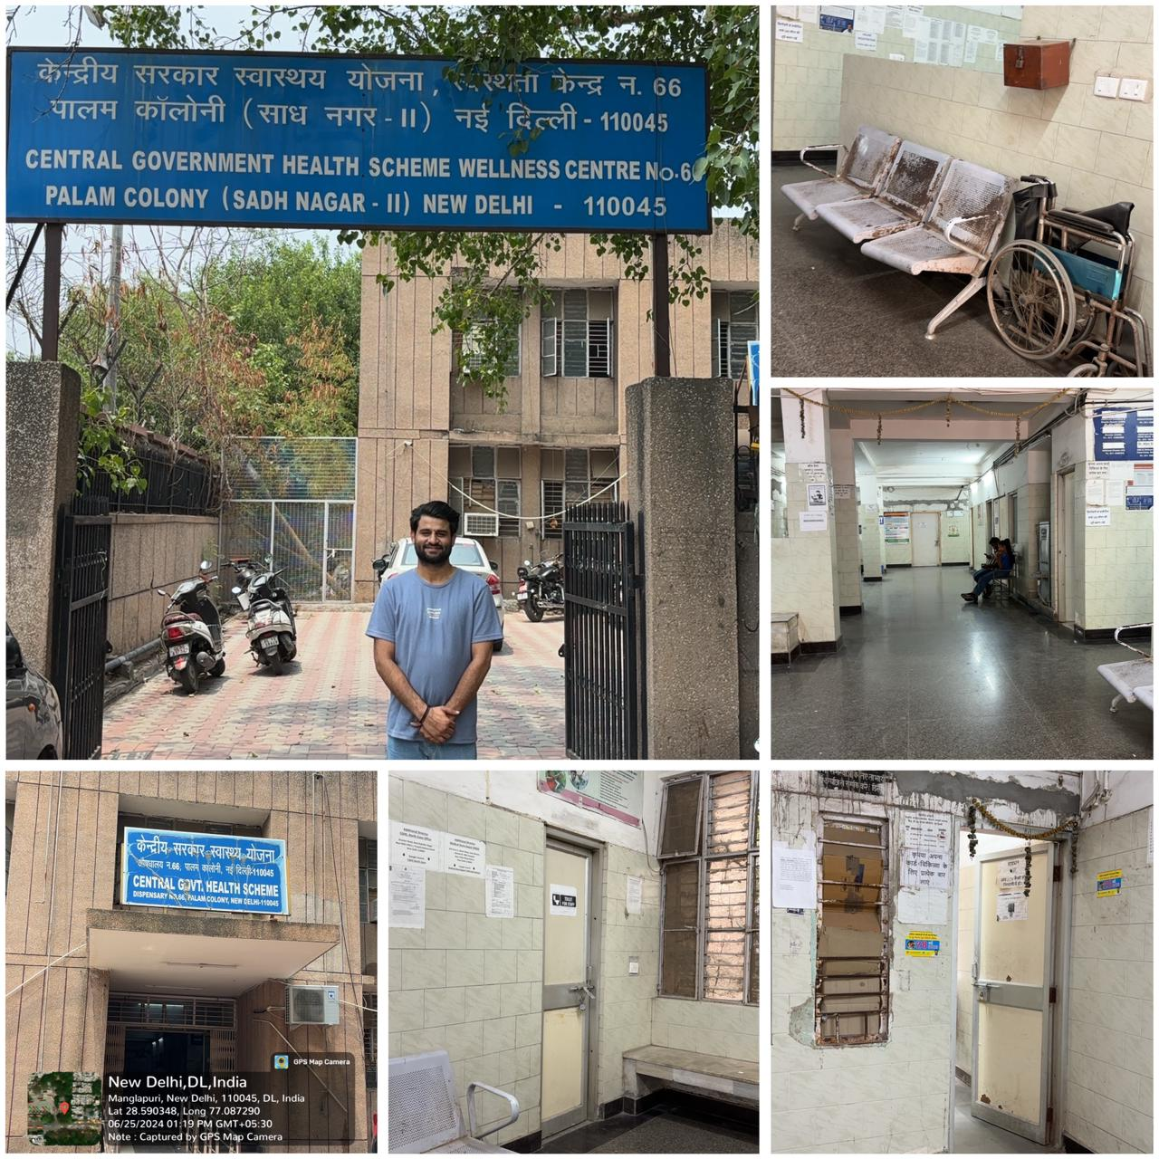
Health And Wellness Center
Findings:
Human Resources - 1 CMO
1 doctor
1 pharmacist
2 guards
Diagnostic – 1 X-ray room, 1 Biochemistry Lab
Recommendation: The infrastructure requires more attention and investment to support the existing human resources and diagnostic facilities effectively.

Slide 16
Thank You

