Slide 1

Analysis of the data collected through Mobile HealthCare Units Using Management Information System for the assessment of health status of Population of India.
Akshay
MIS Officer HelpAge India
PG/17/005

Slide 2
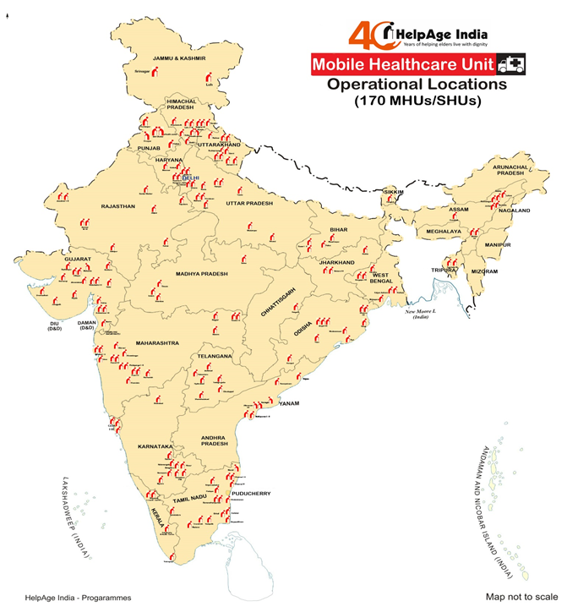
HelpAge India
A leading nationwide organization working with and for the elderly in India for over 40 years.
It protects advocates strongly for their cause their rights, focusing on issues such as pensions, health care, social inclusion etc.
It runs age care programs throughout the country.
It also advises & facilitates the government in policy formation.
1920 community locations in 24 states covering nearly 23.25 lakh Beneficiaries
170 MHUs

Slide 3
What is a Mobile Health Care Unit ?
It brings healthcare to the door steps
Each MHU vehicle in HI is managed with a qualified doctor, pharmacist and a social worker.
Medicines & treatment are dispensed free of cost.
Mobile Medical Units have helped mobilize healthcare to conduct screenings, basic diagnosis.
Regardless of the difficult terrain, low connectivity, or institutional barriers, medical care can be made available to people across socio-economic groups, with minimum expenditure and relatively lesser operations and management responsibilities, as compared to those required by fully functional hospitals.

Slide 4
Mobile HealthCare Unit- Features
Medical consulting
Drug dispensation
Basic diagnostic support
Referral to secondary & tertiary health service providers
Multi-speciality health camps
Health awareness
Community counselling
Linkages with health schemes, social security pension schemes and for cataract operations
Home visits
MHU TEAM
SOCIAL PROTECTION OFFICER (SPO)
DOCTOR (MBBS)
PHARMACIST
DRIVER CUM COMMUNITY WORKER

Slide 5
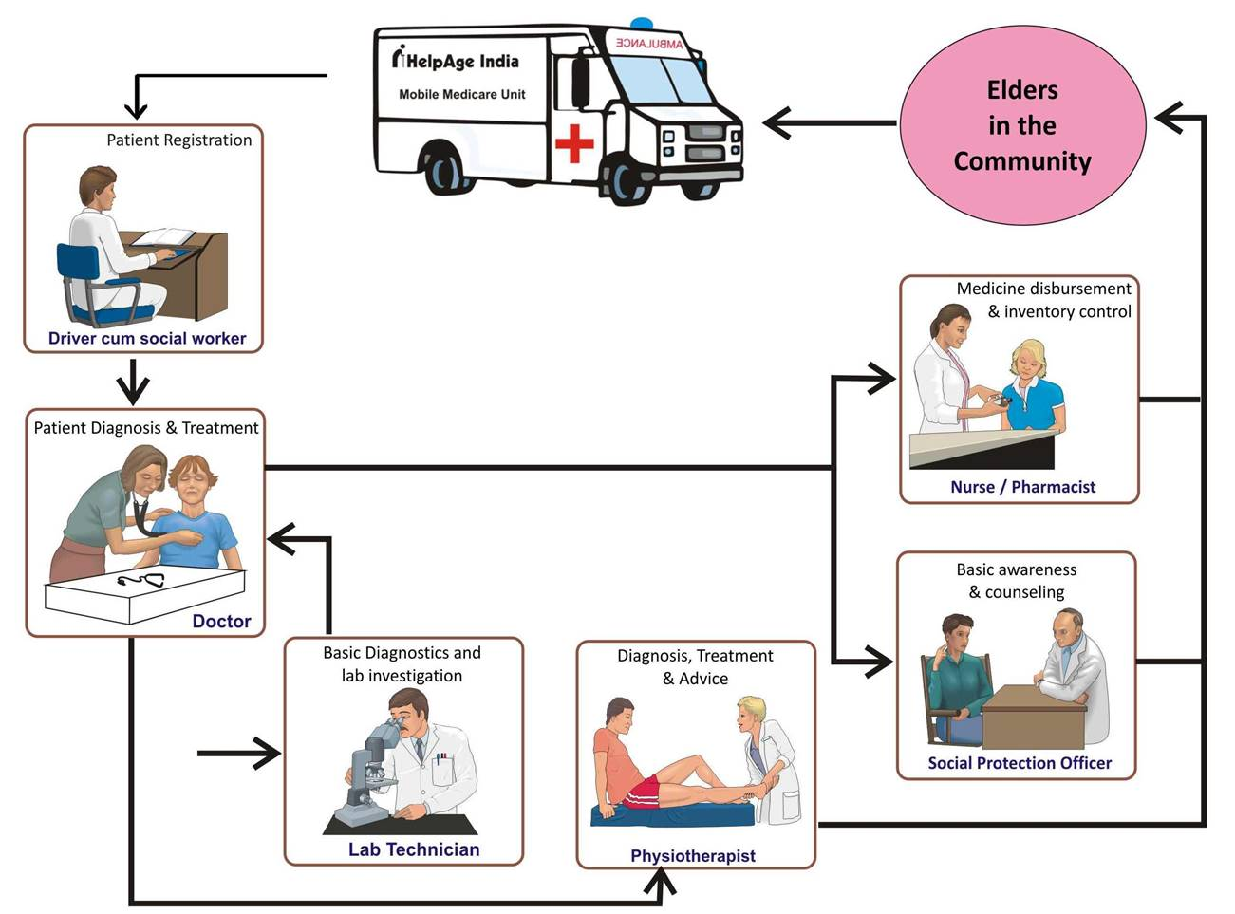
Mobile Health Care Unit Flow

Slide 6
Rationale
Analyzing the health status of the population across various MHU served locations would help in identifying the disease pattern variations which would guide in:
Efficient resource utilization
Minimizing wastage
Avoid duplication of efforts
Preventing shortage of resources/stock-outs
Better awareness and treatment planning

Slide 7
AIM & Objective
AIM:
To analyse the disease pattern among fifteen MHU (HelpAge India) served Sites of India
Objective(s):
To assess the status of the population on five major health issues at fifteen MHU (HelpAge India) served districts of India for the year 2018-19
To develop an efficient disease classification system used for data analysis at HelpAge India
To understand the impact of MHU at regular sites

Slide 8
Methodology
Type of Study: Descriptive, Cross-sectional study
Study Population: All MHU beneficiaries in fifteen MHU (HelpAge India) served Sites of India
Sampling:
Sample Size- 3555496
Sampling Method- Purposive Sampling
Duration of Study: February 2019– April 2019
Type of Data : Secondary (Quantitative, Qualitative)
Source of Data: MIS database of HelpAge India

Slide 9
Methodology
Means of Data Collection:
MIS database of all MHU’s serving in the fifteen districts of India. All treatments/beneficiaries reported at the MHU site, were included. The data definite to this study was gleaned from the disease pattern of the areas covered under the MHUs.
Data Analysis Tool: MS Excel
Data Analysis Techniques: Descriptive Statistics
Bar graphs, pie chart, frequency tables, Etc were used to represent the results of this study, as and when required.

Slide 10
Locations & Health Issues
Leh
Gurdaspur
Rohtak
Kawai
Dewas
shamshabad
Bangalore
Vizhinjam
Borholla
Jorhat
Silchar
Muzaffarpur
Agra
Kawai
Udaipur
Radhanpur
Health Issues
Osteo-Arthritis/Joint Pain/ Rheumatoid Arthritis
Diabetes Mellitus
Hypertension
Respiratory Disorder
GI Disorder

Slide 11
Results

Slide 12
Results
GI Disorder was maximum in May where as minimum in Feb,
Overall the disease’s are under control due to the MHU intervention,
The reason for high disease out put seen in march can be because of the high no. of patients OPD, addition of Rain shadow Health Camps.

Slide 13
Results
A drastic change can be seen when we compare the graph, East from West & North from South.
Osteo-Arthritis/Joint Pain/ Rheumatoid Arthritis, Diabetes Mellitus are the 2 health issues which are prominent & can be seen in all parts of India.
Diabetes is majorly seen in South
In major change, Central & West India has the most cases
East:- the minimum cases of Respiratory dis-order,
For hypertension Leh & Jorhat has the maximum cases, which is very high as compared to that of other 13 location’s

Slide 14
Results
Female population is more exposed as compared to male population,
For Arthritis & GI Disorder, A high increase can be seen from 9% to 14% each

Slide 15
Results
A detailed study of Rohtak was done for the period of 4 year, for 15 separate disease’s
This show the MHU intervention has help control the Disease under the selected MHU,
The drastic change can be seen in almost all the diseases.
Health issues like Disability & Endocrine show that the MHU has targeted a new set of patients in the last FY

Slide 16
Conclusion
Due to Geographic & cultural Difference a change in trend was seen, & preventive action like awareness camp’s can be planned according to it at site & rain shadow area’s
For curative care, the resource distribution can be improved keeping in view the pattern.
More over a depth study can be done for seasonal disease & health issues.

Slide 17
Recommendation
Location Wise:-
Location | Recommendation
Borholla | East has a very high no. of Hypertension, MHU should be prepared for the medication, & more over provide awareness/screening camps in rain shadow area's
Jorhat
Muzaffarpur
Silchar
Agra | Awareness about Arthritis , Respiratory & GI Disorder should be done in Agra & rain shadow area, more over the Respiratory Disease are seen more in North which could be due to the pollution,
Gurdaspur
Leh
Rohtak
Bangalore | As we move towards South the % of disease increase, that could be highly due to the cultural & geographic Factor , MHU need to be prepared for challenges like this.
Shamshabad
Vizhinjam
Dewas | North & west India has the maximum no. of Arthritis patients & Respiratory Disorder, Possible reason could be the Pollution because of crop burning. Distribution of Face mask can help control respiratory issues.
Kawai
Radhanpur
Udaipur
Generation of UBID
Note:-Further a more Depth Study need to be done to get a more clear picture.

Slide 18
Limitation
UBID was not allotted to the patients So no individual Health status can be recorded.
This was a study from the secondary data, A more intense research can be carried with the primary data.
Difference in sample size from each location each month.

Slide 19
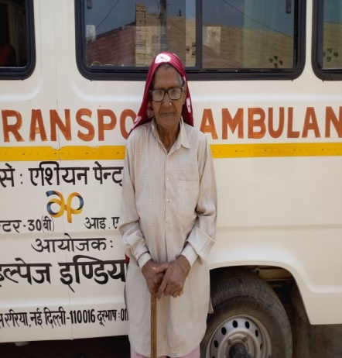
Case Study, Rohtak
Ms. Dharmo, Paksma village
A widow living with her family having two sons.
First Contacted on 20th January 2017.
Complained about joint pain, constipation, severe cough and Asthmatic problem,
Addictions- smoking .
Was undergoing treatment from Primary Health Centre in village.
Medication:-
Tab Deriphylline 300mg
Tab Salbutamol 2mcg
cough Syrup
Diclofenic gel
Tab Ibrufen
Calcium
Biscodyl
Preventive measures prescribed:-
Quit Smoking
Adopt healthy food habits
Current Health Status
Relief in Asthmatic, joint pain and constipation problem, able to walk without severe pain.

Slide 20
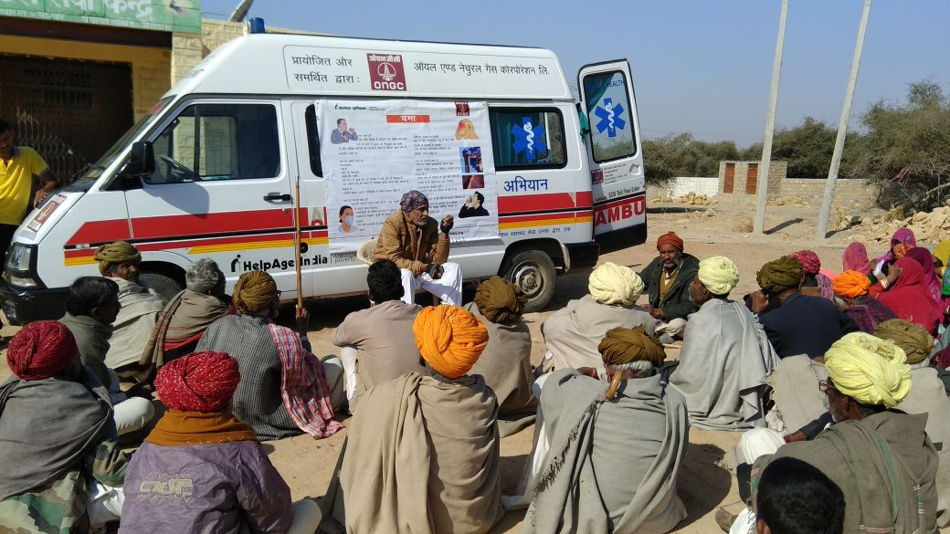
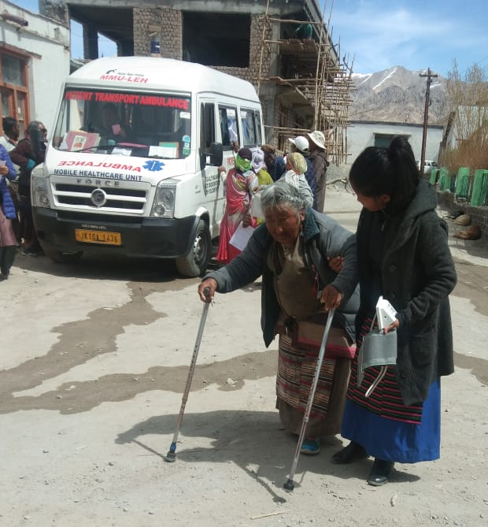
Thank You.
Any Question?

