Slide 1
Dissertation Report
Presentation
Submitted to:
Dr. S. K. Patel
Assistant Professor
Submitted by:
Vishal Kataria
PG/09/060
New Delhi

Slide 2
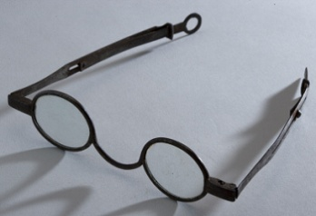
Reflection From Internship
CHP: Center for Human Progress, New Delhi
Duration
Work Allocated
- Qualitative and Quanitative Analysis
- Report Writing and Documentation
- Training of FSWs on various issues
- Field Work
Specific Learning
Understanding of Various Right related issues of Transgender, FSWs and unorganized sector.
Understanding different aspects of Health care and Social Research.
Report writings skills.

Slide 3
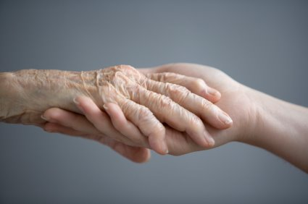
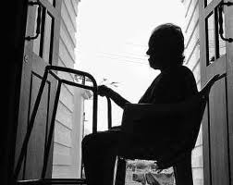
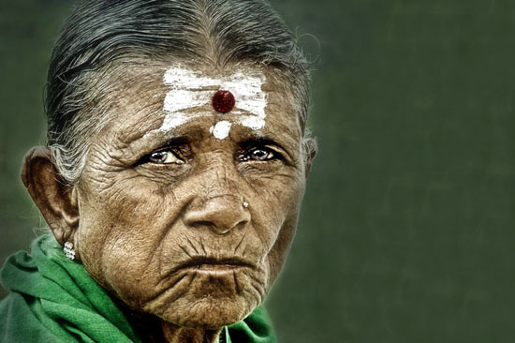
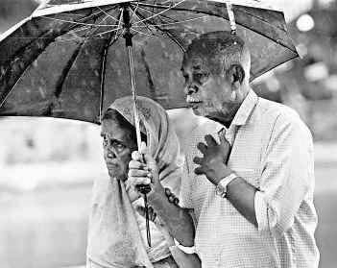
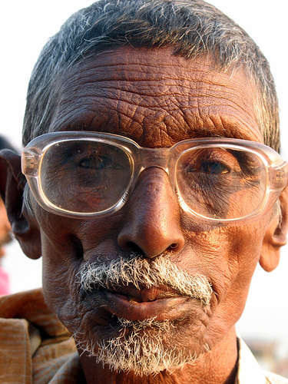
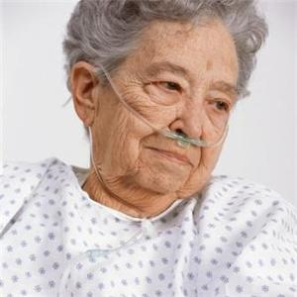
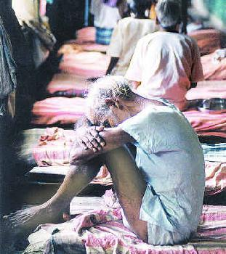
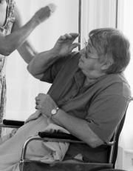
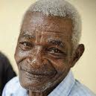
“A Study of Health Problems, Elder Abuse, Care and Support among Elderly in West Delhi”
Presented By:
VISHAL KATARIA

Slide 4
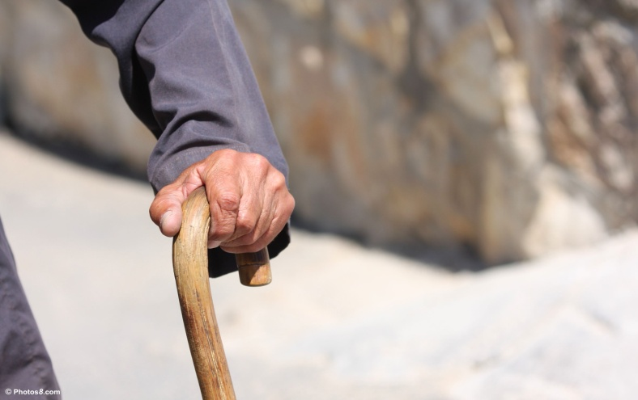
Introduction
Old age term arises scenario like frustration and pity, sickness and poverty, despair and senility, warmth and responsibility.
Ageing is a biological process and experienced by the mankind in all times.
The crude reality of the ageing scenario in India is that there are 77 million older persons in country, and the number is growing to grow to 177 million in another 25 years.

Slide 5

Rationale of the Study
Why Elder’s Problem?
Suffering from multiple physical, psychological, economical, social, and existential problems
India’s Health Program and policies
Why Delhi?
West Delhi population- 21, 28,908
Including 5% of elderly population.
Almost 60-70% elders face abuse in Delhi
WHY

Slide 6
Research Objectives
General Objective:
The main objective of the study is to analyze health and social problems of elderly as well as their family and community support systems in West Delhi.
Specific Objectives:
To study the socio-economic status of the elderly in West Delhi.
To study the elder abuse and health problems faced by the elderly in West Delhi.
To assess the physical and moral support rendered by the family members and community to the elders in West Delhi.
To assess the level of knowledge and benefits received from various welfare and health insurance schemes by the elderly in West Delhi.

Slide 7
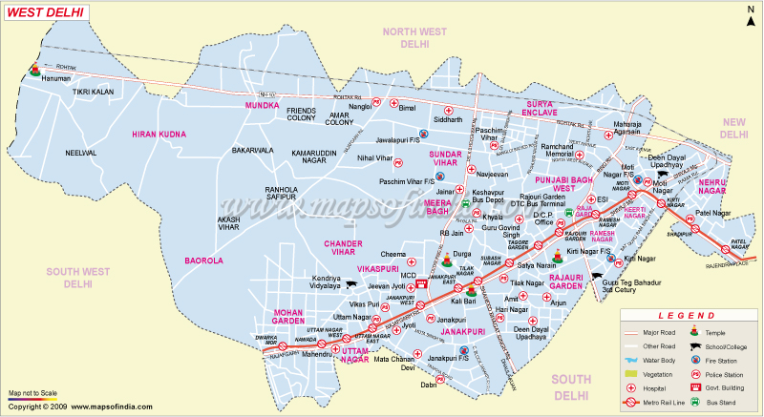
Data and Method
Study Design
- Quantitative Methodology
- Structured Questionnaire Based Study
Sample Population
- West Zone of Delhi State
- Sample of 242 Respondents
Data Collection and Analysis
- Eligible Respondents were interviewed
- Data entering and Analysis was carried out in Cs-pro and SPSS

Slide 8
Study Findings: Socio Demographic Profile
CHARACTERISTICS | TOTAL
SEX
Male | 104 (43.0)
Female | 138 (57.0)
AGE DISTRIBUTION
60-64 Years | 122 (50.4)
65-69 Years | 77 (31.8)
>= 70 Years | 43 (17.8)
Mean Age (Years) | 66.58
MARITAL STATUS
Currently Married | 77 (31.8)
Divorced/Separated/widow/widower | 165 (68.2)
TOTAL N | 242 (100.0)
CHARACTERISTICS | TOTAL
EDUCATIONAL ATTAINMENT
Illiterate | 212 (87.6)
Literate | 30 (12.4)
RELIGION
Hindu | 212 (87.6)
Muslims/Sikh/ Christian | 30 (12.4)
CASTE
SC/ST | 105 (43.4)
OBC | 96 (39.7)
General | 41 (17.0)
MEAN NO. OF CHILDREN
Children | 4.46
Son | 2.33
Daughter | 2.12
TOTAL N | 242 (100.0)

Slide 9
Study Findings: Socio-economic Profile Cont….
Characteristics | Male | Female | Total
CURRENTLY LIVING STATUS
Son/Daughter | 67 (64.4) | 80 (65.2) | 157 (64.9)
Spouse | 16 (15.4) | 07 (5.1) | 23 (9.5)
Alone | 19 (18.3) | 31 (22.5) | 50 (20.7)
Domestic Help workers/Others | 02 (2.0) | 10 (7.2) | 12 (5.0)
TOTAL N | 104 (100.0) | 138 (100.0) | 242 (100.0)
REASONS FOR NOT LIVING WITH SON/DAUGHTER
No support from children | 16 (43.2) | 17 (35.4) | 33 (38.8)
Children working/living in another place | 08 (21.6) | 20 (41.7) | 28 (32.9)
Have no children | 10 (27.0) | 09 (18.8) | 19 (22.4)
Health problem | 03 (8.1) | 02 (4.2) | 05 (5.9)
TOTAL N | 37 (100.0) | 48 (100.0) | 85 (100.0)

Slide 10
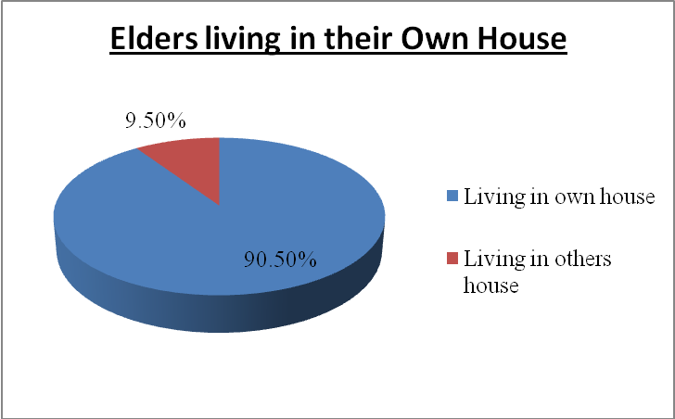
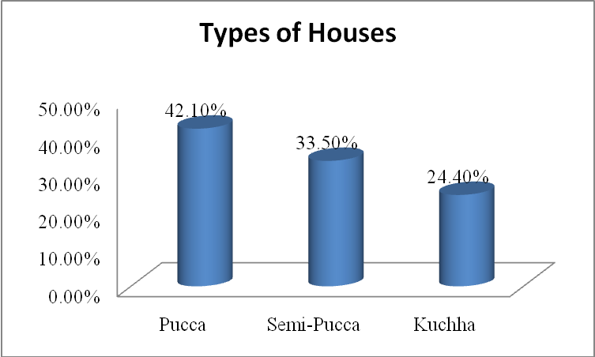
Monthly Household Income (in Rs) | ALL (%)
Less than 2500 | 36.1
2501- 5000 | 32.3
More than 5000 | 19.1
Can’t say/ Don’t know | 11.0
Mean (in Rs) | 4381
Total N | 242
Source of Income | Total
Contributory pension | 48 (19.8)
House rent | 17 (7.0)
Business | 6 (2.5)
Remittance from children | 126 (52.1)
Interest on Savings and Fixed Deposits | 12 (5.0)
No Income source | 33 (13.6)
Total N | 242 (100.0)

Slide 11
Study Findings: Cont….
 | Male | Female | Total
Dependency on Financial requirements | 69 (66.3) | 88 (63.8) | 157 (64.9)
TOTAL N | 104 | 138 | 242
On whom do you depend?
Son | 76.8 | 78.4 | 77.7
Daughter | 24.6 | 33.0 | 29.3
Son-in-law | 5.8 | 9.1 | 7.6
Daughter-in-law | 30.4 | 26.1 | 28.0
TOTAL N | 69 | 88 | 157
Dependency at time of bad health condition | Male | Female | Total
Son/Daughter | 70.2 | 70.3 | 70.2
Daughter-in-law | 49.0 | 43.5 | 45.9
My Self | 46.2 | 35.5 | 40.1
TOTAL N | 104 | 138 | 242

Slide 12
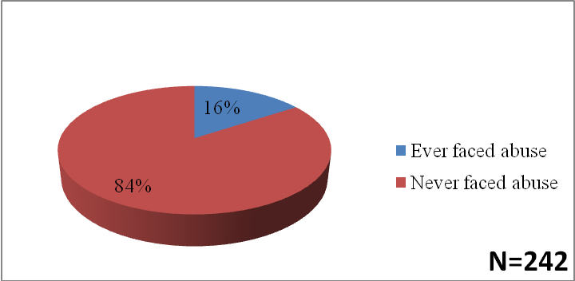
Study Findings: Cont….
Dependency for daily routine activity | MALE | FEMALE | TOTAL
Son/Daughter | 52.9 | 54.3 | 53.7
Daughter-in-law | 52.9 | 42.8 | 47.1
My Self | 52.9 | 47.1 | 49.6
TOTAL N | 104 | 138 | 242
Kind of abuse faced
Percentage of elders who Faced Abuse
Kind of abuse faced | Male | Female | Total
Physical Abuse | 18.8 | 9.1 | 13.2
Verbal Abuse | 100.0 | 77.3 | 86.8
Neglect | 12.5 | 22.7 | 18.4
TOTAL N | 16 | 22 | 38

Slide 13
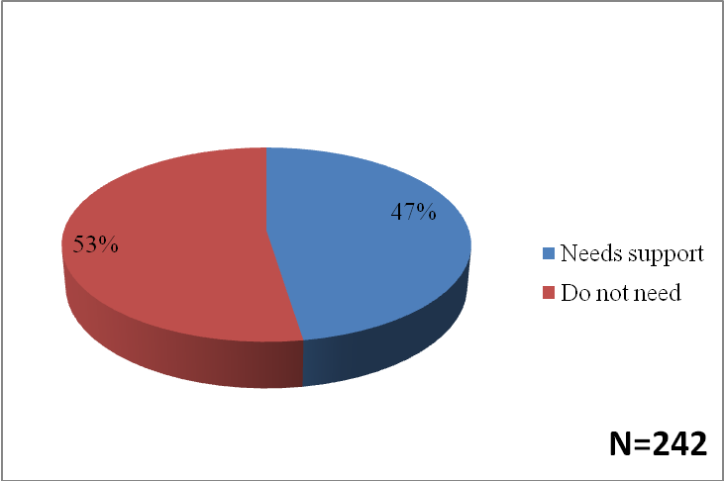
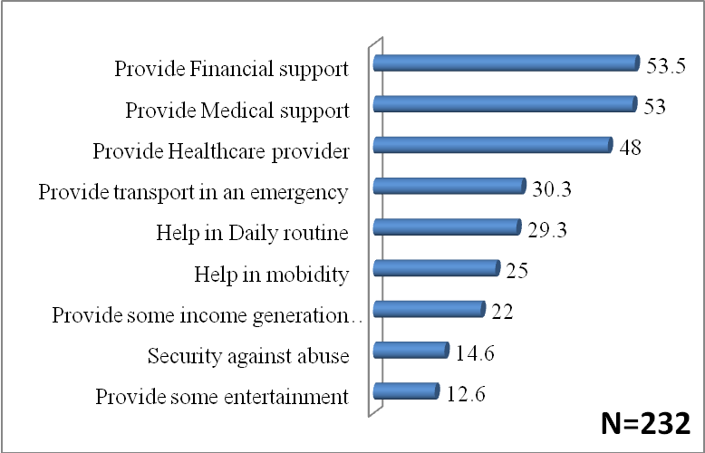
Study Findings: Cont….
Needs of the elders | MALE | FEMALE | TOTAL
Health Care/ Separate Hospital/ Free Treatment | 100.0 | 100.0 | 100.0
Financial Aid/ Pension Scheme/ Free Travel Pass | 100.0 | 100.0 | 100.0
Social security/ House Facility | 45.2 | 47.1 | 46.3
TOTAL N | 104 | 138 | 242
Percentage of elders who Needs Support from Community

Slide 14
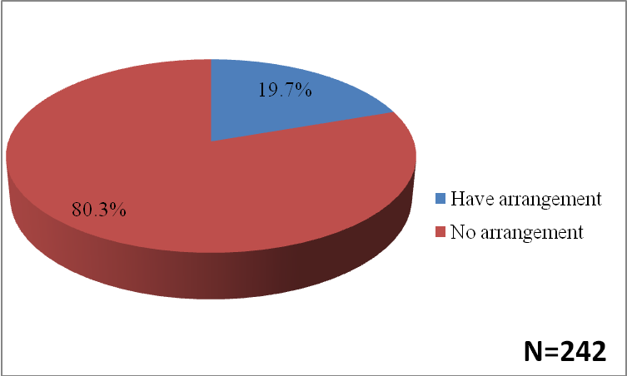
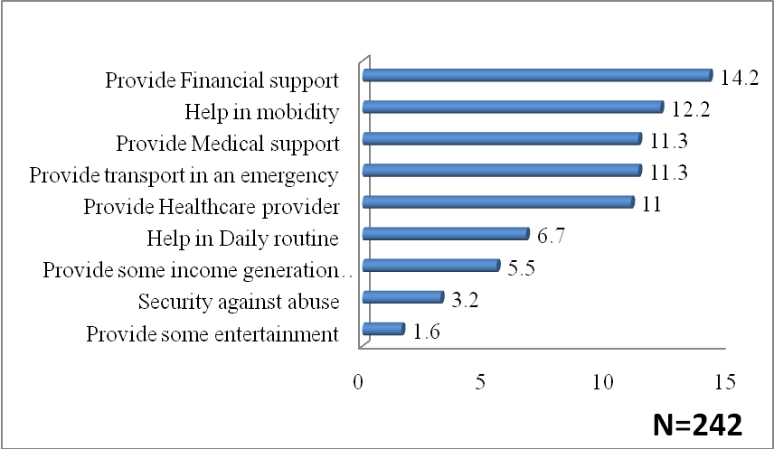
Study Findings: Cont….
Community have Arrangement for Elderly
in Case of Need Reported by elders
Community have Arrangement for Elderly
in Case of Need Reported by elders

Slide 15
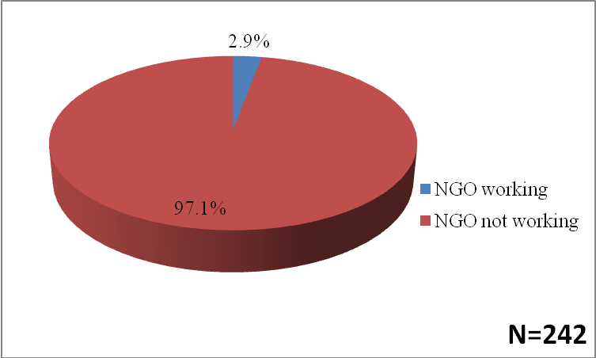
Study Findings: Cont….
Percentage of elders who Reported NGO is Working in their Areas for elders
Health Status of elders | Male | Female | Total
Good | 17 (16.3%) | 19 (13.8%) | 36 (14.9%)
Average | 35 (33.7%) | 42 (30.4%) | 77 (31.8%)
Poor | 36 (34.6%) | 52 (37.7%) | 88 (36.4%)
Very poor | 16 (15.4%) | 25 (18.1%) | 41 (16.9%)
TOTAL N | 104 (100.0%) | 138 (100.0%) | 242 (100.0%)

Slide 16
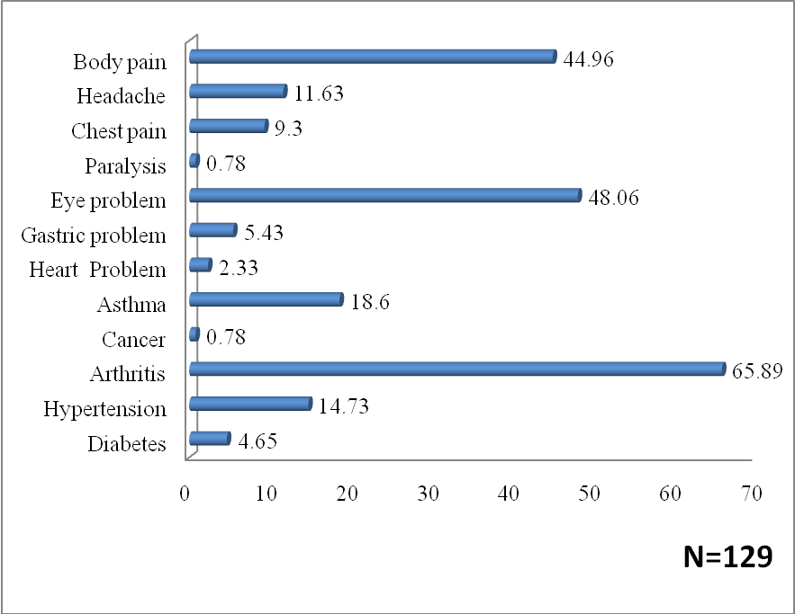
Study Findings: Cont….
Utilization of Health Facility for elders | Male | Female | Total
Govt. Health Facility | 49 (47.1) | 87 (63.0) | 136 (56.2)
Pvt. Health facility | 21 (20.2) | 28 (20.3) | 49 (20.2)
RMP/Traditional Healer | 34 (32.7) | 23 (16.7) | 57 (23.6)
TOTAL N | 104 | 138 | 242
Type of Health Problem for which Taking Treatment

Slide 17
Study Findings: Cont….
Sources of Funding to Meet Health Care Expenses | Male | Female | Total
Savings | 50.0 | 40.6 | 44.6
Health insurance | 7.7 | 13.0 | 10.7
Children | 69.2 | 70.3 | 69.8
Take loan from someone | 25.0 | 24.6 | 24.8
Relatives/ Friends | 17.3 | 12.3 | 14.5
TOTAL N | 104 | 138 | 242

Slide 18
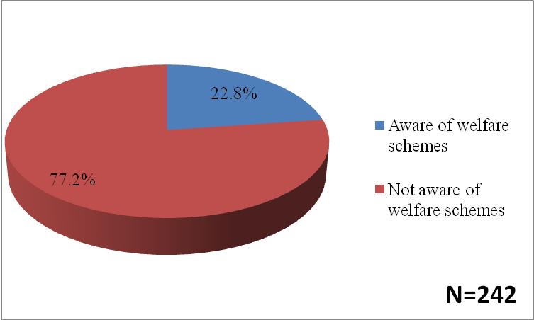
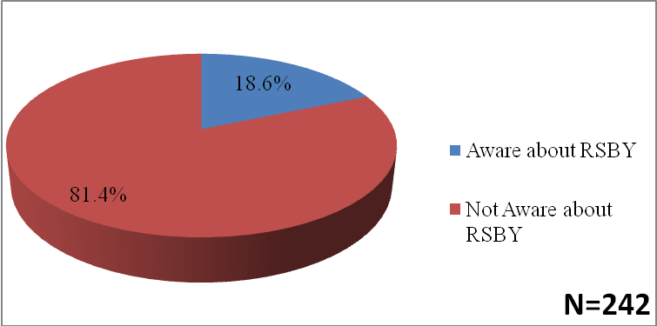
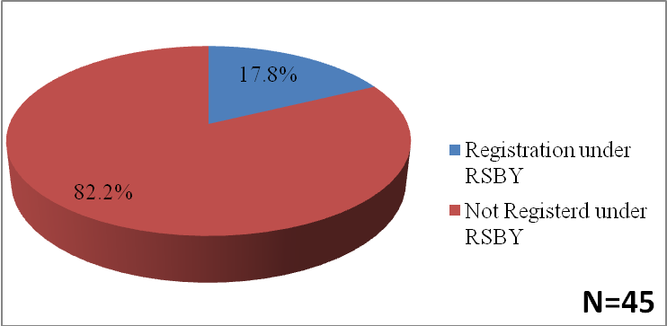
Study Findings: Cont….
Awareness among elder on welfare Schemes
Awareness of RSBY among elders
Percentage of elders Aware any welfare scheme | Total
RSBY | 45 (81.8)
Pension Yojana | 10 (18.2)
TOTAL N | 55
Registration of elders under RSBY

Slide 19
Discussion and Conclusion
The results of this study showed that a major proportion of the elderly were out of the work force, partially or totally dependent on others, and suffering from health problems with a sense of neglect by their family members.
There is a growing need for interventions to ensure the health of this group and to create a policy to meet the care and needs of the disabled elderly.
Further research, especially qualitative research, is needed to explore the depth of the problems of the elderly.

Slide 20
Recommendations
Family members need to be educated about the harms of the elder abuse.
Geriatric facilities need to be provided in hospitals and dispensaries.
Free treatment and medicines or universal health insurance coverage that covers all types of health problems of the elders.
Identification and registration under Outreach services facility for their health status, issues/ concerns.
Mobilization and community based support

Slide 21
GROWING OLD……….
Help the aged,
As one time they were just like you,
don't just put them in a home,
Give a hand and help them , if you can.
Give them hope
& comfort 'cos they're running out of time.
Help the aged
'cos one day you'll be older too
- you might need someone who can
pull you through.
So please help the aged

Slide 22
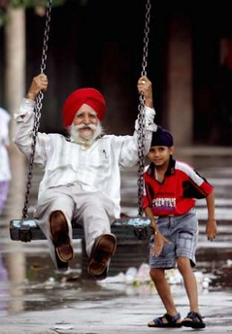
THANK YOU

