Slide 1

A Study at Max Hospital, Ghaziabad
Dr. Punit Yadav
IIHMR Delhi
Topic - “Awareness and Impact of Teleradiology in Rural Ghaziabad”

Slide 2
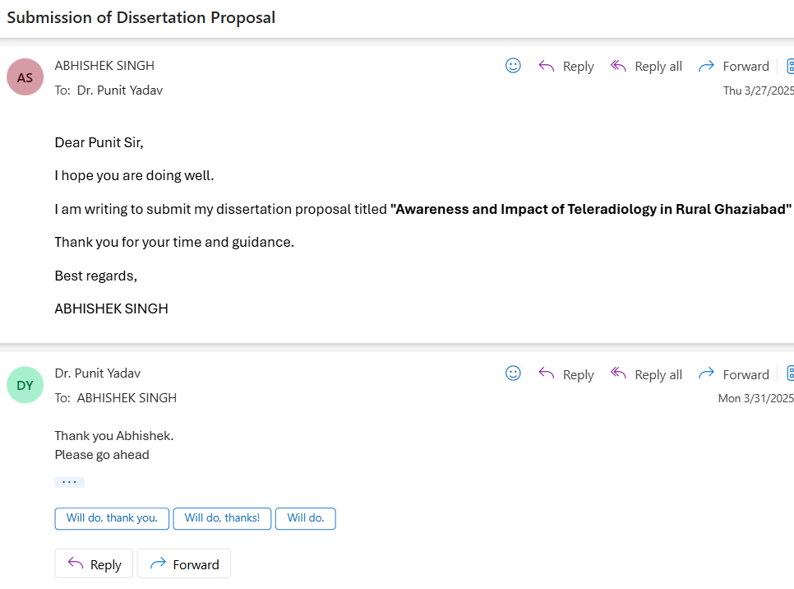
Mentor Approval

Slide 3
Introduction (1/2)
Introduction to Teleradiology in India
Teleradiology is a critical component of telemedicine, enabling the transmission and interpretation of medical images (like X-rays, CT scans, and MRIs) over distances using telecommunications technology. It offers a promising solution for bridging the gap between rural healthcare needs and the availability of specialized radiological services. With 63.4% of India’s population living in rural areas as of 2024, access to diagnostic facilities remains a major challenge. Teleradiology addresses this issue by allowing radiologists to remotely analyze medical images, facilitating timely diagnosis and treatment without the need for patients to travel long distances.
In India, where rural areas suffer from a scarcity of medical professionals and diagnostic infrastructure, the potential of teleradiology is immense. Currently, the country has only 10,000 radiologists while needing at least 20,000 to provide adequate coverage. This shortage forces patients to travel to urban centers, often delaying diagnosis and increasing treatment costs.

Slide 4
Introduction (2/2)
Radiology’s Role in Modern Medicine
Radiology plays a fundamental role in diagnosing and managing diseases. From basic X-rays to advanced CT and MRI scans, imaging helps clinicians make accurate decisions, especially in emergencies. The emergence of digital radiology in the 1980s enabled the first remote consultations. Today, teleradiology is the most widely adopted telemedicine application globally, especially in emergency care. Its value in India lies in improving rural diagnostics, reducing delays, and enabling better disease management.
The Rural Healthcare Landscape: Ghaziabad Case Study
Ghaziabad, with both urban and rural settings, exemplifies the challenges in healthcare delivery. Shortages of trained radiologists and imaging equipment like MRI and CT machines restrict quality diagnostics. The adoption of teleradiology can bridge this divide by enabling image sharing between rural centers and urban specialists. This study focuses on evaluating awareness and readiness for teleradiology in rural Ghaziabad to develop practical implementation strategies.

Slide 5
Objectives of Your Study
This study aims to evaluate the awareness and perceptions of teleradiology among residents of villages in Ghaziabad, Uttar Pradesh. It seeks to determine the extent of their understanding, their views on its potential benefits—such as reduced travel, quicker diagnoses, and improved healthcare accessibility—and their willingness to adopt this technology. Additionally, the study examines concerns regarding data security, reliability, and the absence of direct interaction with healthcare providers.

Slide 6
Methodology (1/3)
Study Design
A cross-sectional survey to evaluate knowledge and awareness if teleradiology among the general population living in the rural villages near Ghaziabad city in UP.
Study Area
The study was conducted in the villages located in near Ghaziabad, UP, India. These villages were selected due to:
Limited access to specialized healthcare services,
Challenges in accessing Radiology Services.
Absence of teleradiology initiatives.

Slide 7
Methodology (2/3)
Study Population
The target population for this study was the general adult population (aged 18 years or older than 18 years) residing in the villages, regardless of gender, education level, or occupation.
Sample Sizes
A total of sample size 402 individual participated in the study. This sample was deemed sufficient to provide a representative understanding of knowledge and awareness level within the selected villages, considering the limited population sizes of rural communities
Data Collection Protocol
Primary data was collected with the help of a questionnaire which was constructed in English as well as Hindi. The questionnaire comprised 15 questions.

Slide 8
Methodology (3/3)
Data Collection Methods
Survey: The online version of the questionnaire was created using Google Forms and distribution through social media platforms relevant to the villages. Participants were encouraged to complete the survey at their convenience using their smartphones or computers (if they have) with internet access.
Data Analysis
All the responses to the questionnaire items that includes closed-ended multiple-choices questions were analysed using descriptive statistics. In order to further analyze the results, the frequency and the proportion for each of the response based on the given question were computed to give a detailed overview of the results. Data was organized and analysed using Google Sheets for both online and offline and visualized using bar charts and Frequency tables.

Slide 9
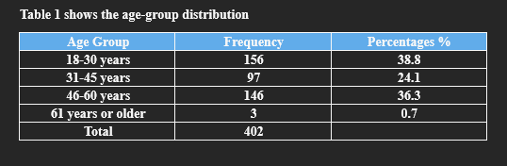
Results (1/3)
According to Table 1, most people who answered the survey were between 18 and 30 years old, making up 38.8%. Another group, 24.1%, was between 31 and 45 years. The biggest group of people were between 46 and 60 years old, and they made up 36.3% of everyone who took part. Only a very small number of people, 0.7%, were older than 61 years.

Slide 10
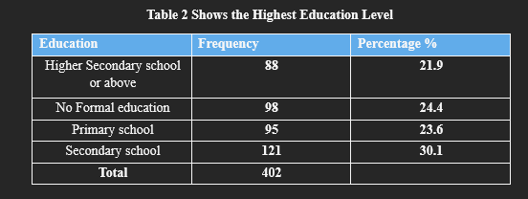
Results (2/3)
According to Table 2, most people said “Secondary school” was the highest level of education they finished, with 30.1% of the total. Many others had “No formal education” or only finished “Primary school,” making up 24.4% and 23.6% of the people, respectively. A smaller group, 21.9%, said they finished “Higher secondary school or above”.

Slide 11
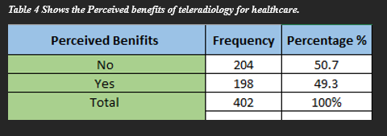
Results (3/3)
According to the Table 4 About 49.3% of the people who answered the survey think that teleradiology can help healthcare in their villages or area. On the other hand, 50.7% of the people do not believe that teleradiology would be useful for them.

Slide 12
Discussion (1/2)
This study is important because it tell us what people in these villages think about teleradiology. By focusing on Ghaziabad and understanding what people think, their knowledge, and the problem they face, this research helps us plan better ways to promote teleradiology. Now, we have a clearer idea of what need to be done to make teleradiology work for them.
This study found that how much people in rural villages in Ghaziabad, UP, know about teleradiology and what they think about it. While other research talks about the problems of getting special healthcare in rural India, most studies focus on cities or give general information. Our study is different because it looks closely at these villages and shows the real situation in rural Ghaziabad.
One big finding is the importance of internet access and knowing how to use it, for making teleradiology it well. Only 3.2% could explain it correctly. This matches what this paper says about the need for clear information and shows how much we need simple teaching materials for people in rural areas who don’t know much about technology.

Slide 13
Discussion (2/2)
Even though people don’t fully understand teleradiology, our study, like other research paper, shows that people in villages see the good things teleradiology can do, like helping them travel less, seeing specialist doctors and getting better diagnoses. But our study goes further by looking at why some people don’t want to use teleradiology. Almost half of the people said they wouldn’t use it which is like what this paper says that “just knowing about teleradiology is not enough to make people use it.”
We found that people are worried about keeping their private information safe, if the technology will work, and not getting to talk to doctor’s face to face. This adds to ewhat other studies like paper say, but gives more real numbers about common these worries are in rural area.
By focusing on rural villages and talking directly to the people, our study gives important data to help make better plans for teleradiology in Ghaziabad. If we focus on the needs of the people, close the digital divide, and give clear, easy to understand information , we can make healthcare fairer and help people in rural area get better healthcare services.

Slide 14
Conclusion
This study looks at how much people in rural Ghaziabad know about teleradiology, what they think about it, and what stops them from using it. These villages are now between old ways and new technology. People can see that teleradiology might help healthcare, like 30.1% said it will save travel time, and 25.9% said it can give better diagnoses. But to make this happen, we need a strong plan.
In our survey, only 51% of people heard the word "teleradiology," and just 3.2% could explain it right. Almost 70% did not know if any teleradiology service is in their area. This shows that there is a big need to fix the technology gap in rural India and teach people in easy ways so they understand what teleradiology is and how it can help.
Even though people know the benefits, 50.2% do not want to use teleradiology. Most of them worry about the safety of their information (24.6%), that the technology might not work (26.4%), and not getting to talk to doctors directly (24.1%). This shows that we need to build trust by making sure the technology works well and protects their private data, while also keeping some personal contact in healthcare.
Teleradiology can change healthcare in rural Ghaziabad, but we need to think about not just the technology but also about the social, cultural, and money problems people face. By making sure everyone can use it, making it easy to get, and keeping it affordable, by running awareness campaigns in the villages and the government and healthcare providers can help people in the villages accept Teleradiology by explaining how Teleradiology works. This can help close the healthcare gap and make the future fairer and healthier for everyone.

Slide 15
Thank You

