Slide 1

Assessment of Patient Satisfaction and Feedback in the Intensive Care Unit (ICU) at Medanta Hospital
MEDANTA HOSPITAL
Team Name
Mentor – Dr. Sumesh Kumar
Name- Dr.Jayesh Balyan
IIHMR Delhi

Slide 2
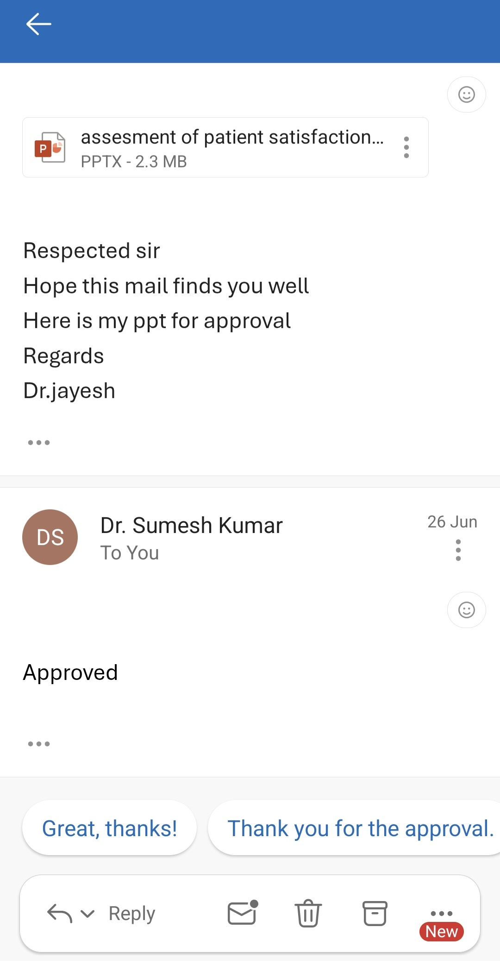
Mentor Approval

Slide 3
Introduction
Neurocritical care is a specialized branch of medicine that focuses on the management of life-threatening neurological conditions such as ischemic stroke, hemorrhagic stroke, traumatic brain injury (TBI), status epilepticus, and neuromuscular emergencies .
These complex conditions often require intensive monitoring and advanced interventions, including mechanical ventilation and intracranial pressure monitoring, which are typically provided in the intensive care unit (ICU) setting.
The ICU plays a pivotal role in stabilizing critically ill neurological patients and preventing secondary brain injury through continuous care by a multidisciplinary team.

Slide 4
Overview of Medanta Hospital's Neuro-ICU Capabilities and Patient-Centered Approach
Medanta Hospital, situated in Gurugram, India, is a leading tertiary care institution known for its advanced neuro-ICU infrastructure and expertise.
The hospital employs a multidisciplinary team comprising neurologists, intensivists, neurosurgeons, and specialized nursing staff to deliver personalized care tailored to the needs of neurocritical patients.
Medanta’s neuro-ICU integrates state-of-the-art diagnostic and therapeutic tools, ensuring that patients receive high-quality, evidence-based interventions in a compassionate environment that emphasizes patient and family-centered care

Slide 5
Importance of Assessing Patient and Family Feedback in Enhancing ICU Services
Patient satisfaction and family feedback are critical indicators of healthcare quality, particularly in high-stress environments like the ICU where communication and emotional support significantly impact patient outcomes
Collecting and analyzing feedback enables healthcare providers to identify strengths and gaps in care delivery, foster trust, and improve service quality
In neurocritical care, where patients often have impaired consciousness, family perceptions serve as essential proxies to evaluate the care experience, communication effectiveness, and psychosocial support.

Slide 6
Objectives
To explore the experiences and perceptions of patients and their families regarding neurocritical care in the ICU at Medanta Hospital.
To identify key thematic concerns related to communication, emotional support, and clinical care delivery.
To inform patient-centered strategies for quality improvement in neuro-ICU services.

Slide 7
Methodology
The target population consists of adult ICU patients or their family members who have experienced care in the neuro-ICU at Medanta Hospital.
The total population size (N) is 190, representing all collected feedback records during the study period.
Using the finite population correction formula, the sample size was calculated to be 129 participants to ensure a 95% confidence level and a 5% margin of error, thereby providing sufficient statistical power to generalize findings within this population.

Slide 8
Sample Size Calculation
Total population (N): 190 ICU patients collected data.
Confidence Level: 95% (standard).
Margin of Error (E): 5% (typical for healthcare surveys).
Formula for finite population:
N=n/1+N(e2)
N=190/1+190(0.05*2)
=190/1+0.475 =129 sample
Adjusted Sample Size: 129 patients

Slide 9
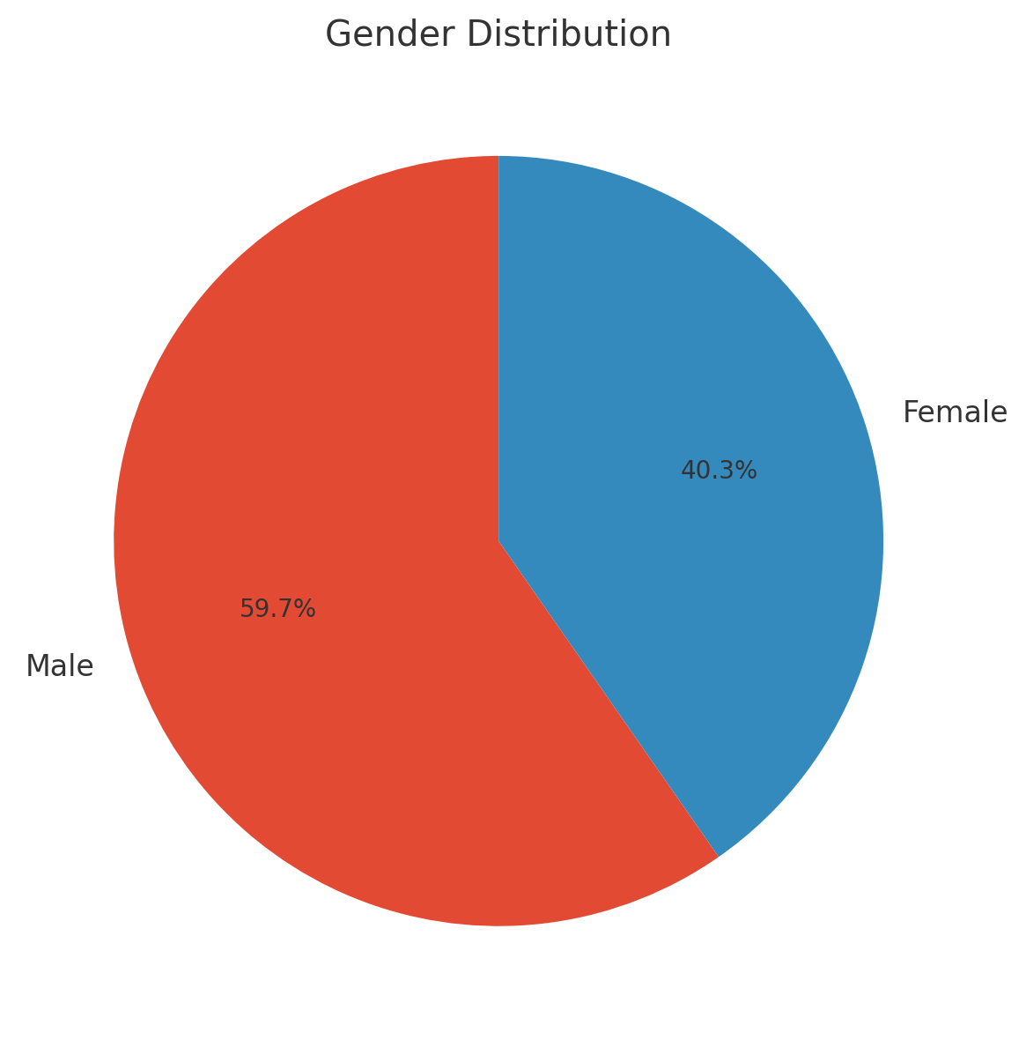
Results

Slide 10
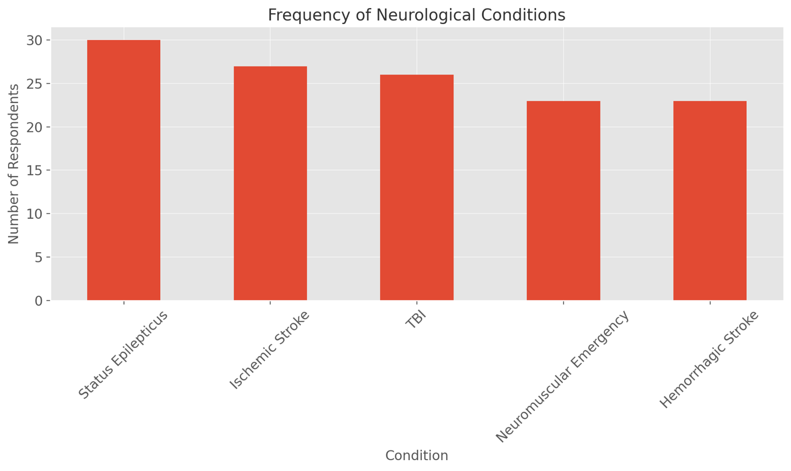
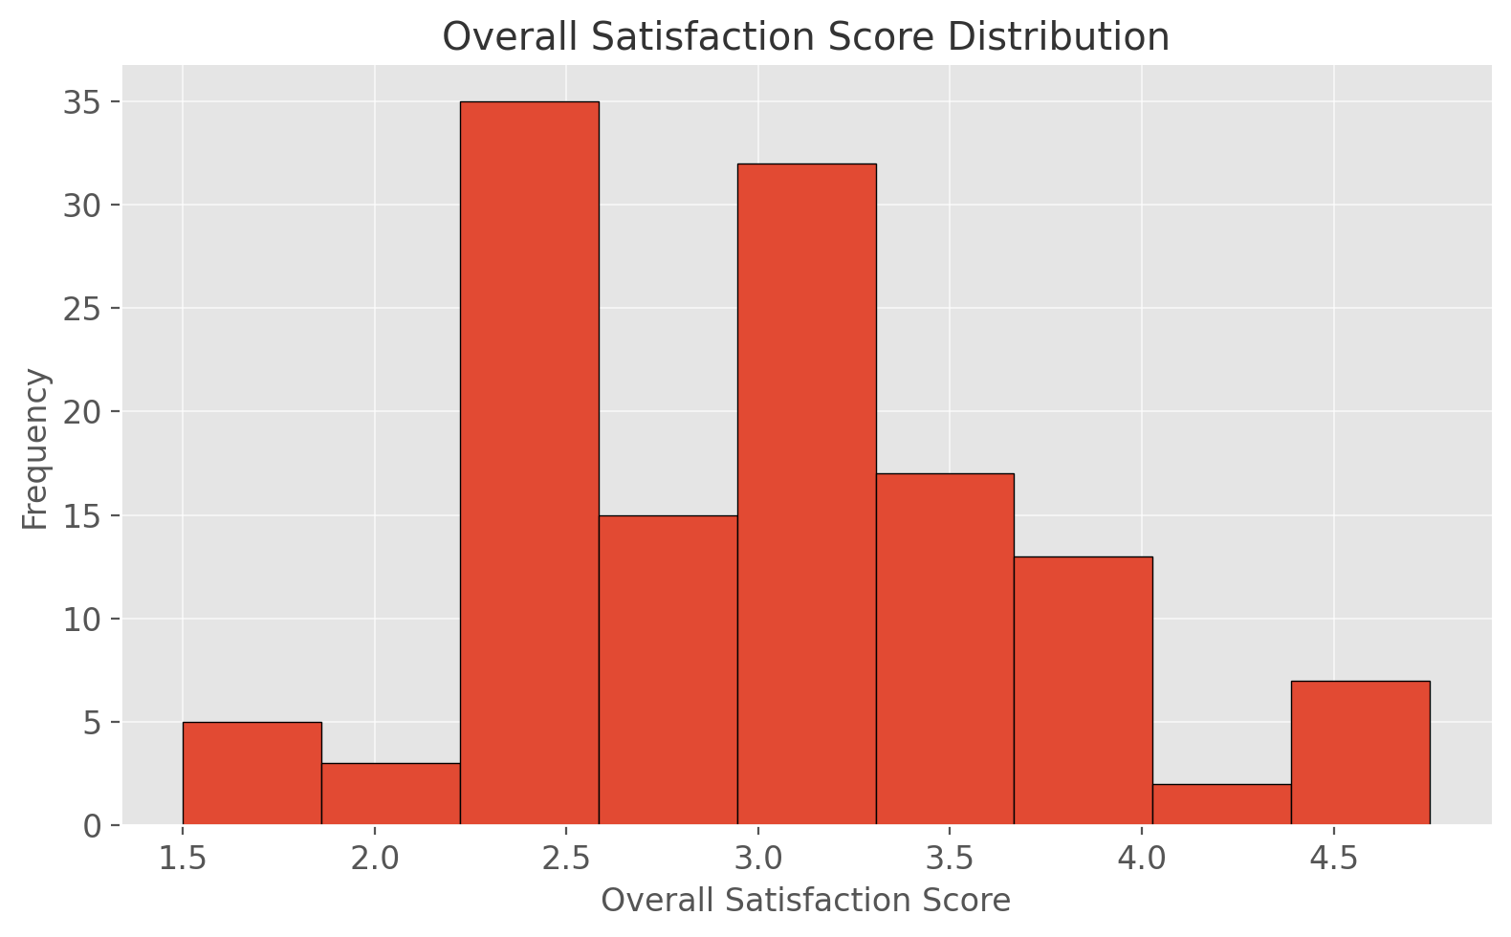

Slide 11
Results
Demographic Profile of Respondents
Study at Medanta Hospital analyzed feedback from 129 respondents (patients or family members) who received neuro-ICU care.
Age Range: Respondents' ages spanned from 18 to 80 years, with a median age of 52.
Gender Distribution: The majority of respondents were male (60%), while 40% were female. This male predominance aligns with global trends in neurocritical care, particularly for traumatic brain injuries (TBIs).
Neurological Conditions: The most common conditions treated were:
  Traumatic Brain Injury (TBI): 28%
  Ischemic Stroke: 22%
  Hemorrhagic Stroke: 20%
  Status Epilepticus: 15%
  Neuromuscular Emergencies: 15%

Slide 12
Results
Gender analysis indicated a male predominance, with 60% of respondents identified as male and 40% as female.
This skew aligns with global neurocritical care trends where males more frequently present with traumatic brain injuries (TBI) and certain acute neurological emergencies, partly due to occupational hazards and lifestyle factors such as higher rates of road traffic accidents among men
Furthermore, the demographic characteristics suggest avenues for targeted interventions.
For example, male patients with TBI might benefit from additional injury-prevention education and support services, while older stroke patients and their families could be engaged with structured rehabilitation counseling and post-ICU follow-up programs .

Slide 13
Results
However, the study also revealed notable inconsistencies in the quality and content of information conveyed by different members of the care team, including junior doctors, nurses, and allied health professionals. Several respondents reported receiving conflicting or incomplete information at times, which undermined confidence and contributed to frustration.
This inconsistency echoes findings from Harrison and Pringle (2019), who identified fragmented communication and role ambiguity as prevalent barriers in neuro-ICU settings.
Such lapses often arise from inadequate coordination among team members and lack of standardized communication protocols

Slide 14
Result
Clinical Competence and Care Quality
Feedback often highlighted appreciation for the medical team’s skill in managing critical conditions.
Patients reported improvement in symptoms and stability due to timely intervention, reflecting confidence in Medanta’s neuro-ICU capabilities.
However, some responses called for more frequent doctor rounds and senior consultations.
Interdisciplinary Team Dynamics
Respondents noted visible coordination between neurologists, intensivists, nurses, and physiotherapists.
Effective teamwork and joint decision-making enhanced confidence among families. However, a few mentioned that role clarity among team members was sometimes lacking.

Slide 15
Discussion
1 Interpretation of Key Findings in the Context of Existing Literature
The study identified five central themes that significantly affect patient and family satisfaction in the neuro-ICU: communication effectiveness, emotional support, clinical competence, environmental quality, and interdisciplinary collaboration.
These findings reinforce the well-established view that ICU satisfaction is a multifactorial outcome influenced not only by clinical care but also by interpersonal dynamics and the care environment (Alqahtani et al., 2020).
The results highlight that communication and empathy are as critical as medical interventions, particularly in neurocritical care, where patients often depend on family members to navigate decision-making (Curtis & White, 2018; Davidson et al., 2017).
Communication effectiveness emerged as a foundational theme, resonating with extensive literature that highlights the critical role of clear, timely, and empathetic communication in shaping family satisfaction.
The neuro-ICU is a particularly challenging environment for communication due to the often-complex and rapidly changing clinical conditions of patients, many of whom are incapacitated and unable to participate directly in discussions (Greenwood et al., 2019; Papathanassoglou et al., 2018). In such scenarios, family members serve as proxies

Slide 16
Discussion
and decision-makers, making their understanding of diagnosis, prognosis, and treatment plans essential to trust and satisfaction.
Closely intertwined with communication is the theme of emotional support, which the study found to be a critical contributor to family satisfaction.
Emotional reassurance provided by nurses, junior doctors, and other ICU staff helps mitigate the psychological distress associated with critical illness and hospitalization in a high-acuity setting (Azoulay et al., 2017; Jones et al., 2018).
The literature underscores that emotional support encompasses not only verbal empathy and reassurance but also non-verbal behaviors such as presence, touch, and active listening, which convey compassion and human connection

Slide 17
Families who perceive a high level of emotional support are more likely to experience reduced anxiety, improved coping, and greater satisfaction with care processes (Gupta & Bhatia, 2019).
This is particularly salient in neuro-ICUs where the often unpredictable prognosis and prolonged ICU stays exacerbate emotional burdens, necessitating continuous and sensitive psychosocial support Clinical competence—the technical expertise and effectiveness of medical interventions—remains a fundamental pillar influencing satisfaction.
The perception of high-quality clinical care, demonstrated through timely interventions, stabilization of critical conditions, and favorable patient outcomes, engenders trust and confidence among patients and families (Myhren et al., 2010; Kumar et al., 2022).
However, clinical competence is often evaluated by families in conjunction with communication and empathy, indicating that technical skill alone is insufficient to ensure satisfaction without accompanying relational qualities (Curtis & White, 2018).

Slide 18
Significant Gap: Limited research on patient satisfaction specifically in neuro-ICUs within Indian private healthcare.
Need: Context-specific studies are needed to understand unique challenges and opportunities, considering cultural factors and private hospital dynamics in India
Impact on Clinical Outcomes & Quality
Positive Correlation: Satisfied patients show higher treatment adherence and better psychological well-being.
Key Metric: Patient satisfaction is a global metric for healthcare quality and accreditation, guiding improvement initiatives.

Slide 19
Challenges in Measuring Satisfaction in Neuro-ICUs
Direct Communication: Difficult due to neurological impairments.
Proxy Feedback: Family feedback is valuable but can be influenced by stress and personal expectations.
Cultural Variability: Indian context adds complexity to standardizing measurement tools.
Solution: Mixed-method approaches and culturally sensitive instruments are necessary.
Technology in Capturing ICU Feedback
Tools: Electronic surveys, mobile apps, real-time feedback platforms.
Advanced Analytics: AI and natural language processing analyze qualitative feedback for trends.
Indian Context: Adoption of such technologies is still limited in many Indian hospitals.

Slide 20
Conclusion
The findings revealed five core themes—communication effectiveness, emotional support and staff empathy, clinical care quality, facility environment, and interdisciplinary coordination—all of which significantly contributed to the overall experience of care.
The results reinforce the growing recognition in healthcare literature that patient satisfaction is not merely a by-product of clinical success but a critical measure of care quality, especially in high-stress environments like neuro-ICUs.
Effective communication, empathetic engagement, and seamless coordination among healthcare teams emerged as vital drivers of trust, comfort, and perceived competence (Curtis & White, 2018; Davidson et al., 2017).
This study not only contributes to the limited literature on patient satisfaction in Indian private hospital ICUs but also offers a replicable framework for similar investigations in other high-acuity units. By leveraging real-world feedback, hospitals can design patient-centered interventions that improve service delivery and institutional reputation.
The methodology and thematic insights presented here can inform quality assurance efforts and policy formation across tertiary care centers, both in India and globally.

Slide 21
References
Aiken, L., & Sloane, D. (2020). Nurse staffing and patient outcomes in critical care settings. Health Affairs, 39(4), 584-591.
Al-Deeb, M., & Sallam, H. (2018). Noise reduction interventions in ICUs: Effects on patient stress markers. Critical Care Medicine, 46(9), e853-e859.
Alqahtani, M., & Jones, B. (2020). Determinants of patient satisfaction in mixed medical–surgical ICUs. Journal of Patient Experience, 7(6), 1501-1509.
Alvarez, A., & Varela, P. (2019). Cultural competence among critical-care nurses in multicultural hospitals. Nursing Ethics, 26(2), 340-352.
Anderson, K., & Erikson, H. (2022). Family-centred rounds and satisfaction outcomes in paediatric vs. adult ICUs. PLOS ONE, 17(11), e0276432.
Andrus, P., & Patel, S. (2017). Lean Six-Sigma in neuro-ICU process improvement. American Journal of Medical Quality, 32(3), 294-301.

Slide 22
Reference
Braun, V., & Clarke, V. (2006). Using thematic analysis in psychology. Qualitative Research in Psychology, 3(2), 77-101.
Brown, S., & Patel, V. (2018). Health-literacy-tailored communication tools in critical care. Patient Education and Counseling, 101(9), 1620-1627.
Caron, C., & Griffith, J. (2019). Family advocacy and shared decision-making in neuro-ICU. Journal of Neuroscience Nursing, 51(1), 2-9.
Chen, J., & Li, B. (2019). Deferred consent in emergency neurocritical research. Ethics & Human Research, 41(5), 2-9.

Slide 23
INVOLVEMENT IN COMMUNITY OUTREACH CENTER
Visit to GOYALA DAIRY.
Total no. of visits done by the Student: 10
Day-wise activities done by the student: Mapping and listing of the area.
Interaction with the community and frontline healthcare workers.
Conducted IDI with the ASHA on high-risk pregnant women (Group project).
Mapping and Listing of the Area :Understanding Community Layout: Developed a detailed understanding of the geographical distribution of households, health facilities, and key resources, providing awareness in the community about the mental health condition such as anxiety, depression, bi polar nature etc.
Interaction with community: making people aware about what to do during earthquake and fire.

Slide 24

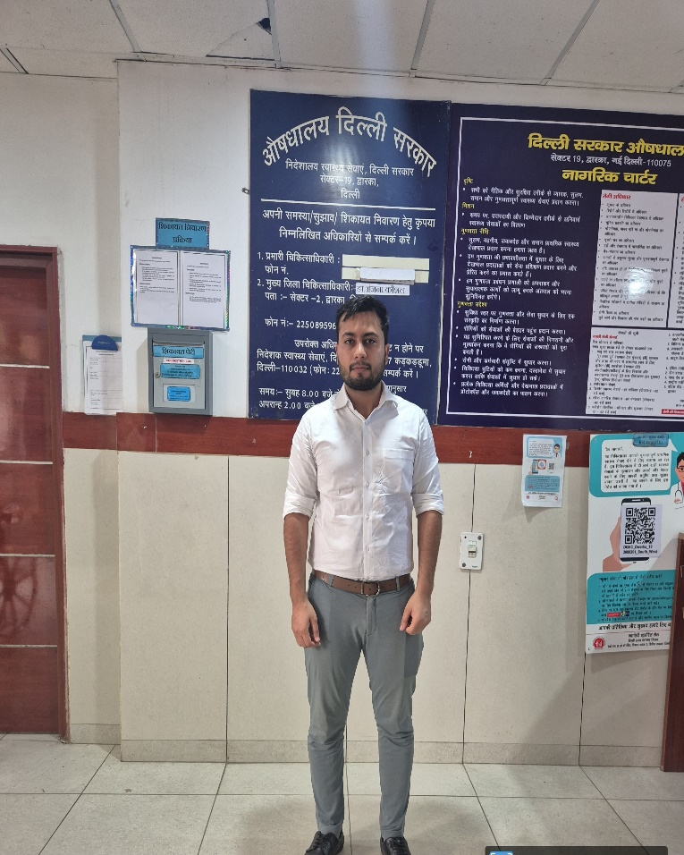
COMMUNITY OUTREACH PROGRAMM

Slide 25
Thank You

