Slide 1
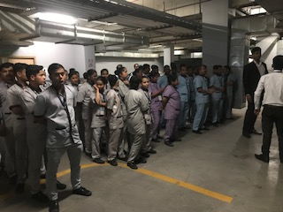
PRESENTATION: AWARENESS OF BIOMEDICAL WASTE AMONGST
NURSING & HOUSEKEEPING STAFF
OF
VENKATESHWAR HOSPITAL DWARKA
LT COL SHYAM SINGH
PG/17/063

Slide 2
INTRODUCTION
Hospital generates lots of waste during diagnosis/ treatment / immunization of patient--- only 15% is hazardous.
Nursing staff & House keeping staff : more prone to injuries.
Annual injury rate (India) is 8-12 per 1000 workers.
As per BMW rules 2016 & subsequent amendments to rule in 2018: Four categories of BMW- Aim is to improve segregation of waste at source.
Rules applicable to everyone who generate, collect, receive, store, transport, treat, dispose, or handle bio medical waste in any form.
BMW must be managed through a pathway: generation, storage, segregation, collection, processing, transport, treatment and disposal.

Slide 3
OBJECTIVE OF THE STUDY
General Objectives
To find out awareness of biomedical waste amongst nursing and housekeeping staff of Venketeshwar Hospital, Dwarka, New Delhi.
Specific Objectives
Whether nursing staff and HK staff possesses good knowledge about handling & management of biomedical waste.
Are BMW waste handled as per provision of BMW rules 2016 and amendment thereto in the year 2018?
Are BWM and Hospital infection committee integrated?
Is formal training provided to all HC personnel on BMW ?
To recommend suggestion, if any

Slide 4
LITERATURE REVIEW
Biomedical Waste (Management & Handling) Rules, 2016
Biomedical Waste Management ( Amendment) Rules, 2018
Shalini Sharma. et.al.,(2010) study on awareness about BMW management in 14 medical centre's at Agra.
Lt Col SKM Rao.et.al., Study on Biomedical Waste Management -An Infrastructural Survey of Hospital.
Datta P, Mohi. et.al.,(2018)- Biomedical waste management in India: Critical appraisal.
S.Muhammad, Salim Khan, Sheikh Mohd Saleem et.al., ( 2019) study on BMW practices at a tertiary care paediatric hospital in Kashmir valley.

Slide 5
RESEARCH METHOLDOLOGY
Study Design: Descriptive and Cross sectional study
Location of the Study: Venketeshwar Hospital, Dwarka,
Duration of the study: 01April to10May 2919.
Sample size: 110 i.e. 50Nursing and 60 housekeeping Staff.
Sampling Technique: Convenient sampling.
Data Collection Tools: Observation Checklist and Structured Questionnaire.
Data Analysis: IBM SPSS and Excel .

Slide 6
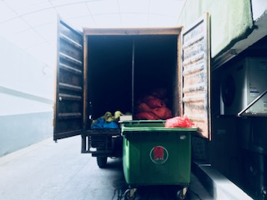
DELIVERABLE
Find out the level of awareness of BMW in nursing & housekeeping staff.
Nursing and HK staff knows about health hazards of the BMW .
Is BWM and HIC integrated.
Vaccination of Nursing and housekeeping staff.
Is formal training provided to staff on BMW
To recommend suggestion, if any.

Slide 7
OBSERVATIONAL CHECKLIST
Are BMW Policy/SOP existing
Nodal officer nominated in Hospital
Pre-treatment of laboratory waste
Use of non chlorinated plastic bags
No blame approach to incident reporting promoted
Free access to PEP
Sufficient budget provided for PEP & Stores
Is HCW and HIC integrated
Is HCW cell functioning within Hospital
PPE worn by BMW handlers all times
Bar coding of BMW
Professionalism of outsource agency dealing with BMW
Awareness about procedure of needle stick injury incidence
General attitude of Staff towards BMW

Slide 8
QUESTIONNAIRE
NURSING STAFF
HOUSEKEEPING STAFF
Awareness about the biomedical waste
Awareness regarding colour coding segregation
Knowledge about disposal of human anatomical waste and soiled dressing
Knowledge about disposal of waste sharps
Knowledge about the solution in puncture proof container
Knowledge about major risks through biomedical waste
Knowledge about different types of disinfectant methods used
Knowledge about safety measure taken during spillage of biomedical waste
Identification of biohazard symbol
Knowledge about the biomedical waste
Awareness regarding colour coding segregation
Identification of biohazard symbol
Knowledge about precaution taken during handling of biomedical waste
Awareness on needle stick injury
Awareness regarding transportation of Biomedical waste
Is any training provided for handling of Biomedical waste
Is training programme effective in providing knowledge about biomedical waste

Slide 9
OBSERVATIONAL CHECKLIST
SER No | CHECKLIST | YES/NO
1 | Is BMW management SOP existing | YES
2 | Nodal officer nominated in Hospital | YES
3 | Pre-treatment of laboratory waste | YES
4 | Use of non chlorinated plastic bags | YES
5 | Free access to PEP | YES
6 | Sufficient budget provided for PEP & BMW Stores | YESS
7 | Is BMW and HIC integrated | YES
8 | PPE worn by BMW handlers all times | YES
9 | Bar coding of BMW | YES
10 | Awareness about procedure of needle stick injury incidence | YES
11 | General attitude of Staff towards BMW | Very good
12 | Annual report of BMW submitted for year 2018-19 to appropriate authorities | YES
13 | Is monthly BMW report being submitted regularly | YES

Slide 10

RESULT : NURSING STAFF

Slide 11
SURVEY STATISTICS
 |  | SEX OF NURSE | AGE OF NURSE IN YEARS | HOSP SERVICE | AWARENESS OF BIOMEDICAL WASTE | KNOWS WHAT BMW INCLUDES | AWARENESS ABOUT COLOR CODING SEGREGATION | DIFFERENT COLOR BINS USED
N | Valid | 50 | 50 | 50 | 50 | 50 | 50 | 50
 | Missing | 0 | 0 | 0 | 0 | 0 | 0 | 0
 |  | DISPOSAL OF WASTE SHARPS | MAJOR RISK IN DEALING WITH HOSP WASTE | VACCINATION FOR HEPATITIS B AND TETANUS | SYMBOL OF BIOHAZARD | ACTION DURING SPILLS | UNDERWENT TRAINING ON BMW HANDLING AT HOSPITAL | DIFFERENT TYPES OF DISINFECTION METHODS
N | Valid | 50 | 50 | 50 | 50 | 50 | 50 | 50
 | Missing | 0 | 0 | 0 | 0 | 0 | 0 | 0

Slide 12
GENDER OF NURSES SURVEYED
 |  | Frequency | Percent | Valid Percent | Cumulative Percent
Valid | MALE | 7 | 14.0 | 14.0 | 14.0
 | FEMALE | 43 | 86.0 | 86.0 | 100.0
 | Total | 50 | 100.0 | 100.0
Age Group | Total
< 22 YRS | 02
22-25 YRS | 34
26-30 YRS | 11
>30YRS | 03
Service Groups (Months) | Total
1-5 | 18
6-10 | 19
11-15 | 8
16-20 | 03
>20 | 02

Slide 13
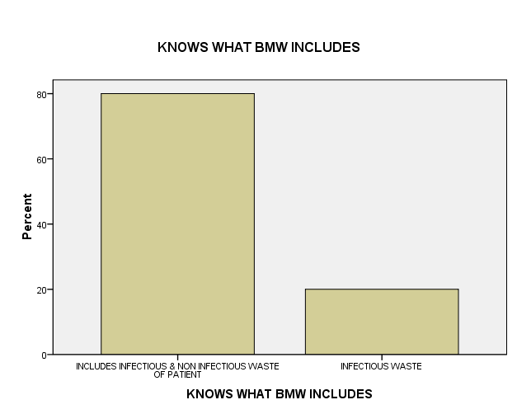
AWARENESS OF BIOMEDICAL WASTE
 |  | Frequency | Percent | Valid Percent | Cumulative Percent
Valid | YES | 50 | 100.0 | 100.0 | 100.0
KNOWS WHAT BMW INCLUDES
 | Frequency | Percent | Valid Percent | Cumulative Percent
INCLUDES INFECTIOUS & NON INFECTIOUS WASTE OF PATIENT | 40 | 80.0 | 80.0 | 80.0
INFECTIOUS WASTE | 10 | 20.0 | 20.0 | 100.0
Total | 50 | 100.0 | 100.0

Slide 14
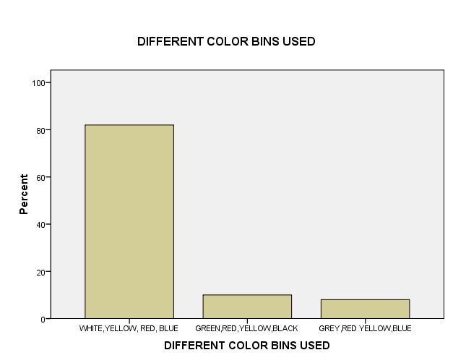
AWARENESS ABOUT COLOR CODING SEGREGATION
 |  | Frequency | Percent | Valid Percent | Cumulative Percent
Valid | YES | 50 | 100.0 | 100.0 | 100.0
DIFFERENT COLOR BINS USED
 |  | Frequency | Percent | Valid Percent | Cumulative Percent
Valid | WHITE,YELLOW, RED, BLUE | 41 | 82.0 | 82.0 | 82.0
 | GREEN,RED,YELLOW,BLACK | 5 | 10.0 | 10.0 | 92.0
 | GREY,RED YELLOW,BLUE | 4 | 8.0 | 8.0 | 100.0
 | Total | 50 | 100.0 | 100.0

Slide 15
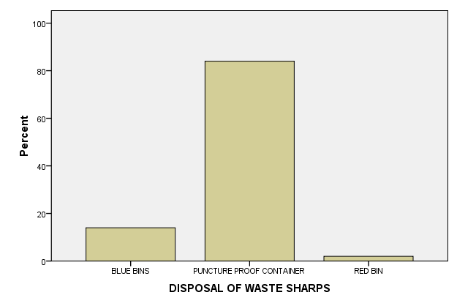
DISPOSAL OF WASTE SHARPS
 | Frequency | Percent | Valid Percent | Cumulative Percent
BLUE BINS | 7 | 14.0 | 14.0 | 14.0
PUNCTURE PROOF CONTAINER | 42 | 84.0 | 84.0 | 98.0
RED BIN | 1 | 2.0 | 2.0 | 100.0
Total | 50 | 100.0 | 100.0

Slide 16
BINS USED FOR HUMAN ANATOMICAL & SOILED WASTE
 |  | Frequency | Percent | Valid Percent | Cumulative Percent
Valid | YELLOW AND RED | 8 | 16.0 | 16.0 | 16.0
 | BLUE | 1 | 2.0 | 2.0 | 18.0
 | YELLOW | 41 | 82.0 | 82.0 | 100.0
 | Total | 50 | 100.0 | 100.0
KNOWLEDGE OF SOLUTION FOR PUNCTURE PROOF
 |  | Frequency | Percent | Valid Percent | Cumulative Percent
Valid | 2% SODIUM HYPOCHLORIDE | 20 | 40.0 | 40.0 | 40.0
 | 2% MAGNESIUM CHLORIDE | 1 | 2.0 | 2.0 | 42.0
 | NONE | 29 | 58.0 | 58.0 | 100.0
 | Total | 50 | 100.0 | 100.0
MAJOR RISK IN DEALING WITH HOSPITAL WASTE
 |  | Frequency | Percent | Valid Percent | Cumulative Percent
Valid | AIDS,HEPATITIS,TYPHOID FEVER | 50 | 100.0 | 100.0 | 100.0

Slide 17
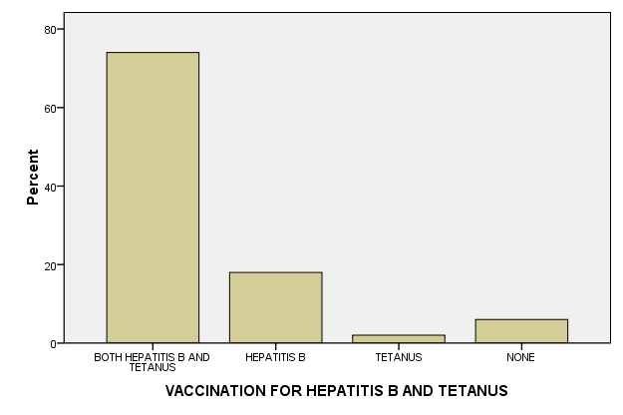
VACCINATION FOR HEPATITIS B AND TETANUS
 |  | Frequency | Percent | Valid Percent | Cumulative Percent
Valid | BOTH HEPATITIS B AND TETANUS | 37 | 74.0 | 74.0 | 74.0
 | HEPATITIS B | 9 | 18.0 | 18.0 | 92.0
 | TETANUS | 1 | 2.0 | 2.0 | 94.0
 | NONE | 3 | 6.0 | 6.0 | 100.0
 | Total | 50 | 100.0 | 100.0

Slide 18
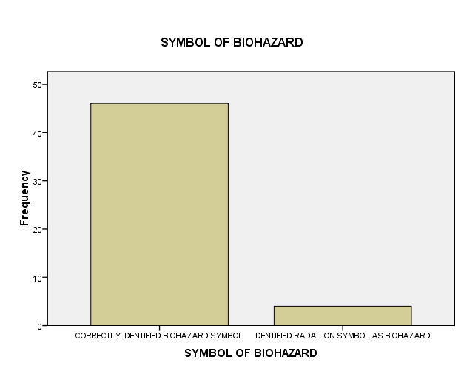
SYMBOL OF BIOHAZARD
 | Frequency | Percent | Valid Percent | Cumulative Percent
CORRECTLY IDENTIFIED BIOHAZARD SYMBOL | 46 | 92.0 | 92.0 | 92.0
IDENTIFIED RADAITION SYMBOL AS BIOHAZARD | 4 | 8.0 | 8.0 | 100.0
Total | 50 | 100.0 | 100.0

Slide 19
AWARENESS OF NURSES : ACTION DURING SPILLS
 |  | Frequency | Percent | Valid Percent | Cumulative Percent
Valid | AFTER CLEANING WITH DISINFECTANT THROW INFECTED MATERIAL IN CORRECT BINS | 49 | 98.0 | 98.0 | 98.0
 | CLEAN INFECTED AREA WITHOUT DISINFECTANT | 1 | 2.0 | 2.0 | 100.0
 | Total | 50 | 100.0 | 100.0
DIFFERENT TYPES OF DISINFECTION METHODS
 |  | Frequency | Percent | Valid Percent | Cumulative Percent
Valid | AUTOCLAVE,CHEMICAL,HYDOCLAVE,MICROWAVE | 44 | 88.0 | 88.0 | 88.0
 | ONLY DISINFECTION FLUID | 6 | 12.0 | 12.0 | 100.0
 | Total | 50 | 100.0 | 100.0
NURSES WHO UNDERWENT TRAINING ON BMW HANDLING AT HOSPITAL
 |  | Frequency | Percent | Valid Percent | Cumulative Percent
Valid | NO | 3 | 6.0 | 6.0 | 6.0
 | YES | 47 | 94.0 | 94.0 | 100.0
 | Total | 50 | 100.0 | 100.0

Slide 20
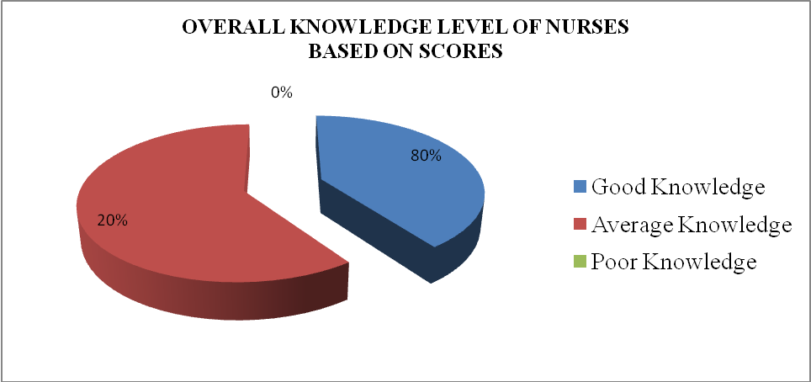
CLASSIFICATION OF KNOWLEDGE LEVEL OF NURSES ON SCORE BASIS
S.No | Various categories | Full score | Score obtained | Total Nurses
1 | Good Knowledge | 11 | 11 | 40
2. | Average Knowledge | 11 | 8-10 | 10
3. | Poor Knowledge | 12 | 0-7 | -

Slide 21
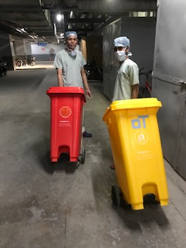
RESULT: HOUSEKEEPING STAFF

Slide 22
GENDER OF HK STAFF
 |  | Frequency | Percent | Valid Percent | Cumulative Percent
Valid | MALE | 41 | 68.3 | 68.3 | 68.3
 | FEMALE | 19 | 31.7 | 31.7 | 100.0
 | Total | 60 | 100.0 | 100.0
AGE & SERVICE IN HOSP ANALYSIS OF HK STAFF
AGE | NO OF HK
<2O YRS | 10
21-25 YRS | 21
26-30 YRS | 15
> 30 YRS | 14
HOSPITAL SERVICE | NO OF HK
< 5 MONTHS | 23
6-10 MONTHS | 9
11-15 MONTHS | 9
16-25 MONTHS | 7
> 26 MONTHS | 12

Slide 23
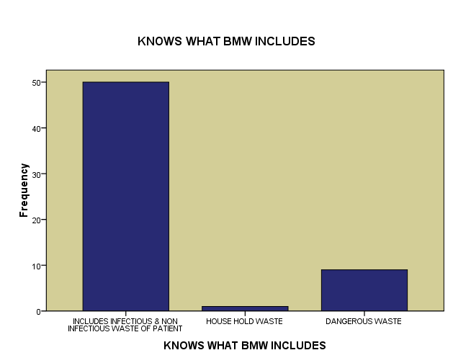
AWARENESS OF BIOMEDICAL WASTE
 |  | Frequency | Percent | Valid Percent | Cumulative Percent
Valid | YES | 60 | 100.0 | 100.0 | 100.0
KNOWS WHAT BMW INCLUDES
 | Frequency | Percent | Valid Percent | Cumulative Percent
Includes infectious & non infectious waste of patient | 50 | 83.3 | 83.3 | 83.3
House hold waste | 1 | 1.7 | 1.7 | 85.0
Dangerous waste | 9 | 15.0 | 15.0 | 100.0
Total | 60 | 100.0 | 100.0

Slide 24
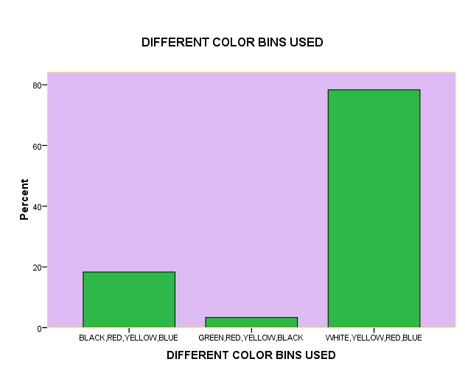
AWARENESS ABOUT COLOR CODING SEGREGATION
 |  | Frequency | Percent | Valid Percent | Cumulative Percent
Valid | YES | 60 | 100.0 | 100.0 | 100.0
DIFFERENT COLOR BINS USED
 | Frequency | Percent | Valid Percent | Cumulative Percent
BLACK,RED,YELLOW, BLUE | 11 | 18.3 | 18.3 | 18.3
GREEN,RED,YELLOW, BLACK | 2 | 3.3 | 3.3 | 21.7
WHITE,YELLOW,RED, BLUE | 47 | 78.3 | 78.3 | 100.0
Total | 60 | 100.0 | 100.0

Slide 25
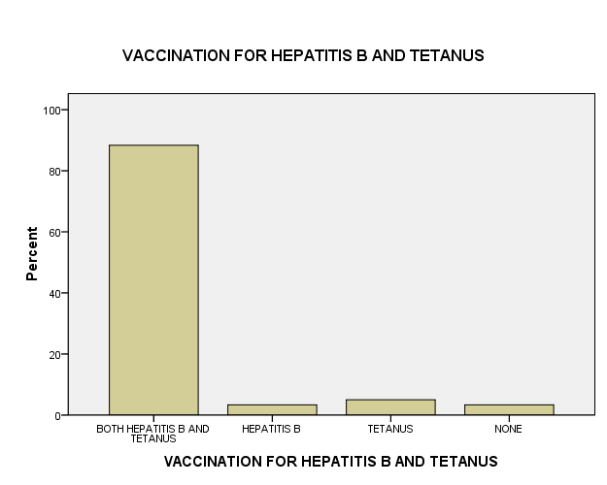
VACCINATION FOR HEPATITIS B AND TETANUS
 | Frequency | Percent | Valid Percent | Cumulative Percent
BOTH HEPATITIS B AND TETANUS | 53 | 88.3 | 88.3 | 88.3
HEPATITIS B | 2 | 3.3 | 3.3 | 91.7
TETANUS | 3 | 5.0 | 5.0 | 96.7
NONE | 2 | 3.3 | 3.3 | 100.0
Total | 60 | 100.0 | 100.0

Slide 26
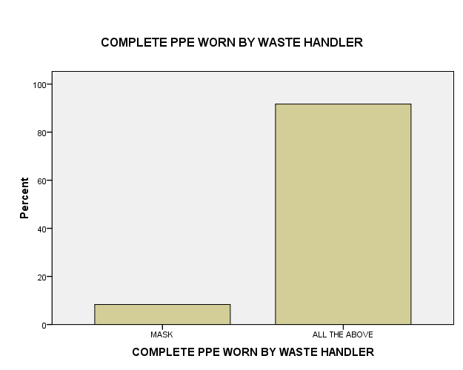
COMPLETE PPE WORN BY WASTE HANDLER
 |  | Frequency | Percent | Valid Percent | Cumulative Percent
Valid | MASK | 5 | 8.3 | 8.3 | 8.3
 | ALL THE ABOVE | 55 | 91.7 | 91.7 | 100.0
 | Total | 60 | 100.0 | 100.0

Slide 27
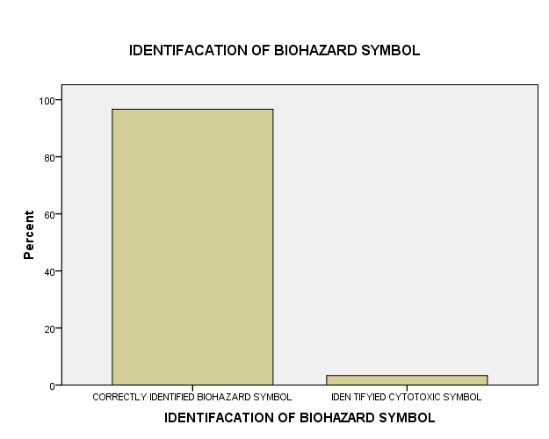
IDENTIFICATION OF BIOHAZARD SYMBOL
 | Frequency | Percent | Valid Percent | Cumulative Percent
CORRECTLY IDENTIFIED BIOHAZARD SYMBOL | 58 | 96.7 | 96.7 | 96.7
IDEN TIFYIED CYTOTOXIC SYMBOL | 2 | 3.3 | 3.3 | 100.0
Total | 60 | 100.0 | 100.0

Slide 28
NSI CAN RESULT IN INFECTION
 |  | Frequency | Percent | Valid Percent | Cumulative Percent
Valid | YES | 60 | 100.0 | 100.0 | 100.0
AVOIDANCE OF CROWDED AREA IN BMW TRANSPORTATION
 |  | Frequency | Percent | Valid Percent | Cumulative Percent
Valid | NO | 1 | 1.7 | 1.7 | 1.7
 | YES | 59 | 98.3 | 98.3 | 100.0
 | Total | 60 | 100.0 | 100.0
TRAINING GIVEN ON BMW AT HOSPITAL
 |  | Frequency | Percent | Valid Percent | Cumulative Percent
Valid | YES | 60 | 100.0 | 100.0 | 100.0
INDIVIDUAL BENEFITTED FROM BMW TRAINING
 |  | Frequency | Percent | Valid Percent | Cumulative Percent
Valid | No | 1 | 1.7 | 1.7 | 1.7
 | YES | 59 | 98.3 | 98.3 | 100.0
 | Total | 60 | 100.0 | 100.0

Slide 29
CLASSIFICATION OF KNOWLEDGE LEVEL OF HK ON BASIS OF SCORES
S.No | Various categories | Full score | Score obtained | Total Nurses
1 | Good Knowledge | 8 | 8 | 47
2. | Average Knowledge | 8 | 5-7 | 13
3. | Poor Knowledge | 8 | 0-4 | -

Slide 30
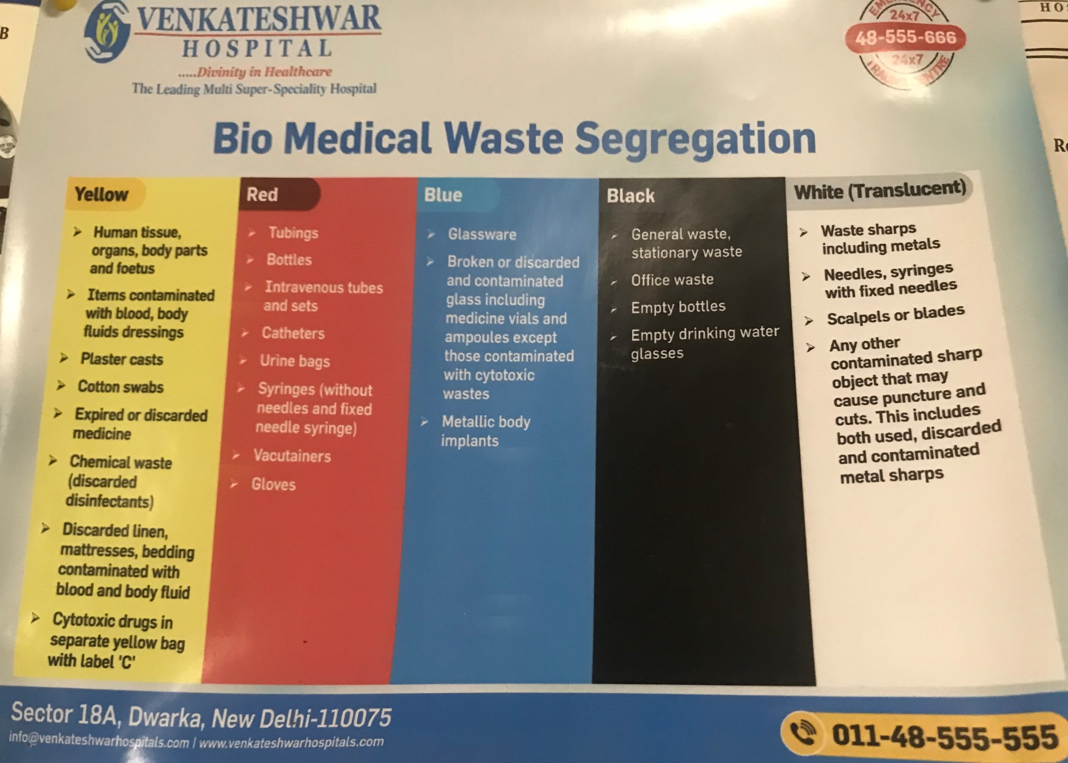

Slide 31
KEY FINDINGS
100 % Nurses and Housekeeping staff are aware about BMW and color coding segregation.
100 % HK staff and 94 % Nurses have undergone BMW training at hospital. 98.3 % HK Staff have benefitted from BMW training.
92 % of nursing staff and 97% of Housekeeping staff correctly identified biohazard symbol.
58 % nurses have correct knowledge about solution for puncture proof container.
84 % nurses were aware that puncture proof container is to be used for discarding waste sharps.
82 % nurses and 78 % housekeeping staff respectively are aware of correct four types of colour bags/bins used in better BMW management.
12 % of HK staffs are not vaccinated for either of Hepatitis B / Tetanus or both while it is about 26 % in case of nurses.
Hospital is adhering to all guidelines of CPCB in respect of BMW handling Rules 2016 and amendment to rules.

Slide 32
RECOMMENDATION
In service training must continue for better BMW awareness.
All nursing and housekeeping staff must be vaccinated for both Hepatitis B and Tetanus.
CBMWTF rep must wear PPE, while handling waste.
Proper securing up of filled non chlorinated bags at source to avoid accidental spills during transportation
Trolleys kept at biomedical room for storage may also be as per color coding of BMW.
Assess the future need to relocate biomedical room from present location.

Slide 33
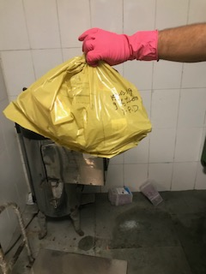
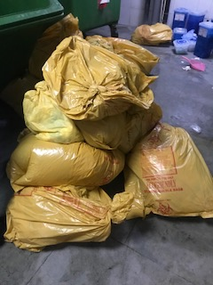
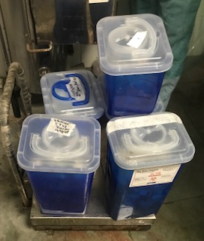
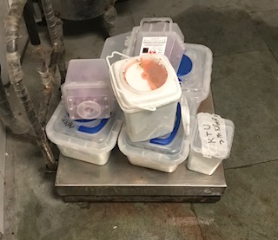
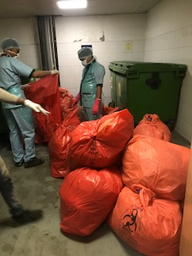

Slide 34
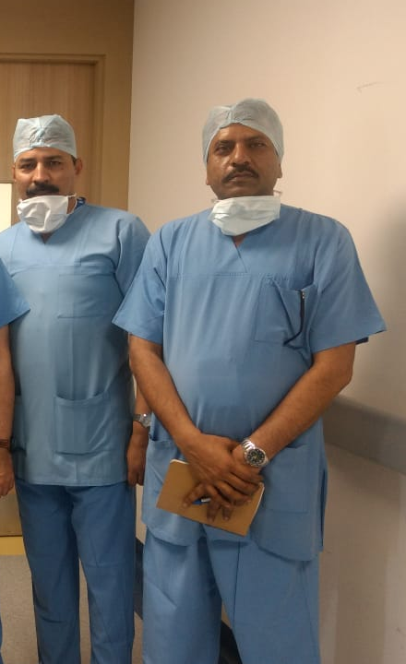
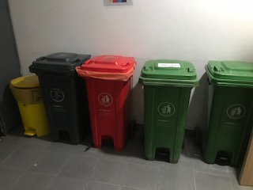
THANK YOU

