Slide 1


Dissertation
- Krati Gupta
(PG/23/052)
TITLE:
ASSESSING REAL-TIME STOCK REPLENISHMENT AND DELIVERY TURNAROUND TIME (TAT) FOR INTRAOCULAR LENSES (IOLS), OPERATION THEATRE (OT) CONSUMABLES, AND MEDICINES IN A TERTIARY EYE CARE SETTING.
IIHMR Mentor: Dr. Ratika Samtani
Organization Mentor: Ms. Nandini Kalme (Operations Manager, Eye Q Udhna Branch, Surat)

Slide 2
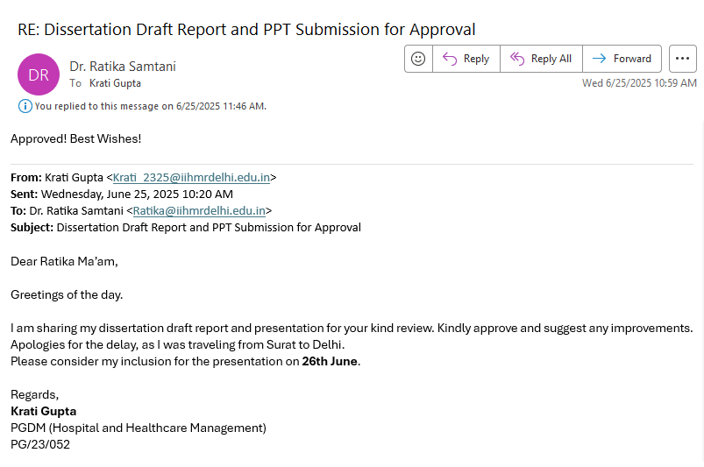

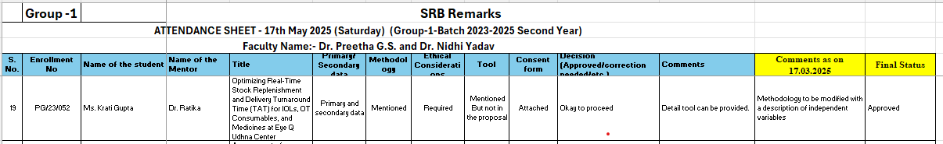
Approval

Slide 3
Content:
Background of Eye Q
Introduction
Objectives
Methodology
Results
Discussion
Recommendation
Limitations
References
Organization Learnings
Key Learnings
Pictorial Journey

Slide 4

Background of Eye Q
SCOPE OF SERVICES
Comprehensive Eye Care
Cataract Services
Refractive Services
Retina Services
Glaucoma Services
Pediatric Services
Visual Aid Services
Occuplasty Services
Optical Services
The Eye-Q hospital chain is committed to providing the best quality eye care at an affordable cost across India.
Established in 2007, Eye-Q is a chain of 30 domestic Super- Speciality Eye Hospitals in Delhi-NCR, Haryana, Uttar Pradesh, Uttarakhand, and Gujarat. Also, 3 hospitals in Nigeria, Africa

Slide 5
Introduction
Background:
Efficient inventory of IOLs, OT consumables, and medicines is critical to avoid surgery delays and care disruptions (1,3,4).
Eye Q Udhna uses the Eyetech system for real-time stock tracking.
Despite automation, delays persist due to PO approval lags, data entry errors, and depot coordination gaps, etc.
Problem Statement:
Recurring stock replenishment delays affect OT scheduling, patient satisfaction, and service efficiency.
Significance:
Timely supply availability improves care quality, prevents cancellations, and optimizes costs.

Slide 6
Objectives
Primary Objective:
To assess real-time stock replenishment processes and delivery turnaround time (TAT) for IOLs, OT consumables, and medicines in a Tertiary Eye Care Setting.
Secondary Objectives:
To analyze the average TAT from stock requisition to replenishment for IOLs, OT consumables, and medicines.
To identify any bottlenecks or delays in the stock replenishment cycle from the central depot to the Udhna Center.
To explore staff perspectives on coordination and delays affecting stock availability.
To provide recommendations for optimizing stock replenishment and improving delivery timelines based on findings.

Slide 7
Methodology
1. Study design:
Cross- Sectional Descriptive Design
Over a fixed Retrospective timeframe
Quantitative as well as Qualitative
2. Study Area:
Eye Q Vision Pvt. Ltd., Udhna Center in Surat, Gujarat.
The center is part of a specialized chain of ophthalmic hospitals, known for integrating digital inventory solutions like Eyetech for real-time stock monitoring.

Slide 8
3. Study population:
staff involved in stock management and logistics, including: 4-5 key personnel
Inventory/Pharmacy staff
Depot coordination personnel
Eyetech software operator
Center/operations manager
4. Sample – sample size and sampling:
A purposive sampling method will be used to select staff with direct involvement in the stock and supply chain.
Quantitative Sample:
Retrospective inventory and TAT records for 6 months (approx.) covering IOLs, OT consumables, and medicines(9 months), with at least 30–50 cases per product category.

Slide 9
5. Study variables:
Independent Variable-
Frequency of stock updates in software
Inventory Request Time
Depot response time
Availability of items in stock
Dependent Variable
Delivery Turnaround Time (TAT)
TAT = Date of Delivery (or Goods received) – Date of request (or Purchase Order)
Stock-out incidence rate
Delay in scheduled surgeries/procedure due to unavailability
Cofounding Variables
Staff Absenteeism
Power/Internet Failure
Seasonal demand surges

Slide 10
6. Data collection tools and techniques:
Quantitative Data:
MS Excel
Extracted from Eyetech logs, depot reports, and manual records using a structured abstraction Table.
Key metrics include:
  Date of request
  Date of approval
  Date of delivery
  TAT in days
  Stock-out or delay instances
Qualitative Data:
Conducted via semi-structured interviews with the selected 4-5 staff members.
Direct observation of 2–3 inventory cycles (stock arrival, stock update, TAT tracking).
Field notes for process issues and communication breakdowns.

Slide 11
7. Data Analysis
Quantitative Analysis:
Tools: Microsoft Excel
Descriptive statistics
Frequency and category-wise delay analysis
Qualitative Analysis:
Thematic coding of interview responses
Identification of recurring challenges such as "manual delays", "system lag", or "depot bottlenecks"
Narrative summaries supporting operational recommendations

Slide 12
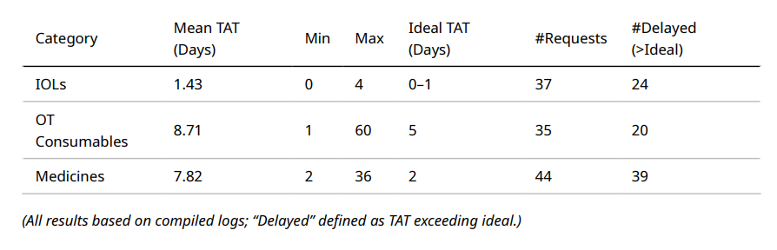
Results:
Summary Table: Turnaround Time by Category

Slide 13
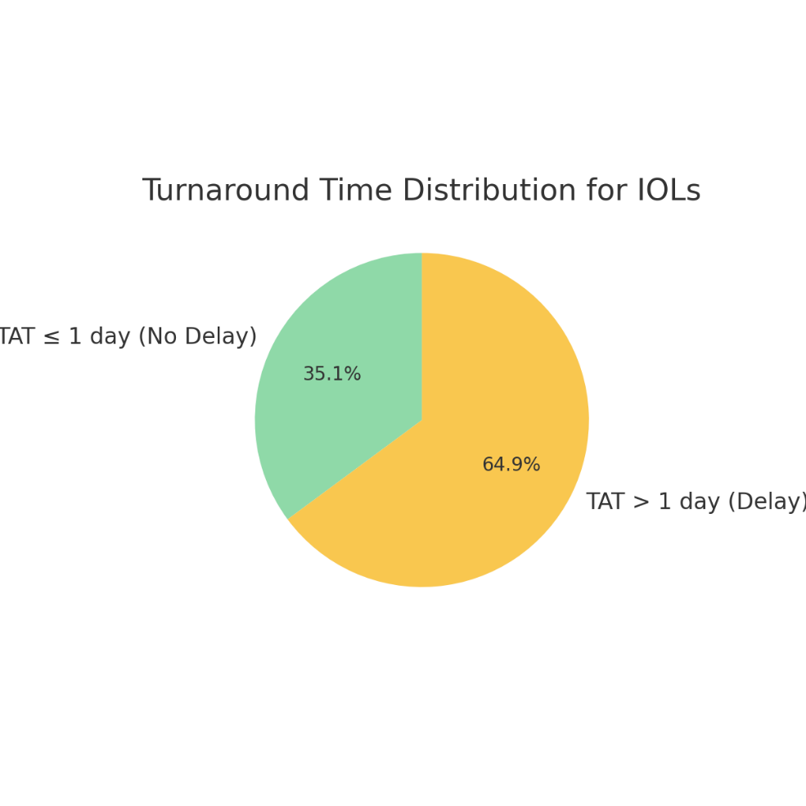
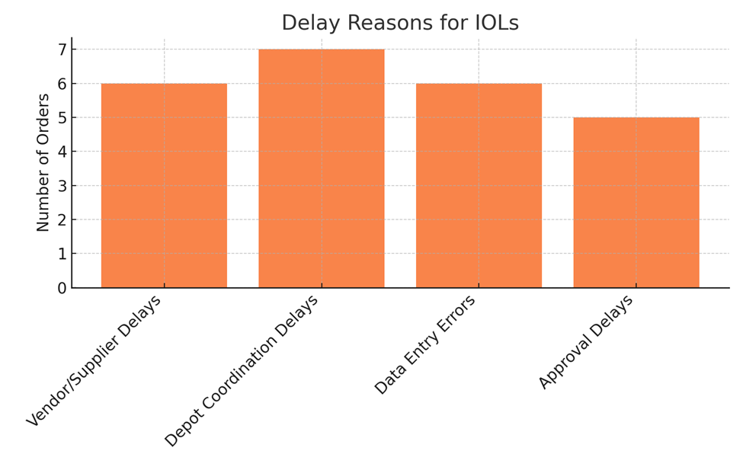
Results
1 Intraocular Lenses (IOLs)

Slide 14
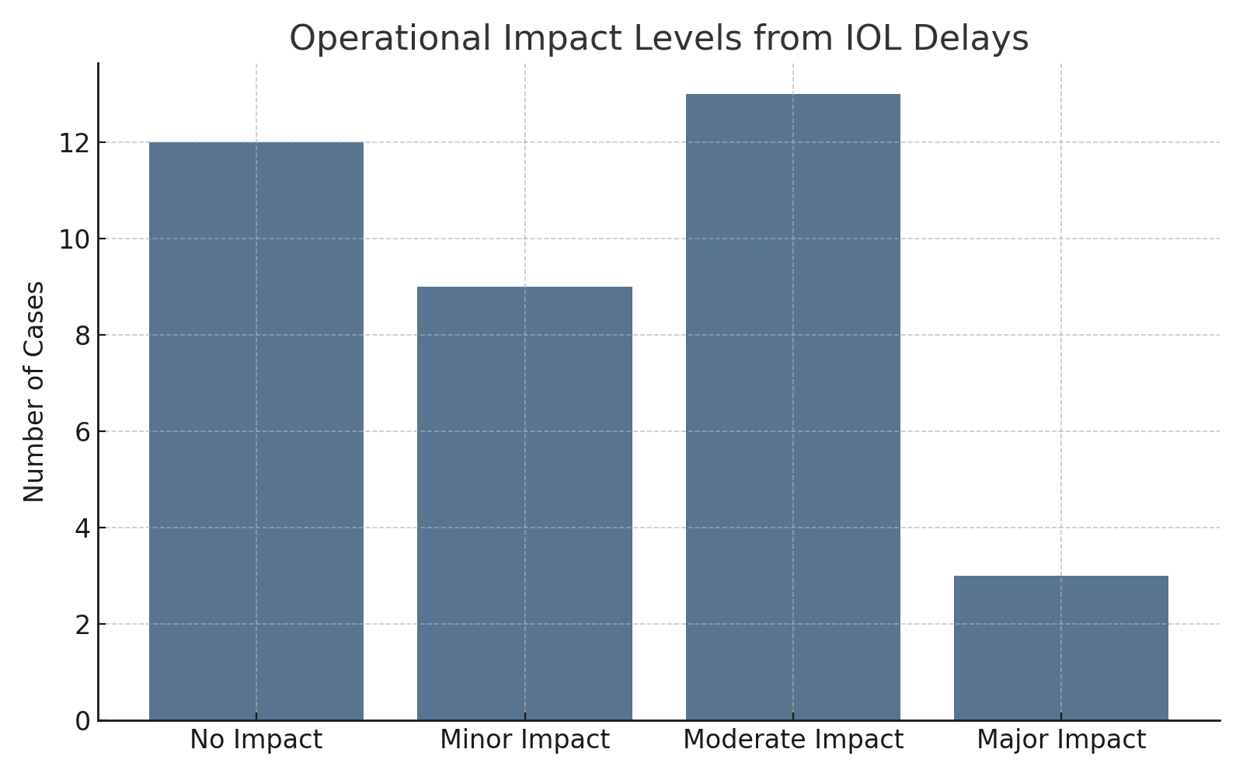
Impact Level | Description / Example
No Impact | Surgery continued as scheduled; stock was sufficient or alternative lens available.
Minor Impact | Short delay in surgery start (e.g., 30 mins–1 hour), but procedure completed same day.
Moderate Impact | Surgery rescheduled to another time/day due to delayed or missing IOL stock.
Major Impact | Surgery canceled or critical patient care compromised; serious patient dissatisfaction.

Slide 15
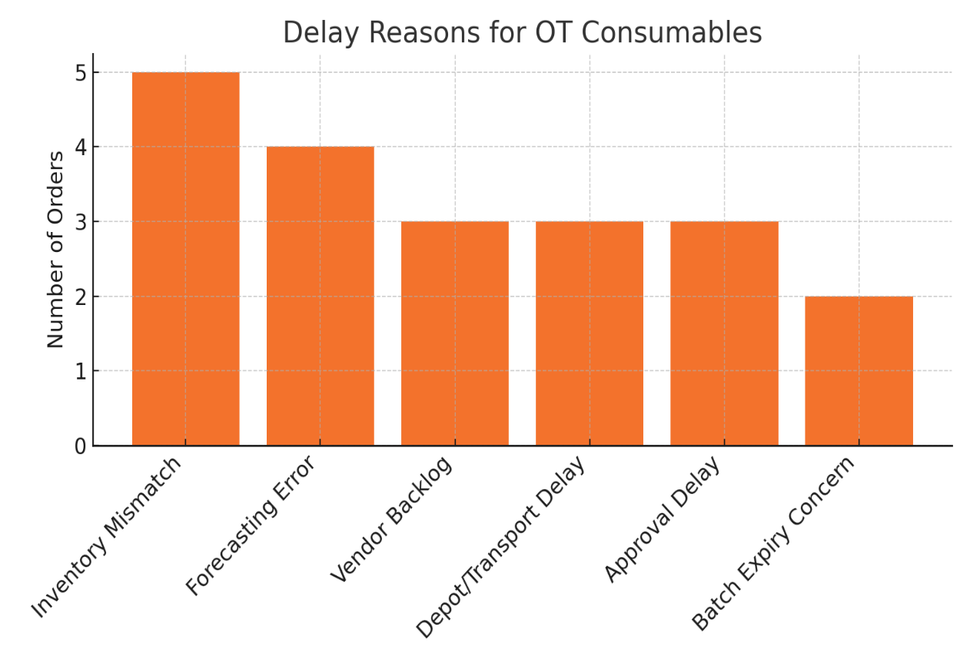
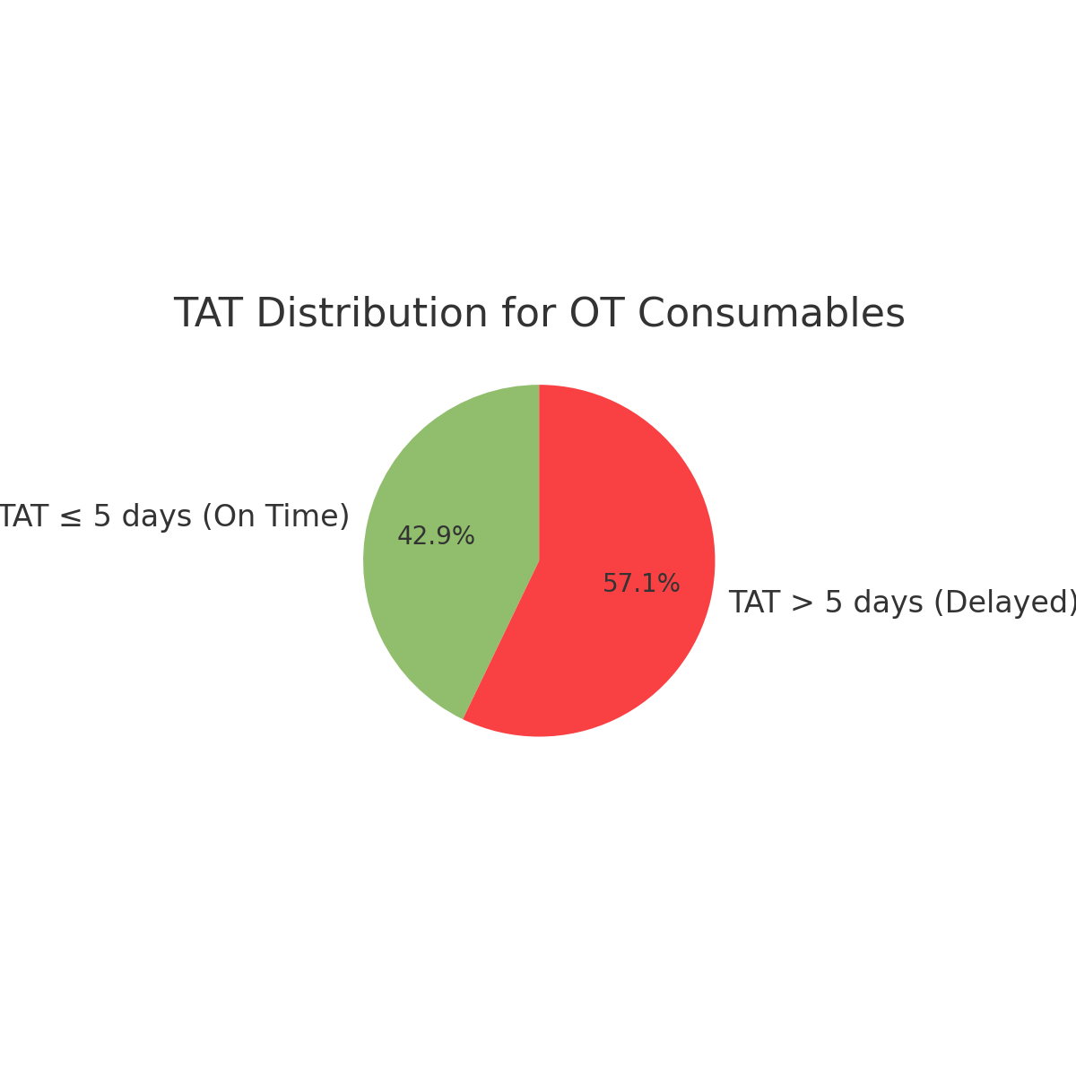
Results:
2 OT Consumables

Slide 16
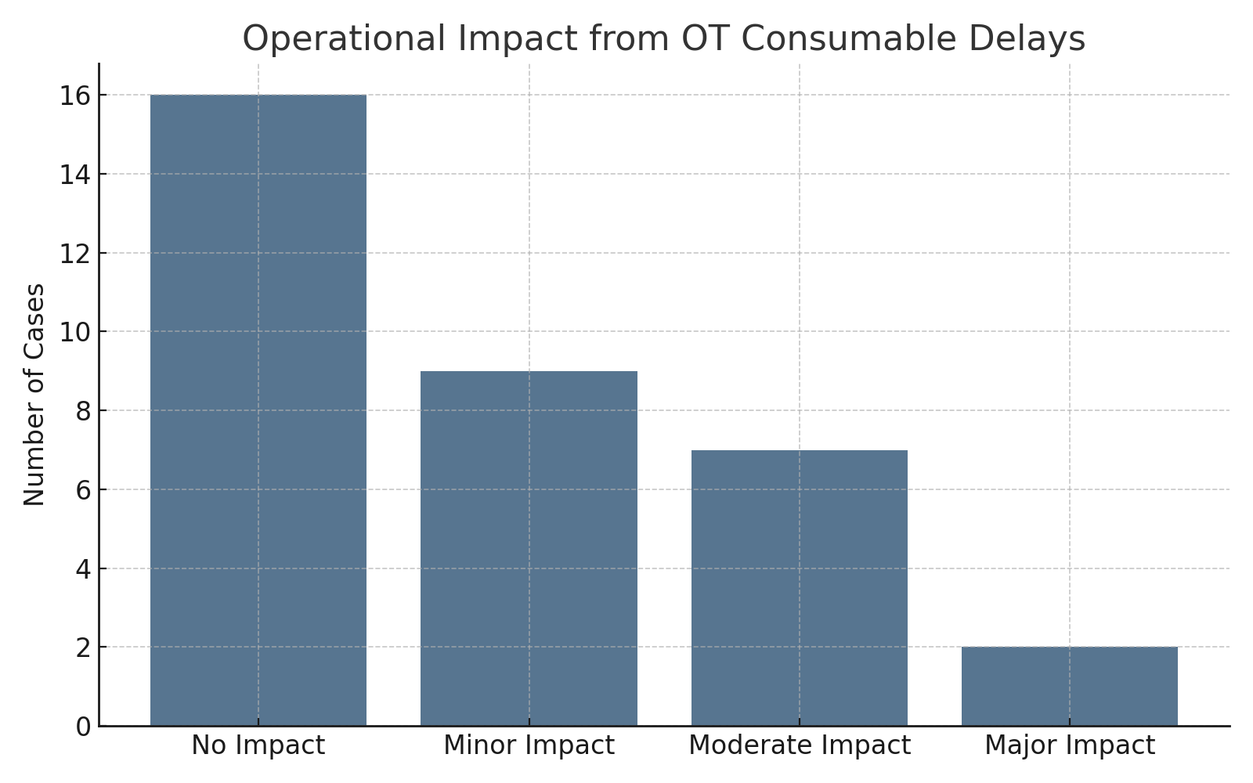
Impact Level | Description / Example
No Impact | Required consumables available or managed through buffer stock.
Minor Impact | Temporary workaround used (e.g., substitute gauze/suture), minor delay in OT flow.
Moderate Impact | Delay of OT schedule due to item shortage; backup plan required.
Major Impact | Emergency OT procedure affected or rescheduled; increased infection risk due to unavailability.

Slide 17
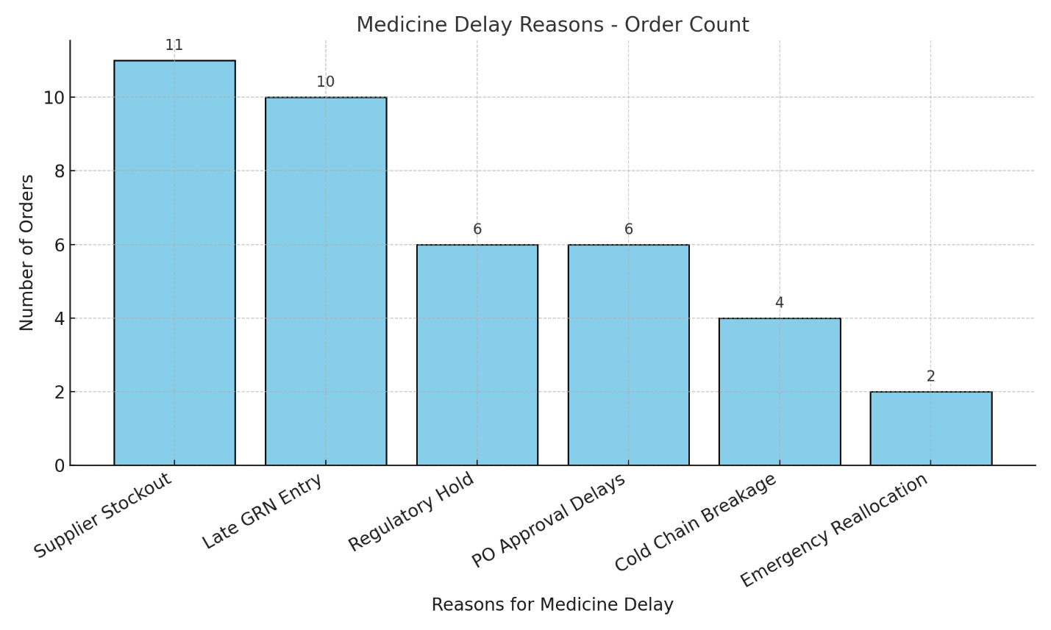
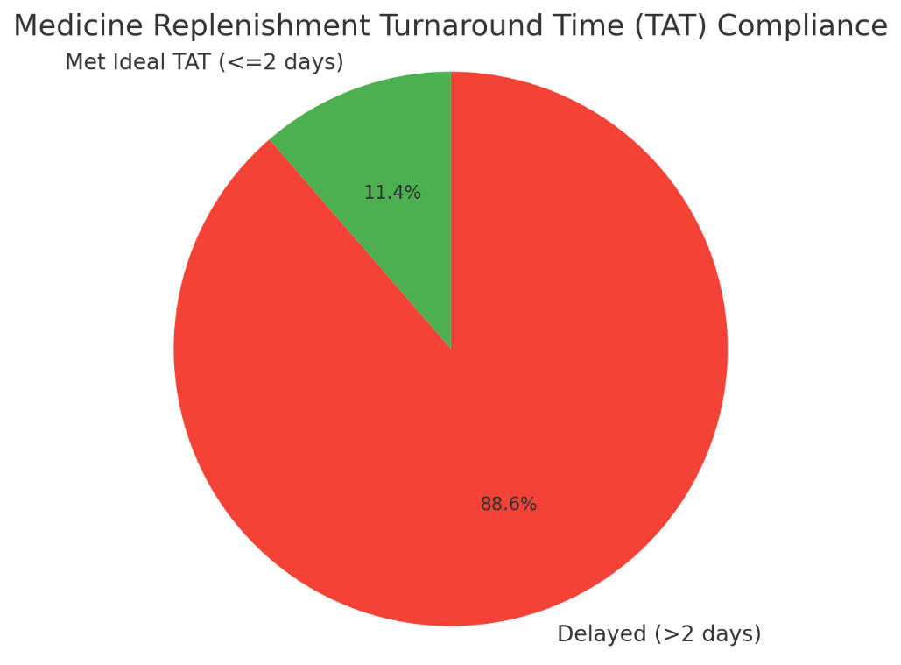
Results
3. Medicines

Slide 18
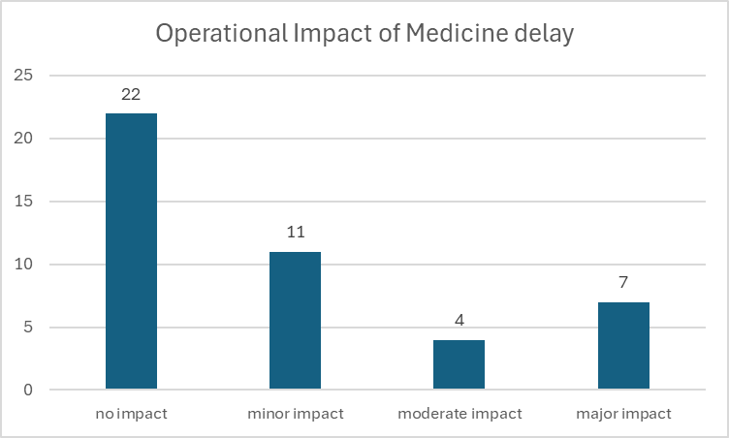
Impact Level | Description / Example
No Impact | Medicine arrived on time or substitution was possible without care disruption.
Minor Impact | Slight delay in dose administration but no clinical consequence.
Moderate Impact | Delay in initiation of treatment or shift to second-line drug with reduced effectiveness.
Major Impact | Critical medicine unavailable, causing treatment suspension or emergency referral.

Slide 19
Qualitative Results Summary Table
🟦 1. Intraocular Lenses (IOLs)
Theme | Summary of Key Insights | Supporting Quotes
Administrative Delays | Approval and vendor communication delays affect surgery scheduling. | “Approvals take 2–3 days minimum.” “Sometimes the vendor confirmation is late.”
Eyetech System Gaps | System doesn’t give real-time alerts on IOL stockouts; manual checks are required. | “There’s no alert when lens power is missing.” “We check manually before PO.”
Emergency Responses & Workarounds | Staff coordinate with nearby Eye Q centers to borrow lenses. | “We borrow from Randher or Parle Point if needed urgently.”
Impact on Revenue & Patient Satisfaction | Delays lead to rescheduling surgeries, loss of patients, and reduced revenue. | “If the IOL isn’t there, we postpone surgery.” “Sometimes patients get angry and don’t return.”
Suggestions for Improvement | Predictive alerts and lens-wise forecasting should be built into the system. | “The system should alert us if any power is low.” “Auto-requisition based on consumption would help.”

Slide 20
🟨 2. OT Consumables
Theme | Summary of Key Insights | Supporting Quotes
Inventory Tracking Challenges | Consumables are difficult to track; mismatch between software and physical stock is common. | “The stock shows in software but isn’t physically there.” “Consumables don’t sync in real time.”
Eyetech System Limitations | No alerts for low stock or expiry of consumables. | “No expiry alerts—sometimes we only find out at the OT table.”
Administrative Gaps | Purchase orders are based on manual stock counts; forecasting is absent. | “We don’t forecast—we raise PO when stock is very low.”
Emergency Workarounds | Staff borrow consumables from other centers or manage with substitutes. | “We got suture packs from another center when we ran out.” “Sometimes we use what’s available if there’s no time.”
Suggestions for Improvement | System should show real-time consumable expiry alerts and reorder triggers. | “If expiry alerts pop up, it’ll help avoid waste.” “A daily use trend report will help in planning.”

Slide 21
🟥 3. Medicines
Theme | Summary of Key Insights | Supporting Quotes
Stockout Consequences | Out-of-stock medicines result in local purchases or revenue loss when patients don’t return. | “If glaucoma meds aren’t in stock, we lose the sale.” “We do local purchase in urgent cases.”
No Forecasting/Manual PO | System lacks forecasting for medicine usage; staff raise orders manually. | “We manually check stock, no pop-ups.” “The system doesn’t help with forecasting.”
Coordination via Ticket System | Coordination happens via EYE Quick, but follow-up is often delayed. | “We raise tickets but they’re not resolved quickly.”
High-demand Medicines | Long-term patients (e.g., glaucoma) expect availability; stockouts affect trust and revenue. | “Patients buy glaucoma drops in bulk—if it’s not there, they don’t come back.”
Suggestions for Improvement | Demand trend-based ordering, alert systems, and expiry tracking needed. | “Add alerts for short expiry medicines.” “Trend-based suggestions for PO would help.”

Slide 22
Discussion
Significant variation in TAT performance across products
IOLs had timely replenishment (avg. TAT ~1.4 days), minimal impact
OT consumables & medicines faced frequent delays
Manual approval steps and outdated Eyetech updates increased delays
Vendor stockouts and coordination issues affected medicine supply most
Medicines had highest number of major disruptions (therapy delays, substitutions)
IOL delays were mostly minor due to available backups
Eyetech’s triggers helpful but limited without lean internal workflows
Findings align with literature stressing need for real-time syncing and process efficiency

Slide 23
Recommendation
Inventory planning should be improved by analyzing past consumption patterns and forecasting future demand, particularly for high-use and critical items.
Collaboration with suppliers and the central depot must be strengthened through clear communication protocols, performance reviews, and timely escalation processes.
Establishing routine coordination mechanisms such as weekly status calls or a shared tracking dashboard can help manage urgent stock requirements effectively.
The hospital should institutionalize key performance indicators (KPIs), including average turnaround time (TAT), stockout rates, and approval duration, to monitor and improve inventory performance over time.
Lean inventory techniques, like the Two-Bin system for OT consumables, should be adopted to balance efficiency with availability and reduce both overstocking and stockouts.
Overall, the organization should shift from a reactive inventory model to a proactive, that supports uninterrupted patient care and optimized resource use.

Slide 24
Limitations
Data accuracy is contingent upon the reliability of the Eyetech system logs and manual record-keeping.
The sample size for staff interviews may be small, which could limit the generalizability of qualitative findings.
The study is retrospective, which may limit the ability to capture real-time operational nuances.

Slide 25
References
Saha E, Ray PK. Inventory management and analysis of pharmaceuticals in a healthcare system. InHealthcare Systems Management: Methodologies and Applications: 21st Century Perspectives of Asia 2017 Sep 7 (pp. 71-95). Singapore: Springer Singapore.
Thomsen PB. Delays in Care Due to Inaccessibility of Essential Medical Items in Surgical Unit.
Sharma N. Implementation of vendor managed inventory (VMI) in managing intraocular lenses (IOL) in eye care organization. International Research Journal of Management, IT and Social Sciences. 2015;2(9):1-9.
Mandara RS. INVENTORY CONTROL OF DISPOSABLE MEDICAL MATERIALS AT THE BALI MANDARA EYE HOSPITAL.
Thomsen PB. Delays in Care Due to Inaccessibility of Essential Medical Items in Surgical Unit.
Landry S, Beaulieu M. The challenges of hospital supply chain management, from central stores to nursing units. InHandbook of healthcare operations management: Methods and applications 2013 Jan 10 (pp. 465-482). New York, NY: Springer New York.
Ahmadi E, Masel DT, Metcalf AY, Schuller K. Inventory management of surgical supplies and sterile instruments in hospitals: a literature review. Health Systems. 2019 May 4;8(2):134-51.
Kelka H. Supply Chain Resilience: Navigating Disruptions Through Strategic Inventory Management.
Pal S. Advancements in AI-enhanced Just-in-Time inventory: elevating demand forecasting accuracy. International Journal for Research in Applied Science and Engineering Technology. 2023;11(11):282-9.
Coslett BG. Just-In-Time/Just-In-Case Inventory Management as an Influence on Supply Chain Disruption in Medical Systems Based in the Southeastern United States During the COVID-19 Pandemic.
Chandran V. CHALLENGES OF LOGISTICS IN INDIAN PHARMACEUTICAL INDUSTRY (Doctoral dissertation, Griffith College.).

Slide 26
Organization Learnings
As a Management Trainee, I underwent a comprehensive 360-degree training program that offered exposure to both clinical operations and administrative systems within a super-speciality eye hospital setting
Training Timeline & Departmental Rotation:
Month | Departmental Focus | Duration
Month 1 | Patient Relations (PRE), Registration, Optometry | Week 1–4
Month 2 | Pharmacy, Optical, OT Training, Product Knowledge | Week 5–8
Month 3 | Counselling, Operations, Quality, CSR, Research Work | Week 9–12

Slide 27
Key Learnings
Gained hands-on experience with EyeTech HMS for hospital operations and inventory control
Developed strong understanding of hospital workflows across pharmacy, OT, optics, and patient services
Strengthened communication and counselling skills through direct patient interaction
Learned to manage PO, GRN, and stock documentation for medicines and surgical items
Understood quality standards and audit processes aligned with NABH protocols
Participated in community outreach and CSR activities, enhancing social accountability
Built confidence in working with clinical teams, administrative staff, and patients
Enhanced decision-making, adaptability, and teamwork through cross-functional training

Slide 28
KEY LEARNING FROM COP ACTIVITIES
Gained practical experience in community-based research.
Improved communication skills with healthcare workers and beneficiaries.
Understood grassroots health service delivery.
Learned data collection and survey techniques.
Gained insights into family planning practices and challenges.
Acquired community mapping and listing skills.
Strengthened teamwork and problem-solving abilities.

Slide 29
INVOLVEMENT IN COMMUNITY OUTREACH PROGRAMME (COP) ACTIVITIES
Total Number of Visits by the Student: 14
Field Visits – Sanganer, Jaipur
Conducted **research on Family Planning knowledge, attitude, and practices.
Collected primary data through structured questionnaires.
Interviewed stakeholders including:
ASHA workers
ANMs (Auxiliary Nurse Midwives)
Lactating and married women (15–49 years)
Assessed usage and awareness of contraceptive methods (e.g., MPA injections, OCPs).
Analyzed barriers to accessing reproductive health services in rural settings.
Outreach Activities – Goyla Dairy, Delhi
Participated in community mapping and listing** of households.
Supported identification of key health indicators and needs in the area.
Engaged with the local community to build rapport and understand living conditions.

Slide 30
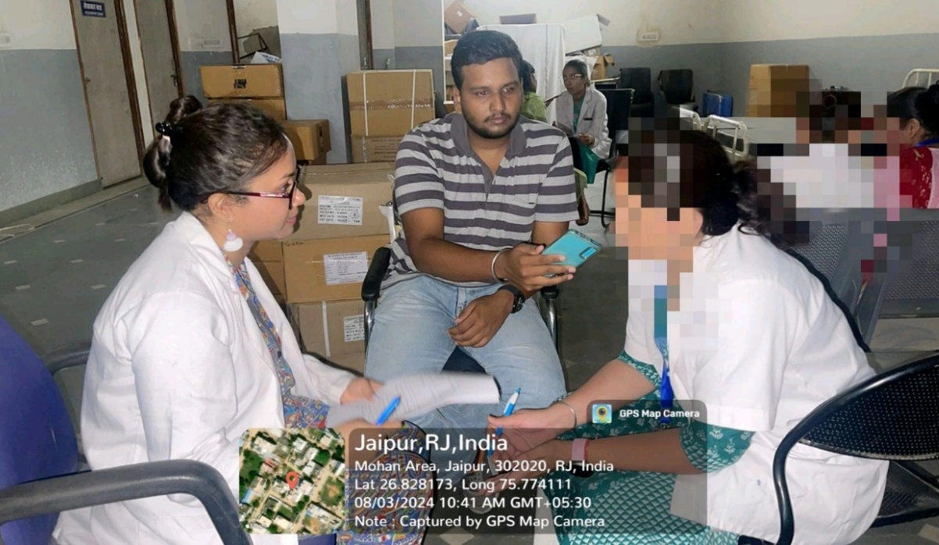
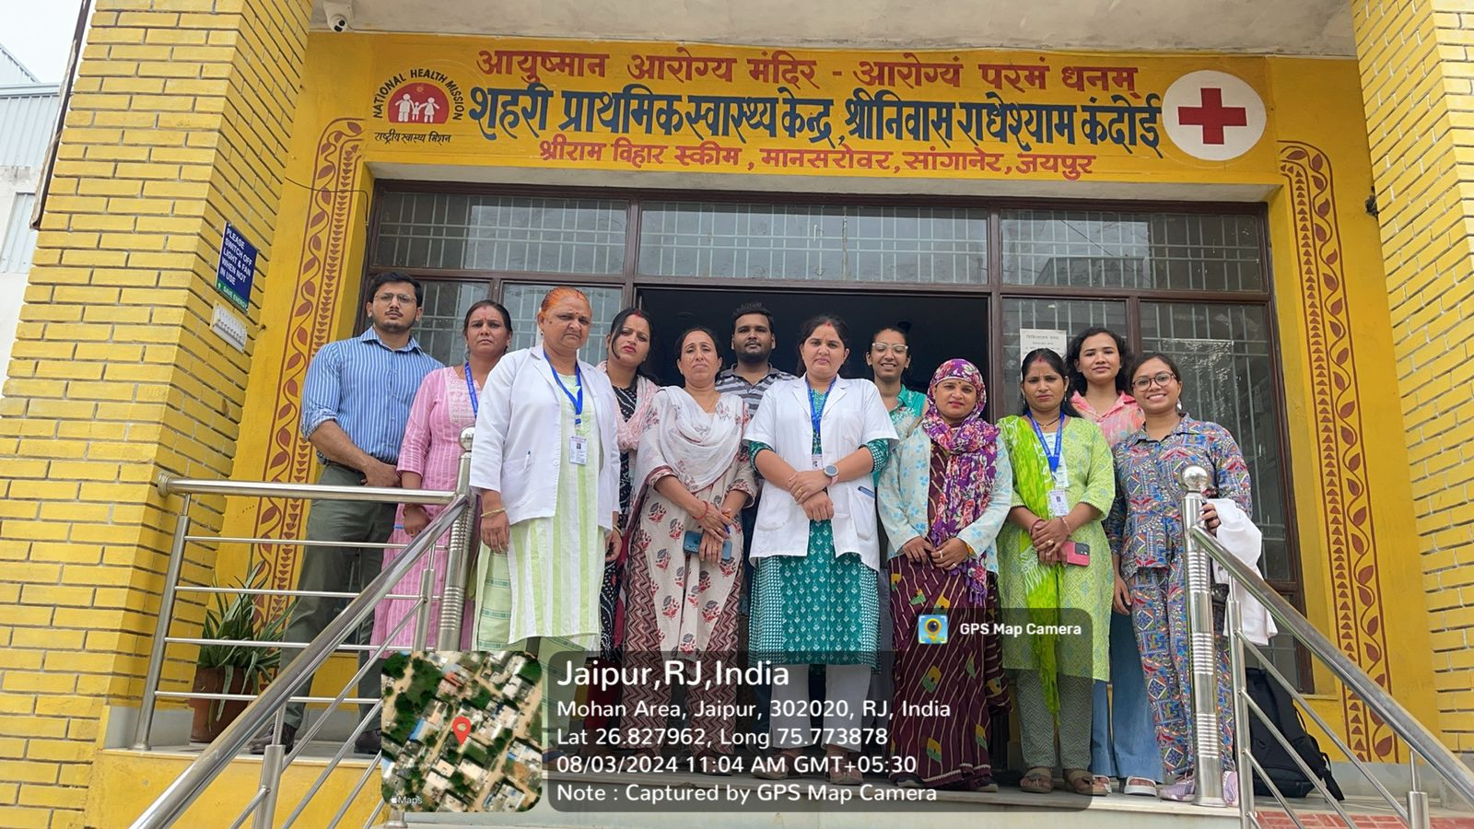
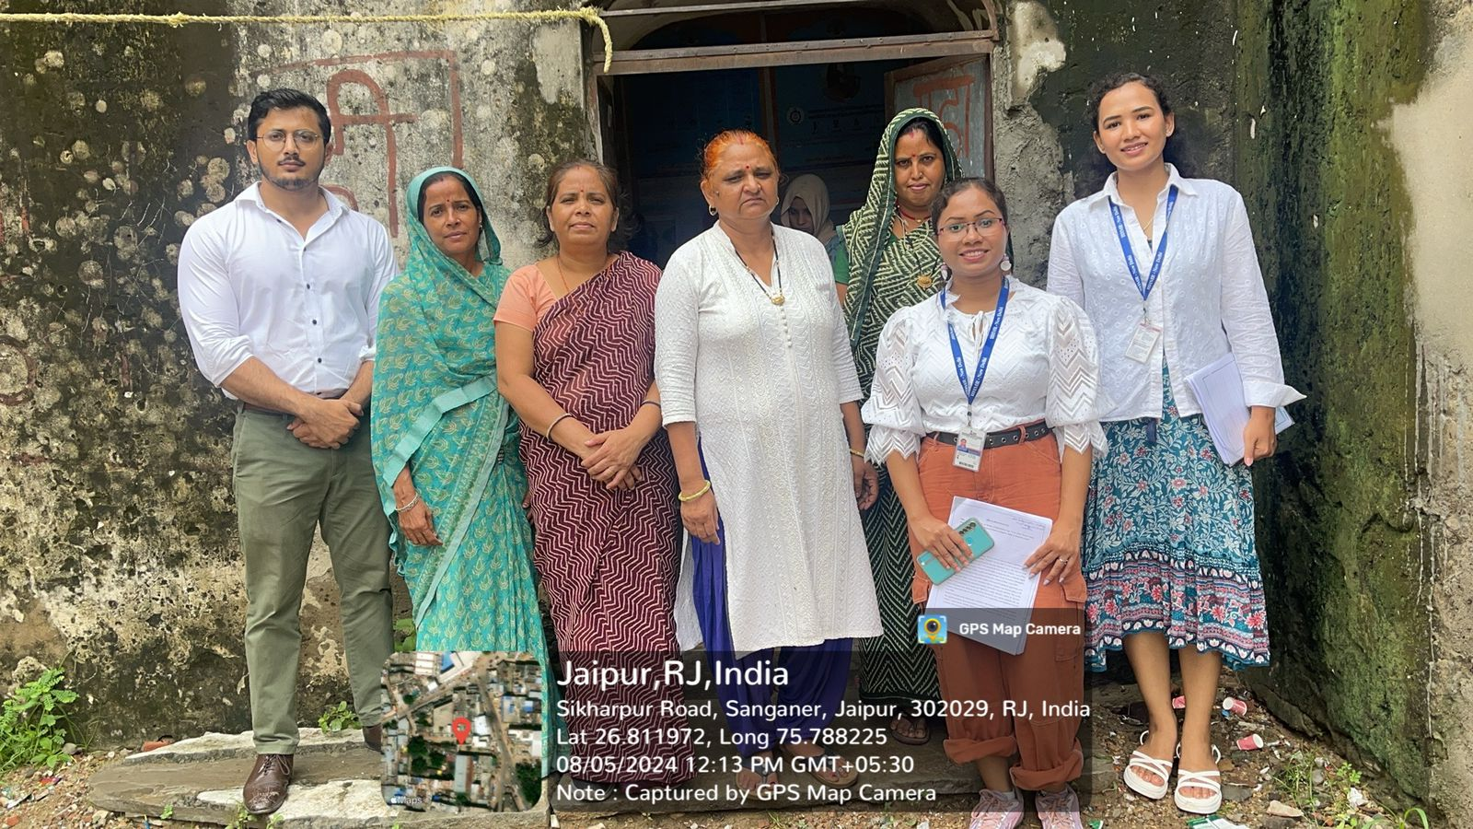
COP FIELD ACTIVITIES PHOTOGRAPHS

Slide 31
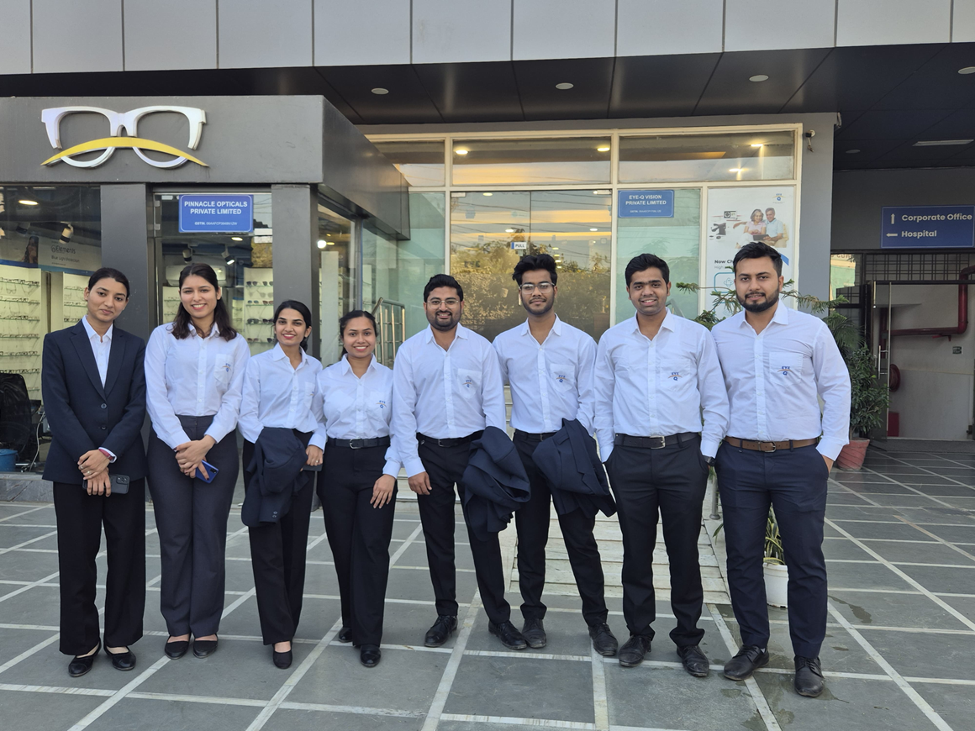
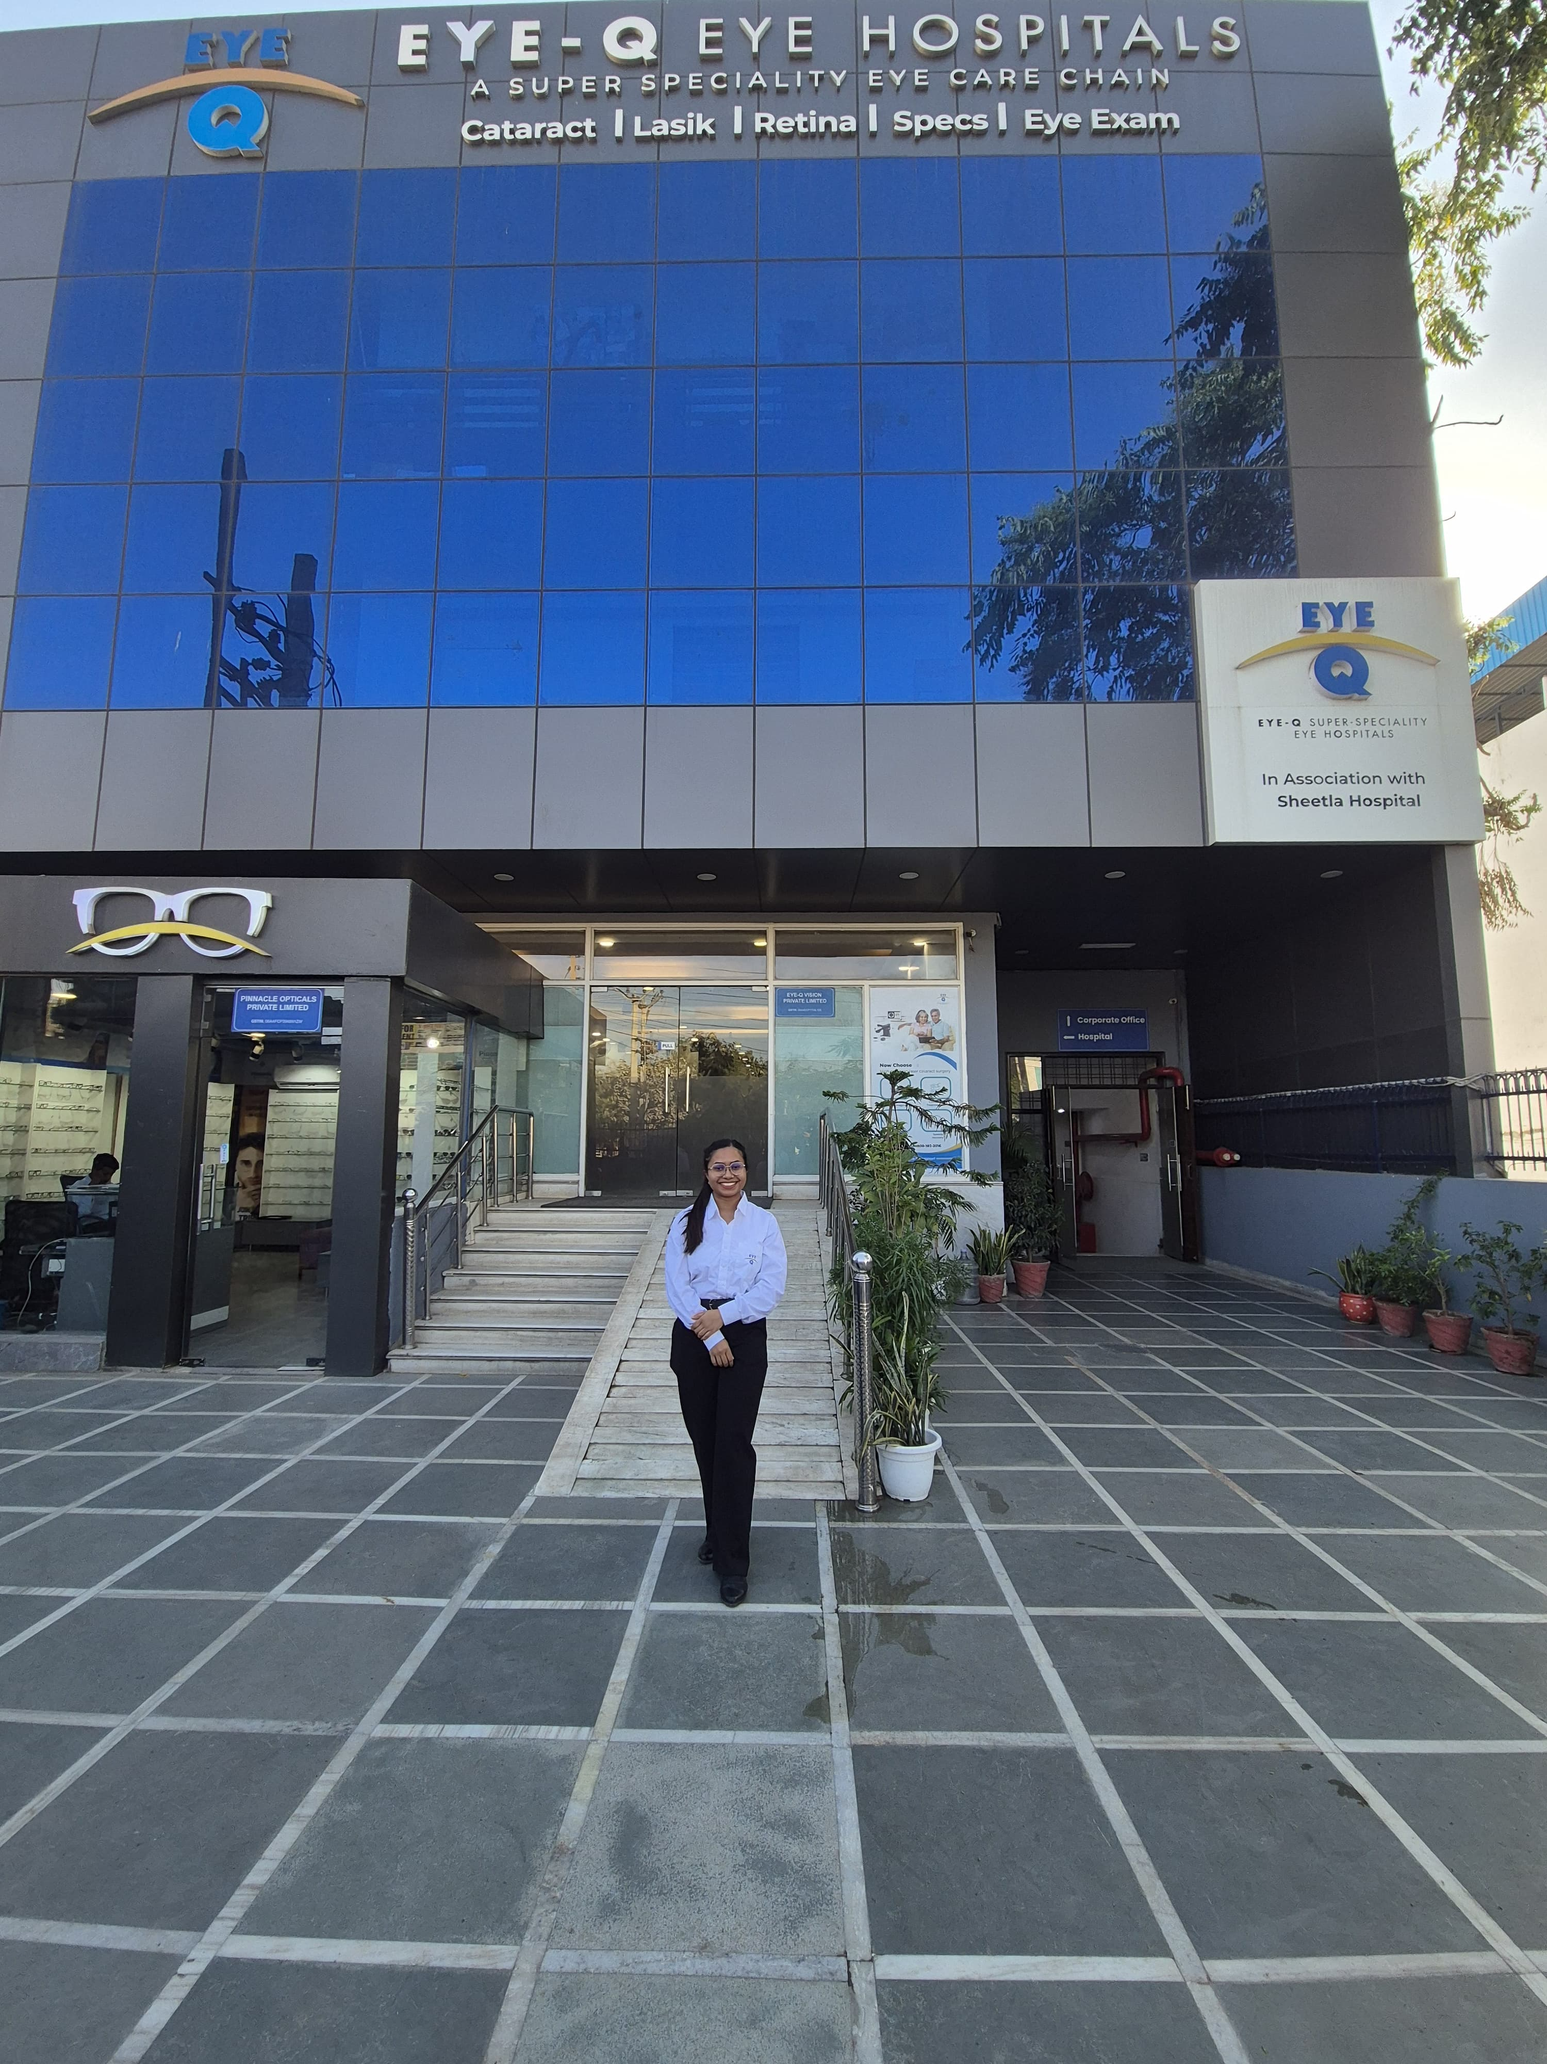
Pictorial Journey

Slide 32
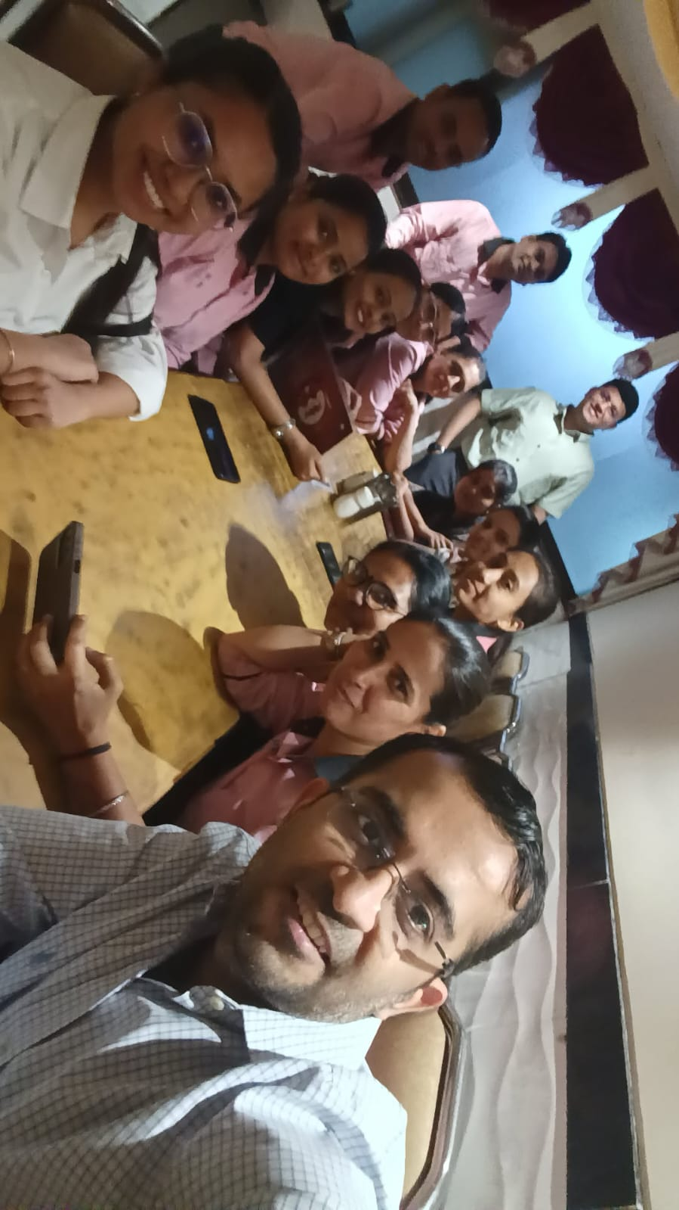
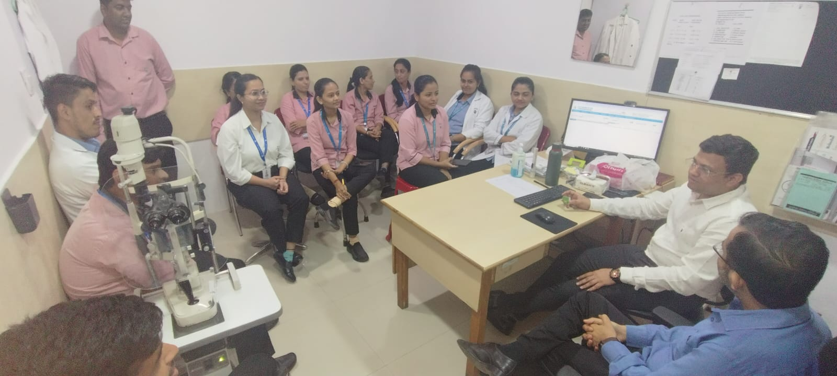

Slide 33
THANK YOU

