Slide 1

OVERVIEW OF SUPPLY CHAIN MANAGEMENT IN HOSPITAL
SHRINATH MISHRA

Slide 2
INTRODUCTION
India's first and only NABH-accredited cancer hospital.
350 bedded hospital
Own pharmacy to ensure availability of genuine drugs
Cental pharmacy store, satellite department pharmacy stores and pharmacy shop

Slide 3
Rationale
Measuring the effectivity of pharmacy department in organisation.
Effective management and supervision
Result oriented requisition and distribution system
Compliance of written policies and procedures.

Slide 4
Objectives
To maintain the specified material quality level as well as a level of quality that allows for efficient and effective operation.
To reduce the overall acquisition cost by improving operations and procedures.
Measure the effect of supply chain management dimensions (the relationship with suppliers, specifications, standards, delivery, and after-sales service)..
To create dependable alternative sources of supply in order to promote atmosphere in performance and pricing.

Slide 5
Methodology
Quantitative Methodology
Hypothesis testing

Slide 6




Results/Findings

Slide 7
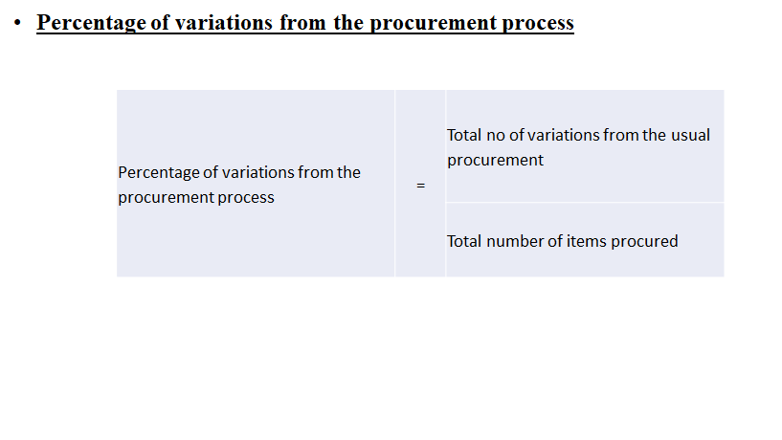

Slide 8
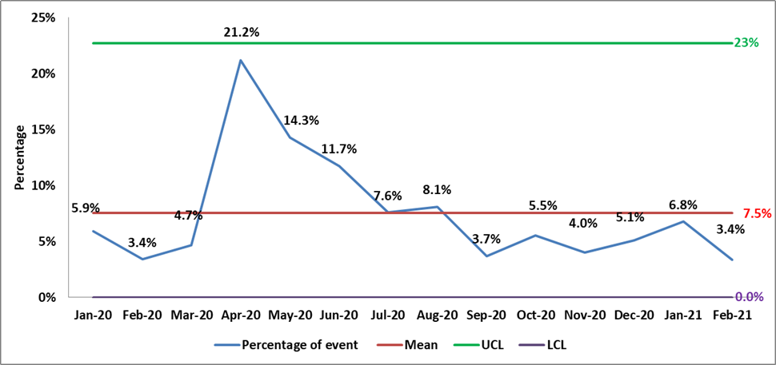

Slide 9
Root Cause Analysis and Corrective and Preventive Action
RCA –
Due to lock down our vendors were unable to supply
Lack of resources at the end of vendors discouraged them to supply to hospitals frequently
CAPA –
Our housekeeping staff and vehicle were used to fulfil the purchase orders on a daily basis
The variations caused due to incorrect invoice (rate, pack size, quantity) were rectified the next day
Urgent requirements were fulfilled and documents were created and entered in system the same day or by next day

Slide 10
Percentage of stock outs including emergency
Percentage of variations from the procurement process | = | Total no of variations from the usual procurement
 |  | Total number of items procured

Slide 11
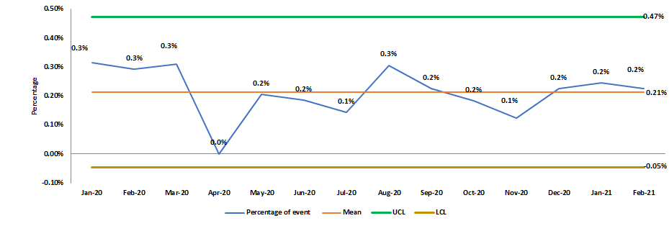

Slide 12
Root Cause Analysis and Corrective and Preventive Action
RCA –
Due to sudden increase in Covid Cases, the vendors were unable to follow the streamlined process of regular supplies
CAPA –
We had to streamline our purchase orders by accounting for the vendor lead time variability in calculating ROL
We increased the safety stock of all moving items

Slide 13
Conclusion
•The goal of this study was to see how supply chain management affected the quality of healthcare services in hospitals.
•The findings revealed a medium relationship between the availability chain management dimensions (supplier relationship, specifications, standards, delivery, and after-sales service) and thus the quality of healthcare services.
•The purpose of this research was to determine how supply chain management affected the quality of healthcare services in hospitals. The findings revealed a moderate relationship between the dimensions of availability chain management
•The findings also revealed that there are no significant differences in supply chain management dimensions, and thus the quality of healthcare services, due to demographic factors such as gender, educational qualification, age, and knowledge.
•Based on the literature, the current study developed a replacement model that depicts the effect of supply chain management dimensions on service quality measurement in the health care sector.

Slide 14
RATING : HOW PGDHM COURSE ADDRESSES THE PROGRAM OUTCOMES
S.No | Category | Score
1. | Internalize the concepts of management such as healthcare delivery system, strategic planning, HR, marketing, finance and operations. | 3
2. | Apply knowledge of research and management techniques and functions in an integrated manner in healthcare set up | 3
3. | Use appropriate skills to support healthcare organizations to take informed decision in planning, building and managing healthcare organizations | 3
4. | Utilize learning acquired from trainings and practical exposures in real time situations. | 2

Slide 15

Recommendations

Slide 16
Recommendations
First, hospitals must specialize in supply chain activities in order to improve the quality of healthcare services.
Second, supply chain officers must make significant contributions to increasing the standard of health services provided to various beneficiaries.
Third, hospital management should specialzein recruiting highly skilled and specialised personnel within supply chain departments and subjecting them to intensive training courses in international quality standards.

Slide 17

References

Slide 18
Al-Taher, A. (2008). The Impact of Financial Resources on Health Services Performance: Ministry of Health, Khartoum State. Unpublished master's thesis, Institute of Development studies and Research Institute, University of Khartoum- Sudan.
Ashcroft, J. (2006). Eight Dimensions of Supply Chain Synchronization, National Business to Business Center, International Digital Laboratory. University of Warwick, UK.
Ayers, J. (2010). Supply Chain Project Management: A Structured Collaborative and Measurable Approach (2nd ed.). Florida: Auerbach Publications, USA.
Boyer, K., & Hult, G. (2005). Extending the Supply Chain: Integrating Operations and Marketing in the Online Grocery Industry. Journal of Operations Management, 23(6), 642-661. http://dx.doi.org/10.1016/j.jom.2005.01.003

