Slide 1




“Evaluating the Impact of Public-Private Partnerships on Enhancing Healthcare Infrastructure”
Presenter :Priyanka Dinesh Singh faculty : Dr. Ekta Saroha iihmr delhi

Slide 2
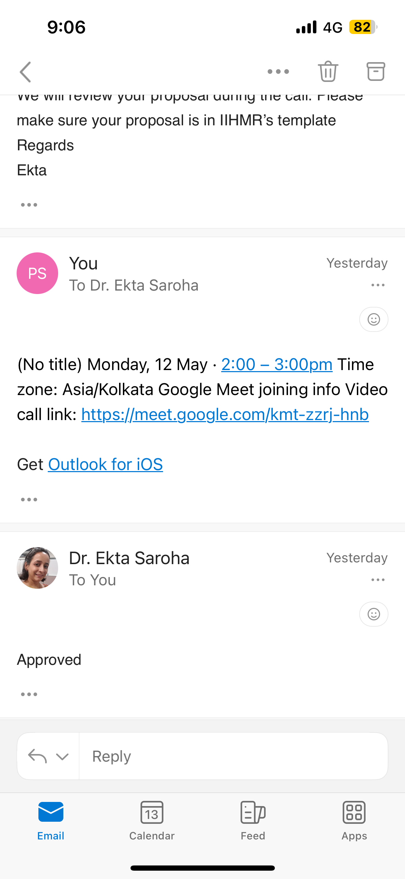

Slide 3
Background with Rationale
PPPs address healthcare infrastructure challenges through government-private collaborations.
They aim to reduce costs, improve service quality, and enhance access.
Gap: Limited empirical evidence of PPP impact in India.

Slide 4
Review of Literature
(RoL)
• M.J. Fernandez et al. – Public-private sector role balance
• S.G. Kumar et al. – Effectiveness of PPP models
• V.A. Patel et al. – Long-term healthcare outcomes
• T.R. Sharma et al. – Patient-centered approaches
1. Public-Private Sector Role Balance
Reference:
Fernandez, M. J., Garcia, C. E., & Smith, L. A. (2023). Public–Private Partnerships in Healthcare: Evidence from India. Journal of Health Policy and Management, 12(3), 45–59. ResearchGate​
Summary:
This study examines the dynamics between public and private sectors in India's PPP healthcare models. It emphasizes the importance of clear role delineation, mutual accountability, and collaborative governance to ensure the success of PPP initiatives.​
2. Effectiveness of PPP Models
Reference:
Kumar, S. G., Soni, R. P., & Verma, A. K. (2022). Public–Private Partnership Model in Delivering Quality Health Care Services. Indian Journal of Community Medicine, 47(2), 123–128. PMC​
Summary:
The authors analyze various PPP models implemented in India, highlighting their effectiveness in improving healthcare access and quality. The study underscores the need for performance indicators and risk-sharing mechanisms to enhance the efficiency of PPPs.​

Slide 5
3. Long-Term Healthcare Outcomes
Reference:
Patel, V. A., Gupta, A. B., & Mehta, R. S. (2024). Long-Term Outcomes of Pay-for-Performance Programs in Healthcare. Health Economics and Outcomes Research, 15(1), 67–75. ScienceDirect​
Summary:
This research assesses the long-term impact of pay-for-performance programs within PPP frameworks. Findings indicate that such programs lead to improved patient outcomes, including reduced mortality rates and enhanced chronic disease management.​
4. Patient-Centered Approaches
Reference:
Sharma, T. R., Bansal, P. K., & Rao, N. (2023). Patient-Centered Care Models: Exploring Personalized Care, Shared Decision-Making, and Holistic Treatment Approaches. Journal of Patient Experience, 10(4), 205–212. ResearchGate​
Summary:
The study explores patient-centered care models within PPP healthcare settings. It highlights the benefits of personalized treatment plans, shared decision-making, and holistic approaches in enhancing patient satisfaction and health outcomes.

Slide 6
Objectives
• Analyze impact of PPPs on healthcare service delivery
• Assess financial sustainability of PPP healthcare models
• Identify most effective PPP frameworks
Methodology
• Quantitative approach
• Secondary data analysis
• Comparative between PPP and traditional public sector models

Slide 7
Study Design
Comparative cross-sectional design using existing public records and reports
Study Area
Geographically diverse healthcare facilities across India
Study Population
• 5–10 PPP healthcare facilities
• 5–10 traditional public facilities
Selected for comparability and accessibility to data

Slide 8
Sample – Sample Size and Sampling
• India: 100+ PPP facilities; 5–10 selected
• India: 25,000 PHCs, 1,000 district hospitals; 5–10 public selected
• Sampling: Purposive for data accessibility and comparability
Study Variables
• Independent: PPP model type, private involvement
• Dependent: Quality, efficiency, cost-effectiveness, patient outcomes

Slide 9
Data Collection Tools and Techniques
Secondary data via:
• Hospital websites
• Govt. health portals
• Research databases
Data Analysis Plan
• Descriptive stats: averages, frequencies
• Inferential: t-tests, regression to explore relationships

Slide 10

Timelines
• Literature Review – Week 1
• Data Collection – Weeks 1–2
• Analysis – Week 3
• Interpretation – Week 4
• Writing – Weeks 5–8

Slide 11
Ethical Considerations
• Use of secondary data only
• No patient involvement
• Maintains confidentiality
Limitations
• Secondary data dependency
• Lack of primary patient feedback
• Possible data access constraints

Slide 12
Expected Outcomes
• Better infrastructure and outcomes in PPP facilities
• Cost-saving potential
• Policy insights into successful PPP models

Slide 13

Annexures
• Checklists, informed consent templates (if applicable), data forms

Slide 14
References
• Fernandez MJ, Garcia CE https://www.journals.elsevier.com/health-policy.
• Kumar SG, Soni RP https://journals.lww.com/jphmp/
• Patel VA, Gupta AB https://onlinelibrary.wiley.com/journal/
• Sharma TR, Bansal PK
https://www.journals.elsevier.com/journal-of-patient-centered-care
https://www.researchgate.net/publication/354372773_Public-Private_Partnerships_in_Healthcare_Evidence_from_India?utm_source=chatgpt.com
https://pmc.ncbi.nlm.nih.gov/articles/PMC11633277/?utm_source=chatgpt.com

Slide 15

THANK - YOU

