Slide 1



Dissertation Report
At
Submitted by
Payal Pawar
PG/12/061

Slide 2
Organization Profile
CARE has been working in India for over 60 years, focusing on ending poverty and social injustice .
It is part of the CARE International Confederation working in 84 countries.
In India CARE focuses on the empowerment of women and girls.
As part of Sector Wide Approach to Strengthen Health in Bihar (SWASTH), CARE is providing Technical Assistance (TA) support to Government of Bihar (GoB) to develop a comprehensive health sector reform, a nutrition policy and capacity building
Key focus areas include: poor and vulnerable sections, health service delivery, nutrition service delivery, capacity building of health service providers, behaviour change, health financing, institutional development, and public-private partnership.

Slide 3
Deliverables of Internship
Ensuring availability of diagnostic kits and medicines for treatment of VL at every PHC in the district.
Liaison with government officials at the district level for ensuring smooth conduction of activities related to SKAEP in the district
Assisted NVDCP officials in the preparation of Indoor Residual Spray (IRS) Microplan at the district level
Prepared formats for reporting IRS daily coverage of households and detailed information about equipment status, manpower status, targeted, pending and remaining households
Monitoring and evaluation of IRS
Monitoring and evaluation of Kala Azar Project in the district
As District Project Officer (VL), Provided administrative, technical and managerial support for effective implementation of the Strengthening Kala Azar Elimination Project (SKAEP) in West Champaran, Bihar

Slide 4
Dissertation Topic
GAP ANALYSIS OF LABOUR ROOMS OF PRIMARY HEALTH CENTRES (PHCs) IN WEST CHAMPARAN, BIHAR BASED ON INDIAN PUBLIC HEALTH STANDARDS (IPHS)

Slide 5
Introduction
Three tier system of healthcare in rural areas:
  Sub Center
  Primary Health Center (PHCs)
  Community Health Center.
PHCs provide
  Preventive
  Promotive
  Curative
  Supervisory
  outreach services
NRHM aims at strengthening PHCs

Slide 6
Introduction: Contd
Availability and functionality of labor rooms present in PHCs affect the situation of maternal health
The Indian Public Health Standards (IPHS) provide framework and structure to find out the gaps existing in the healthcare delivery in the rural communities
It helps to measure the performance with the resources available

Slide 7
Review Of Literature
A study by V Srinath et al (2012) to assess the compliance of PHCs to IPH standards revealed that there were great variations between the PHCs in terms of manpower, and less in terms of drugs and supplies.
A study by Arun Kumar et al (2010) to identify the gaps in facilities existing at the sub-centres in comparison to IPHS norms revealed that significant gaps existed in the available infrastructure and availability of man power (especially male worker) in the selected sub-centres. Gaps were also there in the parameters designed for quality control of the sub-centres e.g. citizen’s charter, external monitoring etc. Availability of services and service delivery at the sub-centres was satisfactory

Slide 8
Rationale of the Study
PHCs provide proper infrastructure for comprehensive health care to the rural population
Reproductive and child health is an important component of universal health of the rural population
Labour rooms are integral to improving the situation of maternal health, and ultimately the continuum of care (RMNCH+A), in rural settings
Essentials of labour room are well captured in IPHS guidelines

Slide 9
OBJECTIVE
General Objective
To assess the existing status of the labour rooms available in the PHC establishments in Bihar as per the IPHS norms developed under the NRHM.
Specific Objectives
To assess the existing status of the labour rooms available in the PHC with respect to dimensions and cleanliness and maintenance activities
To assess the existing status of the labour rooms available in the PHC with respect to practices to prevent cross-infection
To assess the existing status of the labour rooms available in the PHC with respect to preparedness of Labour Rooms to handle septic and infected deliveries
To assess the existing status of the Newborn Care Corners in labour rooms available in the PHC

Slide 10
METHODOLOGY
Study design: Cross sectional analytical study.
Study area and duration: February, 2014 to April, 2014 in PHCs of West Champaran, Bihar.
Sample Size: A sample size of 9 PHCs was purposively achieved.
Sampling Technique: Random sampling out of the total 18 PHCs of West Champaran district
Survey Instrument: Observation check-list based on the Indian Public Health Standards (IPHS) Guidelines for Primary Health Centres (PHCs) Revised 2012.
Data Type:
Primary data: Facility Survey with the help of an observation checklist based on guidelines provided in IPH standards (Revised) for Primary Health Centres- 2012.

Slide 11
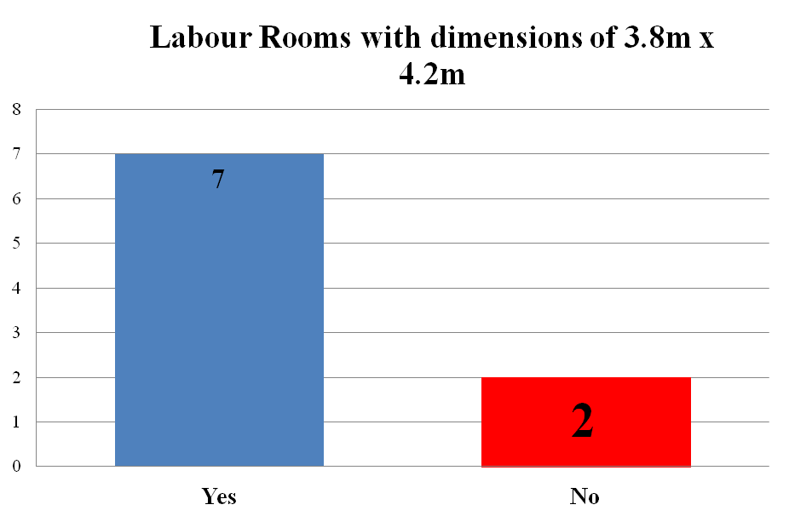
Key Findings: Dimensions of Labour room
N = 9 PHCs

Slide 12
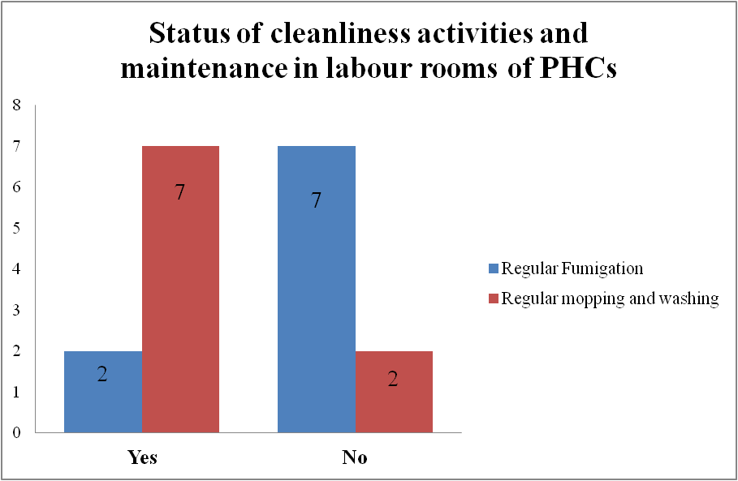
N = 9 PHCs

Slide 13
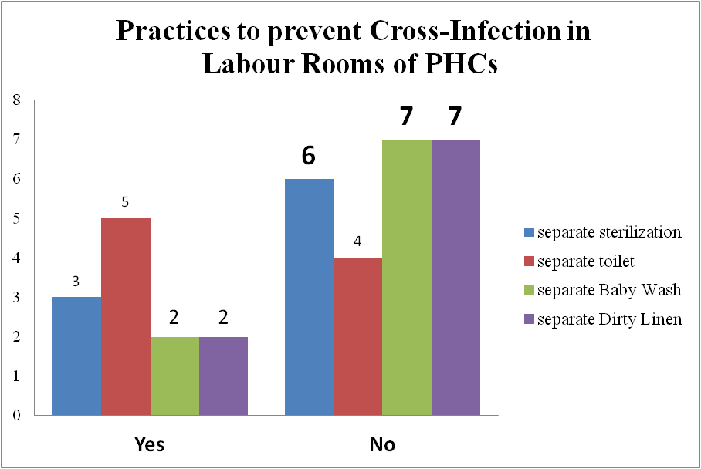
N = 9 PHCs

Slide 14
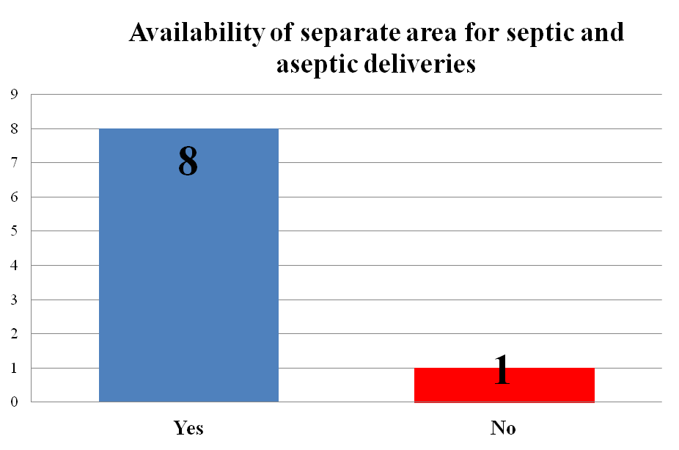
Preparedness of Labour Rooms to handle septic and infected deliveries
N = 9 PHCs

Slide 15
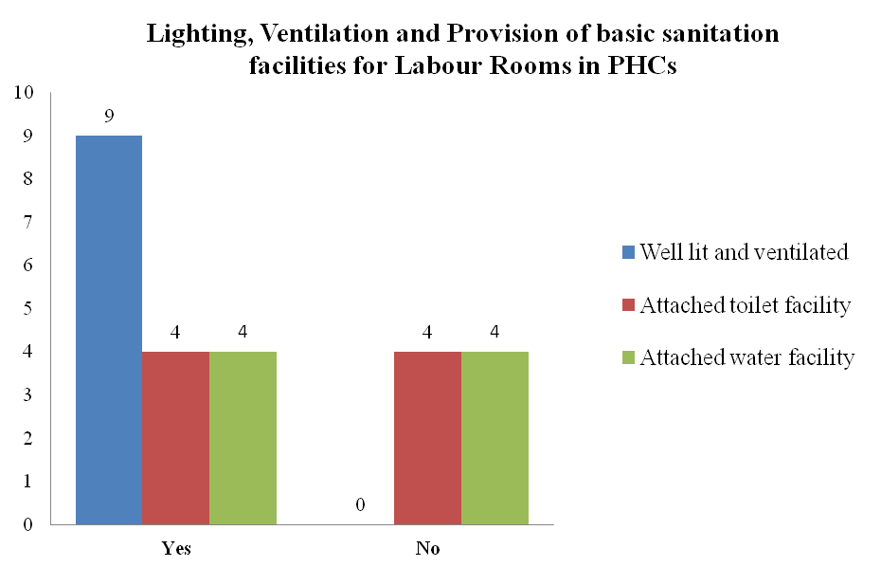
N = 9 PHCs

Slide 16
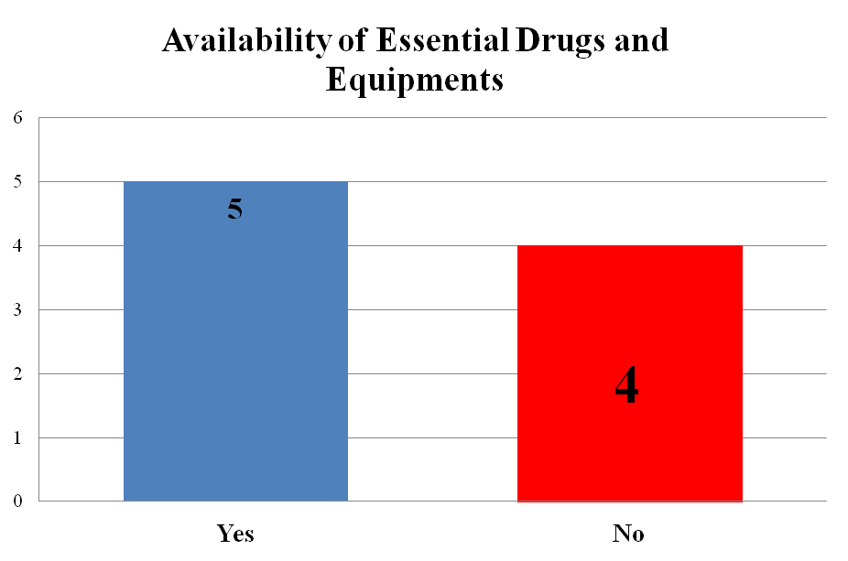
Preparedness of Labour Rooms for meeting basic objective:
N = 9 PHCs

Slide 17
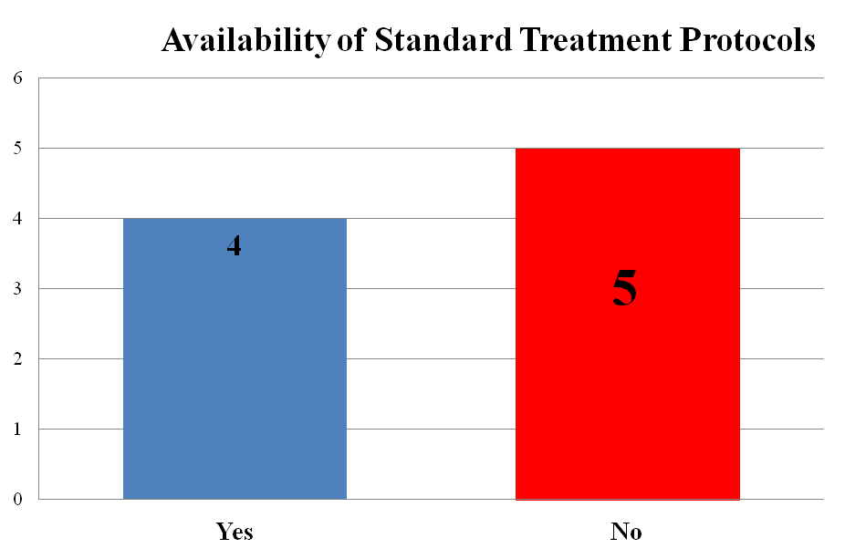
Preparedness of Labour Rooms for handling common problems during labour:
N = 9 PHCs

Slide 18
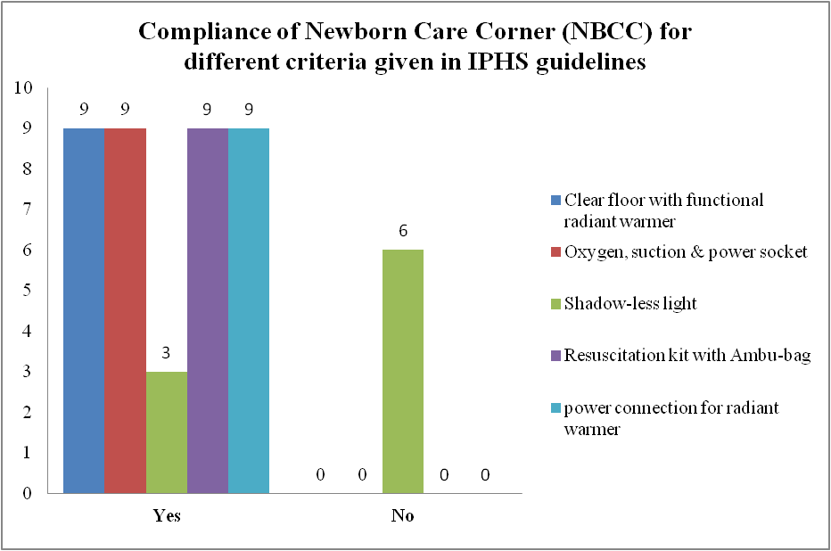
Key Findings: NBCC
N = 9 PHCs

Slide 19
CONCLUSION
Not all of the labour rooms of PHCs meet the IPHS norms fully
Deliveries are being reported to be carried out in the labour rooms of all the 9 PHCs
Compliance by 75%-99% of labour rooms:
  ‘regular mopping and washing’,
  ‘separate areas for septic and aseptic deliveries’
  ‘prescribed dimensions of 3.8 m x 4.2 m’.
Compliance by 50%-74% of labour rooms:
  ‘separate area for toilet’,
  ‘restricted entry in labour room’
  ‘availability of essential drugs and equipments’
Compliance by 0%-49% of labour rooms:
  ‘attached toilet and water facilities’,
  ‘separate area for dirty linen’,
  ‘separate area for baby wash’,
  ‘separate area for sterilization’,
  ‘provision of Standard Treatment Protocols for common problems during labour and for newborns’,
  ‘usage of separate footwear for labour room’
  ‘fumigation at regular intervals’

Slide 20
RECOMMENDATIONS
Ensuring availability and functionality of shadow-less light source in NBCCs
Skill building sessions for implementing practices to prevent cross-infections
Ensuring availability of Essential Drugs and Equipments in labour rooms
Updating knowledge of labour room staff regarding usage of separate footwear for labour room

Slide 21
LIMITATIONS
Ongoing IRS in the district limited the scope of study

Slide 22

THANK YOU

