Slide 1

Invest2care Technologies
Gap Analysis of Existing HIS System in XYZ Multispecialty– Study of Pharmacy & HR Module
Presented by : Anuj Gaur
PG/11/013
IIHMR – New Delhi

Slide 2
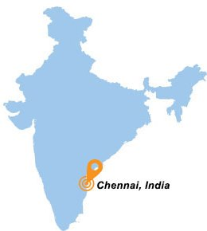


Invest2care Technologies
Company having operations in across the India,
Strong focus in the Healthcare vertical
Client's Operational in Delivery & Implementation, Handling Change Management
Significant domain knowledge in the Healthcare IT space
Healthcare Competence- Management Consulting, Hospital, Patient, Event, Data Management, Product domains

Slide 3
Hospital Brief
XYZ Multispecialty Hospital is a 675 bed multi- specialty state-of-the-art Hospital in India. It provides comprehensive Healthcare services, and has acquired the status of a premier medical institution.
The foundation was laid in April 1954
The hospital is governed by a Board of Management comprising medical consultants of eminence, some with an international standing. The Board of Management operates under the overall guidance of the Trust Society

Slide 4
Product
Unified healthcare information system that lets authorized healthcare professionals access and work with complete patient records
Leading Web-based HIS
Provides a full range of clinical, administrative, lab capabilities
Enables timely and more informed decisions about patient care, based on up-to-date information

Slide 5
Hospital Information System
It is comprehensive, integrated information systems to manage the medical, administrative, financial and legal aspects of a hospital and its service processing

Slide 6
Objective
General objective
Gap analysis of the existing HIS at XYZ – Multispecialty hospital’s the end-user’s perspective.
Specific objectives
The workflow of the hospital as seen on Product-A,B,C in department of HR and Pharmacy , by creating a fictitious personnel
Gather the issues in Product – A,B,C being used at Hospital
To assess the knowledge and behavior of end-user with tool and their issues
Discuss the issues with IT support team of Hospital

Slide 7
Methodology
Study design: Cross sectional , Descriptive
Study area: XYZ Multispecialty Hospital - HR and Pharmacy department
Study population: Pharmacists, End-user of Pharmacy department, Over to counter users
Sampling and sampling design : Sample size 51 ,Convenience.
Data collection tool :
  1. Primary : By on field- observation technique
  2. Secondary: Previous data from the pharmacy prescription record
Duration of study : 2 months
Information thus obtained from the above questionnaire entered in SPSS software and analyzed.

Slide 8
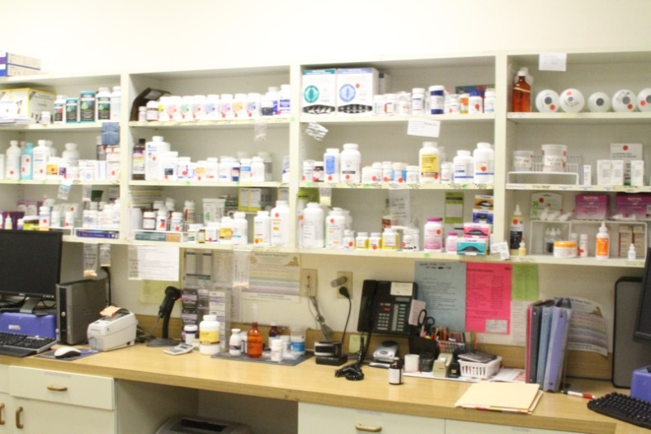
Gap Analysis of
Pharmacy Department

Slide 9
Pharmacy Information System
To enable operational efficiency across the hospital need to deploy proper and adequate due to diligence and right implementation approach

Slide 10
Pharmacy Department
Dispensary
Main Store
Pharmacy
IPD
OPD

Slide 11
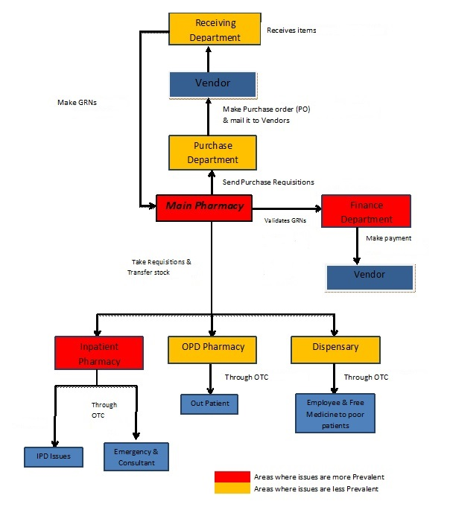
Hospital Pharmacy - Workflow

Slide 12
Department-wise Total Number of User
Fewer repetitive, tedious tasks
Improved intra/inter Office communication
Demonstrable High Quality care
More time for patient care and personal life

Slide 13
Product Uses by User on Hour Bases

Slide 14

OBSERVATIONS
The slow work flow process
License process also complicated for the user
Less upgraded HIS software
Training issues
Run time error mostly faced

Slide 15
Recommendations
Rectify the current issues
Effective communication between respective users and Hospital IT support team
Up-gradation of the current product
Change the old system

Slide 16

Gap Analysis of
Human Resources Department

Slide 17
Human Resource Information System
Human resource Information system helps HR managers perform HR functions in a more effective and systematic way using technology
It is the system used to acquire, store, manipulate, analyze, retrieve, and distribute pertinent information regarding an organization's human resources

Slide 18
HR Department Issues in Hospital
Data recording schema
Data maintaining system
Data retrieving issues
Data are not connected with HIS

Slide 19
Recommendation
Effective communication between respective users and Hospital IT support team for implementation and connectivity of HRMS and HIS.
Up-gradation of the current product which is integrated with all department
Change the new system which has well-functioning HRMS

Slide 20
Thank you

