Slide 1

Economic Burden of Cancer Care in India from Household Perspective – A Scoping Review
IIHMR, Delhi
Prepared By:
Ankita
PG/23/019
Under Supervision of:
Dr. Archana Thakur
IIHMR, Delhi

Slide 2
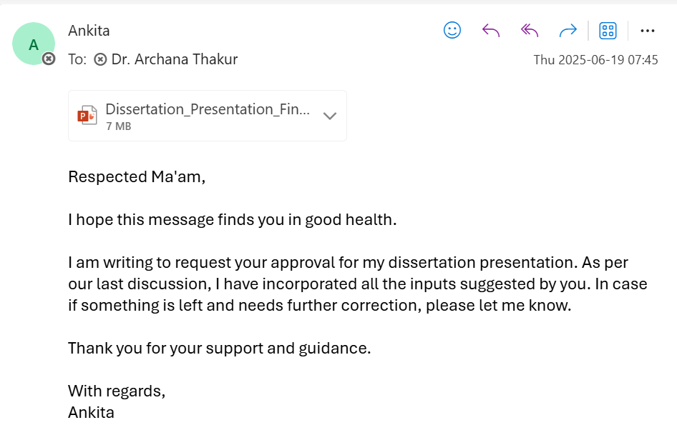

Mentor Approval

Slide 3
BACKGROUND
Global Scenario:
Cancer caused ~10M deaths in 2020; 1 in 6 deaths globally.[1]
As per WHO, 20M new cases, 9.7M deaths globally in 2022.
Projected to reach 35M cases by 2050 (+77%).[2]
India’s Context:
As per NCRP, 1.39M cases in 2020, projected to reach 1.57M by 2025.[3]
India accounts for 7.3% of global cancer cases; 8.4% of deaths.[4]
Indicates high prevalence & poor survival outcomes.

Slide 4
BACKGROUND
Economic Impact:
Cancer: 2nd highest hospitalization cost after CVD.
Based on NSS 2017-18, avg. medical exp. estimated per cancer hospitalization was:
  ₹22.5K (public), ₹93.3K (private) [5]
  ₹15.9K (rural), ₹22K (urban) [6]
Cancer causes highest Catastrophic Health Expenditure (79%) & 43% of households resort to distress financing.[7]
Insurance Coverage Gaps:
Public insurance (PM-JAY/state): Covers bottom 40%(~50 crore), but with limited cancer package cap (₹50K–1.5L).
Private insurance: ~18% coverage, often excludes pre-existing cancer & long-term care.
Uninsured: 30% population bears full OOPE → most vulnerable.[8]

Slide 5
RATIONALE OF STUDY
The most recent comprehensive dataset on cancer care costs in India is from the NSSO 2017-18 survey, leaving a critical gap in understanding the current financial burden amid policy changes like Ayushman Bharat.
This review will synthesize data on out-of-pocket expenses, catastrophic spending, and disparities (rural/urban, insured/uninsured) to help prioritize funding for high-cost treatments and vulnerable populations.
Findings will be helpful to inform insurance schemes (e.g., PMJAY) by highlighting coverage gaps, actual treatment costs, and the need for expanded financial protection to reduce household distress financing.

Slide 6
Review of Literature
Author; Year | Study Design | Study Objective | No. of Studies Included | Findings
Anushikha Dhankhar, Ranjeeta Kumari, Yogesh A Bahurupi; 2021, | Systematic review with meta-analysis | To determine pooled estimates of OOPE, CHE, and distress financing for cancer care in India. Assess correlates of CHE and common financing modes. | 23 studies (January 2011 and July 2020 ) | Total direct OOPE was 47138.95 INR (95% CI = 37589.43-56690.74). Indirect OOPE was 11908.50 INR (95% CI=-5909.33-29726.31). Proportion of individuals facing CHE was 62.7%.
Nicolas Iragorri, Claire de Oliveira, Natalie Fitzgerald, Beverley Essue; 2021 | Systematic literature review | To evaluate the literature on out-of-pocket costs of cancer care and provide a comprehensive overview of the economic burden faced by cancer patients and their caregivers. | 105 studies (inception to 7 May 2019 | Costs by Country: U.S.: USD 180–2,600 per month. Canada: USD 15–400 per month. Western Europe: USD 4–609 per month. Australia: USD 58–438 per month. Costs by Cancer Type: Breast/colorectal cancer: USD 200 per month. Paediatric cancer: USD 800 per month.

Slide 7
Review of Literature
Author; Year | Study Design | Study Objective | No. of Studies Included | Findings
Ghimire et al.; 2024 | Systematic review + meta-analysis | To quantify cancer-related catastrophic health expenditure globally & identify risk factors | 35 studies | Pooled CHE prevalence ~56%; risk factors include low income, low insurance, large households, older age
Ahmed et al.; 2024 | Systematic Review | To describe cost of illness for breast cancer across LMICs | 12 studies | Annual per-patient COI ranged: US$809 to US$27 122; major cost components—hospitalisation, meds, non-med costs (travel/lodging)

Slide 8
RESEARCH QUESTION (PICO FORMAT)
Research Question:
What is the annual household expenditure on cancer care in India?
PICO Format:
  P – Indian households with at least one cancer-diagnosed member
  I – Not applicable
  C – Not applicable
  O – Annual household expenditure incurred on cancer care
      Direct medical Expenditure
      Direct non-medical Expenditure
      Indirect Expenditure
      Catastrophic Healthcare Expenditure

Slide 9
OBJECTIVES
We planned a scoping review to collate and summarize evidence on annual household expenditure on cancer care in India.
Household expenses include direct medical expenditure, direct non-medical expenditure as well as indirect costs due to loss of income. It also includes catastrophic health expenditure leading to financial hardship, distress financing and impoverishment.
This study will provide estimates of household expenditure to understand economic burden of cancer care from household perspective and contribute to generate evidence-based recommendations for innovations in health financing and policy reforms to mitigate catastrophic health expenditures.

Slide 10
METHODOLOGY
Search Strategy & Study Selection
  Database : PubMed, Cochrane Central Register of Controlled Trials (CENTRAL), ProQuest
  Key Concepts: Cancer AND Household Expenditure AND India
  Inclusion & Exclusion Criteria
Screening
  Title and Abstract Screening [Tiab]
  Full Text
Data Extraction
Data Collation & Summarization

Slide 11
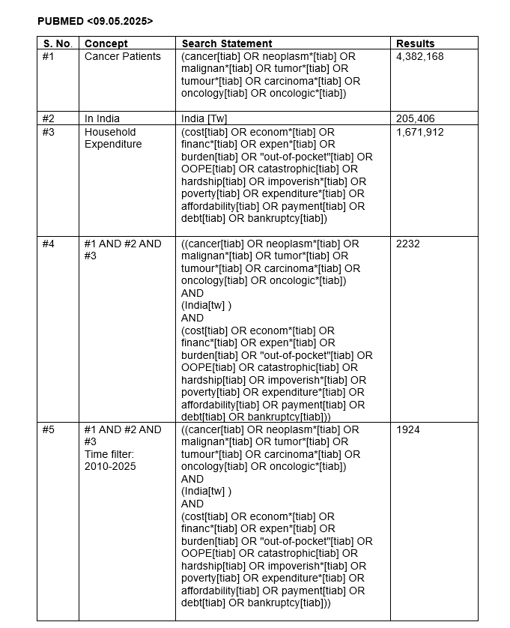
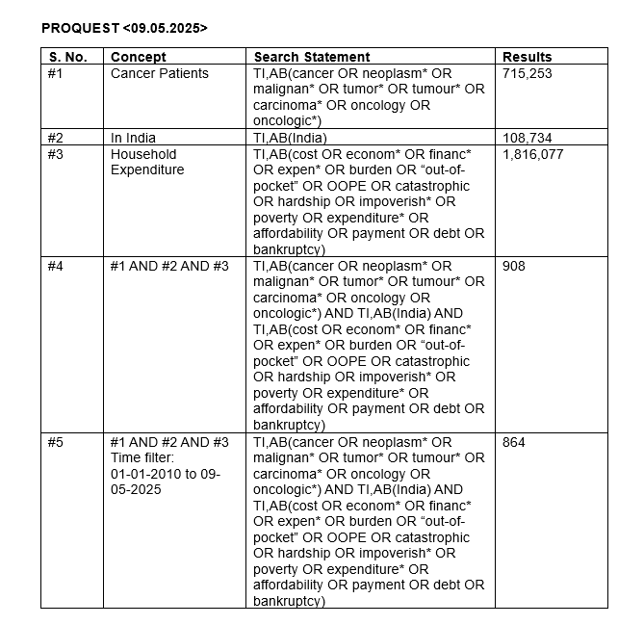

Slide 12
METHODOLOGY
Inclusion Criteria:
Studies focusing on household expenditure, out-of-pocket expenditure (OOPE), catastrophic health expenditure (CHE), or distress financing related to cancer care.
Household expenditure includes both direct and indirect costs.
Direct costs are further classified into:
  Medical costs: consultations, diagnostics, medications, treatments, etc.
  Non-medical costs: transportation, food, accommodation, etc.
Indirect costs include loss of wages and productivity due to illness or psychosocial factors, insurance costs such as co-payments and deductibles.
Studies reporting a confirmed diagnosis of cancer will be eligible for inclusion.
Studies that focus either solely on cancer or include cancer as a comorbidity will be considered.

Slide 13
METHODOLOGY
Inclusion Criteria:
Studies conducted in both hospital-based and community-based settings will be included.
Studies must be conducted on populations based in India.
Studies must be published in English.
Only studies published in the last 15 years (2010–2025) will be included.
The review will include primary quantitative studies, including:
  Observational designs: cross-sectional, case-control, and cohort studies.
  Experimental designs: RCTs, Quasi-experimental studies.
Case series and economic evaluations related to cancer care will also be included.
Abstracts without full-text availability will be included if they contain sufficient data on household expenditure.

Slide 14
METHODOLOGY
Exclusion Criteria:
Studies that focus solely on clinical outcomes without any economic or expenditure-related data.
Studies analysing costs from the health system perspective will be excluded.
Reports lacking primary data, such as policy briefs or expert opinions, will not be considered.
Editorials, case reports, commentaries, letter to editor and narrative/systematic reviews will be excluded.
Conference proceedings or presentations that do not report household expenditure data will be excluded.
Abstracts that are:
  Not available as full text.
  Do not contain adequate data on household expenditure will be excluded.

Slide 15
METHODOLOGY
Screening:
Tiab Screening
  Titles and abstracts of retrieved records were screened using Rayyan software to identify potentially eligible studies.
Full-Text Review
  Shortlisted studies were advanced to rigorous full-text review to evaluate their alignment with the research objectives.
Final Inclusion
  Studies meeting predefined inclusion/exclusion criteria were selected for synthesis in the scoping review.

Slide 16
METHODOLOGY
Data Extraction:
Data Extraction was done using Microsoft excel tool.
A predefined template was used for data extraction to collect details on following major categories of study variables:
  Study Characteristics
  Patient Demographics & Clinical Details
  Expenditure & Financial Impact Variables
  Additional Variables

Slide 17
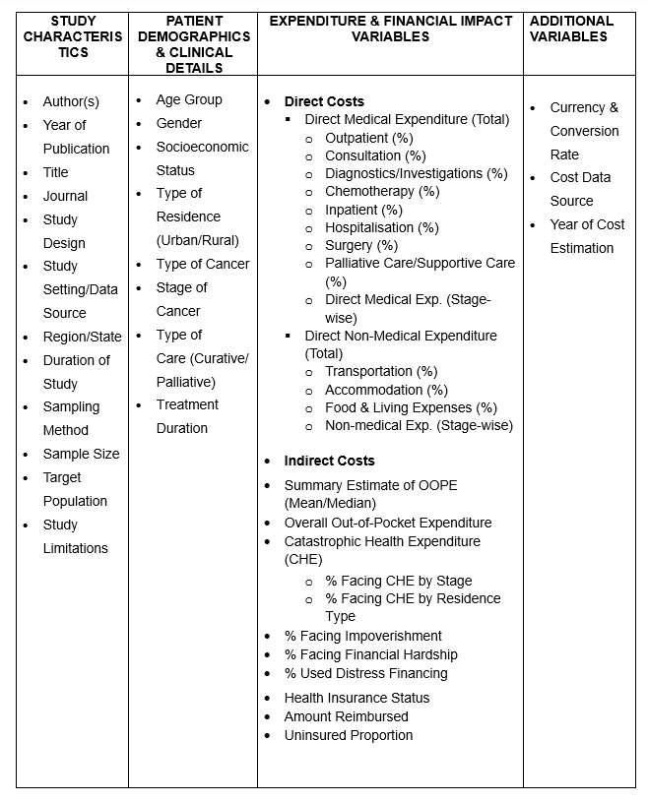
METHODOLOGY
Data Extraction :
Study Variables

Slide 18
METHODOLOGY
Data Collation & Summarization:
Findings were reported in accordance with the Preferred Reporting Items for Systematic Reviews and Meta-Analyses extension for Scoping Reviews (PRISMA-ScR) guidelines.
Study characteristics were tabulated by cancer type, along with the corresponding household expenditures incurred for each category.
To ensure comparability, all cost measures were adjusted to 2025 values using an online inflation calculator specific to India.

Slide 19
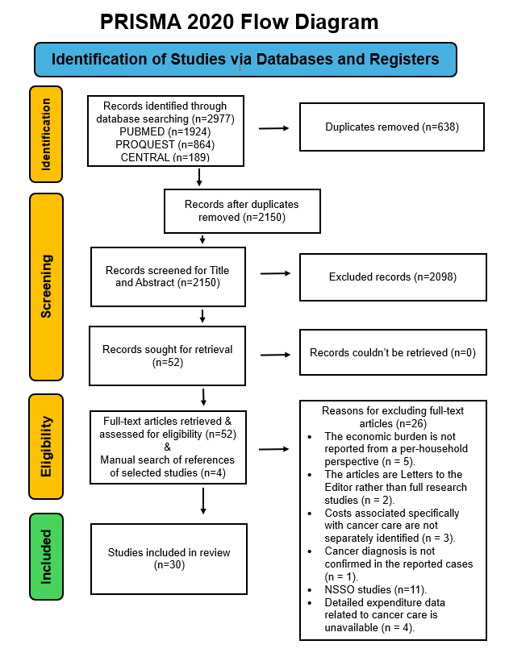
RESULTS
PRISMA Sheet:

Slide 20
RESULTS
STUDY CHARACTERISTICS:
Gender Distribution:
  Females dominate in breast cancer studies (100% female participants), while males are predominant in head and neck (up to 90.2%) and oral cancer studies (81–92%). Mixed cancer categories show variability.
Age Groups:
  Breast cancer patients are typically middle-aged (mean/median age 45–50 years). Pediatric cancers (e.g., leukemia) involve children (mean age ~5–8 years). Head and neck cancer patients are often older (median age ~47–55 years).
Cancer Types:
  Breast cancer is the most studied, followed by head and neck, cervical, and oral cancers. Mixed-category studies include diverse cancers (e.g., breast, head and neck, cervical). Leukemia studies focus on pediatric populations.

Slide 21
RESULTS
Study Characteristics:
Residence and Facility Type:
  Rural residence is common (e.g., 60–72.3% in head and neck cancer studies). Public facilities are predominant (e.g., Tata Memorial Centre, PGIMER), though some studies include private settings (e.g., 58% private healthcare use in Punjab for breast cancer[14]).
Insurance Coverage:
  Low insurance coverage is noted overall, with high uninsured proportions (e.g., 66–98% for breast cancer, 70–92% for cervical cancer). Exceptions include oral cancer in Maharashtra (86% insured)[16] and a Karnataka private hospital (90% insured)[34]. Public facilities often report lower insurance rates compared to private ones.

Slide 22
RESULTS
Annual Household Expenditure Incurred on Cancer Care (INR):
Breast Cancer:
  Highest annual mean OOPE (₹9,98,406), annual median OOPE (32,600), indirect costs (97,712 as per 2012-13) and CHE (79.17% for uninsured).[14][12]
  COVID-19 impact: OOPE rose from ₹2,20,932 (pre-pandemic) to ₹2,91,444 (during pandemic).[11]
Head and Neck Cancer:
  Treatment costs varied by modality:
    Surgery + IMRT + chemo: Annual mean OOPE ₹1,75,118 (2025).[19]
    2-DRT: Annual mean OOPE ₹63,604 (2025)[19]
  CHE (34%) reported[20]

Slide 23
RESULTS
Annual Household Expenditure Incurred on Cancer Care (INR)
Leukemia (Pediatric):
  Annual Median OOPE: ₹95,447–₹1,01,064 (2025), with 72% facing financial hardship.[29]
Mixed Cancers: Public facilities had lower OOPE (₹31,200) vs. private (₹3,47200).[31]
Public facilities reduced OOPE by 50–70% but still led to CHE for 55–96% of patients.
Costs were higher in urban areas and private facilities (e.g., oral cancer in Delhi: ₹4,41,200 vs. ₹1,53,823 in rural Maharashtra).[17][16]

Slide 24
DISCUSSION
OOPE Comparison: Dhankhar et al. (2021) reported a pooled mean direct OOPE ₹85,000 for cancer care, while the scoping review found in the range of ₹ 32,000 - ₹9,98,406, highlighting rising expenses and variability by cancer type.
Indirect Costs: Dhankhar et. al. (2021) reported a pooled mean of 10,000 for cancer care while the scoping review found it in the range of ₹ 7,762 – 97,712.
CHE Prevalence: Both studies identified high CHE rates (pooled CHE 62.7% in Dhankhar et al. vs. range of 34%-96% in the scoping review), underscoring the severe financial burden, especially among uninsured households.
Distress Financing: Dhankhar et al. noted savings, borrowing, and asset sales as common coping mechanisms, aligning with the scoping review’s findings, which also emphasized treatment discontinuation due to costs.
Insurance Gaps: The scoping review expanded on Dhankhar et al.’s data, revealing persistent coverage gaps despite policies like Ayushman Bharat, with 30% of households remaining uninsured.

Slide 25
LIMITATIONS OF THE STUDY
Most data are from states like Maharashtra, Delhi, and Chandigarh, with underrepresentation from rural or low-resource regions (e.g., Bihar, Northeast India).
Some studies had very small samples (e.g., 11 families in Ahuja et al., 2019), reducing generalizability.
Not all studies disaggregated costs into direct medical, non-medical, and indirect expenses, limiting a unified analysis.

Slide 26
CONCLUSION
The review confirmed severe out-of-pocket expenses and catastrophic health spending for Indian households, with uninsured and rural families facing the worst impact.
This scoping review underscores the urgent need for systemic reforms to mitigate the financial toxicity of cancer care in India, ensuring equitable access to treatment without impoverishing households.
The findings call for multi-stakeholder efforts to strengthen health financing mechanisms and reduce the economic burden on families battling cancer.

Slide 27
REFERENCES:
[1] World Health Organization. Cancer [Internet]. Geneva: World Health Organization; 2024 [cited 2025 Apr 9]. Available from: https://www.who.int/news-room/fact-sheets/detail/cancer
[2] World Health Organization. Global cancer burden growing amidst mounting need for services [Internet]. Geneva: World Health Organization; 2024 Feb 1 [cited 2025 Apr 9]. Available from: https://www.who.int/news/item/01-02-2024-global-cancer-burden-growing--amidst-mounting-need-for-services
[3] National Centre for Disease Informatics and Research. Report of National Cancer Registry Programme 2020 [Internet]. Bengaluru: Indian Council of Medical Research; 2020 [cited 2025 Apr 9]. Available from: https://ncdirindia.org/All_Reports/Report_2020
[4] International Agency for Research on Cancer. India Fact Sheets 2020 [Internet]. Lyon: IARC; 2020 [cited 2025 Apr 9]. Available from: https://gco.iarc.fr/today/data/factsheets/populations/356-india-fact-sheets.pdf

Slide 28
REFERENCES:
[5] Ministry of Statistics and Programme Implementation (MoSPI). Key Indicators of Social Consumption in India: Health (NSS 75th Round) [Internet]. New Delhi: National Statistical Office; 2019 Jul [cited 2025 Apr 9]. Available from: https://www.mospi.gov.in/sites/default/files/publication_reports/KI_Health_75th_Final.pdf
[6] Ministry of Statistics and Programme Implementation (MoSPI). Health in India: Summary Analysis of Key Indicators from the 75th Round of the National Sample Survey [Internet]. New Delhi: National Statistical Office; 2021 Apr [cited 2025 Apr 9]. Available from: https://mospi.gov.in/sites/default/files/announcements/Summary%20Analysis_Report_586_Health.pdf
[7] Kastor A, Mohanty SK. Disease-specific out-of-pocket and catastrophic health expenditure on hospitalization in India: Do Indian households face distress health financing? PLoS One. 2018;13(5):e0196106.
[8] NITI Aayog. Health Insurance for India’s Missing Middle [Internet]. New Delhi: NITI Aayog; 2021 Dec 8 [cited 2025 Apr 9]. Available from: https://www.niti.gov.in/sites/default/files/2023-02/Health-Insurance-for-India%E2%80%99s-Missing-Middle_08-12-2021.pdf

Slide 29
REFERENCES:
[9] Patra A, deSouza R, Nag S, Pant HB, Agiwal V, A Y N, Kumar Y, Murthy G. Burden of Financial Hardship Among Breast Cancer Survivors in Maharashtra, India. Cureus. 2024 Jun 3;16(6):e61625. doi: 10.7759/cureus.61625. PMID: 38966461; PMCID: PMC11222713.
[10] Mohanty SK, Wadasadawala T, Sen S, Maiti S, E J. Catastrophic health expenditure and distress financing of breast cancer treatment in India: evidence from a longitudinal cohort study. Int J Equity Health. 2024 Jul 23;23(1):145. doi: 10.1186/s12939-024-02215-2. PMID: 39044204; PMCID: PMC11265332.
[11] Wadasadawala T, Sen S, Watekar R, Rane P, Sarin R, Gupta S, Parmar V, Kannan S, Mohanty SK. Economic Distress of Breast Cancer Patients Seeking Treatment at a Tertiary Cancer Center in Mumbai during COVID-19 Pandemic: A Cohort Study. Asian Pac J Cancer Prev. 2021 Mar 1;22(3):793-800. doi: 10.31557/APJCP.2021.22.3.793. PMID: 33773543; PMCID: PMC8286682.
[12] Pakseresht S, Ingle GK, Garg S, Singh MM. Expenditure audit of women with breast cancer in a tertiary care hospital of Delhi. Indian J Cancer. 2011 Oct-Dec;48(4):428-37. doi: 10.4103/0019-509X.92263. PMID: 22293256.
[13] Unnikrishnan B, Rathi P, Saxena PUP, Sudha KV, Suresh M, Kamath A, Lokesha SB, Aishani K, Rekha T, Mithra P, Kumar N, Holla R. IJCM_29A: Expenditure incurred by cancer patients covered under National Health Protection Scheme attending a tertiary care hospital in Mangalore. Indian J Community Med. 2024 Apr;49(Suppl 1):S9. doi: 10.4103/ijcm.ijcm_abstract29. PMCID: PMC11155737.

Slide 30
REFERENCES:
[14] Jain M, Mukherjee K. Economic burden of breast cancer to the households in Punjab, India. Int J Med Public Health. 2016;6(1):13-8. doi:10.4103/2230-8598.179754.
[15] Singh MP, Chauhan AS, Rai B, Ghoshal S, Prinja S. Cost of Treatment for Cervical Cancer in India. Asian Pac J Cancer Prev. 2020 Sep 1;21(9):2639-2646. doi: 10.31557/APJCP.2020.21.9.2639. PMID: 32986363; PMCID: PMC7779435.
[16] Goswami S, Gupta SS, Gangane N, Vyas V, Royburman A. Financial impact of oral cancer treatment on the households in rural India. Indian J Cancer. 2023 Jul-Sep;60(3):379-389. doi: 10.4103/ijc.IJC_224_19. PMID: 36861695.
[17] Goyal S, Tiwari VK, Nair KS, Raj S. Risk factors and costs of oral cancer in a tertiary care hospital in Delhi. Asian Pac J Cancer Prev. 2014;15(4):1659-65. doi: 10.7314/apjcp.2014.15.4.1659. PMID: 24641385.
[18] Harsvardhan R, Arora T, Singh S, Lal P. Cost Analysis on Total Cost Incurred (Including Out-of-pocket Expenditure and Social Cost) During Palliative Care in Cases of Head-and-Neck Cancer at a Government Regional Cancer Centre in North India. Indian J Palliat Care. 2022 Oct-Dec;28(4):419-427. doi: 10.25259/IJPC_23_2022. Epub 2022 Aug 23. PMID: 36447504; PMCID: PMC9699913.
[19] Chauhan AS, Prinja S, Ghoshal S, Verma R, Oinam AS. Cost of treatment for head and neck cancer in India. PLoS One. 2018 Jan 11;13(1):e0191132. doi: 10.1371/journal.pone.0191132. PMID: 29324861; PMCID: PMC5764364.

Slide 31
REFERENCES:
[20] Chauhan AS, Prinja S, Ghoshal S, Verma R. Economic Burden of Head and Neck Cancer Treatment in North India. Asian Pac J Cancer Prev. 2019 Feb 26;20(2):403-409. doi: 10.31557/APJCP.2019.20.2.403. PMID: 30803199; PMCID: PMC6897025.
[21] Kumar A, Sahu SK, Karunanithi G, Laksham KB. Treatment Seeking Behavior, Treatment Cost and Quality of Life of Head and Neck Cancer Patients: A Cross-Sectional Analytical Study from South India. Asian Pac J Cancer Prev. 2021 Sep 1;22(9):3023-3030. doi: 10.31557/APJCP.2021.22.9.3023. PMID: 34582675; PMCID: PMC8850892.
[22] CROCODILE study group. Catastrophic expenditure and treatment attrition in patients seeking comprehensive colorectal cancer treatment in India: A prospective multicentre study. Lancet Reg Health Southeast Asia. 2022 Nov;6:None. doi: 10.1016/j.lansea.2022.100058. PMID: 36408078; PMCID: PMC9664978.
[23] Basavaiah G, Rent PD, Rent EG, Sullivan R, Towne M, Bak M, Sirohi B, Goel M, Shrikhande SV. Financial Impact of Complex Cancer Surgery in India: A Study of Pancreatic Cancer. J Glob Oncol. 2018 Sep;4:1-9. doi: 10.1200/JGO.17.00151. PMID: 30241272; PMCID: PMC6223534.
[24] Kaur G, Prinja S, Malhotra P, Lad DP, Prakash G, Khadwal A, Ramachandran R, Varma S. Cost of Treatment of Multiple Myeloma in a Public Sector Tertiary Care Hospital of North India. Indian J Hematol Blood Transfus. 2018 Jan;34(1):25-31. doi: 10.1007/s12288-017-0843-7. Epub 2017 Jul 3. PMID: 29398796; PMCID: PMC5786636.
[25] Mathew A, Farooqui HH, Kumar L. Quality of life assessment & out-of-pocket expenditure in multiple myeloma: An observational study. Indian J Med Res. 2021 Jun;154(6):823-832. doi: 10.4103/ijmr.IJMR_4028_20. PMID: 35662087; PMCID: PMC9347259.

Slide 32
REFERENCES:
[26] Ahuja S, Tsimicalis A, Lederman S, Bagai P, Martiniuk A, Srinivas S, Arora RS. A pilot study to determine out-of-pocket expenditures by families of children being treated for cancer at public hospitals in New Delhi, India. Psychooncology. 2019 Jun;28(6):1349-1353. doi: 10.1002/pon.5077. Epub 2019 Apr 16. PMID: 30946504.
[27] Ghatak N, Trehan A, Bansal D. Financial burden of therapy in families with a child with acute lymphoblastic leukemia: report from north India. Support Care Cancer. 2016 Jan;24(1):103-108. doi: 10.1007/s00520-015-2757-y. Epub 2015 May 5. PMID: 25940031.
[28] Sneha LM, Sai J, Ashwini S, Ramaswamy S, Rajan M, Scott JX. Financial Burden Faced by Families due to Out-of-pocket Expenses during the Treatment of their Cancer Children: An Indian Perspective. Indian J Med Paediatr Oncol. 2017 Jan-Mar;38(1):4-9. doi: 10.4103/0971-5851.203493. PMID: 28469329; PMCID: PMC5398105.
[29] Ghatak N, Trehan A, Bansal D. Financial burden of therapy in families with a child with acute lymphoblastic leukemia: report from north India. Support Care Cancer. 2016 Jan;24(1):103-108. doi: 10.1007/s00520-015-2757-y. Epub 2015 May 5. PMID: 25940031.
[30] Nair KS, Raj S, Tiwari VK, Piang LK. Cost of treatment for cancer: experiences of patients in public hospitals in India. Asian Pac J Cancer Prev. 2013;14(9):5049-54. doi: 10.7314/apjcp.2013.14.9.5049. PMID: 24175774.
[31] Maurya PK, Murali S, Jayaseelan V, Thulasingam M, Pandjatcharam J. Economic Burden of Cancer Treatment in a Region in South India: A Cross Sectional Analytical Study. Asian Pac J Cancer Prev. 2021 Dec 1;22(12):3755-3762. doi: 10.31557/APJCP.2021.22.12.3755. PMID: 34967553; PMCID: PMC9080359.
[32] Dinesh TA, Nair P, Abhijath V, Jha V, Aarthy K. Economics of cancer care: A community-based cross-sectional study in Kerala, India. South Asian J Cancer. 2020 Jan-Mar;9(1):7-12. doi: 10.4103/sajc.sajc_382_18. PMID: 31956610; PMCID: PMC6956579.

Slide 33
REFERENCES:
[33] Prinja S, Dixit J, Gupta N, Dhankhar A, Kataki AC, Roy PS, Mehra N, Kumar L, Singh A, Malhotra P, Goyal A, Rajsekar K, Krishnamurthy MN, Gupta S. Financial toxicity of cancer treatment in India: towards closing the cancer care gap. Front Public Health. 2023 Jun 19;11:1065737. doi: 10.3389/fpubh.2023.1065737. PMID: 37404274; PMCID: PMC10316647.
[34] Somu G, Mathew A, Lakshmi RV. Understanding the economic burden of cancer care and the utility of health insurance: An exploratory cross-sectional study in a tertiary care hospital in Karnataka, India. Indian J Public Health. 2023 Jul-Sep;67(3):357-363. doi: 10.4103/ijph.ijph_1405_22. PMID: 37929375.
[35] Mohanti BK, Mukhopadhyay A, Das S, Sharma K, Dash S. Estimating the Economic Burden of Cancer at a Tertiary Public Hospital: A Study at the All India Institute of Medical Sciences. Indian Stat Inst Delhi Plan Unit Discuss Pap. 2011;11-09:1-17.
[36] Sugunan A, Pillai KR, D'souza B, George A. Do patients need additional coverage for chronic ailments? Insights from hospital data. J Educ Health Promot. 2024 Jul 5;13:174. doi: 10.4103/jehp.jehp_34_24. PMID: 39268442; PMCID: PMC11392254.
[37] Sood N, Bendavid E, Mukherji A, Wagner Z, Nagpal S, Mullen P. Government health insurance for people below poverty line in India: quasi-experimental evaluation of insurance and health outcomes. BMJ. 2014;349:g5114. doi:10.1136/bmj.g5114.
[38] Wadasadawala T, Mohanty SK, Sen S, Kanala TS, Maiti S, Puchali N, Gupta S, Sarin R, Parmar V. Out-of-pocket payment and financial risk protection for breast cancer treatment: a prospective study from India. Lancet Reg Health Southeast Asia. 2024 Jan 16;24:100346. doi: 10.1016/j.lansea.2023.100346. PMID: 38756158; PMCID: PMC11096681.

Slide 34
INVOLVEMENT IN COMMUNITY OUTREACH PROGRAMME (COP) ACTIVITIES
Total no. of visits done by the Student: 6
Day-wise activities done by the student:
  Data collection on type of household, no. of family members, family size, nutrition status, education status , type of toilet used, sanitation levels.
  Community sensitization on disaster preparedness via presentation, mock drills and plays.
  Gap analysis and creation of action plans for health quality assurance at primary level.

Slide 35
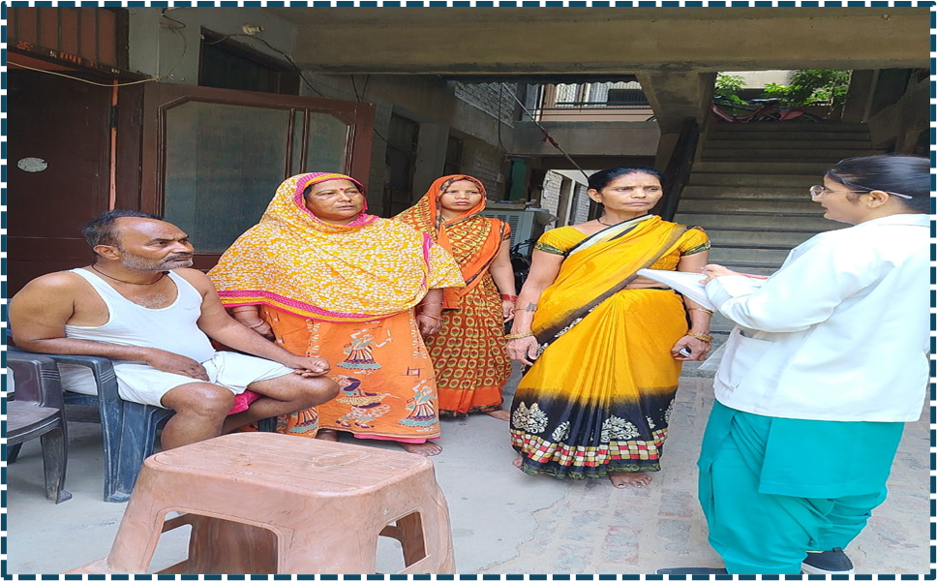
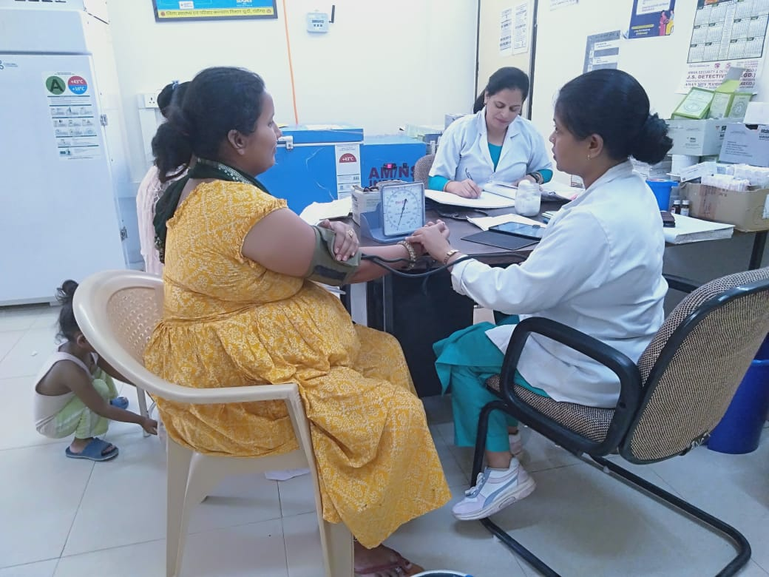
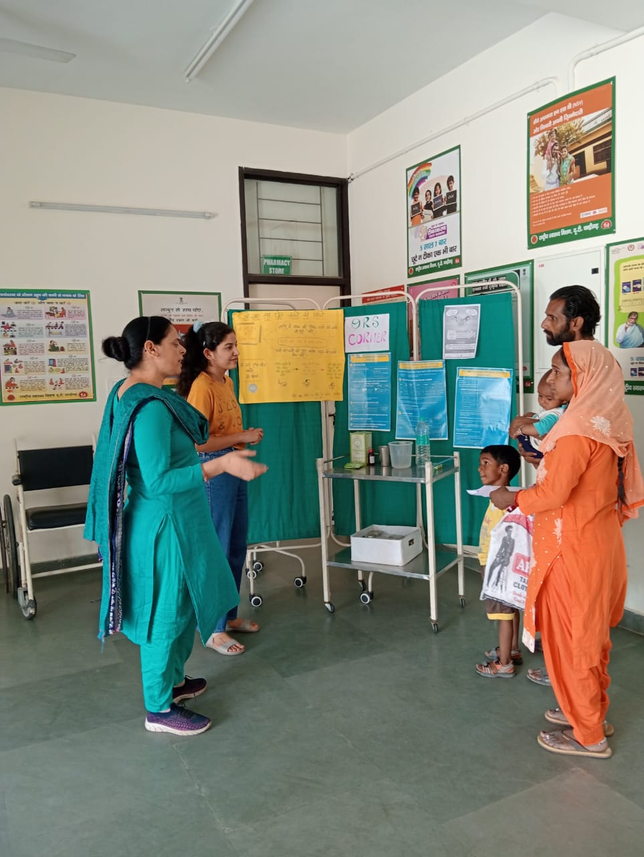
COP FIELD ACTIVITIES PHOTOGRAPHS

Slide 36
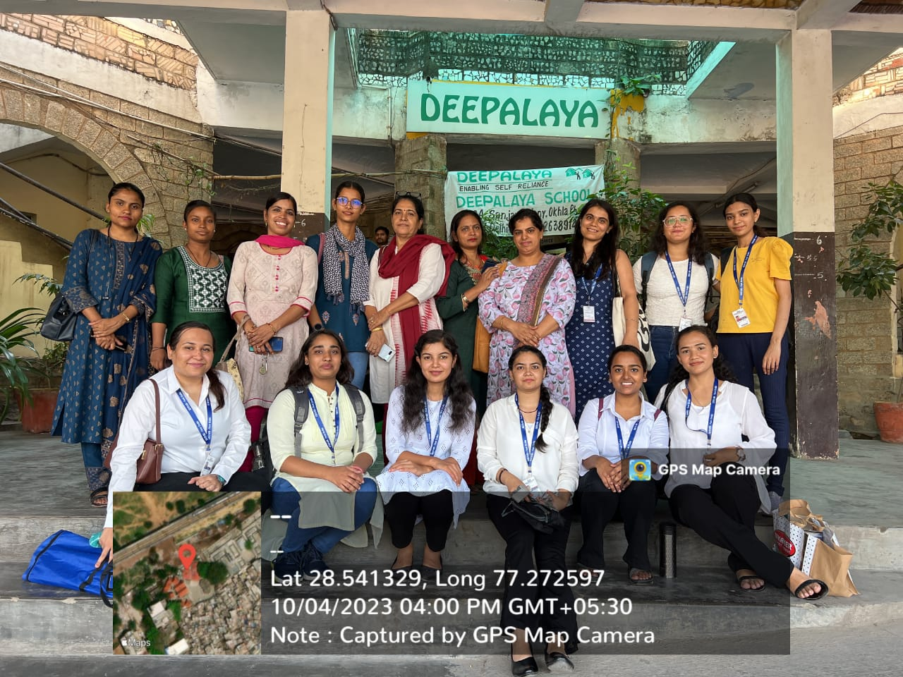
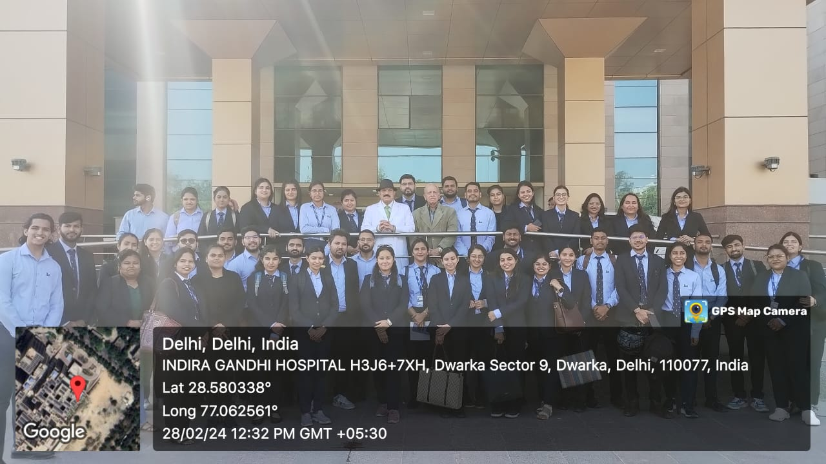
Pictorial Journey

Slide 37
Thank You
Any Questions

