Slide 1


A study on discharge process Turn Around Time (TAT) of Dialysis Unit
Manipal hospital, Gurugram
Javed Ansari
Dr Anandhi Ramachandran
IIHMR Delhi

Slide 2
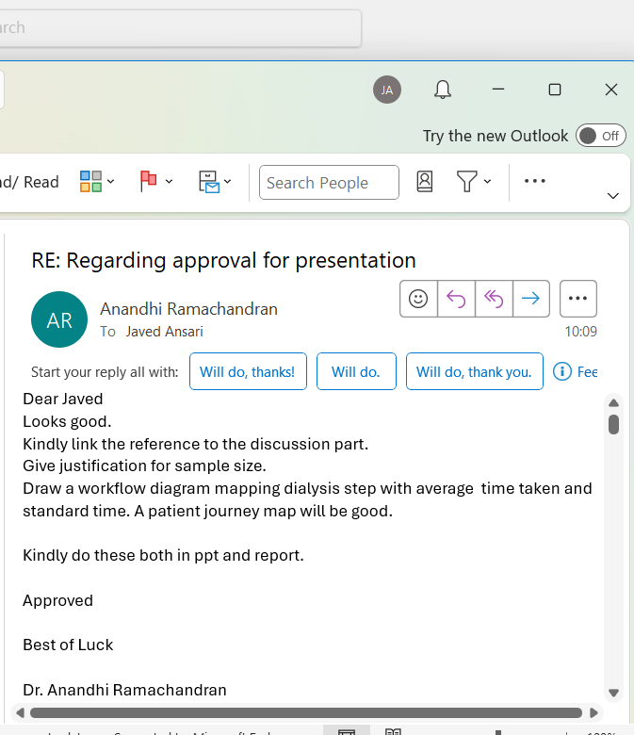
Mentor Approval

Slide 3
Introduction (1/2)
Discharge Turnaround Time (TAT) refers to the time taken from the completion of dialysis treatment to the actual exit of the patient from the unit.
Delay in discharge effects:
Patient satisfaction
Bed/machine turnover
Staff productivity
Hospital revenue

Slide 4
Introduction (2/2)
Prolonged TAT may arise due to multiple reasons—clinical clearance delays, incomplete discharge summaries, unavailability of billing staff, pharmacy issues, or lack of communication among the care team.
Improving discharge TAT can have significant operational and financial implications. It helps in:
Reducing patient wait time.
Improving patient satisfaction.
Increasing machine and bed turnover.
Generating more revenue by accommodating additional sessions.

Slide 5
Objectives
To understand and map the existing dialysis discharge workflow in the hospital
To study the turnaround time of the dialysis service, quantify time delays from the end of dialysis to actual patient discharge.
To identify the bottlenecks and inefficiencies in the discharge process
Based on the above suggest recommendations for quality improvement of the dialysis discharge process.

Slide 6
Methodology (1/2)
Study Area:
Dialysis Unit, Manipal hospital, Gurugram.
Study Design:
This is a cross-sectional mixed study (qualitative and quantitative)
Sample Size: 200 patients from dialysis unit.
We have 16 Cash, 20 ECHS and 34 TPA Patients. Total 70 patients. So in 3 months it would be 210 patients.

Slide 7
Methodology (2/2)
Sampling method: Purposive method
Duration of study: March to June
Source of Data: Information gathered from patient’s electronic medical records through trakcare software used in Manipal hospital and dialysis flow shit
Data Collection Tools:
All the time intervals were noted on observation check list, created, and input into an excel spreadsheet

Slide 8
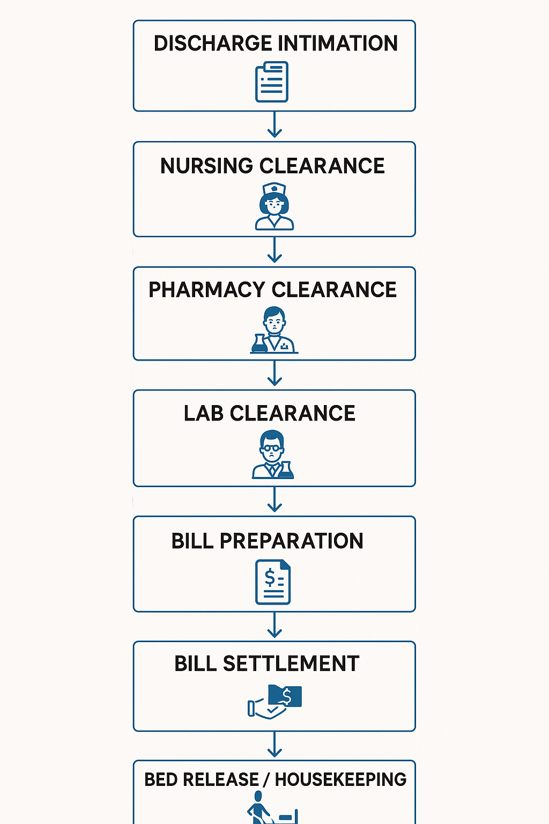
Data analysis
Discharge process TAT mapping
Ideal tine
10 min
15 min
10 min
10 min
5 min
10 min

Slide 9
Data analysis (2/2)
Each step was compared against an ideal time benchmark (60 minutes)
According to NABH, benchmarks for dialysis or day care units range from 30 minutes to 2 hours, depending on patient stability, documentation, and pharmacy/lab clearance.
The number of patients discharged within and beyond the ideal TAT was recorded and converted into percentages.

Slide 10
Results (1/3)
Discharge Step | Ideal Time (min) | Patients Discharged Within Ideal TAT (n) | % Within Ideal TAT | Patients Discharged with Delay (n) | % Discharged with Delay
Nursing Clearance | 10 | 190 | 95% | 10 | 5%
Pharmacy Clearance | 15 | 176 | 88% | 24 | 12%
Lab Clearance | 10 | 182 | 91% | 18 | 9%
Bill Preparation | 10 | 170 | 85% | 30 | 15%
Bill Settlement | 5 | 160 | 80% | 40 | 20%
Bed Release / Housekeeping | 10 | 154 | 77% | 46 | 23%

Slide 11
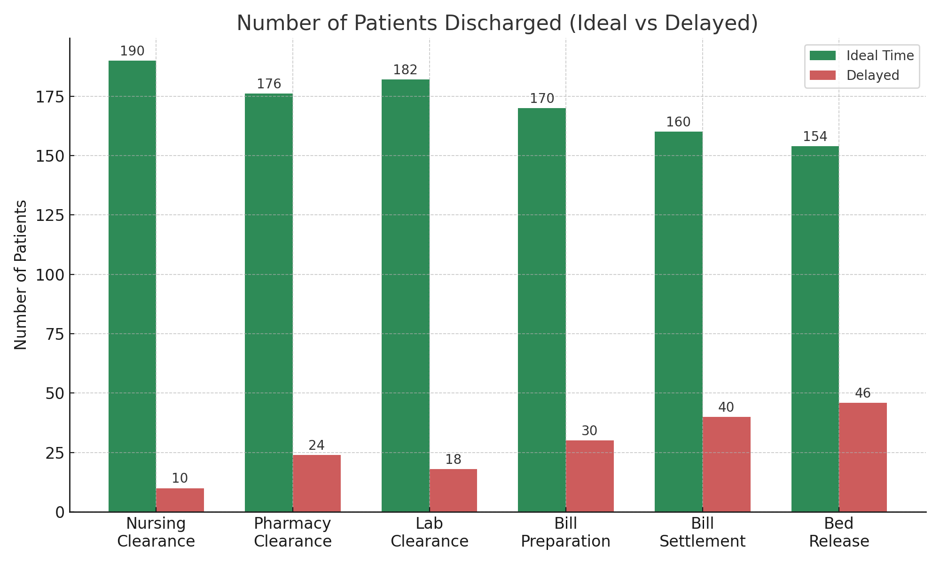
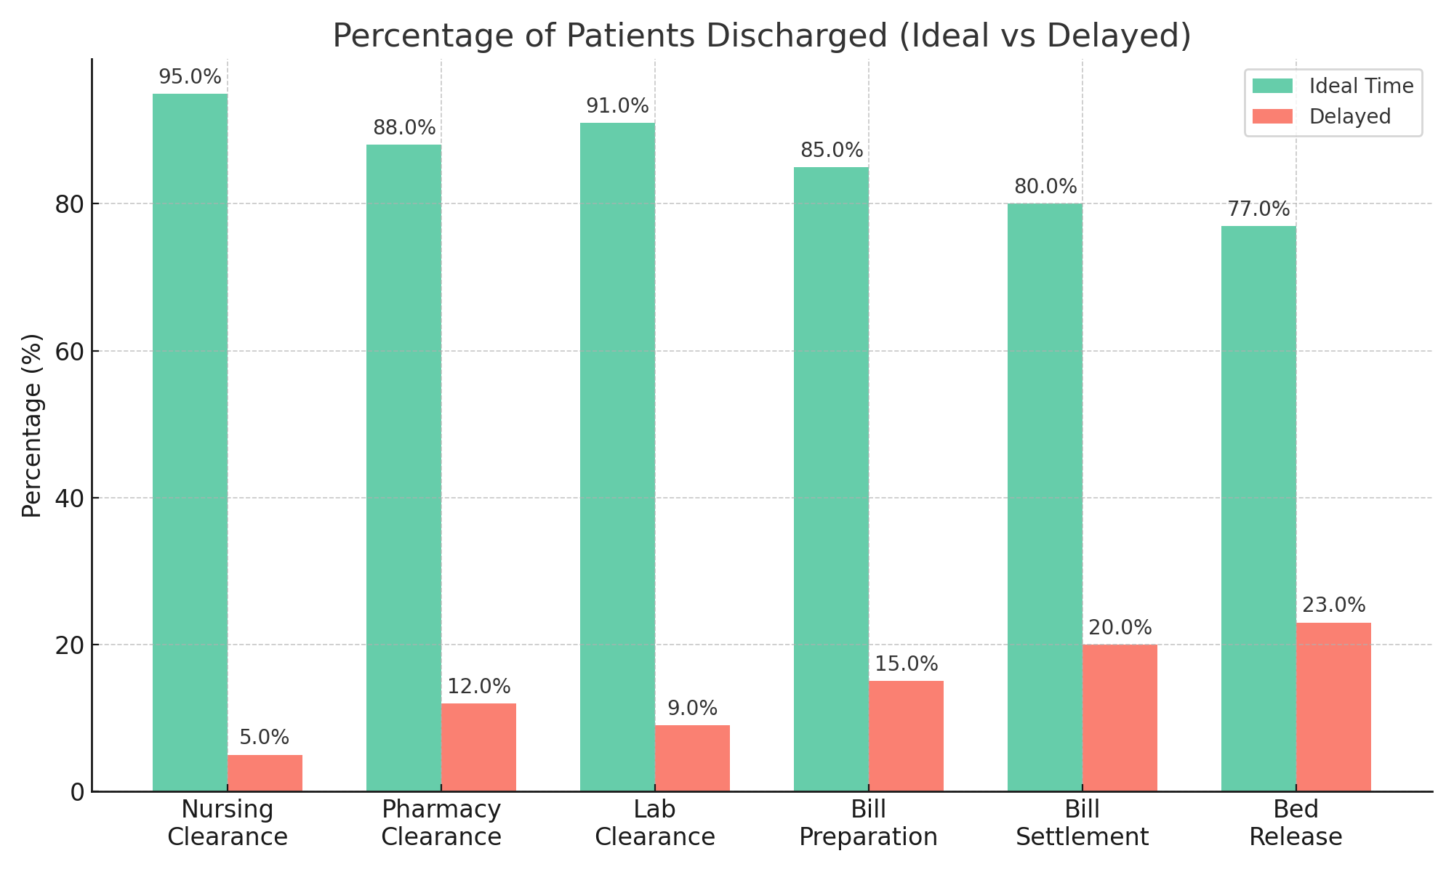
Results (1/3)

Slide 12
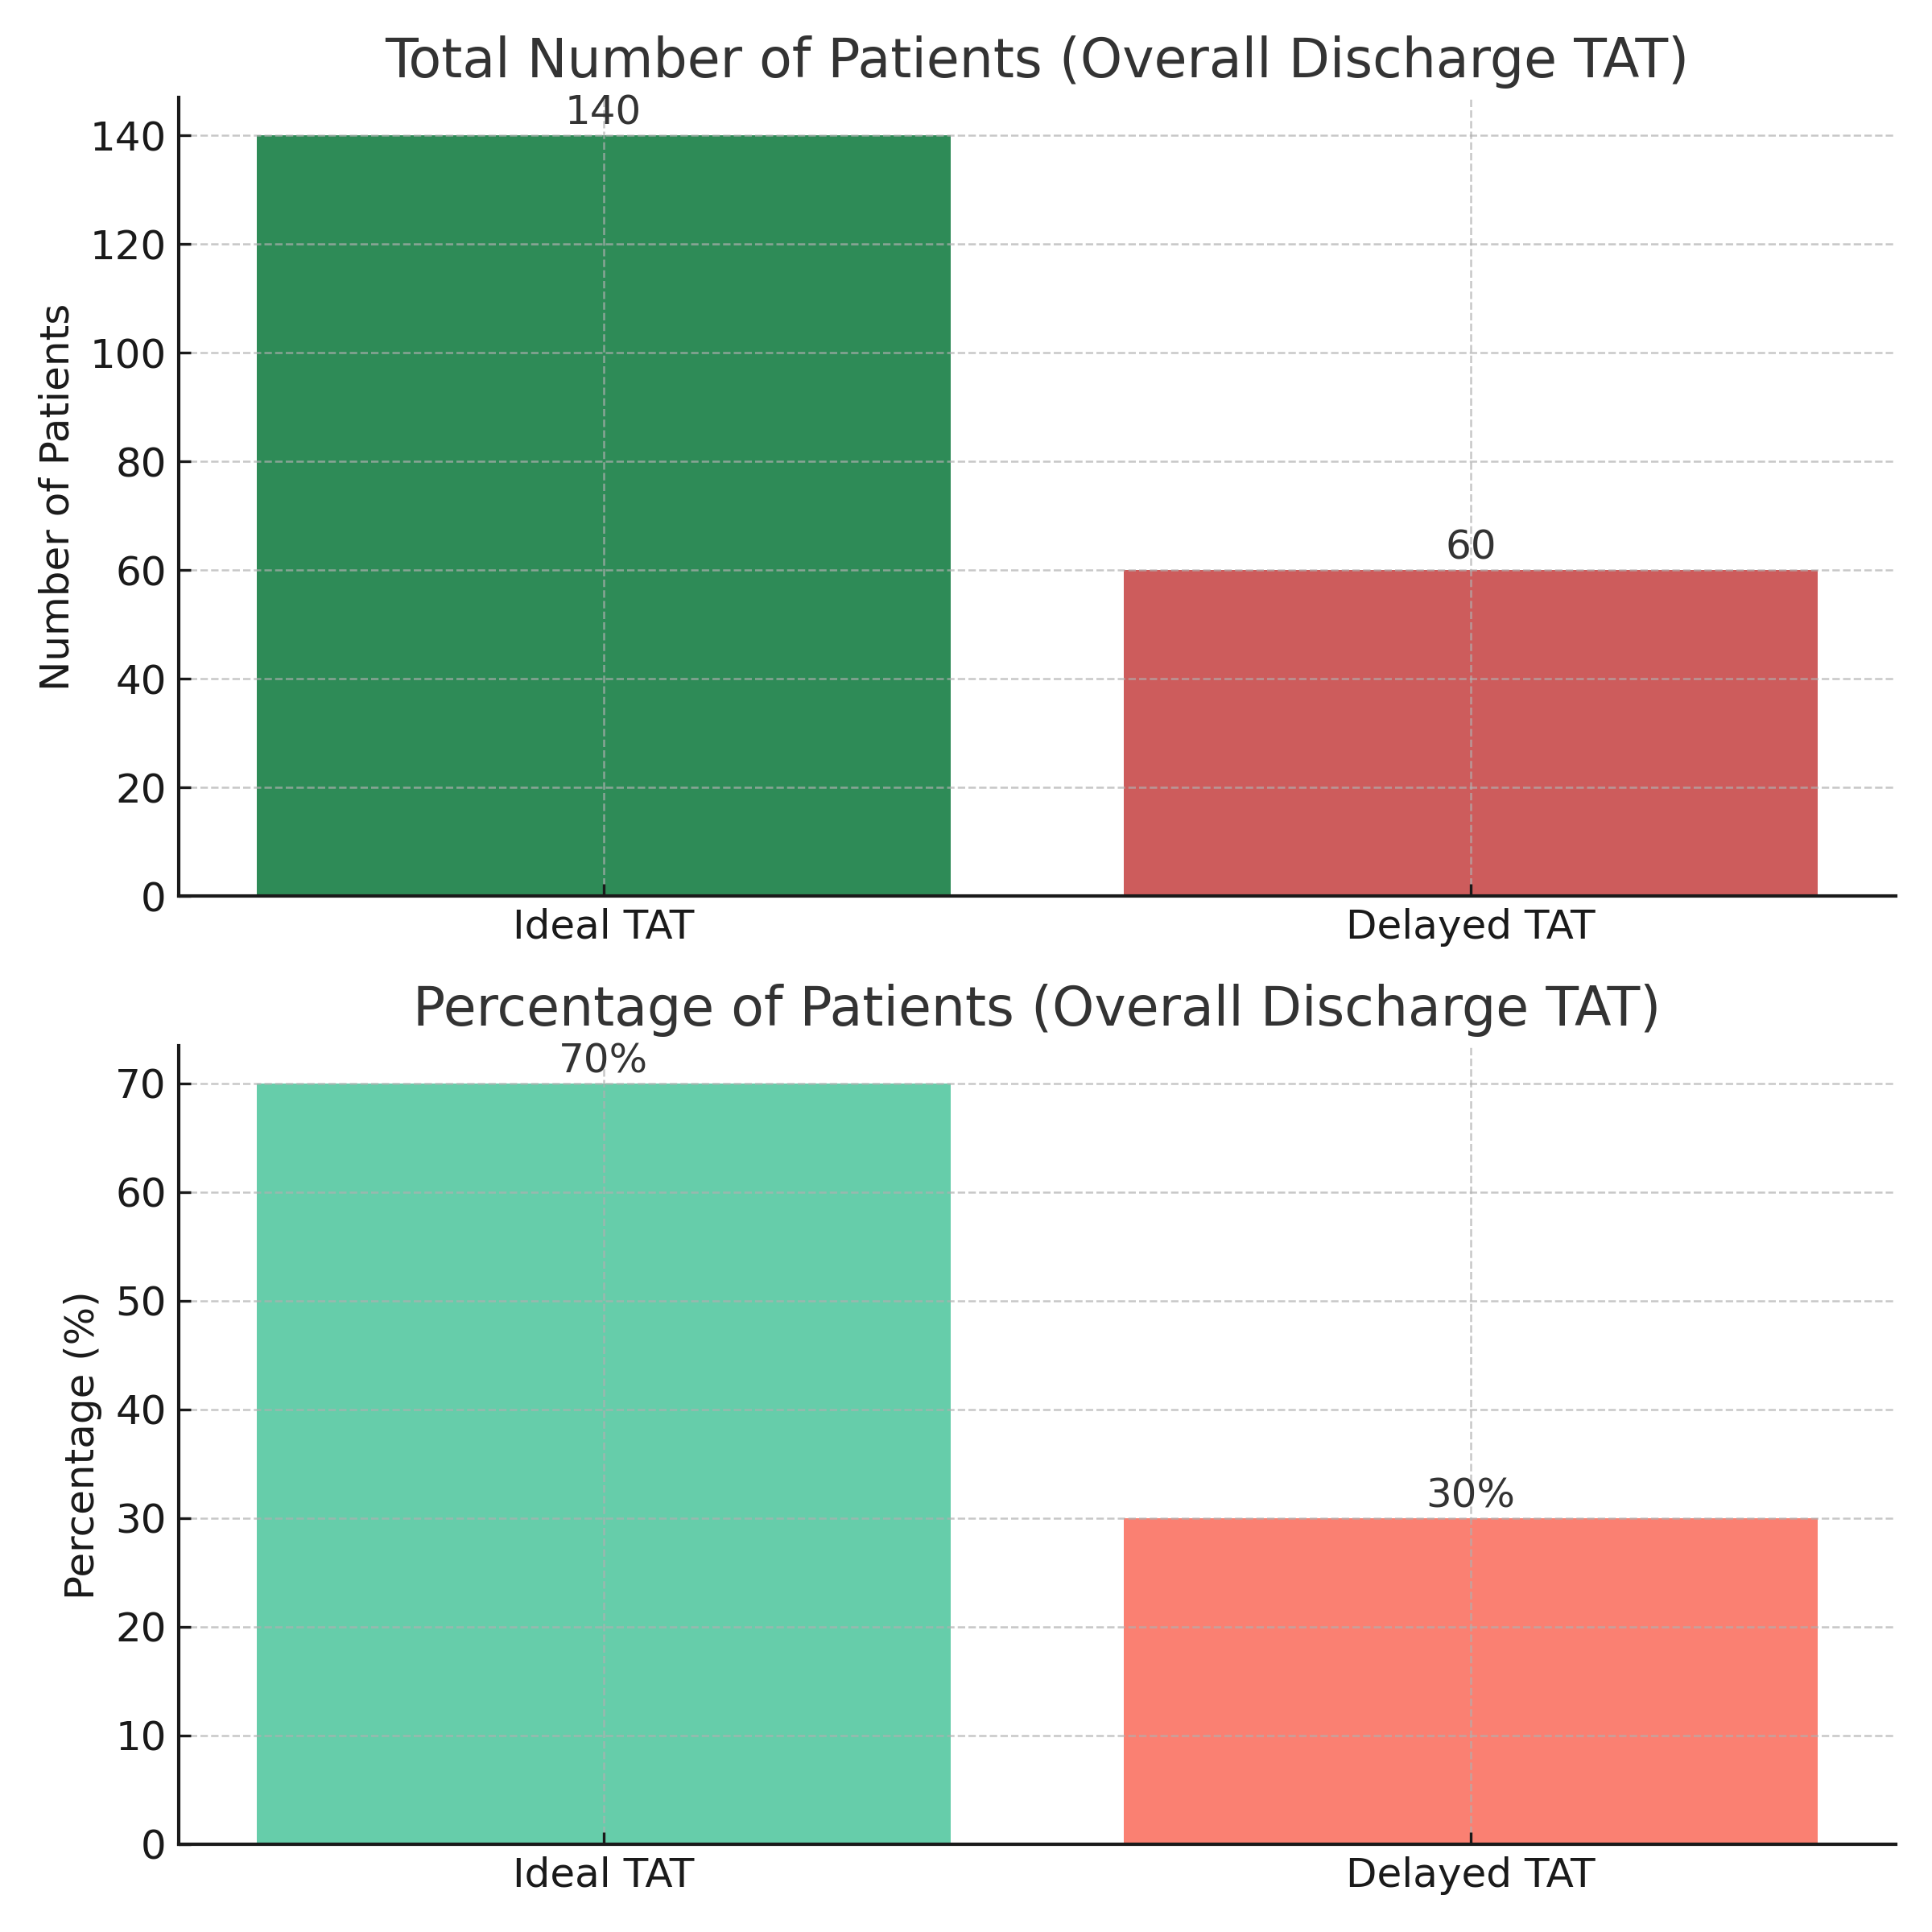
Results (1/3)
Out of 200 patients that were observed, 140 (70%) patients were discharged within the ideal TAT (60 min)
60 patients (30%) experienced delayes beyond the expected timeframe

Slide 13
Discussion (1/2)
The study reveals that majority of patients (70%) were discharged within the ideal TAT, reflecting strong overall process efficiency in the dialysis unit. However, 30% experienced delays, mainly during non-clinical steps such as billing, pharmacy, and housekeeping.
Nursing and lab clearance steps were observed to be well-structured with minimal delays, suggesting that clinical processes are functioning smoothly.
Delays in bill settlement and bed release were often related to administrative workflow inefficiencies or support staff shortages.

Slide 14
Discussion (2/2)
Reasons for Longer Discharge TAT found during study:
Billing & Documentation Delays
  TPA approvals take time
  Some time, investigation reports and documents needed to send in query reply to TPA
Pharmacy Clearance Delays
  Medicine availability check
  Delay in pharmacy dispatch during peak hours
Bed Release / GDA Issues
  GDA or housekeeping staff not available, wheelchair unavailability
  Delay in cleaning & making bed ready

Slide 15
Conclusion
This study concludes that the discharge process in the dialysis unit at Manipal Hospital, Gurugram is moderately efficient, with the majority of patients (70%) discharged within the acceptable TAT of 60 minutes.
However, the presence of delays in 30% of cases, particularly in non-clinical and administrative steps, indicates potential for optimization

Slide 16
RECOMMENDATIONS
Implement parallel processing: Start billing and pharmacy steps simultaneously with discharge summary preparation
Assign discharge coordinators or case managers to follow up on paperwork, especially for insured patients.
Improve GDA scheduling or hire more GDA staff to ensure timely bed turnover and patient transport.
Introduce automated alerts for pharmacy and billing tasks to initiate earlier.
Conduct staff training on documentation standardization and discharge readiness.

Slide 17
References
Bhattacharya, S., Gupta, A., & Chatterjee, P. (2020). Analyzing discharge process delays in a tertiary care hospital in India. Journal of Health Management, 22(4), 457-466.
NABH. (2020). Guidebook to Accreditation for Hospitals. National Accreditation Board for Hospitals and Healthcare Providers. https://nabh.co/
Walker, R. C., & Howard, K. (2019). "Improving discharge efficiency for hemodialysis patients." Journal of Renal Care, 45(2), 89–95.
Al-Farsi, S., & Khan, M. A. (2021). Improving patient flow in a dialysis unit: A quality improvement initiative. Middle East Journal of Nursing, 15(3), 44–49.

Slide 18
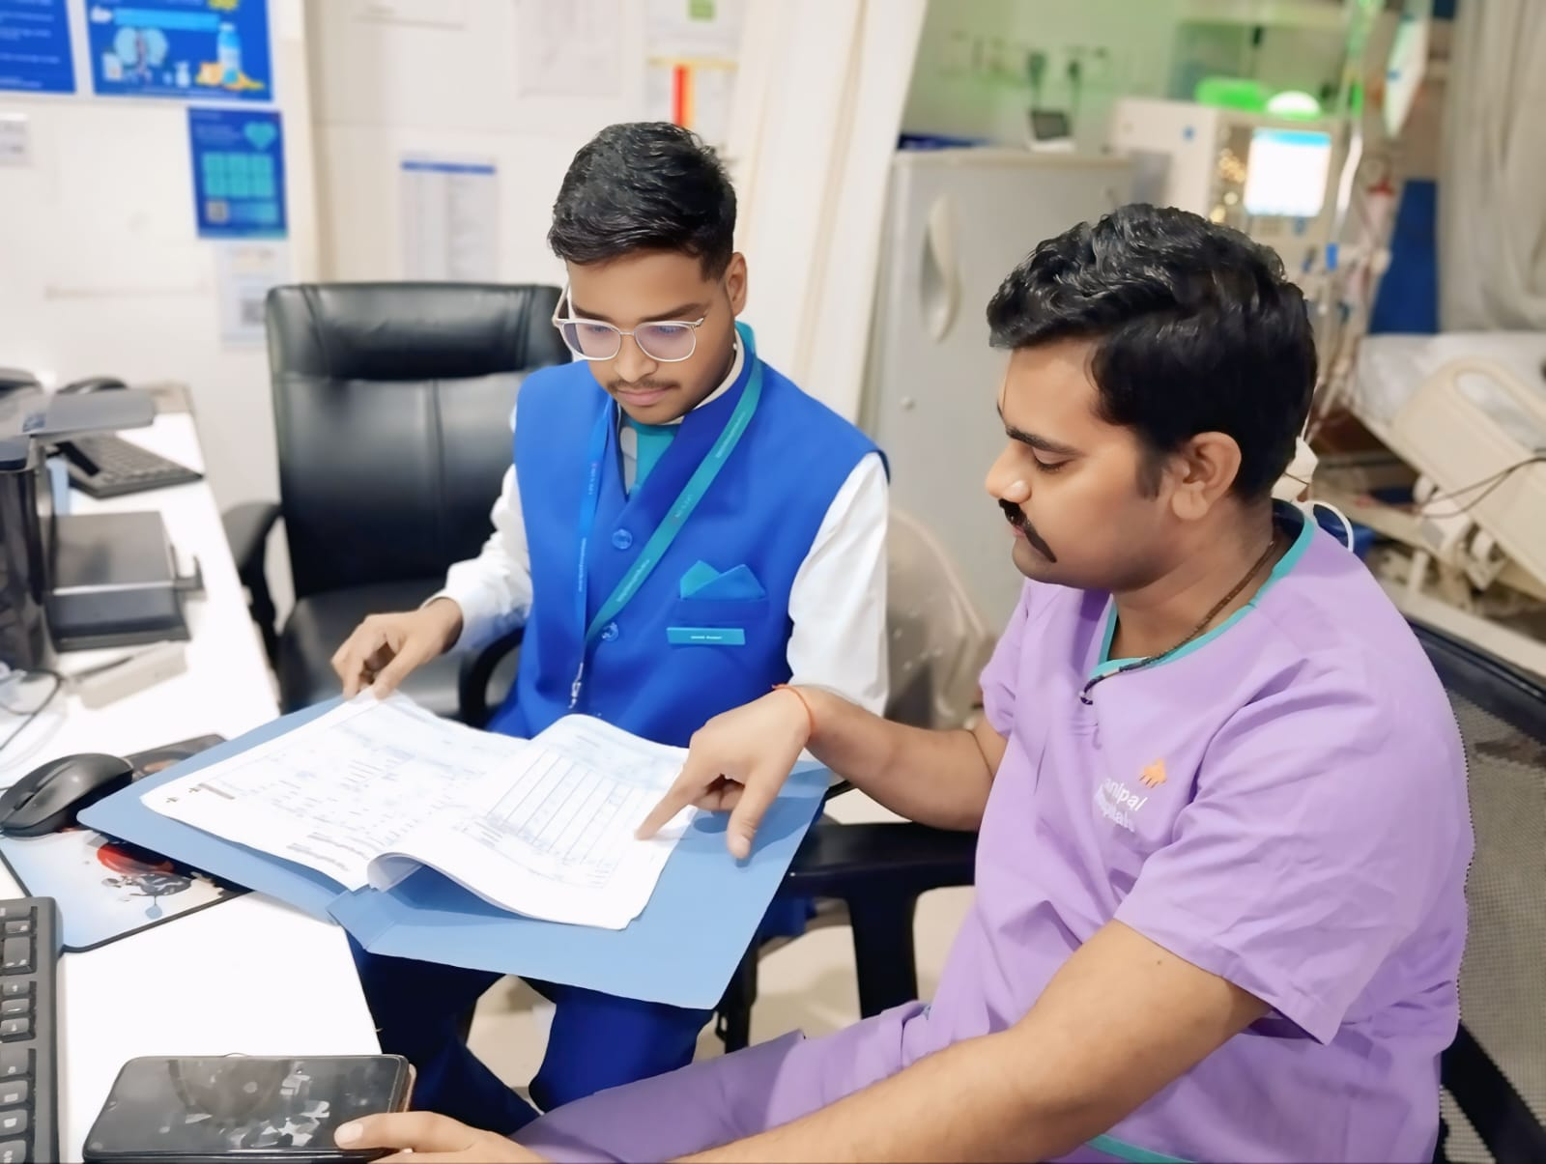
Pictorial Journey

Slide 19
COMMUNITY OUTREACH PROGRAMME (COP) ACTIVITIES
Total no. of visits : 10
Day wise activities:
Mapping and listing of the area
Interacted with the community
Asked questionnaires through google form

Slide 20
Key Learnings from Community Outreach Activity
Enhanced Communication Skills
Understanding Socioeconomic Diversity
Hygiene and Sanitation Awareness
Prevalence of Diseases
Field Exposure to Public Health Realities

Slide 21
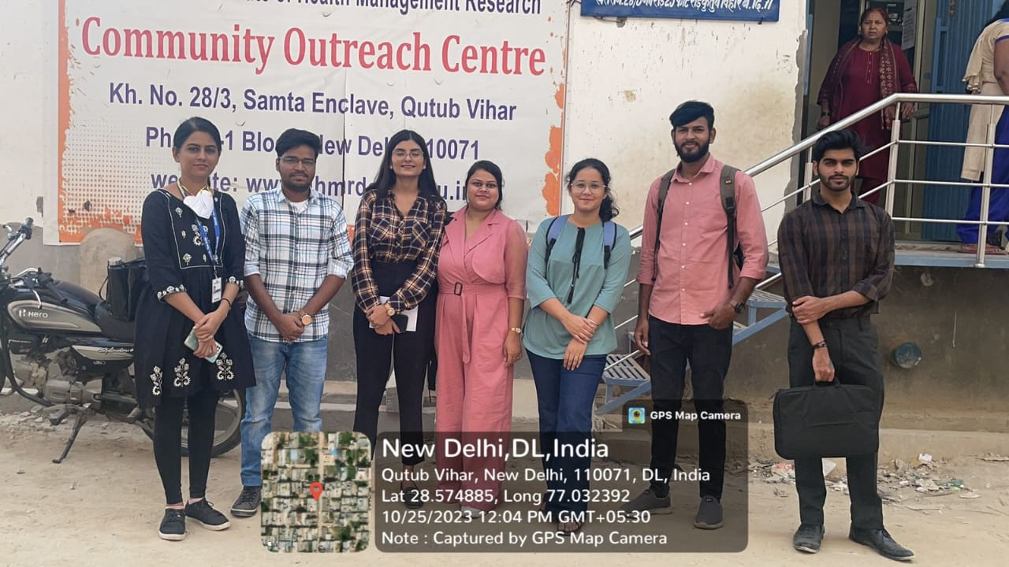
Community outreach

