Slide 1
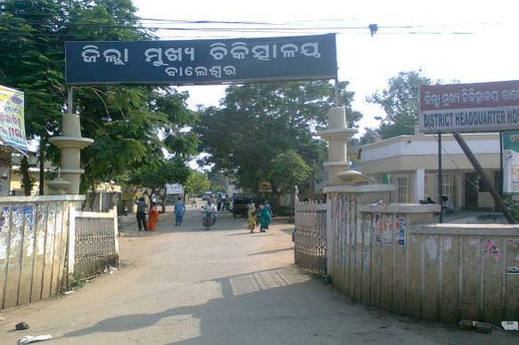
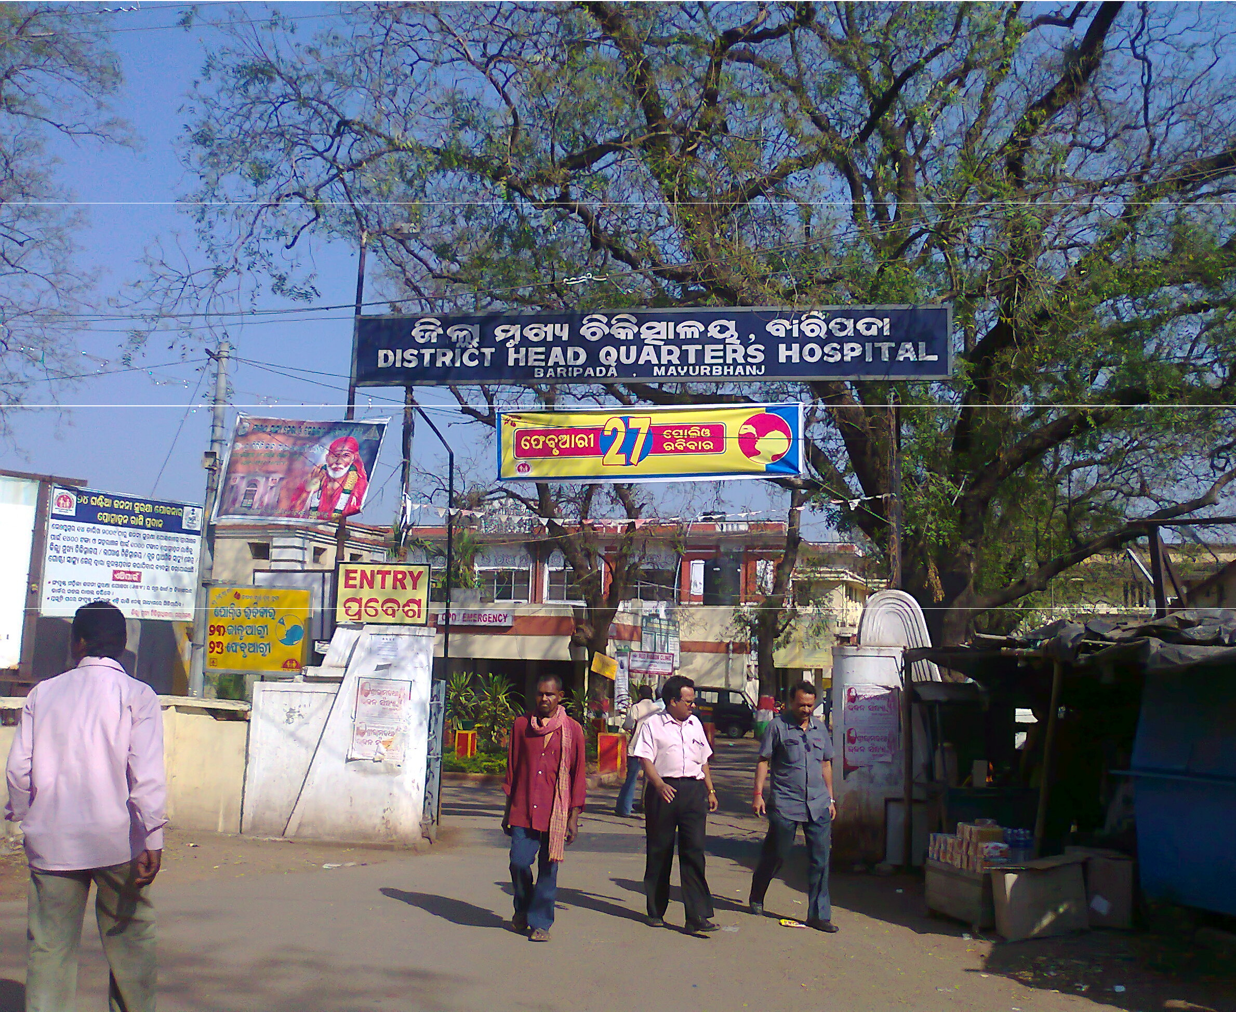

Study on Outcome indicators of HMIS data of District Headquarter Hospital Baripada and Balasore
District Headquarter Hospital, Balasore
District Headquarter Hospital, Baripada
By:
Kapil Agrawal
Management Trainee
Octavo Solution Pvt. Ltd.
New Delhi

Slide 2

Octavo Solutions Pvt. Ltd.
Journey -
“Every great journey starts with a single step. The same is true for Octavo Solutions Pvt. Ltd.”
Started operations in October 2006
Established and managed by health & hospital management experts
Supported in its initiatives and efforts by experienced and reputed experts in field

Slide 3
Octavo Solutions Pvt. Ltd.
OUR MISSION
GUIDING PRINCIPLES
OUR OBJECTIVES
To become the Leader in Healthcare Consulting in India by providing value for money, effective, efficient solutions and hands on support.
Customized Approach
Quality is a core value
Trust and transparency
Timely, responsive, effective, efficient and value for money services
Endeavor to exceed expectations
Robust QMS and CQI programs
Service users delight
Sense of pride among stakeholders
Our goal is to help build institutions that delight the customers and where providers enjoy to work

Slide 4
Our Services
OCTAVO SOLUTIONS PVT. LTD.
Hospital Projects & Strategic Planning
Quality Healthcare Accreditation
Public & Rural Health
Operations & System Development
Capacity Building
Public Private Partnership

Slide 5
Project Initiated By:
Department of Health & Family welfare, Odisha
National Health System Resource Centre(NHSRC)
Octavo Solution Pvt. Ltd.(OSPL), New Delhi
This project was initiated to improve the Quality of Public Health services in the state of Orissa.

Slide 6
Why did we Take this Project
Identification of baseline Healthcare Services
Enhance Service Quality At District Level
Strengthen the Public Health System

Slide 7
Focus Area
Outcomes of Identified Volume & Performance Indicators of HMIS check list which is given by IPHS for a district hospital.
  Volume indicators:- simply represent counts of admissions in which these procedures were performed.
  Performance Indicators:- A statistic or other unit of information which reflects, directly or indirectly, the performance of a health or welfare intervention, facility, service or system. Performance indicators are most fundamentally evaluative criteria.

Slide 8
Overview of DHH- Baripada & Balasore
DHH- Balasore Coverage's
DHH- Baripada Coverage's
Population Coverage | 22,86,561
Total no. of Sub centers | 275
Total no. of PHCs | 70
Total no. of CHCs | 8
No. of Functional Beds | 205
Population Coverage | 22,23,456
Total no. of Sub centers | 295
Total no. of PHCs | 88
Total no. of CHCs | 16
No. of Functional Beds | 275

Slide 9
Services Available at DHH- Baripada & Balasore
Emergency Care | General Medicine
Outpatient Care | Psychiatrics
Inpatient care | Ophthalmology
Orthopaedics | Pharmacy/ Drug dispensary
Paediatrics | Sexually Transmitted diseases
Neonatal care | Obstetrics and Gynaecology
General Surgery | Physiotherapy
Dermatology | Prosthetics Implantation
ENT | Infectious patient care
Antenatal and Post natal care | Immunization services
Blood bank | ART centre

Slide 10
Objectives
General Objective:
To Analyse HMIS Data of DHH- Baripada & Balasore and study the Outcome Indicators to recommend an integral model to deliver quality health care services.
Specific Objectives:
  To Identify and to analyze the main volume and performance Indicators.
  To Understand the existing level of health care delivery system by reviewing the outputs of Identified indicators.
  To Find out the Root Causes based on Real time survey of District Headquarter Hospital Baripada and Balasore.
  To Recommend an integral model for delivering quality healthcare services.

Slide 11
Research Methodology
Study Design:- Descriptive study
Study Area:- DHH-Baripada & Balasore
Data Collection Method:- Both secondary and primary data
  Primary Data:-
    Through Real time Survey
    Observations and Personal interview were used for Root cause Analysis
  Secondary Data:-
    From HMIS System of DHH- Baripada & Balasore
Study Time:-
  HMIS data from Jan-2012 to Dec-2012(12 Months) is analyzed.
  Real time survey is done from 1st - 15th (15 days)April 2013

Slide 12
Identification of Volume and Performance Indicators
Major Volume and Performance Indicators were selected from this HMIS sheet which is mainly related to…
  RCH Indicators
  Overall Functioning of District Headquarter Hospitals.

Slide 13
Volume Indicators
Total OPD Count | Total IPD count
No. of Normal Deliveries | No. of C- section Deliveries
No. of Maternal Deaths | No. of Neonatal Deaths
No. of Major surgeries Performed | No. of Minor surgeries Performed
No. of Laboratory tests done | No. of X-ray & USG performed
Total no. of Deaths

Slide 14
Performance Indicators
Indicators | Formula for Calculation
Bed Occupancy Rate | No. of inpatient days in a given month/No. of available bed days in that month*100
LSCS Rate (IN %) | No. of CS delivery x 100 ÷ No. of Total delivery
Average Length of Stay (ALOS) (In Days) | Total Patient Bed Days in the month ( excluding New Born) ÷ Discharges in the month (including Death, LAMA, absconding)
LAMA Rate (Per hundred Admissions) | Total No. of LAMA cases × 100 ÷ Total No. of Admissions

Slide 15
Volume Indicators of Balasore
Volume | Indicators | Jan-12 | Feb-12 | Mar-12 | Apr-12 | May-12 | Jun-12 | Jul-12 | Aug-12 | Sep-12 | Oct-12 | Nov-12 | Dec-12
OPD | Total OPD | 8760 | 8472 | 8972 | 12779 | 16578 | 13368 | 15132 | 14142 | 14328 | 16183 | 15538 | 16182
IPD | Total IPD | 3930 | 3971 | 4106 | 4534 | 4444 | 4429 | 4392 | 4678 | 4362 | 4802 | 4235 | 4515
 | Normal | 827 | 793 | 822 | 889 | 847 | 602 | 772 | 871 | 842 | 873 | 865 | 823
 | C-Section | 169 | 152 | 209 | 211 | 214 | 197 | 232 | 212 | 332 | 232 | 218 | 256
Delivery | Neonatal Death | 25 | 23 | 19 | 17 | 14 | 12 | 16 | 17 | 3 | 2 | 5 | 6
 | MTP Conducted | 1 | 1 | 3 | 7 | 2 | 3 | 6 | 4 | 3 | 2 | 3 | 4
 | Maternal Death | 3 | 2 | 3 | 0 | 6 | 3 | 0 | 2 | 1 | 0 | 2 | 3
Operation theater | No. Of Major Surgeries | 318 | 297 | 288 | 365 | 365 | 312 | 389 | 231 | 302 | 370 | 345 | 368
 | No. Of Minor Surgeries | 24 | 21 | 31 | 33 | 35 | 37 | 20 | 39 | 42 | 45 | 34 | 48

Slide 16
Contd..
Volume | Indicators | Jan-12 | Feb-12 | Mar-12 | Apr-12 | May-12 | Jun-12 | Jul-12 | Aug-12 | Sep-12 | Oct-12 | Nov-12 | Dec-12
Laboratory | No. of Lab. Test Done | 8976 | 9876 | 8765 | 12356 | 15676 | 15456 | 17654 | 13467 | 14656 | 16787 | 12333 | 16989
Radiology | No. of X-ray | 467 | 451 | 392 | 379 | 501 | 363 | 324 | 412 | 398 | 521 | 467 | 512
 | No. of USG | 86 | 79 | 89 | 104 | 93 | 104 | 98 | 123 | 94 | 132 | 123 | 112
No. of | Deaths | 86 | 82 | 81 | 89 | 74 | 123 | 95 | 98 | 102 | 111 | 99 | 105

Slide 17
Volume Indicators of Baripada
Volume | Indicators | Jan-12 | Feb-12 | Mar-12 | Apr-12 | May-12 | Jun-12 | Jul-12 | Aug-12 | Sep-12 | Oct-12 | Nov-12 | Dec-12
OPD | Total OPD | 11961 | 13199 | 13525 | 13176 | 13467 | 12980 | 15426 | 18369 | 17051 | 15172 | 12095 | 12267
IPD | Total IPD | 3747 | 3916 | 4315 | 4444 | 4471 | 4176 | 4476 | 5025 | 4672 | 4306 | 3587 | 4176
 | Normal | 757 | 497 | 780 | 606 | 694 | 591 | 549 | 565 | 593 | 566 | 519 | 549
 | C-Section | 217 | 199 | 207 | 199 | 227 | 190 | 191 | 171 | 149 | 160 | 159 | 162
Delivery | Neonatal Death | 19 | 20 | 19 | 16 | 14 | 18 | 16 | 21 | 13 | 6 | 5 | 6
 | MTP Conducted | 5 | 12 | 10 | 7 | 6 | 4 | 6 | 3 | 5 | 7 | 3 | 4
 | Maternal Death | 3 | 1 | 3 | 2 | 7 | 8 | 2 | 0 | 3 | 2 | 4 | 3
Operation theater | No. Of Major Surgeries | 239 | 247 | 272 | 235 | 264 | 203 | 211 | 208 | 169 | 189 | 179 | 222
 | No. Of Minor Surgeries | 66 | 53 | 58 | 46 | 86 | 33 | 29 | 39 | 40 | 34 | 35 | 39

Slide 18
Contd..
Volume Indicators |  | Jan-12 | Feb-12 | Mar-12 | Apr-12 | May-12 | Jun-12 | Jul-12 | Aug-12 | Sep-12 | Oct-12 | Nov-12 | Dec-12
Laboratory | No. of Lab. Test Done | 15296 | 12711 | 13558 | 12112 | 13669 | 13229 | 15996 | 19578 | 16058 | 14451 | 11234 | 13234
Radiology | No. of X-ray | 650 | 1014 | 680 | 871 | 807 | 881 | 943 | 873 | 822 | 837 | 812 | 765
 | No. of USG | 250 | 76 | 366 | 368 | 493 | 323 | 481 | 391 | 291 | 306 | 278 | 312
No. of | Deaths | 127 | 139 | 142 | 124 | 179 | 234 | 179 | 168 | 164 | 144 | 164 | 138

Slide 19
Graphical presentation of volumetric indicators

Slide 20
Contd..

Slide 21
Contd..

Slide 22
Contd..

Slide 23
Contd..

Slide 24
Contd..

Slide 25
Contd..

Slide 26
Contd..

Slide 27
Contd..

Slide 28
Contd..

Slide 29
Performance Indicators of Balasore
Performance Indicators | Jan-12 | Feb-12 | Mar-12 | Apr-12 | May-12 | Jun-12 | Jul-12 | Aug-12 | Sep-12 | Oct-12 | Nov-12 | Dec-12
Bed Occupancy Rate(BOR) | 110.47 | 117.94 | 85.52 | 90.84 | 79.81 | 79.60 | 81.73 | 79.88 | 80.43 | 92.08 | 85.16 | 113.84
Average Length of Stay(ALOS) in Days | 2.72 | 2.83 | 2.35 | 3.51 | 1.89 | 1.87 | 2.96 | 3.16 | 2.56 | 2.81 | 2.62 | 3.62
LAMA Rate(per 100 Admissions) | 17.43 | 18.28 | 19.22 | 20.28 | 17.89 | 16.42 | 18.40 | 21.56 | 15.50 | 13.29 | 14.28 | 20.82
LSCS Rate | 16.97 | 16.08 | 20.27 | 19.18 | 20.17 | 24.66 | 23.11 | 19.58 | 28.28 | 21.00 | 20.13 | 23.73

Slide 30
Performance Indicators of Baripada
Performance Indicators | Jan-12 | Feb-12 | Mar-12 | Apr-12 | May-12 | Jun-12 | Jul-12 | Aug-12 | Sep-12 | Oct-12 | Nov-12 | Dec-12
Bed Occupancy Rate(BOR) | 140.13 | 139.57 | 156.85 | 137.46 | 162.19 | 147.77 | 139.75 | 165.28 | 166.71 | 146.23 | 121.94 | 113.84
Average Length of Stay(ALOS) in Days | 3.93 | 3.74 | 3.93 | 3.78 | 3.96 | 3.90 | 3.49 | 3.80 | 3.87 | 3.58 | 3.76 | 3.62
LAMA Rate(per 100 Admissions) | 17.81 | 18.85 | 19.71 | 16.90 | 19.12 | 20.31 | 25.02 | 18.11 | 20.27 | 18.18 | 17.60 | 20.82
LSCS Rate | 22.28 | 28.59 | 20.97 | 24.72 | 24.65 | 24.33 | 25.81 | 23.23 | 20.08 | 22.04 | 23.45 | 23.73

Slide 31
Graphical presentation of Performance indicators

Slide 32
Contd..

Slide 33
Contd..

Slide 34
Contd..

Slide 35
Major Findings of Data Analysis
Bed Occupancy rate of DHH- Baripada & DHH- Balasore is very High.
Death Rate of DHH- Baripada & Balasore is very high which is 37 per 1000 IPD admissions.
Maternal Mortality Ratio per 1,00,000 live births at DHH Baripada & Balasore for given time is 289.
Neonatal Mortality rate of Baripada & Balasore is 40 which is a high no. compare to India’s NNMR 32 per 1000 live births.

Slide 36
Contd..
LSCS rate of DHH-Baripada is Average 21.09%.
No. of Surgeries perform in a day is 7 surgeries only.
X-rays & USG done in a day is only 16 and 11.
No. of Laboratory tests done are less in number.

Slide 37
Root Cause Analysis
Less No. of Surgeries Performed
Less No. of X-rays & USG Done
Less No. of Lab. Test Done
High LAMA Rate
Improper Documentation
Response time is much higher
Important Lab. Equipments are Out of order
Shortfall of Manpower
Less Infection Control Practices
Doctors are unsatisfied with reports
Shortage in min. equipment requirement
Patients are Unsatisfied with Public Facilities
Rescheduling of Surgeries
Poor Performance of DHH- Baripada & Balasore
People have more faith on Private Practicener
Communication gap b/w doctors and Patients
Less Efficient Staff
Delay in Patient Discharge by Doctors
Emergency facilities not available for 24*7
Less Infection Control Practices
Less Registration under ANCs
Patient Response time in Emergency is much High
Lack of adequate IEC activities
Shortage in Availability of Beds strength
Less No. of Institutional Deliveries
ICU and Trauma Centre Facilities are absent
Very less no. of Newborn are breastfed in 1st hour
Shortage of IFA Tablets
High Bed Occupancy Rate
High Death Rate
High Maternal Mortality Rate
High Neonatal Mortality Rate

Slide 38
RCA for High Death Rate
MAN
MACHINE
Nonavilabilty of sufficient staff
Inadequate Investigative Support
Patient Response time in Emergency is much High
Shortage of Emergency Equipments
Undertrained Staff
High Death Rate
Less Infection Control Practices
ICU and Trauma Centre Facilities are absent
Emergency facilities not available for 24*7
Poor Referral System
Lack of awareness about Medications
Nonavilabilty of emergency drugs and consumables
METHOD
MATERIAL

Slide 39
RCA for High MMR
MAN
Less Registration under ANCs leads to Anaemia
Less Awareness about importance of full ANC
People have more faith on home based deliveries besides Institutional Deliveries
Undertrained Staff
Absence of Security and Deputation of Nurses at Night
High Maternal Mortality Rate
Early Discharge after Delivery
Short Supply of IFA Tablets
Less Infection Control Practices
Patient transport system from PHCs to DHH
Absence of facilities to treat High risk pregnancies and deliveries
Lack of SOP’s Practice to handle Mother
METHOD
MATERIAL

Slide 40
RCA for High NNMR
MAN
Inadequate Follow-up of Newborn by ASHA
Incomplete Immunization
Lack of adequate efforts by DHH in term of providing health education and conducting regular IEC initiatives
Undertrained Staff
High Neonatal Mortality Rate
Early Discharge after Delivery
No System to Trace Progress of Vaccination
Improper display of massages regarding Vaccination
Very less no. of Newborn are breastfed in 1st hour
Absence of facilities to treat High risk pregnancies and deliveries
Less Infection Control Practices
METHOD
MATERIAL

Slide 41
RCA for High BOR
MAN
Delay in Discharge of patients by Doctors
High Bed Occupancy Rate
Bed Distribution is not up to mark
Nonavilabilty of beds
Inefficiency of Treatment
Lack of SOP’s Practice to handle IPD Patient Load
METHOD
MATERIAL

Slide 42
Recommendations

Slide 43
BEHAVIOURAL CHANGE COMMUNICATION USING IEC TOOLS TO INCULCATE A HEALTH SEEKING BEHAVIOUR IN THE COMMUNITY
Strengthening Existing Health Interventions
Continuous Training & Capacity Building of Care Providers
Inter-sectoral Co-ordination
Monitoring & Evaluation
Referral System
IMPROVED HEALTH OUTCOMES
Data Management
Public Private Partnership
Public Private Partnership
Quality Assurance (Accreditation)
Framing state specific standards and guidelines to strengthen the safety, aesthetics & sanitation aspects
BEHAVIOURAL CHANGE COMMUNICATION USING IEC TOOLS TO INCULCATE A HEALTH SEEKING BEHAVIOUR IN THE COMMUNITY

Slide 44



Strengthening Existing Healthcare Interventions
3 Steps Approach
Identifying Key Contextual Factor
  Goals: Improving Health Indicators, Responsiveness, Satisfaction
  Overarching Principles: Equity, Efficiency, Sustainability, Quality, Safety, Coverage
  Building Blocks/ Critical Functions: Health Workforce, Health Information, Services, Technologies, Demand Generation
  Processes/ Control Knobs: Resource Allocation, Organization, Integration, Regulation, Behavior

Slide 45

Contd..
2. Strengthening Program Objectives
  Institutional
Set standards for healthcare facilities
Quality Assurance Program
Set policies and procedures
Training on implementation of policies & procedures
Knowledge Management
Capacity Building of care providers
  Non Institutional
    Monitoring and Evaluation
    Shared- Accountability, Goals, Control, power, legitimate view of Interdependence
    Knowledge Sharing
    Capacity Building
    Program Management

Slide 46
Contd..
3. Strengthening Program Implementation
  Rigorous Training
  Using Behavior Change Communication Strategy
  Robust Monitoring Program through tools like TBAP (Time Bound Action Plan)
  Evaluating Program Performance

Slide 47
  Social Insurance/ Community Based Insurance
Out of Pocket Expenditure is the biggest hindrance for the goal of “Health for All”
Social Insurance could be a important tool for reducing Out of Pocket Expenditure and to promote Equity.
Social Insurance could be launched for specific community or unorganized sector

Slide 48

  Public Private Partnership
Public Private Partnership could be very efficient in Improving Health Indicators. PPP model could be adopted for:
Diagnostics
Referral Transport
Specialist Clinics (paediatrics, nephrology, obstetrics & gynaecology, etc)
Primary Health Centers

Slide 49
  Contd..
We can device model, strategies for Public Private Partnership and also can help in identifying Partner Organizations.

Slide 50
  Framing State Specific Standard
Various National and International Standards are available, However there is need of local standards which can commensurate basic needs.
State Specific Standards would include Structural Standards (Infrastructure, Instruments-Equipments, Manpower), Process Standards (Standard Protocols, Infection Control Practices) Outcome Standards (Outcome Indicators, Data Collection Methods), etc.

Slide 51
  Contd..
Standard may includes guidelines for Safety, Sanitation, Aesthetics which can in turn increases Satisfaction of Clients:
Safety
Fire Safety
Electrical Safety
Building Safety
Waste Management & Handling Safety
Medication Safety
Radiation Safety
Vulnerable Patient safety

Slide 52
  Contd..
Sanitation
Cleaning Practices for High Risk and General Areas
Cleaning Practices of Wash rooms
Cleaning Practices of Water Tanks
Disinfection of Operation Theatre, ICU, etc.
Spillage Management
Safe Drinking Water

Slide 53
  Contd..
Aesthetics
  Exterior wall
  Landscaping
  Signage
  Colour
  Lighting
  Floors
  Doors/Windows

Slide 54
  Quality Assurance
To ensure the delivery of Quality Healthcare Service, it is imperative to incorporate Quality Assurance Program. This can be done through:
Framed State Specific Standards
NABH
ISO 9001: 2008 (Certification)

Slide 55
  Inter-Sectoral Co-ordination
For better Healthcare of Community, development of others related sectors is required
  Water
  Hygiene & Sanitation
  Food and Nutrition
  Education
  Housing

Slide 56

Behavior Change Communication
BCC strategies should be directed towards inculcating Health Seeking Behavior among population. High Priority areas for BCC focus are:
  Antenatal Care
  Institutional Deliveries
  Post Natal & New born Care
  Married Adolescents
  Gender Discrimination (Female Foeticide, infant girl, less than 5 girl, son preference and therefore large family size.)

Slide 57
Contd..
  Sexually Transmitted Diseases
  Nutrition through the life cycle (infant, under three, adolescent, woman)
  Routine immunization
  Hygiene and safe water practices.
  Marginalized groups and households including urban poor
  Need for supportive supervision of ASHAs
  Capacity Building of BCC skills for service providers

Slide 58

Continuous Training and Development
To develop knowledge level and skills of delivering healthcare.
Our approach for the training program includes:
  Monitoring and Evaluation of Existing Capacity Building scenario .
  Training Need Assessment (and Impact Assessment)
  Developing Training Modules
  Developing Training Calendar
  Identifying Potential Trainers and preparing Training Schedules
  Conductions of training sessions, CME workshops, Management Development Programs for all categories of staff
  Post Training Evaluation (and Impact Assessment)

Slide 59
Monitoring & Evaluation
  Every system needs a proper monitoring and evaluation to ensure proper functioning, delivery of expected outcomes and ensuring sustainability .
  Monitoring and Evaluation could be adopted for-
    Capacity Building Programmes (E.g. Through Impact Assessment)
    Maternal Child Health Programme (E.g. Evaluating availability and Efficiency of EmOC facilities)

Slide 60
Conclusion
I feel, if all the targeted interventions are carried out in a consorted manner then there would be considerable improvement, such as:
  Increased equity
  Trained and competent workforce
  Strengthened information system
  Strengthened infrastructure
  Health seeking community
  Improved health system
  Improved client satisfaction
  Improved health indicators
  Optimal utilisation of resources

Slide 61
Thank you...

