Slide 1

A STUDY TO ASSESS THE KNOWLEDGE, ATTITUDE AND PERCEPTION REGARDING STREET-FOOD CONSUMPTION AND FOOD SAFETY OF STREET-FOOD AMONG POST-GRADUATE STUDENTS IN NEW DELHI
Himani Ashra
PG/23/038
Under the guidance of Dr. Nidhi Yadav
IIHMR Delhi

Slide 2
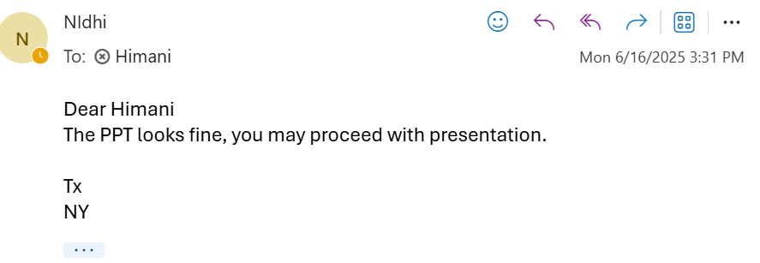
Presentation approval
Himani Ashra
PG/23/038
Under the guidance of Dr. Nidhi Yadav
IIHMR Delhi

Slide 3
INTRODUCTION
Street food/out-of-home food consumption has become a popular food source option in the urban settings of developing countries.
These are generally considered alternatives for many university students, and emerging evidence has shown that university students who consume poor-quality diets can have potential implications for body-weight and long-term health (Almoraie et al., 2024).
According to the NIN, Street/junk food comprises anything that is low in nutritional content (proteins, vitamins, or minerals) but is high in salt, sugar, preservatives, added color, trans-fats, and calories (Krishnaswamy, 2011).
To assess individuals’ understanding of a specific health-related topic or practice, KAP surveys are done to gauge individuals’ behaviour (Jiang et al., 2024).

Slide 4
INTRODUCTION
AIM OF THE STUDY:
The current study is conducted to assess the knowledge, attitude, practice and influencing factors of street-food consumption among postgraduate students in New Delhi.
RESEARCH IMPLICATIONS:
This will help reveal factors that influence the eating behaviour of students, which will further aid in implementing health promotion strategies to encourage healthy eating behaviour.

Slide 5
INTRODUCTION
RESEARCH QUESTIONS:
What is the level of knowledge of among students regarding balanced food and street-food?
Are students aware of health risks associated with consuming unhygienic street food?
What is their attitude, perceptions and beliefs towards street-food consumption and food safety?
How frequently do students consume street food ad what types are most commonly consumed?
Is there a correlation between students’ knowledge of food safety and their street food consumption practices?
Do demographic factors influence knowledge, attitudes, or practices related to street food consumption?

Slide 6
RESEARCH METHODOLOGY
Study design: A descriptive cross-sectional study will be conducted to assess the knowledge, attitude and perception regarding street-food consumption and food safety of street-food among post-graduate students in New Delhi.
Sampling strategy:
Sampling frame: The study will use a sampling size of 96 participants/post-graduate students from a population of approximately 400 students.
Location of study: 400 students include 200 post-graduate students of IIHMR, Delhi and 200 from another college, IIT, Delhi, to facilitate a better comparison between those studying healthcare management and those enrolled in other courses.
Sampling method: Stratified simple random sampling technique will be used.
3. Tool for data collection: Data will be collected using semi-structured questionnaire by a self-administered method.

Slide 7
RESEARCH METHODOLOGY
4. Pilot testing: A pilot study will be conducted with 15 students of IIMHR, Delhi, to refine the questionnaire for clarity and appropriateness.
5. Variables and measures:
Independent variables (influencing factors):
Socio-demographic factors (e.g., age, education, income).
Knowledge-related factors (e.g., awareness of healthy eating habits and knowledge of risk of NCDs)
Attitude-related factors (e.g., beliefs about street food safety)
Dependent variables (outcomes):
Frequency of street food consumption (e.g., daily/weekly/monthly)
Practice-related factors

Slide 8
RESEARCH METHODOLOGY
6. Data analysis: Descriptive statistics (frequency and percentage) will be used to describe demographic data, knowledge, prevalence, practice and influencing factors for street-food consumption. A correlation analysis will be performed to quantify the strength of association between the level of knowledge and selected socio-demographic variables of respondents. Data analysis will be carried out using SPSS software.
7. Inclusion criteria:
Students currently enrolled in a postgraduate program.
Individuals willing to participate and provide informed consent.
8. Exclusion criteria
Individuals not willing to participate to provide informed consent.

Slide 9
ETHICAL CONSIDERATIONS
1. Informed Consent
Ensure participants voluntarily agree to take part in the survey.
Provide clear information about the purpose of the study, procedures, and how the data will be used.
2. Anonymity and Confidentiality
Do not collect personally identifiable information unless necessary.
Keep all data confidential and store it securely
3. Voluntary Participation
Participation should be completely voluntary without coercion or undue influence.
Assure students that there are no academic or social consequences for choosing not to participate.

Slide 10
RESULTS
GENERAL PROFILE OF RESPONDENTS
Variables | Labels | Percentage
Gender
 | Male | 40.43%
 | Female | 59.57%
 | Other | 0
Age
 | 18-25 | 44.68%
 | >25 | 55.38%
Year of study
 | 1st year | 9.57%
 | 2nd year | 90.43%
Field of Post-graduation study
 | Science | 8.51%
 | Arts | 12.68%
 | MBA | 62.77%
 | Mtech | 6.38%
 | Medical Science | 7.45%
 | Others | 1.90%
Name of college
 | IIHMR Delhi | 51.06%
 | Others | 48.94%

Slide 11
RESULTS
GENERAL PROFILE OF RESPONDENTS
Living place during study
 | With family | 45.74%
 | college hostel | 14.89%
 | PG/Flat/Others | 39.36%
Food preference
 | Vegeterian | 46.81%
 | Non-vegeterian | 41.49%
 | Eggetarian | 11.70%
Smoking
 | Regular | 4.26%
 | Occassional | 19.15%
 | Never | 76.60%
Alcohol Frequency
 | Occassional | 43.62%
 | Never | 55.32%
 | Regular | 1.06%

Slide 12
RESULTS
DESCRIPTIVE STATISTICS
K1- Do you know what are the major food groups in a balanced diet?
K2- Are you aware that improper food storage can lead to bacterial contamination?
K3- Do you know the recommended daily servings of fruits and vegetables for adults or children?
K4-Do you think street food can cause foodborne diseases?
K5- Do you think street food consumption/trans-fat can increase the risk of developing non-communicable diseases (NCDs) such as cardiovascular disease?
K6-Do you know the recommended daily water intake for adults?

Slide 13
RESULTS
DESCRIPTIVE STATISTICS
A1- Do you feel motivated to eat healthy food (fruits and vegetables) regularly?
A2- I believe it’s ok to indulge in street food occasionally if we maintain a healthy lifestyle.
A3- I believe street food is generally safe to eat.
A4- I am concerned about hygiene and clean surroundings when eating street food.
A5-I believe that skipping meals can negatively affect my health.
A6-I believe that university canteens should offer more healthy food options.

Slide 14
RESULTS
DESCRIPTIVE STATISTICS
How many meals do you consume per day?
 | 1 to 3 | 72.34043
 | 4 or 5 | 26.59574
 | More than 5 | 1.06383
How often do you eat street food?
 | Daily | 1.06383
 | 2–3 times a week | 2068
 | Once a week | 1.88588
 | Rarely | 1590.769
 | Never | 0.125725
Do you check whether the food is freshly prepared?
 | Always | 31.91489
 | Sometimes | 55.31915
 | Rarely | 10.6383
 | Never | 2.12766
Have you ever fallen ill after consuming street food?
 | Yes | 60.6383
 | No | 39.3617

Slide 15
RESULTS
DESCRIPTIVE STATISTICS
Knowledge-Based Questions
Assigned scores:
Correct/Health-Aware Answer = 1
Incorrect / Not Sure / Misconception = 0
Scoring Summary:
Total Questions: 6
Maximum Score: 6
Minimum Score:0
Mean knowledge (95respondents) | 4.936170213 (Good knowledge)
Max | 7
Min | 0
Stdev | 1.461352971
Score Range | Interpretation
0–2 | Poor Knowledge
3-4 | Moderate Knowledge
5-6 | Good/High Knowledge

Slide 16
RESULTS
Attitude-Based Questions (Likert Scale)
Interpretation:
Result:
Total Score Range | Attitude Level
6–14 | Poor/Negative Attitude
15–23 | Moderate Attitude
24–30 | Good/Positive Attitude
Mean attitude score | 25.93617021 (Good positive attitude)
Max | 33
Min | 12
Stdev | 4.237082864

Slide 17
RESULTS
Practice-Based Questions
Interpretation (Total score: 0 to 11)
Result:
Mean Practice score | 5.478723404 (Moderate Practice)
max | 8
min | -3
stdev | 2.394538321
Score Range | Practice Level
0 to 4 | Poor habits
5 to 8 | Moderate
9 to 11 | Good (healthy lifestyle choices)

Slide 18
ANALYSIS
T-Tests
Used to compare the KAP mean scores of two groups (demographic variables- age/gender/college/living place) to determine if the difference between them is statistically significant.
Key Findings:
 | Gender | N | Mean | Std. Deviation | Std. Error Mean | T | Df | Sig (2-tailed) | Interpretation
Knowledge_Score | Female | 56 | 5.29 | .780 | .104 | 2.735 | 92 | 0.002 | Females have higher knowledge scores than males.
 | Male | 38 | 4.42 | 1.840 | .298
Attitude_Score | Female | 56 | 27.20 | 3.136 | .419 | 3.439 | 92 | 0.001 | Females show significantly more positive attitudes than males
 | Male | 38 | 24.08 | 4.956 | .804
Attitude_Score | 18-25 >25 | 42 52 | 26.88 24.76 | 4.520 3.776 | .697 .524 | 2.481 | 92 | 0.015 | Younger participants have more positive attitudes compared to those >25.

Slide 19
ANALYSIS
T-Tests
Used to compare the KAP mean scores of two groups (demographic variables- age/gender/college/living place) to determine if the difference between them is statistically significant.
Key Findings:
There is no difference in KAP scores between the two colleges (P > 0.005 in all cases, we accept Null hypothesis).
There is no difference in KAP scores between the two places of stay (with family vs others; P > 0.005 in all cases, we accept Null hypothesis).
There is no difference in Practice scores between the two genders (P > 0.005 in all cases, we accept Null hypothesis).
There is no difference in attitude scores between the two colleges & also between the two places of stay (P > 0.005 in all cases, we accept Null hypothesis).

Slide 20
RESULTS
Correlation Analysis
Spearman's rho Correlation Summary
Pair | Correlation Coefficient (ρ) | Sig. (p-value) | Interpretation
Knowledge ↔ Attitude | 0.241 | 0.020 | Weak positive, statistically significant
Knowledge ↔ Practice | 0.173 | 0.095 | Weak, not significant
Attitude ↔ Practice | 0.103 | 0.324 | Very weak, not significant
Knowledge ↔ Attitude
H₀: There is no relationship between knowledge and attitude scores. (ρ = 0)
H₁: There is a relationship between knowledge and attitude scores. (ρ ≠ 0)
Since p = 0.020 < 0.05, reject H₀ → A statistically significant weak positive correlation exists.

Slide 21
ANALYSIS
Regression Analysis
Key Findings:
A simple linear regression was conducted to examine the effect of knowledge on attitude.
The model was significant, F(1, 92) = 21.487, p < .001, with an R² of .189, indicating that knowledge explains 18.9% of the variance in attitude. Knowledge Score significantly predicted Attitude Score (B = 1.342, p < .001), suggesting that higher knowledge is associated with more positive attitudes.
A multiple linear regression was also conducted to examine whether knowledge and attitude scores predicted practice score.
The overall model was not statistically significant, F(2, 91) = 1.239, p = .294, and explained only 2.7% of the variance in practice (R² = 0.027). Neither knowledge score (β = 0.148, p = 0.200) nor attitude score (β = .029, p = 0.804) were significant predictors.

Slide 22
ANALYSIS
Regression analysis (between knowledge score and demographic variables, i.e., age, gender, college of study and living place during study)
Key findings:
The overall model is not statistically significant (p = .055)
Gender is the only significant predictor (p=0.011)
Age, college, and place of living do not significantly affect knowledge score
The model explains only ~11.8% of the variation, meaning most of the variation in knowledge score comes from other unmeasured factors
Regression (between attitude score and demographic variables, i.e., age, gender, college of study and living place during study)
Key findings:
The regression model is statistically significant overall (p = .001).
Age and gender are significant predictors of attitude score.
College and living place are not significant in predicting attitude score.
The model explains 18.5% of the variation in attitude.

Slide 23
ANALYSIS
Regression analysis (between practice score and demographic variables, i.e., age, gender, college of study and living place during study)
Key findings:
The regression model is not significant overall (p = .921)
None of the individual predictors (age, gender, college, living place) significantly explain variation in practice score
R² = 0.010 → means ~90% of the variability in practice is due to other factors not in this model
This model does not explain practice behavior. All predictors are statistically non-significant.

Slide 24
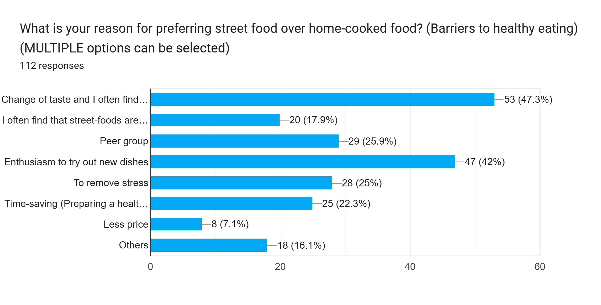
DISCUSSION
DETERMINANTS OF BEHAVIOUR
Increasing knowledge may positively influence attitudes, but not enough to drive better practice — maybe due to behavioral barriers.
What is your reason for preferring street food over home-cooked food?

Slide 25
CONCLUSION
There was a significant positive correlation between knowledge and attitude scores, ρ = .241, p = .020, indicating that higher knowledge was associated with better attitudes.
However, the correlations between knowledge and practice and between attitude and practice were not statistically significant.
Conclusion: Knowledge significantly improves attitude, but does not necessarily translate and directly impact practice — suggesting an attitude-practice gap.
Increasing knowledge may positively influence attitudes, but not enough to drive better practice — maybe due to behavioral or contextual barriers.
Or, Respondents generally possess good knowledge and attitude, but practices lag behind.
There is a statistically significant association between Practice level and College (p < 0.05), suggesting Practice behaviors differ significantly across colleges.

Slide 26
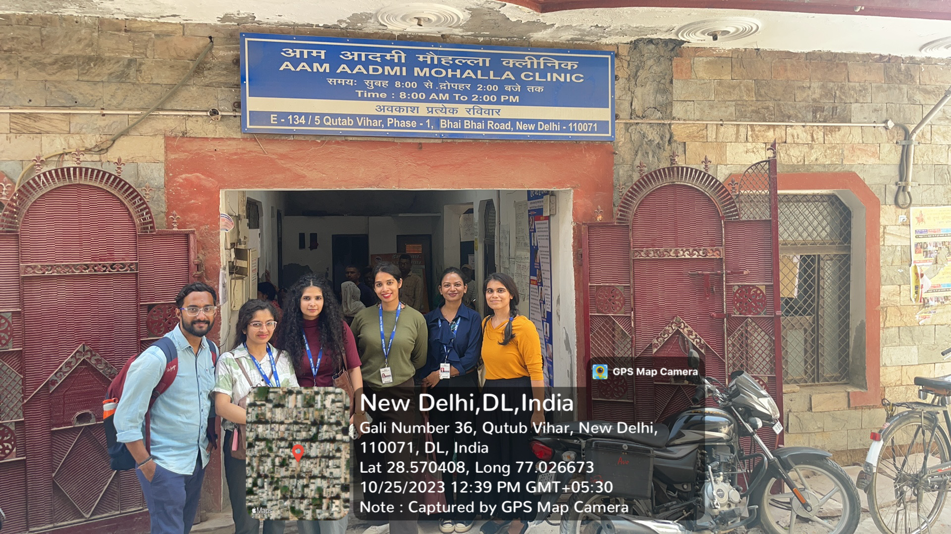
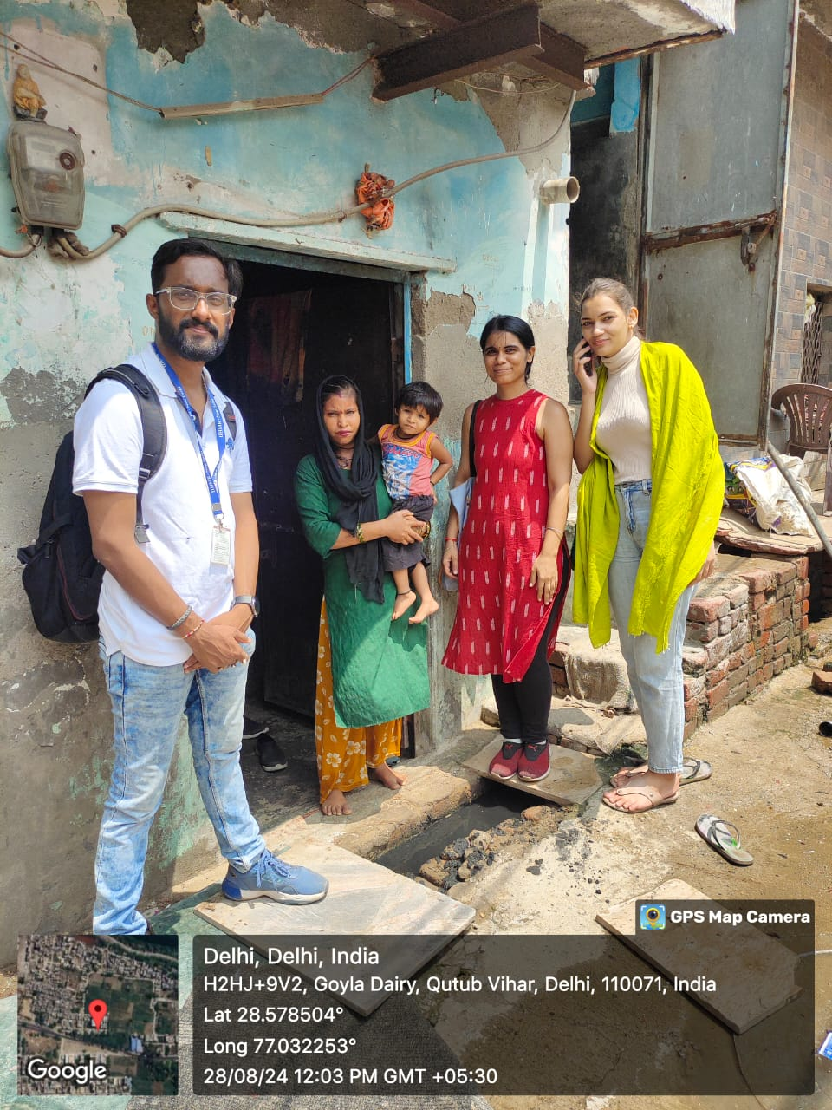
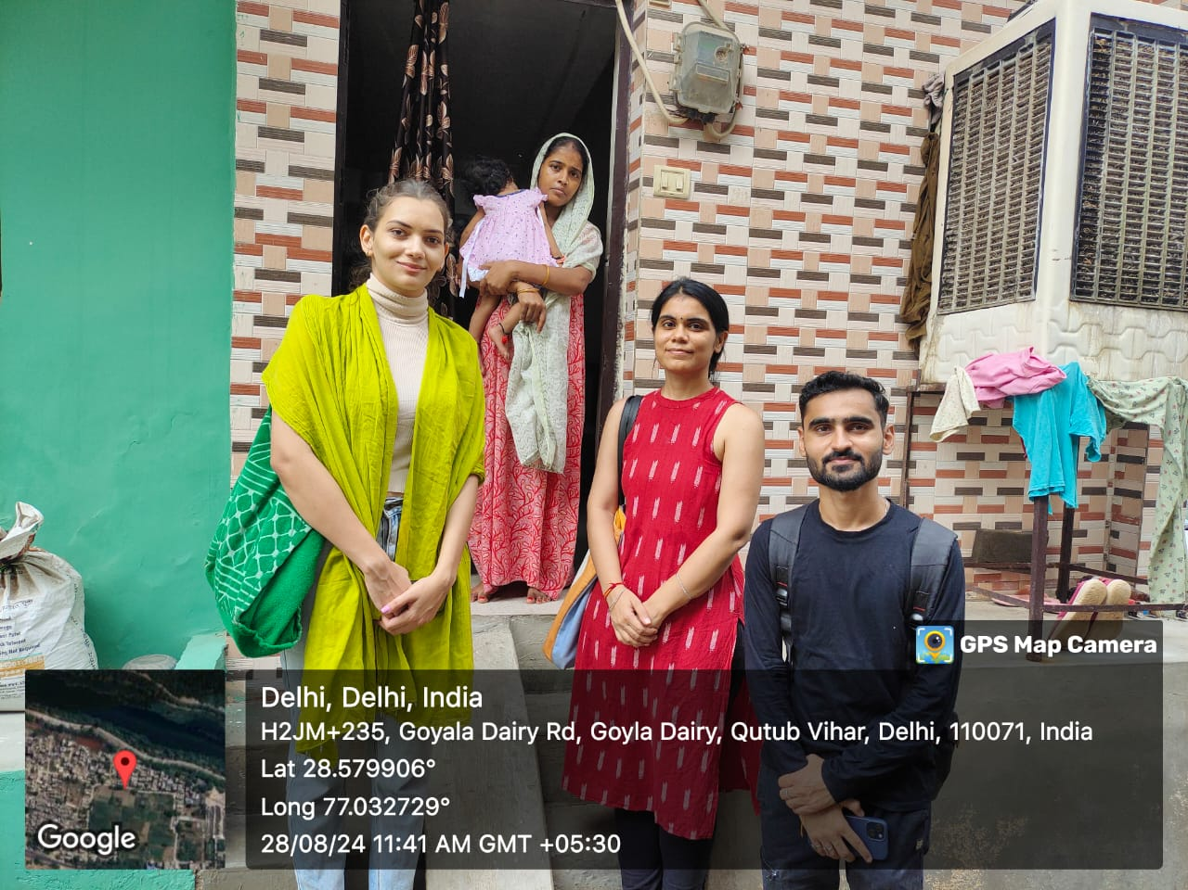
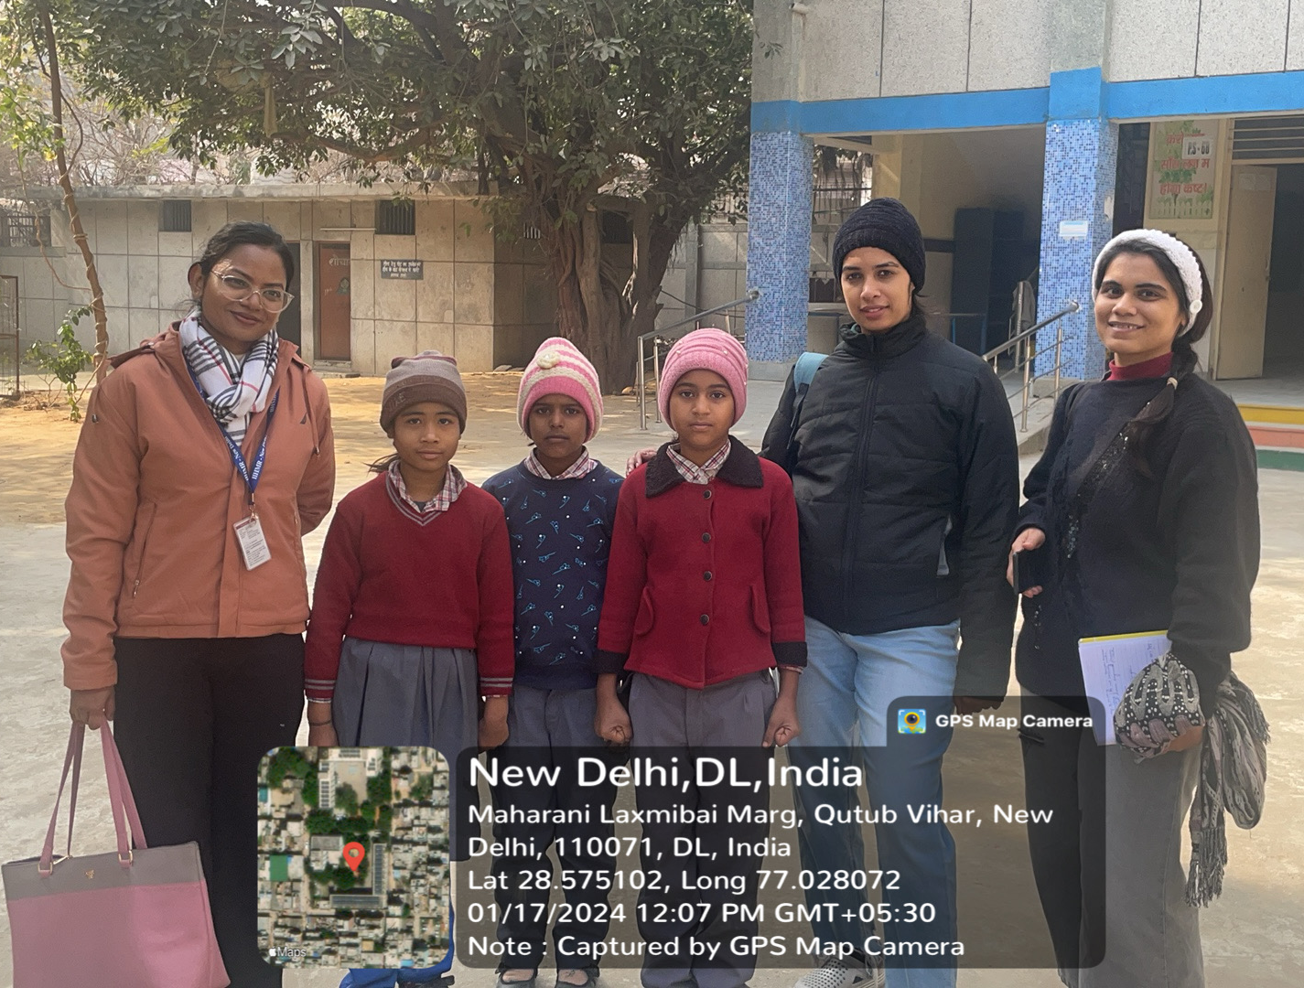
COMMUNITY OUTREACH PROGRAMME (COP) ACTIVITIES
Total number of visits: 8
Activities done:
Mapping and listing of the area
Interaction with community health workers
Key learnings:
1. Understanding field-level challenges
2. Community layout

Slide 27
REFERENCES
Almoraie, N. M., Alothmani, N. M., Alomari, W. D., & Al-Amoudi, A. H. (2024). Addressing nutritional issues and eating behaviours among university students: A narrative review. Nutrition Research Reviews. https://doi.org/10.1017/S0954422424000088
Imathiu, S. (2017). Street vended foods: Potential for improving food and nutrition security or a risk factor for foodborne diseases in developing countries? Current Research in Nutrition and Food Science, 5(2), 55–65. https://doi.org/10.12944/CRNFSJ.5.2.02
Jiang, K., Zhang, L., Xie, C., Li, Z., Shi, Z., Sharma, M., & Zhao, Y. (2024). Understanding the Knowledge, Attitudes, and Practices of Healthy Eating among Adolescents in Chongqing, China: An Empirical Study Utilizing Structural Equation Modeling. Nutrients, 16(1). https://doi.org/10.3390/nu16010167
Krishnaswamy, K. (2011). Dietary Guidelines for Indians - A Manual (2nd Ed.). Hyderabad, India: National Institute of Nutrition, ICMR,.
Liu, X., Chen, H., Zhou, Q., Zhang, H., Asawasirisap, P., & Kearney, J. (2020). Knowledge, attitude and practices (Kap) towards diet and health among international students in dublin: A cross-sectional study. International Journal of Environmental Research and Public Health, 17(9). https://doi.org/10.3390/ijerph17093182
Popkin, B. M., Corvalan, C., & Grummer-Strawn, L. M. (2020). Dynamics of the double burden of malnutrition and the changing nutrition reality. The Lancet, 395(10217), 65–74. https://doi.org/10.1016/S0140-6736(19)32497-3
Shehasen M.Z. & Mohammed A.S. (2020). Street Food Consumption and Associated Health Risk. International Journal of Research Studies in Agricultural Sciences, 6(7). https://doi.org/10.20431/2454-6224.0607002
Siddiqui, Z., & Donato, R. (2020). The dramatic rise in the prevalence of overweight and obesity in India: Obesity transition and the looming health care crisis. World Development, 134. https://doi.org/10.1016/j.worlddev.2020.105050
World Health Organization. (2016). The double burden of malnutrition. Policy Brief. https://iris.who.int/bitstream/handle/10665/255413/WHO-NMH-NHD-17.3-eng.pdf?sequence=1&isAllowed=y
Zarei, F., Dehghani, A., Ratanasiri, A., Ghaffari, M., Raina, S. K., Halimi, A., Rakhshanderou, S., Isamel, S. A., Amiri, P., Aminafshar, A., & Jarrahi, A. M. (2024). ChecKAP: A Checklist for Reporting a Knowledge, Attitude, and Practice (KAP) Study. Asian Pacific Journal of Cancer Prevention, 25(7), 2573–2577. https://doi.org/10.31557/APJCP.2024.25.7.2573

