Slide 1

A Study on the Impact of Health Education on Immunization Rates in India
Presented by: Rishik Gandotra (PG/23/092)
Under the supervision of Dr. Altaf Yousuf Mir

Slide 2
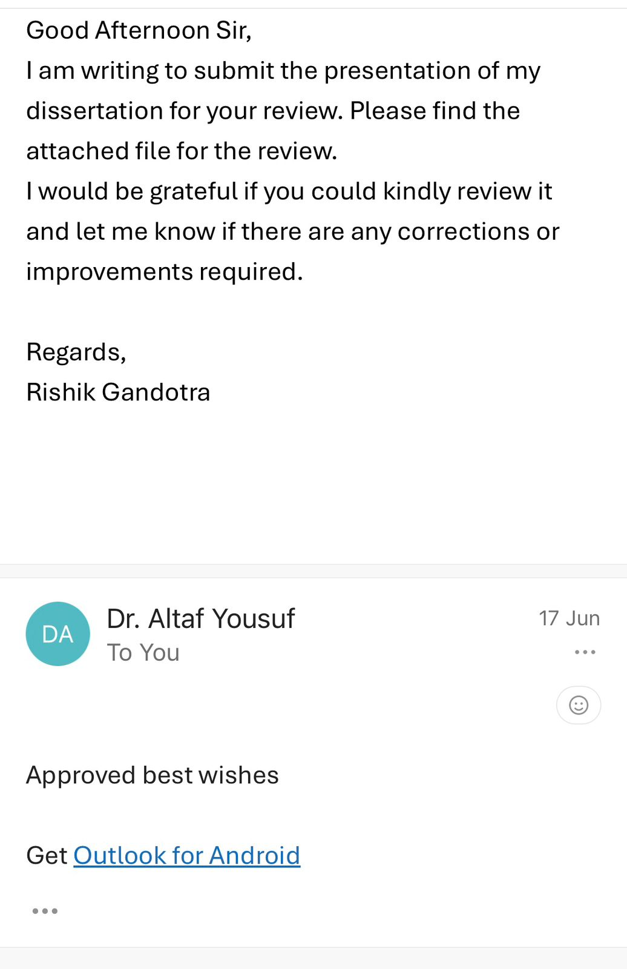
Mentor Approval

Slide 3
Introduction
Prevalence
According to the NFHS-5 report the immunization coverage has been increased from 62% (NFHS-4) to 77%.
Interventions
Many initiatives like UIP, mission indradhanush, and health education campaigns led to this increase in the immunization rate. Along with these maternal education also played a pivotal role in the immunization.
Challenges
Still challenges exist in immunization like lack of knowledge, limited access, vaccine hesitancy exists.

Slide 4
Objectives of Your Study
To access How the health education and communication campaigns influence immunization rates.
Which strategies and channels of health education are most effective in raising immunization uptake.
To assess how a mother’s level of education impacts full immunization coverage among children in India.

Slide 5
Methodology
Study Design:
This is a secondary research (based on existing data and published studies, no new data collection).
Type: Descriptive secondary research
Data Source
Articles and reports were identified through online search using keywords such as “immunization in India,” “health education campaigns,” “vaccine awareness,” and “NFHS immunization.”
Specific scientific databases like Pubmed, Google Scholar, Web of science, Scopus were searched.
Grey literature were also included like- NFHS reports, Ministry of health reports

Slide 6
Methodology
Inclusion:
Studies and data from 2010–2024.
Address health education, communication strategies and immunization impact.
Exclusion:
Studies unrelated to health education or vaccine uptake.
Articles without sufficient methodological detail.

Slide 7
Results

Slide 8
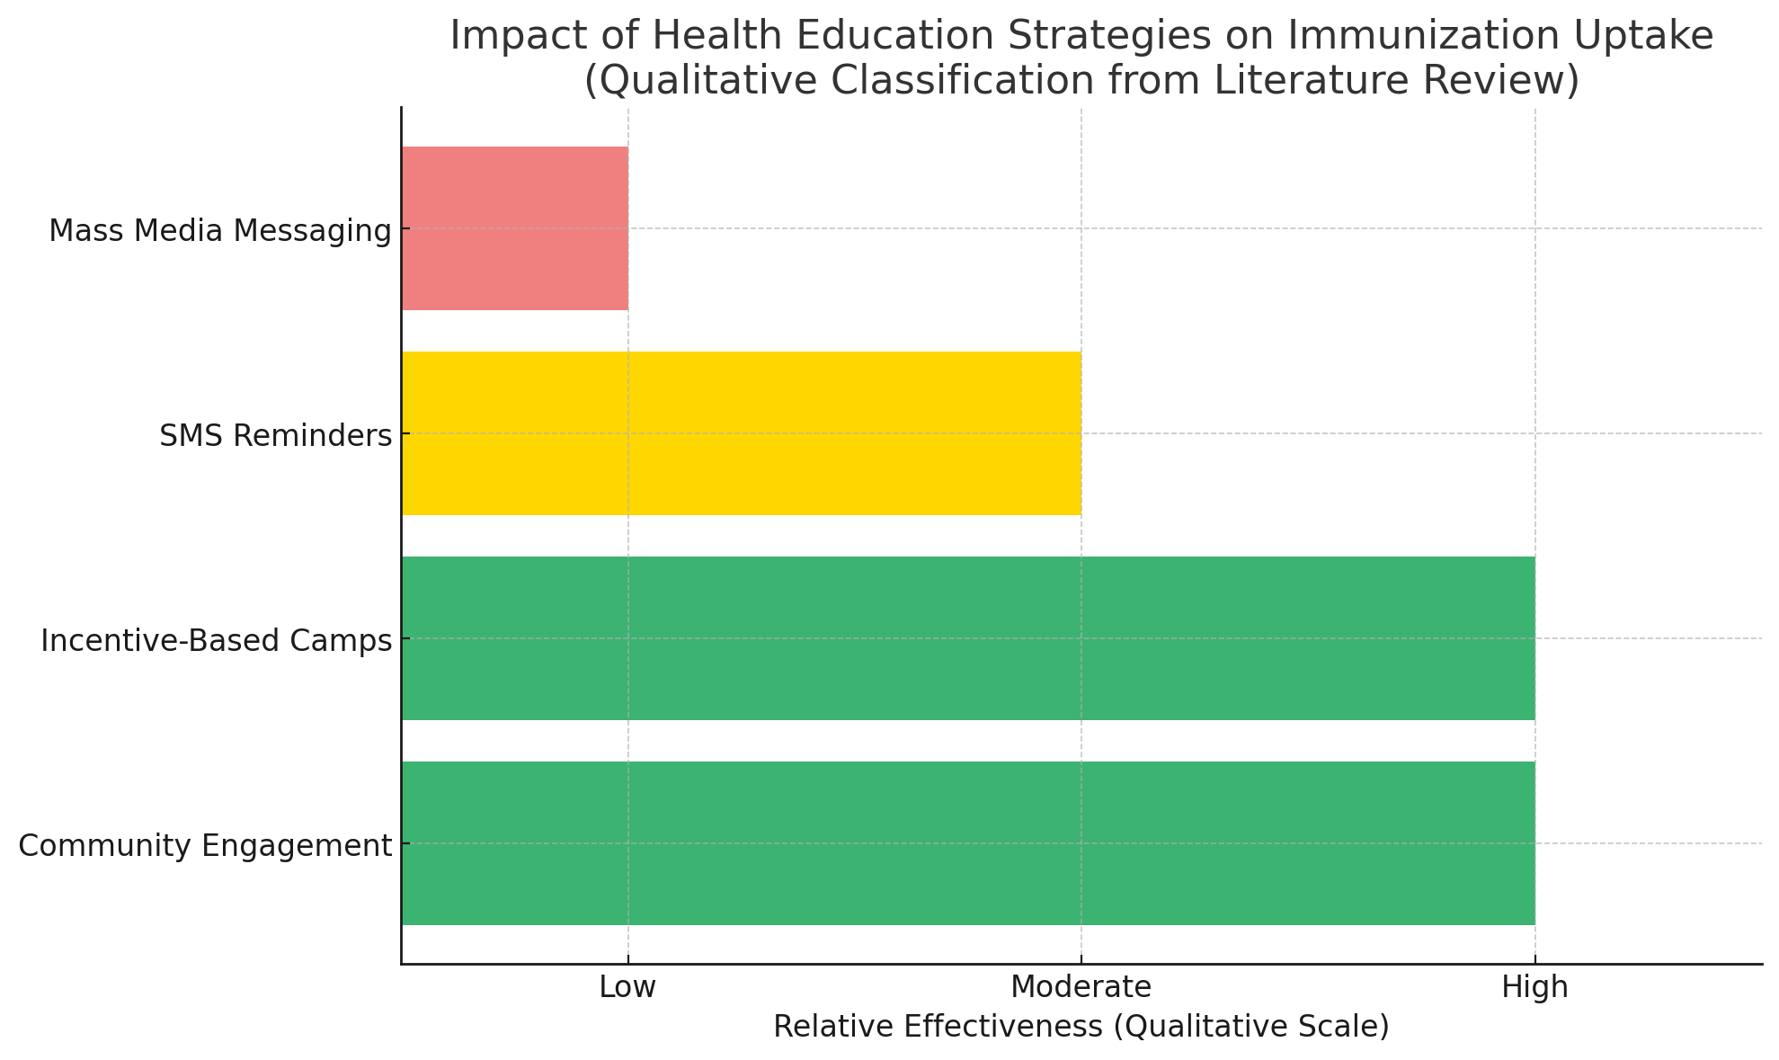
Results

Slide 9
Results

Slide 10
Discussion
Health education campaigns like Mission Indradhanush have significantly contributed to improved immunization rates between NFHS-4 and NFHS-5 through mass media, interpersonal outreach, and community mobilization.“
Need for IEC: Urgent need to strengthen Information, Education, and Communication (IEC) to increase the immunization rates.
While mass media campaigns increased awareness, their limited behavioral influence emphasizes the need for interpersonal follow-up.
On the other hand Incentive-based campaigns (like immunization camps with benefits) significantly improved turnout.

Slide 11
Discussion
Maternal education is the key driver of full immunization—highlighting the need to integrate health education within maternal care systems.

Slide 12
Conclusion
This study concludes that health education campaigns are instrumental in improving immunization outcomes across India. By analyzing NFHS data and reviewing peer-reviewed research, it is evident that regions with consistent and culturally appropriate health communication strategies experienced significant improvements in vaccine uptake.
The role of frontline health workers, such as ASHAs, in delivering door-to-door awareness has been particularly impactful, especially when combined with digital education tools like SMS reminders and mobile applications. The integration of personal and technological outreach strategies forms a strong foundation for future immunization programs.

Slide 13
References
Banerjee, A., Duflo, E., Glennerster, R., & Kothari, D. (2010). Improving immunization coverage in rural India: A clustered randomized controlled evaluation of immunization campaigns with incentives. BMJ, 340, c2220. https://doi.org/10.1136/bmj.c2220
Dubé, E., Laberge, C., Guay, M., Bramadat, P., Roy, R., & Bettinger, J. A. (2013). Vaccine hesitancy: An overview. Human Vaccines & Immunotherapeutics, 9(8), 1763–1773. https://doi.org/10.4161/hv.24657
J-PAL. (2017). Improving Immunization Rates through Incentives and Regular Camps in India. Retrieved from https://www.povertyactionlab.org/evaluation/improving-immunization-rates-through-regular-camps-and-incentives-india
Larson, H. J., Jarrett, C., Eckersberger, E., Smith, D. M. D., & Paterson, P. (2014). Understanding vaccine hesitancy around vaccines and vaccination from a global perspective: A systematic review of published literature, 2007–2012. Vaccine, 32(19), 2150–2159. https://doi.org/10.1016/j.vaccine.2014.01.081
Patil, R., Gokhale, M., & Borkar, A. (2021). Use of mobile applications and SMS-based health education in improving immunization rates. Journal of Public Health Research, 10(1), 201–210. https://doi.org/10.4081/jphr.2021.2121
UNICEF India. (2022). Social mobilizers combat vaccine hesitancy. Retrieved from https://www.unicef.org/india/stories/social-mobilizers-combat-vaccine-hesitancy
Desai, S., & Alva, S. Maternal education and child health: is there a strong causal relationship?. Demography, 35(1), 71–81.
Rudra, S. (2017). Immunisation coverage: India far away from meeting targets. Observer
Research Foundation Expert Speak.

Slide 14
INVOLVEMENT IN COMMUNITY OUTREACH PROGRAMME (COP) ACTIVITIES
Total no. of visits done by the Student: 10
Activities done by the student:
Mapping and listing of the area.
Interaction with the community and frontline healthcare workers.
Conducted a study on determinants, care seeking and managementof diarrhoea among children aged 0-5 years. (Group project).

Slide 15
KEY LEARNING FROM COP ACTIVITIES
Mapping and Listing of the Area
Understanding Community Layout: Developed a detailed understanding of the geographical distribution of households, health facilities, and key resources.
Interaction with Community & FLHWs
Observed field-level challenges (resource gaps, cultural barriers).
Gained clarity on roles of ASHA, ANM, and AWW.
Learned community engagement and trust-building skills.
IDI with the mothers/caregivers on determinants of diarrhoea
Understood their knowledge about the diarrhoea
Learned about what do they do in case of diarrhoea.

Slide 16
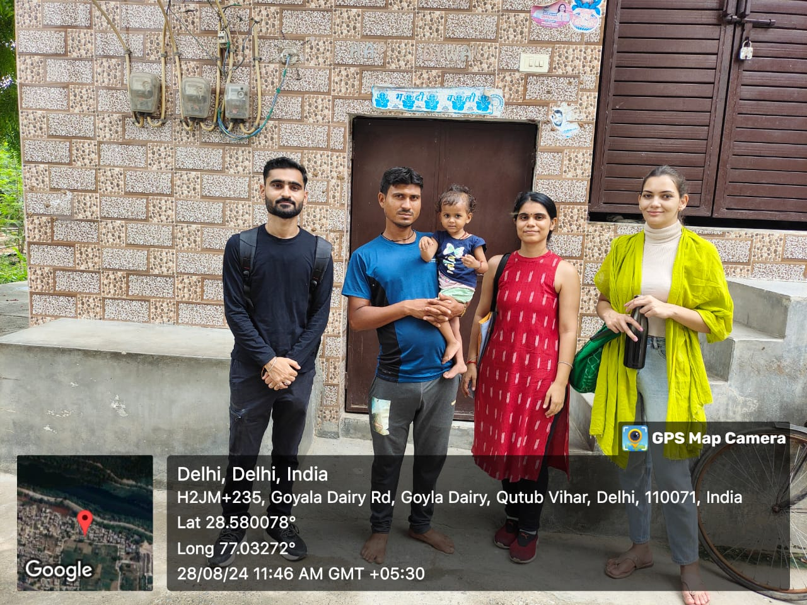
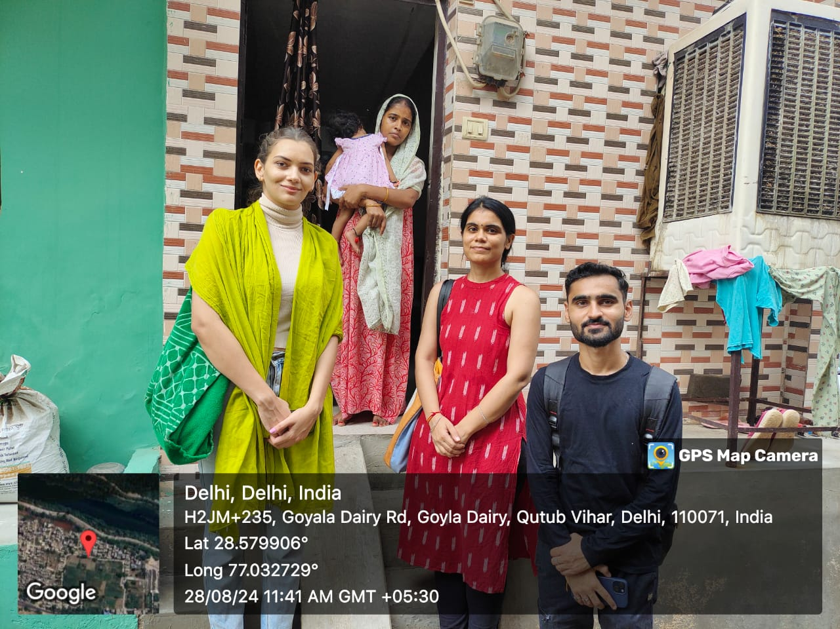
COP FIELD ACTIVITIES PHOTOGRAPHS

Slide 17
Thank You
Any Questions

